Slide 1
Document explainer
Purpose: This slide deck supports staff to understand the context for the SEND reforms and what is meant by inclusion.
Audience: Teachers and support staff in primary and secondary schools.
How to use this document:
This is the first of three introduction sessions focusing on SEND reforms, inclusive teaching and areas of development.
The session can be delivered in full or in parts, depending on the context of your setting and the structure of your planned professional development time.
A facilitator guidance document is available to support delivery of the session.
Further guidance on planning and delivering these professional development materials can be found in the Guide to Materials.
Notes:
Hidden slide:
Facilitation suggestions: Timing

Slide 2
Facilitation guidance – timings
Timings of individual slides (e.g., 2 minutes) and a running timing in minutes (e.g., [4]) are provided based on a 60-minute session.
However, the session is intended to be flexible enough to adapt this to slightly longer or shorter times as required (e.g., 75 mins or 50 mins) –
For shorter sessions, you may need to limit optional slides and consider the use of time provided for reflection activities – for example, considering the length of discussion time and how many responses you elicit.
For longer sessions, you might offer more of the optional slides and extend the time available for reflection and discussion – for example, taking more contributions from staff and explicitly drawing out the suggested key points as they are raised by the staff themselves.
Notes:
Hidden slide:
Facilitation suggestions: Timing

Slide 3

Supporting every child to achieve and thrive
Notes:
Note: Timings of individual slides (e.g., 2 minutes) and a running timing in minutes (e.g., [4]) are provided based on a 60-minute session.
However, the session is intended to be flexible enough to adapt this to slightly longer or shorter times as required (e.g., 75 mins or 50 mins) –
For shorter sessions, you may need to limit optional slides and consider the use of time provided for reflection activities – for example, briefly articulating important points rather than asking for contributions from staff.
For longer sessions, you might offer more of the optional slides and extend the time available for reflection and discussion – for example, taking contributions from staff and explicitly drawing out the suggested key points as they are raised by the staff themselves.
NOTE: You may wish to add your name or the name of your school or college to the bottom of the slide.

Slide 4
Session timings
Activity | Time
Aims of the session | 5 mins
Introduction | 15 mins
Why have the SEND Reforms been introduced? | 15 mins
What is inclusion? | 15 mins
Reflection questions | 5 mins
Notes:
Time: 1 minute [1]
Purpose: To understand what this session will entail.
Guidance: Give staff time to read the slide.
Then explain that:
This is a broad outline of content for this session with approximate timings – this session looks briefly at the context of the government’s SEND reforms, and on the idea of ‘inclusion’
NOTE: Timings have been rounded to the nearest 5 minutes. Where you decide to alter the length of the session, you may need to update this slide accordingly.

Slide 5
Aims of the session
To understand the context for the SEND reforms
To introduce what is meant by inclusion
Notes:
Time: 1 minute [2]
Purpose: To understand what this session will entail.
Guidance: Give staff time to read the slide.
Then explain that:
This session will briefly look at the context which has prompted the government’s Special Educational Needs and Disabilities (SEND) reforms.
We’ll look at the idea of ‘inclusion’ and the role it has in supporting all pupils, but especially those with additional needs
As part of this session, we’ll have an opportunity to reflect and discuss where we’re doing well and where there are challenges.
Lead in: Let’s start with a brief look at the context for the government’s reforms … [Click to next slide]

Slide 6
Introduction to SEND reforms and inclusion
Introduction
Why have the SEND reforms been introduced?
What is inclusion?
Reflections

Slide 7
Facilitation guidance - pupil voice
The following slides are hidden so that you can choose which option to use. Remember to unhide the slide you choose before you start facilitating the session.
The hidden slides are intended to illustrate the impact of a pupil’s positive experience of school; particularly their perception of belonging and ability to achieve and thrive in school.
You may wish to use quotes from your own pupils in place of these suggestions. Where you use your own quotes, it is important that they reflect the following:
They present positive development on the part of the pupil, rather than focusing on their difficulties and challenges.
Notes:
Hidden slide – guidance

Slide 8
Pupil voice from your own context
Pupil voice …
[Insert your own example]
[pupil year group]
Notes:
Option 1: Pupil voice from your own context
Time: 1 minute [3]
Purpose: To situate the learning in the session in pupil experience.
Guidance: Give staff time to read the slide.
Then explain that…
This sort of pupil experience captures what school is like for many children across the country.
Lead in: It’s important to remember that our children, on the whole, benefit from a strong education system, based on effective and dedicated staff.

Slide 9
Pupil voice (year 5)
Pupil voice …
"Coming to school every day makes me feel really happy. My teachers always listen [to what I have to say], and I get to work with my friends on fun projects. Even when I find something tricky, there is always someone to help me… and I never feel left out… I like that everyone in my class, we all get to join in together and learn new things."
Year 5 pupil
Notes:
Option 2: Pupil voice example - primary
Time: 1 minute [3]
Purpose: To situate the learning in the session in pupil experience.
Guidance: Give staff time to read the slide.
Then explain that…
This sort of pupil experience captures what school is like for many children across the country.
Lead in: It’s important to remember that our children, on the whole, benefit from a strong education system, based on effective and dedicated staff

Slide 10
Pupil voice (year 9)
Pupil voice …
"I think school is a great place for us to go everyday and we learn new things, which I will forever be grateful for… [The teachers] encourage us to share our ideas and make sure everyone gets a chance to speak. I used to worry about fitting in, but now I know that our differences are celebrated, and that makes me want to come to school and take part in everything. It’s a good feeling to know you’re included and valued."
Year 9 pupil
Notes:
Option 3: Pupil voice example - secondary
Time: 1 minute [3]
Purpose: To situate the learning in the session in pupil experience.
Guidance: Give staff time to read the slide.
Then explain that…
This sort of pupil experience captures what school is like for many children across the country.
Lead in: It’s important to remember that our children, on the whole, benefit from a strong education system, based on effective and dedicated staff

Slide 11
Supporting every child to achieve and thrive
Schools and colleges in England are already making a positive difference to children and young people’s lives every day:
There are only a handful of countries that are both better performing and more equal than England (Farquharson et al., 2024).
Over the last 10 to 15 years, literacy and numeracy skills in England have improved significantly relative to other high-income countries (Farquharson et al., 2024).
The majority of children enjoy going to school ‘most days’ or ‘every day’ (DfE, 2026a).
Notes:
Time: 2 minutes [5]
Purpose: To provide some statistics demonstrating the positive difference to children and young people’s lives schools and colleges make every day
Guidance: Give staff time to read the slide.
Explain that…
England’s post-COVID performance compares favourably with other countries, and England remains above the average for the rest of the G7 in both maths and reading.
Considering both the level of attainment and the equality of performance together, only Canada, Estonia and Japan outperform England.
This impact has clearly been felt, with most children and young people reporting that they are happy to attend school.
Lead in: However, we know that this is not a universal experience for all children.
SOURCES:
Farquharson, C., McKendrick, A., Ridpath, N. & Tahir, I. (2024). The state of education: what awaits the next government? Institute for Fiscal Studies.
Department for Education. (2026a). Parent, pupil and learner voice: March 2026.

Slide 12

Reflections on pupils’ experiences of school
Reflection
What are some of the best experiences some of your pupils are having at school?
What are some of the most difficult experiences some of your pupils are having at school?
Notes:
Time: 12 minutes [17]
Purpose: To give staff an opportunity to think about the experiences of pupils at their school – both positive and more challenging ones.
Guidance:
Give two minutes for individual thinking and/or notes.
Allow eight minutes for paired discussion.
You may find it helpful to signal when four minutes is up so that both speakers get to share ideas.
You may wish to draw out one or more examples from the discussions, highlighting important points (2 minutes has been given for this) –
Alternatively, you may wish to summarise:
Most children in England have a positive experience of school.
But many still do not have the experience we would want.
Over-represented within this group are children with additional needs.
Lead in: This provides the context for the recent SEND reforms...

Slide 13
Why have the SEND reforms been introduced?
Introduction
Why have the SEND reforms been introduced?
What is inclusion?
Reflections

Slide 14

Context for the reforms
The SEND reform consultation and white paper identify a number of challenges (DfE 2026b & c):
the current system is inefficient and unsustainable, and is not delivering effective inclusion
families are having to fight for support they need, which has led to more families seeking EHCPs (doubled since 2014)
professionals spent too much time caught up in bureaucracy rather than directly supporting children
outcomes remain poor despite increased funding
Notes:
Time: 2 minutes [19]
Purpose: To provide a brief summary of the SEND reforms
Guidance: Give staff time to read the slide.
Explain that:
The system has been under strain for a while, and these reforms aim to make it fairer and more consistent.
Families often facing long delays getting support.
School staff often report that the bureaucracy around SEND takes up a lot of time, which would be better spent directly supporting pupils.
Outcomes for pupils with SEND, including exclusions and attainment, are a concern.
Part of the response to these challenges includes providing more high-quality professional development to all staff in primary and secondary schools
Lead in: We can see an example of some of these national challenges in data on pupil outcomes …
SOURCES:
Department for Education (2026b). SEND Reform: putting children and young people first.
Department for Education (2026c): Every child achieving and thriving.

Slide 15
Facilitation guidance – hidden slides
In the section looking at SEND reforms, there are optional slides related to the national picture in the context of SEND and background.
The following slides are hidden so that you can choose which activity to use. Remember to unhide the slide you choose before you start facilitating the session.
The last of these slides invites you to consider sharing data from your own context. For example, this might be data related to pupil/learner outcomes illustrating whether there is a similar gap compared to national outcomes.
Where you include local data, we would recommend constraint given the sessions timings. For example, sharing a single slide of data you feel would help illustrate the local context of the SEND reforms.
This might involve a bar graph illustrating the difference in outcomes between pupils/learners with SEND or with disadvantaged backgrounds compared to their peers.
Examples on the next two hidden slides
Notes:
Hidden slide:
Facilitation suggestions: Optional slides in this section

Slide 16
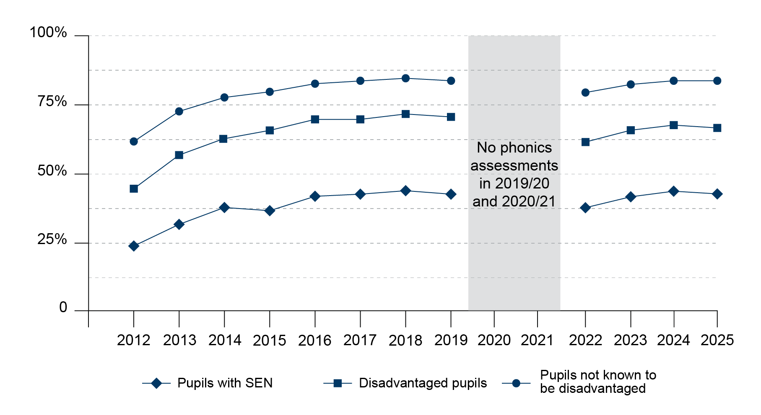
Year 1
Percentage of pupils meeting expected standards in phonics screening check
Notes:
Slide Option 1: Year 1 – phonics check
Guidance: Suggest picking one of these slides, depending on the phase and focus within your context
Time: 2 minutes [21]
Purpose: To illustrate the challenges faced by the sector
Guidance: Give staff time to read the slide.
Then explain that:
Children’s outcomes are still – too often and too much – determined by background or circumstances, and this has led to persistent attainment gaps.
This graph shows an overall increase over time in Year 1 pupils meeting the expected phonics standard, but persistent attainment gaps remain. By 2027, around 83% of pupils not known to be disadvantaged meet the standard, compared with 42% of pupils with SEN.
This top line represents children who are not known to have special needs or disadvantage.
We can see a clear gap between these outcomes and the line below, which are outcomes for children from disadvantaged backgrounds.
This bottom line is the outcomes for children with special educational needs, with an even larger gap in the proportions meeting the expected standard.
It is important to note that there is an intersection between these groups, pupils with SEN are roughly twice as likely to be on free school meals compared to their peers without SEN (Department for Education, 2026c).
Lead in: This national challenge has led to the government proposing large scale reforms, we’ll look a just a couple of them …
SOURCE:
Department for Education (2026c): Every child achieving and thriving.
Department for Education (2026d): Academic year 2024/25. Special educational needs in England
Graphic code: IHM-001-Graph

Slide 17
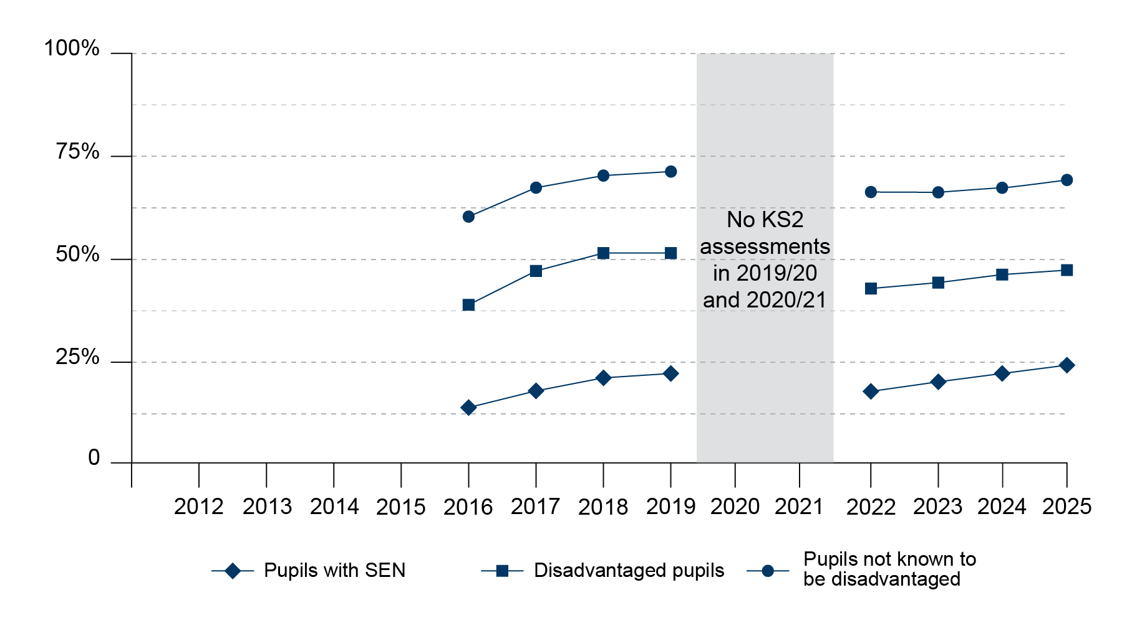
Key stage 2
Percentage of pupils meeting expected standards in reading, writing and maths
Notes:
Slide Option 2: KS2 – reading, writing and maths
Guidance: Suggest picking two of these slides, depending on the phase and focus within your context
Time: 2 minutes [21]
Purpose: To illustrate the challenges faced by the sector
Guidance: Give staff time to read the slide.
Then explain:
Pupils’ outcomes are still – too often and too much – determined by background or circumstances, and this has led to persistent attainment gaps.
This graph shows an overall increase over time in key stage 2 pupils meeting the expected standards in reading, writing and maths, but persistent attainment gaps remain. By 2027, around 70% of pupils not known to be disadvantaged meet the standard, compared with 24% of pupils with SEN.
This top line represents pupils who are not known to have special needs or disadvantage.
We can see a clear gap between these outcomes and the line below, which are outcomes for disadvantaged pupils.
This bottom line is the outcomes for pupils with special educational needs, with an even larger gap in the proportions meeting the expected standard.
It is important to note that there is an intersection between these groups, pupils with SEN are roughly twice as likely to be on free school meals compared to their peers without SEN (Department for Education, 2026c).
Lead in: This national challenge has led to the government proposing large scale reforms, we’ll look a just a couple of them …
SOURCE
Department for Education (2026c): Every child achieving and thriving.
Department for Education (2026d): Academic year 2024/25. Special educational needs in England
Graphic code: IHM-002-Graph

Slide 18
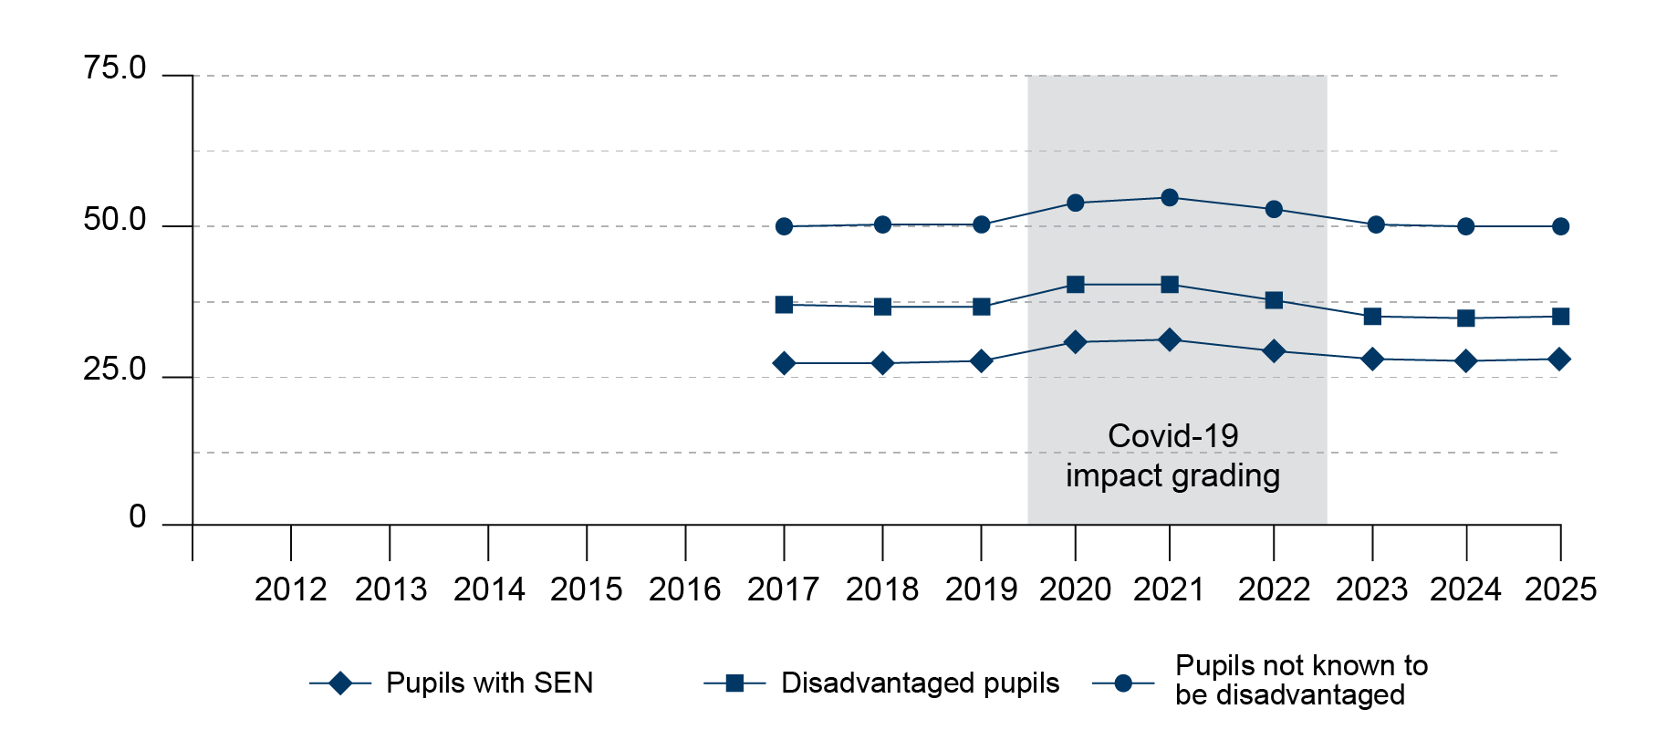
Key stage 4
Average attainment score
Notes:
Slide Option 3: KS4 – Avg. Attainment 8
Guidance: Suggest picking two of these slides, depending on the phase and focus within your context
Time: 2 minutes [21]
Purpose: To illustrate the challenges faced by the sector
Guidance: Give staff time to read the slide.
Then explain:
Pupils’ outcomes are still – too often and too much – determined by background or circumstances, and this has led to persistent attainment gaps.
This graph shows average attainment score for key stage 4 pupils; there are persistent attainment gaps. By 2027, around 49% of pupils not known to be disadvantaged achieved the expected standard, compared with 27% of pupils with SEN.
This top line represents pupils who are not known to have special needs or disadvantage.
We can see a clear gap between these outcomes and the line below, which are outcomes for disadvantaged pupils.
This bottom line is the outcomes for pupils with special educational needs, with an even larger gap in the proportions meeting the expected standard.
It is important to note that there is an intersection between these groups, pupils with SEN are roughly twice as likely to be on free school meals compared to their peers without SEN (Department for Education, 2026c).
Lead in: This national challenge has led to the government proposing large scale reforms, we’ll look a just a couple of them …
SOURCE:
Department for Education (2026c): Every child achieving and thriving.
Department for Education (2026d): Academic year 2024/25. Special educational needs in England
Graphic code: IHM-003-Graph

Slide 19
Our context (adapt for your context)
Our context
…
Notes:
Slide Option 4: Discussion of your own context
Guidance: Suggest picking two of the ‘our context’ slides, depending on the phase and focus within your context
Time: 2 minutes [23]
Purpose: To illustrate the strengths and challenges in our own setting
Suggestion: You may wish to share data from your own context. Some examples to consider below:
The different roles in a school and how they contribute to inclusion.
Some examples of current strengths in the school’s inclusion and SEND provision.
Your school values and how they support inclusion.
School data related to outcomes for pupils with SEND
Lead in: This national challenge has led to the government proposing large scale reforms, we’ll look a just a couple of them …

Slide 20



Our context (headlines)
Our context
e.g. Pupils with SEND perform significantly lower than pupils without SEND across the school
e.g. Recent surveys show pupils with SEND have the lowest satisfaction across the school
e.g. Whilst attendance across the school has improved, it hasn’t for pupils with SEND
Notes:
Hidden slide:
Facilitation example: Illustrating your own context
Graphics code:
IHM-005-Context-1
IHM-005-Context-2
IHM-005-Context-3

Slide 21
Our context (with detail)
Our context
Headline | Detail
Pupils with SEND perform significantly lower than pupils without SEND across the school | Across KS4 and KS5 examinations, the gap has grown over the past two years.
Recent surveys show pupils with SEND have the lowest satisfaction across the school | Pupils with SEND were more likely to mention that they felt worried about attending lessons or getting answers to questions wrong.
Whilst attendance across the school has improved, it hasn’t for pupils with SEND | This is particularly pronounced in Year 9, where attendance for pupils with SEND averages out at a whole day fewer per week.
Notes:
Hidden slide:
Facilitation example: Illustrating your own context

Slide 22
Principles and overall aims
SEND reform aims to ensure more children and young people can achieve and thrive in their local mainstream setting.
Reform Principles:
Early – children should receive the support they need as soon as possible
Local – children with SEND should be able to learn at an education setting close to their home
Fair – a fairer and more consistent SEND system
Effective – reforms should be grounded in evidence
Shared – improved partnership between sectors to deliver better experiences and outcomes for children, including putting the voices of pupils at the heart of decision making
Notes:
Time: 2 minutes [25]
Purpose: To provide a brief summary of the SEND reforms
Guidance: Give staff time to read the slide.
Explain that…
There’s a focus on early identification, clearer national standards based on evidence, and building partnerships between education, health and care.
The reforms put children and young people at the centre, aiming for a simpler and fairer system.
The goal is to improve outcomes and make support more consistent, so every pupil and learner can thrive.
Lead in: To help achieve these aims, the government is changing how identification and support are approached. They have proposed five Areas of Development when it comes to supporting learners with additional needs …
SOURCES:
Department for Education (2026b). SEND Reform: putting children and young people first
Department for Education (2026c): Every child achieving and thriving.

Slide 23
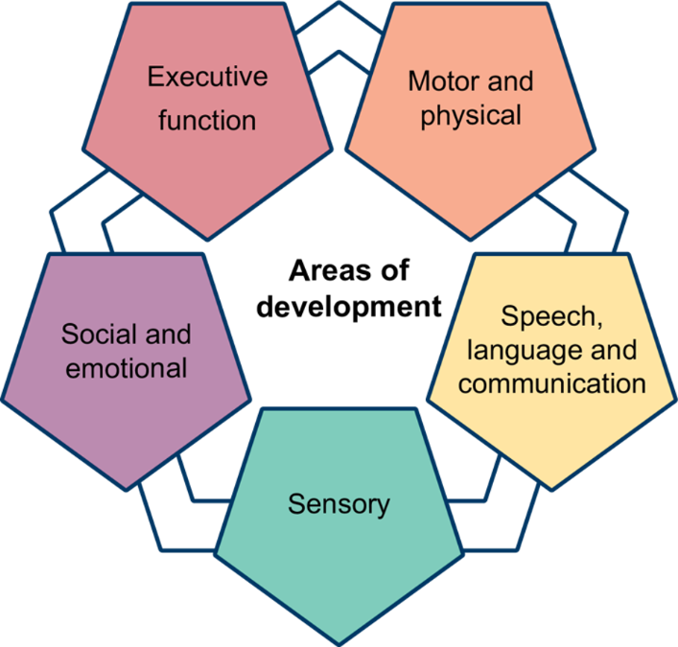
Areas of development
replaces ‘Areas of Need’
recognises both pupil strengths and challenges
reflects key areas of child development
help us to understand a broader array of need, especially those that have a diagnosis
supporting educators to make the environment work harder for all their pupils
Note: The categories are subject to change following the SEND Reform consultation
Notes:
Time: 3 minutes [28]
Purpose: To introduce the five areas of development
Guidance: Give staff time to read the slide. Then explain that…
The SEND reforms propose new ‘Areas of Development’ to replace the current ‘Areas of Need’.
The move to five areas of development recognises that many children, including those with diagnoses such as autism or ADHD, have a unique profile of strengths and challenges across different aspects of development.
However, these are not only related to pupils with a diagnosis. The new Areas of Development better reflect key areas of child development and move away from the categorisation of children and reliance on diagnosis - so that a diagnosis isn’t necessary for a child to access the support they need.
This will make it easier for staff to remove barriers effectively, and in an evidence-based way.
The five proposed ‘Areas of Development’ are proposed as (Department for Education, 2023, Figure 5)
Executive function – Skills for organising, planning, remembering and managing tasks.
Speech, language and communication – Understanding and using language to interact and learn.
Social and emotional – Building relationships, managing feelings and social interaction.
Sensory – Processing and responding to sensory information (such as sight, sound, touch).
Motor and physical – Movement, coordination and physical health needs.
This new framework aims to help staff identify and support needs more holistically and consistently. [NOTE: This is just a brief introduction. Later sessions look at each of these areas of development in turn]
NOTE: The final Areas of Development are subject to change - DfE is considering feedback from SEND reform consultation and recommendations from the Expert Panel.
Lead in: These areas guide how schools assess needs and allocate support in a new system …
SOURCE: Department for Education (2026b). SEND Reform: putting children and young people first
Graphics code: AOD-MainGraphic.png

Slide 24
The universal offer and layers of support
Layer | Who it’s for | What it looks like
Universal Offer | All pupils, in every mainstream school | Inclusive teaching, calm environments, and early help, delivered through everyday classroom practice. Most children's needs will be met at this level.
Targeted | Pupils with ongoing, commonly occurring needs | Structured support such as small-group speech and language work or help managing sensory needs. Recorded in a digital Individual Support Plan (ISP), agreed with parents.
Targeted Plus | Pupils needing specialist input | Children and young people get targeted plus provision from their setting, with input from education and health professionals. School-aged children are also supported through their school group. Support may include access to ‘base support’.
Specialist | Pupils with the most complex needs | Children and young people receive specialist support through EHCP in a mainstream or a special setting, if they require provision set out in one of the new nationally defined Specialist Provision Packages. Support may be delivered through a ‘specialist base’.
Notes:
Time: 2 minutes [30]
Purpose: To understand what we mean by Layers of Support.
Guidance: Give staff time to read the slide.
Then explain: This model replaces the previous approach, focusing on earlier intervention and inclusive teaching. It changes how we think about meeting pupils’ needs every day.
A new national framework for SEND support is proposed, with three flexible layers of support on top of the universal offer.
Every pupil is entitled to a strong Universal Offer as the foundation of their education, with three further layers — Targeted, Targeted Plus and Specialist. These layers are flexible: pupils can draw on them as their needs change, rather than following a fixed ladder.
Universal: High-quality, inclusive teaching for all pupils.
Targeted: Extra support for pupils who need more help, but not specialist provision.
Targeted Plus: More intensive support, possibly involving external specialists.
Specialist: Specialist settings or provision for pupils with the most complex needs.
Pupils can move between different layers as needed.
The aim is to create clear pathways for support, reducing delays and uncertainty. This approach helps schools and colleges match support to pupils’ needs and helps them to achieve.
Then explain: what this means for everyday practice, of teachers in particular:
Inclusive teaching is the first line of SEND provision. A strong Universal Offer should reduce the need for additional support.
Teachers and support staff help by:
Providing high-quality teaching for all pupils.
Noticing pupils who need extra help and making simple adaptations.
Supporting access to specialist help when needed, so all pupils can benefit from the universal offer.
Lead in: Let’s pause for a moment to reflect on some of these ideas…
Source: Department for Education (2026b). SEND Reform: putting children and young people first

Slide 25
Facilitation guidance – reflection options
In this section we have looked at SEND reforms, there is an option at this point for some broader discussion regarding the reforms and your own context.
The following slides are hidden so that you can choose which activity to use. Remember to unhide the slide you choose before you start facilitating the session.
The reflection options are:
Reflecting on role of the teacher within the universal offer and layers of support.
Reflecting on the reforms and which feel most important within your context.
Notes:
Hidden slide:
Facilitation suggestions: Optional slides in this section

Slide 26
Reflection on the universal offer and your role
Reflection
What is meant by the universal offer and layers of support?
What does this mean for you in your role?
Notes:
Reflection Option 1 - Reflecting on the role of the teacher within the universal offer and layers of support.
Guidance: Suggest picking one of these slides, depending your context
Time: 2 minutes [32]
Purpose: To give staff an opportunity to reflect on own context.
Guidance:
Allow 1 minute for staff to reflect on the prompt alone.
Take a sample of responses from the whole group – the number dependent on the timing available for the session.
Lead in: Inclusive teaching is the foundation for the Universal offer – and that is what we’ll primarily focus on in the rest of this session …

Slide 27
Reflection on national challenges and the reforms
Reflection
Do the national challenges discussed align with your own experiences?
Which reforms strike you as especially important in our context?
Notes:
Reflection Option 2 - Reflecting on the reforms and which feel most important within your context.
Guidance: Suggest picking one of these slides, depending on your context
Time: 2 minutes [32]
Purpose: To give staff an opportunity to reflect on own context.
Guidance:
Allow 1 minute for staff to reflect on the prompt alone.
Take a sample of responses from the whole group – the number dependent on the timing available for the session.
Lead in: Inclusive teaching is the foundation for the Universal offer – and that is what we’ll primarily focus on in the rest of this session …

Slide 28
Introducing the ‘What is inclusion?’ section
Introduction
Why have the SEND reforms been introduced?
What is inclusion?
Reflections

Slide 29
What is inclusion?
Inclusion in mainstream education means all staff supporting the learning, wellbeing, and safety needs of every child so they belong, achieve, and thrive.
The Department for Education (2026e) suggests 7 principles of inclusion:
ambitious leadership and governance that embeds inclusion
evidence-based support prioritising early intervention
high-quality inclusive teaching with curriculum designed for all pupils
enriching provision beyond the classroom that all children can access
a safe, respectful culture fostering belonging, attendance, and participation in learning
strong partnerships with families and wider services
inclusive environments with continuous improvements to accessibility
Notes:
Time: 2 minutes [34]
Purpose: To define.
Guidance: This slide is animated so that each statement can be revealed alongside a brief explanation.
Suggested scripting:
[Give staff a moment to read]
There is no single definition of inclusion (Nilholm & Göransson, 2017), and each school will likely have their own.
The DfE’s definition is supported by 7 underpinning principles:
[CLICK x 7]
Lead in: An important feature to pull out of this definition, and the principles that sit underneath it, is that it does not only focus on inclusion for the sake of academic progress…
.
SOURCE
Nilholm, C. & Göransson, K. (2017). What is meant by inclusion? An analysis of European and North American journal articles with high impact. European Journal of Special Needs Education, 32(3), 437–451.

Slide 30
Inclusion
Educational outcomes
Personal development
Wellbeing and belonging
An example of how we might think about whether a pupil feels like they “belong, achieve and thrive”.
Notes:
Time: 2 minutes [36]
Purpose: To understand some key messages regarding inclusive teaching.
Guidance: Explain that…
The aims of our work in inclusion are that every child can achieve and thrive. When we break that aim down into the kinds of experiences and developmental outcomes we want for every pupil, we might end up with three broad areas along these lines:
Educational outcomes: we want all pupils to make the best progress possible across subjects. Across the system, strong progress has been made in embedding into schools the best evidence on how to support pupils to learn and make progress academically, drawing on insights from cognitive science. In terms of system level progress, perhaps a little less attention has been given to the next two areas over the last few years.​
Personal development : we want all pupils to develop their sense of self – their identity, their self-esteem and understanding of how to support and motivate themselves. This relates to the final broad area.
Wellbeing and belonging: we want pupils to feel that they are a valuable member of their community. We want them to have a voice, to be able to make judgements and to play an active role in social groups. We want pupils to have a sense of belonging in their communities.
There is a lot of good work taking place across the sector to support personal development and belonging, but these areas haven’t been addressed so systematically for teachers as academic outcomes. The reality of course, is that pupils’ experiences have an impact across all of these areas and positive experiences in one area are likely to impact the others. If we want pupils to achieve and thrive, we need to consider how we support development across the three areas during pupils’ school experiences.
Lead in: Let’s reflect on how this might apply to our own context…

Slide 31
Reflection on areas of inclusion
Reflection
Educational outcomes
Across which of these three areas do you think your school is strongest?
Where do you think your school could strengthen?
Personal development
Wellbeing and belonging
Notes:
Time: 10 minutes [48]
Purpose: To give staff an opportunity to think about the experiences of pupils at their school – both positive and more challenging ones.
Guidance:
Give two minutes for individual thinking and/or notes.
Allow six minutes for paired discussion.
You may find it helpful to signal when four minutes is up so that both speakers get to share ideas.
You may wish to draw out one or more examples from the discussions, highlighting important points (2 minutes has been given for this) –
Alternatively, you may wish to summarise:
Educational outcomes matter – without them, pupils’ options will be severely limited.
However, there are other ways in which we want our pupils to develop.
Our approaches to inclusion need to reflect this and, where needed, rebalance to account for this shift.
Lead in: Let’s end by breaking down inclusion in a different way, this time by levels of inclusion…

Slide 32
Inclusion at different levels
Inclusion policy
Public policy, e.g. funding for SEND Reforms
Inclusive practice
Setting-focused, e.g. school improvement, school policies, working with services
Inclusive teaching
Classroom-focused, e.g. maintaining and strengthening high-quality teaching
Notes:
Time: 2 minutes [50]
Purpose: To understand the different levels of inclusion.
Guidance: This slide is animated so that each statement can be revealed alongside a brief explanation.
Suggested scripting:
As previous discussion will have revealed, inclusion is a very broad concept that can include topics such as equalities, inclusion bases, inspection frameworks and wider school systems.
[CLICK] Inclusion policy – these are decisions around inclusion determined by public bodies, and influence national funding priorities and frameworks.
[CLICK] Inclusive practice – these are decisions taken by settings on their vision and strategy for inclusion, as well as how they will approach the implementation.
[CLICK] Inclusive teaching – this is where we will focus our attention across the remaining sessions.
Lead in: Let’s end with a reflection…

Slide 33
Reflections
Introduction
Why have the SEND reforms been introduced?
What is inclusion?
Reflections

Slide 34
Facilitation guidance – more reflection options
The following slides are hidden so that you can choose which activity to use. Remember to unhide the slide you choose before you start facilitating the session.
There are options for different reflection activities provided below – you could use one of these or edit/ replace the questions to reflect the priorities, strengths and challenges in your own context.
The options suggested are:
Takeaways from the session on SEND reforms
Broader reflections on systems and challenges regarding inclusive teaching
Broader reflections the school’s strengths and areas of development regarding inclusive teaching
Notes:
Hidden slide:
Facilitation suggestions: Optional slides in this section

Slide 35
Reflection on takeaways on SEND reforms
Reflection
One thing I learned about the SEND reforms is...
One thing I already do that supports inclusion is...
Notes:
Reflection Option 1 – Takeaways from the session on supporting children to achieve and thrive
Time: 6 minutes [60]
Purpose: To give staff an opportunity to reflect at the end of the session.
Guidance:
Allow 3 minutes for staff to reflect on the prompt alone.
Take a sample of responses from the whole group to close the session – the number dependent on the timing available for the session.
Thank the staff for their participation and engagement.

Slide 36
Reflection on systems and challenges regarding inclusive teaching
Reflection
What systems are already in place in our school to support inclusion?
What can make it a challenge?
Notes:
Reflection Option 2 – Broader reflections on systems and challenges regarding inclusion
Time: 6 minutes [60]
Purpose: To give staff an opportunity to reflect at the end of the session.
Guidance:
Allow 3 minutes for staff to reflect on the prompt alone.
Take a sample of responses from the whole group to close the session – the number dependent on the timing available for the session.
Thank the staff for their participation and engagement.

Slide 37
Reflection on school’s strengths and areas of development for inclusive teaching
Reflection
One way our school already supports inclusion is…
One thing our school could do more of to support inclusion is...
Notes:
Reflection Option 3 – Broader reflections the school’s strengths and areas of development regarding inclusion
Time: 6 minutes [60]
Purpose: To give staff an opportunity to reflect at the end of the session.
Guidance:
Allow 3 minutes for staff to reflect on the prompt alone.
Take a sample of responses from the whole group to close the session – the number dependent on the timing available for the session.
Thank the staff for their participation and engagement.

Slide 38
References
Department for Education. (2026a). Parent, pupil and learner voice: March 2026. https://www.gov.uk/government/publications/parent-pupil-and-learner-voice-omnibus-surveys-for-2025-to-2026/parent-pupil-and-learner-voice-march-2026#school-belonging
Department for Education. (2026b). SEND Reform: putting children and young people first. https://www.gov.uk/government/consultations/send-reform-putting-children-and-young-people-first/send-reform-putting-children-and-young-people-first-html-version
Department for Education. (2026c). Every child achieving and thriving. https://www.gov.uk/government/publications/every-child-achieving-and-thriving/every-child-achieving-and-thriving-html-version
Department for Education. (2026d) Academic year 2024/25: Special educational needs in England. https://explore-education-statistics.service.gov.uk/find-statistics/special-educational-needs-in-england/2024-25
Department for Education. (2026e). Developing an inclusion strategy using the inclusive mainstream fund. https://www.gov.uk/government/publications/inclusive-mainstream-fund-support-for-school-leaders/developing-an-inclusion-strategy-using-the-inclusive-mainstream-fund
Farquharson, C., McKendrick, A., Ridpath, N. & Tahir, I. (2024). The state of education: what awaits the next government?. Institute for Fiscal Studies. https://ifs.org.uk/sites/default/files/2024-06/The-state-of-education-IFS-Report-R317.pdf
Nilholm, C. & Göransson, K. (2017). What is meant by inclusion? An analysis of European and North American journal articles with high impact. European Journal of Special Needs Education, 32(3), 437–451.

Slide 39
Closing slide

