Slide 1
Policy Insights Unit support with data analysis for policy

Slide 2
About us
Summary
The Policy Insights Unit (PIU) is a government team that develops analysis and ideas for policy.
We operate like an in-house consultancy, delivering projects for colleagues across government and charging them to recover
our costs.
We have four university partners – Brunel, Lancaster, Surrey and York – but we work with academics and industry experts worldwide.
If you'd like to discuss a project, please email us at enquiries@policyinsightsunit.gov.uk.
Our mission: we help government develop analysis and ideas for policy.
What we offer: high-quality analysis, ideas and advice, usually via projects lasting 3-12 months.
Who delivers it: our team of experienced officials leads and delivers all our work, engaging and collaborating with outside experts as needed.
Who we work with: all government departments and ALBs.
How we work: we engage experts through workshops and interviews, synthesise research, undertake original analysis and develop policy options.
How to commission us: we're part of the Civil Service so there's no lengthy procurement process if you'd like to commission us. It can take as little as a week to scope and agree work.

Slide 3





We offer end-to-end data analysis capability, and can tailor which stages we support you with based on your needs
Discover
We help identify the data most relevant to your policy area, and design new data collection methods such as surveys to plug evidence gaps where needed.
Organise
We work with you to gather, clean, link and organise data to make it easy for your team to use moving forwards.
Visualise
We look for the most important stories in the data and find ways to tell them that are compelling, clear and credible.
Analyse
We interrogate data using tools like R and Excel to give you insight into your policy area, identifying the trends and datapoints that matter most.
Share
We can provide a range of different products for different audiences, including reports for external publication, briefings for ministers and interactive analytical products for officials.
3

Slide 4
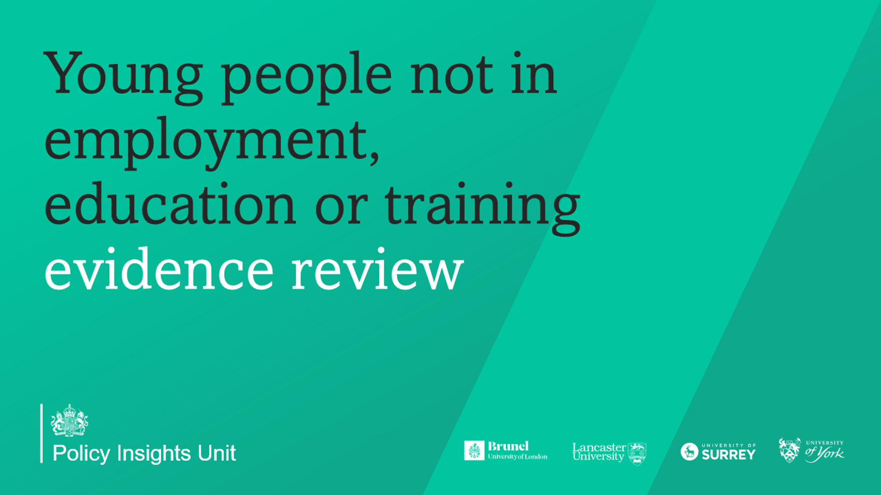
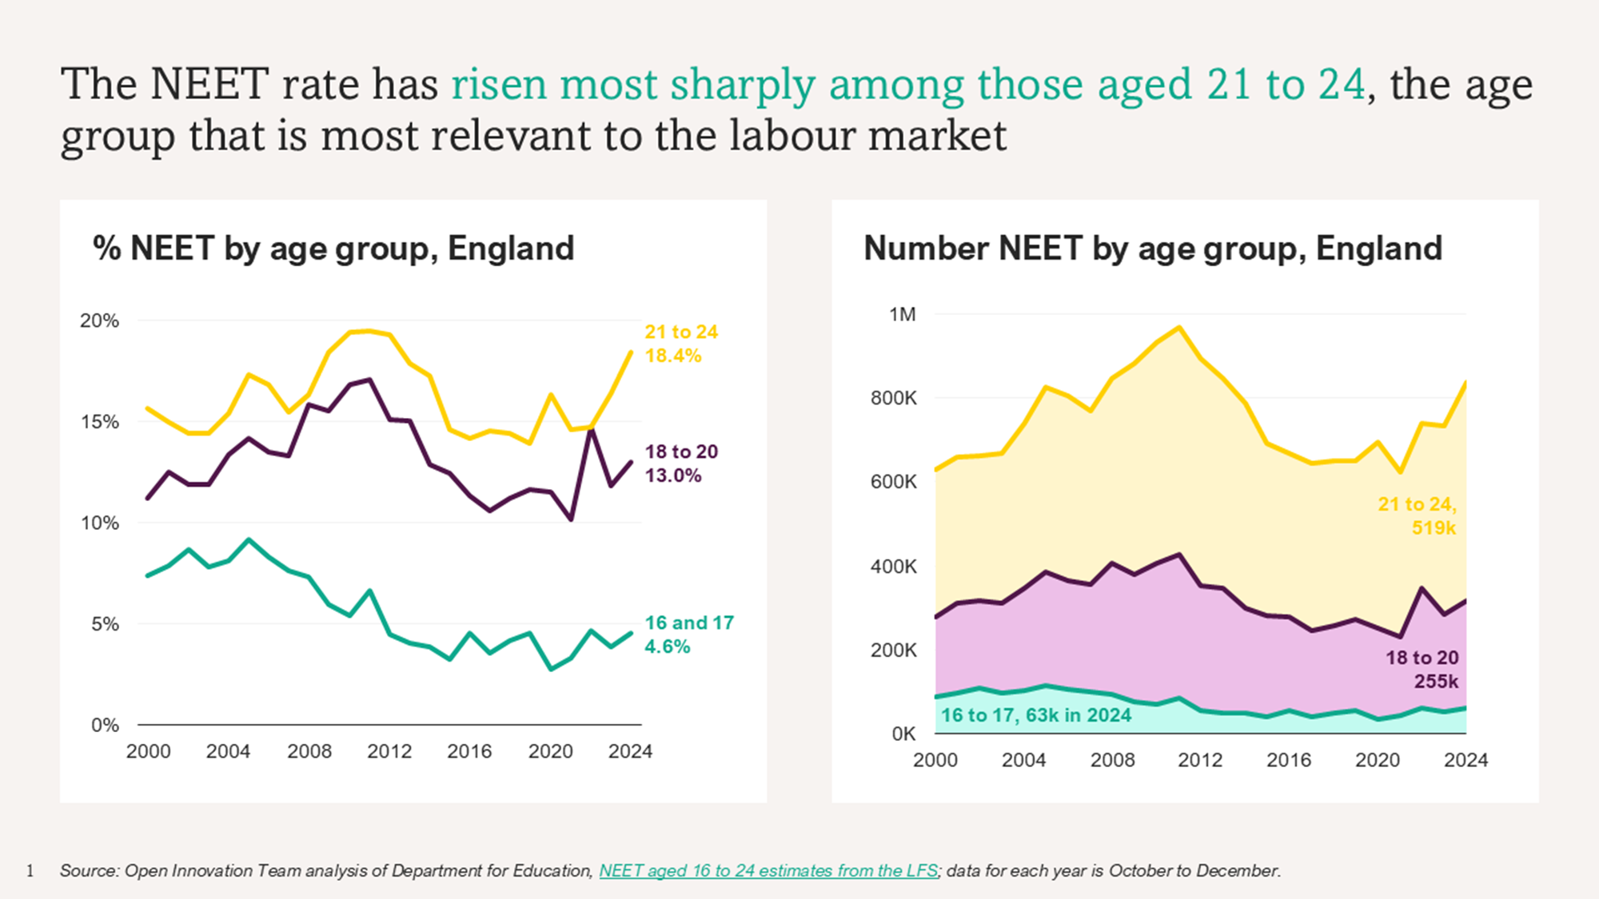
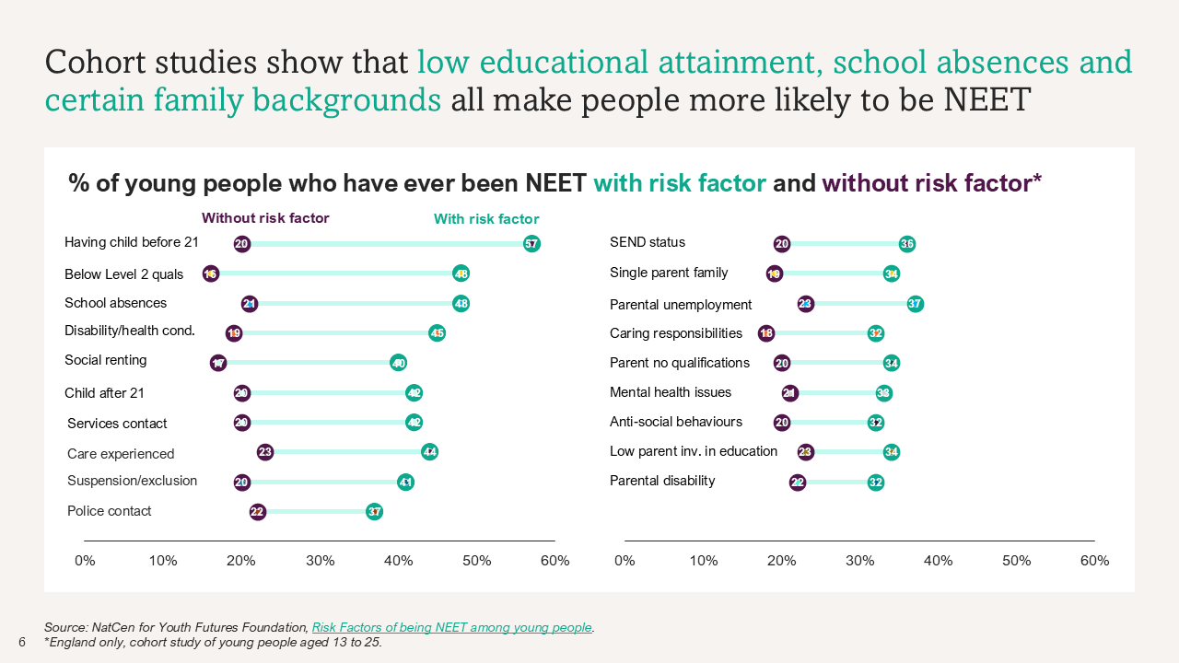
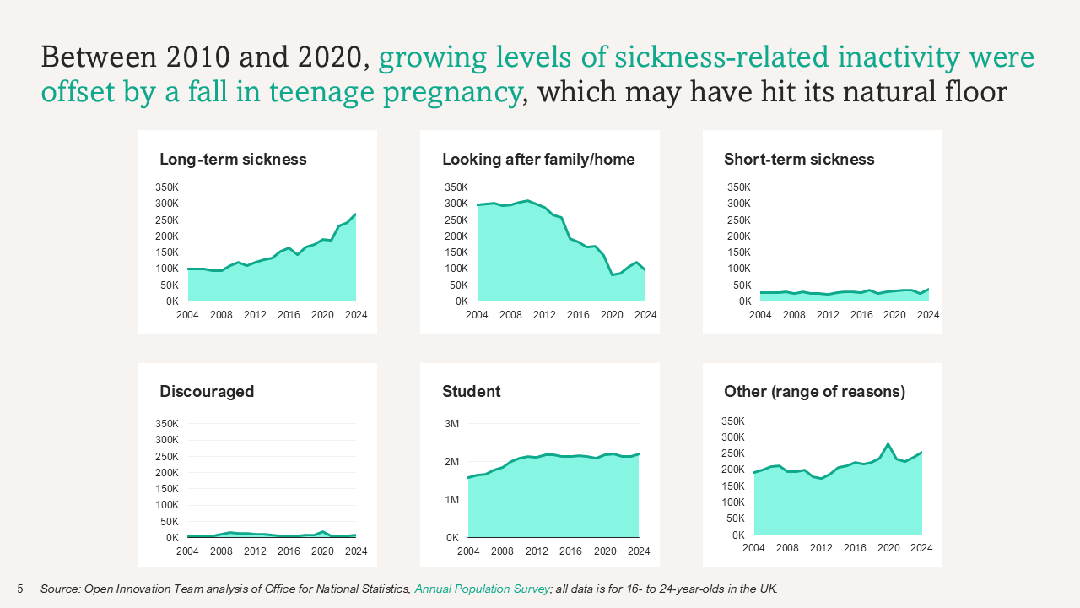
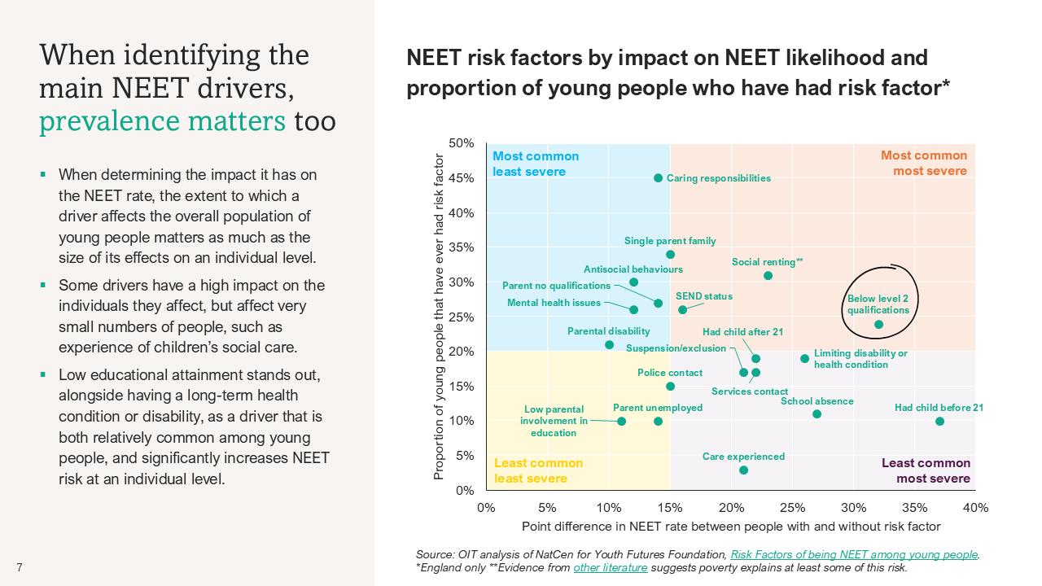
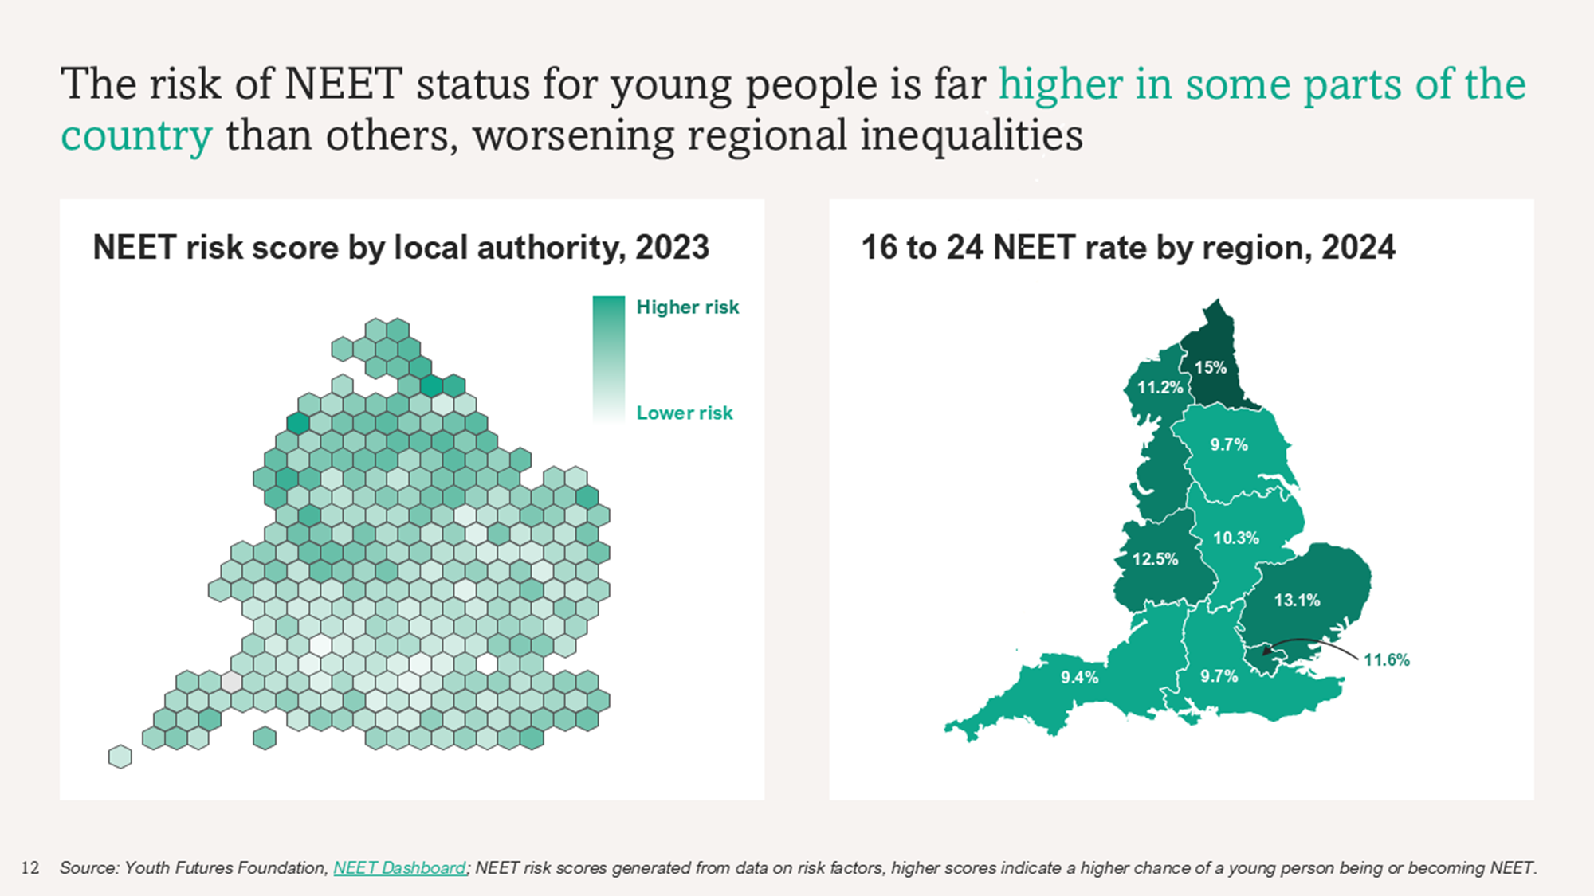
NEET trends and drivers
Our work
The Department for Work and Pensions asked us to rapidly synthesise the evidence on the drivers of the NEET rate among 16 to 24 year olds in the UK.
In ten weeks, we analysed and visualised the data, producing a report with 61 different charts and fronted with a clear, data-led story about the main drivers of NEET status and key trends.
The report has been used to brief ministers and special advisers, and has fed into the ongoing work of both the Milburn Review and the Opportunity Mission.

Slide 5
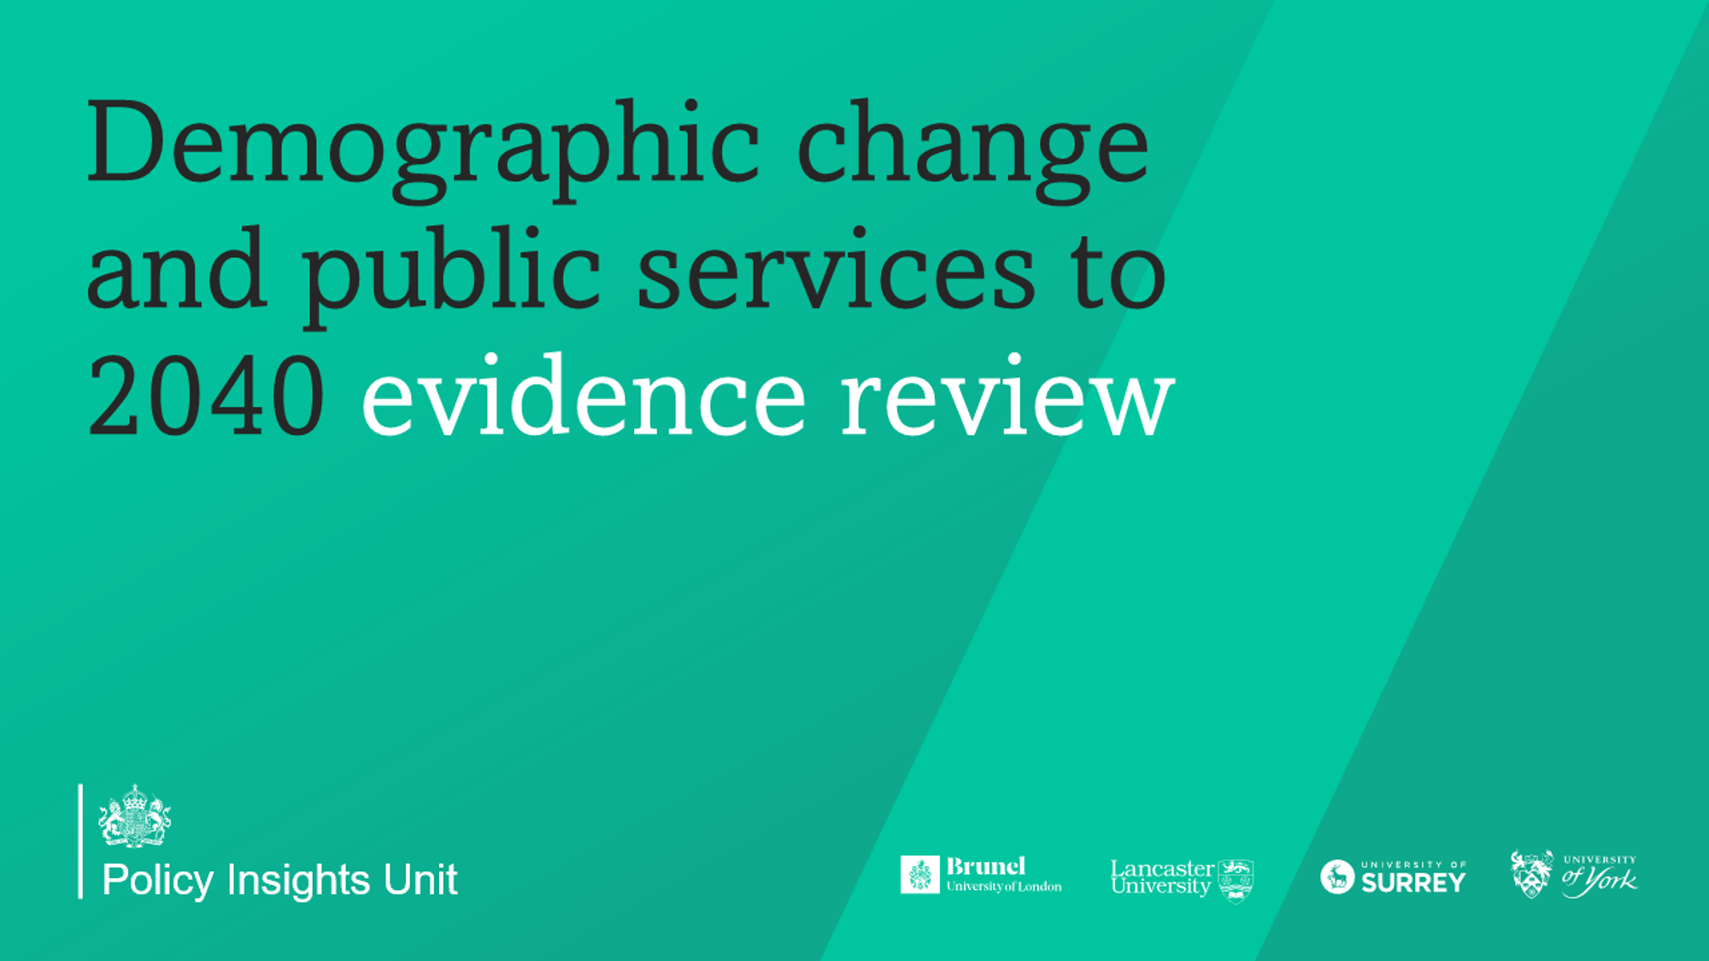
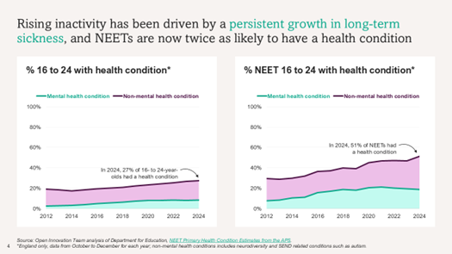
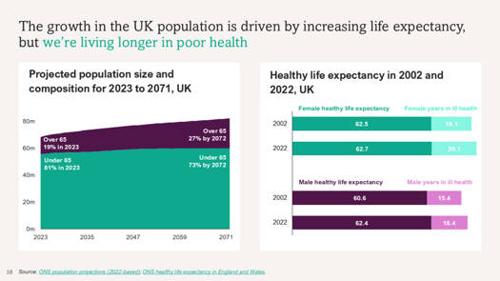
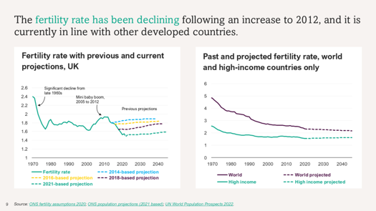
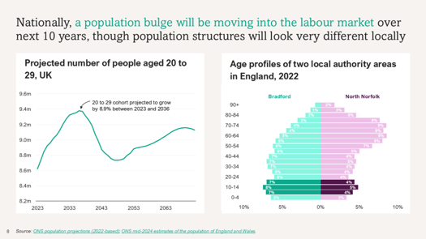
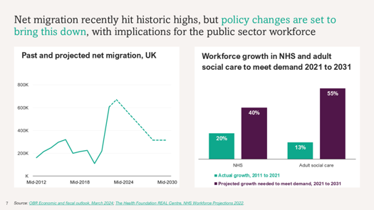
Demographic trends and public services
Our work
The Cabinet Office and Department for Education asked us to synthesise evidence on the impact of demographic change on UK public services.
We worked with the Office for National Statistics and Joint Data Analysis Centre to explore the fertility rate, immigration, the future of the labour market and the public sector workforce as part of an extensive review.

Slide 6
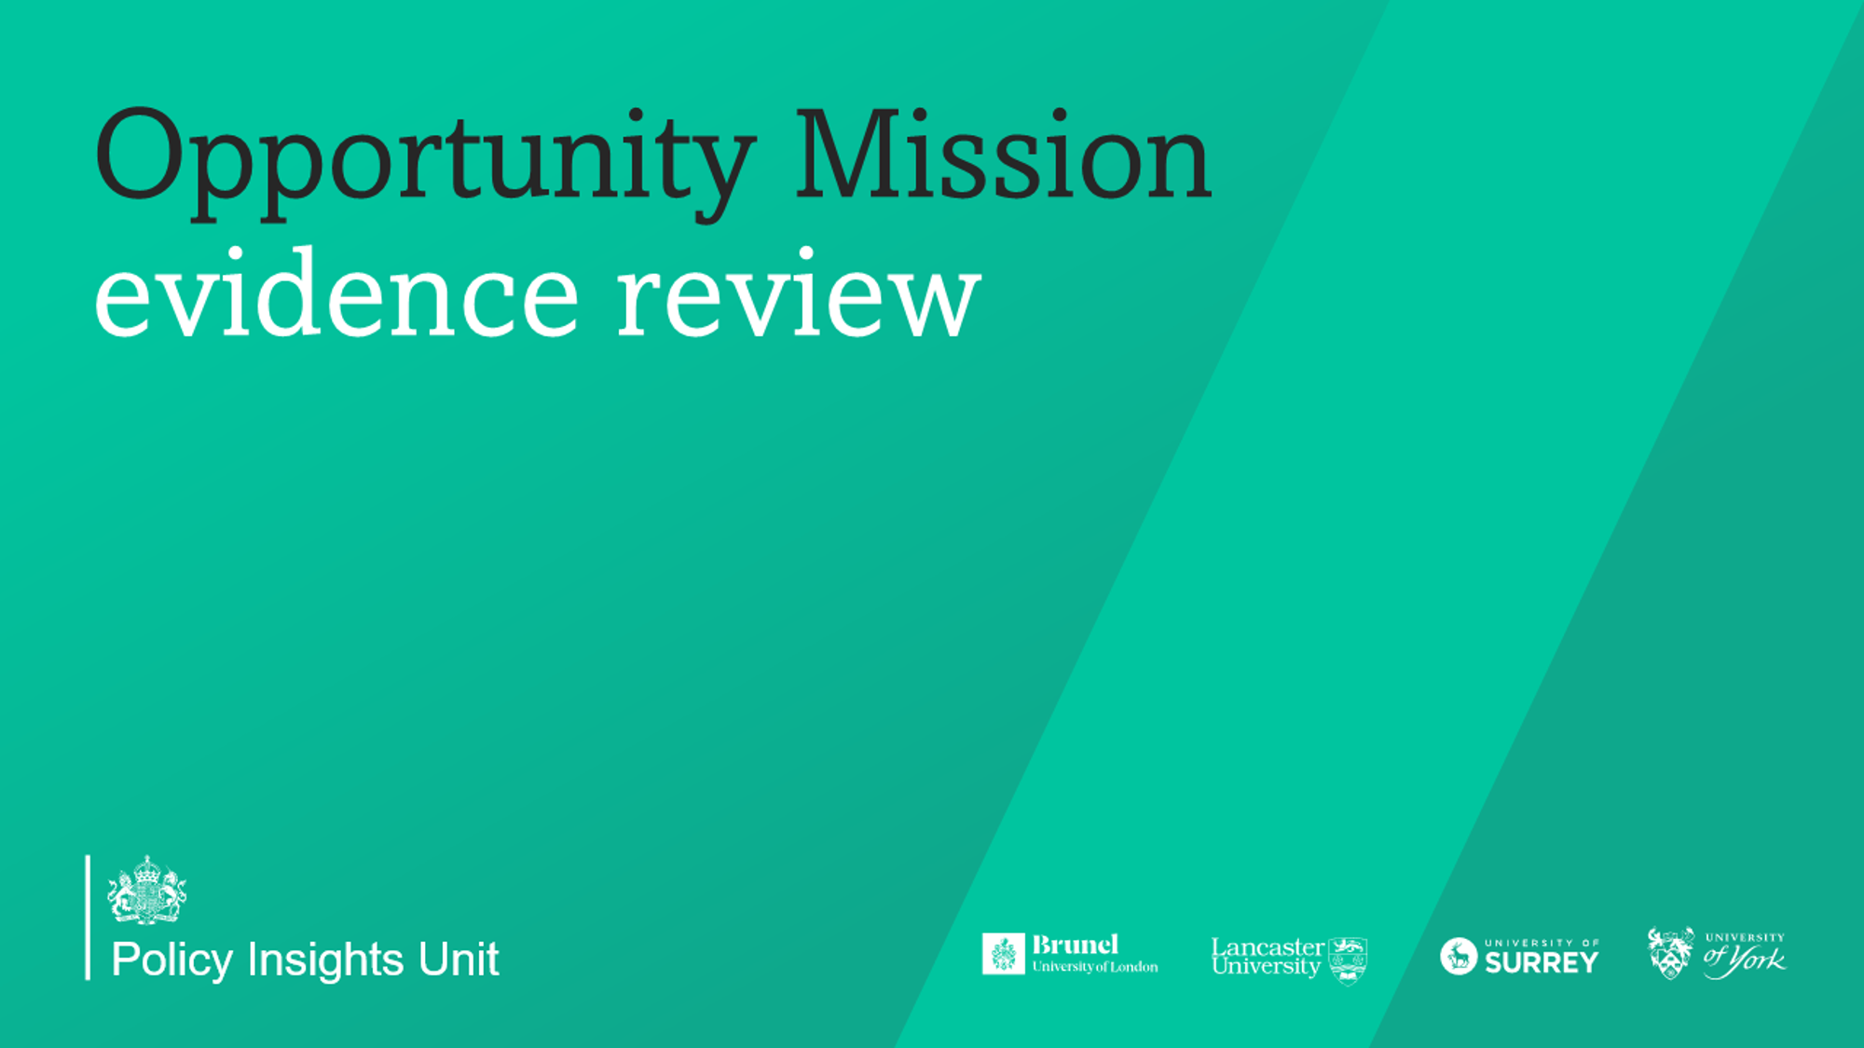
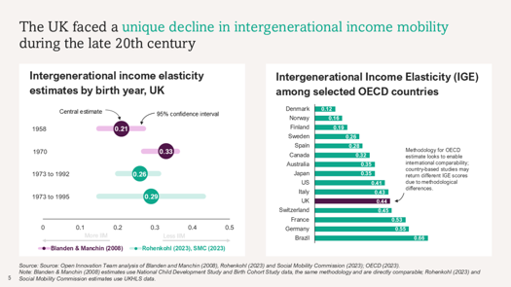
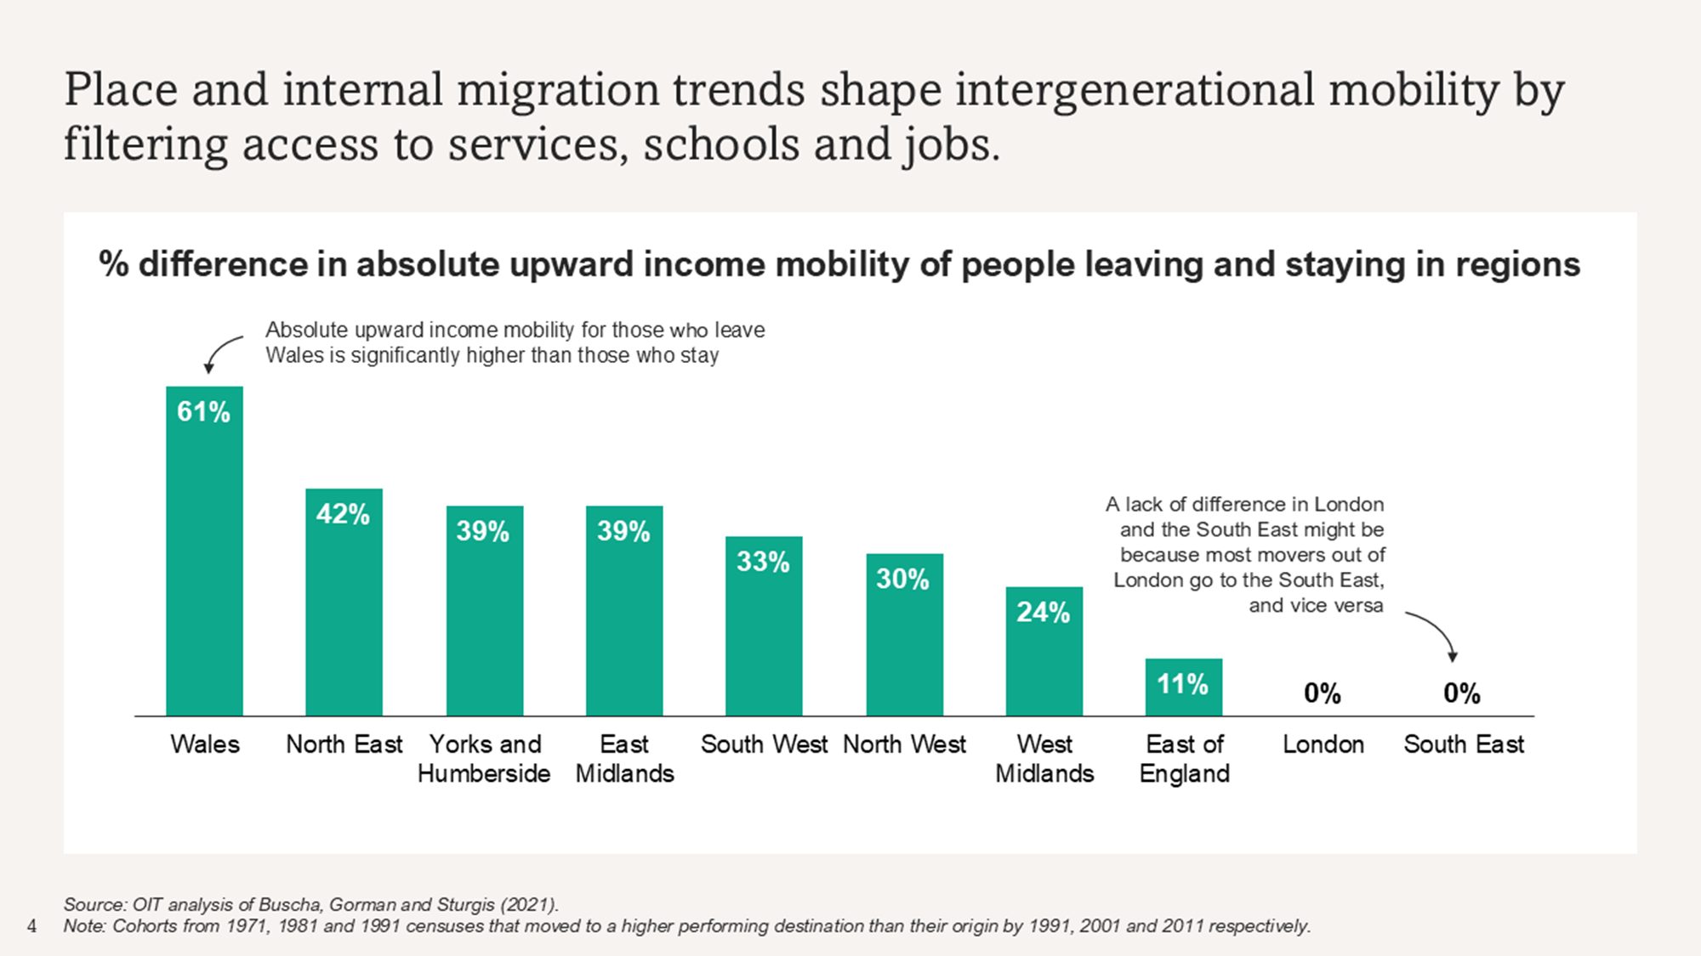
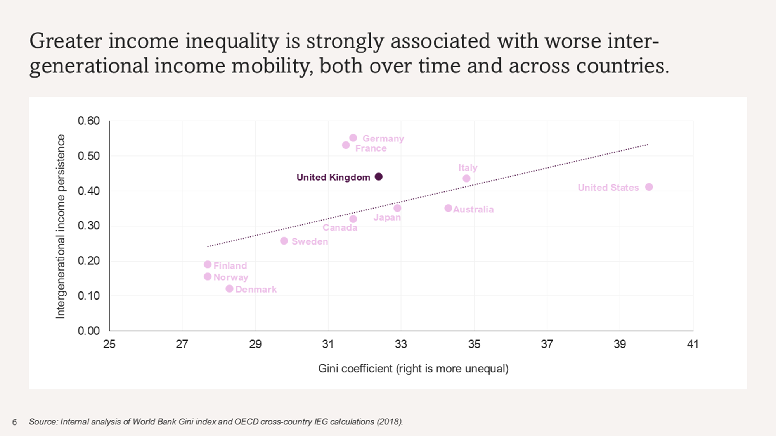
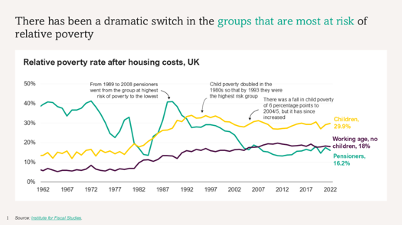
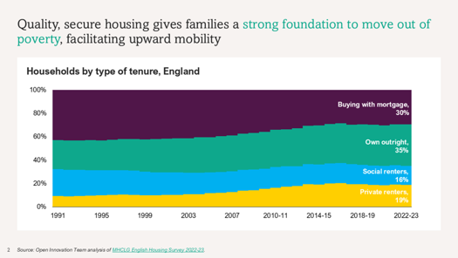
Opportunity Mission evidence review
Our work
The Department for Education asked us to pull together the evidence base on opportunity to prepare the ground for the start of the Opportunity Mission in summer 2024.
In eight weeks, we produced a comprehensive data-led review of opportunity, covering a range of policy areas and providing insight into the metrics that could be used to measure progress against the mission.

Slide 7
We’re trusted by teams across government
PIU did an excellent job supporting a task and finish cross government project looking at demography and public service impacts in 2024. Strong use of international evidence, data visualisations and new analysis generated new insights and framed short and longer-term conclusions.”
The team gave us exactly the product we needed to communicate the NEETs challenge and its various and compounding drivers to inform a cross-government response. We’ve already used their work with Ministers to tell that story.”
The PIU worked at pace to produce a rigorous, data driven evidence review at the outset of the Opportunity Mission. Working with analytical teams, OGDs and external experts, they delivered a high-quality product that enabled us to brief ministers well and really shape discussion at the first Mission Board.”
Juliet Chua
Alex Fitzpatrick
Tony Foot
Director General, Cabinet Office
Director, Dept. for Work and Pensions
Director General, Dept. for Education

Slide 8
How you can work with us
We work with all central government departments and arm's-length bodies
We’re happy to work with any kind of government team, whether it’s policy, analysis, digital, delivery or any other function.
The commissioning process typically begins with a conversation to clarify your needs. It can take as little as a week to scope and agree work.
Initial chat
Agreement
Delivery
Feedback
We schedule a call to understand your needs
We agree an approach covering scope, timelines, deliverables, and costs
We carry out the agreed
work, giving you regular updates and collaborating with you to adjust plans if needed
We ask for your feedback and discuss lessons learned
Tailored
proposal
Kick-off
Reporting
We deploy a team of experienced staff to begin delivering for you
We provide a high-quality output, with sharp analysis and practical advice
You receive a clear plan designed around your needs

Slide 9
The Policy Insights Unit is part of a growing range of services operated by the Open Innovation Team
Making it quicker, easier and more affordable for the Civil Service to deliver high-quality evaluations.
Helping teams tackle complex policy and delivery challenges using systems thinking.
Helping civil servants turn curiosity about generative AI into safer, faster and higher-quality ways of working.
Contact us about evaluations:
Contact us about systems thinking:
Contact us about AI adoption:
enquiries@evaluationservices.gov.uk
netzerosystems@energysecurity.gov.uk
enquiries@openinnovation.gov.uk

