Slide 1
Document explainer
Purpose: This slide deck supports staff to consolidate their understanding of speech, language and communication and reflect on inclusive teaching strategies.
Audience: Staff and support staff in post-16 settings.
How to use this document:
This is a sense-making session on speech, language and communication (SLC). It is designed to be delivered after the introduction session and evidence summary on the same topic.
This session can be delivered in full or in parts, depending on the context of your setting and the structure of your planned professional development time.
A facilitator guidance document is available to support delivery of this session.
Further guidance on planning and delivering these professional development materials can be found in the Guide to Materials.
Some of the content in this session is drawn from primary research conducted in schools, but is included here where there is good confidence it also applies to post-16 settings

Slide 2
Facilitator guidance – timings
Timings are a suggestion: Times shown on individual slides (e.g., 2 minutes) are provided as a suggestion of the minimum amount of time a slide might take to deliver. Adjust these based on how long you might want to spend on an area of content or discussion.
This session is intended to be flexible enough to adapt this to slightly longer or shorter overall running time as required:
On the next slide you will see the session is split into three main parts, these can be delivered flexibly. For example, together as one session or as stand-alone sessions. Depending on which parts you choose to cover, the run time of your session will need to be adjusted accordingly.
Should you wish to run shorter sessions, you can limit optional slides and keep reflection activities concise. In longer sessions you might include more optional slides and allow extended time for discussion and staff contributions.

Slide 3
Facilitator guidance – sections
There are three main parts of this session.
Consolidate understanding
Speech, language and communication development
~ 30 mins
Build understanding
Inclusive teaching strategies relating to speech, language and communication development
~ 30 mins
Analyse and reflect
Teaching examples that show inclusive teaching strategies in practice
~ 30 mins
Notes:
These parts can be delivered together in one longer session, as stand-alone sessions, or as a set of sessions across several weeks/instances. Depending on which parts you choose to cover, the run time of your session will need to be adjusted accordingly.

Slide 4

Speech, language and communication
Sense-making session

Slide 5
Session timings
Activity | Time
Introduction | ~5 mins
Consolidate understanding | ~30 mins
Build understanding | ~30 mins
Analyse and reflect | ~30 mins
Reflection | ~10 mins
Notes:
This slide will need to be edited depending on how you are structuring your session
Time: 1 minute
Purpose: To understand what this session will entail.
Guidance:
You can decide whether you would like to share the timings of the session with staff.
You may choose to edit this slide with your own projected timings and to reflect the sections you are choosing to cover in your session.
Lead in: Let’s begin today’s session.

Slide 6
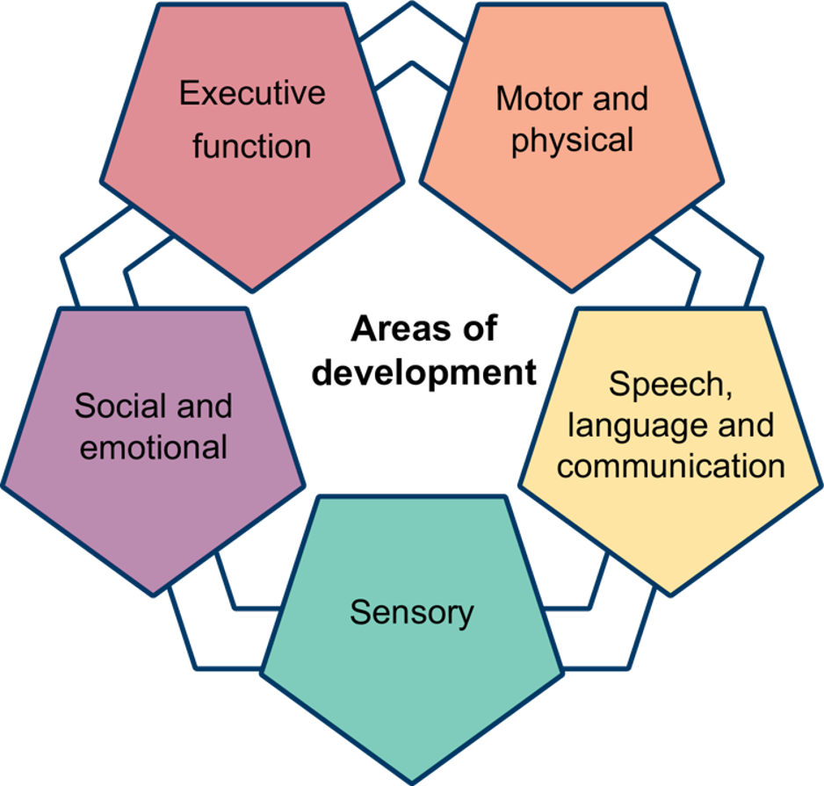
Areas of development
Note: The categories are subject to change following the SEND reform consultation
Notes:
You may wish to unhide and use this slide to support you with introducing and framing the areas of development depending on the prior knowledge of your staff.
Time: 2 minutes
Purpose: To position this session within the context of the five areas of development
Guidance: Give staff time to read the slide. Then explain that…
[If you intend to share the full suite of materials]
We are devoting time to each of the areas for development outlined in this diagram.
Please note, the final Areas of Development are subject to change - DfE is considering feedback from SEND reform consultation and recommendations from the Expert Panel.
[if you do not intend to use the full suite of materials]
This diagram shows the different areas of development. These five areas are: Executive function, sensory, motor and physical, social and emotional, speech, language and communication.
You can see the focus of today’s session, speech, language and communication, sits alongside other areas that focus on need in relation to executive function, motor and physical, sensory and social and emotional.
Lead in: Let’s zoom in on the focus for today’s session.
Graphics code: AOD-MainGraphic.png

Slide 7
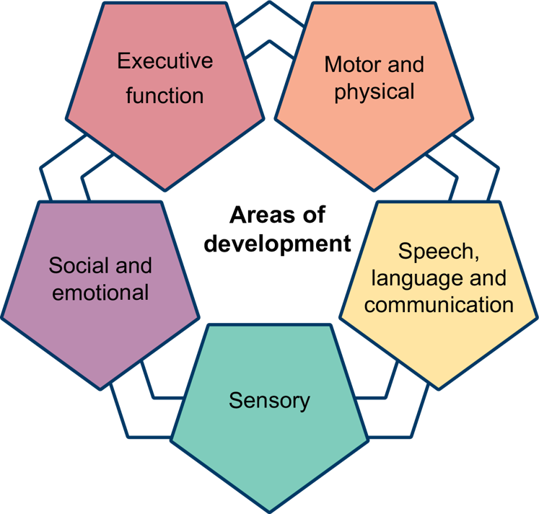
Explaining what we mean by speech, language and communication
Area of development
Speech, Language and Communication (SLC) Needs is an umbrella term which encompasses a broad range of needs that affect a learner’s ability to communicate effectively. ​
Speech, language, and communication (SLC) are foundational to learning and development (Department for Education, 2023). These skills act as a gateway to learners’ wider development, particularly literacy and access to learning materials.
Note: The categories are subject to change following the SEND reform consultation
Notes:
Time: 1 minute
Purpose: To understand what we mean when we refer to this area for development
Guidance: Give staff time to read the slide.
Then explain that…
This session focuses on speech, language and communication development, which is one of the five areas of development.
As part of this session, we’ll consider how SLC needs might present in learning spaces and the strategies that teachers and teaching assistants can use to support all learners, particularly those who experience SLC difficulties.
Lead in: Let’s look at the aims of the session.
References:
Department for Education (2023). Best start in life: Part 2 – The 3 prime areas of learning. Available at: https://www.gov.uk/government/publications/best-start-in-life-a-research-review-for-early-years/best-start-in-life-part-2-the-3-prime-areas-of-learning#communication-and-languageBest start in life part 2: the 3 prime areas of learning - GOV.UK
Graphics code: AOD-MainGraphic.png
Note: The final Areas of Development are subject to change - DfE is considering feedback from SEND reform consultation and recommendations from the Expert Panel.

Slide 8
Session aims
To summarise and clarify the key ideas from the Speech, Language and Communication (SLC) evidence summary.
To examine how understanding SLC informs inclusive teaching, and to share practical strategies for supporting every learner.
To reflect on current practice and identify areas for development in relation to SLC and inclusion.
To set manageable goals for applying new learning in practice.
Notes:
This slide will need to be edited depending on how you are structuring your session. Please delete or edit aims as relevant.
Time: 1 minute
Purpose: To understand what this session will entail.
Guidance:
Give staff time to read the slide. Then explain that…
This session focuses on speech, language and communication development needs and implications these have for teaching.
As part of this session, we will consider the key ideas in the evidence summary around SLC needs and learning.
There will be an opportunity to engage with and unpick an example of teaching practice, whereby the teacher supports a learner with SLC needs during questioning to check for understanding.
Additional aims of this session include:
To ensure that staff understand that inclusion within post-16 is not solely about helping learners access the curriculum or course; it is also about helping them to develop as individuals.
To build staff buy-in around how creating a system of inclusion can support all learners to have a positive experience of education.
To get staff excited about future professional development related to the SEND reforms.
To foster a collaborative environment where staff feel confident to share experiences, discuss challenges and celebrate progress.
Lead in: Let’s get straight on with considering the key ideas from the evidence summary.

Slide 9
Facilitator guidance – consolidate understanding
Consolidate understanding
Speech, language and communication development
~ 30 mins
Build understanding
Inclusive teaching strategies relating to speech, language and communication development
~ 30 mins
Analyse and reflect
Teaching examples that show inclusive teaching strategies in practice
~ 30 mins
Notes:
Suggested timing: This section is approximately 30 minutes long
Section focus: speech, language and communication (SLC)
Within this section there are check for understanding questions alongside slides relating to key concepts. These slides make direct links to the content covered in the ‘Speech, language and communication evidence summary’.
Section aim: to review the key concepts from the ‘Speech, language and communication evidence summary’.
This includes;
Check for understanding: questions and activities used to check knowledge covered in the evidence summary.
Key knowledge: consolidates and builds on key concepts of working memory and teaching practices that put demand on learners’ SLC.
You will find hidden slides that are optional content you may wish to cover dependent on the needs of the group you are working with.

Slide 10
Check for understanding (difficulties with SLC)
Check for understanding
It can be difficult to know when learners’ speech, language and communication skills might be presenting a barrier to accessing learning.
Which of the following activities might learners who experience SLC difficulties commonly find challenging?
  Remembering the sequence of steps in learning space routines.
  Working with shapes and patterns or visual representations.
  Following the language and instructions in written or verbal tasks.
  Maintaining focus during whole-class discussions and understanding what to do next.
Notes:
Time: 3 minutes
Purpose: To check understanding of SLC difficulties.
Guidance:
Use the explanations below to give staff feedback on their answers.
Correct answers explained:
a) Learners with SLC difficulties may struggle to process and retain spoken instructions, making it harder for them to remember and follow routines. This is because understanding and recalling sequences often rely on language skills.
c) This is a core challenge for learners with SLC difficulties. They may find it hard to understand complex instructions, especially if these are delivered quickly or contain unfamiliar vocabulary. This can affect their ability to complete tasks accurately.
d) Learners with SLC difficulties often find it challenging to follow discussions, particularly when there are multiple speakers or abstract concepts. They may lose track of the conversation and struggle to understand what is expected of them afterwards.
Incorrect answer:
b) This activity is less likely to be challenging for learners with SLC difficulties, unless the task relies heavily on verbal instructions or language. Many learners with SLC difficulties can process visual information well, so tasks based on shapes and patterns may not present the same barriers as language-based activities.
Summary: Learners with speech, language and communication difficulties are most likely to struggle with activities that rely on understanding, processing and remembering spoken or written language. Visual tasks, unless they involve complex instructions, are generally less problematic. If you want to support these learners, consider breaking instructions into smaller steps, using visual aids and checking for understanding regularly.
Lead in: Next question focuses on how common teaching practices might present high language demand.

Slide 11
Check for understanding (demands on SLC)
Check for understanding
Learning spaces are communication-rich environments, and everyday teaching routines can place significant cognitive and social demands on learners’ speech, language and communication skills.
Suggest some common practices that put high demand on SLC for learners.
Notes:
Purpose: To check understanding of SLC difficulties in practice.
Guidance:
Give staff time to consider the question.
Hint: direct staff to the ‘How might common practices put pressure on SLC?’ section of the evidence summary for support with this question.
Use the example suggestions below to give staff feedback on their answers.
Asking questions in class requires learners to listen, process language, and formulate a response. This puts a high demand on speech, language and communication (SLC) skills, especially for those who need extra time to understand or express their thoughts.
Giving instructions, particularly multi-step or complex ones, relies on learners’ ability to understand, remember and act on spoken language. Learners with SLC difficulties may find it challenging to retain all the information and follow through accurately.
When teachers explain or model new concepts, learners must process and make sense of unfamiliar language and ideas. This can be demanding for those with SLC needs, as it requires understanding new vocabulary, following the sequence of information, and linking it to prior knowledge.
Each of these practices is common in learning spaces and essential for learning, but they can create barriers for learners with SLC difficulties if not used effectively.
As part of taking participant feedback on this question there is an opportunity here to reflect on the importance of recognising the way using these practices ineffectively or without the appropriate support can present barriers to learner participation and learning.
For example, if questions are posed without appropriate processing time (or ‘wait time’) learners are more likely to find it difficult to respond to the best of their ability.
Lead in: These are moments where demand is put on SLC, let’s think in more detail about what challenges learners might face.

Slide 12

Key knowledge: SLC
Receptive language is the ability to understand and process spoken or written language.
Learners need to understand instructions, questions and explanations before they can act on them.
Difficulties with receptive language can make it harder to follow conversation, remember information and complete tasks.
Receptive language skills are closely linked to working memory. learners need to hold and process language in their minds to learn effectively.
Notes:
Time: 2 minutes
Purpose: To introduce/recap the key ideas on expressive and receptive language and to link these to the role of working memory.
Guidance:
Explain that:
Receptive language is a key part of speech, language and communication (SLC). It refers to how well learners can understand what is said to them, including instructions, explanations and discussion.
If a learner finds it difficult to process spoken language, they may miss important information, misunderstand tasks or struggle to keep up with the pace of learning.
For example, if an teacher or employer gives a set of instructions verbally, a learner with receptive language difficulties might only remember the first or last step or become confused about what to do.
These challenges are often linked to working memory. To follow instructions or answer questions, learners need to hold information in their minds while they think about what to do next.
When receptive language is a barrier, it can put extra strain on working memory, making it harder for learners to learn new content or complete tasks.
Supporting receptive language, for example, by breaking instructions into smaller steps, using visual aids or checking understanding, can help all learners, especially those with SEND, to access learning and reduce cognitive overload.
Lead in: Let’s take a moment to think about how working memory works.

Slide 13
Key knowledge: working memory
  We can only hold up to about four chunks of information in our working memory at any one time.
  Information in working memory will be lost shortly afterwards if it is not actively rehearsed or refreshed.
  Where learners’ working memory processing capacity is exceeded (i.e. they are having to think about too many new things at once) it is unlikely that they will be able to process that information.
Notes:
Time: 3 minutes
Purpose: To introduce/recap the key ideas on working memory.
Guidance:
Explain that:
Working memory capacity varies from person to person. Some learners with special educational needs and disabilities (SEND) may have a lower working memory capacity than their peers, but this is not always the case.
On average, people can hold about four ‘chunks’ of information at a time. A ‘chunk’ is a single piece of information, such as someone’s name, the month they were born, the name of their street, or their dog’s name.
We lose information from working memory if it is not actively rehearsed or refreshed. If we hear something only once and do not revisit or use it, we are likely to forget it.
The key challenge is with new information. When learners are asked to think about too many new things at once, this information has not yet moved into long-term memory. As a result, the brain cannot process it all, and much of it will be forgotten.
Lead in: Let’s check our understanding at this point.

Slide 14
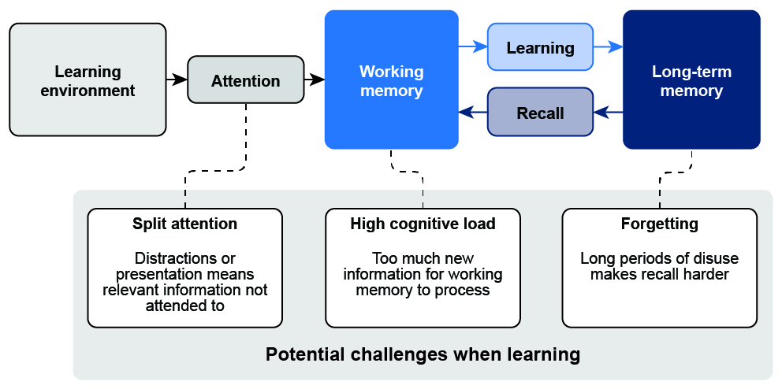
The simple model of memory and learning
Adapted from Willingham (2008)
Notes:
This is an optional slide. Depending on the prior knowledge of your staff, you may wish to unhide this slide and deliver it as part of the session.
Time: 2 minutes
Purpose: To introduce and explain the simple model of memory with a focus on working memory and learning.
Explain that:
The simple model of memory explains that working memory is where we consciously process new information, but it has a limited capacity and can easily become overloaded.
For learning to last, information must move from working memory into long-term memory, where it can be stored and recalled later.
Learners with SLC difficulties may find it especially challenging to hold and process spoken information in their working memory, making it harder to follow instructions and retain new learning.
Knowledge can be thought about as information that exists in our mind in our long-term memory, and teaching aims to generate a persistent change in the knowledge in our long-term memory (Kirschner et al., 2006).
Thinking is the process that catalyses such a change, a process involving our working memory. We attend to information in our environment (or in our minds) and in attempting to make sense of it, we alter the very fabric of our memory (Cowan, 2010).
Suggested script:
Imagine a learner in a learning space, we will call the space ‘the environment’.
The learner is attending to a piece of information in the environment (the teacher is teaching them something). This information is processed in the learner’s working memory. If that information is not referred to or revisited again it will be forgotten.
If the learner is supported to process that information and use it e.g. use some new vocabulary in a sentence, use the information to solve a problem, then the information may move from working memory into the learner’s long-term memory.
The learner is then more likely to retrieve this information and remember it another time (e.g. use the same word in an essay the following week). If the learner does not use that information again (even when it has been stored in their long-term memory) there is a risk that it will be forgotten.

Slide 15
Challenges for working memory
Learners will struggle more with working memory when they experience:
Unfamiliarity: all learners will have different pre-existing knowledge on a topic. If we introduce lots of new material at the same time, with little or no link to previous learning, the demand this places on working memory will be higher.
Complexity: as the number of elements in a task increases, so too does the demand on working memory and less learning is likely to take place.
Notes:
This is an optional slide. Depending on the prior knowledge of your staff, you may wish to unhide this slide and deliver it as part of the session.
Time: 2 minutes
Purpose: To consider how unfamiliarity and complexity can cause learners to struggle more with working memory.
Guidance:
Explain that…
Some learners, including those with special educational needs and disabilities (SEND), may have difficulties with working memory.
Learners have different working memory capacities. Some learners with SLC needs may have a more limited working memory capacity, which can affect how much information they can hold and use at one time.
Both unfamiliarity and complexity increase the risk of overloading working memory.
When information is new or complicated, learners are more likely to forget or lose track of what they need to do.
The way we deliver new and complex information matters.
Clear, manageable steps help learners retain and use what they have learned, rather than becoming overwhelmed and forgetting key points.

Slide 16
What might learners with SLC difficulties find challenging?
Learners may struggle when lessons involve lots of spoken information at once. This can make it harder to understand explanations, questions and instructions. Some learners, especially those with SLC difficulties, may not hold spoken information in mind long enough to act on it.
Working memory demands can lead to difficulties with:
Remembering full instructions.
Following a sequence of steps.
Connecting new learning to what they already know.
Notes:
This is an optional slide. Depending on the prior knowledge of your staff, you may wish to unhide this slide and deliver it as part of the session.
Time: 2 minutes
Purpose: To consider how unfamiliarity and complexity can cause learners to struggle more with working memory.
Guidance:
Explain that…
Learners may find it difficult when lessons include a lot of spoken information at once, as this can overload their working memory. This is especially challenging for learners with speech, language and communication (SLC) difficulties, who may not be able to hold spoken information in mind long enough to use it.
When working memory is overloaded, learners may struggle to remember full instructions, follow a sequence of steps, or connect new learning to what they already know.
Breaking information into smaller chunks, repeating key points, and using visual supports can help learners manage these demands and access learning more effectively.

Slide 17
Check for understanding (working memory and SLC)
Check for understanding
SLC difficulties can lead to learners displaying certain patterns of behaviour, such as failing to follow instructions.
Why might a learner with SLC difficulties find it hard to remember and follow all the steps in a verbal instruction?
  Their working memory may not hold all the spoken information long enough to act on each step.
  They are more comfortable with visual tasks and may ignore verbal instructions.
  They may not have heard the instruction clearly due to background noise.
Notes:
Time: 3 minutes.
Purpose: To check understanding of the relationship between working memory and SLC development.
Guidance:
Use the explanations below to give teachers feedback on their answers.
Correct answer explained:
Learners with speech, language and communication (SLC) difficulties often have challenges with working memory, which means they may struggle to retain and process multi-step verbal instructions. This can make it difficult for them to remember and follow each part of the instruction, especially if it is lengthy or complex.
Incorrect answers:
b) While learners with SLC difficulties may benefit from visual supports, it is not accurate to say they ignore verbal instructions simply because they prefer visual tasks. The main issue is with processing and remembering spoken information, not a preference for one type of task over another.
c) Background noise can affect any learner’s ability to hear instructions, but this is not specific to SLC difficulties. The key challenge for learners with SLC needs is processing and retaining spoken information, rather than hearing it in the first place.
Summary: learners with SLC difficulties may find it hard to remember and follow all the steps in a verbal instruction because their working memory may not hold all the spoken information long enough to act on each step. Using clear, concise instructions and supporting them with visual cues can help these learners access and act on what is being asked.
Lead in: Let’s take a moment to pause.

Slide 18

Reflection on practice
Reflection
Identify two key takeaways about speech, language and communication (SLC).
Think of a learner you have taught. How might these takeaways help you interpret something you noticed about their understanding, participation or behaviour?
Think of a learner or group you teach now. What might you notice or explore differently in light of this session?
Notes:
Time: 10 minutes
Purpose: To give staff an opportunity to reflect on their own practice and think about how they can implement the ideas from this session in their own practice.
Guidance:
Give five minutes for individual reflection, thinking and/or notes.
Allow five minutes for discussion and feedback.
Lead in: How can the universal approaches that we take for all learners support with this?

Slide 19
Facilitator guidance – build understanding
Consolidate understanding
Speech, language and communication development
~ 30 mins
Build understanding
Inclusive teaching strategies relating to speech, language and communication development
~ 30 mins
Analyse and reflect
Teaching examples that show inclusive teaching strategies in practice
~ 30 mins
Notes:
Suggested timing: This section is approximately 30 minutes long
Section focus: Inclusive teaching
This part focuses on the importance of using universal approaches to inclusive teaching strategies to support all learners, especially those with SLC difficulties.
There is an opportunity for staff to consider inclusive teaching practices and associated strategies which can be used to support learners’ SLC. This covers the following teaching practices along with some strategies that they might use:
Use visual cues.
Model and scaffold high-quality conversations: feedback, explanations and questioning.
Create opportunities for oracy development.
Develop speech and language across the course.
Section aim: to remind staff of the universal approaches to inclusive teaching and encourage them to consider specific strategies that can be used universally in their own practice to support learners’ SLC.
You will find hidden slides that are optional and can be used to support the check for understanding question using an example answer.

Slide 20
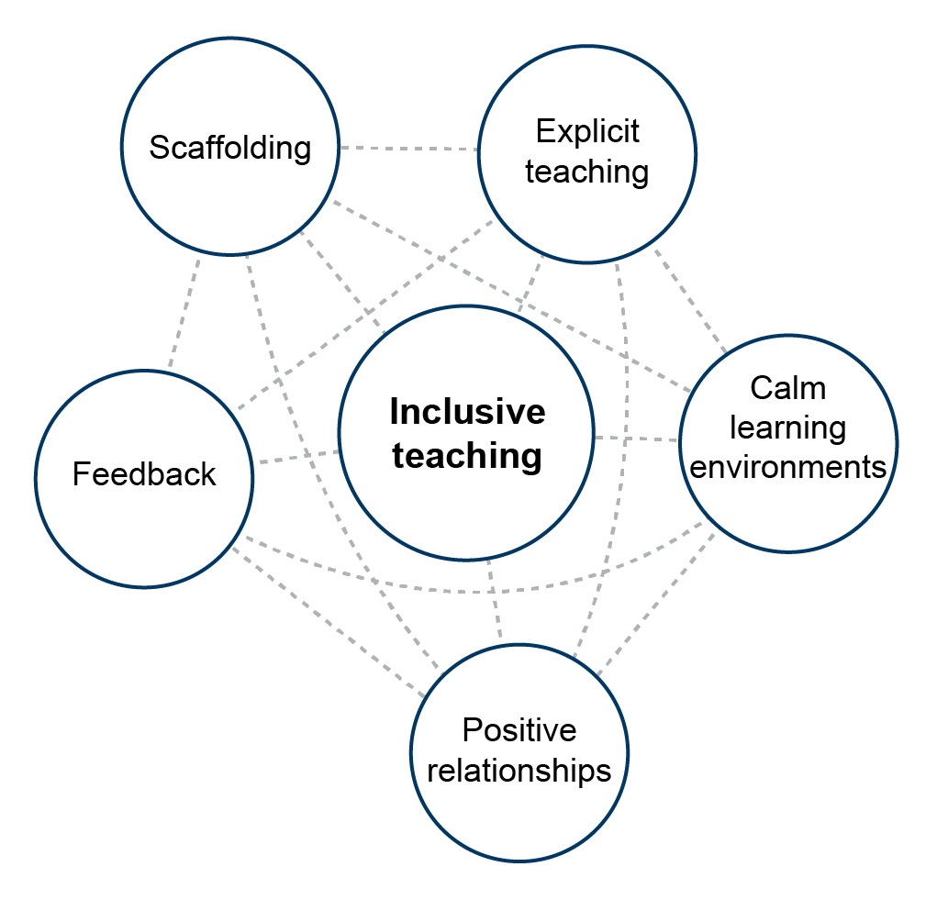
Key knowledge: universal approaches to inclusive teaching
EEF (2026)
Notes:
Time: 2 minutes.
Purpose: To introduce the idea of universal approaches as part of inclusive teaching.
Guidance:
Explain that:
Inclusive teaching means creating learning environments where every learner can participate and succeed, regardless of background, ability or need. It involves recognising and removing barriers to learning, so all learners feel valued and supported. This approach benefits everyone, not just those with identified needs.
Universal approaches are strategies and practices that support all learners. These are proactive methods, designed to meet a wide range of needs before specific challenges arise. Examples include clear instructions, modelling, and positive relationships.
Universal approaches can and should be adjusted within usual teaching practice to suit individuals, groups or the whole class. Adaptations and universal strategies are complementary; they are often used alongside each other to provide effective support. For example, a teacher might use a universal approach such as modelling, while also adapting the task or providing additional prompts for learners who need them.
This diagram focuses the interconnectedness of inclusive teaching.
The universal approach involves using teaching practices include scaffolding, explicit teaching, feedback, positive relationships and calm classroom environments.
The teaching practices around the outside are all part of the core concept at the centre. While these approaches are interconnected in practice, the diagram separates them to highlight the key components that make up inclusive teaching.
It presents inclusive teaching as a network of dynamic, interacting elements, each contributing to a more supportive and effective environment for every learner.
Lead in: There are two ways we might think about how to select and use inclusive teaching practices.
Education Endowment Foundation (EEF). (2026). The EEF Guide to Inclusive Teaching. Accessed at: https://educationendowmentfoundation.org.uk/education-evidence/inclusive-teaching/universal-approaches
Graphics code: IHM_008.png

Slide 21
Inclusive teaching: rationale
Teachers choose different approaches for different purposes in response to the needs of their learners and the course content they are teaching.
Reduce barriers: Some strategies reduce immediate barriers, such as making instructions and questions clearer.
Long-term development: Some strategies help develop learners’ speech, language and communication skills over time.
Some strategies, or combination of strategies, can achieve both these purposes over time.
Notes:
Time: 2 minutes.
Purpose: To outline the purposes of different teaching strategies and how teachers might think about making decisions about which ones to use.
Guidance:
Explain that:
Inclusive teaching strategies can support all learners’ speech, language and communication, and will be particularly important for those experiencing SLC difficulties. Speech, language and communication affect learners’ access to learning and future progress. Therefore, all students need access to inclusive teaching.
It is important to make the distinction between the two purposes of using inclusive teaching as this will be considered in detail later in the session. Highlight to teachers that high-quality teaching will always combine a number of strategies to support learner learning, making decisions about which strategies or approaches to use, when and for what purpose is an essential feature of successfully supporting learners’ needs.
Reduce barriers: Some strategies and teaching practices reduce immediate barriers, for example by providing visual supports such as diagrams or picture cues. These help learners access learning when speech, language, and communication difficulties might otherwise make it challenging to understand the content.
Long-term development: Some strategies can be used across the curriculum to deliberately develop learners’ speech, language, and communication over time.
Lead in: We are going to think about the strategies that can help us to do this.

Slide 22
Check for understanding
What teaching practices and/or strategies can we do everyday that support all learners' SLC, and especially learners with SLC difficulties?
For one or two of these suggest a reason why it will support learners to either access learning or develop their SLC in the long term (or both).
What might make these practices/strategies more or less effective?
In what circumstances might you need to adapt these universal teaching practices/strategies?
Notes:
Time: 6 minutes.
Purpose: To check staff knowledge of different teaching practices and strategies which can support learners with SLC needs.
Guidance:
Give two minutes for individual thinking and/or notes.
Allow four minutes for discussion.
You may find it helpful to signal when two minutes is up so that both speakers get to share ideas.
You may not choose to cover all of these questions at this point, perhaps only focusing on the first two or three questions.
There is an example on the next (hidden) slide with an example of how teachers might respond to these questions. You may choose to use this example to support your own thinking about how you want teachers to respond to these questions or share it with teachers as a model answer before asking them to come up with their own responses.
Small illustrative examples that will support you to deliver questions and set up this task might be: (adjust these to your context where relevant)
Name some teaching practices and/or strategies which can support all learners, especially learners with SLC difficulties.
Example: Providing written summaries or visual organisers (such as flow charts or mind maps) alongside verbal explanations.
For one or two of these suggest a reason why it will support learners to either access learning or develop their SLC in the long term (or both). Example: visual aids such as written summaries makes it easier for learners to access and process complex ideas, supports understanding of key concepts, and gives them a reference point they can revisit. Over time, this approach helps develop independent study skills and confidence in handling subject-specific language.
What might make these practices/strategies more or less effective? Example: This practice is most effective when summaries or organisers are clear, concise and directly linked to the lesson content. If they are too detailed or contain too much new vocabulary, learners may become confused or overwhelmed.
In what circumstances might you need to adapt these universal teaching practices/strategies? For example by increasing the intensity for some learners.
Example: If a learner has significant difficulties with receptive language, you might adapt by providing more or simpler visuals, reducing the amount of text, or providing glossaries for key terms.
Lead in: Keep what you have just discussed in mind as we move on.

Slide 23
Example responses for Q1 and Q2
Check for understanding
Example responses:
Modelling the use of key vocational terms in context during practical sessions can support all learners, especially those with SLC difficulties.
This approach helps learners access learning because hearing and seeing key terms used in real situations makes technical language more meaningful and memorable. Over time, consistently modelling and reinforcing these terms supports learners to develop their SLC, as they become more confident in understanding and using industry-specific vocabulary in both written and spoken tasks.
Notes:
This is an optional slide showing examples of how staff might respond to the questions on the previous slide.
Time: 2 minutes
Purpose: To check staffs’ knowledge of different teaching practices and strategies which can support learners with SLC needs.
Guidance:
The example uses scaffolded group talk to show how teachers might approach these questions.
Lead in: Keep what you have just discussed in mind as we move on.

Slide 24
Example responses for Q3 and Q4
Check for understanding
Example:
This strategy is most effective when teachers introduce only a small number of new terms at a time and revisit them regularly in different contexts. If too many terms are introduced at once, learners may become overwhelmed and struggle to retain or use the vocabulary.
If a learner has significant difficulty with receptive language, you might adapt by repeating the same key term more frequently than you would otherwise and ensure this is done in plenty of different contexts to support understanding.
Notes:
This is an optional slide showing examples of how staff might respond to the questions on the previous slide.
Time: 2 minutes
Purpose: To check staffs’ knowledge of different teaching practices and strategies which can support learners with SLC needs.
Guidance:
The example uses scaffolded group talk to show how teachers might approach these questions.
Lead in: Keep what you have just discussed in mind as we move on.

Slide 25
Inclusive teaching: practices for supporting all learners’ SLC
Use visual cues
Model and scaffold high-quality conversations: feedback, explanations and questioning
Create opportunities for oracy development
Develop speech and language across the course
Notes:
Time: 4 minutes.
Purpose: To explain some inclusive teaching practices that can support learners to access communication.
Guidance:
Explain that:
Inclusive teaching practices are achieved through a range of strategies, which can be combined to support learning. We will look at the strategies for each practice in a moment.
The set of four areas of inclusive teaching practice we have here can be used effectively for lots of different purposes in teaching, but are particularly useful for supporting speech, language and communication. These are examples of universal approaches (first stage of the two-part model of inclusive teaching – universal approaches and adaptations and additional support).
Visual cues: Use pictures, symbols and gestures to make spoken information clearer and easier to process.
Model and scaffold high-quality conversations: Use clear, simple language and pre-teach vocabulary to support understanding (Education Endowment Foundation, 2026).
Opportunities for oracy development: Provide structured talk and regular informal feedback to help learners practise and develop language.
Develop speech and language across the curriculum: Use subject content to build vocabulary and communication skills in different contexts.
Lead in: We are going to discuss some of these practices and think about their associated strategies.

Slide 26
Facilitator guidance – supporting discussion on inclusive teaching
Aim: Support deeper thinking about how these inclusive teaching practices and strategies can be used in your setting. Choose the format that best fits your team’s needs.
Use slides 27-31 to prompt discussion. Each focuses on a different inclusive teaching practice. For example, you might select ‘Model and scaffold high-quality conversations’ and focus on a couple of the strategies within this area of teaching practice. Encourage richer conversations by focusing on one or two practices, rather than covering all four.
Tailor the activity to your group. For example, you may choose to print the slides and assign each group a different practice or keep the group together and focus on one practice for a shared discussion.
If groups are working on different practices, you could:
  Ask each group to present their key points.
  Use a gallery walk, where groups display notes and others add comments.
  Lead a whole-group reflection to draw out similarities and differences.

Slide 27

Inclusive teaching: discussion
Each inclusive teaching practice has several strategies associated with it that can be used to support learners’ SLC development.
On the following slide you will find strategies that support each of the inclusive teaching practices.
Select one of these strategies (e.g. ‘use clear and unambiguous language’).
How might you use this strategy in your setting?
Do you think it might need to be combined with other strategies? Why?
What impact do you think implementing the strategy in this way will have on your learners (both at a whole-group level, and any learners you can think of who experience SLC difficulties)? Will it make this strategy more effective, why?
Notes:
Time: 2 minutes
Purpose: To give teachers an opportunity to think about their own teaching through the lens of inclusive teaching strategies.
Guidance:
These questions should be answered while looking at one of the following four slides. E.g. you might choose to focus on the slide which shows the strategies for ‘Model and scaffold high-quality conversations’.
Encourage richer conversations about one or two practices and their strategies as opposed to trying to cover all four.
You may choose to print the following four slides and give a different practice and strategies to different groups of teachers to then give each group the opportunity to feedback, or you may want the whole group to focus on one practice and facilitate a whole group discussion.
Lead in: I am going to show you one of the practices and the strategies associated with it.

Slide 28
Inclusive teaching practices: visual cues
Inclusive teaching: practices for supporting all learners
Use visual cues Use visuals to scaffold learning Offer reminders using visual cues Use non-verbal cues to reinforce speech
Model and scaffold high-quality conversations: feedback, explanations and questioning
Create opportunities for oracy development
Develop speech and language across the course
Notes:
Time: 10 minutes
Purpose: To give teachers an opportunity to think about their own teaching through the lens of inclusive teaching strategies.
Guidance:
Each participant or group should focus on just one strategy from the slides. This could mean everyone explores the same strategy together, or sub-groups each take a different one.
This approach encourages deeper thinking and avoids spreading attention too thinly.
To gather feedback:
If working as a whole group, invite open discussion and summarise key points together.
If working in sub-groups, ask each group to share their main insights with everyone—either by presenting, posting notes in a shared space to review, or contributing to a shared document.
Feedback:
Use visuals to scaffold learning
Introduce diagrams, pictures or graphic organisers alongside spoken explanations to help learners understand new concepts.
Visual scaffolds are most effective when paired with clear verbal explanations and opportunities for learners to discuss or ask questions, as this supports deeper understanding.
Visual scaffolds can help all learners access content, especially those who find language challenging. Learners with SLC difficulties benefit from having information presented in multiple ways, making learning more accessible and reducing cognitive load.
Offer reminders using visual cues
Display a schedule or checklist with images or symbols representing each activity, referring to it regularly to remind learners what’s happening next.
Visual cues work well alongside verbal reminders and consistent routines, helping learners link spoken instructions to visual cues.
This approach supports whole-class organisation and independence. Learners with SLC difficulties or those who struggle with transitions benefit from clear, predictable routines, which can reduce anxiety and help them follow the day’s structure.
Use non-verbal cues to reinforce speech
Use gestures, facial expressions or pointing to emphasise key instructions or concepts while speaking.
Non-verbal cues are most effective when combined with clear, concise speech and visual supports, ensuring learners understand both the spoken and unspoken elements.
Reinforcing speech with non-verbal cues helps all learners focus and understand instructions. Learners with SLC difficulties often rely on these cues to interpret meaning, so this strategy can improve engagement and comprehension for them.

Slide 29
Inclusive teaching practices: model and scaffold high-quality conversations
Inclusive teaching: practices for supporting all learners
Use visual cues
Model and scaffold high-quality conversations: feedback, explanations and questioning Use clear and unambiguous language Balance simple and developmental language Consider sentence structure Move from simple to complex/concrete to abstract
Create opportunities for oracy development
Develop speech and language across the course
Notes:
Time: 10 minutes
Purpose: To give staff an opportunity to think about their own teaching through the lens of inclusive teaching strategies.
Guidance:
Each participant or group should focus on just one strategy from the slides. This could mean everyone explores the same strategy together, or sub-groups each take a different one.
This approach encourages deeper thinking and avoids spreading attention too thinly.
To gather feedback:
If working as a whole group, invite open discussion and summarise key points together.
If working in sub-groups, ask each group to share their main insights with everyone—either by presenting, posting notes in a shared space to review, or contributing to a shared document.
Feedback:
Use clear and unambiguous language
Choose words that are direct and easy to understand, avoiding idioms or ambiguous phrases when giving instructions or explanations.
Pair clear language with visual cues or examples to reinforce meaning and check learners’ understanding.
All learners benefit from clarity, but those with SLC difficulties are particularly supported, as they are less likely to misinterpret instructions or explanations.
Balance simple and developmental language
Start with straightforward language, then gradually introduce new vocabulary and more complex ideas as learners’ confidence grows.
Combine this approach with modelling and scaffolding, so learners can see and practise using new language in context.
This supports whole-class progression, allowing learners to build on what they know. Learners with SLC difficulties benefit from a gradual approach, as it gives them time to process and use new language.
Consider sentence structure
Use short, well-structured sentences when introducing new concepts, and avoid unnecessarily complex grammar.
Combine clear sentence structure with visual supports and repetition to help learners internalise new information.
Clear sentence structure aids comprehension for all learners, and is especially important for those with SLC difficulties, who may struggle with long or complicated sentences.
Move from simple to complex/concrete to abstract
Begin with concrete examples and simple ideas, then build towards more abstract concepts and complex language as learners’ understanding develops.
Use scaffolding and regular checks for understanding to support learners as they move from simple to complex.
This approach helps all learners make connections and build confidence. Learners with SLC difficulties benefit from starting with tangible examples, making it easier to grasp abstract ideas later.

Slide 30
Inclusive teaching practices: create opportunities for oracy development
Inclusive teaching: practices for supporting all learners
Use visual cues
Model and scaffold high-quality conversations: feedback, explanations and questioning
Create opportunities for oracy development Scaffold questions and responses Promote meaningful talk for a range of purposes Focus on expressive language and specialist terminology Model strategies for checking understanding and asking for clarification
Develop speech and language across the course
Notes:
Time: 10 minutes
Purpose: To give staff an opportunity to think about their own teaching through the lens of inclusive teaching strategies.
Guidance:
Each participant or group should focus on just one strategy from the slides. This could mean everyone explores the same strategy together, or sub-groups each take a different one.
This approach encourages deeper thinking and avoids spreading attention too thinly.
To gather feedback:
If working as a whole group, invite open discussion and summarise key points together.
If working in sub-groups, ask each group to share their main insights with everyone—either by presenting, posting notes in a shared space to review, or contributing to a shared document.
Feedback:
Scaffold questions and responses
Provide sentence starters, prompts or structured frameworks to help learners formulate answers and participate in discussions.
Combine scaffolding with modelling and feedback, so learners can see examples and receive support as they develop their responses.
This approach builds confidence and participation across the class. Learners with SLC difficulties benefit from clear structures, making it easier for them to join in and express their ideas.
Promote meaningful talk for a range of purposes
Encourage learners to engage in discussions, debates, explanations and storytelling, linking talk to real-life contexts.
Use purposeful talk alongside visual cues and scaffolding to support learners in understanding and contributing to conversations.
Meaningful talk helps all learners develop communication skills and deepen their learning. Learners with SLC difficulties gain valuable practice in expressing themselves and understanding others, improving their confidence and language skills.
Focus on expressive language and specialist terminology
Teach and model the use of subject-specific vocabulary and encourage learners to use expressive language when explaining ideas or answering questions.
Combine explicit vocabulary teaching with opportunities for learners to practise using new terms in context, supported by visual aids and repetition.
This supports whole-class understanding of key concepts and language. Learners with SLC difficulties benefit from repeated exposure and practice, helping them to use specialist terminology accurately and confidently.
4. Model strategies for checking understanding and asking for clarification
Demonstrate and teach ways learners can check their understanding and ask for clarification, such as “Could you explain that again?” or “What does that word mean?” Model how to summarise or rephrase information to confirm understanding.
Encourage learners to use these strategies in lessons by providing sentence starters, prompts or scenarios. Give regular opportunities to practise and offer feedback to reinforce effective communication.
This approach helps all learners take an active role in learning and reduces anxiety about mistakes. Learners with speech, language and communication (SLC) difficulties benefit from clear examples and practice, building confidence in seeking help and clarifying information.

Slide 31
Inclusive teaching practices: develop speech and language across the curriculum
Inclusive teaching: practices for supporting all learners
Use visual cues
Model and scaffold high-quality conversations: feedback, explanations and questioning
Create opportunities for oracy development
Develop speech and language across the course Pre-teach specialist vocabulary and give opportunities to practise using it Check understanding and model strategies for resolving misunderstandings/uncertainties Develop reading to learn Build language acquisition by extending what learners say and repeating key concepts
Notes:
Time: 10 minutes
Purpose: To give staff an opportunity to think about their own teaching through the lens of inclusive teaching strategies.
Guidance:
Each participant or group should focus on just one strategy from the slides. This could mean everyone explores the same strategy together, or sub-groups each take a different one.
This approach encourages deeper thinking and avoids spreading attention too thinly.
To gather feedback:
If working as a whole group, invite open discussion and summarise key points together.
If working in sub-groups, ask each group to share their main insights with everyone—either by presenting, posting notes in a shared space to review, or contributing to a shared document.
Feedback:
Pre-teach specialist vocabulary and give opportunities to practise using it
Introduce and model subject-specific vocabulary, encouraging learners to use these terms when explaining ideas or answering questions.
Pair explicit vocabulary teaching with opportunities for learners to practise using new words in context, supported by visual aids and repetition.
This helps all learners deepen their understanding of subject content. Learners with SLC difficulties benefit from repeated exposure and practice, making specialist language more accessible.
Check understanding and model strategies for resolving misunderstandings/uncertainties
Check that learners understand instructions and content, using clear language, visual supports and regular comprehension checks.
Combine receptive language strategies with expressive language activities, so learners can both understand and use new vocabulary.
Ensuring learners understand what’s being taught supports whole-class learning. Learners with SLC difficulties are better able to follow lessons and participate when receptive language is prioritised.
Develop reading to learn
Even at this stage of education, there are still opportunities to improve reading confidence.
Use reading activities to build subject knowledge, focusing on comprehension and vocabulary development within curriculum content.
Support reading with discussion, visual cues and scaffolding to help learners access and understand texts.
Reading to learn strengthens knowledge and language skills for all learners. Learners with SLC difficulties benefit from structured reading activities that build comprehension and vocabulary.
Build language acquisition and confidence by extending what learners say and repeating key concepts
Create opportunities for learners to hear, practise and use new language regularly, through varied activities across subjects.
Combine language acquisition strategies with explicit teaching, modelling and repetition to reinforce learning.
All learners will be building their language related to the specific course. Learners with SLC difficulties benefit from consistent, structured exposure to new language, helping them develop confidence and competence.

Slide 32
Reflection on inclusive teaching practices
Reflection
Think about the inclusive teaching practices and strategies discussed.
    Which strategies do you already use regularly and feel confident with? What helps them work well in your context?
    Which practice(s) or strategy could you use more often? How will you introduce it in an upcoming session?
    How might you adapt one of these strategies for particular learners, your subject or a particular session context? What could make that adaptation more or less effective?
Notes:
Time: 8 minutes
Purpose: To give staff an opportunity to reflect on their own practice and think about how they can implement the ideas from this session in their own practice.
Guidance:
Give five minutes for individual reflection, thinking and/or notes.
Allow three minutes for discussion and feedback.

Slide 33
Facilitator guidance – analyse and reflect (BTEC performing arts)
Before you begin this section, please note that there are two versions available:
Performing Arts (BTEC)
Chemistry (A level)
Each version is tailored to the specific context and needs of these subjects. You can select the version that best matches your staff’s focus and priorities. The different versions are clearly labelled in the slide deck, scroll to the relevant section as needed.
This approach allows you to deliver content that is most relevant and useful for your staff.
The example in this part is Performing Arts (BTEC). If this is not the most relevant context to your own, please select the other subject examples found in later slides.

Slide 34
Facilitator guidance – performing arts example
This section supports teachers to analyse and reflect on an example.
The example in this part is BTEC in Performing Arts. If this is not the most relevant context to your own, please select from two other phase and subject examples found in later slides.
Consolidate understanding
Speech, language and communication development
~ 30 mins
Build understanding
Inclusive teaching strategies relating to speech, language and communication development
~ 30 mins
Analyse and reflect
Teaching examples that show inclusive teaching strategies in practice
~ 30 mins
Notes:
Suggested timing: This section is approximately 30 minutes long
Section focus: Analysing an example of inclusive teaching practices to support all learners, especially those with SLC difficulties.
The example used in this part is an Extended Diploma in Performing Arts.
There are discussion questions posed around the learners’ needs and the teaching practices shown in the example.
There are slides showing the way that the example might be unpicked to support this discussion.
Section aim: to give staff the opportunity to analyse and engage with an example that shows inclusive teaching strategies in practice.
Go to Appendix C (examples with analysis) for further guidance and analysis on your chosen scenario.
You will find hidden slides that are optional and can be used to support deeper analysis of the example.

Slide 35
Example (BTEC performing arts)
Example
Read the example of a teacher using questioning in their setting.
Consider the following questions:
  What do the learner’s responses suggest about SLC difficulties they might be experiencing? Consider factors such as expressive/receptive language, working memory, recall.
  Which strategies did the teacher use to support their learners to access and engage with their questioning?
  What strategies did the teacher use to support their learners to develop their SLC in the longer term?
Notes:
Time: 8 minutes
Purpose: To give teachers an opportunity to think about a time when their teaching decisions or adjustments to practice may have helped a learner with SLC needs.
Guidance:
Explain that:
In this scenario, the teacher employs several inclusive teaching strategies to support their learners. The questions are designed to focus your attention on the underlying teacher thinking and decision-making that is happening here. The scenario is designed to help you see what these teaching practices look like in context, but if this is not your subject you should still be able to see the underlying thinking and strategies being used by the teacher.
Give two minutes for individual reading, thinking and/or notes.
Allow six minutes for discussion.
You may find it helpful to signal when three minutes is up so that both speakers get to share ideas.
You may choose here to do one question at a time as opposed to all questions then all answers/discussion.
Lead in: We will look at each of these questions in turn.

Slide 36
BTEC performing arts example (to print out)
Example (to print out)
Ms Bray is teaching a BTEC Performing Arts class about characterisation. Learners have already explored how performers use voice, movement and physicality to communicate a character to an audience. The key vocabulary is displayed on the board, alongside simple definitions and examples. Ms Bray shows the class a short video clip of a performer playing a character who appears nervous. She asks learners, “Explain how the performer uses physicality to communicate that the character is nervous.” She provides some thinking time and then selects Leo to answer.
Leo: ‘She, erm… moves differently. She uses her body in a closed way so you can tell she’s nervous.’
Ms Bray: Thank you, Leo, you’ve noticed that the performer moves differently when she appears nervous. I want to help you explain exactly what you have noticed.
Ms Bray recognises that Leo has noticed and understood the relevant features of the performance, but he is finding it difficult to put his ideas into words. His response is brief and imprecise. He struggles to organise and use language to clearly explain what he has observed or use the specialist term ‘physicality’ in his answer. Rather than re-teaching the concept, Ms Bray decides to support Leo in expressing the idea more clearly. To do this, she demonstrates two versions of the character: first, standing still with an open, relaxed posture, and then with hunched shoulders, smaller movements and hands close to her body. As she models, she uses the word ‘physicality’, explaining that it comes from the word 'physical’.
Ms Bray: We know that word ‘physical’ can relate to the body, for example, we all did physical education at school. Physicality, in performing arts, is how we use our body to communicate a character through features such as posture, gesture and movement. Watch the difference.
[She demonstrates the two versions again].
Ms Bray: In the first version, my posture is open and relaxed. In the second, my shoulders are hunched and my movements are smaller. Which version of my physicality makes me seem more nervous? [Pause]. Leo, what do you think?
Leo: The second one, because you seem more tense.
Ms Bray: Yes exactly! In performing arts, we could be more precise and say that the performer uses a closed or tense posture. Can you say what the performer does with their body? [She points to the image of the performer with hunched shoulders].
Leo: They hunch their shoulders and keep their body quite small.
Ms Bray: Good. Now let’s connect that to our specialist word. How does the performer use physicality to show that the character is nervous? [Pauses to provide additional processing time].
Leo: The performer uses a hunched posture and small movements as part of their physicality, which shows that the character is nervous.

Slide 37
Discussion part 1 (performing arts)
Discussion
  What do the learner’s responses suggest about SLC difficulties they might be experiencing? Consider expressive/receptive language, working memory, recall.
Notes:
Time: 3 minutes
Purpose: To give teachers an opportunity to think about a time when their teaching decisions or adjustments to practice may have helped a learner with SLC needs.
Guidance:
Take teachers’ responses to this question and facilitate a discussion.
Use the next slide to demonstrate where in the scenario you might identify that this learner is experiencing SLC difficulties and needs support.
Lead in: Let’s look at a specific moment in the scenario.

Slide 38
Example analysis part 1 (performing arts)
Learner struggles to express their understanding using precise vocabulary
Leo: ‘She, erm… moves differently. She uses her body in a closed way so you can tell she’s nervous.’
Ms Bray: Thank you, Leo, you’ve noticed that the performer moves differently when she appears nervous. I want to help you explain exactly what you have noticed.
Ms Bray recognises that Leo has noticed and understood the relevant features of the performance, but he is finding it difficult to put his ideas into words. His response is brief and imprecise. He struggles to organise and use language to clearly explain what he has observed or use the specialist term ‘physicality’ in his answer.
Learner has difficulty linking new learning to previously taught vocabulary
Ms Bray: In the first version, my posture is open and relaxed. In the second, my shoulders are hunched and my movements are smaller. Which version of my physicality makes me seem more nervous? [Pause]. Leo, what do you think?
Leo: The second one, because you seem more tense.
Ms Bray: Yes exactly! In performing arts, we could be more precise and say that the performer uses a closed or tense posture. Can you say what the performer does with their body?[She points to the image of the performer with hunched shoulders].
Leo: They hunch their shoulders and keep their body quite small.
Ms Bray: Good. Now let’s connect that to our specialist word. How does the performer use physicality to show that the character is nervous? [Pauses to provide additional processing time].
Notes:
Time: 2 minutes
Purpose: To give teachers an opportunity to think about a time when their teaching decisions or adjustments to practice may have helped a learner with SLC needs.
Guidance:
Explain that:
It appears that the learner struggles to explain their understanding of how the performer portrays that the character is nervous. His first response is vague and incomplete and doesn’t draw upon the key vocabulary that has been taught and which is displayed.
This might be because they are finding it hard to recall prior learning at the same time as processing new ideas. Their knowledge is not as secure in their long-term memory. As they try to link in lots of pieces of prior knowledge, this puts more demand on their working memory as they try to formulate an explanation.
This might be because they lack confidence with using new vocabulary. They are unsure on its definition and in which context to use more subject specific language.
Lead in: Let’s look at the next question.

Slide 39
Discussion part 2 (performing arts)
Discussion
  What strategies did the teacher use to support their learners to access and engage with their questioning?
Notes:
Time: 3 minutes
Purpose: To give teachers an opportunity to think about a time when their teaching decisions or adjustments to practice may have helped a learner with SLC needs.
Guidance:
Explain that:
There are several purposes behind the approach taken in this scenario. The primary aim of questioning is to check learners’ understanding of the key knowledge.
However, the specific strategies used with the learner serve additional purposes. One of them is to:
Help the learner demonstrate their understanding, allowing the teacher to assess how secure their learning of ‘physicality’ is.
Lead in: Let’s look at a specific moment in the scenario.

Slide 40
Example analysis part 2 (performing arts)
Rather than reteaching the concept, Ms Bray decides to support Leo in expressing the idea more clearly. To do this, she demonstrates two versions of the character: first, standing still with an open, relaxed posture, and then with hunched shoulders, smaller movements and hands close to her body. As she models, she uses the word ‘physicality’, explaining that it comes from the word 'physical’.
Ms Bray: We know that word ‘physical’ can relate to the body, for example, we all did physical education at school. Physicality, in performing arts, is how we use our body to communicate a character through features such as posture, gesture and movement. Watch the difference.
[She demonstrates the two versions again].
Ms Bray: In the first version, my posture is open and relaxed. In the second, my shoulders are hunched and my movements are smaller. Which version of my physicality makes me seem more nervous? [Pause]. Leo, what do you think?
Leo: The second one, because you seem more tense.
Visual cues
Explicit vocabulary teaching
Visual cues
Simple language paired with developmental language
Notes:
Time: 2 minutes
Purpose: To give teachers an opportunity focus on the way the teacher in the scenario creates conditions for all learners to engage with questioning
Guidance:
Explain that:
Ms Bray explicitly teaches subject specific vocabulary of ‘physicality’ by providing a clear definition, focusing on the word ‘physical’, and then demonstrating it and breaking it down into ‘posture, gesture, and movement’.
The two physical examples show ‘physicality’ in different ways, so she can emphasise the common features between the examples. She doesn’t assume that just because the word is displayed on the board that the student can independently use it.
Ms Bray uses simple language alongside the specialist word ‘physicality’ to ask the question: ‘Which version of my physicality makes me seem more nervous’. This makes the concept easier to access for learners with SLC needs.
By using a visual cues such as two physical demonstrations the teacher provides a concrete representation in the form of an example and non-example as a prompt. This helps to make it more accessible and memorable, helping the learner to visually see the different impacts that different body language can have. The two physical examples show ‘physicality’ in different ways, so the teacher can emphasis the common features between the examples.
The visual demonstrations help the learner to:
Understand the concept of physicality more clearly by seeing it demonstrated rather than relying only on a verbal definition.
Connect new learning to what he had previously been taught, linking the visible features of posture and movement back to the specialist term physicality.
Identify and describe specific features of the performance. Once Ms Bray pointed to the image, Leo was able to say, “He hunches his shoulders and keeps his body quite small.”
Access vocabulary more easily. The visual representation gave him something concrete to talk about, making it easier for him to move from “closed” towards the more precise term “hunched posture.”
Organise his verbal response. Rather than having to generate an answer from an abstract question, he could look at the performer's body and explain what he could see.

Slide 41
Example analysis part 3 (performing arts)
Ms Bray: Yes exactly! In performing arts, we could be more precise and say that the performer uses a closed or tense posture. Can you say what the performer does with their body?[She points to the image of the performer with hunched shoulders].
Leo: They hunch their shoulders and keep their body quite small.
Ms Bray: Good. Now let’s connect that to our specialist word. How does the performer use physicality to show that the character is nervous? [Pauses to provide additional processing time].
Leo: The performer uses a hunched posture and small movements as part of their physicality, which shows that the character is nervous.
Oracy development
Additional processing time
Notes:
Time: 2 minutes
Purpose: To give teachers an opportunity focus on the way the teacher in the scenario creates conditions for all learners to engage with questioning
Guidance:
Explain that:
Ms Bray creates an opportunity for oracy development by encouraging the learner to repeat their answer using subject specific vocabulary. She scaffolds this, supporting the learner's confidence in expressing themselves aloud in front of their peers.
She uses the student’s own choice of words ‘closed’ and 'tense' and then slowly progresses onto more precise language (tense posture and physicality), so they can become more familiar with the subject specific terminology.
The learner benefits from additional processing time when questioned. Allowing extra time for a learner to think before responding gives them the chance to process language, organise their thoughts and retrieve the correct vocabulary. For learners with SLC needs, this reduces pressure and anxiety, making it more likely they will share what they know. It also gives the teacher a more accurate picture of the learner’s understanding, rather than assessing only their speed of response.
Lead in: Let’s look at the next question.

Slide 42
Discussion part 3 (performing arts)
Discussion
  What strategies did the teacher use to support their learners to develop their SLC in the longer term?
Notes:
Time: 3 minutes
Purpose: To give teachers an opportunity to think about a time when their teaching decisions or adjustments to practice may have helped a learner with SLC needs.
Guidance:
Explain that:
There are several purposes behind the approach taken in this scenario. The primary aim of questioning is to check learners’ understanding of the key knowledge.
However, the specific strategies used with the learner serve additional purposes. One of them is to:
Supported the development of learner’s confidence, and contributed to improving her speech, language and communication skills over time.
Lead in: Let’s look at a specific moment in the scenario.

Slide 43
Example analysis part 4 (performing arts)
Explicit vocabulary teaching
As she models, she uses the word ‘physicality’, explaining that it comes from the word' physical’.
Ms Bray: We know that word ‘physical’ can relate to the body, for example, we all did physical education at school. Physicality, in performing arts, is how we use our body to communicate a character through features such as posture, gesture and movement. Watch the difference.
[She demonstrates the two versions again].
Ms Bray: In the first version, my posture is open and relaxed. In the second, my shoulders are hunched and my movements are smaller. Which version of my physicality makes me seem more nervous? [Pause]. Leo, what do you think?
Leo: The second one, because you seem more tense.
Ms Bray: Yes exactly! In performing arts, we could be more precise and say that the performer uses a closed or tense posture. Can you say what the performer does with their body?[She points to the image of the performer with hunched shoulders].
Leo: They hunch their shoulders and keep their body quite small.
Ms Bray: Good. Now let’s connect that to our specialist word. How does the performer use physicality to show that the character is nervous? [Pauses to provide additional processing time].
Leo: The performer uses a hunched posture and small movements as part of their physicality, which shows that the character is nervous.
Builds language acquisition
Oracy development
Notes:
Time: 2 minutes
Purpose: To give teachers an opportunity to think about a time when their teaching decisions or adjustments to practice may have helped a learner with SLC needs.
Guidance:
Explain that:
Opportunities are provided for oracy and use of specialist vocabulary. Structured opportunities to practise speaking and using subject-specific terms support learners with SLC difficulties to develop expressive language skills. This practice helps them become more confident in using new vocabulary and concepts.
Ms Bray listens for correct usage and understanding, gaining insight into the learner’s progress and areas needing further support.
Support is given to build language skills across the curriculum. Integrating language development strategies in all subjects helps learners with SLC difficulties to access the full curriculum. This might include explicitly teaching key vocabulary, sharing concrete examples and linking new words to prior knowledge. Teachers can then assess the learner’s subject knowledge more accurately, as language barriers are reduced and learners are better able to demonstrate what they know and can do.
Lead in: Let’s move on to thinking about implementing some of these ideas in our own practice.

Slide 44
Discussion part 4 (performing arts)
Discussion
How could the teacher further reduce language demand while maintaining high expectations?
Take a couple of minutes individually to think about this and make a note if you like.
Discuss in pairs.
Swap speaker after three minutes.
Notes:
This is an optional slide. Depending on the prior knowledge of your staff, you may wish to unhide this slide and deliver it as part of the session.
Time: 5 minutes
Purpose: To give teachers an opportunity to think about a time when their teaching decisions or adjustments to practice may have helped a learner with SLC needs.
Guidance:
Give one minute for individual reading, thinking and/or notes.
Allow four minutes for discussion and feedback.
Feedback:
In the scenario we can see that questions and responses are scaffolded without lowering expectations. For example, the teacher doesn’t suggest that students use an alternate term for ‘physicality’’ and is clear that this vocabulary is something that the learner can and should engage with.
Providing sentence starters, visual supports or guided prompts helps learners with SLC needs to structure their responses and access challenging vocabulary. This scaffolding maintains high expectations for learning while offering the support needed to succeed. teachers can assess the learner’s understanding of complex ideas, rather than just their ability to formulate responses independently.

Slide 45
Reflection (performing arts)
Reflection
Think about a recent lesson where learners were expected to explain their thinking or use specialist vocabulary.
    Reflect on your practice: Which strategies did you use to support them and reduce language demand? (e.g. how did you formulate and build questions, model, prompts or wait-time) Were there any learners who still needed more support?
    Identify one adaptation for your next lesson. What will you look or listen for to know it has improved access and learning?
Notes:
Time: 7 minutes
Purpose: To give staff an opportunity to reflect on their own practice and think about how they can implement the ideas from this session in their own practice.
Guidance:
Give five minutes for individual reflection, thinking and/or notes.
Allow two minutes for discussion and feedback.
Lead in: That brings us toward a final reflection for this session.

Slide 46
Facilitator guidance – analyse and reflect (A-level chemistry)
Before you begin this section, please note that there are two versions available:
Performing Arts (BTEC)
Chemistry (A level)
Each version is tailored to the specific context and needs of these subjects. You can select the version that best matches your staff’s focus and priorities. The different versions are clearly labelled in the slide deck, scroll to the relevant section as needed.
This approach allows you to deliver content that is most relevant and useful for your team.
The example in this part is Chemistry (A level). If this is not the most relevant context to your own, please select from two other phase and subject examples found in later slides.

Slide 47
Facilitator guidance – chemistry example
This section supports teachers to analyse and reflect on an example.
The example in this part is A level chemistry. If this is not the most relevant context to your own, please select from two other phase and subject examples found in later slides.
Consolidate understanding
Speech, language and communication development
~ 30 mins
Build understanding
Inclusive teaching strategies relating to speech, language and communication development
~ 30 mins
Analyse and reflect
Teaching examples that show inclusive teaching strategies in practice
~ 30 mins
Notes:
Suggested timing: This section is approximately 30 minutes long
Section focus: Analysing an example of inclusive teaching practices to support all learners, especially those with SLC difficulties.
The example used in this part is A level chemistry.
There are discussion questions posed around the learners’ needs and the teaching practices shown in the example.
There are slides showing the way that the example might be unpicked to support this discussion.
Section aim: to give staff the opportunity to analyse and engage with an example that shows inclusive teaching strategies in practice.
Go to Appendix C (examples with analysis) for further guidance and analysis on your chosen scenario.
You will find hidden slides that are optional and can be used to support deeper analysis of the example.

Slide 48
A-level chemistry example
Example
Read the example of a teacher using questioning in their setting.
Consider the following questions:
  What do the learner’s responses suggest about SLC difficulties they might be experiencing? Consider factors such as expressive/receptive language, working memory, recall.
  Which strategies did the teacher use to support their learners to access and engage with their questioning?
  What strategies did the teacher use to support their learners to develop their SLC in the longer term?
Notes:
Time: 8 minutes
Purpose: To give teachers an opportunity to think about a time when their teaching decisions or adjustments to practice may have helped a learner with SLC needs.
Guidance:
Explain that:
In this scenario, the teacher employs several inclusive teaching strategies to support their learners. The questions are designed to focus your attention on the underlying teacher thinking and decision-making that is happening here. The scenario is designed to help you see what these teaching practices look like in context, but if this is not your subject you should still be able to see the underlying thinking and strategies being used by the teacher.
Give two minutes for individual reading, thinking and/or notes.
Allow six minutes for discussion.
You may find it helpful to signal when three minutes is up so that both speakers get to share ideas.
You may choose here to do one question at a time as opposed to all questions then all answers/discussion.
Lead in: We will look at each of these questions in turn.

Slide 49
A-level chemistry example (to print out)
Example (to print out)
Ms Hussain shows her students an example of an electrophilic addition reaction in written form. She asks the question, ‘explain why this is an electrophilic addition reaction’. She gives them some thinking time and selects Priya. Priya looks down at her notes, goes back a few pages and looks embarrassed. Ms Hussain decides she will reteach the components of an electrophilic addition reaction again, using visuals to show the how an electrophile is behaving to support her students to connect the name of the reaction with its features.
She then focuses on ensuring she can check Priya's understanding of the concept while still supporting her to engage with specialist terminology, like electrophile. She shares three examples with a visual representation of each and explains why each behaves as an electrophile. Each example increases in complexity.
Ms Hussain writes the word electrophile on the board and breaks it into its two components.
Ms Hussain: ‘Phile’ here means to love and ‘electro’ is telling us about electrons – they are electron loving. So, anything with a partial or full positive charge like these three examples here (points) is going to look for an area that has lots of electrons, like this double bond here (points). We say that the double bond is electron dense. Look here how.
Ms Hussain draws arrows to show how the electrophile reacts.
Ms Hussain: Let’s go back to our example again. How does Bromine behave? Pause. Priya, what do you think?
Priya: erm, it goes towards the double bond.
Ms Hussain: Great – it does! Priya, can you say your answer again but this time using these two words. She points and pauses.
Priya: The positive Bromine is the electrophile and is attracted towards the electron dense double bond.
Ms Hussain: That is better Priya –well done! I like you said exactly which bit is the electrophilic part.

Slide 50
Discussion part 1 (chemistry)
Discussion
  What do the learner’s responses suggest about SLC difficulties they might be experiencing? Consider expressive/receptive language, working memory, recall.
Notes:
Time: 3 minutes
Purpose: To give teachers an opportunity to think about a time when their teaching decisions or adjustments to practice may have helped a learner with SLC needs.
Guidance:
Take teachers’ responses to this question and facilitate a discussion.
Use the next slide to demonstrate where in the scenario you might identify that this learner is experiencing SLC difficulties and needs support.
Lead in: Let’s look at a specific moment in the scenario.

Slide 51
Example analysis part 1 (chemistry)
Ms Hussain shows her students an example of an electrophilic addition reaction in written form. She asks the question, ‘explain why this is an electrophilic addition reaction’. She gives them some thinking time and selects Priya. Priya looks down at her notes, goes back a few pages and looks embarrassed. Ms Hussain decides she will reteach the components of an electrophilic addition reaction again, using visuals to show the how an electrophile is behaving to support her students to connect the name of the reaction with its features.
She then focuses on ensuring she can check Priya's understanding of the concept while still supporting her to engage with specialist terminology, like electrophile. She shares three examples with a visual representation of each and explains why each behaves as an electrophile. Each example increases in complexity.
Ms Hussain writes the world electrophile on the board and breaks it into its two components.
Ms Hussain: ‘Phile’ here means to love and ‘electro’ is telling us about electrons – they are electron loving. So, anything with a partial or full positive charge like these three examples here(points) is going to look for an area that has lots of electrons, like this double bond here (points).We say that the double bond is electron dense. Look here how.
Ms Hussain draws arrows to show how the electrophile reacts.
Ms Hussain: Let’s go back to our example again. How does Bromine behave? Pause. Priya, what do you think?
Priya: erm, it goes towards the double bond.
Ms Hussain: Great – it does! Priya, can you say your answer again but this time using these two words. She points and pauses.
Learner struggles to link new learning to previous learning
Learner struggles to express their understanding using precise vocabulary
Notes:
Time: 2 minutes
Purpose: To give teachers an opportunity to think about a time when their teaching decisions or adjustments to practice may have helped a learner with SLC needs.
Guidance:
Explain that:
It appears that the learner struggles to explain their understanding of why a reaction can be classed as an electrophilic addition reaction, even though they have just gone through a teaching phase learning about it.
This might be because they are finding it hard to recall prior learning at the same time as processing new ideas. Their knowledge is not as secure in their long-term memory. As they try to link in lots of pieces of prior knowledge, this puts more demand on their working memory as they try to formulate an explanation.
This might be because they lack confidence with using new vocabulary. They are unsure on its definition and in which context to use more subject specific language.
Lead in: Let’s look at the next question.

Slide 52
Discussion part 2 (chemistry)
Discussion
  What strategies did the teacher use to support their learners to access and engage with their questioning?
Notes:
Time: 3 minutes
Purpose: To give teachers an opportunity to think about a time when their teaching decisions or adjustments to practice may have helped a learner with SLC needs.
Guidance:
Explain that:
There are several purposes behind the approach taken in this scenario. The primary aim of questioning is to check learners’ understanding of the key knowledge.
However, the specific strategies used with the learner serve additional purposes. One of them is to:
Help the learner demonstrate their understanding, allowing the teacher to assess how secure their learning of electrophilic addition reactions is.
Lead in: Let’s look at a specific moment in the scenario.

Slide 53
Example analysis part 2 (chemistry)
Ms Hussain shows her students an example of an electrophilic addition reaction in written form. She asks the question, ‘explain why this is an electrophilic addition reaction’. She gives them some thinking time and selects Priya. Priya looks down at her notes, goes back a few pages and looks embarrassed. Ms Hussain decides she will reteach the components of an electrophilic addition reaction again, using visuals to show the how an electrophile is behaving to support her students to connect the name of the reaction with its features.
Visual cues
Notes:
Time: 2 minutes
Purpose: To give teachers an opportunity focus on the way the teacher in the scenario creates conditions for all learners to engage with questioning
Guidance:
Explain that:
By using visual cues such as drawings and arrows, the teacher provides a concrete representation of an abstract concept, making it more accessible and memorable. It reduces the demand on working memory. Learners do not have to imagine for themselves what the abstract process looks like but instead can focus on the teacher's verbal explanation.
Lead in: Let’s look at other ways strategies are used here.

Slide 54
Example analysis part 3 (chemistry)
She then focuses on ensuring she can check Priya's understanding of the concept while still supporting her to engage with specialist terminology, like electrophile. She shares three examples with a visual representation of each and explains why each behaves as an electrophile. Each example increases in complexity.
Ms Hussain writes the world electrophile on the board and breaks it into its two components.
Ms Hussain: ‘Phile’ here means to love and ‘electro’ is telling us about electrons – they are electron loving. So, anything with a partial or full positive charge like these three examples here (points) is going to look for an area that has lots of electrons, like this double bond here (points). We say that the double bond is electron dense. Look here how.
Ms Hussain draws arrows to show how the electrophile reacts.
Ms Hussain: Let’s go back to our example again. How does Bromine behave? Pause. Priya, what do you think?
Priya: erm, it goes towards the double bond.
Ms Hussain: Great – it does! Priya, can you say your answer again but this time using these two words. She points and pauses.
Explicit vocabulary teaching
Simple language paired with developmental language
Additional processing time
Oracy development
Notes:
Time: 2 minutes
Purpose: To give teachers an opportunity focus on the way the teacher in the scenario creates conditions for all learners to engage with questioning
Guidance:
Explain that:
The teacher explicitly teaches subject specific vocabulary, by first sharing three relatable concrete examples. Each example increase in complexity with subtle and small changes so the teacher can emphasis the common features between all examples. She then finishes her exposition by linking the components to its etymology.
teacher uses simple language to break down the scientific process. This makes the concept easier to access for learners with SLC needs. Instead of focusing and decoding unfamiliar words, they can focus on understanding the abstract ideas. She then slowly progresses onto more precise language (electron dense), so they can start linking new learning to subject specific terminology.
Learner benefits from additional processing time when questioned. Allowing extra time for a learner to think before responding gives them the chance to process language, organise their thoughts and retrieve the correct vocabulary. For learners with SLC needs, this reduces pressure and anxiety, making it more likely they will share what they know. It also gives the teacher a more accurate picture of the learner’s understanding, rather than assessing only their speed of response.
teacher creates an opportunity for oracy development by encouraging the learner to repeat her answer using subject specific vocabulary. She scaffolds this, supporting the learner's confidence in expressing themselves out aloud in front of their peers.
Lead in: Let’s look at the next question.

Slide 55
Discussion part 3 (chemistry)
Discussion
  What strategies did the teacher use to support their learners to develop their SLC in the longer term?
Notes:
Time: 3 minutes
Purpose: To give teachers an opportunity to think about a time when their teaching decisions or adjustments to practice may have helped a learner with SLC needs.
Guidance:
Explain that:
There are several purposes behind the approach taken in this scenario. The primary aim of questioning is to check learners’ understanding of the key knowledge.
However, the specific strategies used with the learner serve additional purposes. One of them is to:
Supported the development of learner’s confidence, and contributed to improving her speech, language and communication skills over time.
Lead in: Let’s look at a specific moment in the scenario.

Slide 56
Example analysis part 4 (chemistry)
She then focuses on ensuring she can check Priya's understanding of the concept while still supporting her to engage with specialist terminology, like electrophile. She shares three examples with a visual representation of each and explains why each behaves as an electrophile. Each example increases in complexity.
Ms Hussain writes the word electrophile on the board and breaks it into its two components.
Ms Hussain: ‘Phile’ here means to love and ‘electro’ is telling us about electrons –they are electron loving. So, anything with a partial or full positive charge like these three examples here (points) is going to look for an area that has lots of electrons, like this double bond here (points). We say that the double bond is electron dense. Look here how.
Ms Hussain draws arrows to show how the electrophile reacts.
Ms Hussain: Let’s go back to our example again. How does Bromine behave? Pause. Priya, what do you think?
Priya: erm, it goes towards the double bond.
Ms Hussain: Great – it does! Priya, can you say your answer again but this time using these two words. She points and pauses.
Explicit vocabulary teaching
Builds language acquisition
Oracy development
Notes:
Time: 2 minutes
Purpose: To give teachers an opportunity to think about a time when their teaching decisions or adjustments to practice may have helped a learner with SLC needs.
Guidance:
Explain that:
Opportunities are provided for oracy and use of specialist vocabulary. Structured opportunities to practise speaking and using subject-specific terms support learners with SLC difficulties to develop expressive language skills. This practice helps them become more confident in using new vocabulary and concepts. teachers can listen for correct usage and understanding, gaining insight into the learner’s progress and areas needing further support.
Support is given to build language skills across the curriculum. Integrating language development strategies in all subjects helps learners with SLC difficulties to access the full curriculum. This might include explicitly teaching key vocabulary, sharing concrete examples and linking new words to prior knowledge. teachers can then assess the learner’s subject knowledge more accurately, as language barriers are reduced and learners are better able to demonstrate what they know and can do.
Lead in: Let’s move on to thinking about implementing some of these ideas in our own practice.

Slide 57
Discussion part 4 (chemistry)
Discussion
How could the teacher further reduce language demand while maintaining high expectations?
Take a couple of minutes individually to think about this and make a note if you like.
Discuss in pairs.
Swap speaker after three minutes.
Notes:
This is an optional slide. Depending on the prior knowledge of your staff, you may wish to unhide this slide and deliver it as part of the session.
Time: 5 minutes
Purpose: To give teachers an opportunity to think about a time when their teaching decisions or adjustments to practice may have helped a learner with SLC needs.
Guidance:
Give one minute for individual reading, thinking and/or notes.
Allow four minutes for discussion and feedback.
Feedback:
In the scenario we can see that questions and responses are scaffolded without lowering expectations. For example, the teacher doesn’t suggest that students use an alternate phrase for ‘electrophilic’ and is clear that this vocabulary is something that the learner can and should engage with.
Providing sentence starters, visual supports or guided prompts helps learners with SLC needs to structure their responses and access challenging vocabulary. This scaffolding maintains high expectations for learning while offering the support needed to succeed. teachers can assess the learner’s understanding of complex ideas, rather than just their ability to formulate responses independently.

Slide 58
Reflection (chemistry)
Reflection
Think about a recent lesson where learners were expected to explain their thinking or use specialist vocabulary.
    Reflect on your practice: Which strategies did you use to support them and reduce language demand? (e.g. how did you formulate and build questions, model, prompts or wait-time) Were there any learners who still needed more support?
    Identify one adaptation for your next lesson. What will you look or listen for to know it has improved access and learning?
Notes:
Time: 7 minutes
Purpose: To give staff an opportunity to reflect on their own practice and think about how they can implement the ideas from this session in their own practice.
Guidance:
Give five minutes for individual reflection, thinking and/or notes.
Allow two minutes for discussion and feedback.
Lead in: That brings us toward a final reflection for this session.

Slide 59
Facilitator guidance - reflection
There are two reflection activities in this section, it is likely that you will only need to select one.
Option 1: reflect on current practice with a specific group of learners in mind.
Option 2: reflect on current practice within the context of a specific lesson staff have recently taught.
Suggested timing: This section is approximately 10 minutes long
Section focus: Reflecting on current practice in light of the content of this session and action planning how some of the key ideas from this session may be implemented in their own practice.
Section aim: To give staff the opportunity to reflect on how the content of the session applies in their own context and how they do and can use inclusive teaching strategies in practice.

Slide 60
Learner-focused reflection
Reflection
Think of a learner or group of learners that you teach who may experience SLC difficulties and would benefit from some of the universal strategies we have discussed today.
    What is one challenge they currently experience that you have noticed?
    Which strategy or combination of strategies from today's session could help?
    How would you implement it in your next lesson?
Notes:
Reflection activity option 1
Time: 10 minutes
Purpose: To give staff an opportunity to think about how they can implement the ideas from this session in their own practice.
Guidance:
Give five minutes for individual reflection, thinking and/or notes.
Allow five minutes for discussion and feedback.

Slide 61
Lesson-focused reflection
Reflection
Think about a recent lesson where you used questioning to check understanding.
Reflect on the following questions:
    How much language demand did your questions place on learners?
    Did learners have sufficient thinking and processing time?
    How did you support learners to use specialist vocabulary?
    Did your questioning simultaneously assess learning and develop learners' speech, language and communication?
What would you keep, remove or adapt next time?
Notes:
Reflection activity option 2
Time: 10 minutes
Purpose: To give staff an opportunity to think about how they can implement the ideas from this session in their own practice.
Guidance:
Give five minutes for individual reflection, thinking and/or notes.
Allow five minutes for discussion and feedback.

Slide 62
References
Cowan, N. (2010). The magical mystery four: How is working memory capacity limited, and why? Current Directions in Psychological Science, 19(1), 51-57.
Department for Education. (2023). Best start in life: Part 2 – The 3 prime areas of learning. https://www.gov.uk/government/publications/best-start-in-life-a-research-review-for-early-years/best-start-in-life-part-2-the-3-prime-areas-of-learning
Department for Education. (2026). SEND Reform: putting children and young people first. https://www.gov.uk/government/consultations/send-reform-putting-children-and-young-people-first/send-reform-putting-children-and-young-people-first-html-version
Education Endowment Foundation. (2026). The EEF guide to inclusive teaching: Universal approaches. https://educationendowmentfoundation.org.uk/education-evidence/inclusive-teaching/universal-approaches Note: a 16-19 version of this guidance is forthcoming.
Kirschner, P. A., Sweller, J., & Clark, R. E. (2006). Why minimal guidance during instruction does not work: An analysis of the failure of constructivist, discovery, problem-based, experiential, and inquiry-based teaching. Educational Psychologist, 41(2), 75-86.
Willingham, D. T. (2008). Ask the cognitive scientist: What will improve a student's memory? American Educator, 32(4), 17-25.

Slide 63
Closing slide

