Slide 1
Document explainer
Purpose: This slide deck supports staff to understand the context for the SEND reforms and what is meant by inclusion.
Audience: FE teachers and support staff in post-16 settings.
How to use this document:
This is the first of three introduction sessions focusing on SEND reforms, inclusive teaching and areas of development.
This session can be delivered in full or in parts, depending on the context of your setting and the structure of your planned professional development time.
A facilitator guidance document is available to support delivery of the session.
Further guidance on planning and delivering these professional development materials can be found in the Guide to Materials.

Slide 2
Facilitation guidance – timings
Timings of individual slides (e.g., 2 minutes) and a running timing in minutes (e.g., [4]) are provided based on a 60-minute session.
However, the session is intended to be flexible enough to adapt this to slightly longer or shorter times as required (e.g., 75 mins or 50 mins) –
For shorter sessions, you may need to limit optional slides and consider the use of time provided for reflection activities – for example, considering the length of discussion time and how many responses you elicit.
For longer sessions, you might offer more of the optional slides and extend the time available for reflection and discussion – for example, taking more contributions from staff and explicitly drawing out the suggested key points as they are raised by the staff themselves.
Notes:
Hidden slide:
Facilitation suggestions: Timing

Slide 3

Supporting every young person to achieve and thrive
Notes:
Note: Timings of individual slides (e.g., 2 minutes) and a running timing in minutes (e.g., [4]) are provided based on a 60-minute session.
However, the session is intended to be flexible enough to adapt this to slightly longer or shorter times as required (e.g., 75 mins or 50 mins) –
For shorter sessions, you may need to limit optional slides and consider the use of time provided for reflection activities – for example, briefly articulating important points rather than asking for contributions from staff.
For longer sessions, you might offer more of the optional slides and extend the time available for reflection and discussion – for example, taking contributions from staff and explicitly drawing out the suggested key points as they are raised by the staff themselves.
NOTE: You may wish to add your name or the name of your school or college to the bottom of the slide.

Slide 4
Session timings
Activity | Time
Aims of the session | 5 mins
Introduction | 15 mins
Why have the SEND Reforms been introduced? | 15 mins
What is inclusion? | 15 mins
Reflection questions | 5 mins
Notes:
Time: 1 minute [1]
Purpose: To understand what this session will entail.
Guidance: Give staff time to read the slide.
Then explain that:
This is a broad outline of content for this session with approximate timings – this session looks briefly at the context of the government’s SEND reforms, and on the idea of ‘inclusion’
NOTE: Timings have been rounded to the nearest 5 minutes. Where you decide to alter the length of the session, you may need to update this slide accordingly.

Slide 5
Aims of the session
to understand the context for the SEND reforms
to introduce what is meant by inclusion
Notes:
Time: 1 minute [2]
Purpose: To understand what this session will entail.
Guidance: Give staff time to read the slide.
Then explain that:
This session will briefly look at the context which has prompted the government’s Special Educational Needs and Disabilities (SEND) reforms.
We’ll look at the idea of ‘inclusion’ and the role it has in supporting all learners, but especially those with additional needs
As part of this session, we’ll have an opportunity to reflect and discuss where we’re doing well and where there are challenges.
Lead in: Let’s start with a brief look at the context for the government’s reforms … [Click to next slide]

Slide 6
Introduction to SEND reforms and inclusion
Introduction
Why have the SEND reforms been introduced?
What is inclusion?
Reflections

Slide 7
Facilitation guidance - learner voice
The following slides are hidden so that you can choose which option to use. Remember to unhide the slide you choose before you start facilitating the session.
The hidden slides are intended to illustrate the impact of learners’ positive experiences of further education; particularly their perception of belonging and ability to achieve and thrive.
You may wish to use quotes from your own setting in place of these suggestions. Where you use your own quotes, it is important that they reflect the following:
They present positive development on the part of the learner, rather than focusing on their difficulties and challenges.
Notes:
Hidden slide – guidance

Slide 8
Learner voice from your own context
Learner voice…
[Insert your own example]
[year group]
Notes:
Option 1: Learner voice from your own context
Time: 1 minute [3]
Purpose: To situate the learning in the session in the experience of young people.
Guidance: Give staff time to read the slide.
Then explain that…
This sort of experience captures what further education is like for many young people across the country.
Lead in: It’s important to remember that our young people on the whole, benefit from a strong education system, based on effective and dedicated staff.

Slide 9
Learner voice (A-level learner)
Learner voice…
"When I started sixth form, I wasn’t sure what to expect, but it’s been a really good experience so far. I like that we go more in-depth into what we’re learning about…[and] we often have group discussions where we share ideas for our essays and projects…this has helped me become more confident when talking in front of other people.”
A level learner
Notes:
Option 2: Learner voice example A level
Time: 1 minute [3]
Purpose: To situate the learning in the session in the experience of young people.
Guidance: Give staff time to read the slide.
Then explain that…
This sort of experience captures what further education is like for many young people across the country.
Lead in: It’s important to remember that our young people on the whole, benefit from a strong education system, based on effective and dedicated staff.

Slide 10
Learner voice (BTEC learner)
Learner voice…
"Doing a BTEC has made a big difference for me. I enjoy learning in a way that’s practical and hands-on…[the] teachers treat us like adults and listen to our ideas. On my course, we get to work on real projects with local employers…I feel more confident about my future now, because I’m building skills that I’ll be able to use at work.”
BTEC learner
Notes:
Option 3: Learner voice example BTEC
Time: 1 minute [3]
Purpose: To situate the learning in the session in the experience of young people.
Guidance: Give staff time to read the slide.
Then explain that…
This sort of experience captures what further education is like for many young people across the country.
Lead in: It’s important to remember that our young people on the whole, benefit from a strong education system, based on effective and dedicated staff.

Slide 11
Supporting every young person to achieve and thrive
Colleges and schools in England are already making a positive difference to children and young people’s lives every day:
There are only a handful of countries that are both better performing and more equal than England (Farquharson et al., 2024).
Over the last 10 to 15 years, literacy and numeracy skills in England have improved significantly relative to other high-income countries (Farquharson et al., 2024).
The majority of young people look forward to attending their place of study ‘most days’ or ‘every day’ (DfE, 2026a).
Notes:
Time: 2 minutes [5]
Purpose: To provide some statistics demonstrating the positive difference to children and young people’s lives schools and colleges make every day
Guidance: Give staff time to read the slide.
Explain that…
England’s post-COVID performance compares favourably with other countries, and England remains above the average for the rest of the G7 in both maths and reading.
Considering both the level of attainment and the equality of performance together, only Canada, Estonia and Japan outperform England.
This impact has clearly been felt, with most children and young people reporting that they are happy to attend their educational setting.
Lead in: However, we know that this is not a universal experience for all children and young people.
SOURCES:
Farquharson, C., McKendrick, A., Ridpath, N. & Tahir, I. (2024). The state of education: what awaits the next government?. Institute for Fiscal Studies.
Department for Education. (2026a) Parent, pupil and learner voice: March 2026.

Slide 12

Reflections on learners’ experiences of their setting
Reflection
What are some of the best experiences some of your learners are having within your setting?
What are some of the most difficult experiences some of your learners are having within your setting?
Notes:
Time: 12 minutes [17]
Purpose: To give staff an opportunity to think about the experiences of young people at their setting – both positive and more challenging ones.
Guidance:
Give two minutes for individual thinking and/or notes.
Allow eight minutes for paired discussion.
You may find it helpful to signal when four minutes is up so that both speakers get to share ideas.
You may wish to draw out one or more examples from the discussions, highlighting important points (2 minutes has been give for this) –
Alternatively, you may wish to summarise:
Most children in England have a positive experience of school.
But many still do not have the experience we would want.
Over-represented within this group are learners with additional needs.
Lead in: This provides the context for the recent SEND reforms...

Slide 13
Why have the SEND reforms been introduced?
Introduction
Why have the SEND reforms been introduced?
What is inclusion?
Reflections

Slide 14

Context for the reforms
Whilst the FE sector has a solid foundation when it comes to inclusion, the SEND reform consultation and white paper identify a number of challenges (DfE 2026b & c):
increasing numbers of learners identified with special educational needs and disabilities (SEND)
the destinations gap between young people with SEN and those without has increased over the last four years to 8.1 percentage points (84.4% compared with 92.5%).
young people with SEND are around 80% more likely to be NEET
rising costs and pressure on schools and colleges
Notes:
Time: 2 minutes [19]
Purpose: To provide a brief summary of the SEND reforms
Guidance: Give staff time to read the slide.
Explain that:
FE is highly inclusive. The learner population in FE colleges is more diverse than in school sixth forms, with a significant proportion reporting learning difficulties or disabilities, and a high percentage coming from ethnic minority backgrounds. We want to build on that to ensure learners receive more support.
Nationally, across phases, we’ve seen more children and young people identified with SEND, and families often facing long delays getting support
For example, further education saw a 11.2% increase in the number of EHCPs for 16-19-year-olds
Some evidence suggests that young people with SEND are 80% more likely to be not in education, employment or training (NEET) than their peers
The system has been under strain for a while, and these reforms aim to make it fairer and more consistent.
Part of the response to these challenges includes providing more high-quality professional development to all staff in schools and colleges
Lead in: We can see an example of some of these national challenges in data on learner destinations …
SOURCES:
Department for Education (2026b). SEND Reform: putting children and young people first.
Department for Education (2026c): Every child achieving and thriving.
Natspec (2025) Key facts 2025: A summary of data concerning specialist FE
Department for Education (ND). Information on SEND reform for those working in Post-16 settings. https://assets.publishing.service.gov.uk/media/699c0c95339ee33f3ad0ba45/Information_Sheet_for_post-16.pdf
Impetus (2026). Closing the youth jobs gap. https://www.impetus.org.uk/policy/youth-jobs-gap

Slide 15
Facilitation guidance – hidden slides
In the section looking at SEND reforms, there are optional slides related to the national picture in the context of SEND and background.
The following slides are hidden so that you can choose which activity to use. Remember to unhide the slide you choose before you start facilitating the session. It is suggested that you select one or two of these slides, picking the ones you think will be most relevant to your setting’s priorities or your audience’s phase/context.
The last of these slides invites you to consider sharing data from your own context. For example, this might be data related to learner outcomes illustrating whether there is a similar gap compared to national outcomes.
Where you include local data, we would recommend constraint given the sessions timings. For example, sharing a single slide of data you feel would help illustrate the local context of the SEND reforms.
This might involve: A bar graph illustrating the difference in outcomes between learners with SEND or with disadvantaged backgrounds compared to their peers. Simply presenting percentages of learners achieving a ‘good’ outcome, comparing those with SEND or with disadvantaged backgrounds and their peers.
Examples are provided on the next hidden slides.
Notes:
Hidden slide:
Facilitation suggestions: Optional slides in this section

Slide 16
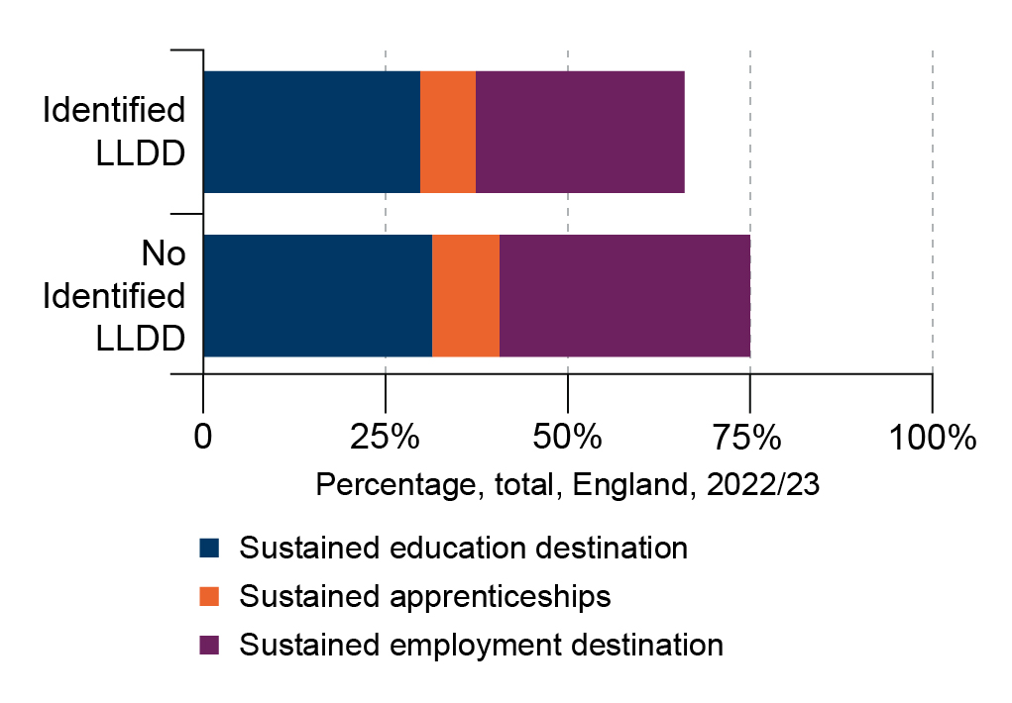
College students with learning difficulties or disabilities were less likely to have a sustained destination
Destinations of 2023 study leavers from the state-funded mainstream colleges in England, broken down by LLDD status
Notes:
Slide Option 1: Sustained destinations LLDD
Guidance: Suggest picking one of these slides to illustrate the context for SEN reform
Time: 2 minutes [21]
Purpose: To illustrate the challenges faced by the sector
Guidance: Give staff time to read the slide.
Then explain that:
A strength of the Further Education sector is its history of working with a high proportion of learners with special educational needs and disadvantaged backgrounds.
In many cases, there are positive outcomes not captured in destination data, such as greater independence ...
However, we know that learners with SEN are less likely to sustain a post-16 destination compared with their peers.
This top bar represents learners known to have learning difficulties or disabilities.
We can see a clear gap between these sustained destinations for the lower bar, which are learners with no identified LLDD.
Lead in: This national challenge has led to the government proposing large-scale reforms, we’ll look a just a couple of them …
SOURCE: Department for Education (2026, April). 16-18 destination measures. https://explore-education-statistics.service.gov.uk/find-statistics/16-18-destination-measures/2023-24#content
Graphics code: IHM-InclusiveTeaching-FE-Graph-3.jpg

Slide 17
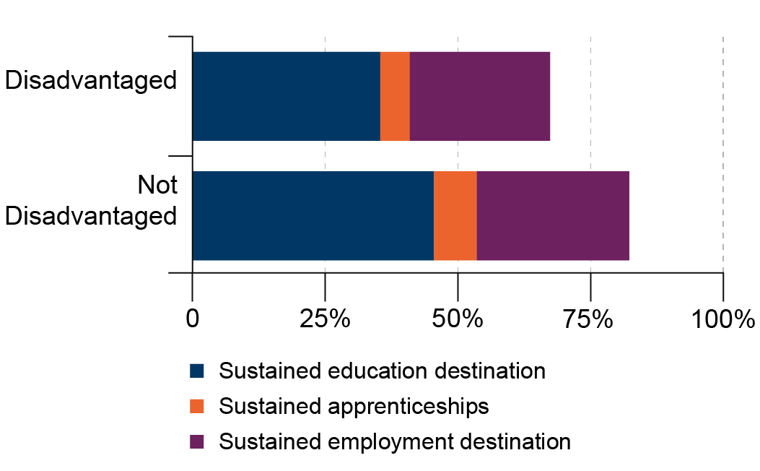
Disadvantaged learners are less likely to have sustained destinations than non-disadvantaged students
Destinations of 2023 study leavers from the state-funded mainstream colleges in England, broken down by disadvantage status
Notes:
Slide Option 2: Sustained destinations Disadvantage
Guidance: Suggest picking one of these slides to illustrate the context for ‘inclusive practice’
Time: 2 minutes [21]
Purpose: To illustrate the challenges faced by the sector
Guidance: Give staff time to read the slide.
Then explain that:
A strength of the Further Education sector is its history of working with a high proportion of learners with special educational needs and disadvantaged backgrounds.
In many cases, there are positive outcomes not captured in destination data, such as greater independence ...
However, we know that learners from disadvantaged backgrounds are less likely to sustain a post-16 destination compared with their peers.
This top bar represents learners who have disadvantaged backgrounds.
We can see a clear gap between these sustained destinations for the lower bar, which are learners who do not have disadvantaged status.
Lead in: This national challenge has led to the government proposing large scale reforms, we’ll look a just a couple of them …
SOURCE: Department for Education (2026, April). 16-18 destination measures. https://explore-education-statistics.service.gov.uk/find-statistics/16-18-destination-measures/2023-24#content
Graphics code: IHM-InclusiveTeaching-FE-Graph-4.jpg

Slide 18
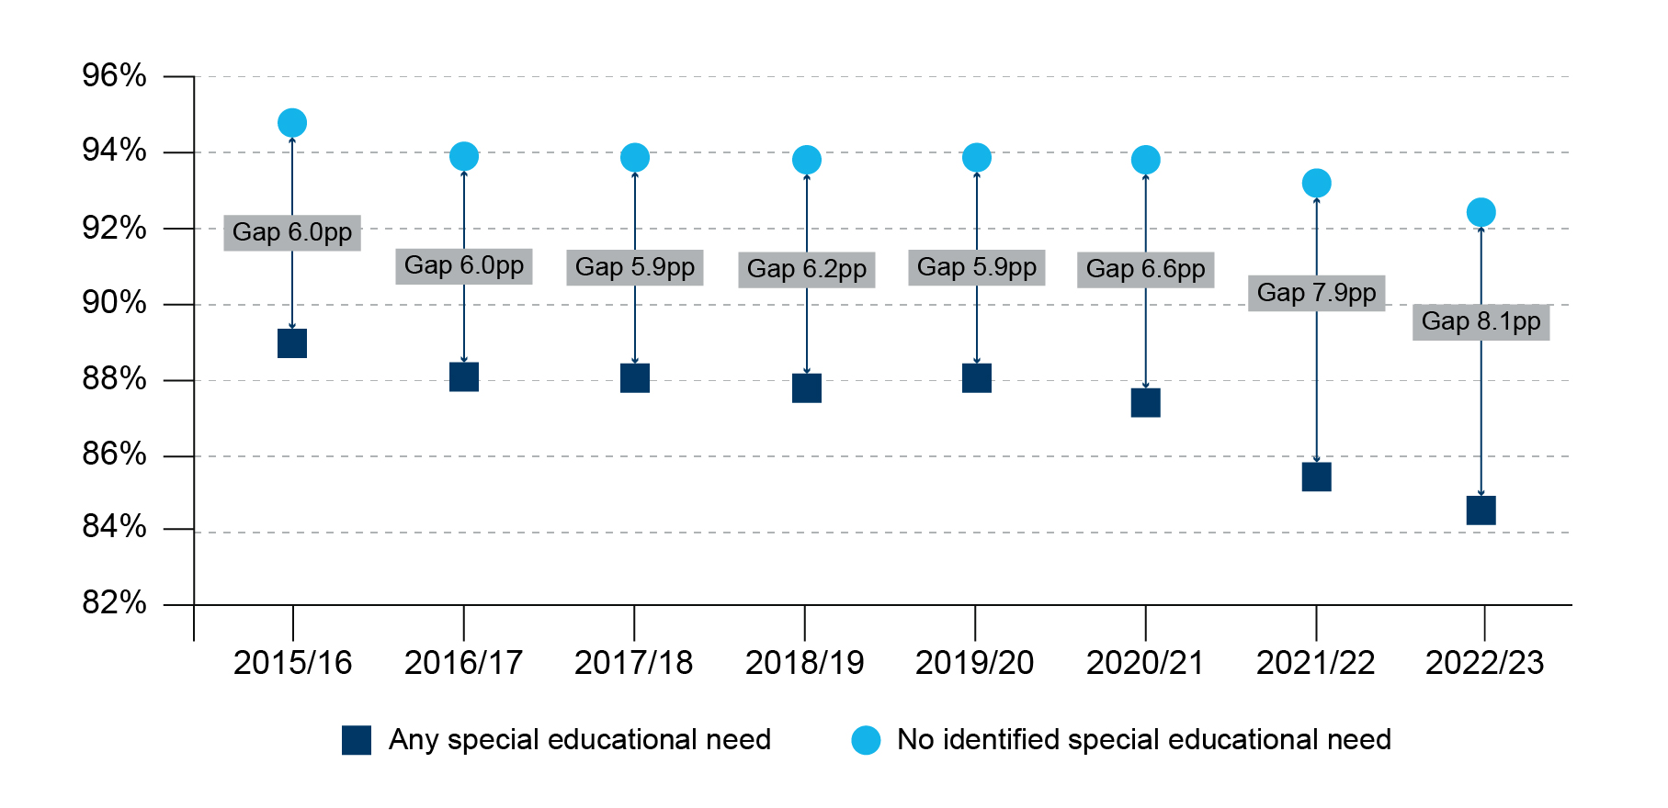
The percentage of children with and without SEN with a sustainable post-16 destination
Notes:
Slide Option 3: Post-16 destinations SEN
Guidance: Suggest picking one of these slides to illustrate the context for SEN reform
Time: 2 minutes [21]
Purpose: To illustrate the challenges faced by the sector
Guidance: Give staff time to read the slide.
Then explain that:
A strength of the Further Education sector is its history of working with a high proportion of learners with special educational needs and disadvantaged backgrounds.
In many cases, there are positive outcomes not captured in destination data, such as greater independence ...
However, we know that learners with SEN are less likely to sustain a post-16 destination compared with their peers.
This top line (light blue) represents learners who are not known to have a special educational need
We can see a clear gap between these outcomes and the line below (dark blue), which are outcomes for children with an identified special educational need
Lead in: This national challenge has led to the government proposing large scale reforms, we’ll look a just a couple of them …
SOURCE: SEND reform: putting children and young people first (HTML version) - GOV.UK
SOURCE: 16-18 study leavers national level destinations’ from ‘16-18 destination measures’ (https://explore-education-statistics.service.gov.uk/data-tables/permalink/a6b10d2a-8fbc-4b10-4450-08de41545152)
Graphics code: IHM-InclusiveTeaching-FE-Graph-1.jpg

Slide 19
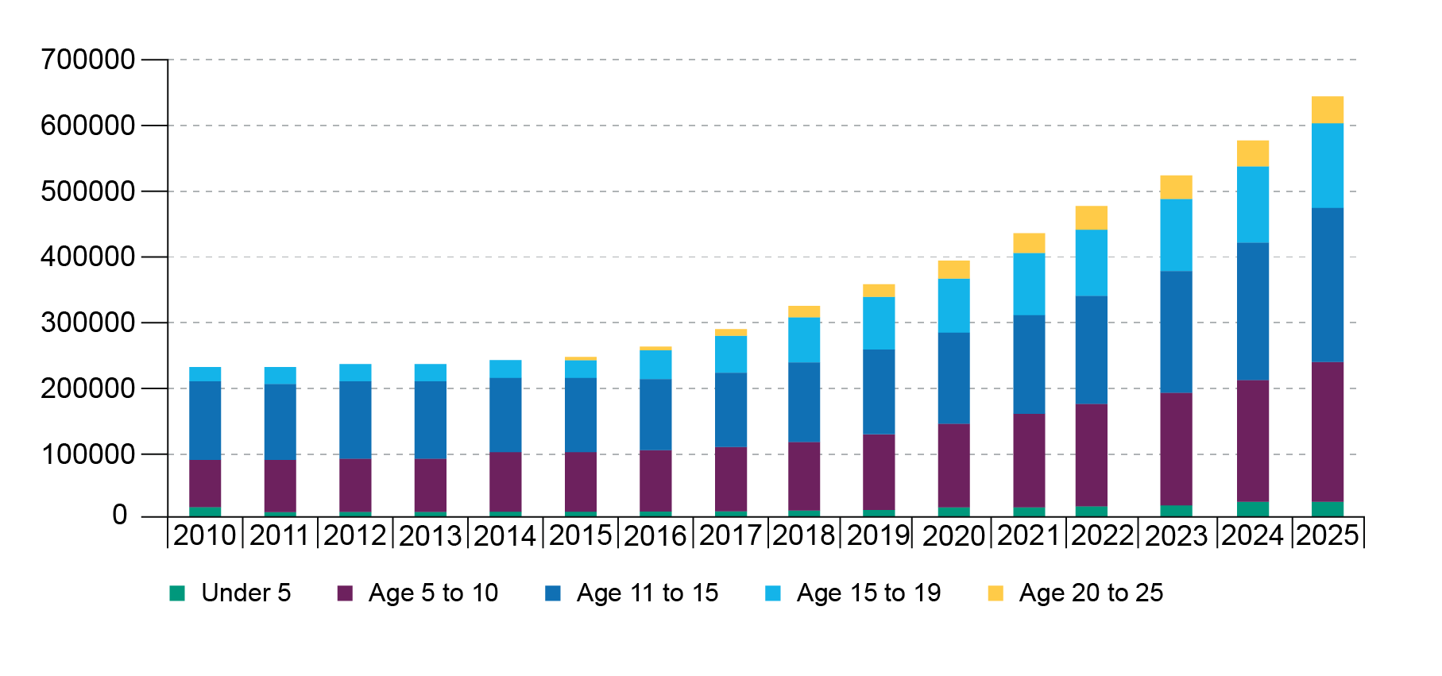
Numbers of learners with statements/ EHCPs 2010 to 2025
Notes:
Slide Option 4: Young people with ECHPs
Guidance: Suggest picking one of these slides to illustrate the context for SEN reform
Time: 2 minutes [21]
Purpose: To illustrate the challenges faced by the sector
Guidance: Give staff time to read the slide.
Then explain that:
A strength of the Further Education sector is its history of working with a high proportion of learners with special educational needs and disadvantaged backgrounds.
In many cases, there are positive outcomes not captured in destination data, such as greater independence ...
However, the numbers of children and young people with a statement or EHCP has risen, and continues to rise, each year across the system.
Supporting increasing numbers of learners with increasingly complex needs creates challenges for all phases of education.
Lead in: This national challenge has led to the government proposing large scale reforms, we’ll look a just a couple of them …
SOURCE: Natspec. Key-facts-2025.pdf
Graphics code: IHM-InclusiveTeaching-FE-Graph-2.jpg

Slide 20
Our context (adapt for your context)
Our context
…
Notes:
Slide Option 5: Discussion of your own context
Guidance: Suggest picking one of the ‘our context’ slides, depending on the focus within your context
Time: 2 minutes [23]
Purpose: To illustrate this challenge in our own setting
Suggestion: You may wish to share data from your own context. The purpose would be to share how the national challenges are reflected in your own context – illustrating where similar patterns exist, where your setting has strengths, and where your setting may share the same challenges. This might form the basis of a short reflection or discussion:
Some examples to consider below:
The different roles in your setting and how they contribute to inclusion.
Some examples of current strengths to your setting’s inclusion and SEND provision.
Your setting’s values and how they support inclusion.
Data related to outcomes for learners with SEND or Disadvantage. A chart or table illustrating outcomes for learners who face additional challenges, e.g., those with identified SEND and/or having a disadvantaged background compared to their peers.
Lead in: Lead in: This national challenge has led to the government proposing large scale reforms, we’ll look a just a couple of them …

Slide 21



Our context (headlines)
Our context
Across GCSE resit examinations, the gap has grown over the past X years
Learners with SEND were X% more likely to mention that they felt worried about attending college or expressed low satisfaction levels.
This is particularly pronounced in Level 2 courses, where engagement for learners with SEND averages out X% lower than their peers
Notes:
Hidden slide:
Facilitation example: Illustrating your own context
Guidance: Creating a slide illustrating your own data.
Where you include local data, we would recommend constraint given the sessions timings. For example, sharing a single slide of data you feel would help illustrate the local context of the SEND reforms.
This might involve: A bar graph illustrating the difference in outcomes between learners with SEND or with disadvantaged backgrounds compared to their peers.
Graphics code:
IHM-005-Context-1
IHM-005-Context-2
IHM-005-Context-3

Slide 22
Our context (with detail)
Our context
Headline | Detail
Learners with SEND perform significantly lower than peers without SEND | Across GCSE resit examinations, the gap has grown over the past X years.
Recent surveys show learners with SEND have the lowest satisfaction | Learners with SEND were X% more likely to mention that they felt worried about attending college or expressed low satisfaction levels.
Whilst engagement has improved, it hasn’t for learners with SEND | This is particularly pronounced in Level 2 courses, where engagement for learners with SEND averages out X% lower than their peers.
Notes:
Hidden slide:
Facilitation example: Illustrating your own context
Guidance: Creating a slide illustrating your own data.
Where you include local data, we would recommend constraint given the sessions timings. For example, sharing a single slide of data you feel would help illustrate the local context of the SEND reforms.
This might involve: Simply presenting percentages of learners achieving a ‘good’ outcome, comparing those with SEND or with disadvantaged backgrounds and their peers.

Slide 23
Principles and overall aims
SEND reform aims to create a system that helps all young people succeed in a fast-changing world and move confidently into adulthood, further education, training or employment, and succeed in a fast-changing world.
Reform Principles:
Early: young people should receive the support they need as soon as possible.
Local: young people with SEND should be able to learn at an education setting close to their home.
Fair: fairer and more consistent SEND system.
Effective: reforms should be grounded in evidence.
Shared: improved partnership between sectors to deliver better experiences and outcomes for young people, including putting the voices of learners at the heart of decision making.
Notes:
Time: 2 minutes [25]
Purpose: To provide a brief summary of the SEND reforms
Guidance: Give staff time to read the slide.
Explain that…
There’s a focus on early identification, clearer national standards based on evidence, and building partnerships between education, health and care.
The reforms put children and young people at the centre, aiming for a simpler and fairer system.
The goal is to improve outcomes and make support more consistent, so every learner can thrive and successfully progress into adult life.
Lead in: To help achieve these aims, the government is changing how identification and support are approached. They have proposed five Areas of Development when it comes to supporting learners with additional needs …
SOURCES:
Department for Education (2026a). SEND Reform: putting children and young people first
Department for Education (2026b): Every child achieving and thriving.

Slide 24
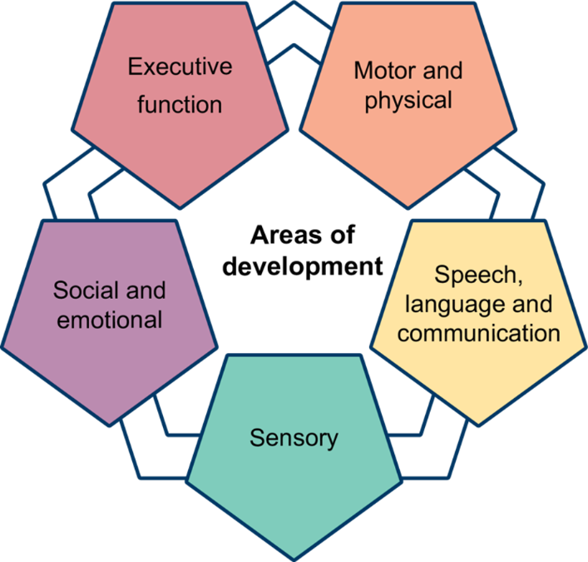
Areas of development
replaces ‘Areas of Need’
recognises both learner strengths and challenges
reflects key areas of child development
help us to understand a broader array of need, especially those that have a diagnosis
supporting educators to make the environment work harder for all young people
Note: The categories are subject to change following the SEND Reform consultation
Notes:
Time: 3 minutes [28]
Purpose: To introduce the five areas of development
Guidance: Give staff time to read the slide. Then explain that…
The SEND reforms propose new ‘Areas of Development’ to replace the current ‘Areas of Need’.
The move to five areas of development recognises that many learners, including those with diagnoses such as autism or ADHD, have a unique profile of strengths and challenges across different aspects of development.
However, these are not only related to learners with a diagnosis. The new Areas of Development better reflect key areas of development and move away from the categorisation of learners and reliance on diagnosis - so that a diagnosis isn’t necessary for a learner to access the support they need.
This will make it easier for staff to remove barriers effectively, and in an evidence-based way.
The five proposed ‘Areas of Development’ are proposed as (Department for Education, 2023, Figure 5)
Executive function – Skills for organising, planning, remembering and managing tasks.
Speech, language and communication – Understanding and using language to interact and learn.
Social and emotional – Building relationships, managing feelings and social interaction.
Sensory – Processing and responding to sensory information (such as sight, sound, touch).
Motor and physical – Movement, coordination and physical health needs.
This new framework aims to help staff identify and support needs more holistically and consistently. [NOTE: This is just a brief introduction. Later sessions look at each of these areas of development in turn]
NOTE: The final Areas of Development are subject to change - DfE is considering feedback from SEND reform consultation and recommendations from the Expert Panel.
Lead in: These areas guide how schools and colleges assess needs and allocate support in a new tiered system …
SOURCE: SEND reform: putting children and young people first (HTML version) - GOV.UK

Slide 25
The universal offer and layers of support
Layer | Who it's for | What it looks like
Universal Offer | All learners, in every mainstream setting | Inclusive teaching, calm environments, and early help, delivered through everyday classroom practice. Most learner’s needs will be met at this level.
Targeted | Learners with ongoing, commonly occurring needs | Structured support such as small-group speech and language work or help managing sensory needs. Recorded in a digital Individual Support Plan (ISP), agreed with the young person.
Targeted Plus | Learners needing specialist input | Young people get targeted plus provision from their setting, with input from education and health professionals. Support may include access to ‘base support’.
Specialist | Learners with the most complex needs | Young people receive specialist support through EHCP in a mainstream or a special setting, if they require provision set out in one of the new nationally defined Specialist Provision Packages, support may be delivered through a ‘specialist base’.
Notes:
Time: 2 minutes [30]
Purpose: To understand what we mean by Layers of Support.
Guidance: Give staff time to read the slide.
Then explain: This model replaces the previous approach, focusing on earlier intervention and inclusive teaching. It changes how we think about meeting learners’ needs every day.
A new national framework for SEND support is proposed, with three flexible layers of support on top of the universal offer.
Every pupil is entitled to a strong Universal Offer as the foundation of their education, with three further layers — Targeted, Targeted Plus and Specialist. These layers are flexible: learners can draw on them as their needs change, rather than following a fixed ladder.
Universal: High-quality, inclusive teaching for all learners.
Targeted: Extra support for learners who need more help, but not specialist provision.
Targeted Plus: More intensive support, possibly involving external specialists.
Specialist: Specialist settings or provision for learners with the most complex needs.
Learners can move between different layers as needed.
The aim is to create clear pathways for support, reducing delays and uncertainty. This approach helps schools and colleges match support to learners’ needs and helps them to achieve.
Then explain: what this means for everyday practice, of teachers in particular:
Inclusive teaching is the first line of SEND provision. A strong Universal Offer should reduce the need for additional support.
Teachers and support staff help by:
Providing high-quality teaching for all learners.
Noticing learners who need extra help and making simple adaptations.
Supporting access to specialist help when needed, so all learners can benefit from the universal offer.
Lead in: Let’s pause for a moment to reflect on some of these ideas…
Source: Department for Education (2026b). SEND Reform: putting children and young people first

Slide 26
Facilitation guidance – SEND reform reflection options
In this section we have looked at SEND reforms, there is an option at this point for some broader discussion regarding the reforms and your own context.
The following slides are hidden so that you can choose which activity to use. Remember to unhide the slide you choose before you start facilitating the session.
The reflection options are:
Reflecting on inclusion within your context
Reflecting on the reforms and which feel most important within your context.
Notes:
Hidden slide:
Facilitation suggestions: Optional slides in this section

Slide 27
Reflection on the universal offer and your role
Reflection
What is meant by the universal offer and layers of support?
What does this mean for you in your role?
Notes:
Slide Option: Reflection on inclusion
Guidance: Suggest picking one of these slides, depending your context
Time: 2 minutes [32]
Purpose: To give staff an opportunity to reflect on own context.
Guidance:
Allow 1 minute for staff to reflect on the prompt alone.
Take a sample of responses from the whole group – the number dependent on the timing available for the session.
Lead in: Inclusive teaching is the foundation for the Universal offer – and that is what we’ll primarily focus on in the rest of this session …

Slide 28
Reflection on national challenges and the reforms
Reflection
Do the national challenges discussed align with your own experiences?
Which reforms strike you as especially important in our context?
Notes:
Slide Option: Reflection on inclusion
Guidance: Suggest picking of these slides, depending on the phase and focus within your context
Time: 2 minutes [32]
Purpose: To give staff an opportunity to reflect on own context.
Guidance:
Allow 1 minute for staff to reflect on the prompt alone.
Take a sample of responses from the whole group – the number dependent on the timing available for the session.
Lead in: Inclusive teaching is the foundation for the Universal offer – and that is what we’ll primarily focus on in the rest of this session …

Slide 29
Introducing the ‘What is inclusion?’ section
Introduction
Why have the SEND reforms been introduced?
What is inclusion?
Reflections

Slide 30
What is inclusion?
Inclusion in mainstream education means all staff supporting the learning, wellbeing, and safety needs of all children [and young people] so they belong, achieve, and thrive.
The Department for Education (2026e) suggests 7 principles of inclusion:
ambitious leadership and governance that embeds inclusion
evidence-based support prioritising early intervention
high-quality inclusive teaching
enriching provision that all learners can access
a safe, respectful culture fostering belonging, attendance, and participation in learning
strong partnerships with families and wider services, where appropriate
inclusive environments with continuous improvements to accessibility
Notes:
Time: 2 minutes [34]
Purpose: To define.
Guidance: This slide is animated so that each statement can be revealed alongside a brief explanation.
Suggested scripting:
[Give staff a moment to read]
There is no single definition of inclusion (Nilholm & Göransson, 2017), and each setting will likely have their own.
The DfE’s definition is supported by 7 underpinning principles:
[CLICK x 7]
Lead in: An important feature to pull out of this definition, and the principles that sit underneath it, is that it does not only focus on inclusion for the sake of academic progress…
.
SOURCE
Nilholm, C. & Göransson, K. (2017). What is meant by inclusion? An analysis of European and North American journal articles with high impact. European Journal of Special Needs Education, 32(3), 437–451.

Slide 31
Inclusion
Educational outcomes
Personal development
and preparation for adult life
Wellbeing and belonging
An example of how we might think about whether a pupil feels like they “belong, achieve and thrive”.
Notes:
Time: 2 minutes [36]
Purpose: To understand some key messages regarding inclusive teaching.
Guidance: Give staff time to read the slide. Then explain that…
Suggested scripting:
The aims of our work in inclusion are that every child can achieve and thrive. When we break that aim down into the kinds of experiences and developmental outcomes we want for every learner, we might end up with three broad areas along these lines:
Educational outcomes: we want all learners to make the best progress possible across academic, and vocational and technical subjects. This is important for access to future opportunities.
Personal development: we also want all learners to develop the key skills they need for day-to-day life beyond education. This includes developing their sense of self – their identity, their self-esteem and understanding of how to support and motivate themselves. This relates to the final broad area.
Wellbeing and belonging: we want learners to feel that they are a valuable member of their community. We want them to have a voice, to be able to make judgements and to develop strong and healthy peer support groups. We want learners to have a sense of belonging in their communities.
The reality of course, is that learners’ experiences have an impact across all of these areas and positive experiences in one area are likely to impact the others. If we want learners to achieve and thrive, we need to consider how we support development across the three areas during learners’ experiences.
Lead in: Let’s reflect on how this might apply to our own context…

Slide 32
Reflection on areas of inclusion
Reflection
Educational outcomes
Across which of these three areas do you think your setting is strongest?
Where do you think your setting could strengthen?
Personal development and preparation for adult life
Wellbeing and belonging
Notes:
Time: 10 minutes [48]
Purpose: To give staff an opportunity to think about the experiences of learners at their setting – both positive and more challenging ones.
Guidance:
Give two minutes for individual thinking and/or notes.
Allow six minutes for paired discussion.
You may find it helpful to signal when four minutes is up so that both speakers get to share ideas.
You may wish to draw out one or more examples from the discussions, highlighting important points (2 minutes has been given for this) –
Alternatively, you may wish to summarise:
Educational outcomes matter – without them, learners’ options will be severely limited.
However, there are other ways in which we want our learners to develop.
Our approaches to inclusion need to reflect this .
Lead in: Let’s end by breaking down inclusion in a different way, this time by levels of inclusion…

Slide 33
Inclusion at different levels
Inclusion policy
Public policy, e.g. funding for SEND Reforms
Inclusive practice
Setting-focused, e.g. working with services, policies
Inclusive teaching
Learning environment-focused, e.g. maintaining and strengthening high-quality teaching
Notes:
Time: 2 minutes [50]
Purpose: To understand the different levels of inclusion.
Guidance: This slide is animated so that each statement can be revealed alongside a brief explanation.
Suggested scripting:
As previous discussion will have revealed, inclusion is a very broad concept that can include topics such as equalities, inclusion bases, inspection frameworks and wider school systems.
[CLICK] Inclusion policy – these are decisions around inclusion determined by public bodies, and influence national funding priorities and frameworks.
[CLICK] Inclusive practice – these are decisions taken by settings on their vision and strategy for inclusion, as well as how they will approach the implementation.
[CLICK] Inclusive teaching – this is where we will focus our attention across the remaining sessions.
Lead in: Let’s end with a reflection…

Slide 34
Reflections
Introduction
Why have the SEND reforms been introduced?
What is inclusion?
Reflections

Slide 35
Facilitation guidance – final reflection options
The following slides are hidden so that you can choose which activity to use. Remember to unhide the slide you choose before you start facilitating the session.
There are options for different reflection activities provided below – you could use one of these or edit/ replace the questions to reflect the priorities, strengths and challenges in your own context.
The options suggested are:
Takeaways from the session on SEND reforms
Broader reflections on systems and challenges regarding inclusive teaching
Broader reflections the setting’s strengths and areas of development regarding inclusive teaching
Notes:
Hidden slide:
Facilitation suggestions: Optional slides in this section

Slide 36
Reflection on takeaways on SEND reforms
Reflection
One thing I learned about the SEND reforms is...
One thing I already do that supports inclusion is...
Notes:
Reflection Option 1 – Takeaways from the session on supporting children and young people to achieve and thrive
Time: 6 minutes [60]
Purpose: To give staff an opportunity to reflect at the end of the session.
Guidance:
Allow 3 minutes for staff to reflect on the prompt alone.
Take a sample of responses from the whole group to close the session – the number dependent on the timing available for the session.
Thank the staff for their participation and engagement.

Slide 37
Reflection on systems and challenges regarding inclusive teaching
Reflection
What systems are already in place in our setting to support inclusion?
What can make it a challenge?
Notes:
Reflection Option 2 – Broader reflections on systems and challenges regarding inclusion
Time: 6 minutes [60]
Purpose: To give staff an opportunity to reflect at the end of the session.
Guidance:
Allow 3 minutes for staff to reflect on the prompt alone.
Take a sample of responses from the whole group to close the session – the number dependent on the timing available for the session.
Thank the staff for their participation and engagement.

Slide 38
Reflection on setting’s strengths and areas of development for inclusive teaching
Reflection
One way our setting already supports inclusion is…
One thing our setting could do more of to support inclusion is...
Notes:
Reflection Option 3 – Broader reflections the setting’s strengths and areas of development regarding inclusion
Time: 6 minutes [60]
Purpose: To give staff an opportunity to reflect at the end of the session.
Guidance:
Allow 3 minutes for staff to reflect on the prompt alone.
Take a sample of responses from the whole group to close the session – the number dependent on the timing available for the session.
Thank the staff for their participation and engagement.

Slide 39
References
Department for Education. (2026a). Parent, pupil and learner voice: March 2026. https://www.gov.uk/government/publications/parent-pupil-and-learner-voice-omnibus-surveys-for-2025-to-2026/parent-pupil-and-learner-voice-march-2026#school-belonging
Department for Education. (2026b). SEND Reform: putting children and young people first. https://www.gov.uk/government/consultations/send-reform-putting-children-and-young-people-first/send-reform-putting-children-and-young-people-first-html-version
Department for Education. (2026c). Every child achieving and thriving. https://www.gov.uk/government/publications/every-child-achieving-and-thriving/every-child-achieving-and-thriving-html-version
Department for Education. (2026d) Academic year 2024/25: Special educational needs in England. https://explore-education-statistics.service.gov.uk/find-statistics/special-educational-needs-in-england/2024-25
Department for Education. (2026e). Developing an inclusion strategy using the inclusive mainstream fund. https://www.gov.uk/government/publications/inclusive-mainstream-fund-support-for-school-leaders/developing-an-inclusion-strategy-using-the-inclusive-mainstream-fund
Farquharson, C., McKendrick, A., Ridpath, N. & Tahir, I. (2024). The state of education: what awaits the next government?. Institute for Fiscal Studies. https://ifs.org.uk/sites/default/files/2024-06/The-state-of-education-IFS-Report-R317.pdf
Impetus (2026). Closing the youth jobs gap. https://www.impetus.org.uk/policy/youth-jobs-gap
Nilholm, C. & Göransson, K. (2017). What is meant by inclusion? An analysis of European and North American journal articles with high impact. European Journal of Special Needs Education, 32(3), 437–451.

Slide 40
Closing slide

