Slide 1
Document explainer
Purpose: This slide deck supports staff to understand the new areas of development and how inclusive teaching practices relate to high-quality teaching.
Audience: Teachers and support staff in primary and secondary schools.
How to use this document:
This is the third of three introduction sessions focusing on SEND reforms, inclusive teaching and areas of development.
This session can be delivered in full or in parts, depending on the context of your setting and the structure of your planned professional development time.
A facilitator guidance document is available to support delivery of the session.
Further guidance on planning and delivering these professional development materials can be found in the Guide to Materials.

Slide 2
Facilitation guidance: timings
Timings of individual slides (e.g., 2 minutes) and a running timing in minutes (e.g., [4]) are provided based on a 60-minute session.
However, the session is intended to be flexible enough for you to adapt it to slightly longer or shorter times as required (e.g., 75 mins or 50 mins):
For shorter sessions, you may need to limit optional slides and consider the use of time provided for reflection activities – for example, considering the length of discussion time and how many responses you elicit.
For longer sessions, you might offer more of the optional slides and extend the time available for reflection and discussion – for example, taking more contributions from staff and explicitly drawing out the suggested key points as they are raised by the staff themselves.
Notes:
Hidden slide:
Facilitation suggestions: Timing

Slide 3

Inclusive teaching and areas of development

Slide 4
Session timings
Activity | Time (approx.)
What do we mean by areas of development? | 15 mins
What do we need to know about learning needs? | 15 mins
How can the areas of development help us approach inclusive teaching? | 25 mins
Reflection | 5 mins
Notes:
Hidden slide – optional
Time: N/A
Purpose: To understand what this session will entail.
Guidance: You can decide whether you would like to share the timings of the session with staff.
Lead in: Let’s begin today’s session.

Slide 5
Aims of the session
to introduce and define the areas of development
to explain how inclusive teaching practices relate to high-quality teaching
to explain how greater awareness of the areas of development can inform our practice
Notes:
Time: 1 minute [1]
Purpose: To understand what this session will entail.
Guidance: Give staff time to read the slide.
Then explain that…
This session focuses on introducing the areas of development within the context of inclusive teaching.
Understanding more about the different areas can help staff consolidate high-quality teaching practices that help all pupils, as well as having specific benefits for those with special educational needs.
It also provides a useful lens to look more deeply at inclusive teaching and think afresh about practice.
Lead in: Let’s pause for a moment and think about your experience of learning needs.

Slide 6

Reflection
Think about a pupil (or group of pupils) you teach, whose needs you don’t always feel confident meeting.
What makes meeting their needs challenging?
What do you think might help with this?
Notes:
Time: 2 minutes [3]
Purpose: To frame today’s session in the classroom experiences of staff.
Guidance:
Give staff a quick two minutes to reflect or discuss with a partner.
Try to be strict about time here, as there are further discussion opportunities in the next section.
Lead in: Let’s have a look at the areas.

Slide 7
What do we mean by areas of development?
What do we mean by areas of development?
What do we need to know about learning needs?
How can the areas of development help us approach inclusive teaching?

Slide 8
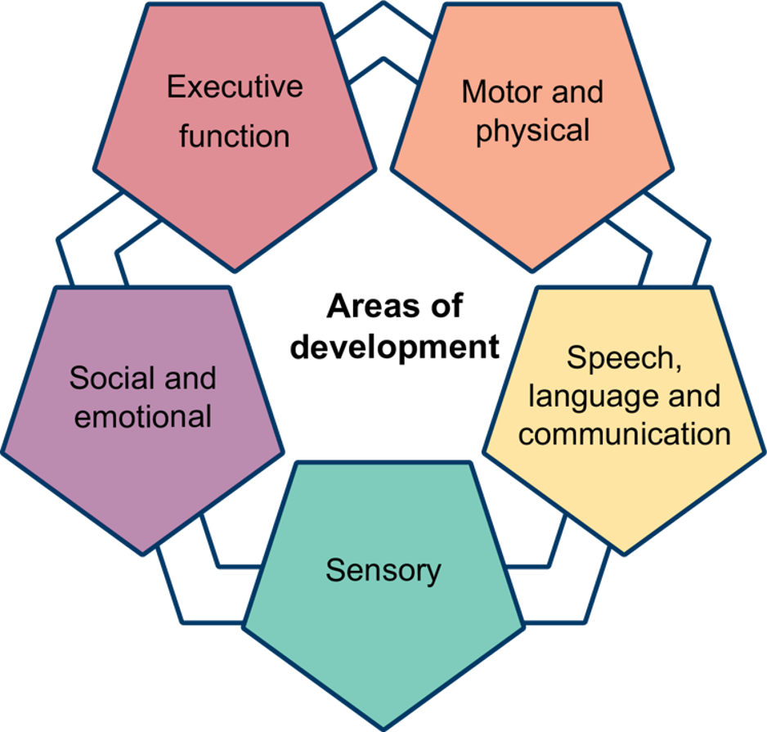
Areas of development
Note: The categories are subject to change following the SEND Reform consultation
Notes:
Time: 2 minutes [5]
Purpose: To introduce the five areas of development.
Guidance: Give staff time to see the graphic.
Then, explain that:
The SEND reforms (2026) propose new ‘Areas of Development’ to replace the current ‘Areas of Need’.
These five areas are: Executive function, sensory, motor and physical, social and emotional, speech, language and communication.
These have replaced old areas to focus on how children and young people develop and function, considering their areas of strength, rather than just their difficulties or challenges.
The areas of development help us to understand the different skills that ALL pupils will develop over their time in education (and beyond), not just those who have additional needs.
The areas of development are designed to support teachers to develop their knowledge in these areas and strengthen their practice, building on what they already know about high-quality teaching but using a lens to focus on specific areas where pupils have developmental needs.
Lead in: Let’s look at a further breakdown of the areas.
Graphics code: AOD-MainGraphic.png
Note: The final Areas of Development are subject to change - DfE is considering feedback from SEND reform consultation and recommendations from the Expert Panel.

Slide 9
Areas of development
Area of development | Description
Speech, language and communication (SLC) | understanding and using language to interact and learn
Sensory | processing and responding to sensory information (such as sight, sound, touch).
Motor and physical | movement, coordination and physical health needs
Executive function | skills for organising, planning, remembering and managing tasks
Social and emotional development | building relationships, managing feelings and social interaction
Department for Education (2026). SEND Reform: putting children and young people first
Notes:
Time: 2 minutes [7]
Purpose: To introduce the five areas of development
Guidance: Give staff time to read the slide. Then explain that…
The five proposed ‘Areas of Development’ are as follows: (Department for Education, 2026, Figure 5)
Speech, language and communication – Understanding and using language to interact and learn.
Sensory – Processing and responding to sensory information (such as sight, sound, touch).
Motor and physical – Movement, coordination and physical health needs.
Executive function – Skills for organising, planning, remembering and managing tasks.
Social and emotional – Building relationships, managing feelings and social interaction.
This new framework aims to help staff identify and support needs more holistically and consistently.
Note: The final Areas of Development are subject to change - DfE is considering feedback from SEND reform consultation and recommendations from the Expert Panel.
Lead in: Let’s think about how these different areas might impact on everyday life for all young people.
Reference: Department for Education (2026). SEND Reform: putting children and young people first. Accessed online at: SEND reform: putting children and young people first (HTML version) - GOV.UK

Slide 10
Facilitator guidance: hidden slide
The following slide is hidden so that you can choose whether to pause for a reflection point, depending on the needs of your staff.
Remember to unhide the slide before you start facilitating the session if you choose to use it.
Staff may find it beneficial to pause and reflect at this point to process the information they've heard so far and relate this to the pupil(s) they had in mind at the start of the session.
Notes:
Hidden slide - guidance

Slide 11
Reflection on areas of development
Reflection
Think again about a pupil (or group of pupils) you teach or support, where you don’t always feel confident in meeting their needs.
How might knowledge of the areas of development help you address pupils' needs?
Note: The categories are subject to change following the SEND Reform consultation
Notes:
Optional reflection/pause point
Time: up to 5 minutes [not included in totals]
Purpose: To pause and reflect on the areas of development and their implications.
Guidance:
This is an optional point to pause if you feel that staff would find it helpful to process the information they’ve heard so far, and relate this to the pupil(s) they had in mind at the start of the session.
Lead in: Let’s think about how these different areas might impact on everyday life for all young people.

Slide 12
"Given that children’s cognitive abilities are in continual flux, it is expected that their cognitive strengths and difficulties will shift over time and in response to environmental demands."
Antalek, et al., 2025
Notes:
Time: 2 minutes [9]
Purpose: To introduce the idea that children’s cognitive strengths and difficulties are not fixed but change over time and in response to their environment.
Guidance: allow teachers time to read the slide.
Explain that:
This quote highlights an important principle: children’s cognitive abilities are always developing, as are their abilities across all areas of development. Their strengths and difficulties can shift, sometimes quite noticeably, as they grow and as the situations around them change.
Suggested script:
It is helpful to remember that no child’s development follows a straight line. Instead, it’s shaped by many factors, including their experiences, the people around them, and the demands placed on them by different environments. For example, a child who finds it easy to focus in a quiet classroom may struggle in a busy playground, or vice versa. This means that what we see as a child’s ‘strength’ or ‘difficulty’ is not always permanent. It can change as they encounter new challenges or supports. For teachers and support staff, this is a reminder to look beyond labels or assumptions about what a child can or cannot do. Instead, we should pay attention to how their abilities can change as they encounter new challenges and different environments.
Lead in: Let’s consider this idea of the interplay between environment and pupils’ development a bit further.
Reference:
Antalek, C., Castro-Kemp, S., Dixon, F., Esposito, R., Hayton, J., Herbert, E., Kamenopoulou, L., Kolak, J., Loyd, D., Roberts, A., Romualdez, A. M., Somerville, M. P., Taha, J., & Tunks, F. (2025). Cross-cutting themes in identifying, supporting and collaborating for children and young people with SEND: A rapid evidence review. Department for Education.

Slide 13
Example of the areas of development in everyday life
Beginning of term
Environmental demands
Individual development
After 8 weeks
Environmental demands
Individual development
Notes:
Time: 3 minutes [12]
Purpose: To show how the areas of development can impact everyday life for pupils.
Guidance: Use the suggested scripting to unpack an example.
Explain that:
Throughout our lives we experience periods where we are well-equipped to respond to challenges and meet the demands of an environment, and other times where we find it more difficult to do this. There are lots of factors which can affect what is shown here as ‘environmental demand’ and these could be in our education settings, social groups, or family and personal lives.
Let’s take a simple example - imagine we are looking at the interplay between an individual’s development and the demands of their environment when starting a new subject.
[click] At the beginning of a school year, a pupil might be in a French class, having never studied French before. They might find it difficult to process the switching between the target language and English meaning they are forgetting or misinterpreting instructions. The teacher recognises this cognitive overload and intentionally separates their instructions in each language more deliberately, leaving a gap between giving the instruction in English and in French as well as ensuring they are giving the pupil non-verbal reminders alongside the instructions.
[click] However, after eight weeks, the pupil appears more able to focus during lessons and is beginning to participate more actively. The teacher notices that the pupil is quick to begin tasks and asks relevant questions about the task at hand.
You may choose to change the examples above to another subject or area of school life, the types of example you might use could look like this:
A pupil adjusting to expectations of a new unit in PE that is a sport they have never encountered before
A Year 7 pupil who is struggling with demands of organising their equipment and movement around the school building
A Year 5 pupil whose friendship group has changed and who is finding it difficult to focus on lesson tasks because of social interactions they have had at a break time.
Lead in: Let’s consider how this might impact on the support that a learner might need.

Slide 14
Areas of development in everyday life
The ability to respond to an environment depends on how well a pupil’s current skills match the demands faced.
When skills closely match demands, pupils are more likely to thrive.
When there is a significant gap between skills and demands, pupils may find it harder to respond and benefit from targeted support or adjustments.
The size of this gap is not fixed. It can grow or shrink depending on changes in development, the environment, or the support received.
The environment and support structures (which include supporting adults) mediate the extent to which pupils can navigate the environment.
Notes:
Time: 3 minutes [15]
Purpose: To explain the role of the areas of development in everyday life.
Guidance: Allow teachers time to read the slide.
Explain the idea that development is lifelong and looks different for individuals at various points in their life, and in response to different environments.
Optional scripting below for support:
Environmental demands refer to the external features and expectations that require a response from an individual. These demands can include the complexity of a task, transitions between settings (such as moving between classrooms or travelling to school), or navigating social situations.
The match between a pupil’s skills and the demands of their environment is crucial. When the gap between the two is small, the pupil is likely to manage well, as their skills are well matched to what is expected of them. When the gap is larger, the pupil may need additional support or adjustments to help them succeed. Universal approaches to high-quality teaching are the first port of call when offering this support and can support all pupils, including those with additional needs, to reach their learning goals.
Support should be responsive to the current match between a pupil’s skills and the demands they face, rather than being based solely on age or stage. This approach recognises that both development and environmental demands are complex and changeable.
Lead in: Let’s think about some examples of the developmental journey a child or young person might take in any of these areas.
Reference:
Antalek, C., Castro-Kemp, S., Dixon, F., Esposito, R., Hayton, J., Herbert, E., Kamenopoulou, L., Kolak, J., Loyd, D., Roberts, A., Romualdez, A. M., Somerville, M. P., Taha, J., & Tunks, F. (2025). Cross-cutting themes in identifying, supporting and collaborating for children and young people with SEND: A rapid evidence review. Department for Education. https://assets.publishing.service.gov.uk/media/68d6580c9ce370a7e0a0fd29/Cross-cutting_themes_in_identifying_supporting_and_collaborating_for_children_and_young_people.pdf

Slide 15
Developmental journeys
Next, we will look at some examples of timelines that show possible developmental journeys for the different areas of development.
While looking at these, it is useful to think about pupils or classes you teach and reflect on what feels relevant here.
Notes:
Time: 4 minutes [19] – if two examples from the next five slides are shared.
Purpose: To provide examples of the development journey for different areas of development.
Guidance: Display slide to explain what staff are seeing.
Lead in: A developmental journey will look different for every individual. Although there are indicative milestones that we may use to determine whether children need help to make expected progress, there will always be areas where some pupils accelerate, and others take longer to reach their goals. This will usually vary across the different areas of development for each person.

Slide 16
Facilitator guidance: example choice
The following slides are hidden so that you can choose which options to use. Remember to unhide the slides you choose before you start facilitating the session.
The examples are of timelines which show possible developmental journeys for the different areas of development.
We recommend sharing two journeys to illustrate two contrasting areas for development.
Four minutes has been allowed for this in the total time for the presentation.
At the end of this section, there is an optional hidden slide which summarises the learning of the first section. You may want to unhide this slide and deliver it if you feel that staff would benefit from this.
Notes:
Time: 4 minutes [19] – if two examples from the next five slides are shared.
Purpose: To provide examples of the development journey for different areas of development.
Guidance:
Choose and unhide your examples to share.
The next slide provides introductory framing for the timelines, encouraging staff to think about how they are relevant to pupils.

Slide 17
Speech, language and communication development
Primary
Language underpins emerging literacy. Understanding more complex vocabulary, giving reasons for opinions, working collaboratively with peers
Further Education
Participating in sessions, using vocationally-specific vocabulary, negotiating group work, communicating professionally with tutors and employers
Early Years
Using gestures and words to express wants and needs, understanding simple instructions, taking turns in conversation
Secondary
Using subject-specific language, debating ideas, understanding inference, interpreting multiple meanings, planning extended spoken and written responses
Early adulthood
Performing in interviews, communicating in the workplace, resolving conflict, adapting communication for different audiences
References:
Department for Education. (2025). Early years foundation stage statutory framework: Setting the standards for learning, development and care for children from birth to five.
The Communication Trust. (2015). Universally Speaking: The ages and stages of children’s communication development from 11 to 18 years.
Notes:
Option 1 – Speech, language and communication development
Time: 2 minutes per slide in allocation.
Purpose: To provide an example of how an area of development might evolve over the course of a young person’s life.
Instruction: We recommend sharing two journeys to illustrate two contrasting areas for development.
Guidance: Give staff time to read the slide.
Explain that:
Speech, language and communication refers to how children’s language and talk emerge through development.
This timeline is illustrative of the ways that this area of development can change over time and is most representative of typical development, although it will vary between children.
Lead in: Let’s move on to thinking about what we might need to know about learning needs.
References:
Department for Education. (2025). Early years foundation stage statutory framework: Setting the standards for learning, development and care for children from birth to five.
The Communication Trust. (2015). Universally Speaking: The ages and stages of children’s communication development from 11 to 18 years.

Slide 18
Sensory development
Secondary
Managing multiple sensory inputs across different classrooms, busy corridors, practical subjects, changing routines and increasing independence while maintaining attention and emotional regulation
Early adulthood
Coping with less structured environments, balancing sensory needs with job expectations, recognising and communicating when sensory input becomes overwhelming
Early Years
Experiencing different textures, responding to sounds and visual cues, beginning to regulate reactions to everyday sensory experiences, exploring the environment through touch and movement
Further Education
Developing practical vocational skills in new settings and managing sensory input in workplaces or classrooms. Some learners use assistive technology or strategies to access learning
References:
Department for Education. (2025). Early years foundation stage statutory framework: Setting the standards for learning, development and care for children from birth to five.
Notes:
Option 2 – Sensory development
Time: 2 minutes per slide in allocation.
Purpose: To provide an example of how an area of development might evolve over the course of a young person’s life.
Instruction: We recommend sharing two journeys to illustrate two contrasting areas for development.
Guidance: Give staff time to read the slide.
Explain that:
Sensory refers to how children experience and perceive the world around them – from balance to touch.
This timeline is illustrative of the ways that this area of development can change over time and is most representative of typical development, although it will vary between children.
Lead in: Let’s move on to thinking about what we might need to know about learning needs.
References:
Department for Education. (2025). Early years foundation stage statutory framework: Setting the standards for learning, development and care for children from birth to five. Accessed online at: EYFS statutory framework for group and school-based providers.

Slide 19
Executive function development
Primary
Following classroom routines, completing simple multi-step tasks, planning simple projects, organising and remembering homework and equipment, managing increasing independence
Further Education
Managing a timetable with greater independence, balancing coursework and placements, planning longer-term assignments, recognising when support is required and seeking this out
Early Years
Waiting for short periods, following simple routines, starting to control impulses with adult support
Secondary
Organising work across multiple subjects, planning revision and homework, prioritising deadlines and tasks, solving problems independently and adapting to change
Early adulthood
Managing work or work application deadlines, organisation and planning for independent living
References:
Department for Education. (2025). Early years foundation stage statutory framework: Setting the standards for learning, development and care for children from birth to five.
World Health Organisation. (2001). International Classification of Functioning, Disability and Health (ICF).
Notes:
Option 3 – Executive function development
Time: 2 minutes per slide in allocation.
Purpose: To provide an example of how an area of development might evolve over the course of a young person’s life.
Instruction: We recommend sharing two journeys to illustrate two contrasting areas for development.
Guidance: Give staff time to read the slide.
Explain that:
Executive function refers to how children think and process information.
This timeline is illustrative of the ways that this area of development can change over time and is most representative of typical development, although it will vary between children.
Lead in: Let’s move on to thinking about what we might need to know about learning needs.
References:
Department for Education. (2025). Early years foundation stage statutory framework: Setting the standards for learning, development and care for children from birth to five.
World Health Organisation. (2001). International Classification of Functioning, Disability and Health (ICF).

Slide 20
Social and emotional development
Primary
Making friendships, beginning to resolve simple disagreements and developing more nuanced social understanding (taking other people’s perspectives)
Further Education
Building new relationships, working effectively with unfamiliar people, resolving conflict appropriately, advocating for personal needs and maintaining wellbeing
Early Years
Sharing and taking turns, forming secure relationships, recognising simple emotions in self and others, seeking comfort from trusted adults
Secondary
Navigating increasingly complex friendships, managing emotions more independently, responding to peer influence, developing identity and self-awareness
Early adulthood
Developing healthy relationships, managing workplace interactions, coping with life transitions, balancing independence with seeking support when needed
References:
Collaborative for Academic, Social, and Emotional Learning (CASEL). (2020). CASEL’s SEL Framework.
Department for Education. (2025). Early years foundation stage statutory framework: Setting the standards for learning, development and care for children from birth to five.
Denham, S. (2018). Keeping SEL Developmental: The Importance of a Developmental Lens for Fostering and Assessing SEL Competencies.
Notes:
Option 4 – Social and emotional development
Time: 2 minutes per slide in allocation.
Purpose: To provide an example of how an area of development might evolve over the course of a young person’s life.
Instruction: We recommend sharing two journeys to illustrate two contrasting areas for development.
Guidance: Give staff time to read the slide.
Explain that:
Social and emotional development refers to how children experience their social world and their feelings.
This timeline is illustrative of the ways that this area of development can change over time and is most representative of typical development, although it will vary between children.
Lead in: Let’s move on to thinking about what we might need to know about learning needs.
References:
Collaborative for Academic, Social, and Emotional Learning (CASEL). (2020). CASEL’s SEL Framework. Department for Education. (2025). Early years foundation stage statutory framework: Setting the standards for learning, development and care for children from birth to five.
Denham, S. (2018). Keeping SEL Developmental: The Importance of a Developmental Lens for Fostering and Assessing SEL Competencies.

Slide 21
Motor and physical development
Early Years
Running, climbing, using cutlery and crayons, developing balance and coordination to move safely
Secondary
Managing movement across a larger school site, participating safely in practical subjects (e.g. PE and science), coordinating complex tasks
Further education
Equipment use, occupationally-specific physical demands
Early adulthood
Meeting the physical demands of independent living and employment, maintaining physical health, adapting movement for different environments and situations
References:
Department for Education. (2025). Early years foundation stage statutory framework: Setting the standards for learning, development and care for children from birth to five.
World Health Organisation. (2001). International Classification of Functioning, Disability and Health (ICF).
Notes:
Option 5 – Motor and physical development
Time: 2 minutes per slide in allocation.
Purpose: To provide an example of how an area of development might evolve over the course of a young person’s life.
Instruction: We recommend sharing two journeys to illustrate two contrasting areas for development.
Guidance: Give staff time to read the slide.
Explain that:
Motor refers to how children develop, move and express themselves physically.
This timeline is illustrative of the ways that this area of development can change over time and is most representative of typical development, although it will vary between children.
Lead in: Let’s move on to thinking about what we might need to know about learning needs.
References:
Department for Education. (2025). Early years foundation stage statutory framework: Setting the standards for learning, development and care for children from birth to five.
World Health Organisation. (2001). International Classification of Functioning, Disability and Health (ICF).

Slide 22
Summary
As children and young people move through education, employment and daily life, they will use, learn and develop skills in the five different areas of development.
These areas of development represent skills that every child and young person will need to develop, not just those who might have additional needs.
As children and young people grow, the demands placed on them may also increase. At the same time, their own skills will continue to develop, but not always at the same pace.
This means that the amount of support they need can change over time.
Notes:
This slide is hidden and optional
Purpose: To summarise the learning of the first section (if you feel that staff would benefit from this).
Guidance: this slide is animated so that each statement can be revealed alongside the explanation below.
Suggested scripting:
[CLICK] Statement 1 – as we have seen, each area of development encompasses a variety of skills that will need to be taught and learned over the course of a young person’s education and beyond.
[CLICK] Statement 2 – all learners will have needs in relation to these areas. These will often be met by high-quality teaching and a well-planned and cohesive curriculum.
[CLICK] Statement 3 – the complexity of language, ideas and skills grows as children move through their education. Sometimes this means that pupils will need support that goes beyond high-quality teaching to meet their needs and enable them to meet expected standards. It is important that teachers and teaching assistants understand the needs of individuals where support is required, and do not rely on labels or assumptions.
Lead in: Let’s move on to thinking about what we might need to know about learning needs.

Slide 23
What do we need to know about learning needs?
What do we mean by areas of development?
What do we need to know about learning needs?
How can the areas of development help us approach inclusive teaching?

Slide 24
Learning needs
Now that we are familiar with the areas of development, we will look at how they link to learning needs.
Note: The categories are subject to change following the SEND Reform consultation
Notes:
Time: <1 minute [19]
Purpose: To explain the link from the first to second section of the session.
Guidance: Use the suggested scripting to explain the link from development to need.
Suggested scripting:
In this section of the session, we will move from thinking about the areas of development to thinking about learning needs and how we can support them.
We’ll start by looking at how learning needs can change over time, and how this might impact the support we give the pupils we teach.

Slide 25
Understanding need
Learning needs can be thought of in three ways:
All children have common needs.
Some children have specific needs that are shared with a similar group.
All children have individual needs.
(EEF, 2025)
Notes:
Time: 1 minute [20]
Purpose: To explain what we mean by ‘need’ in an educational context.
Guidance: This slide is animated so that each statement can be revealed alongside the explanation below.
Suggested scripting:
[CLICK] Statement 1 - For example, the need to receive effective teaching affects all pupils.
[CLICK] Statement 2 - For example, pupils with a hearing impairment need access to audiological support.
[CLICK] Statement 3 - For example, one pupil with a Speech and Language difficulty may need pre-teaching of vocabulary, while another may benefit more from visual supports and additional processing time. These strategies may also support other pupils who experience communication or language needs, whether or not they have an identified diagnosis.
Some pupils with specific needs will have a diagnosed special educational need or disability. Others may not have a formal diagnosis but will still need support.
Special educational needs (SEN) relate to the additional support a pupil needs to learn and participate in school.
A diagnosis is given by health professionals to identify a specific physical, developmental or mental health condition. This can provide helpful information about a pupil's likely strengths and needs and may help the pupil to better understand their own experiences. However, pupils with the same diagnosis can have very different strengths, needs and experiences, and these may change over time.
For this reason, understanding a pupil's individual experience of school is essential for identifying their specific needs and planning effective teaching and support.
Looking beyond diagnostic labels to understand how a pupil learns, communicates, interacts and participates in school helps ensure that support is effective.
Lead in: Let’s consider why we must think about needs as dynamic.
SOURCE: EEF. (2025). Special Educational Needs in Mainstream Schools: Guidance Report.

Slide 26
Needs are often dynamic
Support should be based on the match between a pupil’s skills and their current environment, not just their age or year group.
Many pupils will need tailored or extra support at different times to help them take part fully in school life.
Needs can also come from an undiagnosed need, disadvantage, absence from school, complex home circumstances or changes in a family situation. These needs can be dynamic as circumstances change.
Research shows that changes in SEND are common as pupils move through education.
Antalek et al., 2025
Notes:
Time: 2 minutes [22]
Purpose: To think about the role of the areas of development in everyday life.
Guidance: allow teachers time to read the slide.
Support should be based on the interplay between a pupil's skills and development and the demands of their current environment, not simply on their age or stage of education.
At times, many pupils will require tailored or additional support to fully participate in everything the school has to offer.
Needs do not just relate to SEND identification.
Pupils’ development is not linear. As pupils age, the complexity of their needs will change. Some pupils might not have SEND to begin with but will develop SEND as they mature. Others who are considered to have SEND at the beginning of their lives may no longer have these needs later in life.
Recent research has indicated that this change happens for significant proportions of pupils with SEND.
It is important to note that pupils may have multiple, intersecting needs. Over-focusing on a single area of need can lead to important aspects of a pupil’s profile being overlooked or misinterpreted.
Lead in: Let’s think about the link between learning needs and the areas of development.
Reference:
Antalek, C., Castro-Kemp, S., Dixon, F., Esposito, R., Hayton, J., Herbert, E., Kamenopoulou, L., Kolak, J., Loyd, D., Roberts, A., Romualdez, A. M., Somerville, M. P., Taha, J., & Tunks, F. (2025). Cross-cutting themes in identifying, supporting and collaborating for children and young people with SEND: A rapid evidence review. Department for Education. https://assets.publishing.service.gov.uk/media/68d6580c9ce370a7e0a0fd29/Cross-cutting_themes_in_identifying_supporting_and_collaborating_for_children_and_young_people.pdf
Education Endowment Foundation. (2025). Special Educational Needs in Mainstream Schools: Guidance Report.

Slide 27
Facilitator guidance: discussion options
The following two slides are hidden so that you can choose which activity to use. Remember to unhide the slide you choose before you start facilitating the session.
The two options are:
a general discussion about pupil need and support
A scenario for staff to respond to
You may wish to use both tasks if you have a longer session with staff.
Notes:
Hidden slide – guidance

Slide 28

Discussion on pupil need and support
Discussion
Think of a pupil you currently teach who is showing some signs of finding learning challenging.
How might you plan to support them?
  In terms of high-quality teaching provision.
  In terms of possible adaptations.
  What have you previously found to be effective or ineffective in your practice when supporting this kind of difficulty?
Notes:
Discussion option 1 – a general discussion about pupil need and support
Time: 8 minutes [30]
Purpose: To give staff an opportunity to think about the link between learning needs and pupil support.
Guidance:
Give two minutes for individual thinking and/or notes.
Allow six minutes for discussion.
You may find it helpful to signal when three minutes is up so that both speakers get to share ideas.
Feedback:
Answers will vary depending on context, as needs are so wide-ranging and pupils are individuals who find different things in the school environment challenging. However, it might be helpful to draw out themes across the discussion as to common areas of challenge that teachers see pupils having difficulty with.
For example:
Transitions:
a) support that can help all pupils to manage the demand of transitions, includes consistent routines, as well as clear instructions.
b) an adaptation that some pupils might need could be an earlier warning of a transition that will be coming, so they have longer to mentally prepare.
c) TA support with transitions can be helpful to begin with, but this usually needs to be gradually removed over time, so that pupils develop independence. The gradual removal of support can be more effective when replaced by scaffolding that enables pupils to move towards independence, rather than support just being taken away.
Lead in: Let’s think specifically about inclusive teaching.

Slide 29
Discussion on example scenario
Discussion
Scenario: You teach a pupil who greets their friends confidently, joins in discussion and contributes thoughtful ideas. However, when asked to organise resources, remember the sequence of tasks and complete their work independently, they become overwhelmed and need repeated prompts.
What are their strengths?
How might you plan to support them?
  In terms of high-quality teaching provision and possible adaptations?
  What have you previously found to be effective or ineffective in your practice when supporting this kind of difficulty?
Notes:
Discussion option 2 – a scenario for staff to respond to
Time: 8 minutes [30]
Purpose: To give staff an opportunity to think about the link between learning needs and support.
Guidance:
Give two minutes for individual thinking and/or notes.
Allow six minutes for discussion.
You may find it helpful to signal when three minutes is up so that both speakers get to share ideas.
Feedback:
1. This pupil may find it easier to cope in social situations and manage their emotions, as their social-emotional development equips them well to manage social situations. Their speech, language and communication development is also clearly a strength which supports them to contribute positively to classroom discussion.
2. This pupil may find independent tasks challenging because of the demands they place on executive function or speech, language and communication skills (especially receptive language).
a) Prioritising clearly sequenced instructions and asking pupils to reiterate the sequencing of steps can remind everyone of the order to do things. Checks for understanding of instructions can help all pupils.
b) Support should respond directly to the pupil’s specific challenges. For example, offering written instructions alongside verbal ones can help the pupil refer to key information while working independently.
c) In contrast, providing a ‘talking frame’ for group discussions may not be needed and could be ineffective - limiting opportunities for the pupil to practise meaningful group talk at a level that matches their development.
Lead in: Let’s think specifically about inclusive teaching.

Slide 30
How can the areas of development help us approach inclusive teaching?
What do we mean by areas of development?
What do we need to know about learning needs?
How can the areas of development help us approach inclusive teaching?

Slide 31
What is inclusive teaching?
The Education Endowment Foundation guidance (EEF, 2026) suggests that:
inclusive teaching is about supporting every pupil to achieve and thrive
inclusive teaching involves collaboration to support pupils who find learning hardest
evidence-informed approaches to teaching act as the foundations of inclusion
Notes:
Time: 2 minutes [32]
Purpose: To understand some key messages regarding inclusive teaching.
Guidance: This slide is animated so that each statement can be revealed alongside a brief explanation.
Suggested scripting:
[CLICK] Statement 1 - Inclusive teaching is what great teachers do every day. It means anticipating that pupils will have different strengths, needs and approaches to learning, and adapting teaching so that as many pupils as possible can access, participate and succeed. Anticipating involves inclusive design and planning to meet pupils’ needs where this is possible, but adapting teaching does not mean creating distinct tasks for pupils.
[CLICK] Statement 2 - This is skilled, responsive practice, and it isn't easy. Teachers are constantly making decisions about how best to assess and respond to needs to ensure they support everyone to learn. This is why collaboration is essential. Involving families and carers, specialists, and external agencies helps provide joined-up support and ensures that the views and aspirations of pupils are central to decision-making. Multi-agency working is essential for addressing more complex or changing needs.
[CLICK] Statement 3 – what we know about teaching that makes the biggest difference to pupils still applies when we think about supporting them to make progress in the different areas of development. Using evidence-informed practices such as scaffolding, explicit literacy instruction and well-planned, thoughtfully sequenced explanations can all make a tangible difference to how pupils encounter new information, and the likelihood that new learning will stick.
This idea is unpacked in more detail in the slide deck, ‘What is inclusive teaching?’
Lead in: We can think about a two-part model when we approach supporting all pupils to learn.
Reference: Education Endowment Foundation. (2026). The EEF guide to inclusive teaching.

Slide 32
Two-part model
The EEF (2026) guide on inclusive teaching suggests we should adopt a two-part model when we’re thinking hard about how to support pupils.
universal approaches: what we do every day
approaches that benefit everyone but are likely to be especially important for pupils who face additional challenges.
adaptations and additional support
adaptations and additional support that might only be needed for a short time, or on an ongoing basis for some pupils.
Notes:
Time: 2 minutes [34]
Purpose: To understand the two-part model when seeking to support pupils.
Guidance: Give staff time to read the slide.
Explain that:
The evidence shows that what we do every day makes the biggest difference to our pupils. Great teaching helps support everyone, but it has a disproportionately larger benefit for pupils who have additional needs or face disadvantages.
For some of our pupils, adaptations and additional support may be needed – perhaps for a short time or on a more ongoing basis. However, it is important to recognise that adaptations and additional support can be effective or ineffective, and that ineffective support or adaptation can hinder learning.
Lead in: Let’s take a moment to situate these ideas in our own teaching practice.
Reference: Education Endowment Foundation. (2026). The EEF guide to inclusive teaching.

Slide 33
Discussion on challenging curriculum areas
Discussion
Think about an area of the curriculum that you teach where all or many pupils find the topic or concepts challenging.
What is the demand of the curriculum or the environment that they find challenging?
On which area of development might this place the highest demand?
Note: The categories are subject to change following the SEND Reform consultation
Notes:
Time: 9 minutes [43]
Purpose: To give staff an opportunity to think about the link between the areas of development and inclusive teaching.
Guidance:
See hidden slides for examples you may choose to use to help staff to respond to these questions. You may want to show the example, give staff time to read it and then talk through the possible answers to the discussion questions for that example (which are on the slide).
One minute to explain/ share example.
Give two minutes for individual thinking and/or notes.
Allow six minutes for discussion. You may find it helpful to signal when three minutes is up so that both speakers get to share ideas.
Lead in: Keep what you have just discussed in mind as we move on.

Slide 34
Facilitator guidance: example options (part 1)
The following slides are hidden so that you can choose if you would like to show an example to your staff to support them with the discussion task. Remember to unhide the slide you choose before you start facilitating the session.
The two options are:
Primary example: key stage 2 reading
Secondary example: key stage 3 geography
You may wish to use both tasks if you have a longer session with staff.
Notes:
Hidden slide – guidance

Slide 35

Discussion: primary example (part 1)
Discussion: primary example
Example: In KS2 reading, pupils often struggle with reading comprehension questions that require them to comment on the effect on the reader.
1. What is the demand of the curriculum or the environment that they find challenging?
This task requires pupils to understand the text they have read, identify what the author is doing and explain the intended effect on the reader.
2. On which area of development might this place the highest demand?
Speech, language and communication: pupils might struggle with the receptive language needed to understand the text. Some pupils might not have the expressive language to communicate what they have understood. In both cases, language will affect the quality of their response.
Notes:
Hidden slide – optional example to illustrate discussion task.

Slide 36
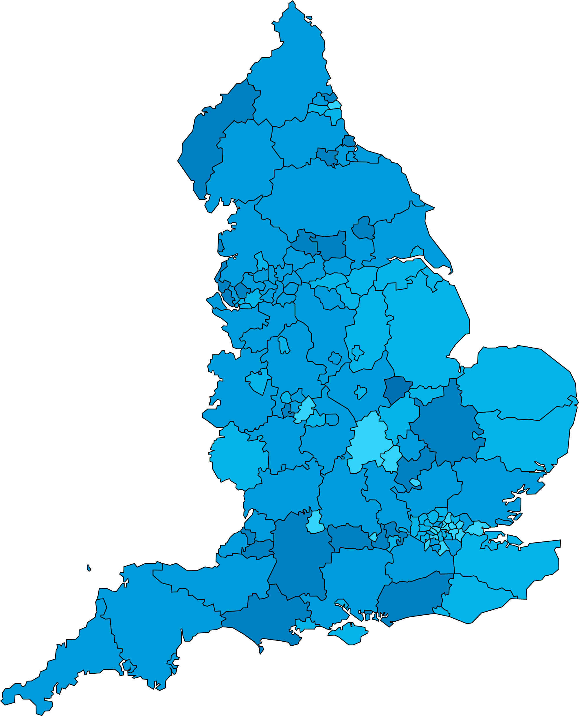
Discussion: secondary example (part 1)
Discussion: secondary example
Example: In KS3 geography, pupils often struggle to plan and accurately complete choropleth maps.
1. What is the demand of the curriculum or the environment that they find challenging?
This task requires pupils to visualise the finished map and understand its purpose - what the map is intended to show and how it should be organised. They need to consider both the data that must be represented and the essential features, such as the key and appropriate labels.
2. On which area of development might this place the highest demand?
Executive function: pupils may find it hard to plan backwards from the desired outcome and organise their approach to the task.
Notes:
Hidden slide – optional example to illustrate discussion task.
Graphics code; IHM-map.png

Slide 37
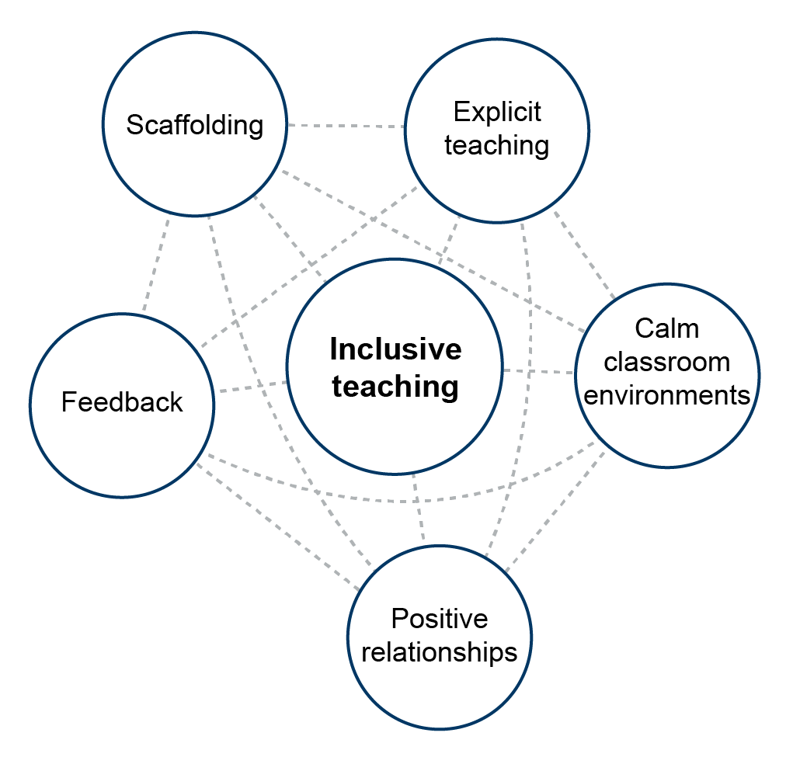
How can universal approaches help?
Adapted from EEF, 2026
Notes:
Time: 2 minutes [45]
Purpose: To illustrate that universal approaches can help in addressing areas of development.
Guidance: Give teachers a moment to read the slide.
Explain that:
Staff will recognise and be familiar with the universal approaches on the slide.
Inclusive teaching practices benefit all pupils and are especially important for those with additional needs. These should be used ‘universally’ as part of your practice and include scaffolding, explicit teaching, feedback, positive relationships and calm classroom environments.
By embedding these approaches consistently, teachers and support staff can create a supportive environment for everyone, reducing the need for further adaptations while still allowing flexibility to respond to individual pupils.
These inclusive teaching practices have specific strategies sitting within them, for example, having clear routines is a key strategy to achieve ‘calm classroom environments.’
Lead in: Let’s focus our thinking about teaching challenges in relation to universal approaches.
Graphics code: IHM_008.png

Slide 38
Discussion on supporting learners in challenging curriculum areas
Discussion
Think back to the area of the curriculum that you teach where all or many pupils find the topic or concepts challenging.
What is the demand of the curriculum or the environment that they find challenging?
On which area of development might this place the highest demand?
How can all pupils be supported?
How might some pupils be supported through adaptation?
What might make these supports effective or ineffective?
Notes:
Time: 10 minutes [55]
Purpose: To give teachers an opportunity to think about the link between the areas of development and inclusive teaching.
Guidance:
See hidden slides for examples you may choose to use to help staff respond to these questions. You may want to show the example, give teachers time to read it and then talk through the possible answers to the discussion questions for that example (which are on the slide).
Two minutes to explain/ share example.
Give two minutes for individual thinking and/or notes.
Allow six minutes for discussion.
You may find it helpful to signal when three minutes is up so that both speakers get to share ideas.
Lead in: Let’s move on to the reflection section of today’s session.

Slide 39
Facilitator guidance: example options (part 2)
If you chose to use one of the previous discussion examples (Primary KS2 reading or Secondary KS3 geography) you can continue to support this next discussion opportunity by showing the second half of each of the examples.
The examples are on the following hidden slides.
You may wish to use both tasks if you have a longer session with staff.
Notes:
Hidden slide – guidance

Slide 40
Discussion: primary example (part 2)
Discussion: primary example
Example: In KS2 reading, pupils often struggle to support their answers to reading comprehension questions that require them to comment on the effect on the reader.
3. How can all pupils be supported?
through explicit teaching and teacher modelling, and then providing scaffolding to support, with a clear plan to remove this step-by-step as pupils develop confidence
through positive relationships that recognise the challenges of reading and support pupils through repeated, inclusive practice and a positive culture of error
4. How might some pupils be supported through adaptation?
A pupil with a specific SLC need might be provided with key words to include in their answer.
5. How might these supports be made effective or ineffective?
This scaffold might be ineffective if the key words give away the answer to the comprehension question and reduce the appropriate level of challenge in the task.
Notes:
Hidden slide – optional example to illustrate discussion task.

Slide 41
Discussion: secondary example (part 2)
Discussion: secondary example
Example: In geography, at KS3 pupils often struggle to plan and accurately complete choropleth maps.
3. How can all pupils be supported?
through explicit teaching and teacher modelling, and breaking down of the processes pupils need to follow to produce a completed accurate map
through scaffolding the task using a well-designed template (this might have a pre-allocated space for a key, or the data intervals pupils should use for each colour on the map) with a clear plan to remove this step-by-step as pupils develop confidence when working on tasks like this across the geography curriculum
4. How might some pupils be supported through adaptation?
Some pupils with a specific SLC need that affects the quantity of verbal information they can hold in their working memory might be supported by having a written set of instructions.
5. How might these supports be made effective or ineffective?
This adaptation might be ineffective if the instructions are not sufficiently broken down or use unnecessarily complex language.
Notes:
Hidden slide – optional example to illustrate discussion task.
Graphics code; IHM-map.png

Slide 42
Facilitator guidance: reflection options
The following slides are hidden so that you can choose which activity to use.
Remember to unhide the slide you choose before you start facilitating the session.
There are options for different reflection activities and you can select the most appropriate one for your staff. The options suggested are:
A final consolidation of how the universal approach might be used to support a class where there is a variety of needs [alongside a second hidden slide providing an example]
A broader reflection of how this session might influence staff practice.
If you have time, you may wish to do both reflection tasks with your staff.
Ensure you choose the task before running the session.
Notes:
Hidden slide – facilitator guidance for reflection section.

Slide 43
Reflection on using universal approaches to support learners
Reflection
How can universal approaches be applied to support pupils, or groups of pupils with specific needs?
Scenario: Imagine you set a task in class that involves several steps.
In your class, one pupil has a diagnosed need related to processing information, while another does not have a diagnosis but often finds it difficult to follow instructions or stay focused for longer periods.
How might you use inclusive teaching practices to support all pupils, including those with specific needs?
Adapted from EEF, 2026
Notes:
Option 1 – Consolidation reflection task
Time: 5 minutes [60]
Purpose: To prompt reflection around the different universal approaches and consolidate this learning.
Guidance: use the suggested scripting below to illustrate how the different universal approaches might help in relation to need.
One minute to explain/ share scenario.
Give two minutes for individual thinking and/or notes.
Allow three minutes for discussion.
You may wish to share the next slide after staff have had time for discussion. It shows a possible response.
Explain that:
While the individual inclusive teaching practices might be particularly helpful in different situations, the way they work together to support learning is key.
Ask teachers to consider the scenario and think about how they would use the inclusive teaching practices together to support the group of pupils in this scenario.
Thank the teachers for their participation and engagement.
Graphics code: IHM_008.png

Slide 44
How can universal approaches support all pupils: example
How might you use inclusive teaching practices to support all pupils, including those with specific needs?
Example:
To support everyone, you break the task into clear stages and talk through each part, using examples to show what’s expected.
You provide visual aids and templates for organising work, making these available to all pupils.
Throughout, you check in with individuals, offering encouragement and guidance, and you maintain a calm, organised classroom where pupils feel comfortable asking for help.
Notes:
Option 1 – Example for option 1 reflection task
Note that the example illustrates one way of approaching this question. There are many ways a teacher might do this successfully.

Slide 45
Reflection on challenging areas of the curriculum and areas of development
Reflection
Think back to a topic in your curriculum where many pupils struggle.
Which area of development does it place the greatest demand on?
What is one possible change or adaptation you might offer some pupils to close that gap?
How will you know it is working?
Note: The categories are subject to change following the SEND Reform consultation
Notes:
Option 2 – Reflection task on developing practice
Time: 5 minutes [60]
Purpose: To give teachers an opportunity to reflect at the end of the session. Choose either this slide or the previous one.
Guidance:
Allow time for teachers to reflect on the prompt alone.
Take a sample of responses from the whole group to close today’s session.
Thank the teachers for their participation and engagement.

Slide 46
References
Antalek, C., Castro-Kemp, S., Dixon, F., Esposito, R., Hayton, J., Herbert, E., Kamenopoulou, L., Kolak, J., Loyd, D., Roberts, A., Romualdez, A. M., Somerville, M. P., Taha, J., & Tunks, F. (2025). Cross-cutting themes in identifying, supporting and collaborating for children and young people with SEND: A rapid evidence review. Department for Education
Collaborative for Academic, Social, and Emotional Learning (CASEL). (2020). CASEL’s SEL Framework.
The Communication Trust. (2015). Universally Speaking: The ages and stages of children’s communication development from 11 to 18 years. Department for Education. (2025). Early years foundation stage statutory framework: Setting the standards for learning, development and care for children from birth to five. Accessed online at: EYFS statutory framework for group and school-based providers.

Slide 47
References (continued)
Department for Education (2026). SEND Reform: putting children and young people first. Accessed online at: SEND reform: putting children and young people first (HTML version) - GOV.UK
Denham, S. (2018). Keeping SEL Developmental: The Importance of a Developmental Lens for Fostering and Assessing SEL Competencies. Accessed online at: https://casel.s3.us-east-2.amazonaws.com/CASEL-Resources-Keeping-SEL-Developmental.pdf
Education Endowment Foundation. (2025). Special Educational Needs in Mainstream Schools: Guidance Report.
Education Endowment Foundation. (2026). The EEF guide to inclusive teaching. Accessed online at: https://educationendowmentfoundation.org.uk/education-evidence/inclusive-teaching/universal-approaches
World Health Organisation. (2001). International Classification of Functioning, Disability and Health (ICF). Accessed online: https://iris.who.int/server/api/core/bitstreams/83e1c3e0-cf9e-4063-a424-71ccc9a84ded/content

Slide 48
Closing slide

