Slide 1
OFFICIAL - SENSITIVE - RECIPIENTS ONLY
Selected Digital Possession Service screens accompanying the Practice Direction
Purpose of the pack
This pack contains a selection of screenshots from the Digital Possession Service, together with descriptions of any information, questions, options and actions shown on each screen.
How the screens relate to the Practice Direction
The Digital Possession Service guides claimants and defendants (parties) through a series of screens which enable users to give the information required by the Online Procedure Rules 2026 and the Practice Direction for online possession proceedings. The screens prompt users to enter information directly and to upload documents.
How to use this pack
The descriptions are intended to help users understand the content and purpose of the selected screens. The pack does not reproduce every screen in the service and does not replace the Online Procedure Rules, the Practice Direction or the live digital service.

Slide 2
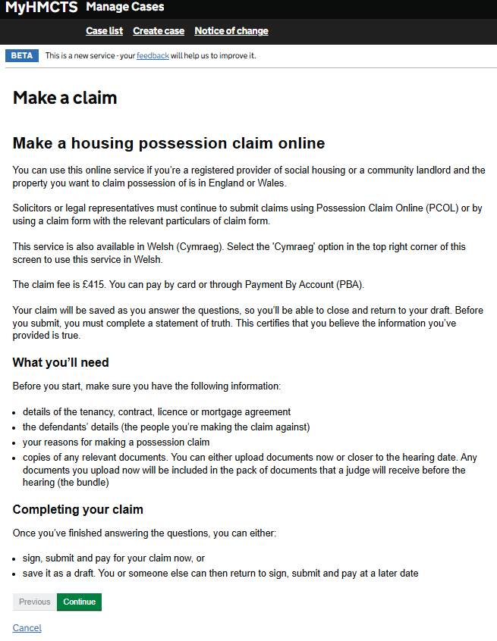
OFFICIAL - SENSITIVE - RECIPIENTS ONLY
Make a housing possession claim
Short page descriptor: Start page explaining who can use the online service, what is needed and how to complete a claim.
Screen description
Heading: “Make a housing possession claim online”
The page states: “You can use this online service if you’re a registered provider of social housing or a community landlord and the property you want to claim possession of is in England or Wales.”
“Solicitors or legal representatives must continue to submit claims using Possession Claim Online (PCOL) or by using a claim form with the relevant particulars of claim form.”
“This service is also available in Welsh (Cymraeg). Select the ‘Cymraeg’ option in the top right corner of this screen to use this service in Welsh.”
“The claim fee is £415. You can pay by card or through Payment By Account (PBA).”
“Your claim will be saved as you answer the questions, so you’ll be able to close and return to your draft. Before you submit, you must complete a statement of truth. This certifies that you believe the information you’ve provided is true.”
Heading: “What you’ll need”
The page states: “Before you start, make sure you have the following information:”
The information listed is:
“details of the tenancy, contract, licence or mortgage agreement”;
“the defendants’ details (the people you’re making the claim against)”;
“your reasons for making a possession claim”; and
“copies of any relevant documents. You can either upload documents now or closer to the hearing date. Any documents you upload now will be included in the pack of documents that a judge will receive before the hearing (the bundle)”.
Heading: “Completing your claim”
The page states: “Once you’ve finished answering the questions, you can either:”
The options shown are:
“sign, submit and pay for your claim now”; or
“save it as a draft. You or someone else can then return to sign, submit and pay at a later date”.
The following actions are available: Start and Cancel.

Slide 3
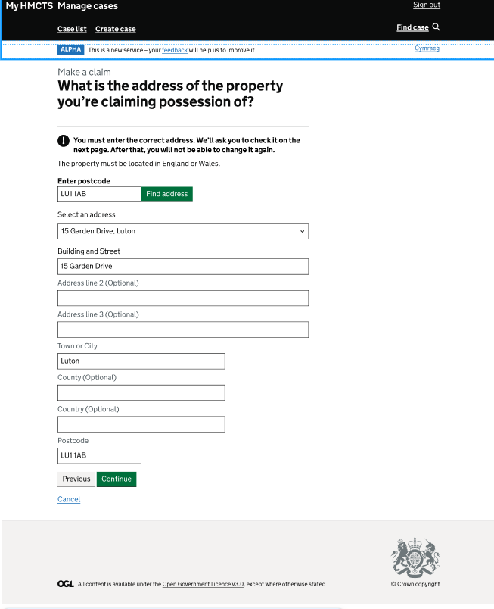
OFFICIAL - SENSITIVE
Property address
Short page descriptor: Property address page with postcode lookup and address fields.
Screen description
Heading: “What is the address of the property you’re claiming possession of?”
The page includes the following instruction and warning:
“You must enter the correct address. We’ll ask you to check it on the next page. After that, you will not be able to change it again.”
The page states: “The property must be located in England or Wales.”
There is a field labelled “Enter Postcode”.
In the example shown, the “Enter postcode” field contains “LU1 1AB”. There is a "Find address" button available to use.
There is a field for “Select an address”. In the example shown the “Select an address” field shows “15 Garden Drive, Luton”.
There is a field for Building and Street. In the example shown the “Select an address” field shows “15 Garden Drive”.
There are fields for:
“Address line 2 (Optional)”,
“Address line 3 (Optional)”,
“Town or City”. In the example shown the field has been filled with “Luton”,
“County (Optional)”,
“Country (Optional)”, and
“Postcode”. In the example shown the postcode has been completed with “LU1 1AB”.
The following actions are available: Previous, Continue and Cancel.

Slide 4
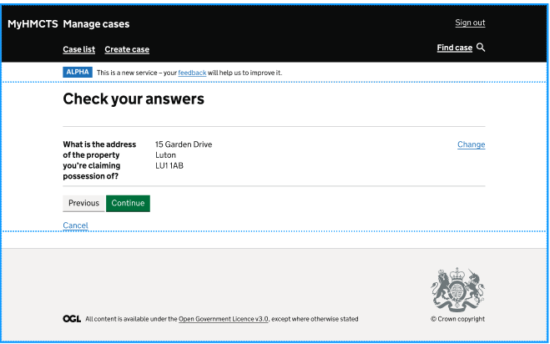
OFFICIAL - SENSITIVE
Check property answers
Short page descriptor: Check your answers page showing the property address answer and a Change link.
Screen description
Heading: “Check your answers”
The page asks: “What is the address of the property you’re claiming possession of?”
In the example shown, the entered answer is “15 Garden Drive”, “Luton”, “LU1 1AB”.
A “Change” link is shown next to the address answer.
The following actions are available: Previous, Continue and Cancel.

Slide 5
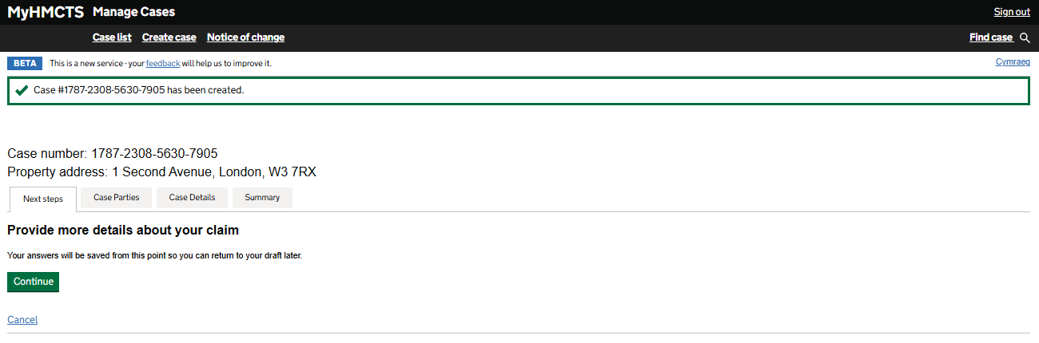
OFFICIAL - SENSITIVE - RECIPIENTS ONLY
Provide more details about your claim
Short page descriptor: Case-created confirmation page showing case details and the next step.
Accessible description
The page includes the following confirmation: “Case #1787-2308-5630-7905 has been created.”
In this example, the case number is “1787-2308-5630-7905”.
In this example, the property address is “1 Second Avenue, London, W3 7RX”.
The tabs shown are: “Next steps”, “Case Parties”, “Case Details” and “Summary”.
Heading: “Provide more details about your claim”
The page states: “Your answers will be saved from this point so you can return to your draft later.”
The following actions are visible: Continue and Cancel.
OFFICIAL - SENSITIVE - RECIPIENTS ONLY

Slide 6
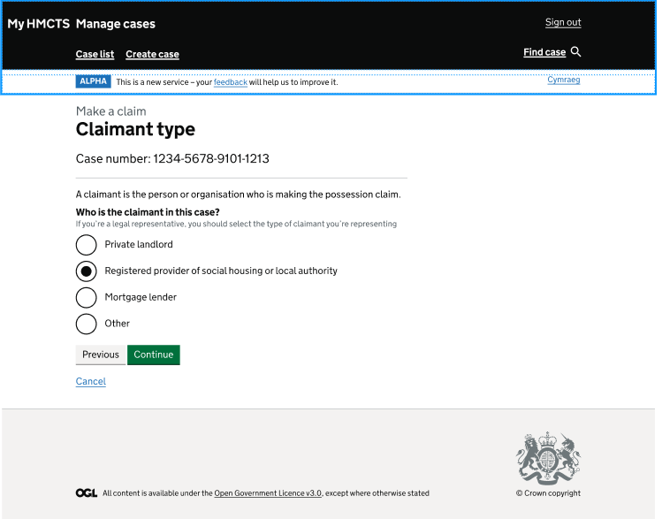
OFFICIAL - SENSITIVE
Claimant type
Short page descriptor: Claimant type page asking who the claimant is.
Accessible description
Heading: “Claimant type”
In this example, the case number is “1234-5678-9101-1213”.
The page states: “A claimant is the person or organisation who is making the possession claim.”
Heading: “Who is the claimant in this case?”
The screen states: “If you’re a legal representative, you should select the type of claimant you’re representing.”
The options shown are:
“Private landlord”;
“Registered provider of social housing or local authority”;
“Mortgage lender”; and
“Other”
In this example, “Registered provider of social housing or local authority” has been selected
The following actions are available: Previous, Continue and Cancel.

Slide 7
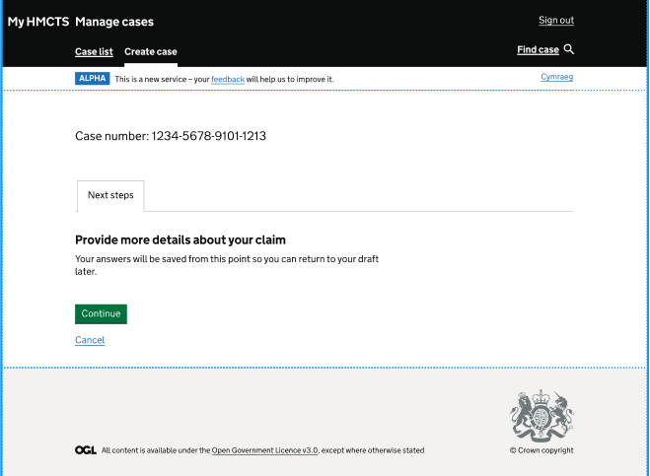
OFFICIAL - SENSITIVE
Next Steps
Short page descriptor: Next steps page asking for more details about the claim.
Accessible description
Heading: “Next steps”
In this example, the case number is “1234-5678-9101-1213”.
Heading: “Provide more details about your claim”
The page states: “Your answers will be saved from this point so you can return to your draft later.”
The following actions are available: Continue and Cancel.
OFFICIAL - SENSITIVE

Slide 8
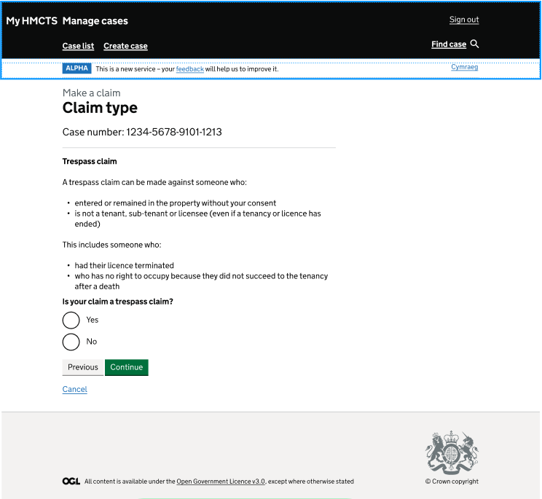
OFFICIAL - SENSITIVE
Claim Type
Short page descriptor: Claim type page asking whether the claim is a trespass claim.
Accessible description
Heading: “Claim type”
In this example, the case number is “1234-5678-9101-1213”.
Heading: “Trespass claim”
The page states: “A trespass claim can be made against someone who:”
“entered or remained in the property without your consent”; and
“is not a tenant, sub-tenant or licensee (even if a tenancy or licence has ended)”.
The page states: “This includes someone who:”
“had their licence terminated”; and
“who has no right to occupy because they did not succeed to the tenancy after a death”.
Heading: “Is your claim a trespass claim?”
The options shown are:
“Yes”; and
“No”.
In this example, no option appears to have been selected.
The following actions are available: Previous, Continue and Cancel.

Slide 9
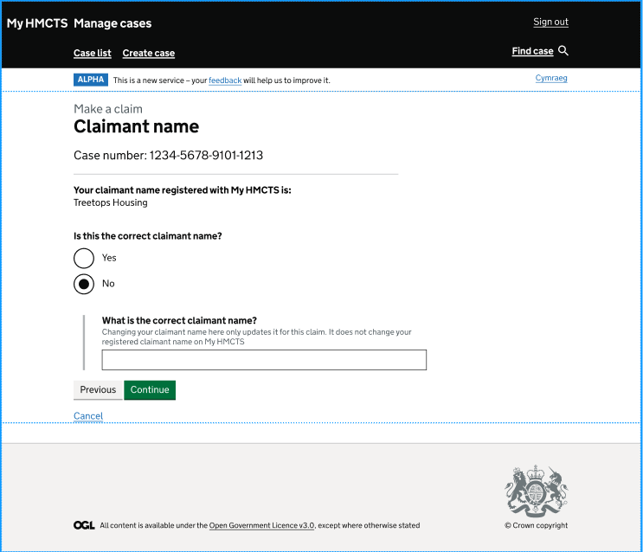
OFFICIAL - SENSITIVE
Claimant name
Short page descriptor: Claimant name page asking whether the registered claimant name is correct.
Accessible description
Heading: “Claimant name”
In this example, the case number is “1234-5678-9101-1213”.
Heading: “Your claimant name registered with My HMCTS is:”
In this example, the claimant name is “Treetops Housing”.
Heading: “Is this the correct claimant name?”
The options shown are:
“Yes”; and
“No”.
In this example, “No” appears to have been selected.
Heading: “What is the correct claimant name?”
The screen states: “Changing your claimant name here only updates it for this claim. It does not change your registered claimant name on My HMCTS.”
The page shows a box for the correct claimant name. In this example, the box is blank.
The following actions are available: Previous, Continue and Cancel.

Slide 10
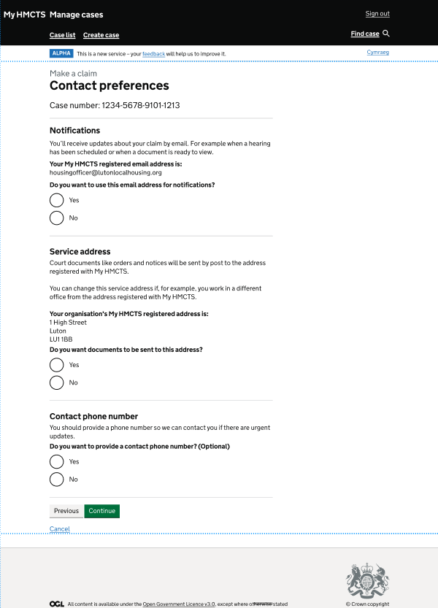
OFFICIAL - SENSITIVE
Contact Preferences
Short page descriptor: Contact preferences page asking about notification email, service address and contact phone number.
Accessible description
Heading: “Contact preferences”
In this example, the case number is “1234-5678-9101-1213”.
Heading: “Notifications”
The page states: “You’ll receive updates about your claim by email. For example when a hearing has been scheduled or when a document is ready to view.”
Heading: “Your My HMCTS registered email address is:” In this example, the email address appears as “housingofficer@lutonlocalhousing.org”.
The page asks: “Do you want to use this email address for notifications?”
The options shown are:
“Yes”; and
“No”.
Heading: “Service address”
The screen states: “Court documents like orders and notices will be sent by post to the address registered with My HMCTS.”
The screen states: “You can change this service address if, for example, you work in a different office from the address registered with My HMCTS.”
The page states: “Your organisation’s My HMCTS registered address is:” In this example, the address is “1 High Street”, “Luton”, “LU1 1BB”.
The page asks: “Do you want documents to be sent to this address?” The options shown are “Yes” and “No”.
Heading: “Contact phone number”
The screen states: “You should provide a phone number so we can contact you if there are urgent updates.”
The page asks: “Do you want to provide a contact phone number? (Optional)” The options shown are “Yes” and “No”.
The following actions are available: Previous, Continue and Cancel.

Slide 11
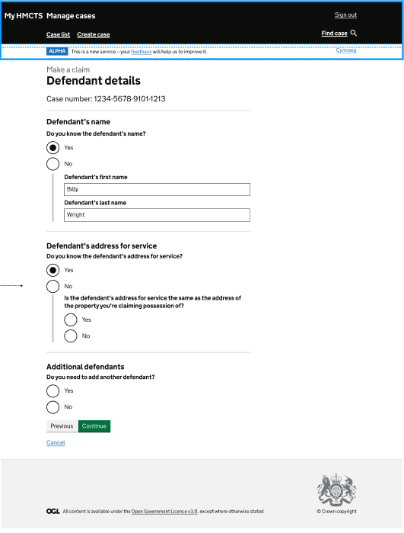
OFFICIAL - SENSITIVE
Defendant details
Short page descriptor: Defendant details page asking for the defendant’s name and address for service.
Accessible description
Heading: “Defendant details”
In this example, the case number is “1234-5678-9101-1213”.
Heading: “Defendant’s name”
The page asks: “Do you know the defendant’s name?”
The options shown are:
“Yes”; and
“No”.
In this example, “Yes” appears to have been selected.
The page shows a box labelled “Defendant’s first name”. In this example, the field contains “Billy”.
The page shows a box labelled “Defendant’s last name”. In this example, the field appears to contain “Wright”.
Heading: “Defendant’s address for service”
The page asks: “Do you know the defendant’s address for service?” The options shown are “Yes” and “No”.
The page asks: “Is the defendant’s address for service the same as the address of the property you’re claiming possession of?” The options shown are “Yes” and “No”.
Heading: “Additional defendants”
The page asks: “Do you need to add another defendant?” The options shown are “Yes” and “No”.
The following actions are available: Previous, Continue and Cancel.

Slide 12
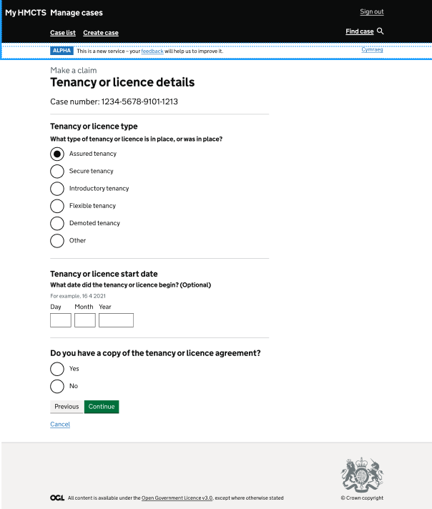
OFFICIAL - SENSITIVE
Tenancy or Licence Details
Short page descriptor: Tenancy or licence details page asking about tenancy type, start date and agreement copy.
Accessible description
Heading: “Tenancy or licence details”
In this example, the case number is “1234-5678-9101-1213”.
Heading: “Tenancy or licence type”
The page asks: “What type of tenancy or licence is in place, or was in place?”
The options shown are:
“Assured tenancy”;
“Secure tenancy”;
“Introductory tenancy”;
“Flexible tenancy”;
“Demoted tenancy”; and
“Other”.
In this example, “Assured tenancy” has been selected.
Heading: “Tenancy or licence start date”
The page asks: “What date did the tenancy or licence begin? (Optional)”
The screen states: “For example, 16 4 2021.”
The date fields are labelled “Day”, “Month” and “Year”. In this example, the date fields are blank.
Heading: “Do you have a copy of the tenancy or licence agreement?”
The options shown are:
“Yes”; and
“No”.
In this example, no option appears to have been selected.
The following actions are available: Previous, Continue and Cancel.

Slide 13
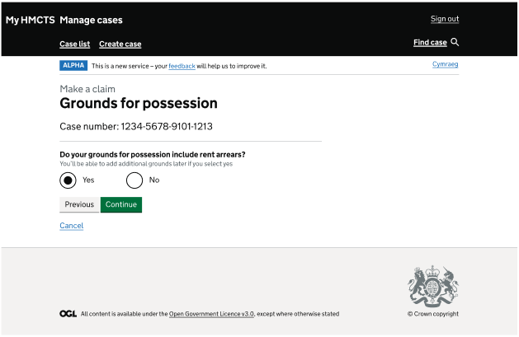
OFFICIAL - SENSITIVE
Grounds for Possession
Short page descriptor: Grounds for possession page asking whether the claim includes rent arrears.
Accessible description
Heading: “Grounds for possession”
In this example, the case number is “1234-5678-9101-1213”.
Heading: “Do your grounds for possession include rent arrears?”
The screen states: “You’ll be able to add additional grounds later if you select yes”
The options shown are:
“Yes”; and
“No”.
In this example, “Yes” appears to have been selected.
The following actions are available: Previous, Continue and Cancel.

Slide 14
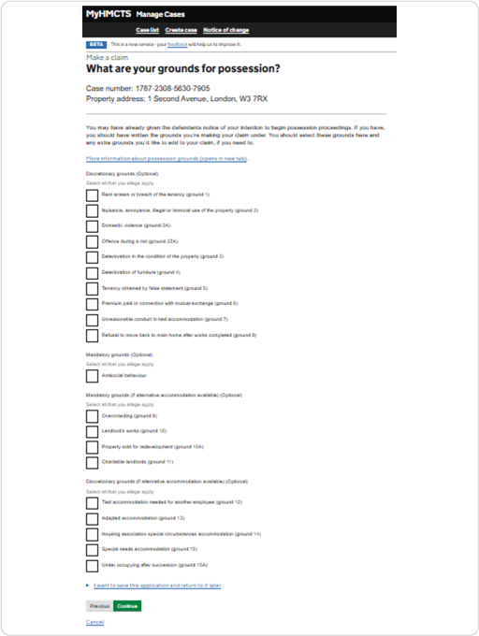
What are your grounds for possession?
Short page descriptor: Grounds for possession page listing discretionary and mandatory grounds.
Accessible description
Heading: “What are your grounds for possession?”
In this example, the case number is “1787-2308-5630-7905”.
In this example, the property address is “1 Second Avenue, London, W3 7RX”.
The page states: “You may have already given the defendants notice of your intention to begin possession proceedings. If you have, you should have written the grounds you’re making your claim under. You should select these grounds here and any extra grounds you’d like to add to your claim, if you need to.”
The link shown is: “More information about possession grounds (opens in new tab)”.
Heading: “Discretionary grounds (Optional)”
The screen states “Select all that you allege apply”.
The available options are:
• “Rent arrears or breach of the tenancy (ground 1)”
• “Nuisance, annoyance, illegal or immoral use of the property (ground 2)”
• “Domestic violence (ground 2A)”
• “Offence during a riot (ground 2ZA)”
• “Deterioration in the condition of the property (ground 3)”
• “Deterioration of furniture (ground 4)”
• “Tenancy obtained by false statement (ground 5)”
• “Premium paid in connection with mutual exchange (ground 6)”
• “Unsuitable conduct in tied accommodation (ground 7)”
• “Refusal to move back to main home after works completed (ground 8)”
Heading: “Mandatory grounds (Optional)”
The states “Select all that you allege apply”.
The available option is:
• “Antisocial behaviour”
Heading: “Mandatory ground (if alternative accommodation available) (Optional)”
The page instructs the user to “Select all that you allege apply”.
The available options are:
• “Overcrowding (ground 9)”
• “Landlord’s works (ground 10)”
• “Property sold for redevelopment (ground 10A)”
• “Charitable landlord (ground 11)”
Heading: “Discretionary grounds (if alternative accommodation available) (Optional)”
The states: “Select all that you allege apply”.
The available options are:
• “Tied accommodation needed for another employee (ground 12)”
• “Adapted accommodation (ground 13)”
• “Housing association special circumstances accommodation (ground 14)”
• “Special needs accommodation (ground 15)”
• “Under occupying after succession (ground 16A)”
In this example, no ground has been selected.
The link “I want to save this application and return to it later” is shown.
The following actions are available: “Previous”, “Continue” and “Cancel”.
Notes:
This slide reproduces and describes the user-provided screen. No external sources have been used.

Slide 15
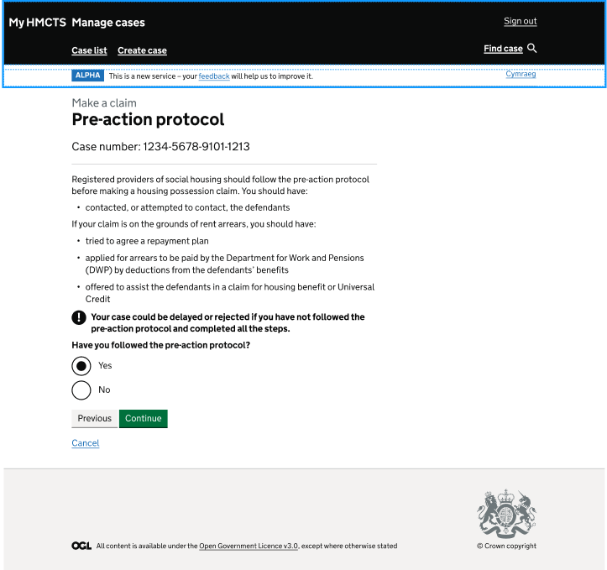
OFFICIAL - SENSITIVE
Pre-Action protocol
Short page descriptor: Pre-action protocol page asking whether the protocol has been followed.
Accessible description
Heading: “Pre-action protocol”
In this example, the case number is “1234-5678-9101-1213”.
The page states: “Registered providers of social housing should follow the pre-action protocol before making a housing possession claim.”
The screen states: “You should have:”
“contacted, or attempted to contact, the defendants”.
The screen states: “If your claim is on the grounds of rent arrears, you should have:”
“tried to agree a repayment plan”;
“applied for arrears to be paid by the Department for Work and Pensions (DWP) by deductions from the defendants’ benefits”; and
“offered to assist the defendants in a claim for housing benefit or Universal Credit”.
The page includes the following warning: “Your case could be delayed or rejected if you have not followed the pre-action protocol and completed all the steps.”
Heading: “Have you followed the pre-action protocol?”
The options shown are:
“Yes”; and
“No”.
In this example, “Yes” appears to have been selected.
The following actions are available: Previous, Continue and Cancel.

Slide 16
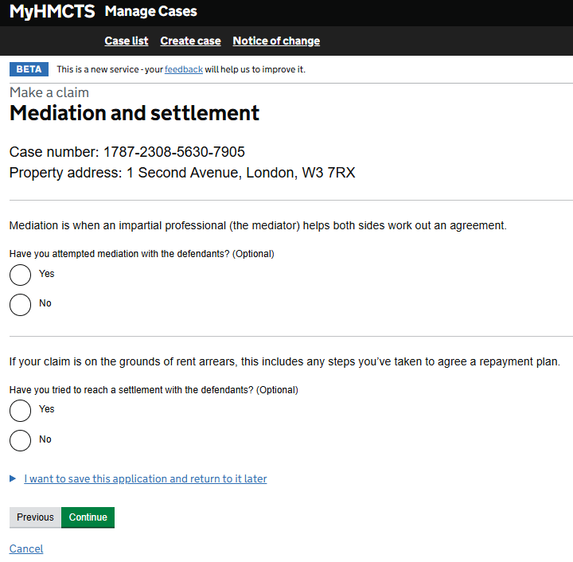
OFFICIAL - SENSITIVE - RECIPIENTS ONLY
Mediation and settlement
Short page descriptor: Mediation and settlement page asking about mediation and settlement attempts.
Accessible description
Heading: “Mediation and settlement”
In this example, the case number is “1787-2308-5630-7905”.
In this example, the property address is “1 Second Avenue, London, W3 7RX”.
The page states: “Mediation is when an impartial professional (the mediator) helps both sides work out an agreement.”
Heading: “Have you attempted mediation with the defendants? (Optional)”
The options shown are “Yes” and “No”. In this example, no option appears to have been selected.
The screen states: “If your claim is on the grounds of rent arrears, this includes any steps you’ve taken to agree a repayment plan.”
Heading: “Have you tried to reach a settlement with the defendants? (Optional)”
The options shown are “Yes” and “No”. In this example, no option appears to have been selected.
The link “I want to save this application and return to it later” is shown.
The following actions are available: Previous, Continue and Cancel.
OFFICIAL - SENSITIVE - RECIPIENTS ONLY

Slide 17
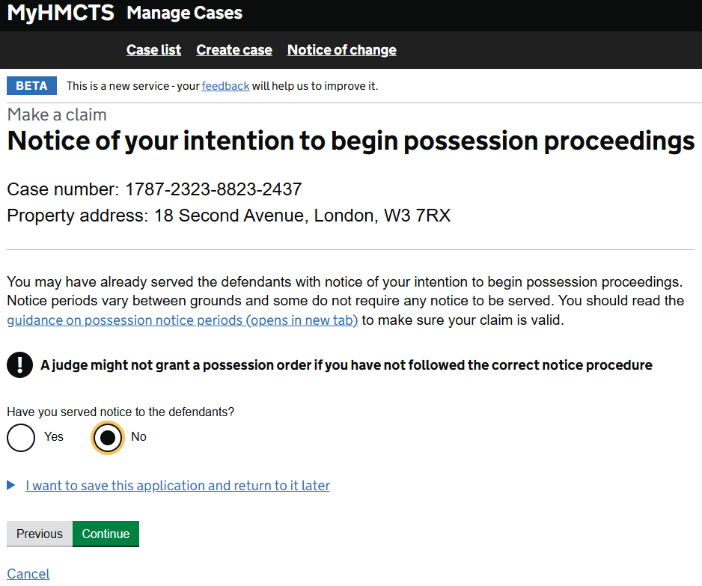
OFFICIAL - SENSITIVE - RECIPIENTS ONLY
Notice of your intention to begin possession proceedings
Short page descriptor: Notice page asking whether notice has been served on the defendants.
Accessible description
Heading: “Notice of your intention to begin possession proceedings”
In this example, the case number is “1787-2323-8823-2437”.
In this example, the property address is “18 Second Avenue, London, W3 7RX”.
The page states: “You may have already served the defendants with notice of your intention to begin possession proceedings. Notice periods vary between grounds and some do not require any notice to be served. You should read the guidance on possession notice periods (opens in new tab) to make sure your claim is valid.”
The page includes the following warning: “A judge might not grant a possession order if you have not followed the correct notice procedure”.
Heading: “Have you served notice to the defendants?”
The options shown are “Yes” and “No”. In this example, no is selected.
The link “I want to save this application and return to it later” is shown.
The following actions are available: Previous and Cancel.
OFFICIAL - SENSITIVE - RECIPIENTS ONLY

Slide 18
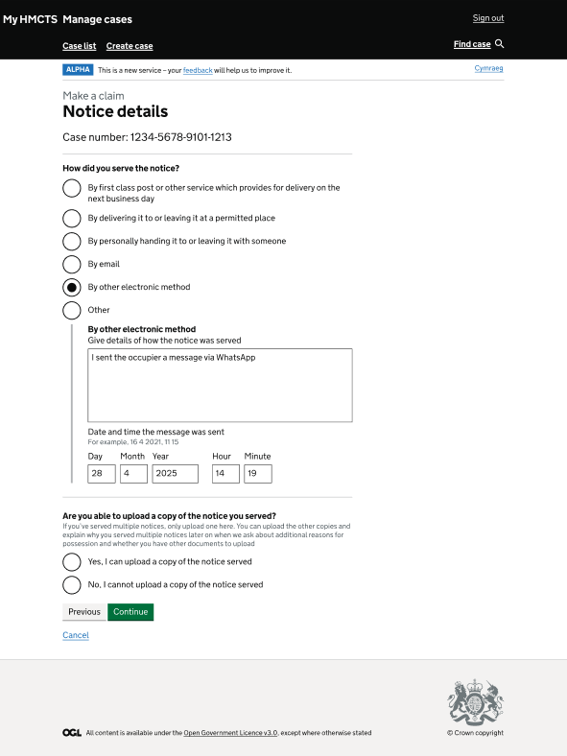
OFFICIAL - SENSITIVE
Notice details
Short page descriptor: Notice details page asking how notice was served.
Accessible description
Heading: “Notice details”
In this example, the case number is “1234-5678-9101-1213”.
Heading: “How did you serve the notice?”
The options shown are:
“By first class post or other service which provides for delivery on the next business day”;
“By delivering it to or leaving it at a permitted place”;
“By personally handing it to or leaving it with someone”;
“By email”;
“By other electronic method”; and
“Other”.
In this example, “By other electronic method” has been selected.
Heading: “By other electronic method”
The page shows a box labelled “Give details of how the notice was served”. In this example, the box contains “I sent the occupier a message via WhatsApp”.
The page shows “Date and time the message was sent” with the example “For example, 16 4 2021, 11 15”. In this example, the fields show Day “28”, Month “4”, Year “2025”, Hour “14” and Minute “19”.
Heading: “Are you able to upload a copy of the notice you served?”
The screen states: “If you’ve served multiple notices, only upload one here. You can upload the other copies and explain why you served multiple notices later on when we ask about additional reasons for possession and whether you have other documents to upload.”
The options shown are:
“Yes, I can upload a copy of the notice served”; and
“No, I cannot upload a copy of the notice served”.
In this example, no upload option appears to have been selected.
The following actions are available: Previous, Continue and Cancel.

Slide 19
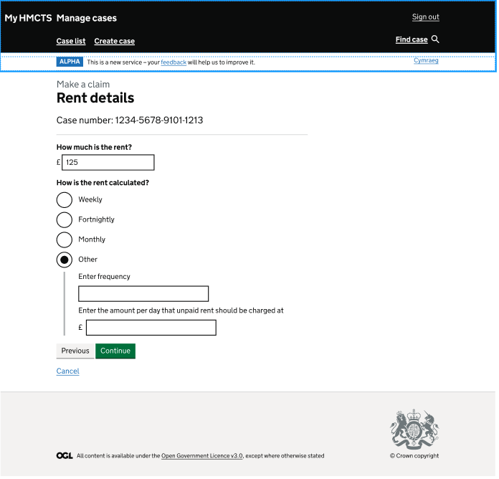
OFFICIAL - SENSITIVE
Rent Details
Short page descriptor: Rent details page asking for the rent amount and how rent is calculated.
Accessible description
Heading: “Rent details”
In this example, the case number is “1234-5678-9101-1213”.
Heading: “How much is the rent?”
The page shows a box for the rent amount. In this example, the figure of £125 has been entered.
Heading: “How is the rent calculated?”
The options shown are:
“Weekly”;
“Fortnightly”;
“Monthly”; and
“Other”.
In this example, “Other” has been selected.
The page shows a box labelled “Enter frequency”. In this example, the box is blank.
The page asks for “Enter the amount per day that unpaid rent should be charged at”. In this example, the amount box is blank and shows the pound sign.
The following actions are available: Previous, Continue and Cancel.

Slide 20
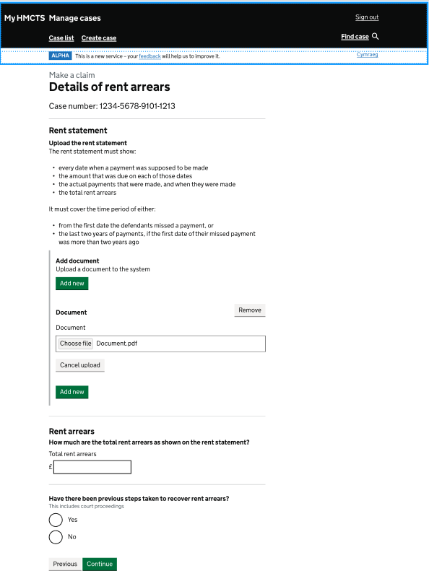
OFFICIAL - SENSITIVE
Details of rent arrears
Short page descriptor: Details of rent arrears page with rent statement upload and arrears questions.
Accessible description
Heading: “Details of rent arrears”
In this example, the case number is “1234-5678-9101-1213”.
Heading: “Rent statement”
The screen states: “Upload the rent statement.”
The screen states: “The rent statement must show:”
“every date when a payment was supposed to be made”;
“the amount that was due on each of those dates”;
“the actual payments that were made, and when they were made”; and
“the total rent arrears”.
The screen states: “It must cover the time period of either:”
“from the first date the defendants missed a payment”; or
“the last two years of payments, if the first date of their missed payment was more than two years ago”.
Heading: Add document
The green buttons are labelled “Add new”. The screen says “Upload a document to the system”. It shows “Document”, a “Remove” link, a “Choose file” button and a “Cancel upload” link. In this example, the uploaded file is “Document.pdf”.
Heading: “Rent arrears”
The page asks: “How much are the total rent arrears as shown on the rent statement?”
The page shows the label “Total rent arrears”. There is a box to enter the amount.
Heading: “Have there been previous steps taken to recover rent arrears?” And then states: "This includes court proceedings".
The options shown are “Yes” and “No”. No option appears to have been selected in this example.
The following actions are available: Previous or Continue.

Slide 21
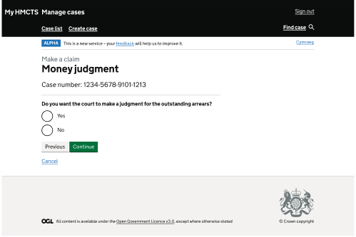
OFFICIAL - SENSITIVE
Money judgment
Short page descriptor: Money judgment page asking whether the court should make a judgment for outstanding arrears.
Accessible description
Heading: “Money judgment”
In this example, the case number is “1234-5678-9101-1213”.
The page asks: “Do you want the court to make a judgment for the outstanding arrears?”
The options shown are:
“Yes”; and
“No”.
In this example, no option appears to have been selected.
The following actions are available: Previous, Continue and Cancel.

Slide 22
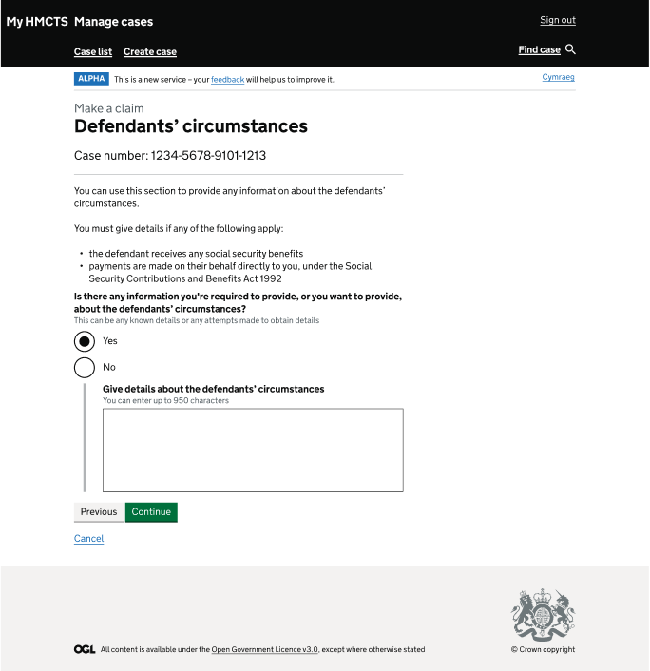
OFFICIAL - SENSITIVE
Defendants’ circumstances
Short page descriptor: Defendants’ circumstances page asking whether information about the defendants should be provided.
Accessible description
Heading: “Defendants’ circumstances”
In this example, the case number is “1234-5678-9101-1213”.
The page states: “You can use this section to provide any information about the defendants’ circumstances.”
The page states: “You must give details if any of the following apply:”
“the defendant receives any social security benefits”; and
“payments are made on their behalf directly to you, under the Social Security Contributions and Benefits Act 1992”.
Heading: “Is there any information you’re required to provide, or you want to provide, about the defendants’ circumstances?”
The screen states: “This can be any known details or any attempts made to obtain details.”
The options shown are:
“Yes”; and
“No”.
In this example, “Yes” appears to have been selected.
The page shows a box labelled “Give details about the defendants’ circumstances”. The page states: “You can enter up to 950 characters.” In this example, the box is blank.
The following actions are available: Previous, Continue and Cancel.

Slide 23
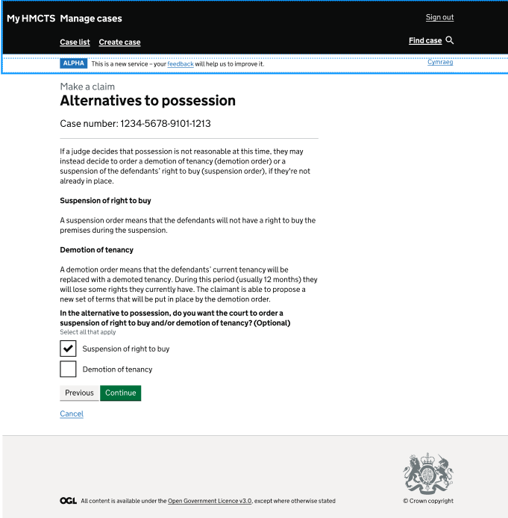
OFFICIAL - SENSITIVE
Alternatives to Possession
Short page descriptor: Alternatives to possession page asking whether suspension of right to buy or demotion of tenancy is sought.
Accessible description
Heading: “Alternatives to possession”
In this example, the case number is “1234-5678-9101-1213”.
The page states: “If a judge decides that possession is not reasonable at this time, they may instead decide to order a demotion of tenancy (demotion order) or a suspension of the defendants’ right to buy (suspension order), if they’re not already in place.”
Heading: “Suspension of right to buy”
The page states: “A suspension order means that the defendants will not have a right to buy the premises during the suspension.”
Heading: “Demotion of tenancy”
The page states: “A demotion order means that the defendants’ current tenancy will be replaced with a demoted tenancy. During this period (usually 12 months) they will lose some rights they currently have. The claimant is able to propose a new set of terms that will be put in place by the demotion order.”
Heading: “In the alternative to possession, do you want the court to order a suspension of right to buy and/or demotion of tenancy? (Optional)”
The screen states: “Select all that apply.”
The options shown are:
“Suspension of right to buy”; and
“Demotion of tenancy”.
In this example, no option appears to have been selected.
The following actions are available: Previous, Continue and Cancel.

Slide 24
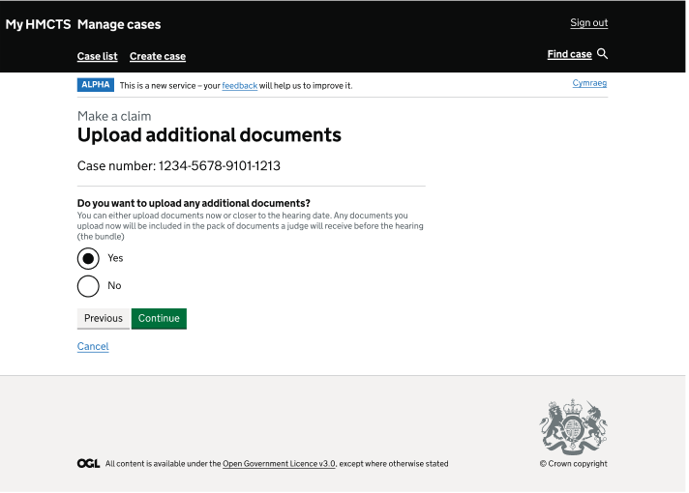
OFFICIAL - SENSITIVE
Upload additional documents
Short page descriptor: Upload additional documents page asking whether any additional documents will be uploaded.
Accessible description
Heading: “Upload additional documents”
In this example, the case number is “1234-5678-9101-1213”.
Heading: “Do you want to upload any additional documents?”
The page states: “You can either upload documents now or closer to the hearing date. Any documents you upload now will be included in the pack of documents a judge will receive before the hearing (the bundle).”
The options shown are:
“Yes”; and
“No”.
In this example, “Yes” appears to have been selected.
The following actions are available: Previous, Continue and Cancel.

Slide 25
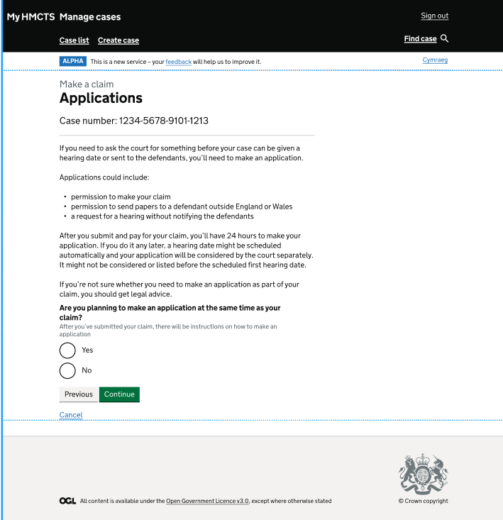
OFFICIAL - SENSITIVE
Applications
Short page descriptor: Applications page asking whether the claimant plans to make an application at the same time as the claim.
Accessible description
Heading: “Applications”
In this example, the case number is “1234-5678-9101-1213”.
The page states: “If you need to ask the court for something before your case can be given a hearing date or sent to the defendants, you’ll need to make an application.”
The page states: “Applications could include:”
“permission to make your claim”;
“permission to send papers to a defendant outside England or Wales”; and
“a request for a hearing without notifying the defendants”.
The page states: “After you submit and pay for your claim, you’ll have 24 hours to make your application. If you do it any later, a hearing date might be scheduled automatically and your application will be considered by the court separately. It might not be considered or listed before the scheduled first hearing date.”
The page states: “If you’re not sure whether you need to make an application as part of your claim, you should get legal advice.”
Heading: “Are you planning to make an application at the same time as your claim?”
The screen states: “After you’ve submitted your claim, there will be instructions on how to make an application.”
The options shown are “Yes” and “No”. In this example, no option appears to have been selected.
The following actions are available: Previous, Continue and Cancel.

Slide 26
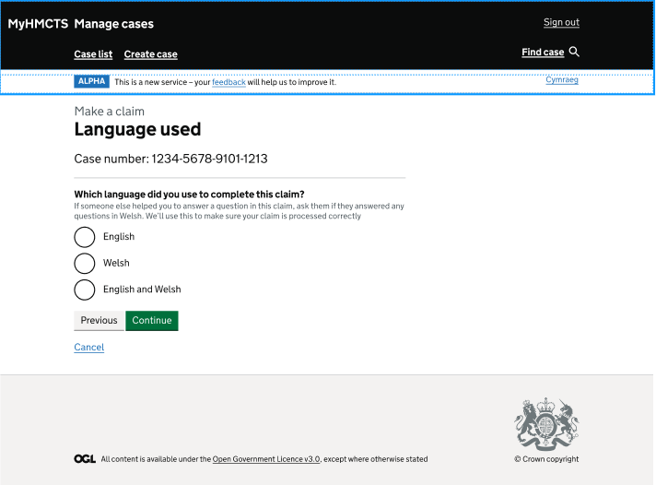
OFFICIAL - SENSITIVE
Language Used
Short page descriptor: Language used page asking which language was used to complete the claim.
Accessible description
Heading: “Language used”
In this example, the case number is “1234-5678-9101-1213”.
Heading: “Which language did you use to complete this claim?”
The page states: “If someone else helped you to answer a question in this claim, ask them if they answered any questions in Welsh. We’ll use this to make sure your claim is processed correctly.”
The options shown are:
“English”;
“Welsh”; and
“English and Welsh”.
The following actions are available: Previous, Continue and Cancel.

Slide 27
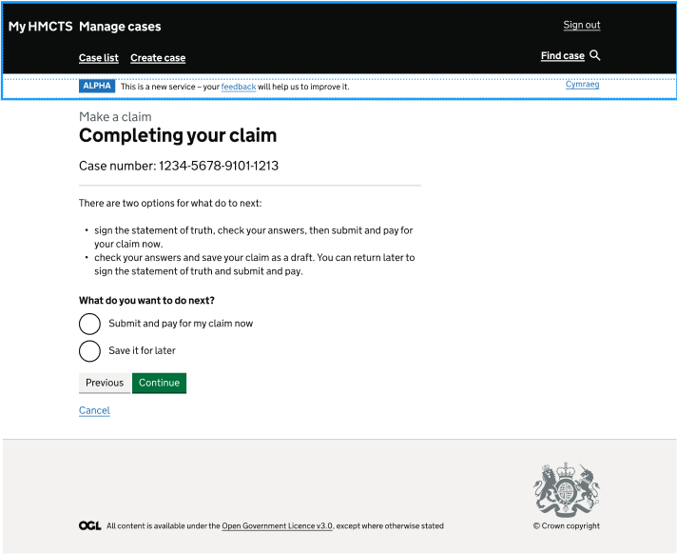
OFFICIAL - SENSITIVE
Completing your claim
Short page descriptor: Completing your claim page asking whether to submit now or save for later.
Accessible description
Heading: “Completing your claim”
In this example, the case number is “1234-5678-9101-1213”.
The page states: “There are two options for what do to next:”
“sign the statement of truth, check your answers, then submit and pay for your claim now”; and
“check your answers and save your claim as a draft. You can return later to sign the statement of truth and submit and pay.”
Heading: “What do you want to do next?”
The options shown are:
“Submit and pay for my claim now”; and
“Save it for later”.
In this example, no option appears to have been selected.
The following actions are available: Previous, Continue and Cancel.

Slide 28
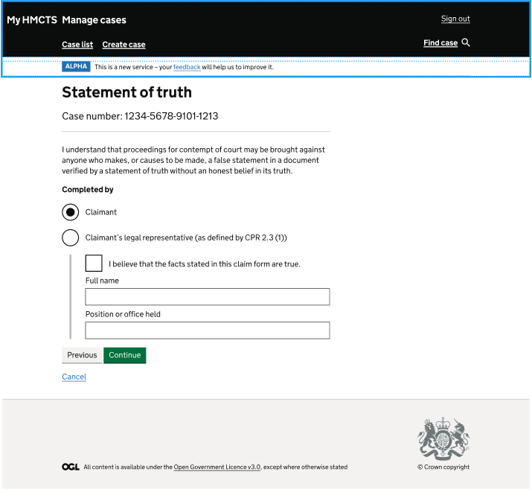
OFFICIAL - SENSITIVE
Statement of truth
Short page descriptor: Statement of truth page asking the claimant to confirm the claim.
Accessible description
Heading: “Statement of truth”
In this example, the case number is “1234-5678-9101-1213”.
The page states: “I understand that proceedings for contempt of court may be brought against anyone who makes, or causes to be made, a false statement in a document verified by a statement of truth without an honest belief in its truth.”
Heading: “Completed by”
The options shown are:
“Claimant”; and
“Claimant’s legal representative (as defined by CPR 2.3 (1))”.
In this example, “Claimant” has been selected.
The screen states: “I believe that the facts stated in this claim form are true.” There is a box to tick next to statement.
The page shows a box labelled “Full name”. In this example, the box is blank.
The page shows a box labelled “Position or office held”. In this example, the box is blank.
The following actions are available: Previous, Continue and Cancel.

Slide 29
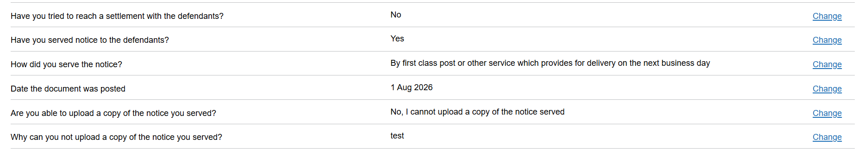
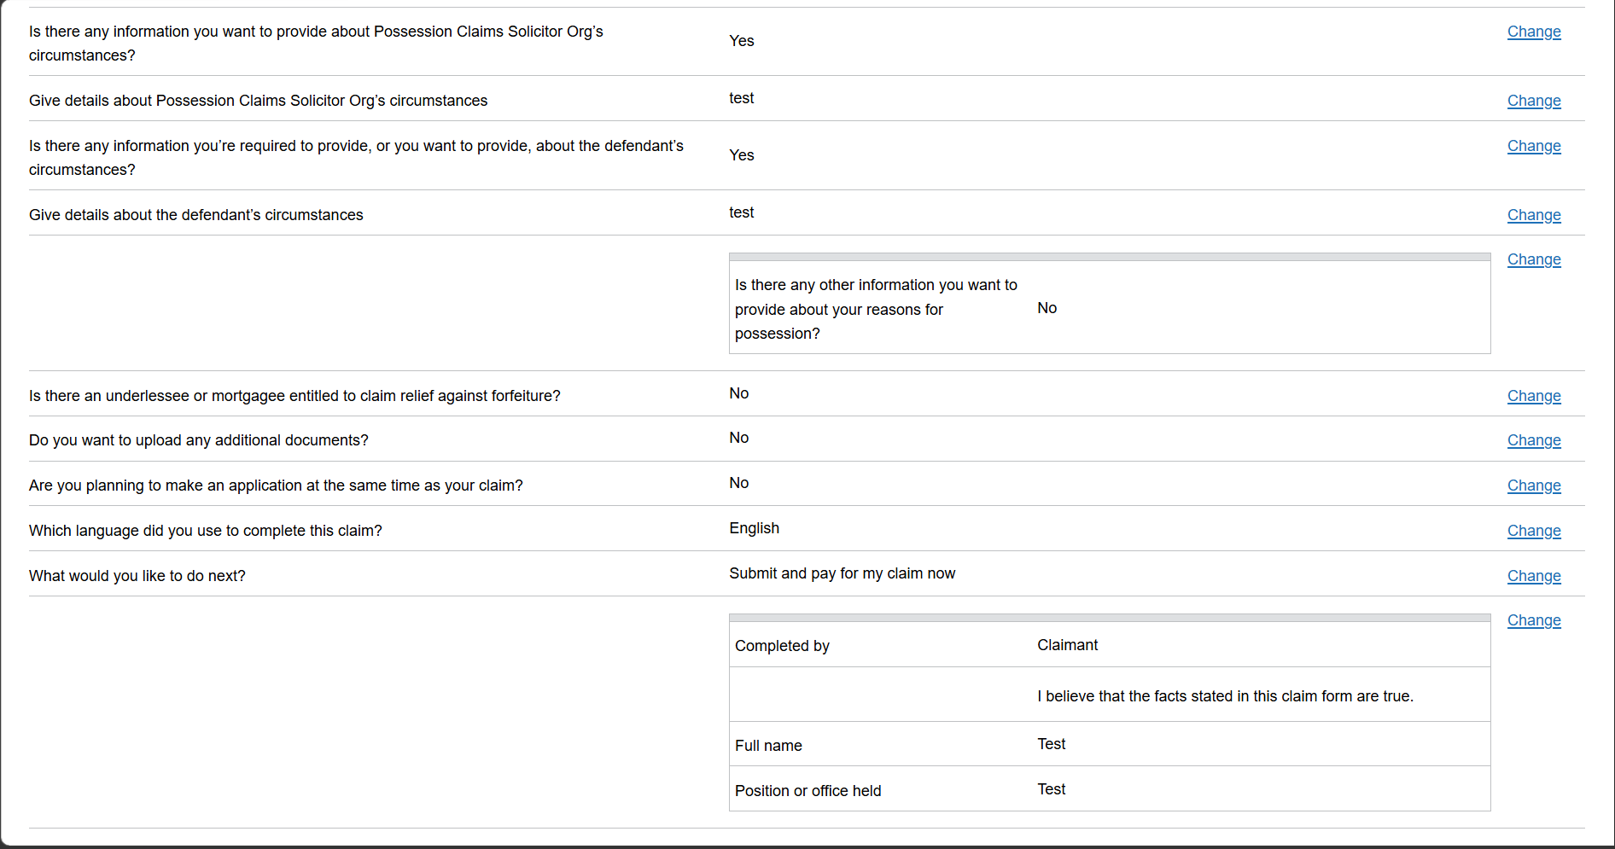
OFFICIAL - SENSITIVE
Check your answers - claim and submission details
Short page descriptor: Check your answers page summarising the information entered for a housing possession claim and providing links to change the answers.
Screen description
The page continues with:
“Have you tried to reach a settlement with the defendants?” In this example, the answer “Yes” is displayed.
“Have you served notice to the defendants?” In this example, the answer “Yes” is displayed.
“How did you serve notice?” In this example, the answer “by first class post or other service which provides for delivery on the next business day” is displayed.
“Date the document was posted” In this example, the answer “1 Aug 2026” is displayed.
“Are you able to upload a copy of the notice you served?” In this example, the answer “No, I cannot upload a copy of the notice served” is displayed.
“Why can you not upload a copy of the notice served?” In this example, the answer “test” is displayed.
“Is there any information you want to provide about Possession Claims Solicitor Orgs circumstances?” In this example, the answer “Yes” is displayed.
“Is there any information you’re required to provide, or you want to provide, about the defendants’ circumstances?” In this example, the answer “Yes” is displayed.
“Give details about the defendant’s circumstances”. In this example, the answer “test” is displayed.
A bordered section shows:
“Is there any other information you want to provide about your reasons for possession?” In this example, the answer “No” is displayed.
The screen asks:
“Is there an underlessee or mortgagee entitled to claim relief against forfeiture?” In this example, the answer “No” is displayed.
“Do you want to upload any additional documents?” In this example, the answer “No” is displayed.
“Are you planning to make an application at the same time as your claim?” In this example, the answer “No” is displayed.
“Which language did you use to complete this claim?” In this example, the answer “English” is displayed.
“What would you like to do next?” In this example, the answer “Submit and pay for my claim now” is displayed.
A section shows the following information:
“Completed by”: “Claimant”.
“I believe that the facts stated in this claim form are true.”
“Full name”: In this example, the answer “Test” is displayed.
“Position or office held”. In this example, the answer “Test” is displayed.
OFFICIAL - SENSITIVE

Slide 30
OFFICIAL - SENSITIVE
Check your answers - claim and submission details
Short page descriptor: Check your answers page summarising the information entered for a housing possession claim and providing links to change the answers.
Screen description
The page continues with:
“Have you tried to reach a settlement with the defendants?” In this example, the answer “Yes” is displayed.
“Have you served notice to the defendants?” In this example, the answer “Yes” is displayed.
“How did you serve notice?” In this example, the answer “by first class post or other service which provides for delivery on the next business day” is displayed.
“Date the document was posted” In this example, the answer “1 Aug 2026” is displayed.
“Are you able to upload a copy of the notice you served?” In this example, the answer “No, I cannot upload a copy of the notice served” is displayed.
“Why can you not upload a copy of the notice served?” In this example, the answer “test” is displayed.
“Is there any information you want to provide about Possession Claims Solicitor Orgs circumstances?” In this example, the answer “Yes” is displayed.
“Is there any information you’re required to provide, or you want to provide, about the defendants’ circumstances?” In this example, the answer “Yes” is displayed.
“Give details about the defendant’s circumstances”. In this example, the answer “test” is displayed.
A bordered section shows:
“Is there any other information you want to provide about your reasons for possession?” In this example, the answer “No” is displayed.
The screen asks:
“Is there an underlessee or mortgagee entitled to claim relief against forfeiture?” In this example, the answer “No” is displayed.
“Do you want to upload any additional documents?” In this example, the answer “No” is displayed.
“Are you planning to make an application at the same time as your claim?” In this example, the answer “No” is displayed.
“Which language did you use to complete this claim?” In this example, the answer “English” is displayed.
“What would you like to do next?” In this example, the answer “Submit and pay for my claim now” is displayed.
A section shows the following information:
“Completed by”: “Claimant”.
“I believe that the facts stated in this claim form are true.”
“Full name”: In this example, the answer “Test” is displayed.
“Position or office held”. In this example, the answer “Test” is displayed.
OFFICIAL - SENSITIVE

Slide 31
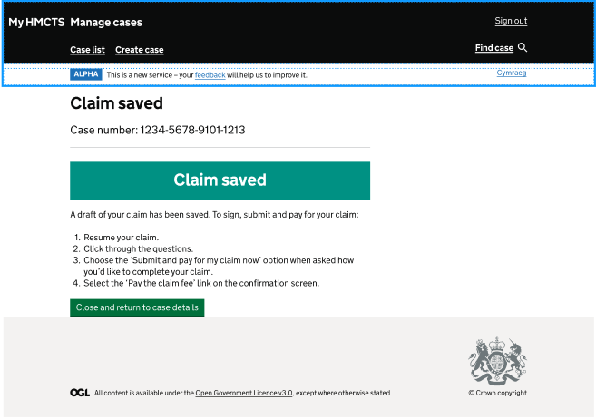
OFFICIAL - SENSITIVE
Claim saved
Short page descriptor: Claim saved confirmation page with instructions for returning to the draft claim.
Accessible description
Heading: “Claim saved”
In this example, the case number is “1234-5678-9101-1213”.
A confirmation banner states: “Claim saved”
The page states: “A draft of your claim has been saved. To sign, submit and pay for your claim:”
The instructions shown are:
“Resume your claim”;
“Click through the questions”;
“Choose the ‘Submit and pay for my claim now’ option when asked how you’d like to complete your claim”; and
“Select the ‘Pay the claim fee’ link on the confirmation screen”.
The following action is available: Close and return to case details.

Slide 32
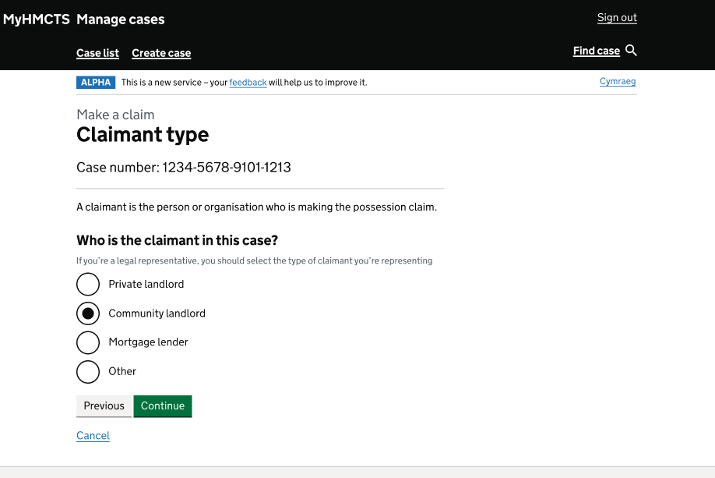
OFFICIAL - SENSITIVE
Welsh claimant type
Short page descriptor: Welsh journey claimant type page asking who the claimant is.
Accessible description
Heading: “Claimant type”
In this example, the case number is “1234-5678-9101-1213”.
The page states: “A claimant is the person or organisation who is making the possession claim.”
Heading: “Who is the claimant in this case?”
The screen states: “If you’re a legal representative, you should select the type of claimant you’re representing.”
The options shown are:
“Private landlord”;
“Community landlord”;
“Mortgage lender”; and
“Other”.
In this example, “Community landlord” appears to have been selected.
The following actions are available: Previous, Continue and Cancel.

Slide 33
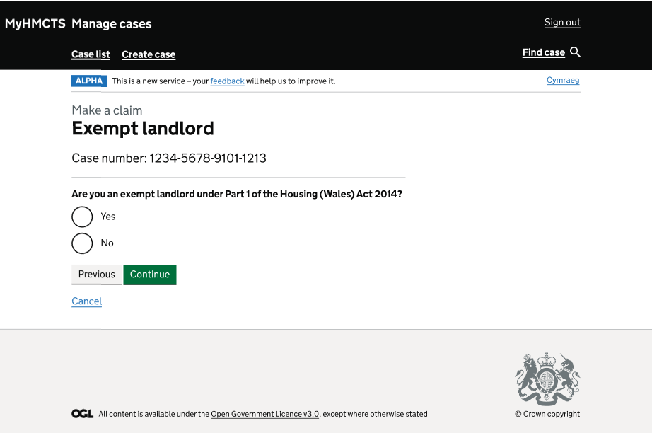
OFFICIAL - SENSITIVE
Exempt landlord
Short page descriptor: Welsh journey exempt landlord page asking whether the claimant is an exempt landlord.
Accessible description
Heading: “Exempt landlord”
In this example, the case number is “1234-5678-9101-1213”.
Heading: “Are you an exempt landlord under Part 1 of the Housing (Wales) Act 2014?”
The options shown are:
“Yes”; and
“No”.
In this example, no option appears to have been selected.
No visible consequence or branching text appears on this screenshot.
The following actions are available: Previous, Continue and Cancel.

Slide 34
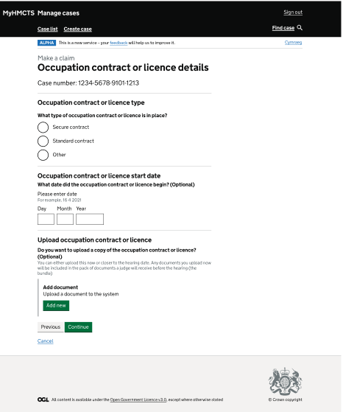
OFFICIAL - SENSITIVE
Occupation contract or licence details
Short page descriptor: Welsh journey occupation contract or licence page with type, date and upload sections.
Screen description
Heading: “Occupation contract or licence details”
In this example, the case number is “1234-5678-9101-1213”.
Heading: “Occupation contract or licence type”
The screen asks: “What type of occupation contract or licence is in place?”
The options shown are:
“Secure contract”;
“Standard contract”; and
“Other”.
In this example, no option appears to have been selected.
Heading: “Occupation contract or licence start date”
The page asks: “What date did the occupation contract or licence begin? (Optional)”
The screen states: “Please enter date”. It also gives the example “16 4 2000”.
The page shows date fields labelled “Day”, “Month” and “Year”. In this example, the date fields are blank.
Heading: “Upload occupation contract or licence”
The page asks: “Do you want to upload a copy of the occupation contract or licence? (Optional)”
The page states: “You can either upload this now or closer to the hearing date. Any documents you upload now will be included in the pack of documents a judge will receive before the hearing (the bundle).”
Heading: “Add document” and “Upload a document to the system”. There is a green “Add new” button.
The following actions are available: Previous, Continue and Cancel.

Slide 35
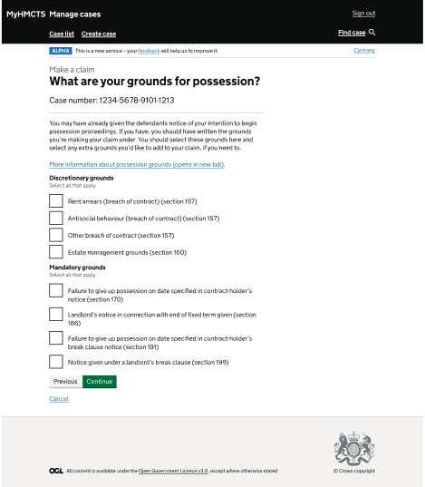
OFFICIAL - SENSITIVE
Welsh grounds for possession
Short page descriptor: Welsh journey grounds page asking which discretionary and mandatory possession grounds apply.
Screen description
Heading: “What are your grounds for possession?”
In this example, the case number is “1234-5678-9101-1213”.
The page states: “You may have already given the defendants notice of your intention to begin possession proceedings. If you have, you should have written the grounds you’re making your claim under. You should select these grounds here and select any extra grounds you’d like to add to your claim, if you need to.”
A link labelled “More information about possession grounds (opens in new tab)” is shown.
Heading: “Discretionary grounds”
The screen states: “Select all that apply”.
The options shown are:
“Rent arrears (breach of contract) (section 157)”;
“Antisocial behaviour (breach of contract) (section 157)”;
“Other breach of contract (section 157)”; and
“Estate management grounds (section 160)”.
Heading: “Mandatory grounds”
The screen states: “Select all that apply”.
The options shown are:
“Failure to give up possession on date specified in contract-holder’s notice (section 170)”;
“Landlord’s notice in connection with end of fixed term given (section 186)”;
“Failure to give up possession on date specified in contract-holder’s break clause notice (section 191)”; and
“Notice given under a landlord’s break clause (section 199)”.
In this example, no ground appears to have been selected.
The following actions are available: Previous, Continue and Cancel.

Slide 36
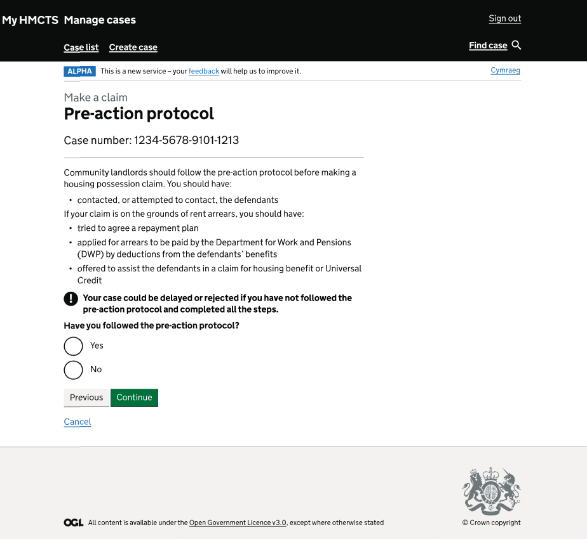
OFFICIAL - SENSITIVE
Welsh pre-action protocol
Short page descriptor: Welsh journey pre-action protocol page asking whether the protocol has been followed.
Accessible description
Heading: “Pre-action protocol”
In this example, the case number is “1234-5678-9101-1213”.
The page states: “Community landlords should follow the pre-action protocol before making a housing possession claim. You should have:”
“contacted, or attempted to contact, the defendants”.
The page states: “If your claim is on the grounds of rent arrears, you should have:”
The following steps are shown:
“tried to agree a repayment plan”;
“applied for arrears to be paid by the Department for Work and Pensions (DWP) by deductions from the defendants’ benefits”; and
“offered to assist the defendants in a claim for housing benefit or Universal Credit”.
The page includes the following warning: “Your case could be delayed or rejected if you have not followed the pre-action protocol and completed all the steps.”
Heading: “Have you followed the pre-action protocol?”
The options shown are:
“Yes”; and
“No”.
In this example, no option appears to have been selected.
The following actions are available: Previous, Continue and Cancel.

Slide 37
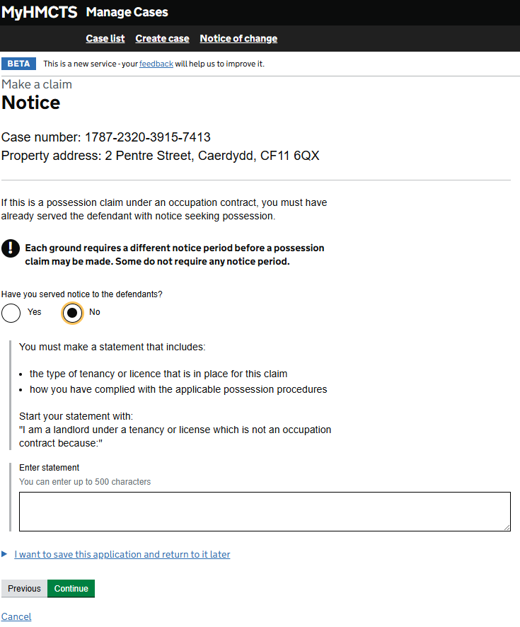
OFFICIAL - SENSITIVE - RECIPIENTS ONLY
Notice
Short page descriptor: Welsh-journey notice page asking whether notice was served and requiring a statement where No is selected.
Accessible description
Heading: “Notice”
In this example, the case number is “1787-2320-3915-7413”.
In this example, the property address is “2 Pentre Street, Caerdydd, CF11 6QX”.
The page states: “If this is a possession claim under an occupation contract, you must have already served the defendant with notice seeking possession.”
The page includes the following warning: “Each ground requires a different notice period before a possession claim may be made. Some do not require any notice period.”
Heading: “Have you served notice to the defendants?”
The options shown are “Yes” and “No”. In this example, “No” appears to have been selected.
The page states: “You must make a statement that includes:”
“the type of tenancy or licence that is in place for this claim”; and
“how you have complied with the applicable possession procedures”.
The page states: “Start your statement with:” “I am a landlord under a tenancy or license which is not an occupation contract because:”
The page shows a box labelled “Enter statement”. The screen states: “You can enter up to 500 characters”. In this example, the box is blank.
The link “I want to save this application and return to it later” is shown.
The following actions are available: Previous, Continue and Cancel.
OFFICIAL - SENSITIVE - RECIPIENTS ONLY

Slide 38
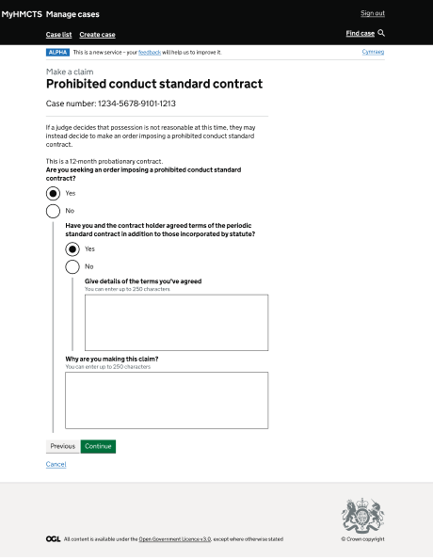
OFFICIAL - SENSITIVE
Prohibited conduct standard contract
Short page descriptor: Welsh journey prohibited conduct standard contract page with questions and boxes for further details.
Accessible description
Heading: “Prohibited conduct standard contract”
In this example, the case number is “1234-5678-9101-1213”.
The page states: “If a judge decides that possession is not reasonable at this time, they may instead decide to make an order imposing a prohibited conduct standard contract.”
The screen states: “This is a 12-month probationary contract.”
Heading: “Are you seeking an order imposing a prohibited conduct standard contract?”
The options shown are:
“Yes”; and
“No”.
In this example, “Yes” appears to have been selected.
Heading: “Have you and the contract holder agreed terms of the periodic standard contract in addition to those incorporated by statute?”
The options shown are:
“Yes”; and
“No”.
In this example, “Yes” appears to have been selected.
The page shows a box labelled “Give details of the terms you’ve agreed”. The screen states: “You can enter up to 250 characters”. In this example, the box is blank.
The page shows a box labelled “Why are you making this claim?” The screen states: “You can enter up to 250 characters”. In this example, the box is blank.
The following actions are available: Previous, Continue and Cancel.

Slide 39
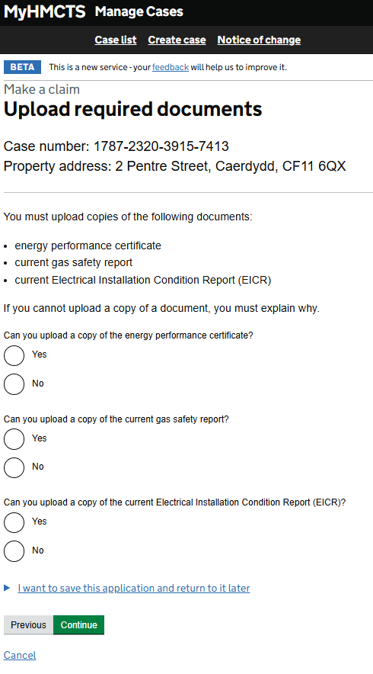
OFFICIAL - SENSITIVE - RECIPIENTS ONLY
Upload required documents
Short page descriptor: Required-documents page asking whether three documents can be uploaded.
Accessible description
Heading: “Upload required documents”
In this example, the case number is “1787-2320-3915-7413”.
In this example, the property address is “2 Pentre Street, Caerdydd, CF11 6QX”.
The page states: “You must upload copies of the following documents:”
The documents shown are “Energy performance certificate”,
“current gas safety report” and
“current Electrical Installation Condition Report (EICR)”.
The page states: “If you cannot upload a copy of a document, you must explain why.”
The page asks: “Can you upload a copy of the energy performance certificate?” The options shown are “Yes” and “No”.
The page asks: “Can you upload a copy of the current gas safety report?” The options shown are “Yes” and “No”.
The page asks: “Can you upload a copy of the current Electrical Installation Condition Report (EICR)?” The options shown are “Yes” and “No”.
In this example, no option appears to have been selected for any question.
The link “I want to save this application and return to it later” is shown.
The following actions are available: Previous, Continue and Cancel.
OFFICIAL - SENSITIVE - RECIPIENTS ONLY

