Slide 1
Reasonable Adjustment Processes
Employer and Employee Attitudes to Waiting Periods:
Final findings summary

Slide 2
01
02
03
04
Screening Survey
Pilot Survey #1
Pilot Survey #2
Next steps and limitations
Survey with 2,714 employees with disabilities
Vignette Completion Survey
Attitudes to regulation/
guidance on waiting periods
Where we intend to go from here
These are interim findings from the first phases of research. Further analysis and a scaling up of the samples are required to test these further.

Slide 3
Screening Survey

Slide 4
We divided the instrument into three key areas:
Need Recognition (‘Naming’): The screener explored whether respondents felt their disability or health condition required workplace adjustments to enable effective work performance.
Responsibility Attribution (‘Blaming’): Examined respondents' views on who should be responsible for implementing necessary workplace adjustments.
Adjustment-Seeking Behaviour (‘Claiming’): Investigated actual behaviours around requesting adjustments, including:
• Reasons for not pursuing needed adjustments.
• Outcomes of adjustment processes.
• Experiences of delay.
An online survey of an unrepresentative group of 2,714 disabled respondents in the UK in full or part-time employment

Slide 5
Uptake and barriers
23.3% of respondents who filed requests for adjustments from their employers waited over one month for a decision, with 9.8% waiting over three months.
14% experienced ‘significant’ delays in the implementation of adjustments, while 23% reported ‘minor’ delays.
A majority reported no delays in implementation.
17.6% of respondents believed that the employer should bear primary responsibility for implementing the adjustments they needed for the workplace
79% thought that both they (the disabled individual) and employer shared responsibility for implementing the adjustments they needed.

Slide 6
Uptake and barriers
16% of respondents felt they needed reasonable adjustments, but had not requested them.
Within this group:
53% expressed concerns about potential negative consequences from asking for adjustments.
9.6% were unaware they could ask for adjustments.
5.1% did not know what adjustments to request or found the process too complicated.

Slide 7
Vignette Completion
Results #1

Slide 8
What are employers’ and employees’ expectations around waiting periods?
Employer Sample (n=411)
Employee Sample (n=525)
Receiving or reviewing reasonable adjustment requests | 67.2%
Making decisions about reasonable adjustment requests | 56%
Implementing reasonable adjustments | 54%
Setting policy about reasonable adjustments | 38%
Requested reasonable adjustments from an employer | 75%
Had reasonable adjustments provided to me at work | 73%
Been involved in discussions about reasonable adjustments with an employer | 69%
Had a reasonable adjustment request declined or only partially approved | 21%
Participants all work in HR/in a senior role in an organisation
Participants all recruited from the first screening survey of 2,714 disabled people

Slide 9
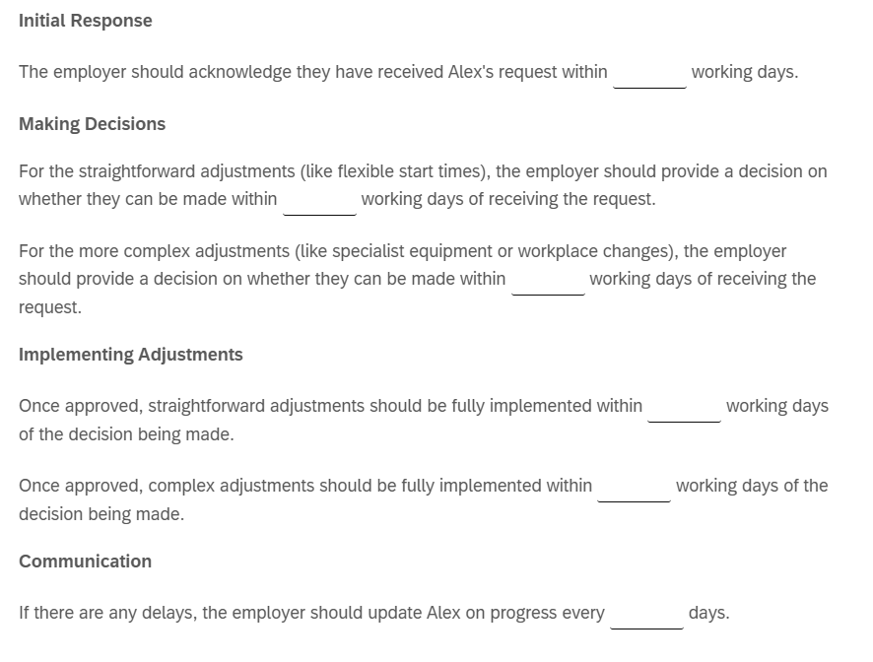
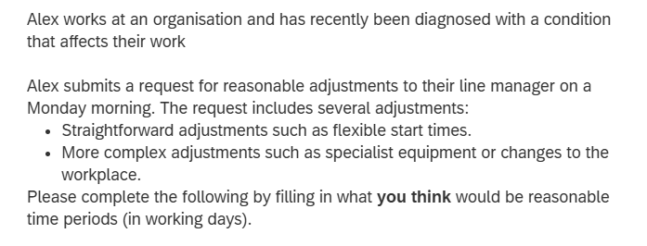
Vignette design
Designed to provide an initial reaction to a ‘reasonable’ waiting period for each stage a process – and to explore if attitudes to this differ between employers and employees

Slide 10
Vignette results
Issue | Employee Average | Employer Average | Difference
Initial Acknowledgment | 2.6 days | 6.8 days | +163% longer
Straightforward Decisions | 6.7 days | 11.4 days | +71% longer
Complex Decisions | 16.0 days | 18.5 days | +16% longer
Straightforward Implementation | 8.8 days | 12.4 days | +41% longer
Complex Implementation | 21.3 days | 22.2 days | +5% longer
Progress Updates | Every 4.3 days | Every 8.4 days | +95% longer

Slide 11
Vignette results: An expectation gap
Employers consistently believe longer response times are ‘reasonable’ compared to employees across every stage of the adjustment process.
The gap is most pronounced for initial acknowledgment and progress updates:
Initial acknowledgment: Employers think 6.8 days is reasonable vs. employees' expectation of 2.6 days (+163%)
Progress updates: 8.4 vs. 4.3 days (+95%)
Straightforward decisions: 11.4 vs. 6.7 days (+71%)
The expectation gap narrows substantially for complex matters, almost disappearing for complex implementation (+5%).
Views are different on reasonable waiting periods for different stages of the process, and for straightforward or complex matters.

Slide 12
Sample qualitative responses: Employees
“
I think for more complex adjustments, especially those that affect the wider team, it's understandable and appreciated that these decisions and implementations take longer. The key thing here is being transparent and communicative with the person requesting adjustments to alleviate anxiety.
Employee

Slide 13
Sample qualitative responses: Employees
“
Reasonable adjustments, by their very nature are reasonable - they shouldn't take long and an employee's health, wellbeing and their ability to thrive at work is depending on these adjustments - it's not special treatment, it's giving those who struggle in certain ways due to a disability the opportunity to thrive as much as someone without it.
Employee

Slide 14
Sample qualitative responses: Employees
“
I think it depends on the organisation involved. Mine personally is the Ambulance Service who are well resourced and with access to HR, and occupational health, to assist. Complex tasks such as office redesign and the potential fitting on assistive equipment may take some time and be more restrictive in a smaller organisation. Yes individuals may be on tenterhooks waiting for an outcome, but managers have to get it right.
Employee

Slide 15
Sample qualitative responses: Employees
“
I tried to work based on the requirements of Alex, but also the requirements of the company. For example, changing rotas may need a delay of a couple of weeks (based on my experience), whilst buying and implementing things like equipment can take a lot longer. However, there is no reason why communication cannot be regular. I know personally that receiving regular updates definitely reduces stress and anxiety in such a situation.
Employee

Slide 16
Sample qualitative responses: Employers
“
All situations are different but communication should be ongoing and consistent. The days detailed above are probably textbook rather than based on a person and their circumstances. I'd try to deal with the situation quickly in all instances and keep communication open for questions and reassurance
Employer

Slide 17
Sample qualitative responses: Employers
“
I think it depends on the complexity and equipment required. Some items may have a longer delivery time and that might mean that the time limit need readjusting. As long as there is communication with the employee to advise them, then that should be fine.
Employer

Slide 18
Sample qualitative responses: Employers
“
The timescales I suggested feel fair and practical. It’s important that Alex hears back quickly so they know their request is being taken seriously. Straightforward changes can usually be sorted quite fast, while more complex ones naturally need a bit more time to plan and implement. Regular updates help keep Alex reassured that things are moving forward, even if there are delays.
Employer

Slide 19
Survey experiment
Results #2

Slide 20
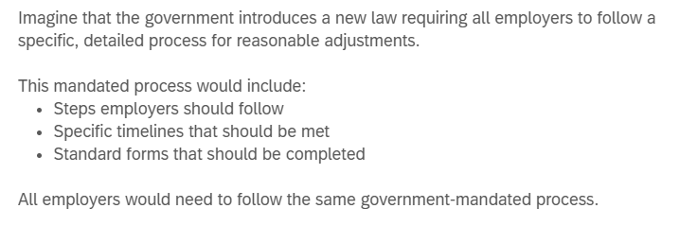
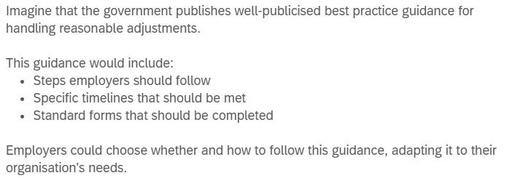
Vignette design
Using the same sample as Pilot #1, we randomised participants between two scenarios – a ‘law’ based scenario, and a ‘guidance’ based one

Slide 21
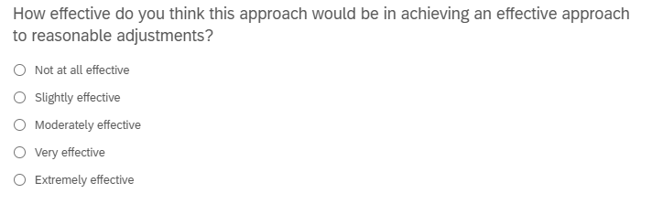
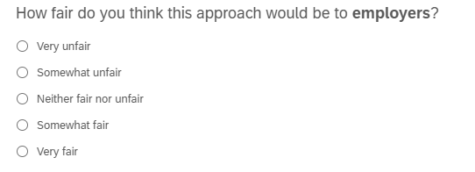
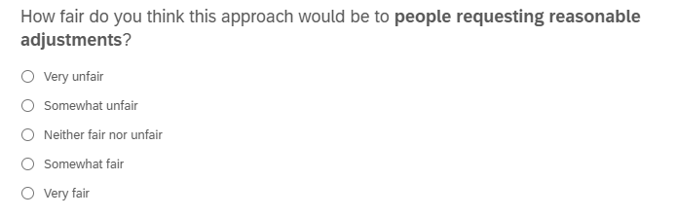
Vignette design
Participants were asked about the effectiveness of the approach, and its fairness to employers and people requesting adjustments

Slide 22
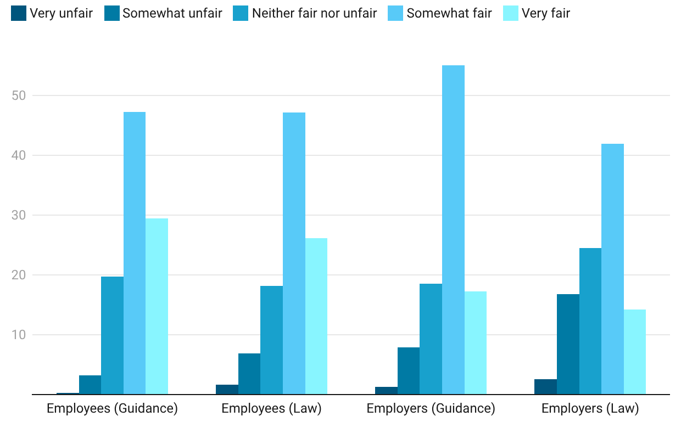
Vignette design
Perceived Fairness to Employers
Employees thought law would be fair and more effective – vice versa for employers
However, the only significant difference between the samples (p=0.040, employees, and p=0.008 for employers) was how fair guidance v. law would be for employers. Both saw law as significantly less fair to employers than guidance.

Slide 23
Limitations
Sample representativeness: The screening survey consists of an unrepresentative group of disabled respondents, which may limit generalizability to the broader population of disabled employees in the UK.
Self-selection bias: Online survey recruitment may attract respondents with stronger views or particular experiences with reasonable adjustment processes.
Employer sample scope: The employer sample is limited to those in HR or senior roles, which may not fully represent decision-making processes across all organizational levels.
Vignette methodology: The use of hypothetical scenarios may not fully capture real-world decision-making complexity and actual workplace experiences.

