Slide 1



Who we are, what we do
and how we can help

Slide 2
Who we are
What we do
The Systems Insight Team is a new
cross- government unit providing robust, systemic solutions to complex problems.
From the team who created the award-winning Net Zero Systems Tool, we have a proven record of applying systems thinking to real-world policy and delivery challenges.
We now operate as an in-house consultancy, providing analysis, advice and training to colleagues across government on a cost-recovery basis.
Get in touch if you’d like to talk to us about a project: netzerosystems@energysecurity.gov.uk
Innovative systems tools
Policymakers sometimes struggle to understand how complex systems knit together.
Our award-winning tools allow users to explore interconnectedness across large, complex systems and think through the impact of different policy options.
Cross-cutting systems analysis
Policy is frequently designed around organisational structures and policy boundaries.
Our analysis identifies interdependencies, explains the associated risks and opportunities, and provides frameworks to strengthen governance and delivery confidence.
Integrated systems training
Teams are often keen to use systems thinking but sometimes lack the capability and confidence needed to do so.
Our training caters for both beginners and experienced practitioners by offering an introduction to the basic concepts and deep dives into core techniques.

Slide 3
How you can work with us
We’re part of the Civil Service so other government teams can commission us easily, without the need for a complicated procurement process. The process typically begins with a conversation to clarify your needs. It can take as little as a week to scope and agree work.
Initial chat
Kick-off
Reporting
We schedule a call to understand your needs
We deploy a team of experienced staff to begin delivering for you
We provide a high-quality output, with sharp analysis and practical advice
Agreement
Delivery
Feedback
We agree an approach covering scope, timelines, deliverables, and costs
We carry out the agreed work, giving you regular updates and collaborating with you to adjust plans if needed
We ask for your feedback and discuss lessons learned

Slide 4
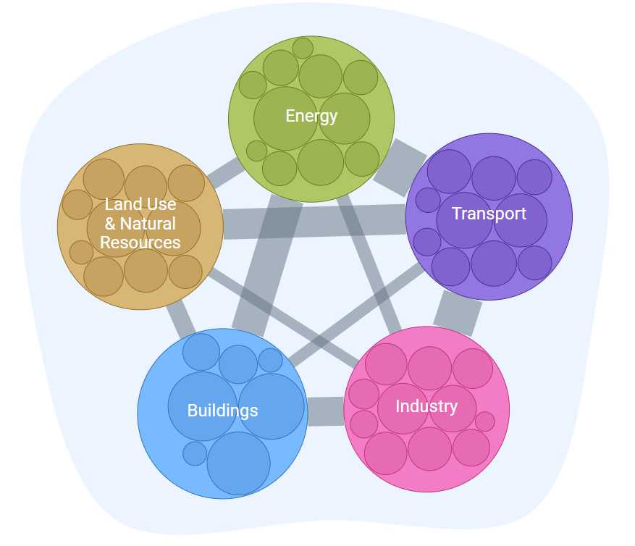
Tools
EXAMPLE
The Net Zero Systems Tool
Our sector leading tools help users understand how their complex systems knit together.
Systems Insight Tool: helps assess the wider impacts of policy choices and explore levers for policy outcomes
Systems Pathway Tool: helps explore the impact of delays or reductions of ambition to policies & milestones to huge strategic plans
The Net Zero Systems Tool, built using the Systems Insight Tool, is a revolutionary cross-government platform that helps net zero policymakers understand the complexity of their policy areas.
It brings together interdependencies across sectors so decisions can be made with a clearer view of the whole system:
Reveals ripple effects, risks, trade-offs, and co-benefits
Enables scenario testing and smarter x-govt. collaboration
~200-400 visits per month
Provides knowledge management function

Slide 5

EXAMPLE
Carbon Budgets & Net Zero Strategy
Analysis
Our team is equipped with a range of systems approaches to deliver the right analysis for the right problem:
Analysis to identify interdependencies, risks, and opportunities
Frameworks to strengthen governance and delivery confidence
Systems framing to support major strategies
We have brought systems thinking to the foreground of net zero strategy:
Set the tone in critical climate change policy publications such as the Net Zero Strategy and Carbon Budget Growth & Delivery Plan
Identified cross-cutting carbon emissions savings for Carbon Budget 6 previously un-accounted for
Developed an innovative Risk-Opportunity Analysis for the appraisal of the CB7 level - soon to be included into the Green Book

Slide 6

EXAMPLE
Cross-Government Training
Training
Our training helps upskill colleagues so they can confidently use systems thinking techniques themselves
Our Systems Thinking College course to build systems capability in your department.
Systems Leadership guidance
to support the development of internal champions
We have developed several training products to enhance capability across government:
Worked with Go-Science to develop the cross-govt. guidance for Systems Thinking & Systems Leadership
Established and Delivered a Systems Thinking College in DESNZ
Developed a framework to communicate the different parts of government where Systems Thinking can be embedded

Slide 7
Our award-winning work in DESNZ shows what a valuable role systems thinking can play in the policy process
We have received strong support
from some of the most senior officials
in government.
Our work across Net Zero has been acknowledged in a wide range of areas
“
The pathway to Net Zero is complex, and we need to understand how different factor, from energy types, to infrastructure needs, work together. [The Net Zero Systems Tool] helps us to think about the ‘big picture’ – understanding the economic, scientific, and people factors that we need to address to deliver the future of net zero
Sarah Sharples,
Former Chief Scientific Advisor, DfT
The prestigious OR Society President’s Medal
The GORS Award for Collaboration across Government Departments
“
The dataIQ award for
Environmental, Social, & Governance

Slide 8

Contact Us
If you have a complex challenge and you think we could help, get in touch
netzerosystems@energysecurity.gov.uk

