Slide 1

The Safe and Effective Use of AI in Education
Module 4: Use cases of Generative AI in education

Slide 2


The Safe and Effective Use of AI in Education module overview
Module 1: Understanding AI in education
Module 2: Interacting with generative AI in education
Module 3: Developing the safe use of generative AI in education
Module 4: Use cases of generative AI in education
The Safe and Effective Use of AI in Education: Leadership Toolkit
Module 4: Use cases of Generative AI in education
Notes:
This outlines where in the resources this presentation is in the sequence and also highlights the contents of the programme.

Slide 3
About this workbook
Welcome to the workbook. This workbook is part of The Safe and Effective Use of AI in Education online resources.
This workbook has been produced in PowerPoint format. To work through the activities you should move through the slides in order.
On the following slides you can expect to find:
Video presentations containing key information with accompanying transcripts
Slides consolidating summaries of the information presented in the videos
Activities to consolidate knowledge such as multiple-choice questions
Templates to enable you to reflect and plan to put this knowledge into practice in your setting
Any examples of AI use and specific tools referenced within these resources are for context only and do not imply endorsement or recommendation of any particular tool or approach from the Department for Education.
Module 4: Use cases of Generative AI in education

Slide 4


Objectives for the module
By the end of the module you will be able to:
Understand the opportunities generative AI presents to a wide range of use cases in education
Know how to select generative AI tools for specific purposes
Know how to prompt effectively
Know how to create an action plan for exploring AI use
Module 4: Use cases of Generative AI in education

Slide 5
Navigating Module 4: Use cases of generative AI in education
Evidence is still emerging on the impact of direct pupil use of generative AI and its role in learners’ development, the relationship of AI use to educational outcomes, and the safety implications of children and young people using this technology in the classroom.
We are working with the education sector, educational technology (edtech) industry, experts and academics to build evidence and support the education sector to use AI safely, responsibly and effectively.
From our research and engagement with the sector, we have learned that generative AI could be used for:
Creating educational resources
Lesson and curriculum planning
Tailored feedback and revision activities
Administrative tasks
Supporting personalised learning
Generative AI in Education, DfE, August 2025
When selecting generative AI tools it’s important that they meet the DfE: product safety standards.
Module 4: Use cases of Generative AI in education

Slide 6
Planning for engagement with Module 4: Use cases of AI in Education
Section | Slides | Relevance
Introduction to Module 4 | 7 | Everyone should watch this introduction
AI for Teaching and Learning | 10 | Relevance for all educators including teachers, lecturers and teaching assistants
AI for Inclusion and Accessibility | 31 | Relevance for all educators including teachers, lecturers and teaching assistants and any member of staff who is parent or student facing
AI for Administrative Tasks | 40 | Relevant for all members of staff in schools and colleges
AI for Business and Operations | 47 | Relevant particularly for school, college and trust business professionals and operations staff, but also for SLT and other leaders
Annex: Role-Specific use cases for business, operations and support staff | 70 | Examples of use cases for a wide range of support staff roles
Module 4: Use cases of Generative AI in education

Slide 7
Introduction to use cases of AI in education

Slide 8


Module 4 Video 1: Introduction to use cases of AI in education
Click here to watch:
Module 4 Video 1: Introduction to use cases of AI in education
Click here to read the transcript of:
Module 4 Video 1: Introduction to use cases of AI in education
There is further reading and viewing available on the Chartered College of Teaching site.
Module 4: Use cases of Generative AI in education

Slide 9
Use cases of generative AI
There is a wide range of AI tools available that can do a variety of tasks and are useful to us in different ways. We will introduce you to some use cases in the following three areas:
Teaching and learning
Inclusion and accessibility
Administrative tasks
Business and operations
Module 4: Use cases of Generative AI in education

Slide 10
Generative AI in teaching and learning

Slide 11
Module 4 Video 2: Generative AI in teaching and learning
Click here to watch:
Module 4 Video 2: Generative AI in teaching and learning
Click here to read the transcript of:
Module 4 Video 2: Generative AI in teaching and learning
There is further reading and viewing available on the Chartered College of Teaching site.
Module 4: Use cases of Generative AI in education

Slide 12
Teaching and learning
Generative AI tools can support teaching and learning in many ways. Here are just a few examples we have seen from the sector.
It’s important to always consider the pedagogical need ahead of the tool you are going to use; it won’t always be the right choice to use AI.
Ideas for lesson content and lesson structure
Long-term planning assistance
Formative assessment, such as quiz generation from specific content, offering feedback on errors
Generating text in a specific style, length or reading age
Generating images to support understanding of a concept or as an exemplar
Generating exam-style questions from set texts
Generating visual resources, such as slide decks, knowledge organisers, infographics
Audio resources from text, such as podcasts or verbal explanations
It is worth remembering that generative AI systems can generate content in the form of image, video, audio, music, code and other content types. Different approaches will be appropriate to the phase and subject you are teaching in your setting as well as the individual needs of your pupils or students.
Module 4: Use cases of Generative AI in education

Slide 13
Key questions to ask when considering uses
On the following slides you will find examples of AI use in teaching and learning based on examples that educators have shared with us. As you explore these, consider the following questions:
Would this be useful to me or my pupils/students in my setting?
How would I need to contextualise this example for my setting?
How does this example align with my setting’s teaching and learning policy?
How would I ensure that I’m protecting data and intellectual property?
How would I check the output for accuracy and bias?
How could I adapt the output for use in my setting?
Module 4: Use cases of Generative AI in education

Slide 14
Where does the thinking happen?
Below are examples of different thought processes that three teachers might go through when creating slides with AI. This highlights their decision-making and rationale for using AI or not. It’s useful to think carefully about any task you decide to do with AI and how it can support rather than replace your thinking.
Teacher 1 - an early career teacher (ECT)
“I have tried creating slides for my lesson using AI, but I don’t feel as prepared for the lesson. I realised that, as I create each slide, I consider how I’m going to teach and what I’m going to say at that point in the lesson. The creative task is part of my thinking process, so I don’t use AI for it.”
Teacher 2 - a middle leader
“I create my own lesson plans as I have experience of teaching these topics for several years now. However, I find that creating slides is a big job and I’m happy to outsource this to AI. I can also ask it to make my slides more accessible, incorporating dual coding, and clear and easy-to-read layouts that are well designed. I upload the lesson plan and ask it to create a slide-deck, then I tweak it to suit my teaching style.”
Teacher 3 - secondary English teacher
“I don’t need to use AI for the planning process as I already have collections of slides for the topics I teach from a bought scheme of work. But I do find AI useful to adapt resources quickly for different learner needs in class, as it lets me create a wider range of personalised resources that I didn't have time to do before I used AI. I always check the resource AI has created.”
Module 4: Use cases of Generative AI in education

Slide 15
Lesson planning
Learning Objectives
By the end of the lesson, students should be able to:
Describe photosynthesis in simple terms.
Identify the key components needed for photosynthesis.
Understand the word equation for photosynthesis.
Use key terms correctly.
Lesson Breakdown
Starter (10 mins) – Think, Pair, Share
Objective: Activate prior knowledge and engage all learners.
Display an image of a plant in the sun with arrows pointing to it from CO₂, water, and light.
Ask students: What do you think plants need to grow? (Think quietly → discuss with a partner → share ideas as a class).
TA supports pupils with learning needs by prompting with pictures/icons.
Introduce the lesson title and objectives.
Main Activities (35 mins)
1. Teacher Explanation & Demonstration (10 mins) – Photosynthesis Process
Objective: Introduce key terms and basic process.
Use a simple diagram on the board to explain:
  Plants take in carbon dioxide from the air, water from the soil, and use sunlight to make food (glucose).
  Oxygen is released as a waste product.
Demonstrate with a real plant:
  Shine a torch on a plant. Ask; what do you think will happen if we put this in a dark cupboard?
  Pour water into the soil and explain absorption.
Provide a simplified version of the explanation for the TA to reinforce with the students requiring support.
For information: Aila, from Oak National Academy, is designed to support teachers by helping to create high-quality, curriculum-aligned resources. While general AI large language models (LLMs) can generate teaching materials, the results may not fully align with the curriculum. Aila is specifically grounded in the National Curriculum in England, making it more likely to generate relevant content for teachers. It also encourages teachers to answer questions, increasing the level of context and detail provided.
In this example, a prompt has been used to create a lesson plan.
The output would then be checked for accuracy and appropriateness by the teacher and edited where necessary.
Prompt:
Create a lesson plan for a 60- minute lesson with 30 pupils. The pupils are 12/13 years old and they need to understand the basics of photosynthesis including keywords relevant to the National Curriculum in England. Suggest effective approaches that the TA can take with students who have a lower reading age, two have a reading age of 9 but a comprehension age of 10 and 11. Base strategies for inclusion on EEF guidance. I’ve attached the scheme overview for context.
Module 4: Use cases of Generative AI in education
Notes:
The prompt used to create the lesson plan on the right is shown here in the blue box.
Remember this is a starting point and the teacher would need to assess the output for suitability before using it.
This could be considered ‘draft 1’ as further prompts could tweak the output or it could be further edited manually until the teacher is happy with the plan.

Slide 16
Lesson planning continued…
2. Interactive activity (10 mins) – card sorting task
Objective: Reinforce key terms through sorting.
Students work in small groups to match words to pictures (e.g., ‘sunlight’ to an image of the sun, ‘chloroplast’ to a leaf).
Differentiation:
  Pupils with learning needs have colour-coded cards (e.g., green = plant parts, blue = gases, yellow = products).
  TA provides scaffolding with verbal prompts.
3. Word equation challenge (10 mins) – active learning
Objective: Understand the equation in a practical way.
Display the photosynthesis word equation:
Carbon dioxide + Water → Glucose + Oxygen (with light & chlorophyll)
Get students to act it out:
  Assign students roles: ‘sunlight’, ‘water’, ‘CO₂’, ‘chloroplasts’, etc.
  They physically move to ‘combine’ into glucose and oxygen.
TA ensures students with learning needs are included with adapted roles
(e.g., holding visual aids instead of reading aloud).
Plenary (15 mins) – quickfire quiz and exit ticket
Objective: Consolidate learning and check understanding.
1. Quickfire quiz (5 mins)
Ask questions like:
  What gas do plants take in?
  Where does photosynthesis happen in a plant?
  What do plants produce as food?
Use mini whiteboards so all students can answer at the same time.
TA supports students with learning needs by providing a word bank.
2. Exit ticket (10 mins) – ‘one fact, one question’
Each student writes down:
  One fact they learned.
  One question they still have.
TA helps those who struggle with writing by scribing or using sentence starters.
Differentiation and support
TA Support for students with reading difficulties:
  Simplified instructions.
  Colour-coded or pictorial resources.
  Word banks for key terms.
Stretch and challenge for high-attaining students:
  Introduce the concept of limiting factors (light intensity, CO₂, temperature).
  Ask why photosynthesis is important for humans (link to oxygen production and the food chain).
Don’t outsource all the thinking! Remember that this is just the starting point, and that any output needs to be adapted for your context and setting using your professional judgement. It’s important to understand what a high-quality lesson looks like to be able to evaluate the output for effectiveness. If you are training as a teacher, you may want to practice writing lessons yourself to get familiar with the process before using AI to support the process. Use your knowledge of students or pupils to ensure that the lesson will be precisely appropriate for the class.
Module 4: Use cases of Generative AI in education

Slide 17
Breaking down or translating written content
Consider if this level of scaffolding is useful for each individual learner. Some learners with English as an additional language (EAL) may not need the whole text translated in which case the example on the next page may be more effective for them.
This example is from KS4 Geography
Energy Sources
Energy sources are classified as renewable or non-renewable. Non-renewable sources like coal, oil, and natural gas take millions of years to form and release carbon dioxide when burned, contributing to climate change. They are finite and will eventually run out. Renewable energy sources include solar, wind, hydroelectric, geothermal, and biomass. These replenish naturally and produce less pollution. Solar and wind depend on weather conditions, while hydroelectric power uses moving water to generate electricity. Geothermal taps into Earth's heat, and biomass burns organic material. The UK is increasing renewable energy use to reduce reliance on fossil fuels and lower emissions. However, challenges include high costs, energy storage, and ensuring a constant supply. The future of energy depends on balancing sustainability, affordability, and reliability.
Energy Sources
We need energy to power our homes, schools, and transport. There are two types of energy sources: renewable and non-renewable. Non-renewable energy, like coal, oil, and gas, comes from the Earth. It takes millions of years to form and will one day run out. When burned, it makes pollution that harms the planet. Renewable energy comes from things that won’t run out, like the Sun, wind, and water. Solar power uses sunlight, wind power uses the wind, and hydroelectric power uses flowing water. Geothermal energy comes from heat underground, and biomass comes from burning plants and natural waste. The UK is using more renewable energy to help the environment. But some types depend on the weather and can be expensive. In the future, we need energy that is clean, cheap, and always available.
Les Sources d'Énergie
Nous avons besoin d’énergie pour alimenter nos maisons, nos écoles et nos transports. Il existe deux types de sources d’énergie : renouvelables et non renouvelables. L’énergie non renouvelable, comme le charbon, le pétrole et le gaz, vient de la Terre. Elle met des millions d’années à se former et finira par disparaître. Lorsqu’on la brûle, elle produit de la pollution qui abîme la planète. L’énergie renouvelable vient de sources qui ne s’épuiseront pas, comme le Soleil, le vent et l’eau. L’énergie solaire utilise la lumière du soleil, l’énergie éolienne utilise le vent et l’hydroélectricité utilise l’eau qui coule. L’énergie géothermique vient de la chaleur souterraine, et la biomasse provient de la combustion de plantes et de déchets naturels. Le Royaume-Uni utilise de plus en plus d’énergies renouvelables pour protéger l’environnement. Mais certaines dépendent de la météo et peuvent être coûteuses. À l’avenir, nous aurons besoin d’une énergie propre, peu chère et toujours disponible.
Prompt: ‘I would like this text to use simpler language’
Prompt: ‘Translate
this into French’
Module 4: Use cases of Generative AI in education
Notes:
In this example, text from a geography lesson (on the left) has been copied into a generative AI tool with the prompt: ‘I would like this text in a reading age of 7’.
The output is shown in the central column.
This central text is then inputted again alongside the prompt: ‘Translate this into French’
We can then see the text has been translated clearly in the column on the right.

Slide 18
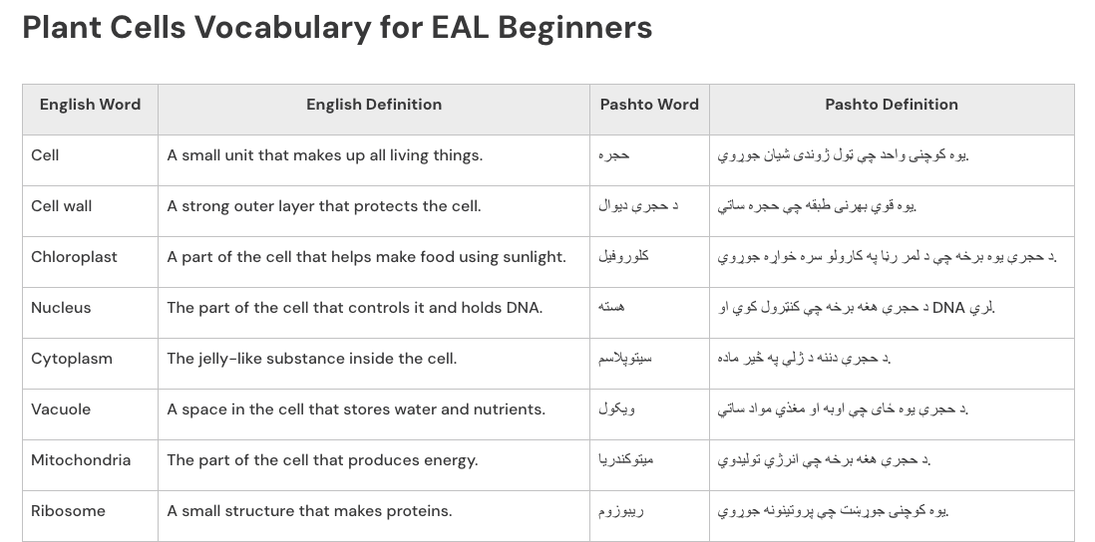
Scaffolding for a learner with English as an Additional Language
If a learner with EAL had been progressing and now could read some English as well as being confident at reading in their primary language, you may just want to provide a crib sheet for some of the more complex and key vocabulary.
The level of support and scaffold offered should be specific to the individuals needs, considering their level of proficiency with English and their level of literacy in their own language and in English.
You should consult with your EAL lead if you need further information on the student/pupil.
This example is from KS3 Biology
Prompt: Create a crib sheet for my students with Pashto as their first language for the attached worksheet (upload worksheet), translate and explain the more complex and key vocabulary with a translation into Pashto.
Module 4: Use cases of Generative AI in education

Slide 19
Early years – a personalised phonics story
With all generative AI outputs, the content will need checking for accuracy and appropriateness, such as changing the US spelling to UK spelling. In this case the class teacher will need to align the output with the needs of the pupils and the phonics scheme they are following in their setting. It does not replace a detailed phonics scheme.
Theo’s Shiny Thrill
Theo the thin little mouse lived in a cozy burrow beneath a thick oak tree. One shiny morning, he scurried outside and spotted a shimmering object near the thorny bushes.
“What’s that?” Theo thought, his whiskers twitching. He shuffled closer and gasped – it was a shiny silver thimble!
Excited, Theo tried to shove it along the path, but – thump! – it tumbled into a shallow puddle. “Oh no!” Theo shrieked.
Just then, a friendly thrush fluttered down. “Need a shove?” she chirped. Together, they nudged the shimmering thimble home.
Back in his burrow, Theo placed his treasure on a shelf. “My thimble throne!” he giggled, shivering with delight.
From that day on, whenever Theo saw the shimmer of his shiny thimble, he thought of his thrilling adventure with the kind thrush.
Prompt: create a short story of 150-ish words using the phonics 'sh' and 'th' about a small mouse named 'Theo'. Ensure it follows the attached (upload) approach to phonic learning that our school uses.
Module 4: Use cases of Generative AI in education

Slide 20
Early years – activity ideas
Prompt: Create a short game that a four-year-old could play to help them learn their first letters: S A T P I N. Keep on making suggestions until you create one that I think will work for my pupils. It should employ active, play-based learning based on the attached approach.
Here's a fun and engaging phonics game for a 4-year-old to help them learn their first letters: S, A, T, P, I, N.
Game: "Silly Sound Safari!"
👦🏽 Ages: 4+
🕒 Time: 5–10 minutes
📖 Focus Letters: S, A, T, P, I, N
🎉 Skills Practiced: Letter recognition, phonics, vocabulary
How to Play
1️⃣ Set the Scene:
Tell the child: "We’re going on a silly sound safari! We need to find things that start with these magic letters: S, A, T, P, I, and N!"
2️⃣ Treasure Hunt:
Give them a small basket (or a space on the table) and challenge them to find objects around the room that begin with each sound. For example:
S – Spoon, sock, sun (picture)
A – Apple, ant (toy), apron
T – Toy, teddy, toothbrush
P – Pencil, peg, plate
I – Inchworm (toy), ink, insect (drawing)
N – Nut, necklace, newspaper
(If indoors, you can use picture cards instead of real objects.)
3️⃣ Super Sound Sorting!
Lay out the letters S, A, T, P, I, N on the floor (written on paper or blocks).
The child places each item next to the correct letter and says the sound:
"Sss for sock! T-t-t for teddy!"
4️⃣ Action Round! (Optional)
For extra fun, have the child act out an action for each letter.
For example:
S – Slither like a snake
A – Arms up like an alligator
T – Tiptoe like a tiger
P – Pretend to pop like popcorn
I – Itch like an insect
N – Nod like a night owl
5️⃣ Victory Dance!
Once they’ve sorted all their objects, celebrate with a silly victory dance!
This game is playful, hands-on, and multisensory, making it perfect for 4-year-olds learning their first phonics sounds.
Would you like a printable version of the letter cards? 😊
Module 4: Use cases of Generative AI in education

Slide 21
College students using an LLM provided by the college for research
In this case the Extended Project Qualification (EPQ) teacher supports learners to research using an LLM provided by the college that meets the DfE’s product safety standards. The use of the LLM is for research purposes and the students are aware that they must verify facts and credit the use of AI in their work.
Research Questions to Explore:
1. Definitions and Foundations
What are the academic definitions of "society" and "culture"?
How have these definitions evolved over time and across disciplines?
Are there universally accepted definitions, or do they vary by context?
2. Historical and Theoretical Perspectives
How have classical sociologists (e.g. Durkheim, Weber, Marx) approached the concepts of society and culture?
What are the main theories that explain the relationship between society and culture?
3. Structure and Function
In what ways do society and culture influence or shape one another?
4. Examples and Case Studies
Can you identify a society where subcultures challenge the dominant culture?
How do different societies express similar cultural ideas (e.g. family, religion) in different ways?
What happens when societies with different cultures interact (e.g. colonisation, immigration, globalisation)?
5. Contemporary Relevance
How have modern phenomena like globalisation, the internet, or migration blurred or reshaped the lines between society and culture?
Are new digital cultures forming that challenge traditional societal structures?
How do different academic disciplines (e.g. sociology vs anthropology) treat the concepts of society and culture?
Prompt:
I'm an EPQ student who has chosen the following question: "What’s the difference between society and culture?". I don't want you to answer the question but instead formulate a series of questions that I need to research and suggest places that I can find relevant research.
Module 4: Use cases of Generative AI in education

Slide 22

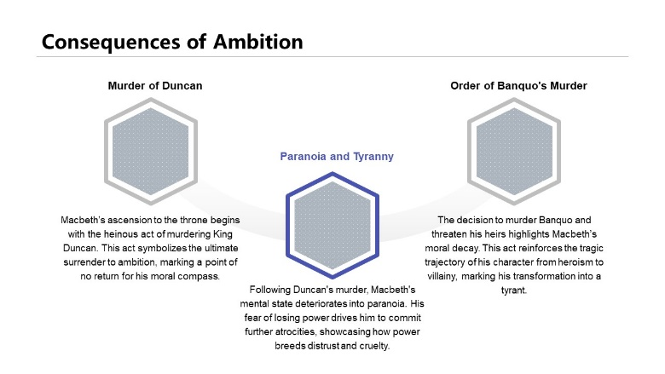

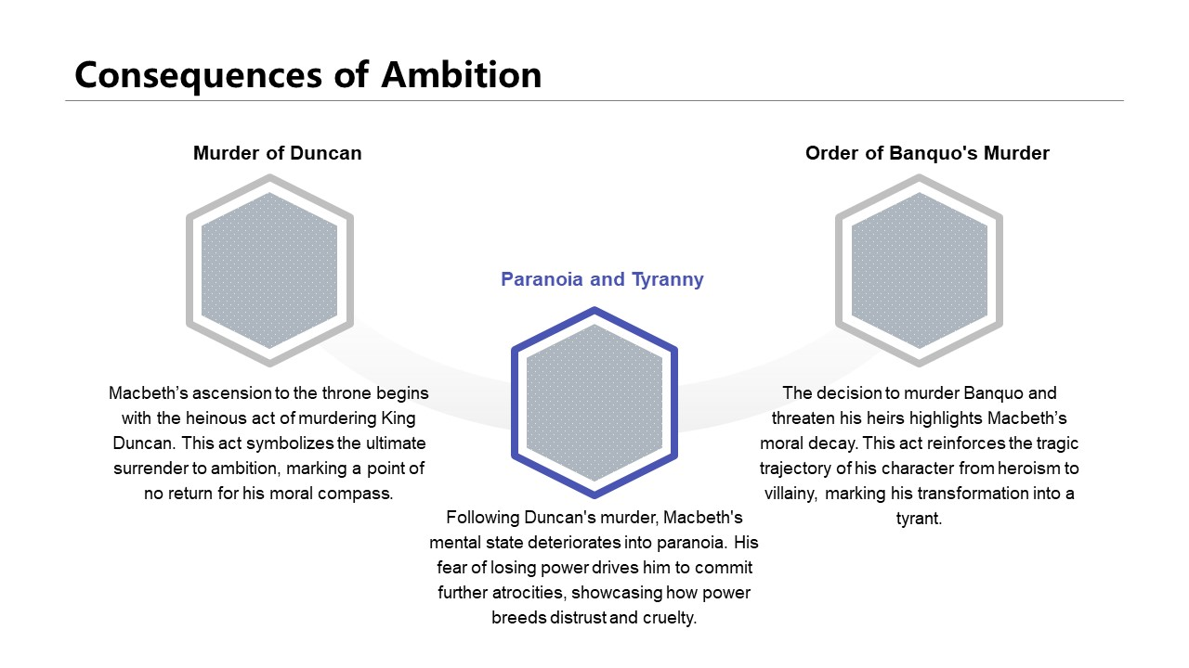
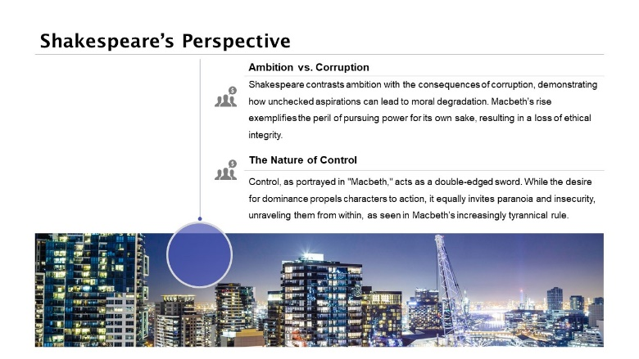
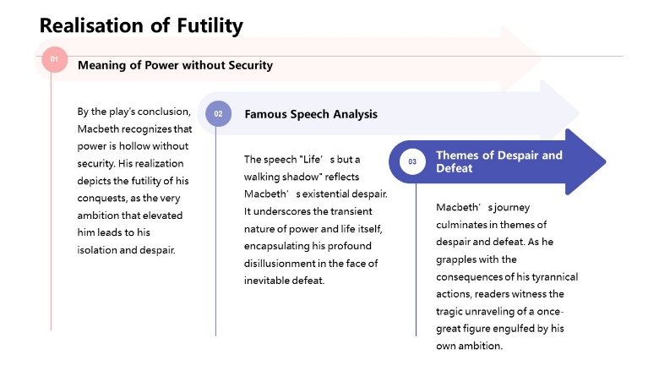
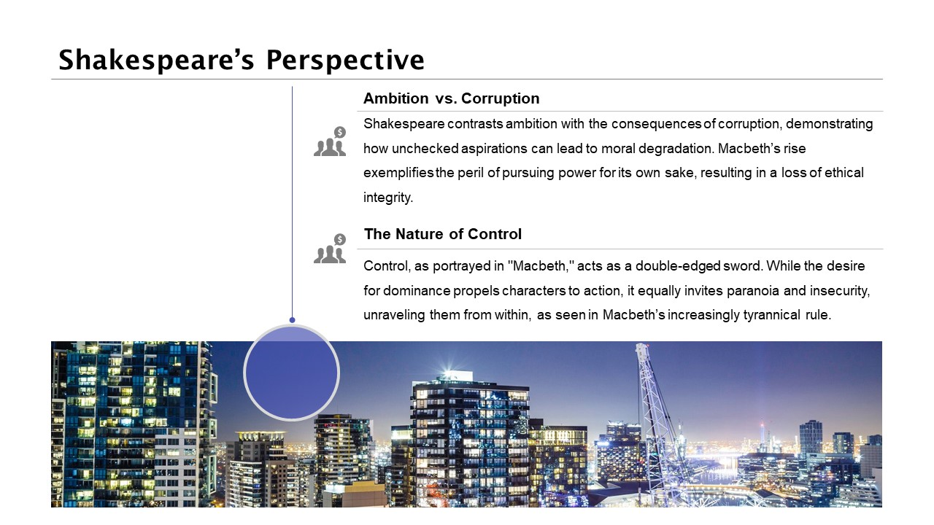

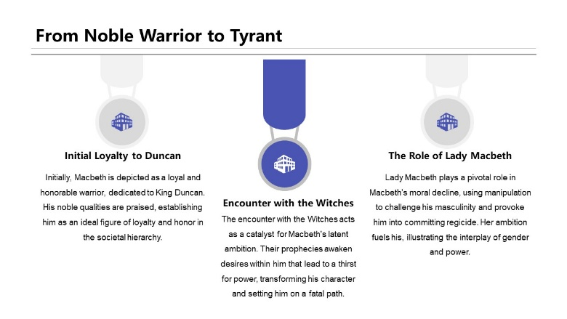
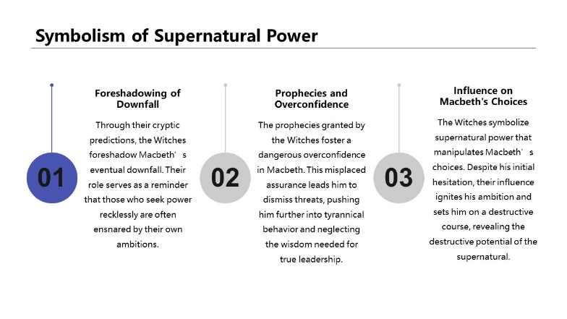

Creating slides from text
The text below was given to an AI slide creator tool
Shakespeare’s Presentation of Power in Macbeth
Shakespeare explores the theme of power in Macbeth through ambition, corruption, and control. At the start, Macbeth is a noble warrior, loyal to King Duncan. However, after hearing the Witches’ prophecy, his desire for power grows. Lady Macbeth manipulates him, questioning his masculinity, which pushes him to murder Duncan and seize the throne. Once king, Macbeth becomes paranoid and tyrannical. He orders the murder of Banquo and Macduff’s family, showing how power corrupts him. Shakespeare presents power as something that destroys morality - Macbeth shifts from a brave hero to a ruthless dictator.
The Witches symbolise supernatural power, influencing Macbeth’s choices. Their prophecies make him overconfident, leading to his downfall. Shakespeare suggests that power without wisdom is dangerous. In contrast, Malcolm represents rightful leadership. Unlike Macbeth, he is cautious and tests Macduff’s loyalty before reclaiming the throne. This contrast shows Shakespeare’s belief in the importance of legitimate power and the consequences of abusing it.
By the end, Macbeth realises that power is meaningless without security. His famous speech “Life’s but a walking shadow” reflects his despair as he faces defeat. Shakespeare ultimately presents power as destructive when pursued selfishly but restorative when used justly.
Module 4: Use cases of Generative AI in education
Notes:
Creating slides from text is very useful for teachers and can play a part in workload reduction.
It is important that the slides are checked thoroughly before use and edited where appropriate.

Slide 23
Quizzing and formative assessment
1. Types of Forces
Which of the following is a non-contact force?
A) Friction
B) Tension
C) Gravity
D) Normal Contact Force
2. Newton’s Second Law
A car of mass 1,200 kg accelerates at 3 m/s². What is the resultant force acting on the car?
(Use F = ma)
3. Hooke’s Law
A spring has a spring constant of 50 N/m. If the spring is stretched by 0.2 m, what is the force applied to the spring?
(Use F = kx)
1. Types of Forces
✅ C) Gravity (Correct!)
Gravity is a non-contact force because it acts at a distance, unlike forces such as friction or tension that require physical contact.
2. Newton’s Second Law
Formula: F = ma
F = 1200 × 3 F = 3600 N
✅ Answer: 3600 N (Correct!)
3. Hooke’s Law
Formula: F = kx
F = 50 × 0.2 F = 10 N
❌ Your answer was 60 N – the correct answer is 10 N.
(Maybe you used the wrong value for k or x?)
Prompt:
Ask me three questions about forces from the attached GCSE Physics lesson.
Answers:
C
3600 N
60N
Module 4: Use cases of Generative AI in education
Notes:
Generative AI can be used for quizzing and feedback.
In this example, the teacher has asked for 3 questions on a specific topic and then enters in a second prompt with some answers to receive feedback.

Slide 24

Sixth form or college, preparing for resits in Sociology
In this example the teacher has used generative AI to create a resource to aid revision of a key topic in Sociology for students preparing for resits. They have generated a podcast from trusted resources created by the teacher. They have customised the podcast to make it more useful using a prompt. It only forms a part of the revision strategies for this cohort.
Prompt:
Create a revision podcast from the materials, it is for students preparing for resits, ensure the materials are presented clearly, that you consolidate what you have said regularly and present questions where the student can pause, answer the question and then check their answer.
When inserting text into an AI tool that was written by someone else you must be confident that you are not infringing intellectual property laws. Ensure you select a tool that does not use the material you have uploaded to train the model.
Module 4: Use cases of Generative AI in education
Notes:
In this example the teacher has used generative AI to create a resource to aid revision of a particular topic in a fun and engaging way.
The audio file has been cropped so this is not the whole podcast.
Audio transcript:
Hey, welcome back to the Deep Dive. We're zeroing in on something super important today, really solidifying your understanding of key sociological theories.
Yeah, definitely.
Think of this as like your ultimate study session, specifically designed to boost your confidence for those A-level sociology residents. We want to make sure these concepts really stick.
Exactly. And it's not just about, you know, memorizing definitions. It's more about understanding how these theoretical frameworks help us analyse the world around us. Right. So, we'll be covering structural theories that's functionalism, Marxism, neo-Marxism, and feminism.
Okay.
Then we'll shift to social action theories, symbolic interactionism, labelling theory, phenomenology, and ethnomethodology.
Got it.
And we'll also explore postmodernism and modernity, late modernity. Then finally kind of pull it all together with the comparison.
Awesome. And the way we'll do it, we're breaking down the core ideas, refreshing your memory, and giving you chances to actively check your knowledge as we go.
That's the plan.
We'll be pausing with questions. That's your cue to pause the recording, maybe jot down some notes, and then jump back in to compare your answer. Active participation is key here. Ready to get started with structural theories?
Let's do it. So structural theories, they focus on the big picture, the large-scale social structures that, well, shape our lives.
Like the skeleton of society.
Yeah, kind of. Think of society as this complex system, and these theories are trying to understand how that system works as a whole. We'll kick off with functionalism.
Okay, functionalism. That's the one that sees society as this interconnected system, almost like a human body.
Yeah.
The organic analogy, right?
Precisely. And the big emphasis here is on value consensus, this idea that A shared set of values and norms holds everything together, creating social order, stability.
So, we all broadly agree on what's important.
That's the core idea. Functionalists look at how different social institutions, you know, education, family, religion, how they perform as central functions to maintain that stability.
Right. So, the family socializes kids, education teaches skills, religion maybe gives moral guidelines, that sort of thing.
Exactly that. Each part has a job to do for the good of the whole. Now, within functionalism, we've got some key thinkers. Emile Durkheim, for instance.
Durkheim, collective conscience.
Yep, the collective conscience, those shared beliefs and moral attitudes that act like a social glue. He also talked about anomie.
Anomie. That rings a bell. It's when things break down, isn't it? Like normlessness.
Spot on. A state where social regulations weaken and people feel adrift, disconnected. You could maybe even argue social media sometimes fosters a sense of anomie today, you know, challenging traditional norms.
Hmm. Interesting point. Okay. So, who else? Telcott Parsons.
Parsons. Yeah. He developed a really, uh, elaborate framework, the AGIL schema. AGIL. Okay. What does that stand for? That sounds a bit technical. It can seem that way, but it's fairly logical. It stands for adaptation, goal attainment, integration, and latency for basic needs or functional prerequisites that any social system has to meet to survive.
Okay, break that down with an example.
Sure. Think of, say, the education system again. To adapt, A, it needs resources, funding, buildings, teachers.
Makes sense?
Its goal, G, is attainment educating students, giving qualifications.
Right.
Integration involves fostering a sense of community, making sure the different parts work together, teachers, students, admin.
Okay.
And latency, that was sometimes called pattern maintenance, is about maintaining the culture, passing on values, motivating people to play their roles.
Gotcha. So AGIL is like a checklist for how systems keep going. And Merton, Robert Merton.
Merton added a useful layer. He distinguished between manifest functions and latent functions.
Manifest and latent, so intended versus unintended consequences.
Exactly. Manifest functions are the recognized and intended outcomes of any social pattern. Latent functions are the unrecognized and unintended ones.
Like the manifest function of school is education, but a latent function might be creating friendships or even keeping young people off the streets.
Perfect example. Or maybe reinforcing social class differences unintentionally?
Okay, I think I'm getting the hang of functionalism.
Great. So perfect time to pause and check your understanding.
Okay, listeners, here's pause for listener question one. According to functionalists, what are two key functions performed by the education system? Pause the recording now, think it over, and come back when you're ready.
Sure, pause.
All right, welcome back. So, two key functions. Well, functionalists might point to transmitting society's shared norms and values that value consensus idea.
Yep, socialization is key.
And also teaching specific skills needed for the economy, equipping people for work roles.
Exactly. Selecting and allocating people into roles. How did you do? that helped clarify things. Now, let's switch gears completely. Marxism.
Right. From consensus to conflict.
Absolutely. Marxism is fundamentally about conflict, specifically class conflict. Society isn't harmonious. It's divided.
Into the bourgeoisie and the proletariat, owners and workers.
That's the core division. which was he owning the means of production, the factories, the land, the capital, the proletariat only own their labour power, which they have to sell to survive.
And Marx saw this as inherently exploitative, didn't he?
He did, because the workers create the value, but the owners take the profit, the surplus value. This leads to fundamental conflict.
Okay, and what about the base superstructure model?
Ah, yes. crucial concept. For Marx, the base is the economy, the forces and relations of production, how things are made, who owns what.
The foundation.
Exactly. And the play structure is everything else built on top of that base. The state, law, education, family, religion, culture, ideas.
And the idea is the superstructure supports the base.
Precisely. It serves to maintain and legitimize the economic base and the power of the ruling class, the bourgeoisie. It reflects their interests.
So, education, for instance, would reproduce class inequality according to Marxists.
That's the argument. We'll come back to that. Other key ideas are false consciousness.
False consciousness. Like the workers don't realize they're being exploited. They buy into the ruling class ideas.
Yeah, it's a state where the subordinate class accepts the ideology that justifies their own oppression. They don't see the reality of their situation.
Tricked, almost.
In a way. And then there's alienation.
Alienation. Feeling separated.
Yes. Workers under capitalism feel alienated or separated from the product they make, from the process of work itself, from their fellow workers, and even from their own essential human nature or potential. Work becomes meaningless. Just a means to an end.
That sounds pretty bleak. Any other key Marxists we should mention here? Althusser.
Louis Althusser, yes. A French Marxist. He talked about the state maintaining control through two apparatuses, the repressive state apparatuses or RSA.

Slide 25



Visual resource generation
Occasionally, images can represent biases present in the data the model has been trained on. It is important to check for bias and make sure your prompt ensures diversity of representation.
Images can be used as a catalyst for learning in several different ways. These examples have been created by the teacher for use in lessons.
For class discussion, or to spark debate:
To use as exemplars and examples for creative work:
As catalysts for creative work:
Teacher: “How might Romeo and Juliet’s lives have been different if they lived today?”
Teacher: “We are going to create posters for a sustainability competition.”
Teacher: “Can you write the first chapter of this story?”
Prompt: Romeo and Juliet in modern dress conducting their relationship through social media
Prompt: A colourful poster to promote considering sustainability created by a child aged 8.
Prompt: A little boy looking out of his window at night and witnessing magic.
Module 4: Use cases of Generative AI in education
Notes:
Please note, these examples of image generation are for use in the classroom by the class teacher. Images created by AI should not be shared widely, e.g. on the school or college website because of risk of secondary copyright infringement. For our examples we have used a tool that is only trained on creative common images.
In the first example, the teacher wanted to engage the class in a discussion about how Romeo and Juliet would have felt if their love story had played out today. The teacher is able to generate an image to support this discussion with the following prompt: Romeo and Juliet in modern dress conducting their relationship through social media. The image can then be shared on the class screen to encourage discussion.
In the second example the class teacher wanted to inspire students in their class to create a hand drawn poster but does not have any examples from previous students as this is the first year the competition has run in school. Using the following prompt: A colourful poster about sustainability created by an eight year old at school. The teacher is able to create exemplar(s) that can be shown to their year 3 class to inspire them to produce their own versions.
In the third example the image has been created by the teacher for use as a catalyst to a creative writing task.

Slide 26
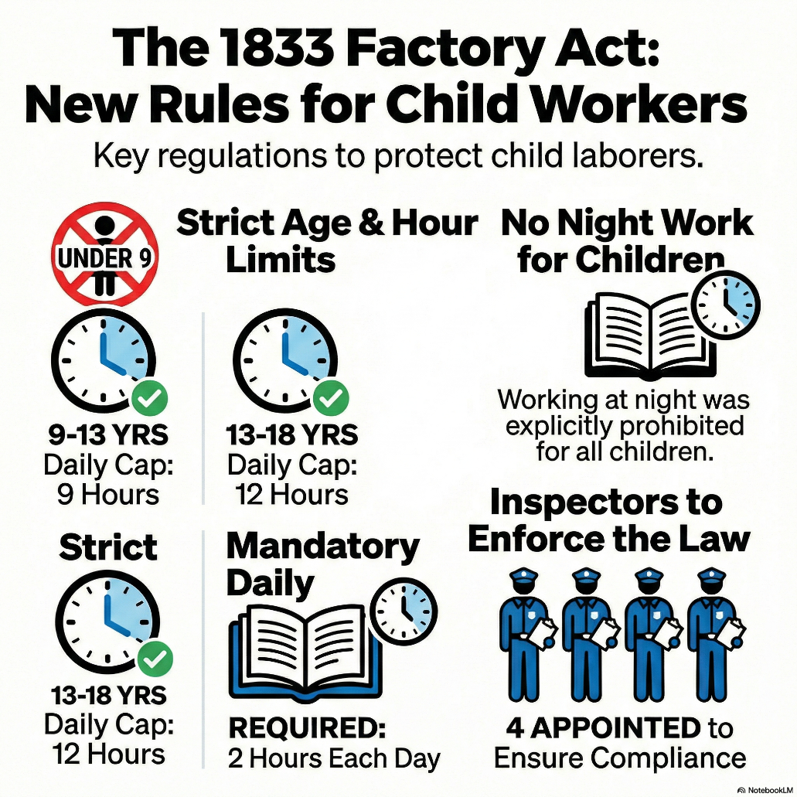
Infographics
Some generative AI tools can be used to help with dual coding, such as converting text-based information into infographics. This example is a graphic generated from text from the National Archive’s education resources.
Source text:
In 1833, the Government passed a Factory Act to improve conditions for children working in factories. Young children were working very long hours in workplaces where conditions were often terrible. The basic Act was as follows:
no child workers under nine years of age
employers must have an age certificate for their child workers
children of 9-13 years to work no more than nine hours a day
children of 13-18 years to work no more than 12 hours a day
children are not to work at night
two hours schooling each day for children
four factory inspectors appointed to enforce the law
However, the passing of this Act did not mean that the mistreatment of children stopped overnight. Use the original sources in this lesson to investigate how far the 1833 Factory Act solved the problems of child labour.
Module 4: Use cases of Generative AI in education

Slide 27
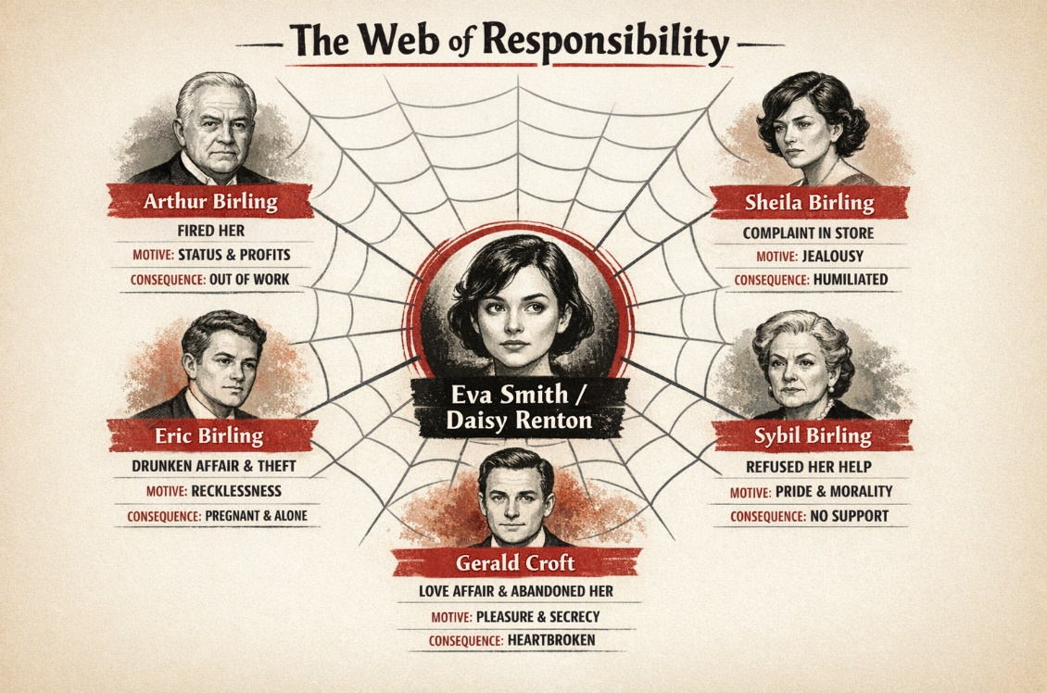

Infographics continued
Prompt: For An Inspector Calls; create an infographic showing a spider-web diagram with Eva Smith/ Daisy Renton at the centre and the other characters radiating outwards. Each connection should show actions, motivations and consequences, visually reinforcing Priestley’s message that responsibility is shared and no action exists in isolation.
Prompt: Create an infographic showing the events of An Inspector Calls as a spiral timeline, beginning with a celebratory dinner and tightening as each confession is revealed. Include who speaks, what is uncovered, and how the mood shifts, ending with the shocking final phone call.
Module 4: Use cases of Generative AI in education

Slide 28
Sixth form or college, preparing for resits in English Literature (set text: The Great Gatsby)
In this example, the teacher has used generative AI to create a resource to aid revision of a set text in English Literature (The Great Gatsby) for students preparing for resits. They have generated a podcast from trusted resources created by the teacher. They have customised the podcast to make it more useful using a prompt. It only forms a part of the revision strategies for this cohort.
Prompt:
Create a revision podcast from the materials, it is for students preparing for resits, ensure the materials are presented clearly, that you consolidate what you have said regularly and present questions where the student can pause, answer the question and then check their answer.
When inserting text into an AI tool that was written by someone else you must be confident that you are not infringing intellectual property laws. Ensure you select a tool that does not use the material you have uploaded to train the model.
Module 4: Use cases of Generative AI in education
Notes:
In this example, the teacher has used generative AI to create a resource to aid revision of a particular topic in a fun and engaging way. Audio can be generated in different languages. The audio clip has been edited and shortened and is for illustrative purposes only.
Audio transcript:
This is the brief on the themes of The Great Gatsby. Now, you might be tempted to view F. Scott Fitzgerald's masterpiece as just a tragic little romance, but look closer, and you'll spot a rather ruthless dismantling of the 1920s Jazz Age and all its supposed optimism. First, we're looking at the absolute death of the American dream. Unlike the hopeful rags to riches tales before it, Fitzgerald paints this dream as completely unattainable. You see, think of our main character, Gatsby, not as some great hero, but as a false prophet. And that famous green light? Well, it isn't just a beacon. It's a symbol of an unrealizable goal that only ever leads to profound corruption. Second, we have the inescapable trap of class permanence. The novel draws a brilliant razor-sharp line between the entrenched power of old money and new money upstarts like Gatsby. The stark reality is that you simply cannot buy your way out of the station you were born into. Even with a massive fortune, Gatsby remains socially inferior to the established elite because, quite frankly, class entirely Trump's wealth. Finally, consider the intense anxieties surrounding identity and status. Take his love interest, Daisy, for instance. She represents the modern flapper girl, but lacks real agency, functioning merely as a trophy for Gatsby. And this societal fear absolutely extends to race. Daisy's husband, Tom Buchanan, clings to horrific white supremacy views because he's terrified of being displaced by new immigrants challenging the old guard. Ultimately, the novel argues that despite the dazzling surface glitter of the Jazz Age, Americans are trapped by rigid social structures, forever chasing a dream that doesn't actually exist. And that, I'm afraid, is the harsh reality behind the romance.

Slide 29
Audio outputs and podcasts – T-Level
Learning material from T-Level; Design, Surveying and
Planning for Construction
The Construction (Design and Management) Regulations 2015 (CDM 2015) form the primary legal framework governing health and safety on construction projects across Great Britain, regardless of size or complexity. The regulations promote a proactive approach to risk management, requiring hazards to be identified and addressed early in a project’s lifecycle to protect both workers and the public.
CDM assigns clear responsibilities to defined ‘duty holders’, with each party legally accountable for fulfilling their own role. Clients must ensure suitable arrangements are in place to manage projects safely, including allocating sufficient time and resources. Where more than one contractor is involved, clients must appoint a Principal Designer to plan and coordinate health and safety during the pre-construction phase and a Principal Contractor to manage safety during construction. Designers must eliminate or reduce risks through safe design decisions, while contractors and workers must follow site rules, cooperate with others and report hazards.
Compliance depends on several key documents. Pre-construction Information, supplied by the client as soon as practicable, outlines existing site risks such as asbestos or underground services. A Construction Phase Plan is required for every project and must be in place before work begins; it explains how safety will be managed on site. For projects involving multiple contractors, a Health and Safety File must also be produced, containing information needed for safe future maintenance or alterations.
The Health and Safety Executive enforces CDM 2015 and can issue enforcement notices or prosecute where duties are breached.
Prompt: Create a podcast to help students understand this content, be clear and consolidate knowledge as you go through, summarising key points.
When inserting text into an AI tool that was written by someone else you must be confident that you are not infringing intellectual property laws. Ensure you select a tool that doesn’t train off the material that you upload.
Module 4: Use cases of Generative AI in education
Notes:
For more complex topics and older students certain AI tools can create podcasts from text provided to it. Providing students with content in this way could have potential impact for engagement as well as accessibility for certain learning needs.
When considering tools like this, make sure that you are confident the tool does not train on the inputted data as this could lead to a breach of copyright legislation.
Audio transcript:
So, let's start with the big picture then. Before 2015, we had the older 2007 regulations.
It did.
Why did they even change it? Was the old way just broken?
Well, it wasn't that it wasn't working, but it was incredibly bureaucratic. The 2015 update was really about simplification. It was about focusing on what actually matters on the ground. The sources we're looking at today highlight this massive shift in philosophy. The core of CDM 2015 isn't about the paperwork itself. It's about being proactive.
Proactive. Okay, let's dig into that word. Because I mean, in my head, safety usually feels really reactive.
How do you mean?
You know, like a guy trips over a loose cable, hurts his ankle, and then suddenly everyone on site has to attend a two-hour seminar on cable management the next morning.
Yes, that is the classic old school mentality.
Right.
Accident happens, fix the problem.
Right.
But CDM 2015 entirely flips that timeline. It asks the question, why was the cable there in the 1st place? Why did we design A walkway that crossed a major cable run? The goal is to identify the hazards and manage the risk before a single shovel even hits the ground.
So, we're essentially trying to predict the future.
We're trying to design out the danger.
Design it out.
Exactly. If you can change a drawing on a computer screen to remove a risk, it costs practically nothing and it saves lives. But if you wait until the steel is actually being erected, to realize there's a huge safety issue.
And it's expensive.
It's expensive, it's dangerous, and it's massively stressful for everyone involved.
That makes a lot of sense. Now, before we get into the whole who does what part of the regulations, I need to ask about the scope.
Sure.
Because I feel like whenever we talk about regulations, people just tune out. They think, oh, this is for the guys building a skyscraper in London or a new terminal at Heathrow.
Right, the mega projects.
Yeah. Does this actually apply to the smaller guys? Like the Is there a local builder down the street doing a kitchen extension?
This is the first-place people get tripped up. And if you're listening, pay attention to this. The regulations apply to all construction projects in Great Britain.
All of them.
All of them.
Wait, even if I'm just getting my driveway paved?
The principles absolutely apply, yes. There are no exemptions based on the size of the job. Wow. Whether you're building a nuclear power station or you're just knocking through a wall for an open plan living room, CDM 2015 is in play. Now, obviously, the scale of the compliance looks very different.
You don't need a 100-page manual for a driveway.
Exactly. But the legal duties don't just vanish into thin air, because the budget happens to be small.
That is such a crucial takeaway for any students tuning in. You might start your career working on really small residential jobs, thinking you can just fly under the radar.
But you can't.
According to this, you are on the hook from day one.
Absolutely. The law doesn't care about the size of the project. It cares about the risk to human life.
Okay, so we know it applies to everyone. Now we need to talk about the cast of characters. The regulations use this specific term, duty holders.
Yes.
It sounds very formal.
It is formal, but it's totally necessary. Because on a construction Chaos is the real enemy.
Oh yeah.
When something goes wrong, you so often hear, oh, I thought he was doing that, or that wasn't my job, I thought the sparky was handling it.
The classic passing the buck.
Exactly. So CDM 2015 assigns specific legal responsibilities to clearly define roles. It essentially forces everyone to stay in their lane, but it also ensures every single lane is covered.
Let's start at the top of the food chain then. The client. Now, traditionally, the client is just the person with the cheque book, right?
That's the overview, yes.
They hire the experts to do the actual work. Like, here's a million pounds, build me a library, call me when you're done.
And that exact attitude is what CDM 2015 is trying to kill off.
Really.
Yes. The whole ignorance defence is dead. The regulations state very clearly that the client has legal safety duties. They have to ensure that suitable arrangements are in place to manage the project safely.
But wait, playing devil's advocate here for a second. If I'm a client, I might be a tech company CEO or a school board.
Right.
I don't know the first thing about structural engineering or scaffolding. How on earth can I be legally responsible for site safety?
Well, you aren't expected to know how to actually build a brick wall, but you are expected to set the overarching conditions that allow that wall to be built safely.
Okay.
The source material specifically mentions that the client must allocate sufficient time and resources.
Time.
Yes.
That's the real friction point, isn't it? Because every single client wants their project finished yesterday.
Precisely. Let's say you're a client and you demand a project be finished in three weeks.
Right.
But literally. any competent builder will tell you it's a six-week job to do it safely. If you force that three-week deadline anyway and an accident happens because the guys were rushing.
Then the client is in trouble.
You as the client can absolutely be held liable. You created the unsafe condition by withholding the necessary time.
That is huge. It basically gives the project team a legal shield.
It does.
They can push back against those totally unreasonable deadlines. by literally pointing to the law.
Exactly. It forces the client to be realistic. You simply can't outsource your conscience just because you're the one paying the bills.
Okay, so the client sets the tone and provides the resources, but they aren't out there managing the day-to-day mud and boots.
No, they aren't.
And there's a specific trigger mentioned in these documents that changes the whole structure of the team. It talks about a scenario where there is more than one contractor.
This is the major pivot point in the regulations. The moment a project involves or is even foreseeable to involve more than one contractor, the client must legally appoint 2 specific roles.
And those are.
A principal designer and a principal contractor.

Slide 30
Subject-specific generative AI use
Subject specialists may have specific use cases they wish to use in their lessons for a variety of purposes.
There are many different tools that use generative AI and which could support subject-specific learning. AI tools should be evaluated against the DfE’s product safety standards before being used in a school or college setting – remember, AI tools can pose a range of risks especially when used by pupils or students.
Some subject-specific examples (this list is not exhaustive):
Music creation tools, and music listening tools
Sketch to render tools
Computer aided design tools
Coding and programming tools
Video analysis of physical technique in sport and dance
3D immersive image generation
Animation and video editing tools
Simulations of natural disasters
Simulations of science experiments
Module 4: Use cases of Generative AI in education

Slide 31
Generative AI for inclusion and accessibility

Slide 32
Module 4 Video 3: Generative AI for inclusion and accessibility
Click here to watch:
Module 4 Video 3: Generative AI for personalising learning
Click here to read the transcript of:
Module 4 Video 3: Generative AI for personalising learning
There is further reading and viewing available on the Chartered College of Teaching site.
Module 4: Use cases of Generative AI in education

Slide 33


How can AI tools support with inclusion and accessibility?
Breaking down tasks / chunking
Summarising
Further explain or expand on a concept or theory
Exemplars
Scaffolds, such as writing frames, knowledge organisers, sentence starters
Translation – live or prepared
Differentiation through reading age
Dual coding through visual and audio materials
Audio to text recording and summarising
Audio descriptions of images
Module 4: Use cases of Generative AI in education

Slide 34
Key questions to ask when considering uses of generative AI
On the following slides you will find examples of AI use to personalise learning based on examples that teachers and lecturers have shared with us. As you explore these, consider the following questions:
Would this be useful to me or my pupils/students in my setting?
How would I need to contextualise this example for my setting?
How does this example align with my setting’s teaching and learning policy?
How would I ensure that I’m protecting data and intellectual property?
Will this tool be safe in my setting? Have I considered the potential emotional impact if the tool is to be used by students or the risks associated with misinformation?
How would I check the output for accuracy and bias?
How could I adapt the output for use in my setting?
Module 4: Use cases of Generative AI in education

Slide 35
Breaking down complex tasks
Prompt:
For students who find focus challenging, how would you break down this essay title into manageable steps: What are the causes and impacts of deforestation in the Amazon rainforest?
It is the educator’s responsibility to check the output for accuracy and appropriateness before using with their pupil or student.
Step 1: Understand the question
Break the title into three parts:
What is deforestation?
What causes deforestation in the Amazon?
What impacts does it have?
👉 Encourage students to underline ‘causes’ and ‘impacts’ so they don’t miss either.
Step 2: Plan your ideas (quick bullet points)
Write a short list:
2–3 causes (e.g. farming, logging, mining)
2–3 impacts (e.g. habitat loss, climate change, impact on people)
👉 Keep this fast — just key words, not full sentences.
Step 3: Write the main paragraphs
Turn each idea into a short paragraph:
One paragraph explaining causes (or split into two if needed)
One paragraph explaining impacts
Use simple structure:
State the idea
Add a brief explanation
Say what it leads to
Helpful starters:
‘One cause of deforestation is…’
‘This happens because…’
‘One impact of deforestation is…’
‘This leads to…’
Step 4: Add the introduction and conclusion
Introduction:
  What deforestation is
  Mention causes and impacts
Conclusion:
  Summarise the main causes and impacts
  Add a final sentence about why it matters
✔️ Final check
Have I included both causes and impacts?
Have I explained each idea clearly?
Module 4: Use cases of Generative AI in education
Notes:
In this example the teacher can prepare a scaffold for a student with a specific learning need using generative AI. In this case the step-by step scaffold is created from this prompt: For students who find focus challenging, how would you break down this essay title into manageable steps: What are the causes and impacts of deforestation in the Amazon rainforest?
Once any output has been generated it is then the educators responsibility to check the content for accuracy and appropriateness.

Slide 36
Tailoring resources to special interests
In this example, a learner with specific needs has been given their resource in a theme that makes them comfortable and more willing to complete the task. This particular pupil loves trains. Whether this is something you should do is dependent on the individual and you should consult individual plans and consult your SENCO and other relevant professionals when planning this personalised approach.
🚂 Train-Themed Fractions Quiz for 10-Year-Olds 🚂
Instructions: Read each question carefully and choose the correct answer. Have fun on this fraction-filled train journey! 🚆
1️⃣ Ticket Trouble 🎟️
A train has 8 carriages, and 4 of them are first-class. What fraction of the train is first-class?
A) 4/8
B) 2/8
C) 1/2
D) 3/4
2️⃣ Train Seats 🪑
On a train, there are 12 seats in a row. If 6 seats are window seats, what fraction of the row has window seats?
A) 1/3
B) 1/2
C) 6/12
D) 2/3
3️⃣ Chugging Along 🛤️
A train is traveling 60 miles, but it has only completed 1/4 of the journey. How many miles has it travelled so far?
A) 15 miles
B) 20 miles
C) 30 miles
D) 45 miles
4️⃣ Snack Cart 🍪
The snack cart has 20 sandwiches. If 5 sandwiches are vegetarian, what fraction of the sandwiches are vegetarian?
A) 1/2
B) 1/4
C) 1/5
D) 2/5
Prompt: create a short quiz that tests the understanding of a 10 year old on fractions in line with the KS2 Maths Curriculum for England but make all the questions about trains.
Module 4: Use cases of Generative AI in education
Notes:
In this example, a student has been given their resource in a theme that makes them comfortable. This particular pupil loves trains. Creating resources themed to interests can be very effective and is easy to do using generative AI tools.

Slide 37
Audio outputs and podcasts – A Level
A Level Sociology text:
Functionalism is a sociological perspective that views society as a complex system where different parts work together to maintain stability and social order. It emphasises the idea that institutions such as family, education, religion, and government serve essential functions that contribute to the smooth running of society.
This theory, associated with sociologists like Émile Durkheim, Talcott Parsons, and Robert Merton, compares society to a human body, where each organ (institution) plays a crucial role in keeping the system functioning. Durkheim argued that social cohesion is achieved through shared norms and values, which help integrate individuals into society. He believed that institutions reinforce this through socialisation and collective consciousness.
Talcott Parsons expanded on this by identifying four key needs of society:
Adaptation – The economy provides resources for survival.
Goal attainment – The government establishes societal aims and policies.
Integration – Institutions like education and law maintain harmony.
Latency – Family and culture sustain long-term social stability.
Robert Merton refined functionalism by distinguishing between manifest functions (intended outcomes, e.g. education teaching skills) and latent functions (unintended consequences, e.g. school reinforcing social hierarchies). Although functionalism highlights the importance of stability, critics argue it overlooks conflict and inequality, particularly issues of power and oppression. Nevertheless, it remains a foundational sociological theory that explains how societal structures contribute to overall cohesion and continuity.
Prompt: Create a podcast to help students understand this content, be clear and consolidate knowledge as you go through, summarising key points.
When inserting text into an AI tool that was written by someone else you must be confident that you are not infringing intellectual property laws. Ensure you select a tool that doesn’t train using the material that you upload.
Module 4: Use cases of Generative AI in education
Notes:
For more complex topics and older students, certain AI tools can create podcasts from text provided to it. Providing students with content in this way could have potential impact for engagement as well as accessibility for certain learning needs.
When considering tools like this, make sure that you are confident the tool does not train on the inputted data as this could lead to a breach of copyright legislation.
Audio transcript:
Hey everyone, welcome back. Ready for another deep dive? Today we're tackling a pretty fundamental concept in sociology, one that aims to explain how societies tick functionalism.
Yep, we're going deep on this one. Functionalism. It's a way of looking at society as this kind of complex system, right?
Like a machine almost, with all these interconnected parts working together.
Exactly. It's all about seeing how different parts of society, you know, like institutions, groups, individuals, all of that, contribute to the overall functioning of the whole shebang.
And who better to break down this shebang for us than you? literally wrote the textbook on this. No pressure or anything.
Well, textbook might be a bit of an overstatement, but yeah, I've spent a good chunk of time wrapped up in this stuff. And one of the earliest thinkers who really dove into this was Emil Durkheim.
Durkheim, right? He was all about how shared values and norms are like the glue that holds society together.
Exactly. He argued that these shared understandings, you know, like our beliefs, values, the rules we all kind of agree to play by, they help create social solidarity, make people feel connected, like they're part of something bigger.
Okay, that makes sense. So, it's like we're all on the same team, striving for the same goals.
In a way, yeah. But, you know, it's not just about shared values. Societies also have some pretty practical needs they got to meet if they want to, you know, survive and thrive.
Right, like food, shelter, those kinds of things, keeping the lights on. Literally and figuratively.
Exactly. And that's where Telcott Parsons comes in. He built upon Durkheim's ideas and identified 4 basic needs. He called them functional prerequisites.
Functional prerequisites. Sounds fancy. Break those down for me. What are we talking about here?
Well, think of them as the essential ingredients, right? The things every society needs to have in place to function effectively. The first one is adaptation.
Adaptation. Okay, so like adapting to the environment to changes in technology, resources, that kind of thing?
You got it. It's all about how societies adjust to meet those basic needs, you know, like food, shelter, all the essentials. And this is where things like the economy and, you know, our political systems come into play.
So, like businesses adapting to new technologies or governments implementing policies to address climate change, those would be examples of adaptation.
Perfect examples. Now, the second prerequisite is goal attainment. And this is all about setting goals and, figuring out how to achieve them.
So, like a society setting a goal to reduce poverty or to improve education, something like that?
Precisely. And this is where, leadership comes in. Governments, political parties, they all play a role in defining those societal goals and then mobilizing resources to try and achieve them.
Right. So, you need a clear vision for where you're headed as a society.
Got it.
What's the third need?
Integration. This one's all about making sure that all the different parts of society are working together, you know, smoothly and harmoniously.
Okay, so like a well-oiled machine, all the gears meshing together.
Exactly. And this is where things like the legal system, education, even media, they all play a crucial role in maintaining social order and cohesion. You know, making sure everyone's on the same page.
Right, because without some level of integration, you just have chaos.
Right.
Everyone doing their own thing with no sense of shared personality.
Yeah, exactly. Now the 4th and final prerequisite is what Parsons called latency.
Latency. That one sounds a bit more abstract.
It is a little bit. Think of it as the background processes that help maintain stability and transmit those shared values from one generation to the next.
Okay, so like families passing down traditions. cultural institutions, reinforcing those norms and values, that kind of thing.
Right on. It's all about keeping those core values alive, you know, making sure they don't fade away. And this is where things like family, education, religion, they all play a big part.
So, we've got adaptation, goal attainment, integration, and latency. Those are the four pillars of a functional society, according to Parsons.
You got it. Those are the biggies. But, you know, it's not always quite as neat and tidy as it sounds. And one guy who really delved into this was Robert Merton. He pointed out that institutions can have unintended consequences. Things he called latent functions.
Latent functions. Okay, give me an example. How can something have an unintended consequence?
Take education, for instance. the manifest function, the obvious intended one, right? Is to, teach kids, give them knowledge and skills.
Might prepare them for the workforce for life in general.
Exactly. But then you've got these latent functions, these unintended side effects. Like schools also end up sorting kids into different social groups, you know?
Oh, right.
Yeah.
Like the whole jocks and nerds thing. That's not the school's intended purpose, but it happens anyway.
Exactly. And those social divisions, they can have a huge impact on kids' lives, you know, even beyond their school years. So those are latent functions, the unintended, but often very real consequences of social institutions.
That's super interesting. It's like there's this whole other layer of effects happening beneath the surface. It makes you wonder how many other things have these kind of hidden impacts.
Right. And that's what makes studying society so fascinating. You start peeling back the layers and realize it's way more complex than it might seem at first glance.
Totally. But hold on. You're making functionalism sound pretty airtight, but I know it's had its fair share of critics.
Oh, absolutely. It's not without its flaws. One of the biggest criticisms is that it tends to focus a bit too much on stability, you know, like everything working together in perfect harmony.
And that's not always the reality, is it? Conflict and inequality are pretty major parts of the social world, too.
Exactly. Critics argue that functionalism kind of downplays those issues, that it doesn't fully account for the power struggles and social injustices that exist in, well, pretty much every society.
So, it's a useful framework, but it's important to remember it's not a perfect or complete picture, right?
Precisely. It's a tool for understanding, you know, but like any tool, it has its limitations. You've got to use it wisely and, you know, consider other perspectives too.
Right, because the social world is messy, complex. No single theory can capture it all.
Totally agree.
Well, this has been super insightful. I feel like I've gotten a much better grasp of functionalism and how it tries to make sense of, well, society as a whole.
Glad to hear it. It's a fascinating lens to view the world through, even with its limitations.
Totally. And before we go, I want to leave everyone with a little something to ponder. As you go about your day, try to pay attention to the institutions you encounter. Think about their roles in society. Ask yourself, what are their intended consequences? and what might be some of those unintended ones. It's a great way to start seeing the world through a more sociological lens. And who knows, maybe you'll even spot some latent functions in action.
Yeah, give it a try. It's like a little scavenger hunt for the social world.
Exactly. All right, that's all the time we have for today. Thanks for joining us for another deep dive. We'll catch you next time.

Slide 38

Audio transcriptions
Prompt:
Write a short story starter for 10-year-olds about a dog and a cat hiding from the rain
Benny, a scruffy brown dog, and Cleo, a sleek black cat, dashed under an old oak tree as heavy raindrops splashed around them.
‘Great,’ Cleo grumbled, shaking her wet paws. ‘Now we’re stuck.’
Benny wagged his tail. ‘At least we’re dry! For now…’
Prompt:
The written output above was input into a generative tool, with the prompt: ‘please make an image to accompany this story’
The text above was then inputted into an AI voice generator. A British female voice was selected.
This is the same voice but now speaking Spanish to support a new English speaker in the class understand the task.
Module 4: Use cases of Generative AI in education
Notes:
On this slide there are several examples of using generative AI to make text accessible.
The first example is asking for a simple story starter, then the outputted text has been used to create an image to accompany it visually for dual coding.
The output text has also been used to create an AI generated voice ‘reading’ it and a second one ‘reading’ the same text but this time we have selected Spanish as the output language.
Audio transcript in English:
Benny, a scruffy brown dog, and Cleo, a sleek black cat, dashed under an old oak tree as heavy raindrops splashed around them.
‘Great,’ Cleo grumbled, shaking her wet paws. ‘Now we’re stuck.’
Benny wagged his tail. ‘At least we’re dry! For now…’
Audio transcript in Spanish:
Benny, un perro marrón y desaliñado, y Cleo, una elegante gata negra, corrieron bajo un viejo roble mientras gruesas gotas de lluvia salpicaban a su alrededor. Genial, gruñó Cleo sacudiendo sus patas mojadas. Ahora estamos atrapados. Benny movió la cola. Al menos estamos secos por ahora.

Slide 39

Visual impairment
AI read description:
The image shows a wooden table with various items placed on it.
1. **Laptop**: A laptop is positioned on the table, slightly angled. The screen displays a webpage from the GOV.UK website titled "Using AI in education settings: support materials“. The page includes text and links, with the header and navigation bar visible at the top. The laptop has stickers on the bottom left corner, including an Intel Core i5 sticker and an HDMI sticker.
2. **Mug**: To the right of the laptop, there is a white ceramic mug with a blue design. The mug is placed on a coaster and appears to be empty.
3. **Wooden item**: Next to the mug, there is a wooden object resembling a napkin or coaster holder.
4. **Slate**: A rectangular slate piece is placed near the mug.
5. **Other objects**: In the background, there is a patterned rug on the floor, a wooden cabinet with shelves, and a green sofa on the left. On the floor, near the cabinet, there are two blue balls and a basket. A candle is visible behind the laptop on the table.
The setting appears to be a living room or a casual workspace.
Some AI tools can help turn visual information into something students with visual impairment can access. Some tools can describe pictures, diagrams and screen content out loud, while others can read text, turn speech into writing, and help students explore digital and real-world spaces by identifying objects, tools and surroundings.
Module 4: Use cases of Generative AI in education

Slide 40
Generative AI to support administrative tasks

Slide 41
Module 4 Video 4: Generative AI to support administrative tasks
Click here to watch:
Module 4 Video 4: Generative AI to support workload and administrative tasks
Click here to read the transcript of:
Module 4 Video 4: Generative AI to support workload and administrative tasks
There is further reading and viewing available on the Chartered College of Teaching site.
Module 4: Use cases of Generative AI in education

Slide 42

How can generative AI tools support with administrative processes?
Composing emails and letters
Policy writing
Data analysis and modelling
Long-term planning (strategic and financial)
Timetabling
Automating repetitive tasks
Identifying trends and patterns in data sets
Planning trips
To support the continued professional development (CPD) of school and college staff
Module 4: Use cases of Generative AI in education

Slide 43
Questions to consider when exploring the examples of the next slides
On the following slides you will find examples of AI use for administrative and operational tasks based on examples that teachers have shared with us. As you explore these, consider the following questions:
Would this be useful in my setting?
How would I need to contextualise this example for my setting?
How does this example align with my setting’s teaching and learning policy?
How would I ensure that I’m protecting data and intellectual property?
How would I check the output for accuracy and bias?
How could I adapt the output for use in my setting?
Module 4: Use cases of Generative AI in education

Slide 44
Emails and letters home
Prompt: I am going to upload a letter we sent last month about being a nut-free school, using the same tone and style can you inform year 6 parents we have a nit outbreak!
Dear Parents/Carers,
Head Lice Notification
I hope this letter finds you well. I am writing to inform you that we have had reported cases of head lice in Year 6. While this is a common occurrence in schools, we want to ensure that it is managed effectively to minimise further spread.
We kindly ask all parents to check their child’s hair as soon as possible and to continue doing so regularly. If you find any live lice or eggs, please treat them immediately using an appropriate method, such as wet combing with conditioner and a fine-toothed nit comb, or using an over-the-counter treatment from a pharmacy.
To help prevent reinfestation:
Tie long hair back.
Remind children not to share hair brushes, hats, or pillows.
Continue checking hair at least once a week as part of your routine.
Children do not need to stay off school if they have head lice, but we do ask that treatment is started promptly. If you need any advice on treatment, the NHS website provides reliable information, or you can speak to a pharmacist.
Thank you for your cooperation in keeping our school community healthy. If you have any questions, please feel free to contact the school office.
Yours sincerely,
Mrs Smith,
Headteacher, Riverside Primary School
Dear Parents/Carers,
Nut-Free School Reminder
I hope this letter finds you well. I am writing to remind all parents that Riverside Primary School is a nut-free school. This is to ensure the safety of pupils with severe nut allergies, for whom even the smallest trace of nuts can cause a serious allergic reaction.
To help us keep all children safe, we kindly ask that no nuts or nut-containing products are brought into school. This includes:
Peanut butter or Nutella sandwiches
Cereal bars containing nuts
Snack packs of nuts
Cakes or biscuits containing nuts
Any other products with nuts listed as an ingredient
Please check labels carefully when preparing packed lunches or snacks. While we appreciate this may require extra attention when shopping, it is essential for the wellbeing of children with allergies.
We thank you for your continued support in keeping our school a safe environment for all pupils. If you have any questions, please do not hesitate to contact the school office.
Yours sincerely,
Mrs Smith,
Headteacher, Riverside Primary School
Output
Module 4: Use cases of Generative AI in education
Notes:
In this example, the generative AI tool has been provided with a letter that has already been used previously by the school. The prompt then asks the generative AI to use the same ‘style and tone’ to produce a similar letter on a different matter.
In all use cases where generative AI content is produced, it is the responsibility of the human involved in the process to check the content for accuracy and appropriateness and edit or iterate where necessary.

Slide 45
Policy documents
When writing policy documents, staff can use AI tools to assist their process.
Existing policies in the setting’s writing style
Prompt describing the document parameters. For example, content, style, audience, length etc
Human oversight to check content and make changes
Generative AI
Final policy document
Please note that:
“Any content produced requires critical judgement to check for appropriateness and accuracy. The quality and content of any final documents remains the responsibility of the professional who produced it and the organisation they belong to, regardless of the tools or resources used.”
- DfE Generative AI in Education updated January 2025
National policy templates or best practice documents
Module 4: Use cases of Generative AI in education
Notes:
Using generative AI for policy writing or compiling official documents can be useful and can be approached by following this diagram.
Please note that ‘whatever tools or resources are used to produce plans, policies or documents, the quality and content of the final document remains the professional responsibility of the person who produces it and the organisation they belong to.’ - DfE Nov ‘23

Slide 46
Trips and excursions
Year 7 History Trip to Cirencester – Itinerary
Morning
Arrival and Corinium Museum (10:00 AM): Begin at the Corinium Museum, home to Roman artifacts from Corinium Dobunnorum. Book in advance for group access and check wheelchair accessibility.
Town walk and orientation (11:30 AM): A short walk through Cirencester to explore key historical landmarks, including the marketplace, Roman walls, and St. John Baptist Church exterior.
Lunch
Picnic in Abbey Grounds (12:30 PM): A spacious park with accessible paths, ideal for a group picnic. Check for any restrictions on large gatherings.
Afternoon
St. John Baptist Church Visit (1:30 PM): Known as the "Cathedral of the Cotswolds," this church offers rich historical insights. Contact in advance to arrange a visit and confirm wheelchair access.
Optional: Roman Amphitheatre (2:30 PM): If time and accessibility allow, visit the nearby amphitheatre remains. The terrain may be uneven, so check accessibility with English Heritage.
Departure
Coach pickup and return to school (3:30 PM): Aim to depart in the late afternoon.
Key considerations
Pre-book venues and confirm accessibility.
Check coach parking with the council.
Divide the group into smaller units for smooth movement.
Prepare activities like quizzes or scavenger hunts.
Have a weather contingency plan.
This itinerary ensures an educational and accessible day exploring Cirencester’s rich history.
As with all generative AI outputs the response will need to be fact checked and critically evaluated before use, often with edits and iterations.
Prompt:
Help me plan a trip with my year 7 history class to Cirencester for the day. One of my pupils uses a wheelchair.
Module 4: Use cases of Generative AI in education
Notes:
Generative AI can be a useful tool to help plan trips and generate ideas. As with all generative AI outputs the response will need to be fact checked and critically evaluated before use, often with edits and iterations.

Slide 47
Generative AI to support Business and Operations

Slide 48
Module 4 Video 5: Generative AI to support Business and Operations
Click here to watch:
Module 4 Video 5: Generative AI to support business and operations
Click here to read the transcript of:
Module 4 Video 5: Generative AI to support business and operations
There is further reading and viewing available on the Chartered College of Teaching site.
Module 4: Use cases of Generative AI in education

Slide 49

How can generative AI tools support with business and operations?
1. Communications and documentation
Drafting and refining routine correspondence, formal letters, and internal updates
Creating executive summaries and briefing documents for governance
Creating reports / business cases
Translating communications for multilingual families
Summarising meeting minutes and extracting key decisions and actions
Generating consistent staff newsletters and procedural updates
Module 4: Use cases of Generative AI in education

Slide 50
Creating reports or business cases
When creating reports or producing business cases, staff can use AI tools to assist their process.
Existing documents in the setting’s writing style
Prompt describing the parameters. For example, content, style, audience, length etc
Human oversight to check content and make changes
Generative AI
Final document
Please note that:
“Any content produced requires critical judgement to check for appropriateness and accuracy. The quality and content of any final documents remains the responsibility of the professional who produced it and the organisation they belong to, regardless of the tools or resources used.”
- DfE Generative AI in Education updated January 2025
Supporting documentation, data, evidence or costs
Module 4: Use cases of Generative AI in education
Notes:
Using generative AI for policy writing or compiling official documents can be useful and can be approached by following this diagram.
Please note that ‘whatever tools or resources are used to produce plans, policies or documents, the quality and content of the final document remains the professional responsibility of the person who produces it and the organisation they belong to.’ - DfE Nov ‘23

Slide 51

How can generative AI tools support with Business and Operations?
2. Policy, guidance and compliance
Comparing current policies against updated statutory guidance
Recommendations for improving policies or documentation
Comparing against other examples
Identifying gaps in safeguarding or operational procedures
Creating staff briefing documents for inspection readiness
Supporting business continuity and crisis response planning
Reviewing contract documentation and procurement processes
Module 4: Use cases of Generative AI in education

Slide 52
Recommendations for improving policies
As with all generative AI outputs, the response will need to be fact checked and critically evaluated before use, often with edits and iterations.
I’ve read the policy in full. Overall, it is strong, mature, and unusually well-developed for the sector—particularly in its treatment of ethics, governance, safeguarding, and alignment with regulation. It clearly reflects lived operational experience rather than being a generic compliance document.
That said, there are several areas where clarity, consistency, or operational sharpness could be improved, especially to support staff confidence, student understanding, and defensibility if challenged. I’ve grouped feedback into clarity gaps, structural improvements, and strategic enhancements, referencing the policy throughout.
1. Areas Requiring Greater Clarity
1.1 What Is Permitted vs Prohibited AI Use (Especially for Students)
While the policy strongly emphasises integrity, it often explains risks more clearly than allowed practice.
Issue
Students are told AI can “support learning but never replace cognition”, but there are few concrete examples.
This may lead to inconsistent interpretation by staff and anxiety among students.
Suggested improvement
Add a short “Permitted / Not Permitted” table, for example:
✅ Brainstorming ideas
✅ Draft feedback or explanations
❌ Writing final assessed answers unless explicitly permitted
❌ Using AI during exams or NEAs where prohibited by JCQ
This could sit in Section 6 (Teaching and Learning), or as a short Appendix for Students
Prompt:
Read our AI policy for staff and students. Can you suggest areas of improvement or that require more clarity?
Module 4: Use cases of Generative AI in education

Slide 53

How can generative AI tools support with business and operations?
3. Data analysis and reporting
Exploring patterns in attendance, attainment or operational metrics at cohort level
Exploring patterns in attendance, attainment or operational metrics by key demographic (like disadvantaged, FSM or EAL)
Creating data visualisations to support leadership discussion
Analysing anonymised survey responses from pupils, students, parents or staff
Generating insights to inform resource allocation and
intervention planning
Analysing historic data to identify trends or patterns
in attendance or attainment but key characteristics
Module 4: Use cases of Generative AI in education

Slide 54
Exploring patterns in absence data
When analysing large volumes of data, staff can use AI tools to assist their process.
Class or cohort attendance report for a term or year
Prompt describing the parameters of dataset and requirements. For example, analyse this lesson by lesson data for each student. Are there any patterns or trends that emerge?
Human oversight to check content and make changes
Identified Trends
Generative AI
Please note that:
“Any content produced requires critical judgement to check for appropriateness and accuracy. The quality and content of any final documents remains the responsibility of the professional who produced it and the organisation they belong to, regardless of the tools or resources used.”
- DfE Generative AI in Education, updated January 2025
Module 4: Use cases of Generative AI in education

Slide 55

How can generative AI tools support with business and operations?
4. Planning and coordination
Creating comprehensive trip planning documentation including risk assessments
Developing detailed itineraries, checklists and communication materials
Generating task lists with responsibilities and deadlines
Supporting estates coordination and development planning
Creating standard operating procedures from voice recordings or process notes
Analysing staff costs, other costs or budgets to identify underlying trends and support planning
Pay reconciliation between budget
software and payroll
Module 4: Use cases of Generative AI in education

Slide 56
Budget planning
When planning the new budget staff can use AI tools to assist their process.
Historic and current budget data. Other supporting documents, list of assumptions, context or known costs.
Human oversight to check content and make changes
Prompt describing the requirements. For example, based on the last three years’ budgets and the current staff costs, help me draft a budget for next year. I have attached a list of assumptions and known costs to help.
Generative AI
Identified trends
Please note that:
“Any content produced requires critical judgement to check for appropriateness and accuracy. The quality and content of any final documents remains the responsibility of the professional who produced it and the organisation they belong to, regardless of the tools or resources used.”
- DfE Generative AI in Education, updated January 2025
Module 4: Use cases of Generative AI in education

Slide 57

Additional reading
AI for learners with SEND: Implementation guidance for safe and effective use by Mike Finlay, Headteacher Springwater School
Personalised, not prescriptive: AI’s role in making maths more inclusive for learners with SEND by Jon Cripwell, National Education Lead, Primary Maths, Twinkl
Artificial humanities: Can we maintain the 'human' in the humanities with AI? by Jack Wardle, Twinkl Education
Leveraging artificial intelligence to support teaching English by Kirsty Kelsey, Principal Development Lead, Ark Curriculum Plus
Augmenting instruction with artificial intelligence in geography lessons by George Davies-Craine, Lancaster Girls’ Grammar School
Using generative AI to enhance teaching and learning by Tim Clarke, Henry Penfold, Annie Harris, Amy Green, Lauren Anderson and Tamara Goddard, Cornerstone C of E primary school
Barton Peveril Sixth Form College's Journey with Artificial Intelligence and development of AI Agents by Chris Loveday, Vice Principal, Barton Peveril Sixth Form College.
Module 4: Use cases of Generative AI in education

Slide 58
Additional video and audio case studies
Listen to Sacha van Straten talk about using AI to enhance teaching in a primary setting
Watch Neelam Parmar, Lauren Thorpe and Al Kingsley discuss using AI for teaching and learning in a multi-academy trust
Watch Scott Hayden and Chris Loveday talk about using AI for teaching and learning in further education
Watch Peter Reeves talk about using AI for inclusion and accessibility in a special school
Watch Chris Loveday and Scott Hayden talk about using AI for Inclusion and accessibility in further education
Watch Al Kingsley, Lauren Thorpe and Chris Goodall talk about using AI to support inclusion and accessibility in a multi-academy trust
Listen to David Curran talk about using AI effectively at a specialist dyslexic school
Module 4: Use cases of Generative AI in education

Slide 59
Putting your learning into practice

Slide 60
The FACTS framework
The FACTS framework offers a structured approach to prompting in education by emphasising clarity, accuracy and contextual relevance. It effectively addresses key concerns such as bias and factual integrity while encouraging iterative improvement. However, its success depends on consistent application and user awareness of AI limitations and potential biases.
The next few slides explore the FACTS framework and could be adopted as a reminder of the stages of working with generative AI.
Module 4: Use cases of Generative AI in education

Slide 61
FACTS Framework overview
F
Focus Prompts: ensure prompts are clear, concise, and purposeful
A
Analyse Outputs: check for hallucinations, errors in facts and bias
C
Check for Bias: identify any bias in the output
T
Tailor Suitability: ensure the content is suitable for the context and requirements
S
Strengthen Prompts: refine instructions for better results in future iterations
Module 4: Use cases of Generative AI in education
Notes:
The FACTS framework offers a structured approach to prompting in education by emphasising clarity, accuracy, and contextual relevance. It effectively addresses key concerns such as bias and factual integrity while encouraging iterative improvement. However, its success depends on consistent application and user awareness of AI limitations and potential biases.

Slide 62

FACTS Framework – focus prompts
Any resource created for teaching and learning must be guided first and foremost by sound pedagogical principles and clear learning goals
F – Focus prompts
Explanation
Prompts should be clear, concise and purposeful to ensure AI-generated responses are relevant and useful. Ambiguous or overly broad prompts can lead to vague or incorrect outputs. Consider the context of the prompt and the user of the output.
Example (geography)
Instead of asking, "Tell me about climate change"
a focused prompt would be:
"Explain three human activities that contribute to climate change and their impact on the environment, suitable for a Year 9 geography lesson."
F
Module 4: Use cases of Generative AI in education

Slide 63
FACTS Framework – analyse outputs and check for bias
A – Analyse outputs
Explanation
After receiving an AI-generated response, it’s crucial to critically evaluate the output for factual accuracy, logical consistency, and potential errors. This helps to avoid misinformation in educational content.
Example (history)
If AI provides a response on World War II causes, the teacher should verify key facts (such as dates, events, causes) with credible sources before using them in a history lesson.
C – Check for bias
Explanation
AI-generated content can reflect biases present in its training data. Educators should assess responses for cultural, gender, or socio-political biases to ensure balanced and inclusive learning materials.
Example (design and technology)
When generating a prompt about influential inventors, check whether the output includes a diverse range of figures across different genders and cultures, rather than focusing solely on Western figures.
A
C
Module 4: Use cases of Generative AI in education

Slide 64
FACTS Framework – tailor suitability and strengthen prompts
T – Tailor suitability
Explanation
AI outputs should align with the specific educational context, such as student age, subject requirements, or curriculum standards, ensuring content is appropriate and accessible.
Example (science)
If AI generates a complex explanation of photosynthesis, the content should be simplified and aligned with the comprehension level of a Year 7 science class.
S – Strengthen prompts
Explanation
Based on previous responses, prompts should be refined and iterated to enhance quality and precision, ensuring better results in future interactions.
Example (maths)
If an AI-generated explanation on fractions lacks clarity, a refined prompt could be: "Explain fractions using step-by-step examples and simple language for Year 6 students." This adjustment provides clearer guidance for the generative AI tool.
T
S
Module 4: Use cases of Generative AI in education

Slide 65
Planning for AI use
On the following slides you will find templates to help you plan how you might use AI to support your practice if your setting has decided to start using AI. Always remember to ensure that AI use aligns with your settings guidance and policies and DfE product safety standards, follow good data practices and only use tools approved for use in your setting.
Module 4: Use cases of Generative AI in education

Slide 66
Planning for AI use - something I will try this week…
Area of generative AI | An area of my work I could use generative AI in… | How could I use AI to enhance this activity or task? | What tools am I allowed to use? Which are approved by my setting and are safe? | What should I consider when prompting generative AI?
Teaching and Learning
Inclusion and Accessibility
Administrative Tasks
Business and Operations
Module 4: Use cases of Generative AI in education

Slide 67
Reflections and next steps
Use these questions to support you as you continue to explore and discover what works best for you and your pupils and students.
A: Identify your teaching needs
Consider the following questions to determine how AI might support your teaching:
What tasks in your daily teaching take the most time?
Are there areas where you struggle to find or create resources?
How could AI help make learning more accessible for your students?
B: Go to the next slide/page to plan your AI use
Use the table on slide 68 to help plan your AI use
D: Next steps
Based on your experience, consider:
How will you continue exploring AI tools in your teaching?
What further training or support might you need?
Could AI help you save time or enhance student engagement?
C: Reflect on your experience
After using the tools, reflect on the following:
What did you find helpful about the AI tool(s)?
Were there any challenges or limitations?
How might you use AI in your regular teaching practice?
Are there ethical or bias considerations to keep in mind?
FACTS framework for AI prompting
When using AI, keep the following framework in mind:
Focus Prompts: be clear and specific.
Analyse Outputs: check for factual accuracy.
Check for Bias: identify potential biases.
Tailor Suitability: ensure content fits the audience.
Strengthen Prompts: refine for better results.
Module 4: Use cases of Generative AI in education
Notes:
The next two slides can be shared in a digital format or printed out.
Staff should use the prompt questions to aid them in the planning of their AI use.

Slide 68
Planning your AI use
Use this grid as a guide to continue exploring and discovering what works best for you and your pupils and students.
Activity | Tool selected | Does it meet DfE product safety standards? Is it authorised for use in my setting? | What is my prompt? (use the FACTS framework) | Outcome/reflection
Generate a lesson plan
Create quiz questions
Design a classroom poster
Plan a learning trip outside of your setting
Create a scaffold for a specific pupil or student to access a task
What else?
Module 4: Use cases of Generative AI in education

Slide 69

Objectives review
Take a moment to reflect on the objectives for this module and check if you have achieved them. By the end of this module you should:
Understand the opportunities generative AI presents to a wide range of use cases in education
Know how to select generative AI tools for specific purposes
Know how to prompt effectively
Know how to create an action plan for exploring AI use
Module 4: Use cases of Generative AI in education

Slide 70
Appendix

Slide 71
Appendix: Business and operations – example use cases by role
On the following slides you will find examples of AI use for business and operations organised by roles. The list isn’t exhaustive but gives an overview of some typical tasks that schools and college staff have told us that they use AI for in particular roles, and the benefits that they have found.
Any use of AI will vary based on the school of college context, roles, approved tools and current confidence with digital tools. These are provided to support exploration of potential uses. With all documents it’s important to check the output for accuracy.
Module 4: Use cases of Generative AI in education

Slide 72
School support staff example use cases arranged by role, page 1
Support role | Core activities where efficiencies have been found using AI | How generative AI has supported people in this role | Potential input documents to support | Concrete examples of use | Potential efficiency / value gains
Finance Team (Finance Manager / Officers) | Budgeting, forecasting, reconciliations, reporting | Draft explanations, scenario modelling, policy interpretation | Annual budget & latest forecast Monthly management accounts Chart of accounts / nominal codes DfE funding guidance & returns calendars Finance policies (procurement, expenses, reserves) | Summarise monthly variances in plain English Stress-test budget assumptions Translate funding guidance into actions | Faster reporting, better strategic insight
HR / People Services | Recruitment, policies, casework, compliance | Draft documents, interpret policy, support case preparation | Staff handbook HR policies (absence, disciplinary, grievance, flexible working) Job descriptions & person specifications Pay scales / terms & conditions CPD, appraisal & probation frameworks | Draft job descriptions and adverts Summarise HR policies for managers Prepare meeting notes for disciplinaries | Reduced admin load, improved consistency
Module 4: Use cases of Generative AI in education

Slide 73
School support staff example use cases arranged by role, page 2
Support role | Core activities where people have found efficiencies through using AI | How generative AI has supported people in this role | Potential input documents to support | Concrete examples of use | Potential efficiency / value gains
Estates & Facilities | Maintenance planning, compliance, contractor management | Planning, documentation, risk analysis | Asset register PPM / maintenance schedules Compliance records (H&S, fire, asbestos, legionella) Estates development plan / works programme Contractor SLAs, reports & logbooks | Draft PPM schedules Summarise H&S audits Generate risk assessments from templates | Improved compliance, better planning
IT Services | User support, systems admin, documentation | Knowledge base creation, troubleshooting guidance | IT strategy / roadmap Acceptable Use, data protection & cybersecurity policies System inventory & architecture diagrams Helpdesk knowledge base / FAQs / ticket taxonomy Vendor contracts & SLAs | Draft user-facing IT guides Summarise system changes Triage support tickets | Faster response, reduced repeat issues
Module 4: Use cases of Generative AI in education

Slide 74
School support staff example use cases arranged by role, page 3
Support role | Core activities where people have found efficiencies through using AI | How generative AI has supported people in this role | Potential input documents to support | Concrete examples of use | Potential efficiency / value gains
Exams Office | Timetabling, access arrangements, JCQ compliance | Compliance checking, document drafting | JCQ regulations & updates Exam timetables & key dates Access arrangements policy & evidence checklist Centre policies (malpractice, contingencies, appeals) Previous incident logs / lessons learned (redacted) | Summarise JCQ updates Draft student/parent communications Cross-check arrangements for compliance | Reduced risk, improved accuracy
Student Services / Pastoral | Student support, referrals, records | Drafting, summarisation, signposting | Student support & behaviour policies Referral pathways / thresholds / signposting lists Pastoral intervention frameworks Safeguarding procedures (and DSL escalation flow) Template letters / scripts (meetings, concerns, plans) | Draft student meeting summaries Prepare referral documentation Generate support plans (staff-facing) | More time for student-facing work
Module 4: Use cases of Generative AI in education

Slide 75
School support staff example use cases arranged by role, page 4
Support role | Core activities where people have found efficiencies through using AI | How generative AI has supported people in this role | Potential input documents to support | Concrete examples of use | Potential efficiency / value gains
Admissions & Marketing | Applications, communications, outreach | Copywriting, FAQs, data interpretation | Prospectus & course guides Brand / style guide & tone of voice Admissions policy & criteria Website copy, FAQs & enquiry scripts Campaign performance reports / personas | • Draft prospectus content • Create FAQs for applicants • Summarise enquiry trends | Improved communications, consistency
Data / MIS Team | Returns, analysis, compliance | Interpretation, narrative building | Data definitions / data dictionary ILR guidance & validation rules Reporting templates & KPI definitions Error logs and common fixes (documentation) Ofsted/ESFA data requirements and deadlines | • Explain data trends to non-technical staff • Draft reports for governors • QA checking of returns | Clearer insight, fewer errors
Module 4: Use cases of Generative AI in education

Slide 76
School support staff example use cases arranged by role, page 5
Support role | Core activities where people have found efficiencies through using AI | How generative AI has supported people in this role | Potential input documents to support | Concrete examples of use | Potential efficiency / value gains
Timetabling / Curriculum Support | Scheduling, resource allocation | Scenario testing, constraint explanation | Curriculum plan & course blocks Rooming and resource constraints Staffing allocations and constraints Historical timetables / patterns Curriculum change proposals | Model timetable constraints Explain clashes to managers Test staffing scenarios | Faster planning, fewer revisions
Governance / Clerk to Governors | Agendas, minutes, compliance | Drafting, summarisation, action tracking | Instrument & Articles of Government Scheme of delegation Previous governing body minutes (appropriately redacted) Governance handbook / code of conduct Annual governance calendar & committee terms of reference | Draft agendas and minutes Summarise papers Track actions and decisions | Stronger governance support
Module 4: Use cases of Generative AI in education

Slide 77
School support staff example use cases arranged by role, page 6
Support role | Core activities where people have found efficiencies through using AI | How an LLM can support the role | Suggested input documents to support | Concrete examples of use | Efficiency / value gained
Procurement / Contracts | Tendering, supplier management | Drafting, comparison, risk identification | Procurement policy & thresholds Contracts register / key supplier list Tender templates & evaluation criteria Supplier performance reviews / KPIs Value-for-money / benchmarking reports | Draft tender specifications Compare supplier proposals Identify contractual risks | Better value for money
Safeguarding Team | Policy, case documentation, training | Policy summarisation, staff guidance | Safeguarding & child protection policy Keeping Children Safe in Education (KCSIE) summary & local addendum Reporting and escalation procedures Concern / disclosure templates and guidance (no live cases) Training materials / annual updates | Summarise key updates Draft staff briefings Prepare anonymised case notes | Consistency, reduced admin burden
Module 4: Use cases of Generative AI in education

Slide 78
School support staff example use cases arranged by role, page 7
Support role | Core activities where people have found efficiencies through using AI | How an LLM can support the role | Suggested input documents to support | Concrete examples of use | Efficiency / value gained
Teaching Assistants (TAs) | In-class support, learner support plans, admin liaison | Planning support, summarisation, communication drafting | Support plans / EHCP templates (redacted examples) SEND strategies and guidance Classroom support frameworks Behaviour support plan templates Assistive technology guidance / accessibility tools | Summarise EHCPs / support plans for staff use Draft notes from support meetings Prepare staff-facing strategies for learner support (not teaching content) Translate complex needs into practical classroom adjustments | More time supporting learners; clearer consistency across staff
Catering Team (Manager & Staff) | Menu planning, compliance, ordering, customer service | Planning, documentation, communication support | Food safety policies & HACCP documentation Allergen matrices and menu specs Cleaning schedules and compliance checklists Stock, ordering and waste logs (templates) Service standards / customer service scripts | Draft compliant menus (allergens, nutrition) Summarise food safety guidance Create signage and student comms Analyse sales trends and wastage patterns | Reduced waste; improved compliance; better student engagement
Module 4: Use cases of Generative AI in education

Slide 79
Acknowledgements
Content developed by:
Overall project lead: Christian Turton, EdTech Lead, Chiltern Learning Trust
Chartered College of Teaching Publishing Editor: Holly Gardner
Michelle Pauli, Author, Connected Learning Newsletter
Trudi Barrow, AI in education expert and design educator
James Searle, Senior Leader, Chiltern Learning Trust
Material development contributions also from: Laura Knight, Digital Education and AI Expert; Chris Loveday, Vice Principal, Barton Peveril 6th Form College; Peter Reeves, Digital Education Lead, Cavendish Education Group
Advisory Board:
Chris Loveday, Sam Twiselton, Pip Sanderson, Prof Miles Berry, Sonja Hall, Ann Palmer, Andy Samways, Jane Waite, Stacey Booth, Bukky Yusuf, Sue Attewell, Roz Hicks, David Railton, Chris Goodall, Mark Monahan, Dr. Fiona Aubrey-Smith, Darrell-Jane Muir, Annie Lawson-Foley, Austin Earl, Usman Gbajabiamila, Peter Doyle, Lee Herridge, Daniel Fairbairn
With thanks to staff from across the sector who contributed through completing the sector survey, attended roundtables and contributed video interviews to the materials.
Module 4: Use cases of Generative AI in education

Slide 80
Department for Education
© Crown copyright 2026

