Slide 1
Group provision: childcare on domestic and childcare on non-domestic
Pre-registration briefing
Notes:
This pre-registration briefing is for group provision working on domestic and non-domestic premises.

Slide 2
A childcare on domestic provider is a group of 5 or more individuals providing or assisting with the provision of childcare in someone’s home. They look after at least 1 child for more than 2 hours a day and receive payment. They can also work some of their time from approved non-domestic premises if they choose to. Childcare on domestic providers can register with Ofsted or a childminding agency.
Notes:
This is the definition of childcare as defined by the Childcare Act 2006.
Remember “payment means any type of reward other than occasional gifts. This could be money, goods, vouchers or any contributions towards childcare costs”

Slide 3
A childcare on non-domestic provider is a type of group provision that can only operate from non-domestic premises. They look after at least 1 child for more than 2 hours a day, for more than 14 days in a year, and receive payment. Childcare on non-domestic providers can only register with Ofsted.
Notes:
This is the definition of childcare as defined by the Childcare Act 2006.
Remember “payment means any type of reward other than occasional gifts. This could be money, goods, vouchers or any contributions towards childcare costs”

Slide 4
The Department for Education (DfE) introduced flexibilities on 1 November 2024:
The total number of people who can work together under a childminder’s registration is 4. This includes other childminders (often known as co-childminders) and assistants.
When 5 or more people work together to provide or assist with childcare in a domestic setting, the provision is classified as ‘childcare on domestic premises.’ This is considered as a type of group provision.
Childminders and childcare on domestic premises have flexibility to spend more time operating outside of domestic premises, such as at a community hall or school, removing the previous 50% limit.
Childcare providers have the option to register as childminders without domestic premises, who can work entirely from non-domestic premises such as a village hall.

Slide 5
Roles and responsibilities

Slide 6
Local authorities’ role
The Childcare Act 2006 sets out a list of duties for local authorities:
to make sure there is sufficient childcare in their area for working parents
to make sure there is sufficient government-funded childcare for parents who are entitled to it
to provide information, advice and assistance to parents and prospective parents
to publish certain information to help with finding childcare
to provide information, advice and training to childcare providers
Notes:
Section 6 places a duty on English local authorities, so far as reasonably practicable, to secure sufficient childcare in their area for working parents.
Section 7 places a duty on English local authorities to secure early years provision free of charge. Regulations made under section 7 set out the type and amount of free provision and the children who benefit from free provision.
Section 7A – regulations made under this section make provision about how local authorities should discharge their duty under section 7.
Section 9A – regulations made under this section limit the requirements local authorities can impose when they make arrangements to deliver early education places for eligible children.
Section 12 places a duty on English local authorities to provide information, advice and assistance to parents and prospective parents. This section was amended by section 5 of the Childcare Act 2016 to enable the Secretary of State to make regulations placing a duty on English local authorities to publish certain information at prescribed intervals.
Section 13 places a duty on English local authorities to provide information, advice and training to childcare providers.

Slide 7
Ofsted’s role
Ofsted must register applicants, if they meet the requirements for registration and are not disqualified from caring for children
If necessary, Ofsted will take action to ensure registered providers continue to comply with the requirements of registration
If providers fail to meet or fully meet specific requirements at inspection, Ofsted will give them actions to help them improve
If there are serious concerns, Ofsted may take other enforcement action to prevent risks to children, such as suspending or cancelling a provider’s registration
Notes:
Ofsted is the government body responsible for the registration and inspection of childcare provision. Ofsted’s legal powers are set out in the Childcare Act 2006. A rigorous process for registration is important, because this opens the gateway to the provision of childcare and gives the best protection for children and reassurance to parents.

Slide 8
The role of childminder agencies
The Children and Families Act 2014 enabled childcare providers to register with Ofsted or a childminder agency (CMA)
CMAs register and regulate childminders, childminders without domestic premises, and providers offering childcare on domestic premises
CMAs help providers with training, business support, advice and finding parents. Parents can use CMAs to find childcare
Providers registered with an agency receive 1 quality assurance visit each year. Ofsted then inspects CMAs at intervals set by the Department for Education
Notes:
The Department for Education and Ofsted have published several guidance documents for providers, parents and local authorities to better understand the role of childminder agencies.
Childminder agencies: a guide - GOV.UK
Childminder agencies: registration and suitability - GOV.UK
Childminder agencies: inspection guidance - GOV.UK

Slide 9
Childcare provider’s role
Once registered, childcare providers must meet, and continue to meet, the requirements of their registration at all times. This applies even when a provider is not caring for children
Providers must also notify Ofsted of any significant events, and of any changes to people living or working where childcare takes place. They must also keep their details up to date
Providers must work closely with parents and other agencies, such as the local authority

Slide 10
Legal requirements

Slide 11
Can I register?
You must:
have the right to work in the UK
be suitable to work with children
be physically and mentally capable of caring for children

Slide 12
Who is required to register
You must register with Ofsted or with a childminder agency (childcare on domestic premises only) if you are paid to look after children under 8 for more than 2 hours a day in a domestic dwelling and/or a non-domestic premises.
You could be prosecuted if you are not registered, and you provide childcare services that must be registered.

Slide 13
Disqualification
You are disqualified from registration if:
you have been convicted of a disqualifiable offence or are barred from working with children
you have been refused registration from Ofsted before
you have been made subject to an order or determination removing a child from your care or preventing a child from living with you
your registration has been cancelled for a reason other than not paying your annual fee

Slide 14
Disqualification by association
If applying to be a childcare on domestic premises provider, you are disqualified by association if:
you live in the same premises as another person who is disqualified
or
you live in a household where a disqualified person is employed

Slide 15
Registration exemptions
Not all people who care for children are required to register with Ofsted or a childminding agency. For example, a childcare provider is exempt if they care for an individual child for less than 2 hours per day.
Ofsted’s exemption from registration guidance sets out:
when you must register
when you cannot register
when you do not have to register but choose to
how to contact Ofsted about an exemption for temporary provision

Slide 16
Examples of registration exemptions
Looking after children aged 8 or over
Looking after children for fewer than 2 hours a day
Caring for children as the children’s parent, step-parent, foster parent or relative (such as a grandparent) – relatives also include half-siblings and people related by marriage or civil partnerships
Notes:
The Childcare Exemptions from Registrations Order (2008) is legislation that is set by the Department for Education. This legislation allows some childcare to be carried out without the requirement of compulsory registration.

Slide 17
Further examples of registration exemptions
Looking after children of a friend or multiple friends for less than 3 hours a day for some payment
Babysitting (looking after children at home between 6pm and 2am)
Provision during home education – where a person (who is not the parent) is (wholly or partly) educating a child, who is of compulsory school age and is receiving full-time education otherwise than at a school, and any childcare made is incidental to the home education. For example, caring for the child during lunchtime
Notes:
The Childcare Exemptions from Registrations Order (2008) is legislation that is set by the Department for Education. This legislation allows some childcare to be carried out without the requirement of compulsory registration.

Slide 18
Choosing the right registration

Slide 19
Which register to join
Compulsory part of the Childcare Register
Voluntary part of the Childcare Register
Early Years Register
Caring for children aged eight and over
or
If you do not need to register by law, you can still choose to register on the voluntary part of the Childcare register
Looking after children from birth to 31 August after their 5th birthday
Looking after children aged five up to their 8th birthday
Notes:
There are two registers, the early years register and the childcare register.
However, the childcare register is split into two parts, the compulsory part and the voluntary part.
Providers of childcare on domestic premises and childcare on non-domestic premises can register on one of the above registers or both, depending on the type of childcare they want to provide. Providers that register on the Early Years Register must understand and must be able to demonstrate that they can meet the requirements of the EYFS. Providers registering on either part of the childcare register must meet the requirements for the provision and register they choose.
Childminder agencies can register on the Early Years Register and/or the compulsory part of the Childcare Register. If a CMA is part of the compulsory part of the Childcare Register, they can also then apply to join the voluntary part of the Childcare Register.
Nannies do not have to register with Ofsted can but can choose to register on the voluntary part of the Childcare Register, if they wish to do so.

Slide 20
Choosing the right registration – CoDP or CoNDP
 | Childcare on domestic premises (CoDP) | Childcare on non-domestic premises (CoNDP)
Can I work from domestic and approved non-domestic premises? | Yes. You can work most of your time from Ofsted approved non-domestic premises, as long as you spend some of your time working from your domestic premises. | No. You can only work from Ofsted approved non-domestic premises. You cannot work from any domestic premises at any time.
How many people can provide childcare? | There must be at least 5 people providing or assisting with the provision of childcare. | There can be any number of people providing childcare if they meet the relevant requirements.
Will I need an enhanced DBS check with barred lists? | Yes, everyone caring for children will need an enhanced DBS check with barred lists. This will need to be a home-based check. | Yes, all people who make up the ‘registered person’ and anyone working directly with children, will need an enhanced DBS check with barred lists. This will not need to be a home-based check.
Do household members require DBS checks? | Yes, anyone aged 16 or over living or working in the home where the childcare is provided will also need to apply for an enhanced DBS check with barred lists. | No. Ofsted will only request checks from those people who make up the ‘registered person’.
Do I need to follow requirements of school- and group-based EYFS? | Yes (if applying to be on the Early Years Register).
Notes:
More information about the registered person on the next slide.

Slide 21
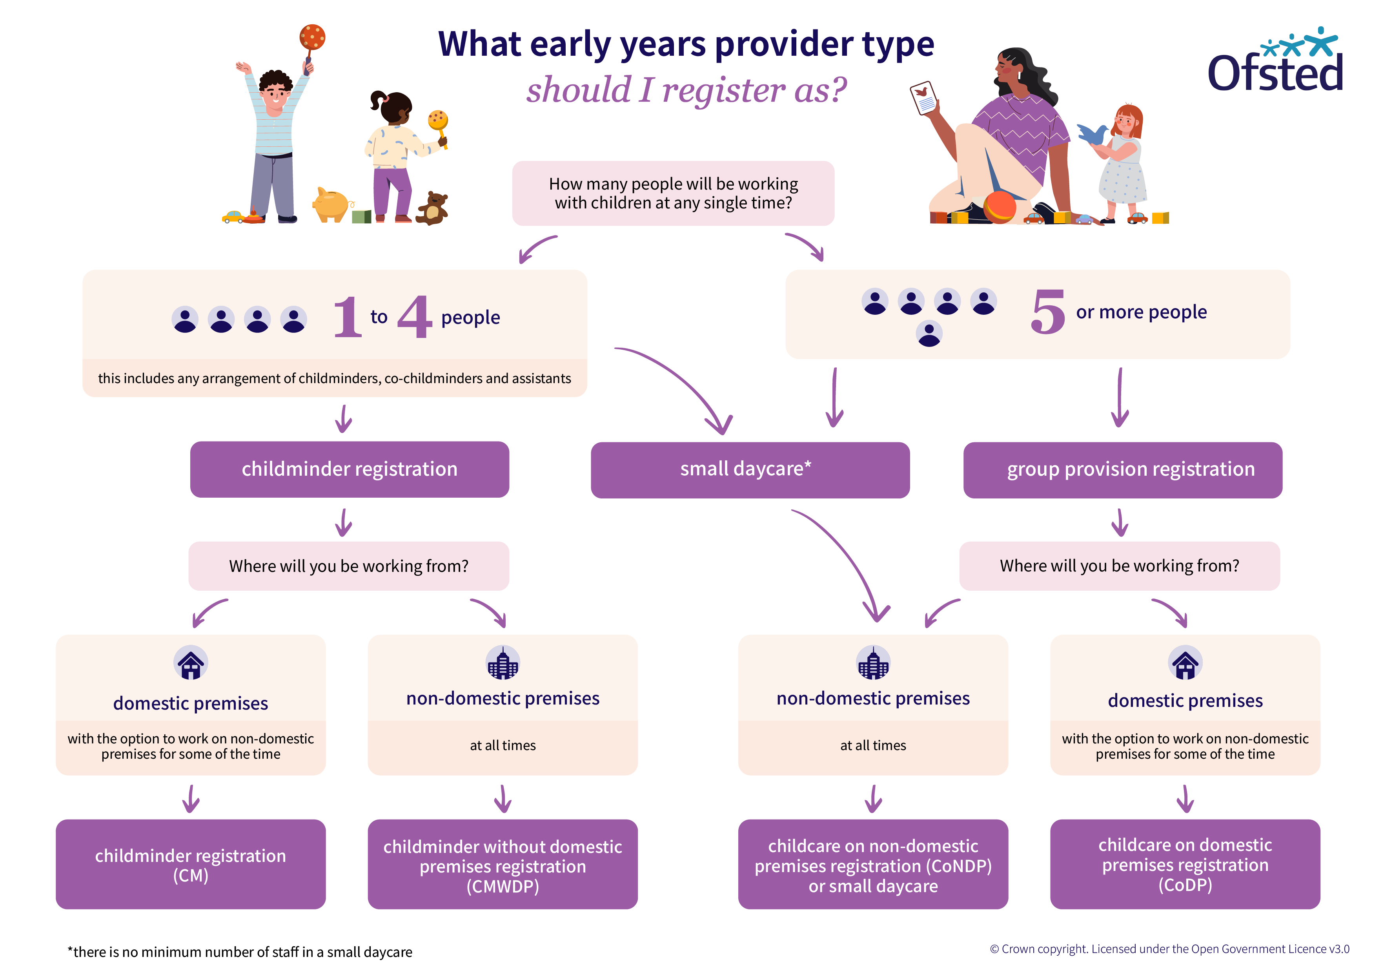
Choosing the right registration
This flow-chart shows the different options for registering with Ofsted, depending on the number of people providing childcare and where the childcare takes place
Notes:
This infographic will help applicants determine what kind of provider type is right for them.
If you want to work with up 3 other people, providing or assisting with childcare, and from a domestic premises, you should register as a childminder. Under this registration, you can also work from non-domestic premises for some of the time.
If you want to work with up 3 other people, providing or assisting with childcare, and only from non-domestic premises, you should register as a childminder without domestic premises. Under this registration, you are not permitted to work from any domestic premises at any time.
If you want to work with 4 or more people (5 or more in total), providing or assisting with childcare, and from a domestic premises, you should register as childcare on domestic premises. Under this registration, you can also work from non-domestic premises for some of the time.
If you want to work with any number of people, providing or assisting with childcare, and only from non-domestic premises, you should register as childcare on non-domestic premises or small daycare. Under this registration, you are not permitted to work from any domestic premises at any time.

Slide 22
The ‘registered person’
The registered person will be an individual or an organisation that is registered to provide childcare. This means that for:
an individual owner of a daycare – the individual owner will be the registered person
a daycare organisation owned by a company or group – the company or group will be the registered person
a school with one of the allowed daycare types – the group of individuals who run the school, for example the board of governors, will be the registered person

Slide 23
The ‘nominated individual’
The ‘nominated individual’ will usually complete the application for schools or daycare organisations owned by a company or group. To be the nominated individual of a group, you must be one of the registered individuals who is chosen to represent them and the daycare with Ofsted.
To be the nominated individual of a daycare organisation owned by a company or group with:
the sole or main purpose to provide childcare, you must be a member of the organisation’s governing body
a different purpose than providing childcare, you must be the most senior person in the organisation with direct responsibility for childcare

Slide 24
Childcare on domestic premises (CoDP)
Childcare on domestic premises is group provision, and must follow the group and school-based early years foundation stage (EYFS) framework (pdf) if registered on the Early Years Register
Ofsted or a childminding agency will need to check all household members, and everyone living and working in the house
It is also the provider’s responsibility to ensure that anyone who lives or works on the childcare premises are suitable to work or be in contact with children
Notes:
Childminders and childcare providers: register with Ofsted - Childminders and childcare on domestic premises: registration - Guidance - GOV.UK
Childcare on domestic premises - GOV.UK
Childcare on domestic premises is where 5 or more people provide or assist with childcare on a domestic premises (that is, someone’s home).
Providers of CoDP need to meet the specific requirements that relate to group- and school-based providers. These are set out in the EYFS for group and school-based providers and the General Childcare Register requirements.

Slide 25
Childcare on non-domestic premises (CoNDP)
Childcare on non-domestic premises operates from any non-domestic premises that are not someone’s home – for example, a community hall or a purpose-built nursery
If you register as an organisation, you must appoint a nominated individual. This individual will liaise with Ofsted and is responsible for the registration
Ofsted does not carry out checks on staff members, including the manager
It is your responsibility to ensure that all staff members, and other people living or working on the premises, are suitable to work with children
Notes:
Childminders and childcare providers: register with Ofsted - Nurseries and other daycare (childcare on non-domestic premises): registration - Guidance - GOV.UK
Any number of people can register as a provider of CoNDP, as long as they meet the relevant requirements. However, if there are 4 or fewer people providing or assisting with childcare you may wish to register as a childminder without domestic premises instead.
Register as a childminder without domestic premises - GOV.UK

Slide 26
Application and Registration

Slide 27

Registration timescales
12 weeks – Early Years Register applications and Childcare Register applications
Approval of additional premises is usually quicker, depending on whether additional checks are needed.
Notes:
Applications to work from additional settings, or to work on non-domestic premises for some of the time, are usually much quicker. This depends on whether we need to carry out additional checks or visit a premises. In the past, some have been approved within 1 day in emergency situations, and a lot are approved in a matter of weeks. Those with several additional people connected to the registration can take longer. We work with a lot of agencies to gather data to check the suitability of new individuals, so this can take some time.

Slide 28




Application and registration process
Before you apply
Application stage
Application review
Registration or refusal
You need to consider what checks will be needed to support your application. You may need to consider training and will need to choose a premises.
You must decide which application form to submit based on the type of provision you want to register. Choose which registers you need. Check who needs to complete a connecting application form.
We call at the start of the process to schedule the visit. This call helps set expectations for you and us about what to expect during the registration process.
We will visit the premises to determine your suitability to be registered. We do not routinely visit the premises if you are only applying for an additional setting.
Notes:
In summary, there are four stages to the application and registration process.
The first stage is where you are considering what information you need to support your application. For example, if you’re a childminder working at your own home, you’ll need an enhanced home-based DBS check with barred lists check which is for the child workforce.
If you’re thinking about opening a nursery on a non-domestic premises, this doesn’t need to be home-based, but still must state ‘child workforce’ on the enhanced DBS check with barred lists.
If your nursery will be registered as a company, all directors of the nursery will need this too. For this part of the process you can follow our guidance to learn about what you need before you apply.
The application stage is where you apply with all of the correct information we need to make a decision on your suitability. You and anyone else connected to the application, such as committee members, childminding assistants, will need to complete forms too. We’ll go into these forms later in more detail.
The next stage is where we review applications. We will call you at the start of this process to help set expectations for you about what we will be doing during the process. For example, we will contact local authorities where you have lived for the previous 5 years for information they hold that may be relevant to our decision-making on your suitability to care for or be in regular contact with children. At this stage we’ll also schedule a visit if this is needed.
Once we have received all the information from other agencies, we will risk assess this and discuss at the registration visit your understanding of legal requirements, such as the EYFS or Childcare register requirements. If you’re already registered and are applying to work on an additional premises, or open a new setting, or are only applying to register on the childcare register only, we will not always visit the premises if we are confident you understand the risk assessment process, and we have no other concerns about your ability to meet the legal requirements. We can make the decision to register you at the premises or shortly after the visit, or as part of a paper-based application for an additional setting if we decide we do not need to visit.

Slide 29

Before you apply – DBS checks
Apply for your DBS check via OfstedDBSApplication.co.uk
The cost for each check is set by the Disclosure and Barring service
Each person connected with your application must have received their completed DBS check before applying to Ofsted. You can’t apply without a DBS check.
Notes:
This slide relates only to the DBS checks that Ofsted carries out. The next slide relates to checks the applicant or registered provider must complete on their staff.
The check on a person’s criminal record is done through the Disclosure and Barring Service (DBS) via Capita. All DBS checks are processed online through the Capita website (http://ofsteddbsapplication.co.uk).
Ofsted strongly recommends that applicants applying for a DBS check via the above link also sign up to the DBS update service. This update service enables employers to check a certificate online and also lets applicants keep their DBS history up to date online. They can do this at the point of application or sign up within 30 days of the certificate date.
Childcare providers must pay for their DBS checks, the cost of which is set by the DBS at £49.50 (as of 15 April 2025). In addition, Capita will charge a handling fee for the application. This cost will vary depending on how the applicant chooses to apply – full details are available at the above website.

Slide 30
Before you apply – DBS update service
Ofsted strongly recommends joining the DBS update service. The DBS sets the fees for this.
You must register for the Update Service within 30 days of the certificate being issued.
If you are not on the DBS update service, we cannot accept Ofsted DBS checks older than three months, or checks obtained via a different organisation.
We may be able to accept existing certificates if you are signed up to the update service and:
the DBS is an enhanced certificate for a childcare role
the certificate is for a home-based role

Slide 31
Before you apply – other certificates
Early Years Register:
At least one person must have a current paediatric first aid (PFA) certificate. They must be on the premises and available at all times when children are present, and must accompany children on outings
The lead practitioner must attend a child protection training course

Slide 32
Before you apply – other certificates
Compulsory part of the Childcare Register only:
Make sure that at least one person who is caring for the children has an appropriate first-aid qualification
Make sure that a person (provider, manager or person who works for the provider) is designated to attend child protection training
Voluntary part of the Childcare Register only:
At least one person who is caring for the children has an appropriate first-aid qualification
Make sure that at least one person who is caring for children on the premises has a minimum level 2 qualification in an area of work relevant to the childcare provided, OR training in the common core skills

Slide 33
Before you apply – other requirements
This requirement is only applicable only for the CoDP on the Early Years Register
If applying to be a manager of a childcare on domestic premises provider, complete a health declaration form, signed by you and your GP. GPs set their own fee for signing the health declaration form and you should factor in costs for this

Slide 34
Application stage – costs
We will issue you an invoice for your fees, once we have completed checks on your application. It costs:
Register | Cost
Early Years Register only | £220
Early Years Register and Childcare Register | £220
Childcare Register only | £114
Registration fees are paid annually.
Notes:
For full information about fees, visit Ofsted’s guidance linked below.
Childminders and childcare providers: register with Ofsted - Fees - Guidance - GOV.UK
There are also reduced fees for CoDP and CoNDP providers. The reduced fee is £35 for the Early Years Register and applies if the provider works for less than any of the following:
3 hours a day
5 days a week
45 weeks a year

Slide 35

Application stage – completing your form
You will need to provide an email address and mobile number. An email will be sent to you with a link to access the registration service
You will be able to leave the form part way through if you need to. When you return to complete the form, a five-digit verification code will be sent to the mobile number you provided. You will need to enter this code to access your application
Read the relevant guidance in full before applying:
Childcare on domestic premises
Childcare on non-domestic premises

Slide 36

Application review – calling all applicants
Ofsted calls all applicants to make sure we have all the information we need.
Sometimes we need to return your application form, either because information is missing or incorrect. We will explain what you need to do before resubmitting your form.
Please remember to submit the application back to us. We cannot start reviewing it without all the correct information.
The registration timescales begin once we have accepted your application.
Notes:
You must complete each stage of the application fully in order to continue to the next stage of the process. You can call Ofsted’s helpline (0300 123 1231) if you need assistance.
Ofsted will only accept DBS disclosure notices obtained via another organisation if it is an enhanced level check, the position applied for states ‘child workforce’ and the individual has also registered with the update service. Furthermore, if an individual is applying for a role that involves being at their home address, Ofsted will only accept their DBS check if it has been obtained for a home-based role. Ofsted’s decision on portability only applies to those individuals and organisations for whom Ofsted makes the suitability decision; it does not apply to other people working in settings, where the employer has decided whether or not to allow portability.
Ofsted carries out checks on people connected with the registration set out in the ‘Guide to registration’. It does not carry out checks on other staff members unless they live or work on childcare on domestic premises.
You must pay a fee to apply for registration, which is set by law.
Before the visit, the inspector will telephone you to confirm the date of the visit and make sure you have all the necessary documents to hand as set out in the EYFS. Ofsted also produced a booklet, ‘Early Years Register: Preparing for your registration visit’ (ref. 120151), to help you.
By the time the registration visit is arranged, the applicant must be ready for registration. If the applicant is not ready for registration at the time of the visit, the inspector must consider refusing registration. In rare cases, having considered all the information and evidence available, the regulatory decision-maker may decide that a further visit is necessary.

Slide 37
Application review stage – accepting and reviewing
Ofsted will acknowledge receipt of your application by email after your complete application form is received
If you have applied to the Early Years Register, Ofsted will book a time for a registration visit at the start of the process. This visit will usually be 8 weeks after we accept your application
We will keep you updated every 2 weeks on the progress of your application and will let you know if we need any further information from you
Notes:
The inspector will telephone you first to arrange a time for the visit, and to go through any documents you will need to have to hand during the visit.
You must demonstrate to the inspector how you intend to deliver the EYFS framework. Ofsted will refuse registration at this stage if you cannot demonstrate how you will meet the safeguarding and welfare and the learning and development requirements. It is up to you to show the inspector that you have sufficient knowledge to care for children and help them to learn by following the requirements set out in the EYFS. The inspector will go through the safeguarding and welfare and the learning and development requirements and ask you questions about how you intend to meet them.
The inspector may want to see all the parts of the premises that you intend to use for childcare, and will look at how you have ensured they are safe and suitable for children.

Slide 38

The registration visit – checking your suitability
The inspector will check:
your identity
your suitability to provide childcare
your understanding of the ages and numbers of children you can care for
documents about your car (if applicable), qualifications and first aid
suitability of your premises and equipment
your understanding of risk assessment, safety and security
your understanding of the EYFS and Childcare Register requirements
that you speak English well enough to teach children and keep records in English
Notes:
We do not always complete a registration visit if an applicant has only applied to register on the compulsory or voluntary part of the childcare register.
The inspector will telephone you first to arrange a time and to go through any documents you will need to have to hand during the visit.
You must demonstrate to the inspector how you intend to deliver the Early Years Foundation Stage (EYFS). It is up to you to show the inspector that you have sufficient knowledge to care for children and help them to learn by following the requirements set out in the EYFS. Ofsted will refuse registration at this stage if you cannot demonstrate how you will meet the safeguarding and welfare and the learning and development requirements. The inspector will go through the safeguarding and welfare and the learning and development requirements and ask you questions about how you intend to meet them.
The inspector may want to see all the parts of the premises that you intend to use for childcare, and will look at how you have ensured they are safe and suitable for children.

Slide 39
The registration visit – checking your suitability
A decision will be made either at the visit or after the visit has ended and the inspector will tell you whether they will recommend you ‘suitable’ or ‘not suitable’ for registration
If you do change your mind and decide you do not want to pursue your application, you can withdraw up until the point of our decision to register or refuse your application. You will be able to apply again in the future but will need to pay a new application fee. Application fees cannot be refunded
We know people can find discussing their suitability a worrying time. Inspectors will take all reasonable steps to prevent undue anxiety and to minimise stress during the registration visit. You can always contact Ofsted if you have concerns that cannot be resolved with the inspector
The safety and well-being of children will always be our priority, so it is important that we ensure those working with children have the right knowledge and skills
Notes:
In order to check your identity the inspector will need to see:
ID documents, including photographic identification such as a passport, and evidence confirming your current address
evidence of change of name (if applicable), for example a marriage certificate
any relevant qualifications (if you intend to work with the children)
The inspector will look at the numbers of children that you intend to care for. The maximum numbers and ages of children you can care for are set out in sections 3.28 to 3.40 of the EYFS framework.
The decision will be based on a number of factors, including available space, the organisation of the premises, the ages and needs of the children you intend to care for and the number of staff you intend to employ.

Slide 40
Inspection

Slide 41
Inspection of providers on the Early Years Register
Ofsted is required to inspect all providers at intervals set by the Secretary of State for Education
Under these arrangements we will inspect all providers on the Early Years Register in a 4-year window from the date of their last inspection
The 4-year inspection window will be introduced from April 2026 and phased in over 4 years, with full implementation expected by March 2030
Newly registered providers will usually be inspected within 18 months of their registration date
You can find all our information about inspection in our collection of guidance documents.

Slide 42
Inspection of providers on the Childcare Register
Childcare Register inspections are a compliance check to make sure providers are meeting the ongoing requirements for registration
Ofsted inspects 10% of all providers on the register each year, on a proportionate and risk basis, rather than following a prescribed inspection cycle
Our guidance on carrying out Childcare Register inspections sets out the full inspection process

Slide 43
Resources

Slide 44
Help and support
Your local authority can help you with advice and support throughout the registration process. You may also wish to contact:
your local authority environmental health department, to make sure you comply with food safety regulations and other legislation
your local fire safety officer, to make sure you comply with fire safety regulations
your local planning authority, to make sure you have planning permission for childcare
your local building control department, with regard to building
work undertaken
Notes:
Your local authority will provide you with advice and support throughout the registration process. It will also make available appropriate training, such as first aid training, although your first-aid training does not need to be approved by the local authority and you can undertake another course as long as it covers the appropriate content, as set out in the EYFS.
It is important to ensure that your health and safety procedures comply with local environmental health department guidance and regulations; for example, with regard to food handling. Your local environmental health department will advise you of their requirements.
Applicants must comply with the requirements of their local authority environmental health department and local fire authority. Fire authorities will not routinely check all premises where a childcare application has been made. Ofsted will inform the relevant fire authority of a proposed registration in a new building or where there is a significant change of use of premises. The fire authority will then decide if it wishes to inspect the premises and will advise Ofsted of any proposed enforcement action. The protocol with fire authorities does not require Ofsted to wait until there is a fire safety inspection before granting registration unless the inspector has concerns about fire safety.
You may need planning permission, for example, if there is a change of use of the premises that you intend to use for childcare. You can seek advice from your local planning department. You must ensure that you obtain planning permission, if it is required.
You may need to contact the local authority building control department about certain types of building work. They will need to be satisfied that the work has been carried out to the required standard.

Slide 45

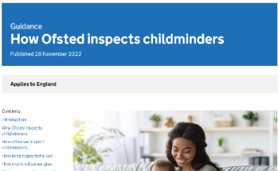
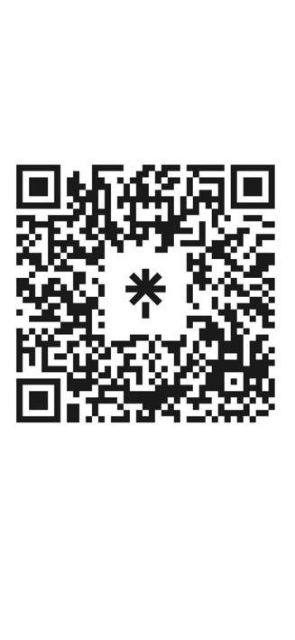
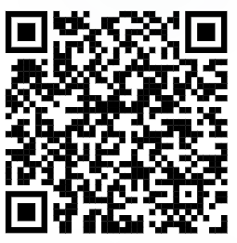
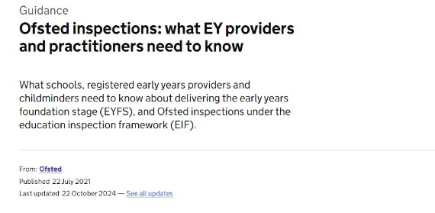
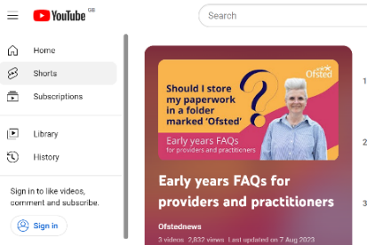
SCAN ME
Further guidance:
Early years and childcare registration
Early years and childcare regulation
Ofsted inspections of early years and childcare providers
linktr.ee/ofstedbeststartinlife
Notes:
Our collections:
We have organised all Ofsted’s early years guidance into three collections. Every single piece of early years guidance can be found in one of these links. They cover registration, regulation and inspection, respectively.
Please help signpost all applicants and providers to these collections so that they can find all of the information they need about Ofsted.
We have recently updated over 40 guidance documents to make reference to the new childminder flexibilities. If you have any questions about the guidance or recommendations for blogs our policy team would like to hear it. Our blogs, covered on the next page, help us to explain guidance with examples to help with understanding and to help myth-bust things we hear from the sector.

Slide 46
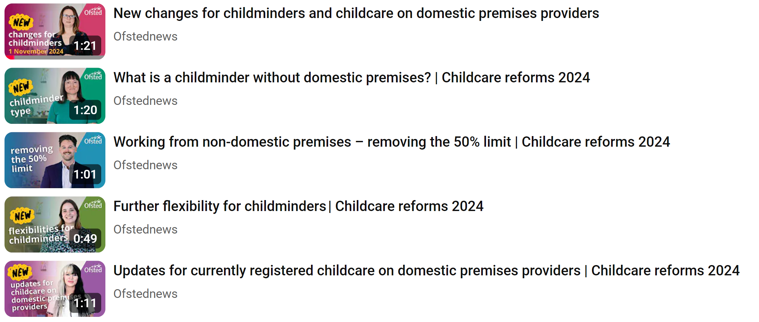
Watch Ofsted’s videos explaining each new flexibility available from 1 November 2024:

