Slide 1
Childminders and childminders without domestic premises
Pre-registration briefing

Slide 2
A childminder is a person who receives payment for working in a domestic dwelling. They look after at least one child for more than two hours a day. Childminders can also work some of their time from approved non-domestic premises if they choose to do so.
Notes:
This is the definition of a childminder as defined by the Childcare Act 2006.
Remember *payment means any type of reward other than occasional gifts. This could be money, goods, vouchers or any contributions towards childcare costs.

Slide 3
A childminder without domestic premises is a person who receives payment for working on non-domestic premises, such as a church hall. They are not permitted to work from any domestic dwelling at any time.
Notes:
This is the definition of a childminder as defined by the Childcare Act 2006.
Remember *payment means any type of reward other than occasional gifts. This could be money, goods, vouchers or any contributions towards childcare costs.

Slide 4
The Department for Education (DfE) introduced flexibilities on 1 November 2024:
The total number of people who can work together under a childminder’s registration is 4. This includes other childminders (often known as co-childminders) and assistants.
When 5 or more people work together to provide or assist with childcare in a domestic setting, the provision is classified as ‘childcare on domestic premises.’ This is considered as a type of group provision.
Childminders and childcare on domestic premises have flexibility to spend more time operating outside of domestic premises, such as at a community hall or school, removing the previous 50% limit.
Childcare providers have the option to register as childminders without domestic premises, who can work entirely from non-domestic premises such as a village hall.

Slide 5
Roles and responsibilities

Slide 6
Local authorities’ role
The Childcare Act 2006 sets out a list of duties for local authorities:
to make sure there is sufficient childcare in their area for working parents
to make sure there is sufficient government-funded childcare for parents who are entitled to it
to provide information, advice and assistance to parents and prospective parents
to publish certain information to help with finding childcare
to provide information, advice and training to childcare providers.
Notes:
Section 6, which places a duty on English local authorities, so far as reasonably practicable to secure sufficient childcare in their area for working parents
Section 7, which places a duty on English local authorities to secure early years provision free of charge. Regulations made under section 7 set out the type and amount of free provision and the children who benefit from free provision
Section 7A. Regulations made under section 7A make provision about how local authorities should discharge their duty under section 7
Section 9A. Regulations made under section 9A limit the requirements local authorities can impose when they make arrangements to deliver early education places for eligible children
Section 12, which places a duty on English local authorities to provide information, advice and assistance to parents and prospective parents. Section 12 was amended by section 5 of the Childcare Act 2016 to enable the Secretary of State to make regulations placing a duty on English local authorities to publish certain information at prescribed intervals
Section 13, which places a duty on English local authorities to provide information, advice and training to childcare providers

Slide 7
Ofsted’s role
Ofsted must register applicants, if they meet the requirements for registration and are not disqualified from caring for children.
If necessary, Ofsted will take action to ensure providers comply with the requirements of registration.
If childminders fail to meet or fully meet specific requirements at inspection, Ofsted will give them actions to help them improve.
If there are serious concerns, Ofsted may take other enforcement action to bring about improvement, such as suspending or cancelling a provider’s registration.
Notes:
The Childcare Act 2006 places a duty on Ofsted to register, inspect and regulate providers who are registered. There are also powers given to Ofsted in the Act to enable Ofsted to regulate childcare providers, to help drive improvement. Ofsted is also required to inspect all providers at intervals set by the Secretary of State, currently every 6 years from the last inspection.

Slide 8
The role of childminder agencies
The Children and Families Act 2014 enabled childcare providers to register with Ofsted or a childminder agency (CMA)
CMAs register and regulate childminders, childminders without domestic premises, and providers offering childcare on domestic premises
CMAs help providers with training, business support, advice and finding parents. Parents can use CMAs to find childcare
Providers registered with an agency receive 1 quality assurance visit each year. Ofsted then inspects CMAs at intervals set by the Department for Education
Notes:
The Department for Education and Ofsted have published several guidance documents for providers, parents and local authorities to better understand the role of childminder agencies.
Childminder agencies: a guide - GOV.UK
Childminder agencies: registration and suitability - GOV.UK
Childminder agencies: inspection guidance - GOV.UK

Slide 9
Childcare provider’s role
Once registered, childcare providers must meet, and continue to meet, the requirements of their registration at all times. This applies even when a provider is not caring for children.
Providers must notify Ofsted of any significant events, and of any changes to people living or working where childcare takes place. They must also keep their details up to date.
Providers must work closely with parents and other agencies, such as the local authority.

Slide 10
Legal requirements

Slide 11
Can I register?
You must:
have the right to work in the UK
be suitable to work with children
be physically and mentally capable of caring for children.

Slide 12
Who is required to register
You must register with Ofsted or with a childminder agency (childcare on domestic premises only) if you are paid to look after children under 8 for more than 2 hours a day in a domestic dwelling and/or a non-domestic premises.
You could be prosecuted if you are not registered, and you provide childcare services that must be registered.

Slide 13
Disqualification
You are disqualified from registration if:
you have been convicted of a disqualifiable offence or are barred from working with children
you have been refused registration from Ofsted before
you have been made subject to an order or determination removing a child from your care or preventing a child from living with you
your registration has been cancelled for a reason other than not paying your annual fee

Slide 14
Disqualification by association
If applying to be a childcare on domestic premises provider, you are disqualified by association if:
you live in the same premises as another person who is disqualified
or
you live in a household where a disqualified person is employed

Slide 15
Registration exemptions
Not all people who care for children are required to register with Ofsted or a childminding agency. For example, a childcare provider is exempt if they care for an individual child for less than 2 hours per day.
Ofsted’s exemption from registration guidance sets out:
when you must register
when you cannot register
when you do not have to register but choose to
how to contact Ofsted about an exemption for temporary provision

Slide 16
Examples of registration exemptions
Looking after children aged 8 or over
Looking after children for fewer than 2 hours a day
Caring for children as the children’s parent, step-parent, foster parent or relative (such as a grandparent) – relatives also include half-siblings and people related by marriage or civil partnerships
Notes:
The Childcare Exemptions from Registrations Order (2008) is legislation that is set by the Department for Education. This legislation allows some childcare to be carried out without the requirement of compulsory registration.

Slide 17
Further examples of registration exemptions
Looking after children of a friend or multiple friends for less than 3 hours a day for some payment
Babysitting (looking after children at home between 6pm and 2am)
Provision during home education – where a person (who is not the parent) is (wholly or partly) educating a child, who is of compulsory school age and is receiving full-time education otherwise than at a school, and any childcare made is incidental to the home education. For example, caring for the child during lunchtime
Notes:
The Childcare Exemptions from Registrations Order (2008) is legislation that is set by the Department for Education. This legislation allows some childcare to be carried out without the requirement of compulsory registration.

Slide 18
Choosing the right registration

Slide 19
Which register to join
Compulsory part of the Childcare Register
Voluntary part of the Childcare Register
Early Years Register
Caring for children aged eight and over
or
If you do not need to register by law, you can choose to register your exempt childcare voluntarily
Looking after children from birth to 31 August after their fifth birthday
Looking after children aged five up to a child’s eighth birthday
Notes:
There are two registers, the early years register and the childcare register.
However, the childcare register is split into two parts, the compulsory part and the voluntary part.
Childminders can register on one of the above registers or both, depending on the type of childcare they want to provide. Childminders that register on the Early Years Register must understand and must be able to demonstrate that they can meet the requirements of the EYFS. Childminders registering on either part of the childcare register must meet the requirements for the provision and register they choose.

Slide 20
Choosing the right registration
 | Childminders | Childminders without domestic premises (CWDP)
Can I work from domestic and approved non-domestic premises? | Yes. You can work most of your time from Ofsted approved non-domestic premises, as long as you spend some of your time working from your domestic premises. | No. You can only work from Ofsted approved non-domestic premises. You cannot work from any domestic premises at any time, including for pick-up and drop-off with this registration.
Can I work with other people? | Yes. You can work with up to three other childminders and or assistants.
Will I need an enhanced DBS check with barred lists? | Yes. This will also need to be a home-based check. | Yes. However, this will not need to be a home-based check.
Do household members require DBS checks? | Yes. Anyone aged 16 or over living or working in the home where the childcare is provided will also need to apply for an enhanced DBS check (with barred list). | No. Household members of the childminder without domestic premises will not be checked by Ofsted and will not need to apply for an enhanced DBS check (with barred list).
Do I need to follow requirements of childminder EYFS? | Yes (If applying to be on the Early Years Register).

Slide 21
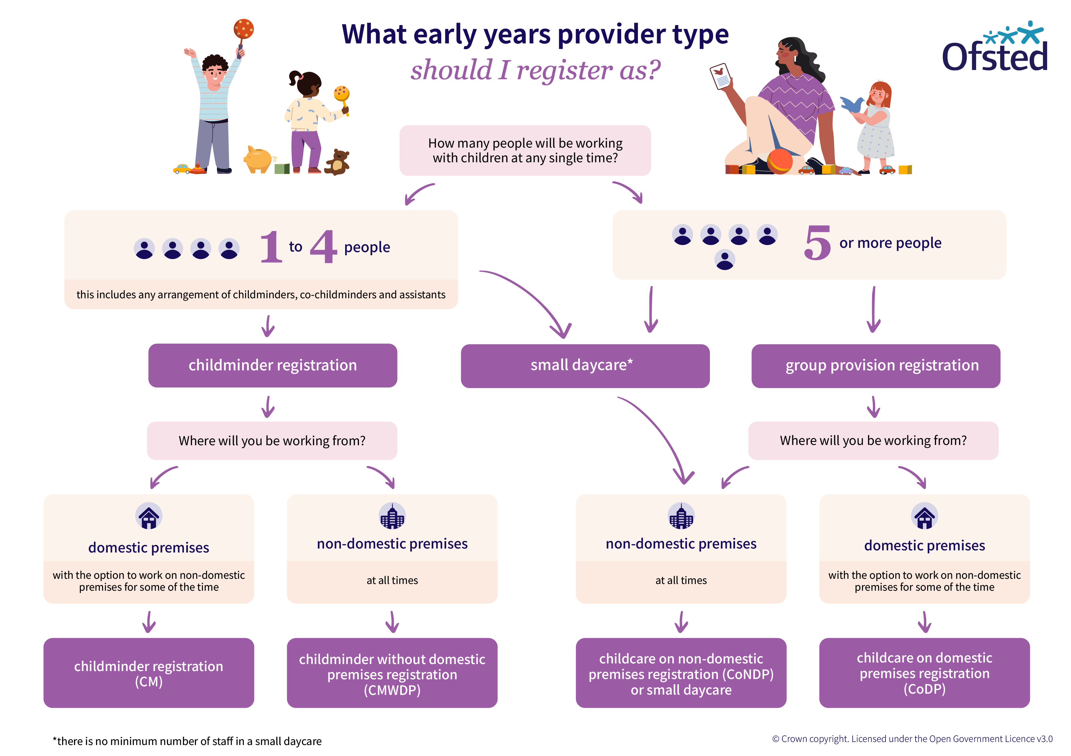
Choosing the right registration
This flow-chart shows the different options for registering with Ofsted, depending on the number of people providing childcare and where the childcare takes place
Notes:
This infographic will help applicants determine what kind of provider type is right for them.
If you want to work with up 3 other people, providing or assisting with childcare, and from a domestic premises, you should register as a childminder. Under this registration, you can also work from non-domestic premises for some of the time.
If you want to work with up 3 other people, providing or assisting with childcare, and only from non-domestic premises, you should register as a childminder without domestic premises. Under this registration, you are not permitted to work from any domestic premises at any time.
If you want to work with 4 or more people (5 or more in total), providing or assisting with childcare, and from a domestic premises, you should register as childcare on domestic premises. Under this registration, you can also work from non-domestic premises for some of the time.
If you want to work with any number of people, providing or assisting with childcare, and only from non-domestic premises, you should register as childcare on non-domestic premises or small daycare. Under this registration, you are not permitted to work from any domestic premises at any time.

Slide 22
Application and registration

Slide 23

Registration timescales
12 weeks – Early Years Register and Childcare Register applications
10 weeks – Nannies on the voluntary part of the Childcare Register
Approval of additional premises is usually quicker; however, it depends on whether we need to visit the provider or carry out any additional checks.
Notes:
Ofsted’s registration timescales are 12 and 10 weeks for the EYR and CCR respectively.
Applications to work from additional settings, or to work on non-domestic premises for some of the time, are usually much quicker. This all depends on whether we need to carry out additional checks, or visit a premises. In the past, some have been approved within 1 day in emergency situations, a lot are approved in a matter of weeks. Some, due to several additional people connected to a registration, can take longer. We work with lots of agencies to gather data to suitability check new individuals so this can take some time.

Slide 24




Application and registration process
Before you apply
Application stage
Application review
Registration or refusal
You need to consider what checks will be needed to support your application. You may need to consider training and will need to choose a premises.
You must decide which application form to submit based on the type of provision you want to register. Choose which registers you need. Check who needs to complete a connecting application form.
We call at the start of the process to schedule the visit. This call helps to set expectations for you and us about what to expect during the registration process.
We will visit the premises to determine your suitability to be registered. We do not routinely visit the premises if you are only applying for an additional setting.
Notes:
In summary, there are four stages to the application and registration process.
The first stage is where you are considering what information you need to support your application. For example, if you’re a childminder working at your own home, you’ll need an enhanced home-based DBS check with barred lists check, which is for the child workforce.
If you’re thinking about opening a nursery on a non-domestic premises, this doesn’t need to be home-based, but still must state child workforce on the enhanced DBS check with barred lists.
If your nursery will be registered as a company, all directors of the nursery will need this too. For this part of the process you can follow our guidance to learn about what you need before you apply.
The application stage is where you apply with all of the correct information we need to make a decision on your suitability. You and anyone else connected to the application, such as committee members or childminding assistants, will need to complete forms too. We’ll go into these forms later in more detail.
The next stage is where we review applications. We will call you at the start of this process to help set expectations for you about what we will be doing during the process. For example, we will contact local authorities where you have lived for the previous five years for information they hold that may be relevant to our decision-making on your suitability to care for or be in regular contact with children. At this stage we’ll also schedule a visit if this is needed.
Once we have received all the information from other agencies, we will risk assess this and discuss at the registration visit your understanding of legal requirements, such as the EYFS or Childcare register requirements. If you’re already registered and are applying to work on an additional premises, or open a new setting, or are only applying to register on the childcare register only, we will not always visit the premises if we are confident you understand the risk assessment process, and we have no other concerns about your ability to meet the legal requirements. We can make the decision to register you at the premises or shortly after the visit, or as part of a paper-based application for an additional setting if we decide we do not need to visit.

Slide 25

Before you apply – DBS checks
Apply for your DBS check at OfstedDBSApplication.co.uk
The cost for each check is set by the Disclosure and Barring Service.
Childminders will need a home-based check. Separate DBS checks will be needed for anyone aged 16 or over who lives or works in your home.
Childminders without domestic premises do not need a home-based check. DBS checks will not be required for anyone aged 16 or over who lives in your home.

Slide 26
Before you apply – DBS update service
Ofsted strongly recommends joining the DBS update service. The DBS sets the fees for this.
You must register for the update service within 30 days of the certificate being issued.
If you are not on the DBS update service, we cannot accept Ofsted DBS checks older than three months, or checks obtained through a different organisation.
We may be able to accept existing certificates if you are signed up to the update service and:
the DBS is an enhanced certificate for a childcare role
the certificate is for a home-based role (if applying to be a childminder).

Slide 27
Before you apply – other certificates
Early Years Register:
Complete a paediatric first aid course.
Attend child protection training.

Slide 28
Before you apply – other certificates
Compulsory part of the Childcare Register only:
Make sure that at least one person looking after children has an appropriate first aid qualification.
Attend child protection training.
Complete a relevant childminding course.
Voluntary part of the Childcare Register only:
Make sure that at least one person looking after children has an appropriate first aid qualification.
Have a minimum level 2 qualification in an area of work relevant to the childcare provided, OR training in the common core skills.

Slide 29
Before you apply – other requirements for the EYR only
Complete a health declaration form, signed by you and your GP. GPs set their own fee for signing the health declaration form and you should factor in costs for this.
Details of two references. One of these must be from your most recent childcare employer if you have worked with children within the last five years (either employed or voluntary).
Your full employment history.

Slide 30

Application stage – completing your form
Read the guidance in full of how to become a childminder before applying.
You will need to provide an email address and mobile number. An email will be sent to you with a link to access the registration service.
You will be able to leave the form part way through if you need to. When you return to complete the form, a five-digit verification code will be sent to the mobile number you provided. You will need to enter this code to access your application.
You will pay your application fee when you submit your completed form. It costs:
£35 to join both the Early Years Register and Childcare Register, or
£103 to join the Childcare Register only.
Registration fees are then paid annually on your registration date.

Slide 31

Application review – calling applicants
Ofsted calls all applicants to make sure we have all the information we need.
Sometimes we need to return your application form, because information is either missing or incorrect. We will explain what you need to do before resubmitting your form.
Please remember to submit the application back to us. We cannot start reviewing it without all the correct information.
The registration timescales begin once we have accepted your application.

Slide 32
Application review stage – accepting and reviewing
Ofsted will acknowledge receipt of your application by email after we receive your complete application form.
If you have applied to the Early Years Register, we will arrange a registration visit at the start of the process. This visit will usually be eight weeks after we have accepted your application.
We will update you every two weeks on the progress of your application and let you know if we need any further information from you.

Slide 33

The registration visit – checking your suitability
The inspector will check:
your identity
your understanding of the ages and numbers of children you can care for
documents about your car (if applicable), qualifications and first aid
suitability of your premises and equipment
your understanding of risk assessment, safety and security
your understanding of the EYFS and Childcare Register requirements
that you speak English well enough to teach children and keep records in English.
Notes:
We do not always complete a registration visit if an applicant has only applied to register on the compulsory or voluntary part of the childcare register.

Slide 34
The registration visit – checking your suitability
A decision will be made either at the visit or after the visit has ended.
The inspector will tell you whether they will recommend that you are ‘suitable’ or ‘not suitable’ for registration.
You can withdraw your application at this stage. You will then be able to apply again in the future but will need to pay a new application fee. Application fees cannot be refunded.
Inspectors will take all reasonable steps to prevent undue anxiety and to minimise stress during the registration visit. You can always contact Ofsted if you have concerns that cannot be resolved with the inspector.
Children’s safety and well-being will always be our priority.

Slide 35
Inspection

Slide 36
Inspection of providers on the Early Years Register
Ofsted is required to inspect all providers at intervals set by the Secretary of State for Education
Under these arrangements we will inspect all providers on the Early Years Register in a 4-year window from the date of their last inspection
The 4-year inspection window will be introduced from April 2026 and phased in over 4 years, with full implementation expected by March 2030
Newly registered providers will usually be inspected within 18 months of their registration date
You can find all our information about inspection in our collection of guidance documents.

Slide 37
Inspection of providers on the Childcare Register
Childcare Register inspections are a compliance check to make sure providers are meeting the ongoing requirements for registration
Ofsted inspects 10% of all providers on the register each year, on a proportionate and risk basis, rather than following a prescribed inspection cycle
Our guidance on carrying out Childcare Register inspections sets out the full inspection process

Slide 38
Resources

Slide 39

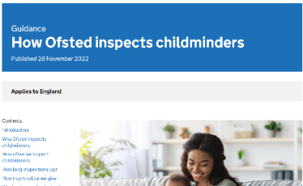
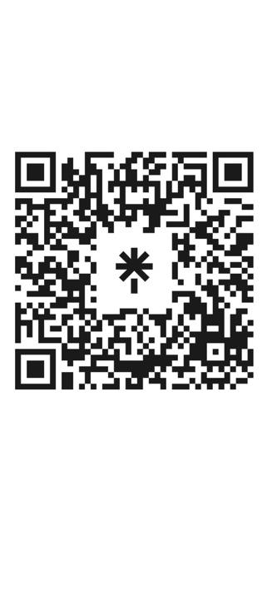

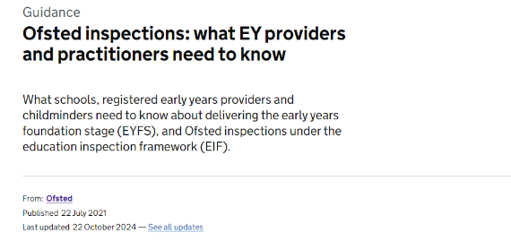
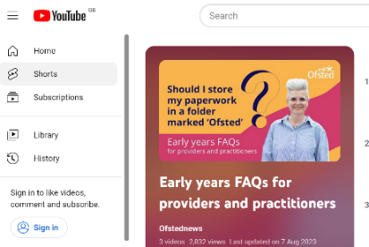
Further guidance:
Early years and childcare registration
Early years and childcare regulation
Ofsted inspections of early years and childcare providers
SCAN ME
linktr.ee/ofstedbeststartinlife
Notes:
Our collections
We have organised all Ofsted’s early years guidance into three collections. Every single piece of early years guidance can be found in one of these links. They cover registration, regulation and inspection, respectively.
Please help signpost all applicants and providers to these collections so that they can find all of the information they need about Ofsted.
We have recently updated over 40 guidance documents to make reference to the new childminder flexibilities. If you have any questions about the guidance or recommendations for blogs our policy team would like to hear it. Our blogs, covered on the next page, help us to explain guidance with examples to help with understanding and to help myth-bust things we hear from the sector.

Slide 40
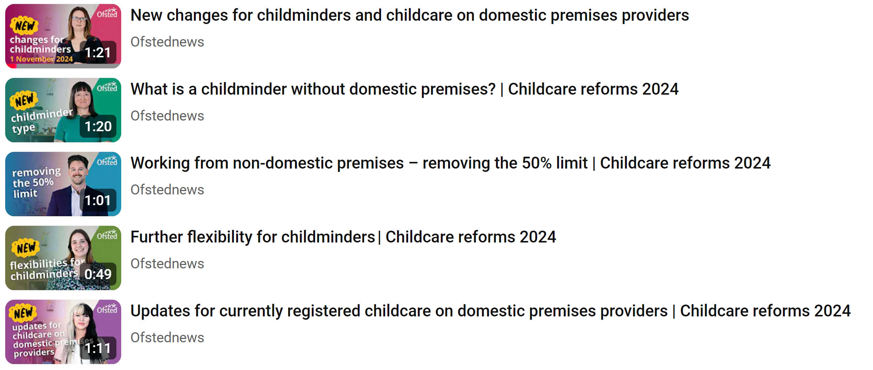
Watch Ofsted’s videos explaining each new flexibility available from 1 November 2024:

