Slide 1




How your exams are marked and graded
What happens between the exam hall and results day?

Slide 2

How your exams are marked and graded
1. The journey of your exam paper

Slide 3

1. The journey of your exam paper

Slide 4
1. The journey of your exam paper
4
6
2
Answer paper split into individual questions
Quality checks ensure consistency
Grades determined and sent back to school
1
3
5
Answer paper sent to exam board
Trained examiners mark each question using detailed mark scheme
Grade boundaries set
Notes:
After you finish your exam:
Your answer paper is packaged up and sent to the exam board.
It’s scanned at the exam board scanning centre and normally split into individual questions.
Then trained examiners mark each question using a detailed mark scheme that they have been trained on. They need to pass this training before they’re allowed to mark.
Quality checks are done throughout marking to make sure examiners are all marking consistently.
Exams boards start work on setting grade boundaries only once marking is nearly complete. This is done using a combination of statistical data about how everyone who’s sat that exam has performed, and the expert judgment of experienced senior examiners. We’ll look at this some more in a few slides’ time.
Once the grade boundaries are agreed, your marks are converted into the corresponding grades and sent back to school in time for results day.

Slide 5
2. Fair and anonymous marking

Slide 6

2. Fair and anonymous marking
Your grade reflects what you wrote, nothing else.
Anonymous
Flossie Guerrero
Titus Whitney
Tadao Hirano
Notes:
It’s important to remember that your grade reflects what you wrote, nothing else about you.
Your answer paper is completely anonymous – the marker doesn't know your name, your school, or anything about you.

Slide 7


2. Fair and anonymous marking
Your grade reflects what you wrote, nothing else.
Anonymous
Xxxxx xxxxxx
Xxxxx xxxxxx
Xxxxx xxxxxx
Notes:
It’s important to remember that your grade reflects what you wrote, nothing else about you.
Your answer paper is completely anonymous – the marker doesn't know your name, your school, or anything about you.

Slide 8
3. How grade boundaries work
Notes:
Let’s now spend a couple of minutes understanding how grade boundaries work.

Slide 9

3. How grade boundaries work
Grade boundaries are set to keep standards consistent
Real student answers
Expert examiner judgment
Comparisons
with last year
Grade
boundaries
Data
Notes:
First things first: grade boundaries are set with the aim of keeping standards consistent from one year to the next. In other words, to make sure that it’s no harder or easier for any student to get any particular grade just because of the year they sit their exams.

Slide 10
3. How grade boundaries work
Grade boundaries are set to keep standards consistent
Real student answers
Expert examiner judgment
Comparison
with
last year
Data
+
+
+
=
Grade boundaries
Notes:
Exam boards look at data on how this year's students compare to those in previous years.
Senior examiners then look at examples of actual student answers around each of the potential boundaries that the data initially suggests might be appropriate.
They compare those answers to answers with the same marks from previous years to make sure standards – the quality of work needed for each grade – stay the same.
Once the senior examiners are satisfied, they recommend those grade boundaries to the exam board.
As you can see from this process, boundaries can go up or down compared to the previous year, because it depends on how hard the particular paper was.

Slide 11
3. How grade boundaries work
Why grade boundaries change year to year
Different grade boundaries DOES NOT EQUAL different quality of work needed
Year X
Year Y
Year Z
Grade
154
153
152
151
150
149
148
147
146
145
144
143
154
153
152
151
150
149
148
147
146
145
144
143
154
153
152
151
150
149
148
147
146
145
144
143
Notes:
To illustrate…

Slide 12
3. How grade boundaries work
Why grade boundaries change year to year
If a paper is easier than last year → boundaries are set higher
Year X
Year Y
Year Z
Grade
154
153
152
151
150
149
148
147
146
145
144
143
154
153
152
151
150
149
148
147
146
145
144
143
154
153
152
151
150
149
148
147
146
145
144
143

Slide 13
3. How grade boundaries work
Why grade boundaries change year to year
154
153
152
151
150
149
148
147
146
145
144
143
If a paper is harder than last year → boundaries are set lower
154
153
152
151
150
149
148
147
146
145
144
143
Year X
Year Y
Year Z
154
153
152
151
150
149
148
147
146
145
144
143
Grade
Notes:
This ensures it's no harder or easier to get a grade from one year to the next.
The quality of your work determines your grade – not how the paper compares to last year's.

Slide 14
4. Myths vs facts

Slide 15
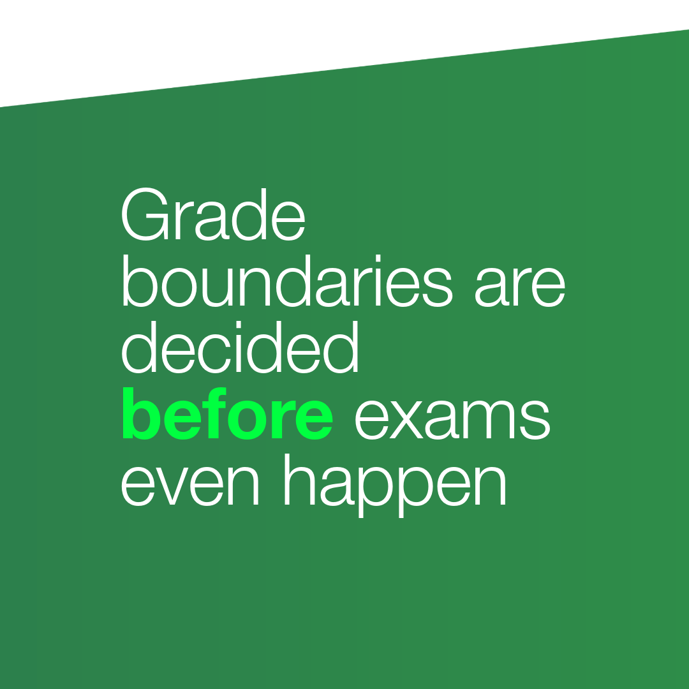
4. Myths vs facts

Slide 16
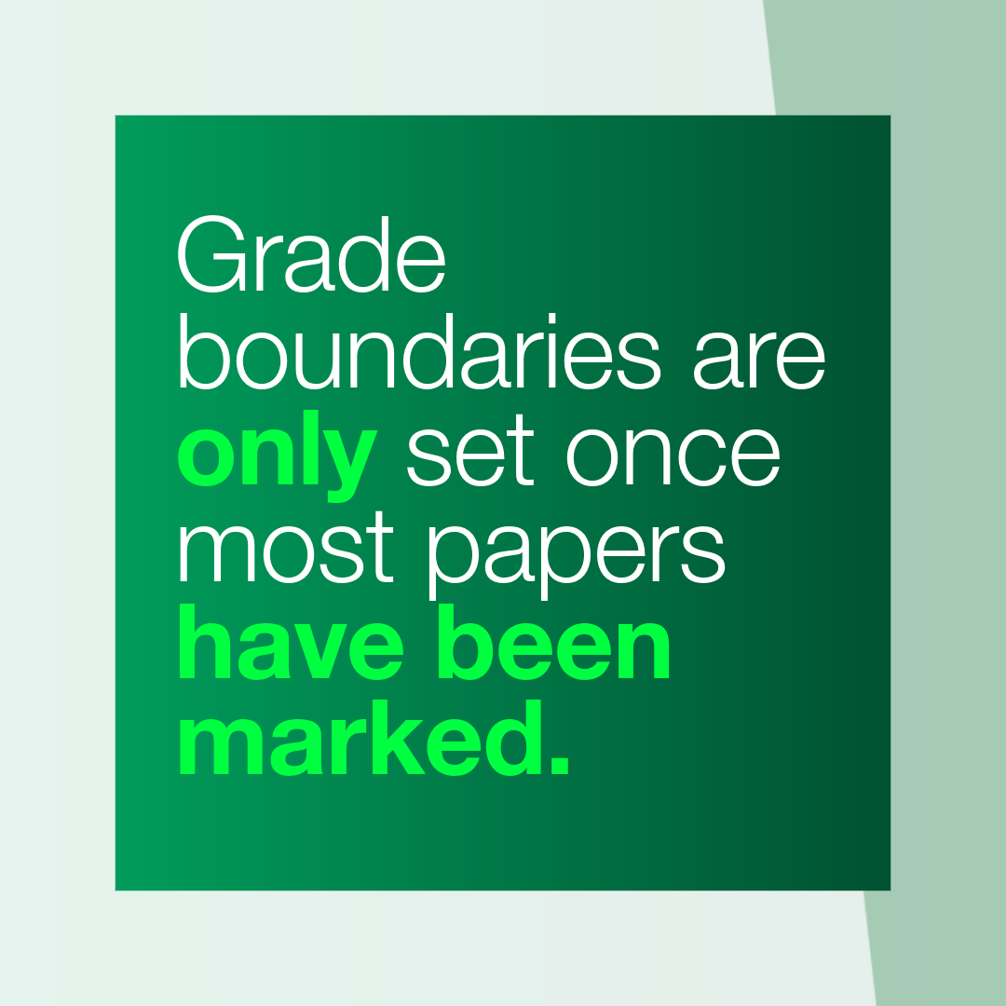

4. Myths vs facts
Notes:
Myth
Grade boundaries are only set once most papers have been marked.
This allows exam boards to compare students’ work to previous years and check if papers were any harder or easier.
This is to help make sure the quality of work needed to achieve each grade stays consistent year on year.

Slide 17
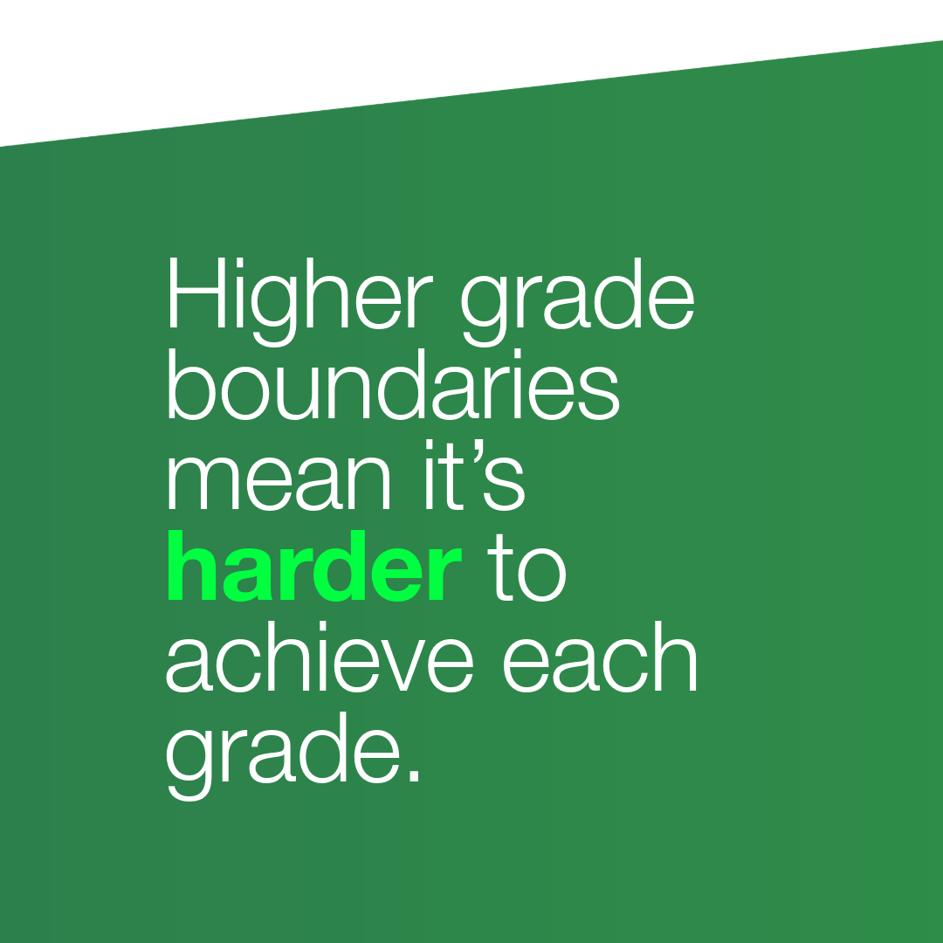
4. Myths vs facts

Slide 18
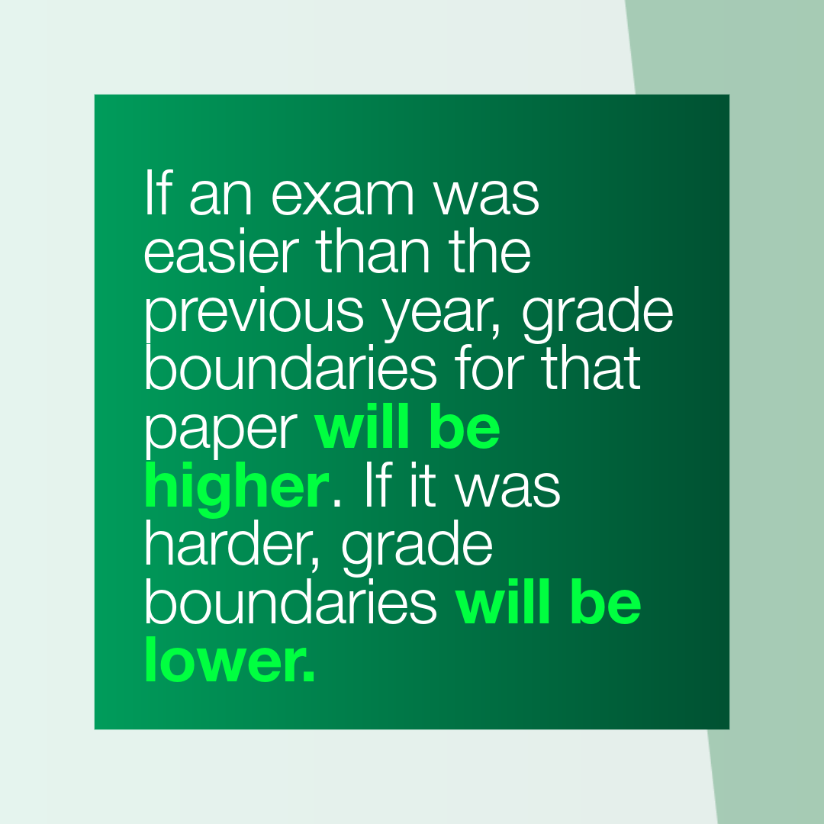
4. Myths vs facts
Notes:
This is also a myth.
Higher grade boundaries than a previous paper only indicates that that exam paper was easier. If the paper was harder, the grade boundaries would be lower.

Slide 19
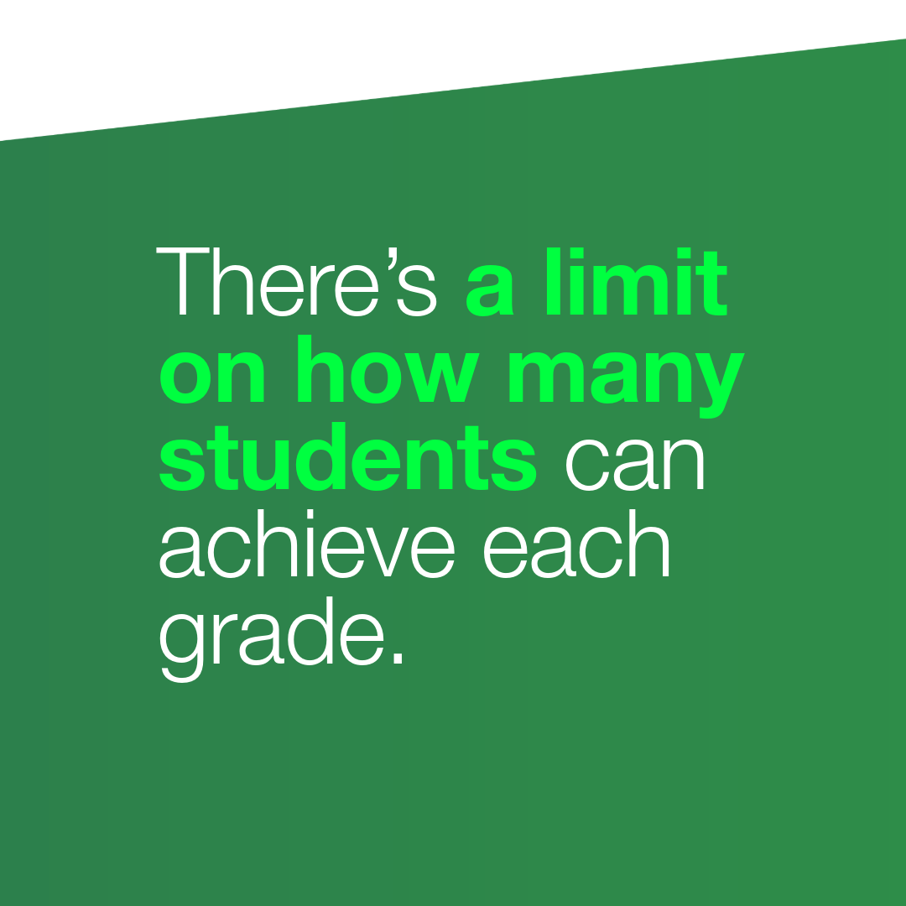
4. Myths vs facts

Slide 20
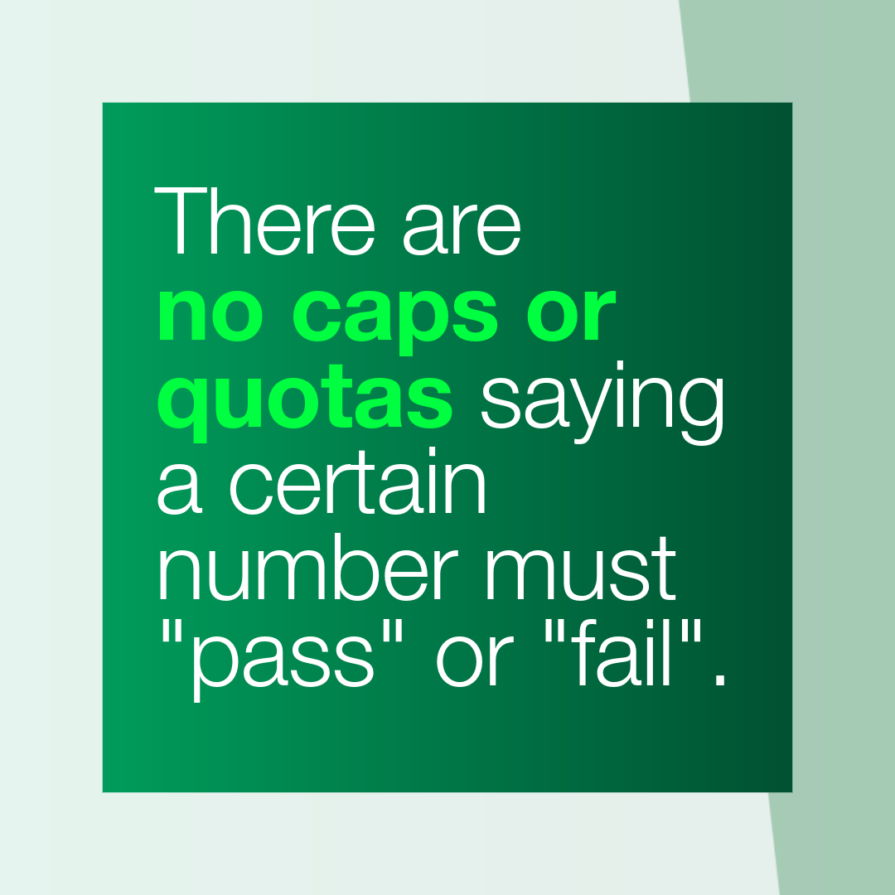
4. Myths vs facts
Notes:
Again, this isn’t true.
There are no quotas for the number of students who must pass or fail a subject each year, and no cap on the number of students that can get each grade.
The fact the number of top grades awarded is relatively stable from year to year just reflects the fact that student performance, nationwide, is usually relatively stable too. ​

Slide 21

4. Myths vs facts

Slide 22
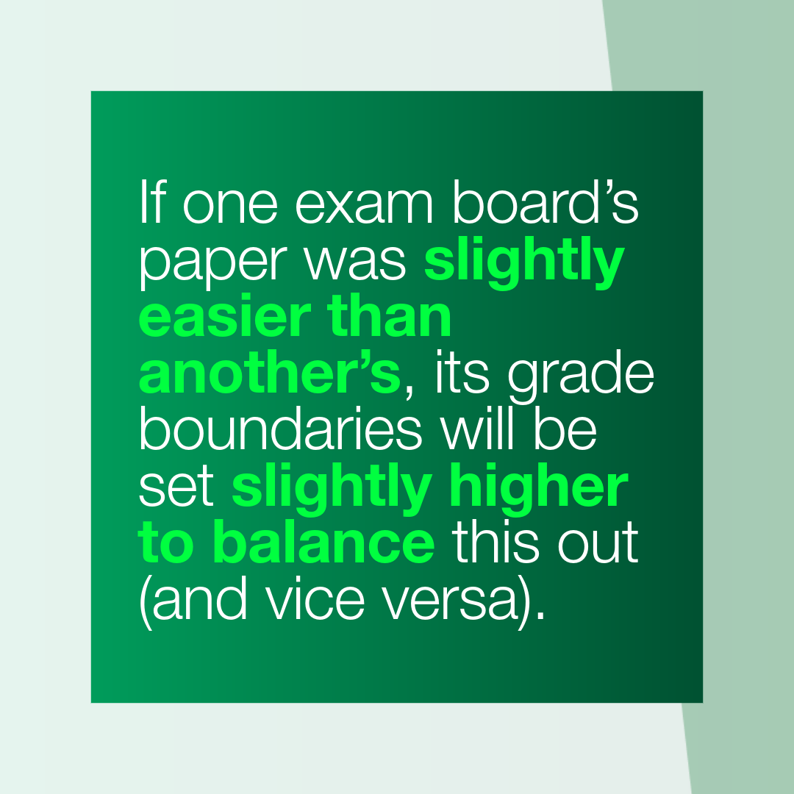
4. Myths vs facts
Notes:
All exam boards must cover the same subject content and follow the same rules. But because they each create their own exam papers, there are often small differences between the type of questions they ask or the balance of different types of questions in a particular paper. This has to be taken into account in the setting of grade boundaries - that's why they can differ between boards.

Slide 23
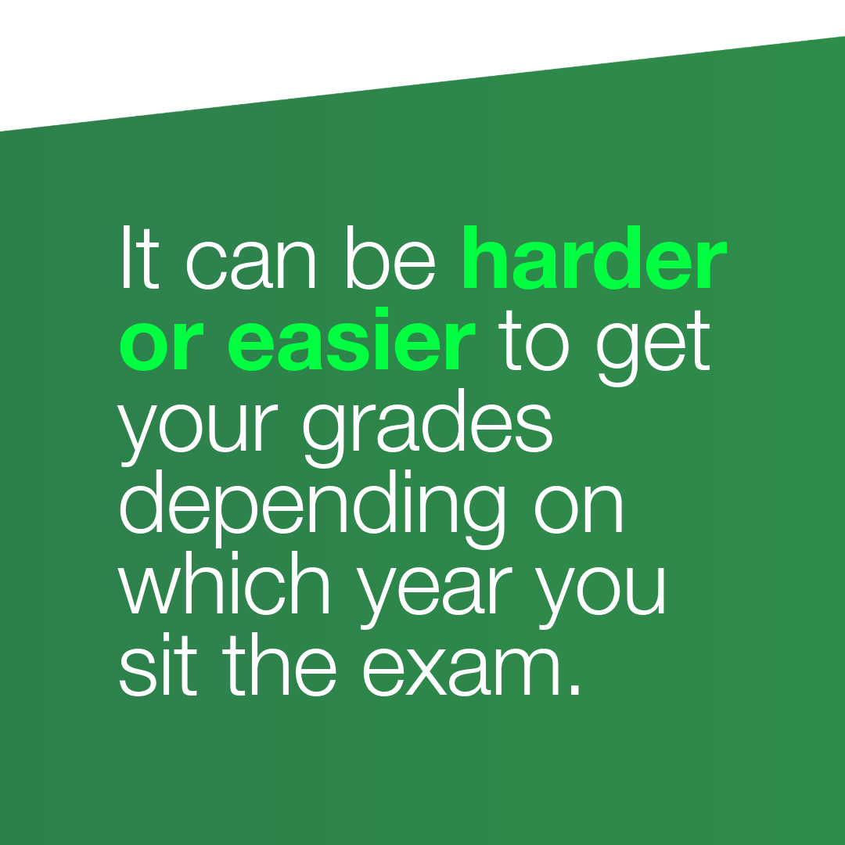
4. Myths vs facts

Slide 24
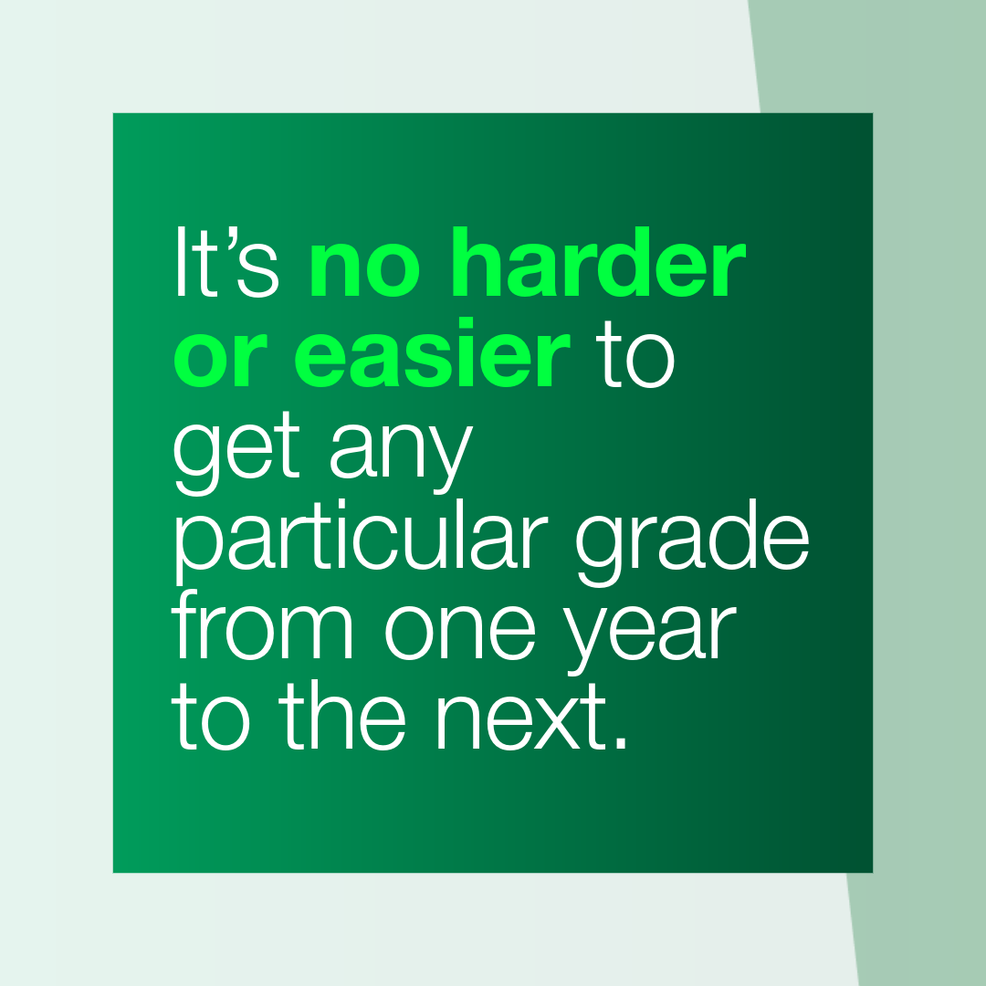
4. Myths vs facts
Notes:
This is really important to understand. The grading system is designed so that no one is advantaged or disadvantaged by the year they happen to sit their exams.

Slide 25

Recap
Your exam is marked anonymously and fairly.
Trained examiners use consistent mark schemes.
Grade boundaries adjust to keep standards consistent year on year.
Your grade reflects what you know, understand and can do.

Slide 26
Your job is to
do your best!
Your revision
Your exam technique
Showing what you know

Slide 27

Your job is to
do your best!
Now focus on:
Your revision
Your exam technique
Showing what you know
You've got this!

Slide 28
More information
Video: How GCSE and A level grading works
Teachers’ and headteachers’ toolkit: Understanding grading: toolkit for schools and colleges
Teachers’ and headteachers’ Q&A: GCSE and A level grading: what you need to know
For parents: GCSE 9 to 1 grade scale explained

