Slide 1

PFI & PF2 Projects: 2025 Summary Data
OFFICIAL

Slide 2
CONTENTS
Click on any of the below to navigate to that page.
3 Background
4 Notes on Data Quality
5 About PFI and PF2
6 Portfolio Overview
7 Future Unitary Charge (UC) Payments
9 Expiring Projects
12 Expiries Within the Next Year
13 Expiries Within the Next Seven Years
14 Portfolio Joiners and Leavers
15 Annex A: Definitions

Slide 3

BACKGROUND
This summary note provides information about Private Finance Initiative (PFI) and Private Finance 2 (PF2) projects as of 31 March 2025. It sits alongside an interactive dashboard and two supporting datasets for PFI and PF2.
This data is collated by the National Infrastructure and Service Transformation Authority (NISTA), which is part of HM Treasury (HMT).
What does it include?
Projects that are based on standard PFI or PF2 contractual terms which are delivered by:
Central government departments or their arms length bodies, including NHS Trusts
Local authorities which receive PFI grants from a sponsoring government department
Devolved administrations
What does is exclude?
Other forms of Public Private Partnerships, such as:
Projects delivered under the NHS Local Improvement Finance Trust programme (except where in receipt of a PFI grant)
Projects delivered under the Non-Profit Distributing and hub models used in Scotland and the Mutual Investment Model in Wales
Projects delivered by Local Authorities which do not receive PFI grant funding from a sponsoring government department
Projects delivered by Universities

Slide 4
NOTES ON DATA QUALITY
This information is provided by the central government departments, contracting authorities and devolved administrations that have procured or sponsored projects.
Where there are gaps in the data, this is because it has not been provided by the department and/or contracting authority responsible for the project.
97.4% of PFI projects on the portfolio provided a data return in 2025.
For the seventeen projects that did not provide a return, the most recently available data from previous years is used. Additionally, 6 projects did not include unitary charge data in their return; in these cases, the latest available historical data has also been used.
The data in this publication is not audited by HMT or NISTA, although NISTA continues to work with departments to improve its quality and reliability.

Slide 5
ABOUT PFI AND PF2
PFI and PF2 are forms of Public Private Partnerships (PPPs). PPPs are long-term contractual arrangements between a public sector entity and a private sector provider.
The private sector partner is engaged to design, build, finance, maintain and operate infrastructure assets and related services. The risks associated with construction delay, cost overrun and asset maintenance are transferred to the private sector partner.
The public sector entity does not pay for the asset during construction, as these costs are financed by the private sector. Once the asset is operational, the public sector entity pays a monthly fee – sometimes referred to as a ‘unitary charge’ – to the private sector provider. This payment includes the costs of construction, financing costs, lifecycle replacement expenditure, maintenance and services and is subject to performance, meaning that payments are reduced if services are not delivered to the standards set out in the contract.
2.1 Change in policy
In 2012, PFI was replaced with PF2. PF2 was subsequently discontinued in 2018. Due to this change in policy, the portfolio consists of a sizeable but decreasing number of projects which each have a diminishing number of years left in their contract. As a result, the portfolio represents a decreasing amount in financial liabilities for the public sector (£128bn estimated unitary charge payments remaining from the 2025-26 financial year onwards).

Slide 6
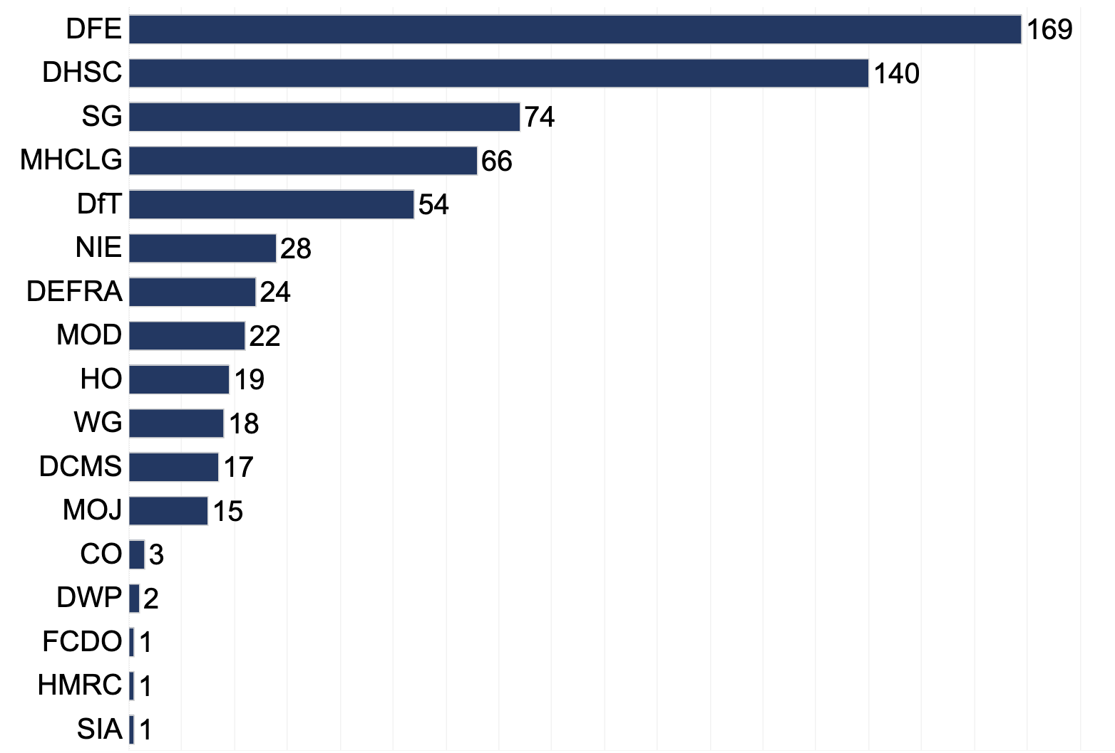
PORTFOLIO OVERVIEW
Number of Projects by Department
As of 31 March 2025, there were 654 operational PFI projects with an original total capital value of £49.6bn.
Capital value is the total nominal capitalised cost as recorded in the financial model at financial close.
The two largest departments in the portfolio - Department for Education (DfE) and Department of Health and Social Care (DHSC) - account for 309 projects, just under half (47%) of the total number of projects in the portfolio.
Similarly, the most common sectors for PFI are “Hospitals and Acute Health,” “Schools (Non-BSF)” and “Schools (BSF), which represent 57% of the PFI portfolio (376 projects).

Slide 7
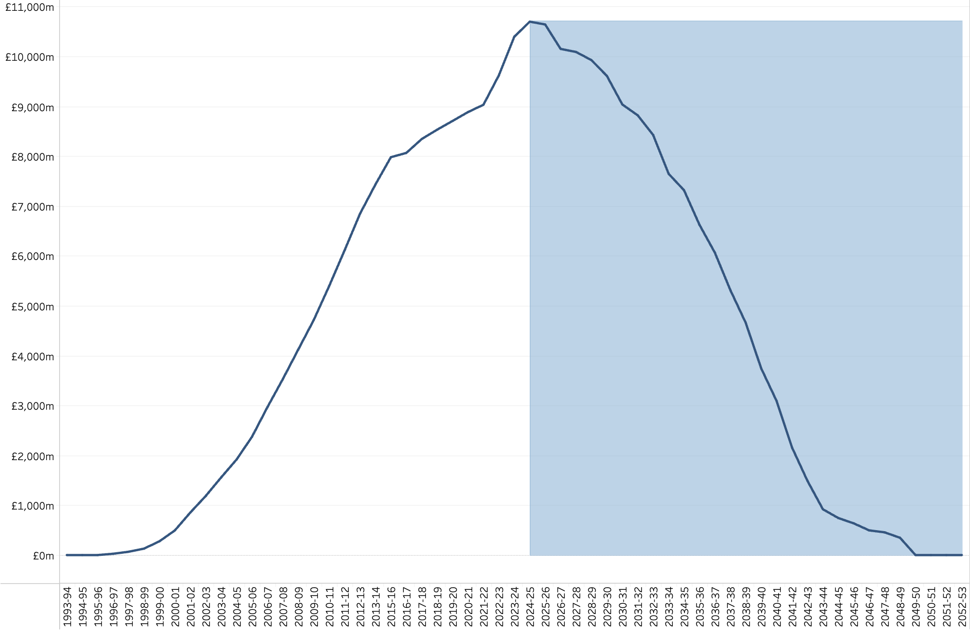
FUTURE UNITARY CHARGE PAYMENTS
Unitary Charge Payments By Financial Year
£10.7bn of UC payments were made during the 2024-25 financial year.
The estimated remaining UC payments (from 2025-26 until the final payment is made) total £128bn.
This represents just under half (46%) of the total expected lifetime UC payments for the operational portfolio
Actual unitary charge payments to date
Estimated future unitary charge payments
It is anticipated that 2024-25 represents the peak (£10.7bn) of UC payments. Payments will continue to decline year on year until the 2048-49 financial year.
Just under three quarters (71%, or £91.7bn) of the total remaining UC is expected to be paid within the next 10 years (2025-26 until 2034-35).

Slide 8
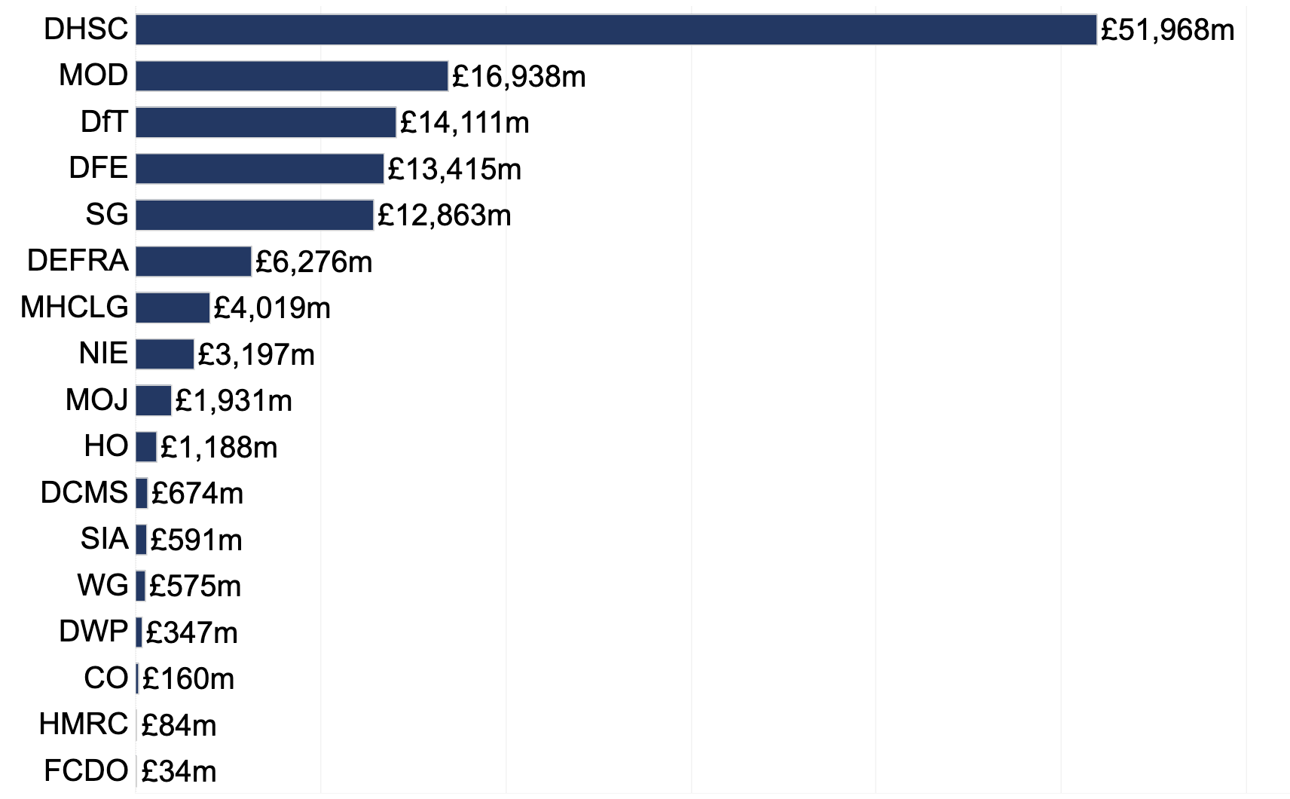
FUTURE UNITARY CHARGE PAYMENTS
Estimated remaining (2025-26 onwards) unitary charge payments by department
While DFE has the greatest number of projects, DHSC has the largest estimated UC payments remaining (from 2025-26 onwards).
A large portion of these payments relate to the ongoing required maintenance of assets.
DHSC represents two fifths (40%) of the estimated remaining UC payments from 2025-26 onwards.

Slide 9
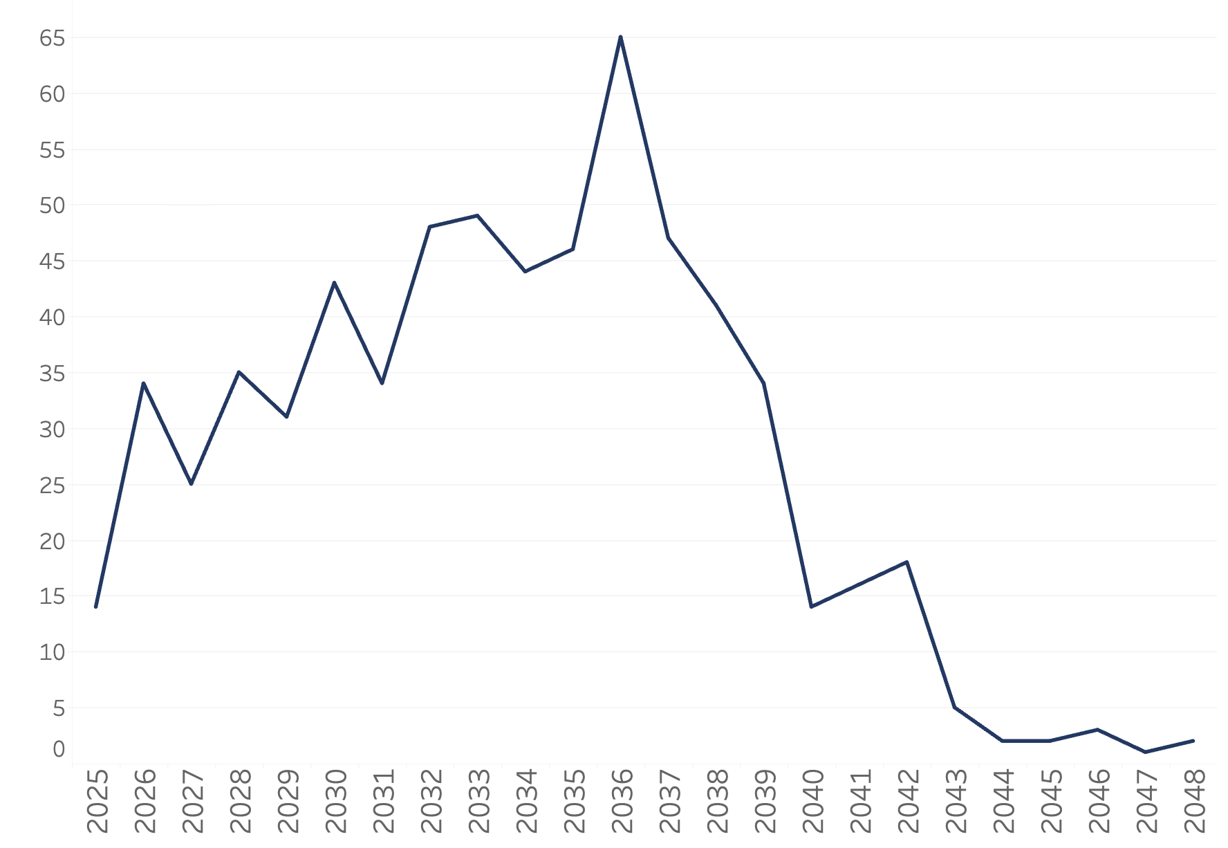
EXPIRING PROJECTS
Contract expiries over time
The number of contract expiries are expected to increase each year, from now until 2036.
Following this, there is a steep decline in the number of expiries each year, with the final two expiries coming in 2048
There are 14 contract expiries expected in 2025, increasing steadily to a peak of 65 in 2036. After 2036, the number of expiries per year declines rapidly, with the final two occurring in 2048.
For a small number of DHSC projects, their expiry dates are listed as their first contract break date.

Slide 10
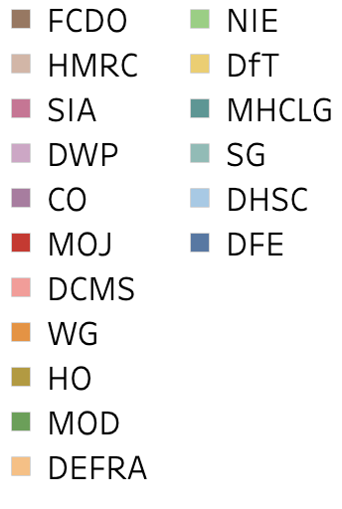
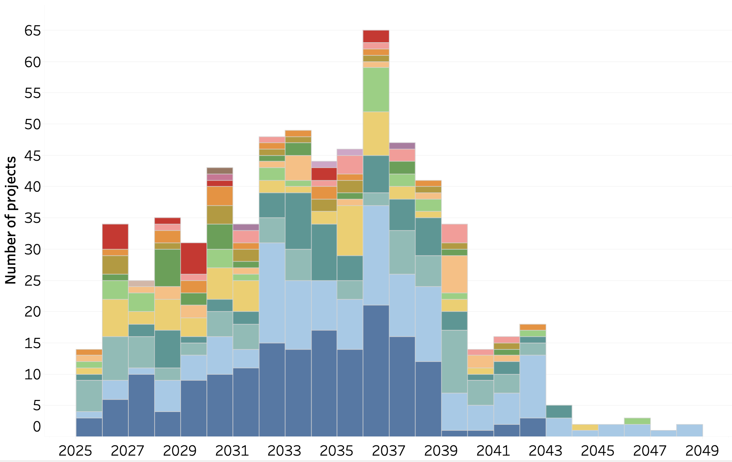
EXPIRING PROJECTS
Contract expiries over time, by department
The 2036 expiry “peak” is driven mainly by DFE and DHSC projects.
Later expiries (from 2043 onwards) consist mainly of DHSC projects.

Slide 11
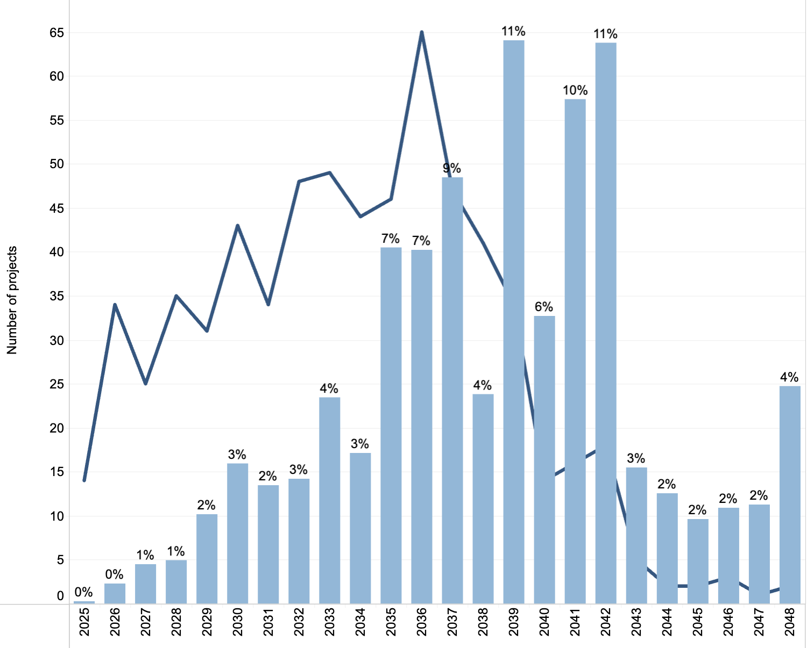

EXPIRING PROJECTS
Projects expiring each year, and their % share of estimated remaining unitary charge payments
Number of expiring projects
While the peak of expiries occurs in 2036, projects expiring between 2039-2042 account for the largest proportion (38%) of total remaining UC payments.
Gripping these projects now by improving contract management will protect the associated value at risk. This underlines the fact that the PFI Contract Management Programme should not be exclusively expiry focused.
Their % share of total remaining UC payments

Slide 12
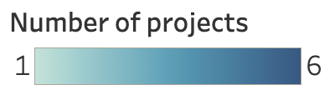
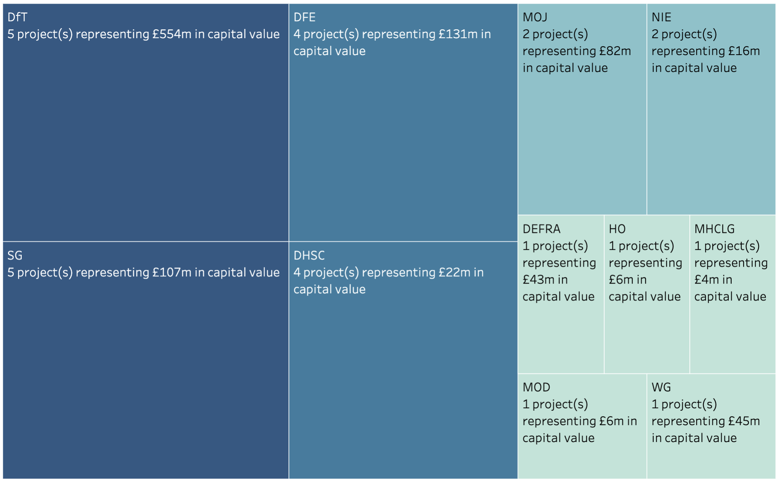
EXPIRIES WITHIN THE NEXT YEAR
Contract expiries within the next year
Years from expiry is calculated from 31 March 2025
Capital value is the total nominal capitalised cost as recorded in the financial model at financial close.

Slide 13
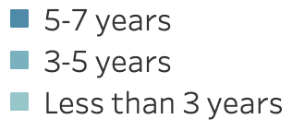
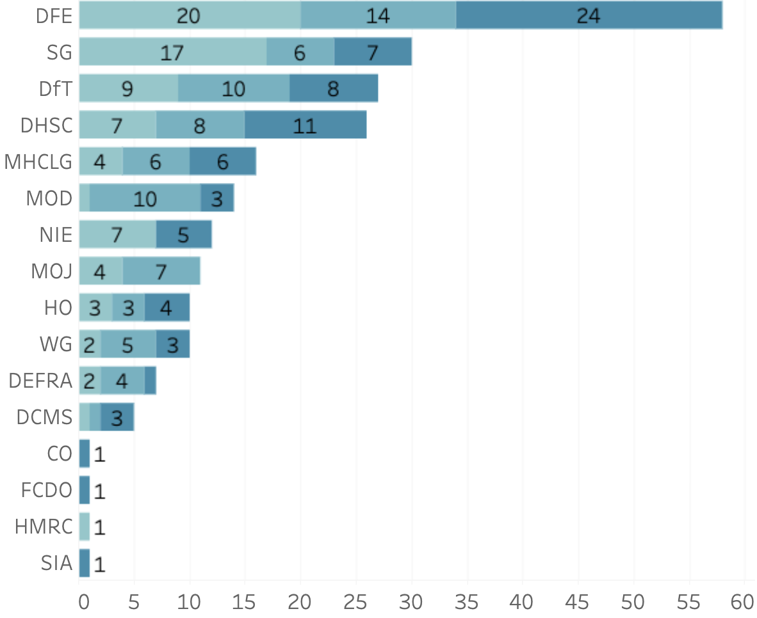
EXPIRIES WITHIN THE NEXT SEVEN YEARS
Contract expiries within the seven years
DFE accounts for one quarter (25%) of expiries occurring within the next 7 years.
Local authority contracted projects account for 48% of those expiring over the next seven years. A further 23% are contracted by devolved authorities.
Years from expiry is calculated from 31 March 2025. This means that projects listed as ‘7 years from expiry’ are expected to expire between 31 March 2025 and 31 March 2032.

Slide 14
PF2 equity return data
Project | Shareholders | Total Expected Returns¹
 |  | At Financial Close |  |  | At Reporting Period 31MAR2025
 |  | Date | IRR (Nominal) | IRR (Real) | IRR (Nominal) | IRR (Real)
PSBP - Hertfordshire, Luton and Reading
 | IUK Investments Limited | 19/03/2015 | 10.30% | 7.59% | 10.48% | 6.58%
 | Greenwood Partnership Venture | 19/03/2015 | 10.30% | 7.59% | 10.48% | 6.58%
PSBP - North East
 | IUK Investments Limited | 03/10/2015 | 12.00% | 9.40% | 12.88% | 9.92%
 | John Laing Investments Holdings Ltd | 03/10/2015 | 12.00% | 9.40% | 12.88% | 9.92%
PSBP - North West
 | IUK Investments Limited | 23/03/2015 | 12.00% | 9.27% | 12.40% | 9.67%
 | Equitix Infrastructure 6 Limited | 23/03/2015 | 12.00% | 9.27% | 12.40% | 9.67%
 | Equitix Infrastructure 3 Limited | 23/03/2015 | 12.00% | 9.27% | 12.40% | 9.67%
PSBP - Yorkshire
 | IUK Investments Limited | 19/03/2015 | 11.20% | 7.79% | 11.91% | 7.69%
 | Equitix Limited | 19/03/2015 | 11.20% | 7.79% | 11.91% | 7.69%
PSBP - Midlands²
 | IUK Investments Limited | 08/12/2015 | 11.50% | 8.80% | n/a | n/a
 | International Public Partnerships Limited | 08/12/2015 | 11.50% | 8.80% | n/a | n/a
¹ Equity Internal Rate of Return (IRR) excluding fees
² Midlands Schools equity written off September 2018
To improve transparency under PF2, the government requires the private sector to disclose both actual and forecast equity returns for publication.
This table sets out the equity internal rate of return (IRR) data as of 31 March 2025 for PF2 projects. These projects are all schools.
The data for each of these projects are also included in a supporting spreadsheet available alongside this report on the gov.uk website.

Slide 15
PORTFOLIO LEAVERS AND JOINERS
HMT ID | Project Name | Department | Procuring Authority | Leaving / Joining | Reason
69 | Barnhill School | DFE | Hillingdon | Leaving | Expired
136 | Stretford Divisional Headquarters Fire Station | HO | Greater Manchester Fire and Rescue Service | Leaving | Expired
382 | Forrester Court Residential & Nursing Home | DHSC | Westminster | Leaving | Expired
431 | Defence Fixed Telecommunications Service | MOD | Ministry of Defence (MOD) | Leaving | Expired
440 | Heavy Equipment Transporters | MOD | Ministry of Defence (MOD) | Leaving | Expired
462 | Strategic Sealift Service | MOD | Ministry of Defence (MOD) | Leaving | Expired
479 | HMP Ashfield | MOJ | National offender management service | Leaving | Expired
528 | Kinnegar WwTW | NIE | Northern Ireland Water | Leaving | Expired
630 | Chepstow Community Hospital | Welsh Government | Aneurin Bevan Local Health Board | Leaving | Expired
631 | Day Surgery Unit, Nevill Hall Hospital | Welsh Government | Aneurin Bevan Local Health Board | Leaving | Expired
1512 | Dawlish Hospital | DHSC | Torbay and Southern Devon Health and Care NHS Trust | Leaving | Expired
2106 | The Meadows | DHSC | Stockport Healthcare NHS Trust | Leaving | Expired
2408 | Oakhill PFI Expiry and Future Service Project | MOJ | HM Prison and Probation Service | Joining | Previously assessed as non-PFI, the project has now been reclassified
The size of the portfolio has reduced to 654 projects in 2025 compared to 665 in 2024.
This is due to twelve projects leaving the portfolio and one joining.

Slide 16
ANNEX A: DEFINITIONS
Capital Value: This is the total nominal capitalised cost of the project as recorded in the financial model at financial close. This includes SPV debt plus total shareholder investment (equity and shareholder loans) plus any authority capital contribution.
Financial Close: The date the project reached contract signature
Procuring Authority: The procuring authority responsible for commissioning the project
SPV: The Special Purpose Vehicle which is the company carrying out the project
Remaining Unitary Charge (UC): The estimated total unitary charges remaining from the next financial year (2025-26) until the final payment is made.
Unitary Charge (UC): The payment made by the procuring authority to the contractor from the start of operation until the end of the contract. It covers the cost of the construction of the asset, of borrowing debt and equity investment, taxes, operating services such as cleaning, and maintenance.
Nominal Equity Internal Rate of Return (IRR): The projected nominal internal rate of return (IRR) represents the return equity providers expect to receive over the whole life of the project, including the impact of inflation.
Real Equity Internal Rate of Return (IRR): The projected nominal internal rate of return (IRR) represents the return equity providers expect to receive over the whole life of the project, excluding the impact of inflation.

