Slide 1


Weatherbury College
Management Accounts for the period to 31 January 202X
Headlines | Current Status | Impact | RAG | Change
Operating surplus (deficit) to date | Operating deficit to Jan 202X of £575,000 | £150,000 adverse | Red | Decreased
Income vs budget to date | Income to January 202X £10.147 million | £202,000 (2%) adverse | Red | No change
Pay costs vs budget to date | Pay costs tracking £84,000 (1%) below budget |  | Green | Increased
Non-pay costs vs budget to date | Non pay costs £28,000 (1%) over budget |  | Amber | Decreased
Forecast out-turn surplus (deficit) | Forecast deficit for year of £262,000 | £242,000 adverse | Red | Decreased
Forecast out-turn EBITDA | Forecast EBITDA £655,000 (3.2% of turnover) | £250,000 adverse | Red | Decreased
Capital Programme | All planned capital expenditure on track |  | Green | No change
Asset Disposals | No major asset disposals planned |  | Green | No change
Cash vs forecast | Projected year-end cash 38 cash days in hand | £200,000 adverse | Amber | Decreased
Cash generation from operations | Forecast £700,000 increase | £207,000 adverse | Red | Decreased
Covenant compliance | Prospect of loan covenant breach | Work ongoing | Red | Decreased
Financial health | Revised forecast 120 points (RI) | Risk of inadequate FH | Red | Decreased

Slide 2
Key Performance Indicators
Indicator | Actuals | Forecast (full year) | Budget / Target (full year) | Variance | RAG | Movement
Turnover | £10.15m | £20.67m | £21.03m | (£0.36m) | Red | Decreased
Operating Surplus/Deficit | (£0.58m) | (£0.26m) | (£0.02m) | (£0.24m) | Red | Decreased
Operating Surplus/Deficit as % of Turnover | (5.7%) | (1.3%) | (0.1%) | (1.2%) | Red | No change
Education EBITDA | (£0.04m) | £0.66m | £0.91m | (£0.25m) | Red | Decreased
Education EBITDA as % of Turnover | (0.4%) | 3.2% | 4.3% | (1.1%) | Red | No change
Cash Reserves | £2.09m | £2.08m | £2.28m | (£0.2m) | Red | No change
Cash Days in Hand | 38 | 38 | 41 | -3 days | Amber | Decreased
Loan balance | £8.12m | £7.92m | £7.92m | nil | Green | No change
Debt service cover |  | 0.97 | 1.26 | (0.29) | Red | Decreased
Staff Numbers (fte’s) | 329.2 |  | 335.8 |  | Green | No change
Pay as % of Turnover | 69.7% | 68.2% | 68.1% | (0.1%) | Green | No change
Debtor Days | 15 | 13 | 14 | 1 | Green | No change
Creditor Days | 31 | 26 | 26 | - | Green | No change

Slide 3
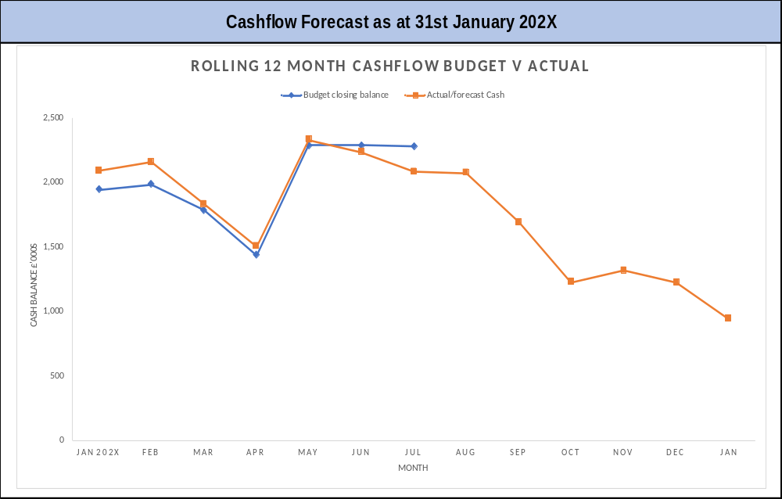
Cash
Notes and assumptions
Actual cash at bank at 31 January is £2.09 million, equivalent to 38 cash days in hand. This is marginally lower than forecast due to the adverse operating performance to date.
Cash balances are forecast to fall to a low-point of £1.5 million at the end of April 202X, equivalent to 27 cash days in hand (below the FEC benchmark of 40 cash days)
Creditor payments are not falling behind.
However, forecast EBITDA for the year of £655,000 is substantially less than the combined costs of debt servicing (£720,000) and the capital programme (£691,000). This underlines the need to improve EBITDA going forward to avoid the continuing decline in cash reserves.
Debt recovery actions are working well, with debtor days currently at 15 compared to the target of 14 for the year as a whole.
This is an illustrative example of a cashflow forecast as described under ‘notes and assumptions.’

Slide 4
Loan Covenant Compliance
Not | Forecast (full year) | Budget (full year) | Covenant Met? | Head room
Debt service cover > 1.25 | 0.97 | 1.26 | NO | Not met
Net borrowings: EBITDA < 7.0 | 8.91 | 6.23 | NO | Not met
Net Assets (excluding pension liability) >0 | £3.17m | £3.41m | YES | £3.17m
In order to avoid a covenant breach, EBITDA performance would need to improve by £199,000.
Given the prospect of a covenant breach, dialogue is ongoing with the bank to secure a waiver or agreement not to measure the covenants at year-end.
In the event that agreement cannot be reached and the bank loan has to be re-classified as a current liability, this will impact adversely on the solvency ratio and almost certainly push the financial health autoscore to inadequate (headroom above inadequate is already as low as £37,000).
The DfE has been informed of this risk.

Slide 5
Financial Health
Indicator | Budget (full- year) | Points | Forecast Out-turn | Points | Move ment
Solvency (adjusted current ratio) | 0.89 | 40 | 0.83 | 40 | No change
Performance (EBITDA as % of adjusted income) | 4.3% | 40 | 3.2% | 30 | Decreased
Borrowing (Loans as % of adjusted income) | 37.7% | 50 | 38.3% | 50 | No change
Automated Financial Health Grade | RI | 130 | RI | 120 | Decreased
Self-Assessed Financial Health Grade | RI |  | RI
In the event that agreement cannot be reached and the bank loan has to be re-classified as a current liability, this will impact adversely on the solvency ratio and almost certainly push the financial health autoscore to inadequate (headroom above inadequate is already as low as £37,000).
The DfE has been informed of this risk.

Slide 6
Student Numbers
Headcount | Full year actuals (last year) | Actuals (current year) | Full-year budget | Full-year forecast | RAG | Financial Implications
16-19 students | 2,820 | 2,780 | 2,710 | 2,790 | Green | Increase in lagged funding in 202X/2Y of circa £350,000
ASF (including devolved) | 1,120 | 743 | 1,230 | 1,150 | Red | Forecast shortfall of £139,000 in 202W/2X which is outside tolerances
16-18 Apprenticeships | 210 | 115 | 136 | 128 | Red | Forecast shortfall in income of £36,000. Substantial decline from previous year
19+ Apprenticeships | 220 | 123 | 145 | 135 | Red | Forecast shortfall in income of £20,000
HE: full-time | 162 | 128 | 135 | 125 | Red | Forecast shortfall in income of £85,000 Substantial decline from previous year
HE: part-time | 165 | 160 | 160 | 155 | Amber | Marginally behind budget (£7,000 shortfall forecast)
Advanced Learner Loans | 185 | 155 | 180 | 180 | Green | Broadly on budget

Slide 7
Income and Expenditure Commentary
Income
Adult Skills Fund (ASF and devolved) performance tracking 6% behind budget to date, forecast shortfall at year-end £139,000 (therefore outside tolerance)
Apprenticeships income tracking £29,000 (6%) behind budget to date, forecast shortfall £56,000 (6%) at year-end
HE loan income tracking £45,000 (5%) behind budget to date, forecast to increase to £92,000 shortfall (5%) by year-end
Overall income performance for the period to 31 January is £202,000 (2%) below budget. Full-year forecast income at £20.670m is £356,000 (2%) below budget.
Compared with 202V/2W, forecast income is down 5% from £21.8m to £20.67m
Pay
Teaching pay costs to date are £47,000 (1%) below budget to date, partly offset by an additional £33,000 on sessional staff. Forecast outturn is a net underspend of £69,000 (1%) on teaching and sessional staffing
Non-teaching pay costs are tracking £62,000 (2%) below budget to date, which is forecast to continue to year-end (underspend of £128,000 or 2%)
Overall pay costs to date are £84,000 (1%) below budget to date, forecast to increase to an underspend of £216,000 (2%) by year end.
Despite this pay costs as % of turnover are forecast to out-turn slightly above budget at 68.2% due to lower forecast turnover. At 68.2% pay costs remain 3.2% above the FEC benchmark of 65%.

Slide 8
Income and Expenditure Commentary (continued)
Non-pay
Overall non-pay expenditure to 31 January is tracking £28,000 over budget to date, with the main pressure points being other operating expenditure(£54,000 which includes £31,000 on student laptops); rent and lease costs(£33,000); estates(£30,000);
The forecast out-turn non-pay costs at £6.119m are £110,000 (2%) over budget despite a forecast underspend of £33,000 on education supplies and services
Sub-contracted Delivery
Sub-contracted delivery is budgeted at £300,000 for the year as a whole, representing under 2% of total delivery
Delivery to date is marginally behind profile but forecast to hit the contracted volume by year-end.
Direct costs of subcontracted delivery at £240,000 for the year equate to 80% of the value of the provision
Overall Income and Expenditure Performance
Actual performance to date is behind budget giving rise to an operating deficit to date of -£575,000 and EBITDA of -£37,000
The forecast out-turn deficit of £262,000 is £242,000 higher than the budgeted deficit of £20,000 giving rise to EBITDA of £655,000 (3.2%). This is substantially worse than the previous year out-turn surplus of £827,000 (EBITDA of £1.893m or 8.7%)

Slide 9
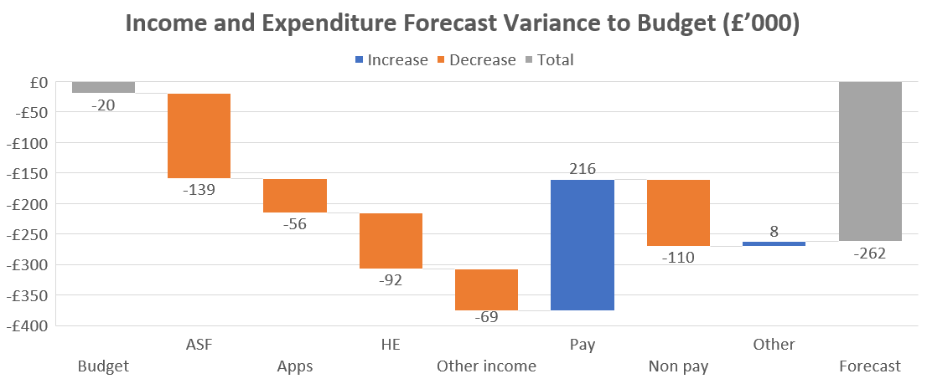
Income and Expenditure Bridge

Slide 10
Sensitivity testing
Forecast Out-turn (£’000) | Base case | Best case | Worst case
16-19 Grant Income | 13,022 | 13,022 | 13,022
Adult Skills Fund | 2,848 | 2,987 | 2,688
Other Grants / LA Income | 653 | 653 | 653
Apprenticeships | 855 | 855 | 855
Higher Education Grants / Fees | 2,126 | 2,126 | 2,126
Adv Learner Loans, FE and Full Cost Fees | 849 | 849 | 799
Other Income | 317 | 317 | 317
Total Income | 20,670 | 20,809 | 20,460
Pay Costs (excluding staff restructuring) | 13,896 | 13,814 | 13,896
Staff Restructuring Costs | 0 | 0 | 0
Other Non-Pay Costs | 6,119 | 5,959 | 6,119
Total Operating Expenditure | 20,015 | 19,773 | 20,015
Education EBITDA | 655 | 1,036 | 445
Release of Capital Grants | 102 | 102 | 102
Investment Income | 12 | 12 | 12
Depreciation | (715) | (715) | (715)
Interest | (316) | (316) | (316)
Operating Surplus / Deficit | (262) | 119 | (472)
The table opposite indicates three scenarios for the forecast out-turn reflecting three key variables (see numbers highlighted in boxes):
ASF income (full achievement of allocations under best case and shortfall of 10% worst case)
FE / Full cost fees potential additional shortfall of £50,000 (worst case)
Achievement in-year of £82,000 savings in pay costs and £160,000 non-pay costs (best case)
The best case scenario would result in an operating surplus of £119,000 i.e. marginally better than budget.
The base case scenario (most likely outcome) results in a operating deficit of £262,000 which will trigger a covenant breach, which needs to be discussed with the DfE. If a waiver can be secured financial health will remain requires improvement.
The worst case scenario results in an operating deficit of £472,000 and covenant breach. Even if a waiver is secured, the financial health autoscore would fall to inadequate to a lower EBITDA and a weaker adjusted current ratio.

Slide 11
Capital expenditure
Capital Budget | Year to date actual £’000 | Committed £’000 | Total (actual + committed) £’000 | Full year budget £’000 | Forecast Full Year £’000 | Forecast under/(overspend) £’000
Server upgrades | 34 | 15 | 49 | 60 | 60 | 0
New HR system | 10 | 34 | 44 | 40 | 45 | (5)
Replacement PCs | 141 | 22 | 163 | 250 | 237 | 13
Curriculum equipment | 32 | 28 | 60 | 60 | 67 | (7)
Relocation of electrical | 20 | 0 | 20 | 160 | 140 | 20
Refectory upgrade | 88 | 29 | 117 | 131 | 142 | (11)
Total | 325 | 128 | 453 | 701 | 691 | 10
Notes: All capital projects are proceeding to plan. Overall capex for the year is forecast to be £10,000 below the full-year budget.

Slide 12
Summary of Key Financial Risks
Ref | Risk | RAG rating
1 | Failure to achieve budget targets for 202W/2X leads to a breach of loan covenants that could trigger a decline in financial health to inadequate | Red
2 | Failure to improve the underlying financial sustainability, including forward cashflows, of the college leading to a possible case for structural change | Red
3 | Failure to secure agreement with the bank regarding waiver of the forecast covenant breach and/or to revised covenant terms, leading to requirement to report to DfE | Red
4 | Cash days of 27 days in April 202X (low point for year), decreasing to 17 days in January 202Y | Amber

Slide 13
Issues for further review
Ref | Issue | Timescale
1 | Monitoring of forecast loan covenant breach and progress with securing waiver before year-end. Inform DfE of potential breach. | July 202X
2 | Monitoring of potential for decline in forecast financial health grade for 202W/2X to inadequate (linked to covenant breach). Inform DfE of potential decline. | July 202X
3 | Confirmation of cost reduction actions aimed at achieving target in-year savings of circa £242,000 | April 202X (actions agreed) July 202X (actions implemented)
4 | Confirmation of strategies to achieve ASF budget targets for 202W/2X i.e. closing projected shortfall of £139,000 | April 202X (actions confirmed) July 202X (actions implemented)

