Slide 1

Toolbox Talk: Drivers' Hours, Breaks & Tachographs
Understanding regulations for safe and compliant driving schedules

Slide 2
Introduction and Objectives
Notes:
---
This slide references information from the following file: https://dvsauk-my.sharepoint.com/personal/nicholas_tiplady_otc_gov_uk/_layouts/15/Doc.aspx?sourcedoc=%7B986E5C4B-ADE7-4F8A-A99D-50F4E3179472%7D&file=DriversHoursBlog%20for%20KR.docx&action=default&mobileredirect=true
Purpose of the Toolbox Talk, Objectives of the Session

Slide 3

Purpose of the Toolbox Talk
Importance of Drivers’ Hours
  Drivers’ hours regulations prevent fatigue, promote safety, and ensure fair competition in transport industries.
Break Scheduling Compliance
  Proper break scheduling helps drivers stay rested, reducing accident risks and maintaining health.
Tachograph Best Practices
  Using tachographs correctly ensures accurate tracking of driving time and regulatory compliance.
Goals
  This talk aims to equip you with useful knowledge to stay legal, rested, and safe on the road.
Notes:
---
This slide references information from the following file: https://dvsauk-my.sharepoint.com/personal/nicholas_tiplady_otc_gov_uk/_layouts/15/Doc.aspx?sourcedoc=%7B986E5C4B-ADE7-4F8A-A99D-50F4E3179472%7D&file=DriversHoursBlog%20for%20KR.docx&action=default&mobileredirect=true
This toolbox talk is designed to help drivers understand the critical importance of drivers’ hours regulations, proper break scheduling, and tachograph usage. The purpose is to reinforce safety, compliance, and professionalism in daily operations. Drivers’ hours rules exist to prevent fatigue-related accidents, safeguard driver health, and maintain fair competition in the transport industry. By following these rules, drivers not only protect themselves and others on the road but also contribute to the reputation and reliability of their company. The session will cover why these rules matter, which regulations apply to different journeys, key limits for driving and rest periods, tachograph best practices, common pitfalls with real-world examples, and practical tips for compliance. The ultimate goal is to ensure that every driver leaves with actionable knowledge to stay legal, rested, and safe.

Slide 4
Objectives of the Session
(Optional)
Purpose of Drivers' Hours Rules
  Explain why drivers’ hours rules exist and how they protect drivers and the public.
Applicable Rules for Journeys
  Identify rules for goods vehicles and passenger service vehicles on specific journeys.
Limits on Driving and Rest Times
  Outline driving time limits, breaks, daily rest, and weekly rest periods for drivers.
Tachograph Usage and Mistakes
  Demonstrate correct tachograph use and highlight common mistakes causing infringements.
Compliance Risks and Examples
  Show real-world examples of compliance failures and consequences for drivers.
Practical Strategies for Drivers
  Provide strategies for route planning, managing breaks, and record keeping.
Notes:
---
This slide references information from the following file: https://dvsauk-my.sharepoint.com/personal/nicholas_tiplady_otc_gov_uk/_layouts/15/Doc.aspx?sourcedoc=%7B986E5C4B-ADE7-4F8A-A99D-50F4E3179472%7D&file=DriversHoursBlog%20for%20KR.docx&action=default&mobileredirect=true
The objectives of this toolbox talk are clear: first, to explain why drivers’ hours rules exist and how they protect both drivers and the public. Second, to identify which rules apply to specific journeys, whether for goods vehicles or passenger service vehicles (PSVs). Third, to outline key limits for driving time, breaks, daily rest, and weekly rest periods. Fourth, to demonstrate correct tachograph usage and highlight common mistakes that lead to infringements. Fifth, to provide real-world examples of compliance failures and their consequences, helping drivers understand the risks of non-compliance. Finally, the session aims to equip drivers with practical strategies for planning routes, managing breaks, and maintaining accurate records. By achieving these objectives, drivers will be better prepared to meet legal requirements and uphold safety standards.

Slide 5
Why Drivers’ Hours Rules Matter
Notes:
---
This slide references information from the following file: https://dvsauk-my.sharepoint.com/personal/nicholas_tiplady_otc_gov_uk/_layouts/15/Doc.aspx?sourcedoc=%7B986E5C4B-ADE7-4F8A-A99D-50F4E3179472%7D&file=DriversHoursBlog%20for%20KR.docx&action=default&mobileredirect=true
Safety and Health Benefits, Fair Competition and Industry Standards

Slide 6


Safety and Health Benefits
Fatigue Prevention
  Drivers’ hours regulations prevent fatigue, a major cause of road accidents, by enforcing rest and break periods.
Health Protection
  The rules reduce stress and promote adequate rest, supporting drivers’ long-term health and wellbeing.
Public Confidence
  Compliance with regulations demonstrates professionalism, maintaining public trust in the transport industry.
Notes:
---
This slide references information from the following file: https://dvsauk-my.sharepoint.com/personal/nicholas_tiplady_otc_gov_uk/_layouts/15/Doc.aspx?sourcedoc=%7B986E5C4B-ADE7-4F8A-A99D-50F4E3179472%7D&file=DriversHoursBlog%20for%20KR.docx&action=default&mobileredirect=true
Drivers’ hours regulations are primarily designed to prevent fatigue, which is a major contributor to road accidents. Studies show that tiredness can impair driving ability as severely as alcohol, making it a silent but deadly risk. By enforcing structured rest and break periods, these rules significantly reduce the likelihood of fatigue-related crashes. Beyond safety, the rules also protect driver health by ensuring adequate rest and reducing stress caused by overwork. Compliance with these regulations promotes a healthier work-life balance, which is essential for long-term wellbeing. Furthermore, adherence to drivers’ hours rules helps maintain public confidence in the transport industry, demonstrating that operators and drivers prioritize safety and professionalism over shortcuts or unlawful practices.

Slide 7

Fair Competition and Industry Standards for us all
The rules make business fair
  Regulations prevent companies from pressuring drivers to work excessive hours, ensuring a level playing field.
Promoting Safety Standards
  Uniform rules help protect you from unsafe working conditions and reduce risks on the road.
Upholding Industry Integrity
  Compliance with standards maintains transport industry integrity benefiting drivers, operators, and the public.
Notes:
---
This slide references information from the following file: https://dvsauk-my.sharepoint.com/personal/nicholas_tiplady_otc_gov_uk/_layouts/15/Doc.aspx?sourcedoc=%7B986E5C4B-ADE7-4F8A-A99D-50F4E3179472%7D&file=DriversHoursBlog%20for%20KR.docx&action=default&mobileredirect=true
Another critical reason for drivers’ hours regulations is to ensure fair competition among operators. Without these rules, some companies might pressure drivers to work excessive hours, gaining an unfair advantage over compliant operators. This creates a dangerous environment where safety is compromised for profit. By enforcing uniform standards, regulators maintain a level playing field and uphold the integrity of the transport industry. Compliance also protects drivers from exploitation, ensuring they are not forced into unsafe working conditions. Ultimately, these rules benefit everyone—drivers, operators, and the public—by promoting a culture of safety, fairness, and accountability.

Slide 8
Key Rules and Limits
Notes:
---
This slide references information from the following file: https://dvsauk-my.sharepoint.com/personal/nicholas_tiplady_otc_gov_uk/_layouts/15/Doc.aspx?sourcedoc=%7B986E5C4B-ADE7-4F8A-A99D-50F4E3179472%7D&file=DriversHoursBlog%20for%20KR.docx&action=default&mobileredirect=true
Driving Time and Break Requirements, Daily and Weekly Rest Periods

Slide 9

Driving Time and Break Requirements
Continuous Driving Limit
  Drivers must not exceed 4.5 hours of continuous driving without a break to reduce fatigue and risk.
Mandatory Break Duration
  A 45-minute break is mandatory after 4.5 hours of driving, which can be split into 15 and 30-minute segments.
Importance of Breaks
  Structured breaks help maintain alertness and reduce fatigue, decreasing accident risks significantly.
Route Planning for Breaks
  Drivers should use route planners or apps to schedule breaks and avoid last-minute rushes and penalties.
Notes:
---
This slide references information from the following file: https://dvsauk-my.sharepoint.com/personal/nicholas_tiplady_otc_gov_uk/_layouts/15/Doc.aspx?sourcedoc=%7B986E5C4B-ADE7-4F8A-A99D-50F4E3179472%7D&file=DriversHoursBlog%20for%20KR.docx&action=default&mobileredirect=true
Under assimilated EU rules, drivers must not exceed 4.5 hours of continuous driving without taking a break. After this period, a 45-minute break is mandatory. This break can be split into two segments: the first of at least 15 minutes, followed by a second of at least 30 minutes, taken before reaching the 4.5-hour limit. These structured breaks are essential for reducing fatigue and maintaining alertness. Failure to comply with these requirements can result in infringements, penalties, and increased risk of accidents. Drivers should plan their routes with these breaks in mind, using apps or route planners to identify suitable rest stops and avoid last-minute rushes.

Slide 10
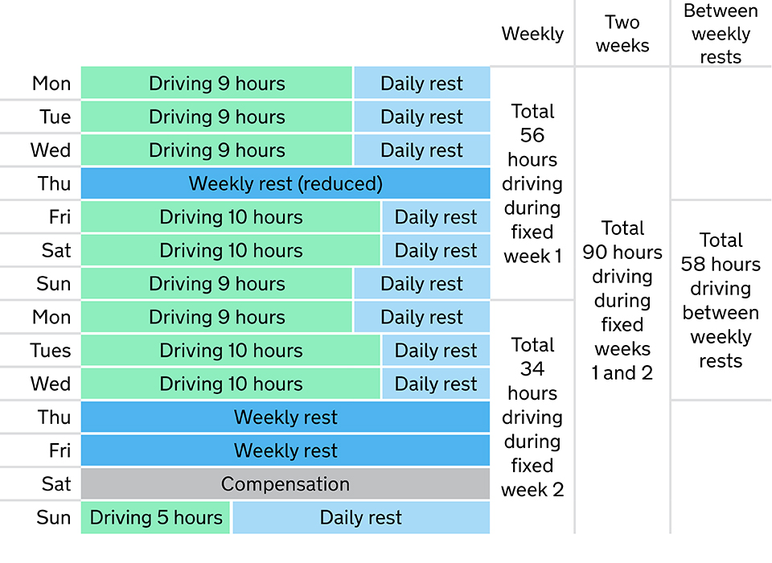
Daily and Weekly Rest Periods
Daily Rest Requirements
  Drivers must observe a daily rest period of 11 hours; you can reduce this to 9 hours up to three times per week.
Weekly Rest Requirements
  Weekly rest periods must be at least 45 hours, with occasional reduction to 24 hours under specific conditions.
Importance of Compliance
  Accurate tachograph recording and proper planning ensure compliance, preventing fines and license suspension.
Notes:
---
This slide references information from the following file: https://dvsauk-my.sharepoint.com/personal/nicholas_tiplady_otc_gov_uk/_layouts/15/Doc.aspx?sourcedoc=%7B986E5C4B-ADE7-4F8A-A99D-50F4E3179472%7D&file=DriversHoursBlog%20for%20KR.docx&action=default&mobileredirect=true
In addition to break requirements, drivers must observe daily and weekly rest periods. The standard daily rest is 11 hours, which can be reduced to 9 hours up to three times per week. Weekly rest must be at least 45 hours, though it can occasionally be reduced to 24 hours under specific conditions. These rest periods are crucial for recovery and long-term health. Drivers should use tachographs to record rest accurately and ensure compliance. Planning for these rest periods is as important as scheduling breaks, as failure to meet these requirements can lead to serious regulatory consequences, including fines and potential licence suspension.

Slide 11
Tachograph Usage and Common Pitfalls
Notes:
---
This slide references information from the following file: https://dvsauk-my.sharepoint.com/personal/nicholas_tiplady_otc_gov_uk/_layouts/15/Doc.aspx?sourcedoc=%7B986E5C4B-ADE7-4F8A-A99D-50F4E3179472%7D&file=DriversHoursBlog%20for%20KR.docx&action=default&mobileredirect=true
Best Practices for Tachograph Use, Common Mistakes and Real-World Examples

Slide 12
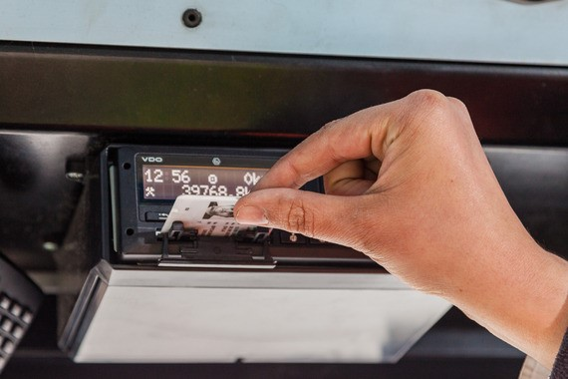

Best Practices for Tachograph Use
Driver Card and Recording
  You must insert your card before journeys and ensure tachograph records are accurate and complete.
Manual Entries for Exceptions
  Manual entries should be made for off-vehicle rest, ferry travel, delays, or other work activities.
Record Retention and Review
  You must review entries each shift and keep records for 28 days or 56 days for international trips.
Digital Tools for Compliance
  Are their any apps that you have found useful?
Notes:
---
This slide references information from the following file: https://dvsauk-my.sharepoint.com/personal/nicholas_tiplady_otc_gov_uk/_layouts/15/Doc.aspx?sourcedoc=%7B986E5C4B-ADE7-4F8A-A99D-50F4E3179472%7D&file=DriversHoursBlog%20for%20KR.docx&action=default&mobileredirect=true
Proper tachograph use is essential for compliance. Drivers must insert their driver card before starting any journey and ensure the device is recording correctly. Manual entries should be made for off-vehicle rest, ferry travel, delays, or other work. At the start and end of each shift, drivers should review tachograph entries to confirm accuracy and completeness. Records must be retained for at least 28 days (or 56 days for international journeys). Using tachograph data effectively not only helps drivers stay compliant but also protects them in case of inspections or disputes. Apps and digital tools can assist in monitoring driving time and alerting drivers before they reach legal limits.

Slide 13

Common Mistakes and Real-World Examples
Common Tachograph Errors
  Mistakes include missing split breaks, exceeding limits, and removing driver cards during shifts. We can get into trouble legally if we don’t keep records properly.
Consequences of Infringements
  Serious breaches can lead to license revocation, fines for the company, and disqualification for our drivers and transport managers.
Real-World Case Examples – insert your own.
  Cases of failing to record breaks and deliberate card removal show risks of fatigue and falsification flagged by authorities.
Importance of Ethical Recordkeeping
  Accurate tachograph records and ethical compliance ensure safety and prevent severe professional consequences.
Notes:
---
This slide references information from the following file: https://dvsauk-my.sharepoint.com/personal/nicholas_tiplady_otc_gov_uk/_layouts/15/Doc.aspx?sourcedoc=%7B986E5C4B-ADE7-4F8A-A99D-50F4E3179472%7D&file=DriversHoursBlog%20for%20KR.docx&action=default&mobileredirect=true
Common tachograph-related mistakes include failing to take proper split breaks, exceeding driving limits due to poor planning, and removing driver cards mid-shift to avoid recording excess hours. These actions are considered serious infringements and can lead to licence revocation, operator penalties, and even disqualification of transport managers. For example, one case involved drivers repeatedly failing to record mandatory breaks, resulting in fatigue-related risks flagged during a DVSA roadside check. Another operator faced severe consequences for instructing drivers to remove tachograph cards mid-shift, which was deemed deliberate falsification. These examples highlight the importance of accurate recordkeeping and ethical practices.

Slide 14
Practical Tips and Takeaways
Notes:
---
This slide references information from the following file: https://dvsauk-my.sharepoint.com/personal/nicholas_tiplady_otc_gov_uk/_layouts/15/Doc.aspx?sourcedoc=%7B986E5C4B-ADE7-4F8A-A99D-50F4E3179472%7D&file=DriversHoursBlog%20for%20KR.docx&action=default&mobileredirect=true
Planning and Wellbeing Strategies, Commitment to Compliance

Slide 15

Planning and Wellbeing Strategies
Route Planning and Breaks
  You should use route planning tools to schedule breaks and rest stops with essential facilities for safety and compliance.
Wellbeing Prioritisation
  Staying hydrated, eating balanced meals, and taking mental breaks are crucial for your health during trips.
Communication and Compliance
  You must communicate tiredness/fatigue concerns to managers and engage in compliance audits to ensure safety and professionalism.
Notes:
---
This slide references information from the following file: https://dvsauk-my.sharepoint.com/personal/nicholas_tiplady_otc_gov_uk/_layouts/15/Doc.aspx?sourcedoc=%7B986E5C4B-ADE7-4F8A-A99D-50F4E3179472%7D&file=DriversHoursBlog%20for%20KR.docx&action=default&mobileredirect=true
To stay compliant and safe, drivers should plan routes with breaks and rest periods in mind. Use route planning tools and apps to identify rest stops with essential facilities. Build buffer time into schedules to accommodate delays without compromising compliance. Prioritize personal wellbeing by staying hydrated, eating balanced meals, and taking mental breaks during rest periods. If fatigue sets in, drivers must communicate with their managers and prioritize safety over deadlines. Engaging proactively with compliance processes, such as requesting audits and feedback, demonstrates professionalism and reduces the risk of infringements.

Slide 16

Commitment to Compliance
Shared Responsibility
  Both we all must work together to ensure compliance with drivers’ hours regulations. It’s no use only having one part of the business involved.
Proper Tachograph Use
  You need to correctly use tachographs to maintain accurate records and plan breaks effectively. Make sure your training is up to date. If it’s not, let someone know.
Continuous Learning
  Staying updated on rule changes via DVSA, newsletters, and training supports ongoing compliance.
Safety and Sustainability
  Compliance promotes safer roads, better working conditions, and a sustainable transport industry. Getting this right keeps the business in better health.
Notes:
---
This slide references information from the following file: https://dvsauk-my.sharepoint.com/personal/nicholas_tiplady_otc_gov_uk/_layouts/15/Doc.aspx?sourcedoc=%7B986E5C4B-ADE7-4F8A-A99D-50F4E3179472%7D&file=DriversHoursBlog%20for%20KR.docx&action=default&mobileredirect=true
Compliance with drivers’ hours rules is a shared responsibility between drivers and operators. Drivers should commit to using tachographs correctly, planning breaks effectively, and maintaining accurate records. Staying informed about rule changes through DVSA updates, union newsletters, or refresher training is essential. By embracing these practices, drivers contribute to safer roads, healthier working conditions, and a stronger reputation for their company. Compliance is not just about avoiding penalties—it is about protecting lives and ensuring the sustainability of the transport industry.

Slide 17
….and finally
Notes:
---
This slide references information from the following file: https://dvsauk-my.sharepoint.com/personal/nicholas_tiplady_otc_gov_uk/_layouts/15/Doc.aspx?sourcedoc=%7B986E5C4B-ADE7-4F8A-A99D-50F4E3179472%7D&file=DriversHoursBlog%20for%20KR.docx&action=default&mobileredirect=true
Planning and Wellbeing Strategies, Commitment to Compliance

