Slide 1



Lesson plan slides: Understanding how your exams are marked and graded

Slide 2
True or false?
Can you spot the real exam facts?
Examiners know which school you're from when marking
Grade boundaries are set after everyone has sat the exam
There's a limit on how many students can get top grades
It's no easier to get a grade with one exam board than another
It can be harder or easier to get your grades from one year to the next

Slide 3

The journey of your exam paper
4
6
2
Answer paper split into individual questions
Quality checks ensure consistency
Grades determined and sent back to school
1
3
5
Answer paper sent to exam board
Trained examiners mark each question using detailed mark scheme
Grade boundaries set

Slide 4
Why grade boundaries change year to year
Different grade boundaries DOES NOT EQUAL different quality of work needed
If a paper is easier than last year → boundaries are set higher
If a paper is harder than last year → boundaries are set lower
152
151
150
149
148
147
146
151
150
149
148
147
146
145
150
149
148
147
146
145
144
Year X
Year Y
Year Z
Grade

Slide 5
Put the steps in order
(A) Senior examiners recommend grade boundaries to exam boards
(B) Exam boards look at data about this year’s students and previous years’
(C) Grades are sent to schools to give to students
(D) Raw marks are converted into grades
(E) Exam board splits up answer papers into individual questions ​
(F) Answer paper sent to exam board ​
(G) Senior examiners review examples of student answers around the provisional grade boundaries
(H) Examiners mark lots of same question

Slide 6
Put the steps in order – answers
Time for the answers!
(F) Answer paper sent to exam board ​
(E) Exam board splits up answer papers into individual questions ​
(H) Examiners mark lots of same question
(B) Exam boards look at data about this year’s students and previous years’
(G) Senior examiners review examples of student answers around the provisional grade boundaries
(A) Senior examiners recommend grade boundaries to exam boards
(D) Raw marks are converted into grades
(C) Grades are sent to schools to give to students

Slide 7
True or false?
Let’s reveal the answers
False
Examiners know which school you're from when marking
Grade boundaries are set after everyone has sat the exam
There's a limit on how many students can get top grades
It's no easier to get a grade with one exam board than another
It can be harder or easier to get your grades from one year to the next
True
False
True
False

Slide 8
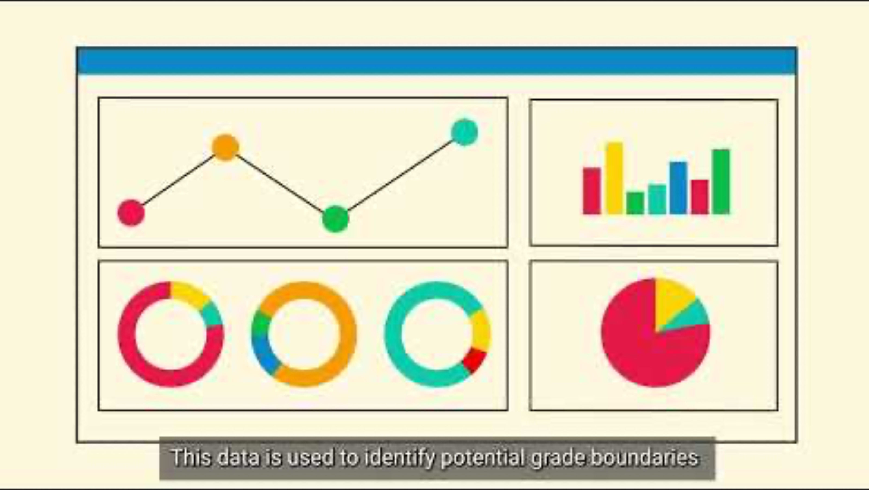
How GCSE and A level grading works

