Slide 1

UK Photonics Sector
Evidence pack provided by the Photonics Leadership Group
February 2026

Slide 2
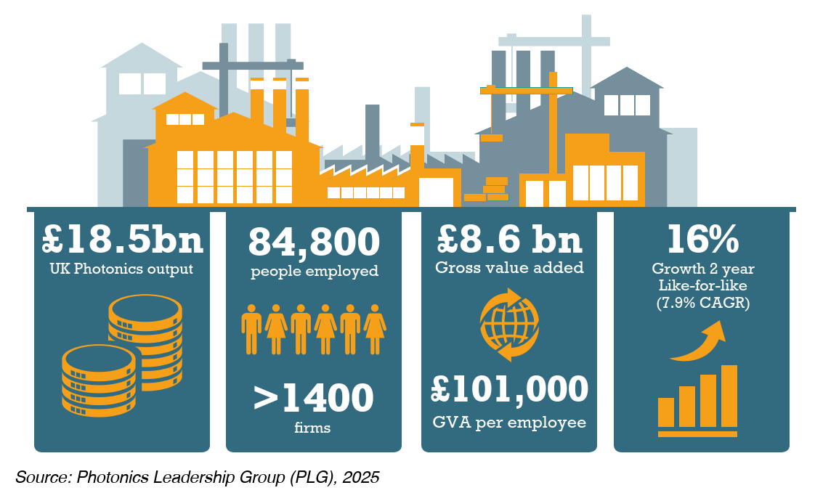


The UK photonics industry represents one of the UK's most economically productive sectors
The UK has the 2nd largest photonics industry in Europe after Germany and the 9th largest globally.
Employs more people than aerospace or motor manufacturing.

Slide 3
Photonics underpins critical sectors within the UK’s Modern Industrial Strategy
Photonics is an enabling technology for AI, quantum, defence, clean energy, healthcare and more.
UK firms are most active in:
Industrial manufacturing: reflecting UK strengths in laser materials processing.
Photonics supply chain: expertise in high value components, such as optical fibre.
Medical, health and life sciences: technology applied across drug discovery, diagnostics, and treatment.
In addition, more than a third of the industry cite involvement within the semiconductor sector as well as space and satellite markets.
Notes:
Relative decline in integration not real decline squeezed by AI
Q – publications globally or UK only?

Slide 4
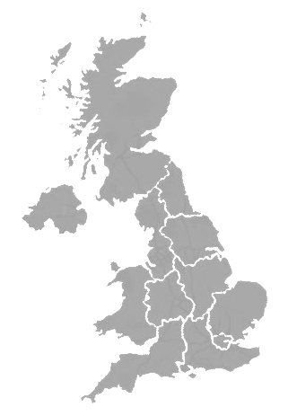
The UK has clusters of photonics research and start-up activity distributed across the country
Over 1650 company operating sites exist across the UK, alongside over 40 universities and 18 research and training organisations.
All regions see growth, and nine regions produce over £1bn output.
10 regions have productivity over £90k GVA/employee, highest in northern regions.
Clusters have developed into ecosystems outside of the ‘golden triangle’.
Employment ; Revenue

Slide 5
Photonics companies need stable demand to invest and grow
The UK sector is growing at 4.4%/year, with the potential to achieve £50bn value by 2035.
The UK has a pipeline of small, innovative firms:
Over 50% of firms have fewer than 10 employees.
40% of firms were founded in the last 20 years.
Over 70% invest over 5% of their turnover back into R&D.
Creating stable demand for firms is critical to ensure we capture value and mitigate future dependency on importing photonics components.

Slide 6
UK photonics companies attract significant foreign direct investment and are already globally focussed
Many global industry leaders have acquired and expanded operations in the UK including Coherent, Trumpf, Microsoft, Thales, TÜV Nord, Huber+Suhner and Excelitas.
Over half of firms export more than 75% of their output. The main export markets are North America and Europe.

