Slide 1

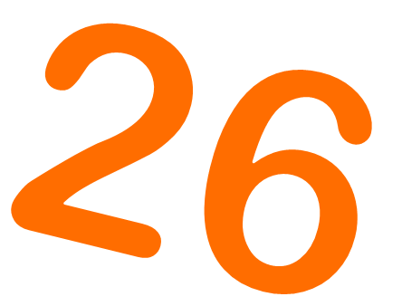


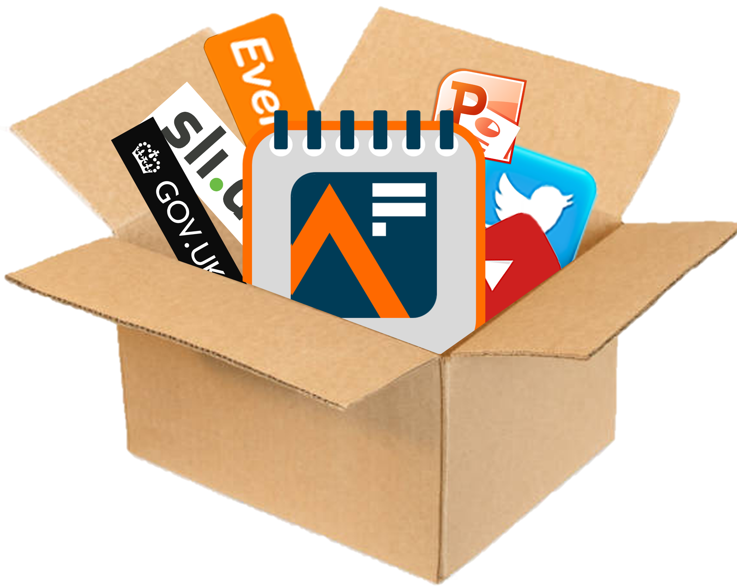


  Analysis in Government Month
AiG Month
1-31 May 2026
IMPACT IN ACTION
‘Campaign in a Box’
For Analysis Function leaders, Analysis Function Champions, Communications teams, Profession Support teams, and Business Support teams
The UK’s largest learning & development event for government analysts

Slide 2


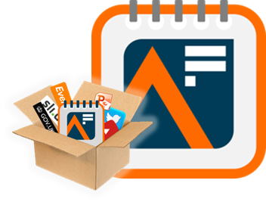








Campaign in a Box: What it is and how to use it
This Campaign in a Box pack is for Analysis Function leaders, Analysis Function Champions, Communications teams, Profession Support teams, and Business Support teams
The products within this pack are designed to help you promote the event within your department or profession, by first getting people to contribute to the events and then by encouraging them to join in events
The resources are designed to be used in a ‘pick and mix’ style, allowing freedom for you to do what is best for your teams
This year’s theme is impact in action
We hope that you find these useful and if you have any queries or feedback, please contact the team at Analysis.Function@ons.gov.uk
Join us in showcasing Impact in Action across government, and let’s make AiG Month 2026 our most impactful year yet!
Campaign in a Box
The Analysis Function is a cross-government community of analysts from all the analysis professions. Our members work in every government department and are actuaries, digital and data analysts, economists, geographers, operational researchers, social researchers, statisticians, are ‘dual-badged’, ‘unaffiliated’, or work with analysis.

Slide 3


About Analysis in Government (AiG) Month 2026

Slide 4
About Analysis in Government (AiG) Month 2026
Analysis in Government Month is the UK’s largest learning and development event for government analysts and takes place every May.
AiG Month is first and foremost a learning event, featuring live events, L&D resources, blogs, interactive activities, and much more going on throughout May.
Whilst content is designed with government analysts in mind, everyone interested in sharing or developing their analysis skills is welcome to join in with AiG Month.
All our live events are virtual, meaning everyone can dial in no matter where they’re based.
Events take place throughout May on Tuesdays, Wednesdays and Thursdays, starting at 10, 12, and 2, so you’ll always know when to tune in.
Hundreds of colleagues from different government departments and professions, academia, and the private sector have already presented engaging and educational events to thousands of attendees at AiG Month. Why not join them by expressing an interest in delivering a session this year?
All activities and content will be listed on the AiG Month Hub but make sure to also sign up to our monthly newsletter, LinkedIn, and X @gov_analysis for all the latest news and follow us on Eventbrite to be the first to find out about events.
The Analysis Function is a cross-government community of analysts from all the analysis professions. Our members work in every government department and are actuaries, digital and data analysts, economists, geographers, operational researchers, social researchers, statisticians, are ‘dual-badged’, ‘unaffiliated’, or work with analysis.

Slide 5

Theme: Impact in Action
The theme of AiG Month is Impact in Action
AiG Month will focus on:
Making a positive impact across government
Helping government make informed, evidence-based decisions
Communicating the results of your analysis effectively to influence different audiences, such as Policy Profession, Operational Delivery Profession colleagues, Ministers, or even the public
And much more!
Learn directly from a diverse range of government analysts (and speakers from the outside world), access exclusive Learning and Development (L&D) resources and blogs, or get involved in an interactive session…
The Analysis Function is a cross-government community of analysts from all the analysis professions. Our members work in every government department and are actuaries, digital and data analysts, economists, geographers, operational researchers, social researchers, statisticians, are ‘dual-badged’, ‘unaffiliated’, or work with analysis.

Slide 6

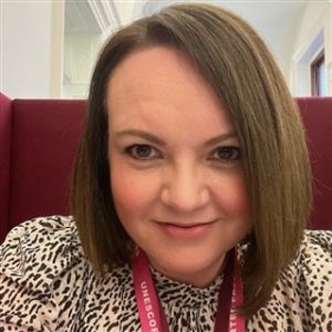

A message from our senior sponsors
“As proud supporters of Analysis in Government (AiG) Month, we’re thrilled to see the UK’s biggest learning and development event for government analysts returning for its seventh year.
Throughout May, colleagues from across the analytical community will come together to showcase their expertise through live online sessions, demonstrations, and presentations. This year’s theme, ‘Impact in Action’, shines a spotlight on the real and meaningful difference that government analysts make every day.
Analysts play an essential role in shaping policy, improving operational delivery, and strengthening the public services people across the UK rely upon. If you have insights, tools, or experiences that could help develop fellow analysts and strengthen the Analysis Function community, we’d love you to consider putting yourself forward as a presenter. And we encourage everyone to join as many sessions as they can to connect with and learn from peers right across government.
By getting involved in AiG Month, you’ll be able to build your skills, broaden your professional network, and draw inspiration from the fantastic work happening across our community. We strongly urge you to register and make the most of this hugely valuable opportunity”.
Alison Woodhouse
Jess Mitchell
Alison Woodhouse and Jess Mitchell
Senior Sponsors, Analysis in Government (AiG) Month, Co-Directors of Knowledge and Information (KAI) in HM Revenue & Customs (HMRC)

Slide 7
Timings
Events take place every Tuesday, Wednesday, and Thursday during May
Events start at 10:00, 12:00 and 14:00 (“Ten, Twelve, and Two”), so you know when to tune in
Events are all virtual, so you can dial in to any AiG Month session wherever you are
10:00
12:00
14:00

Slide 8

How to get involved in AiG Month

Slide 9


Promote AiG Month in your department / profession
We’d love for you to promote AiG month within your departments and professions, encouraging staff to contribute content or to attend events. On the next two slides you’ll find some examples of template posts/articles you could use on your own LinkedIn or X account, or adapt for your departmental / profession newsletter, intranet, or SharePoint.
The Analysis Function Central Team will be active on X and LinkedIn in the build-up and throughout AiG Month 2026, so you can also help us make an even bigger impact by interacting and engaging with us on social media. Every time you retweet, like, or even look at our content, it makes an innovation on the algorithm and makes it more likely more people will see our tweets and posts!
So, whether you’re an influencer, or just interested…
  Connect with us on LinkedIn at Gov Analysis Function and sign up for our monthly LinkedIn newsletter
  Follow us on X at @gov_analysis
  Retweet, repost, ‘like’, and tag us in to help build conversations and increase engagement and interest in the event

Slide 10



Use our template text for internal channels
Why not use our template text to create an article or post for your department / profession internal channels – such as your newsletter, intranet, or SharePoint?
*
The UK’s largest learning and development event for government analysts is back for 2026! Analysis in Government (AiG) Month returns this May with the theme of ‘Impact in Action’. The month-long L&D event includes webinars, panel sessions, learning resources, and more that you can participate in and develop your skills.
Last year, thousands of people took part in AiG Month. This is an unmissable opportunity to share learning from a diverse range of government analysts, connect and collaborate with other analysts from different professions and departments, and find out why innovation is so important to government analysis.
The month-long event is open to anyone with an interest in government analysis. So, whether you are already an analyst, want to know more about working with analysts or analysis in government or would like to investigate a career in government analysis, AiG Month is for you…
Tell your colleagues and teams today!
The AiG Month Hub on the Analysis Function website has links to all key content
Go straight to the full calendar of events on Eventbrite
Follow the Analysis Function on LinkedIn and X @ gov_analysis
Sign up for their monthly newsletter for the latest news at AF Newsletter - subscribe

Slide 11
Use our template social media posts
Why not use our template tweets and posts on your departmental / profession / personal social media accounts to join in with AiG Month 2026, and use our campaign to promote things that are going on in your area too?
*
[Insert department/profession name] is proud to support AiGMonth26! Join us and other government professionals to learn more about how we put impact in action. You can find out how to get involved by visiting the Analysis Function AiG Month Hub today! https://tinyurl.com/4dz57eem
Are you ready for AiGMonth26? [Insert department/profession name] is excited to show how we put impact in action. Stay tuned for updates on our upcoming events and how you can get involved! @gov_analysis
As part of AiGMonth26, [Insert department/profession name] will be hosting a session on [insert topic]! Don't miss this opportunity to learn from experts in the field how we showcase impact in action. Sign up on Eventbrite https://tinyurl.com/3bufh7y3 and join us on [insert date and time]. @gov_analysis
[Insert department/profession name] is dedicated to delivering impact in action including [add example] and we're thrilled to be a part of AiGMonth26. Check out our website and follow us on LinkedIn https://tinyurl.com/y6fu7atu for updates on our upcoming events! @gov_analysis
AiGMonth26 is the perfect opportunity to put impact in action and develop your analytical skills. Join [insert department/profession name] for our session on [insert topic] on [insert date and time]. Sign up on Eventbrite today! https://tinyurl.com/3bufh7y3 @gov_analysis

Slide 12
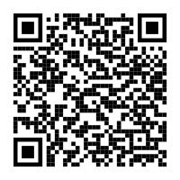
Quick reference guide
Join us in showcasing Impact in Action across government and let’s make AiG Month 2026 our most impactful year yet!
Key dates: 1-31 May 2026 (live events every Tuesday, Wednesday, and Thursday)
Calls to action:
  Present at AiG Month
  Submit written content such as blogs, articles, or ‘5 quickfire questions’ to be published during AiG Month
  Host a Community or ‘micro’ event for AiG Month in your department
Links:
  AiG Month Hub – for everything you need to know about AiG Month
  AiG Month EOI to present – to secure your space to present at AiG Month
  Analysis Function Eventbrite – to secure your space to attend AiG Month events
Contact info: Anlaysis.Function@ons.gov.uk
Scan me to go to the AiG Month Hub

Slide 13

Share your story: 5 quickfire questions
How have you showcased impact in action? We’re always keen to find out more about our members, and AiG Month is a perfect opportunity to do so. Why not share your story with your cross-government government analysis community by answering our five quickfire questions? We also welcome blogs, articles, or L&D links about impact in action.
Send your responses to us at Analysis.Function@ons.gov.uk and we’ll publish our favourites on the Analysis Function website.
What’s the best thing about being part of the Analysis Function?
What is the highlight of your career so far?
What’s the top piece of advice you would give to someone interested in joining the Analysis Function?
Can you tell us something our audience may not know about you?
Which book / film / music / piece of art has changed your life the most?
Want some inspiration? You can read some of our previous ‘quickfire question’ interviews online including: 5 quickfire questions with Fiona Dawe, 5 quickfire questions with Philippa Robinson, 5 quickfire questions with Sean Mattson, 5 quickfire questions with Jenny Dibden

Slide 14

Sign up to deliver a Community event
  Want to run your own event for AiG Month 26?
  Already got something going on for Learning at Work Week?
  Got something that’s only for specialists?
Then let us know about it and we’ll promote it as part of our Community Programme
Have you considered some of the micro-events you could organise to join in, such as lightning talks, lunchtime data clubs, or meet‑the‑analyst sessions? We’ll help to promote all Community Programme events in the run up to and during AiG Month, and offer you support by providing graphics, top tips, and links to more information on running an event.
By holding a Community Programme event you’ll be helping to build a greater sense of community, cross-government interaction and engagement, and opportunities to share best practice with an audience of government analysts.
If you are hosting a live event or webinar during May that would be of interest to government analysts, contact us so we can help promote it.
Email us at Analysis.Function@ons.gov.uk

Slide 15





AiG Month events: a live, interactive experience
“AiG Month sessions are not recorded. This is intentional – it helps us keep the event interactive, encourages open discussion, allows for questions and answers, and ensures presenters can share freely. Can’t attend a specific event or want to remind yourself of something from a session? Don’t worry – we’ll publish the key learning outcomes, links, tools, and resources after the session so you can refer back or share with colleagues. Thanks for helping us keep AiG Month a safe, engaging, live learning experience!”
The Analysis Function is a cross-government community of analysts from all the analysis professions. Our members work in every government department and are actuaries, digital and data analysts, economists, geographers, operational researchers, social researchers, statisticians, are ‘dual-badged’, ‘unaffiliated’, or work with analysis.

Slide 16

The benefits of attending live events
Analysis in Government (AiG) Month events are designed as live, engaging learning experiences that bring people together in real time. User research shows that live events are preferable to recorded events because they:
Create an energising interactive atmosphere: making the most of real-time chat, polls, Q&As, and reactions,
Encourage open, high-quality participation: helping people feel comfortable asking questions and sharing ideas freely
Support presenter confidence: knowing they are speaking directly to an active, present audience
Provide a safe and well-managed space: helping ensure sensitive or early-stage material is shared appropriately
Ensure everyone can benefit: After each session, clear written learning outcomes, tools, links, and tips are shared so people can continue learning even if they were not able to join live.
User insight shows that colleagues prefer quick, accessible ways to learn, and written summaries consistently perform exceptionally well
Learn more on the AiG Month Hub online
The Analysis Function is a cross-government community of analysts from all the analysis professions. Our members work in every government department and are actuaries, digital and data analysts, economists, geographers, operational researchers, social researchers, statisticians, are ‘dual-badged’, ‘unaffiliated’, or work with analysis.

Slide 17






Get involved: Analysis Function channels
Subscribe to the monthly AF Newsletter
Visit the Analysis Function website
Connect with us on LinkedIn at Gov Analysis Function
Join the Analysis Function community on AF Basecamp
Follow us on X @gov_analysis
Subscribe to our YouTube channel YouTube/Government Analysis Function
Be the first to find out about our events at Eventbrite/Government Analysis Function

Slide 18

Further resources to help promote AiG Month

Slide 19
Logos
Simply select, then Copy + Paste.
Please note - if resizing the logos, please make sure ‘Lock aspect ratio’ is ticked in Format Shape menu to avoid squashing or stretching the logos.
If you require any of these designs in a different format, please contact the team at Analysis.Function@ons.gov.uk
Analysis Function logo
Analysis in Government (AiG) Month logo

Slide 20
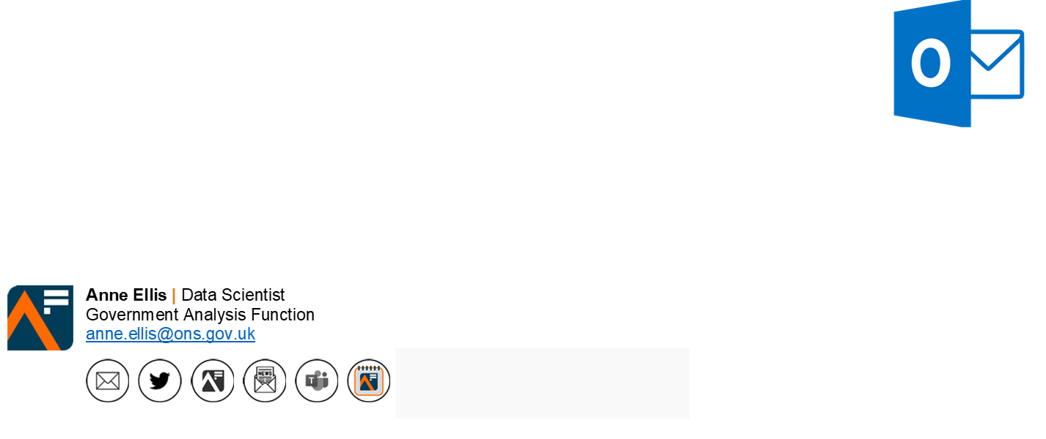
Custom email signature
Add the AiG Month 2026 ‘button’ to your email signature. The button contains a hyperlink to the new Analysis in Government Month hub on the Analysis Function website
Remember to refer to the latest guidance on Understanding accessibility requirements for public sector bodies - GOV.UK (www.gov.uk)
Select, Copy and Paste

Slide 21

AiG Month Teams backgrounds

Slide 22

Notes:
Gallery Space

Slide 23



Slide 24


Slide 25

Notes:
Chic Office

Slide 26

Notes:
Urban hub

Slide 27

Notes:
Stylish studio

Slide 28

Notes:
Sunny office

Slide 29

Notes:
Sunny office

Slide 30

Notes:
Sunny office

Slide 31


Slide 32


