Slide 1

UK-VARSS 2024 Power Point Set Published November 2025

Slide 2
UK-VARSS 2024
The following selected PowerPoint slides provide the core for a presentation on antibiotic sales, antibiotic use and antibiotic resistance.
These slides are based on the UK-VARSS 2024 Report which provides further details.
2

Slide 3
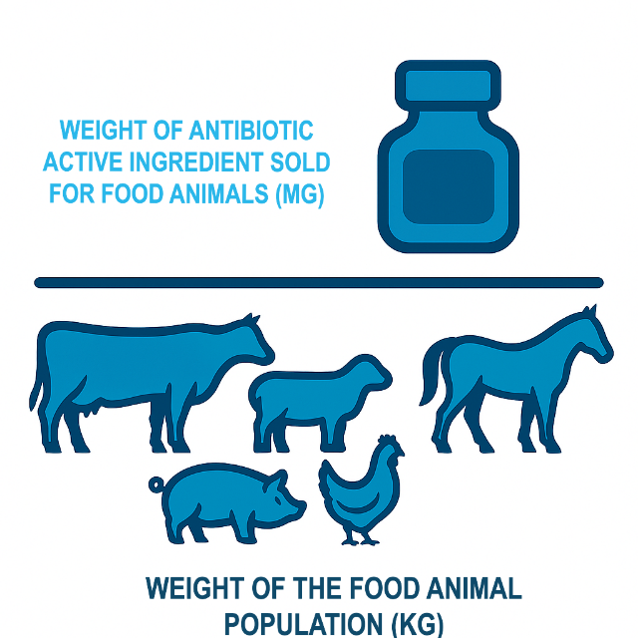
Antibiotic Sales
New harmonised mg/kg metric for all animals
Antibiotic sales for food-producing animals are presented as weight of antibiotic active ingredient used in food animals (in mg) compared with the weight of the food population (in kg). This population weight is calculated by multiplying the number of animals in each category by a standardised weight. Previously, we used the Population Correction Unit (PCU) method to calculate the weight of the food animal population, but this year we will be adopting a new methodology which was developed and adopted by the EU in their ESUAvet report.
It includes more animal categories (for cattle, laying hens, ducks) and therefore better represents the UK population weights.
It also uses higher standard weights based on average living or slaughter weight, rather than the average weight at time of treatment, aligning better with the internationally recognised WOAH metric.
As a result, the total animal weight is higher, making the mg/kg figure about 40% lower. All data reported as mg/kg now reflects this new metric. Comparisons between the new metric (mg/kg) and the old metric (mg/PCU) are included throughout the report.
Source: p. 10

Slide 4
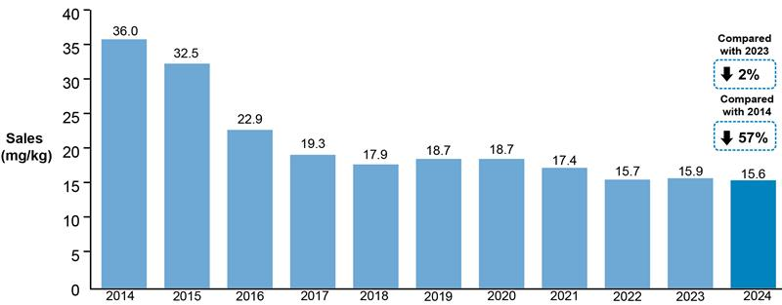
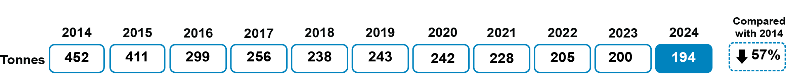
Antibiotic Sales
Sales of veterinary antibiotics for use in food-producing animals, adjusted for animal population, were 15.6 mg/kg in 2024. This represents a 2% (0.3 mg/kg) decrease since 2023 and a 57% (20.5 mg/kg) decrease since 2014.
Total sales (all animals tonnes)
Source: p. 10

Slide 5
Antibiotic Sales
Sales of Highest Priority Critically Important (HP-CIAs) for food-producing animals remain very low at 0.06 mg/kg and are essentially unchanged (0.001 mg/kg reduction) since 2023 and 84% (0.32 mg/kg) lower than 2014. For the fourth year in a row, no colistin was sold in the UK for use in animals.
Source: Fig. 1.3; p. 26

Slide 6
Antibiotic Sales
For the fifth year running, the proportion of total antibiotic sales licensed for an in-water/ milk* use (53%) was higher than the proportion of antibiotic sales licensed for in-feed route of administration (27%). 18% was for injectable use. Oral/water administration of antibiotics allows for more targeted treatment, which represents a lower risk of AMR compared to in-feed antibiotics.**
* Includes oral powders and oral solutions.
** Scientific Risk Assessment of risk of antibiotic use in animals to public health
Source: Fig. 1.5; p. 28

Slide 7
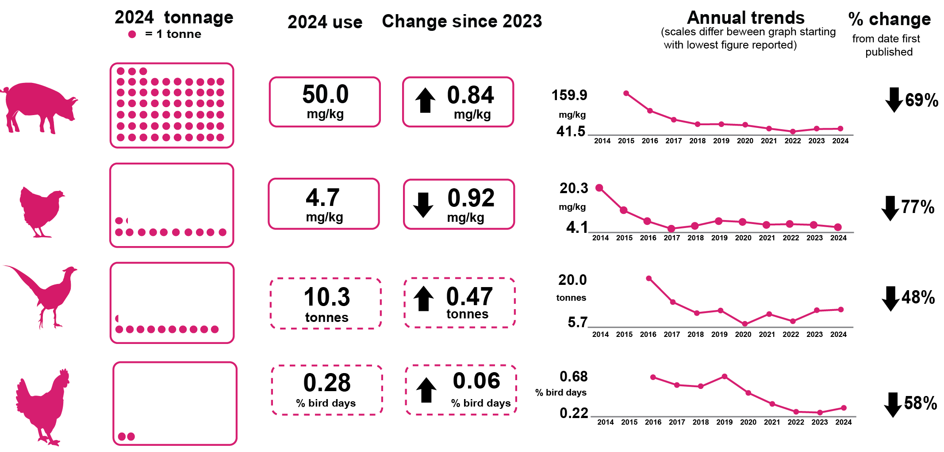
Antibiotic Usage Data
Antibiotic usage refers to the amount of antibiotics prescribed and/or administered per sector. The data have been collected and provided to the VMD by the animal industry on a voluntary basis. Coverage is at least 85% for all sectors shown.
Antibiotic usage by food-producing animal species
Pigs
Broilers
Gamebirds
Laying
hens
Source: p. 11
indicates a different metric for usage

Slide 8
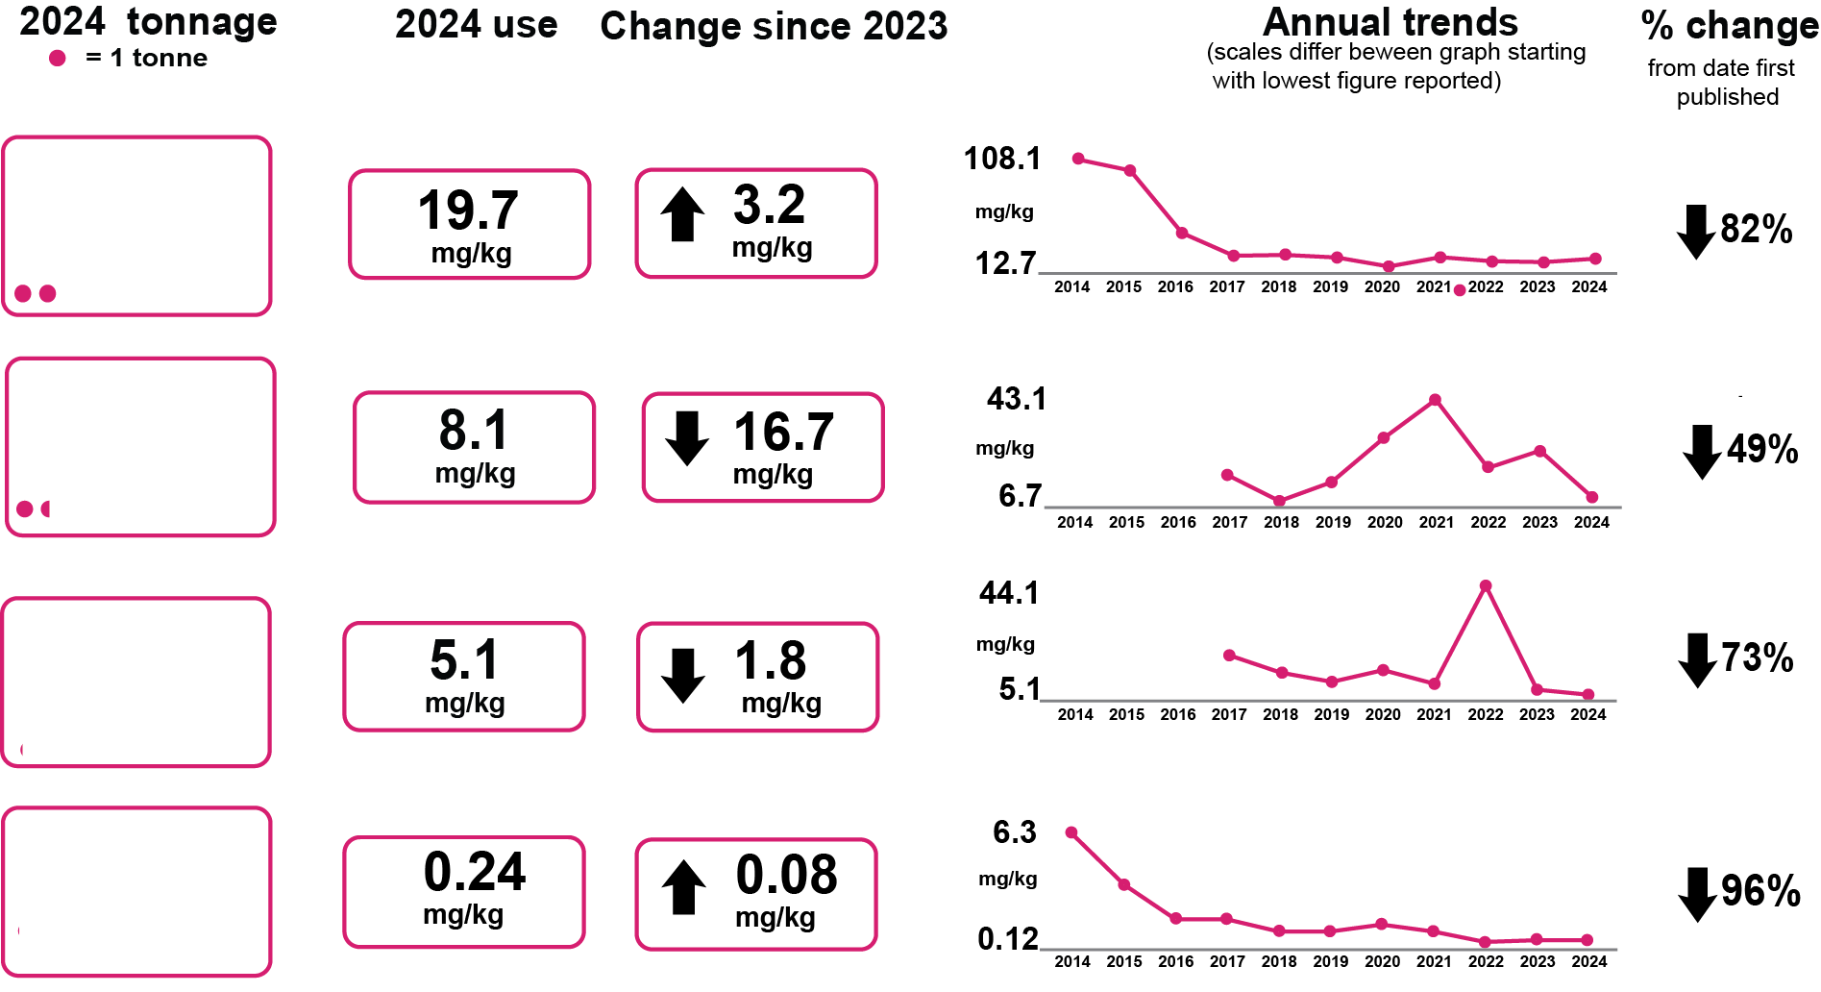

Antibiotic Usage Data
Antibiotic usage by food-producing animal species
Turkeys
Salmon*
Trout
Ducks
indicates a different metric for usage
* These figures are different from those originally published due to a data correction from Salmon Scotland, which we were informed about on 7th January 2026. See section 2.3.5.1 of the main report for further information.
Source: p. 10

Slide 9
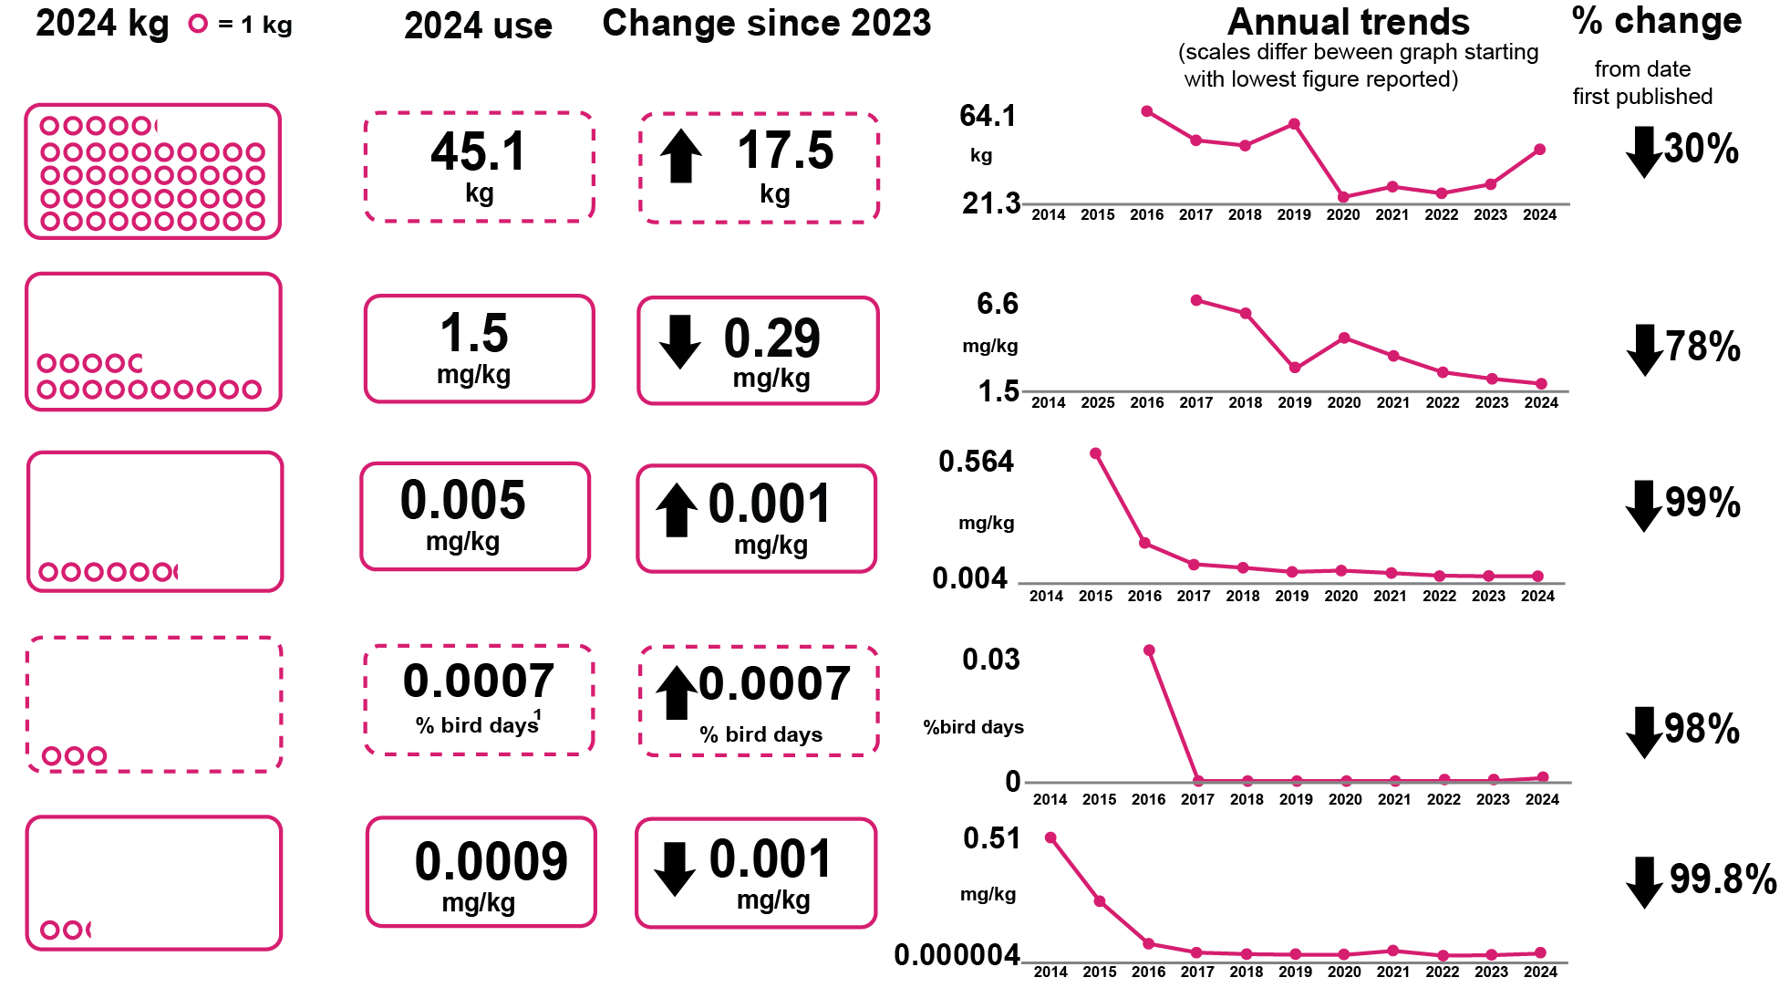
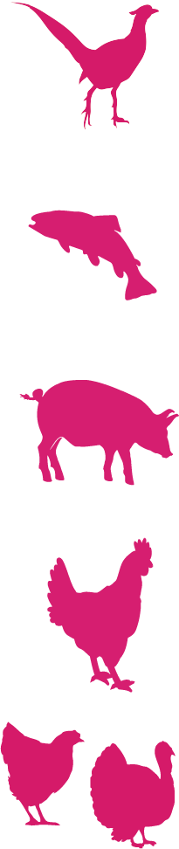
Antibiotic Usage Data
Highest Priority Critically Important Antibiotics by food-producing animal species
Gamebirds
Trout
Pigs
Laying
hens
Meat
poultry
indicates a different metric for usage
Source: p. 10
¹ BEIC have indicated that this relates to a single course of treatment administrated to a breeder flock and not for birds producing eggs for the food chain

Slide 10
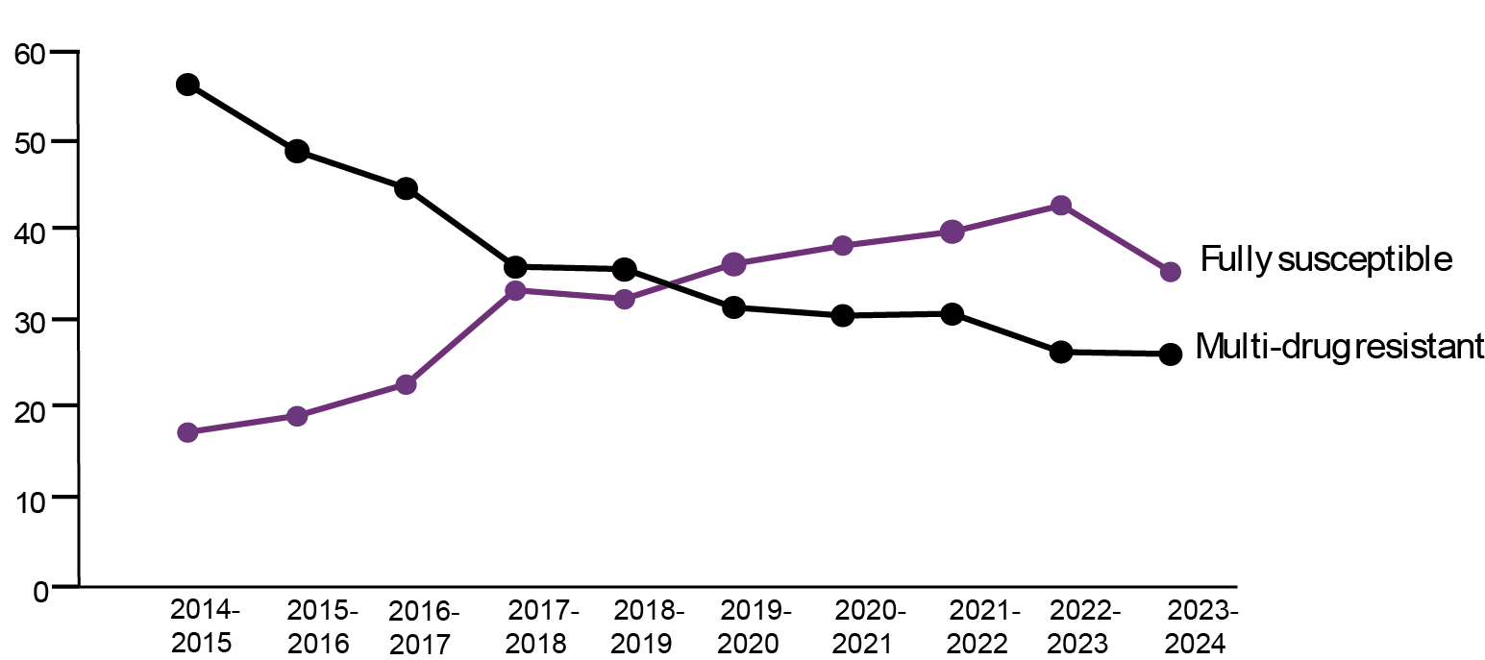
Harmonised Monitoring of AMR
Key resistance outcome indicators: E.coli
The harmonised monitoring outcome indicators combine results from healthy pigs and poultry at slaughter to give an overall picture of antimicrobial resistance (AMR), and are internationally comparable.
Results show a decrease in fully susceptible E. coli from 43% in 2022/2023 to 36% in 2023/2024. This is the first substantial decrease since harmonised monitoring began in 2014 and is attributable to increased resistance in broilers. The percentage of multi-drug resistant isolates (resistant to three or more antibiotic classes) continues to decrease and remains at the lowest recorded level of 27%.
Resistant isolates (%)
Source: p. 12

Slide 11
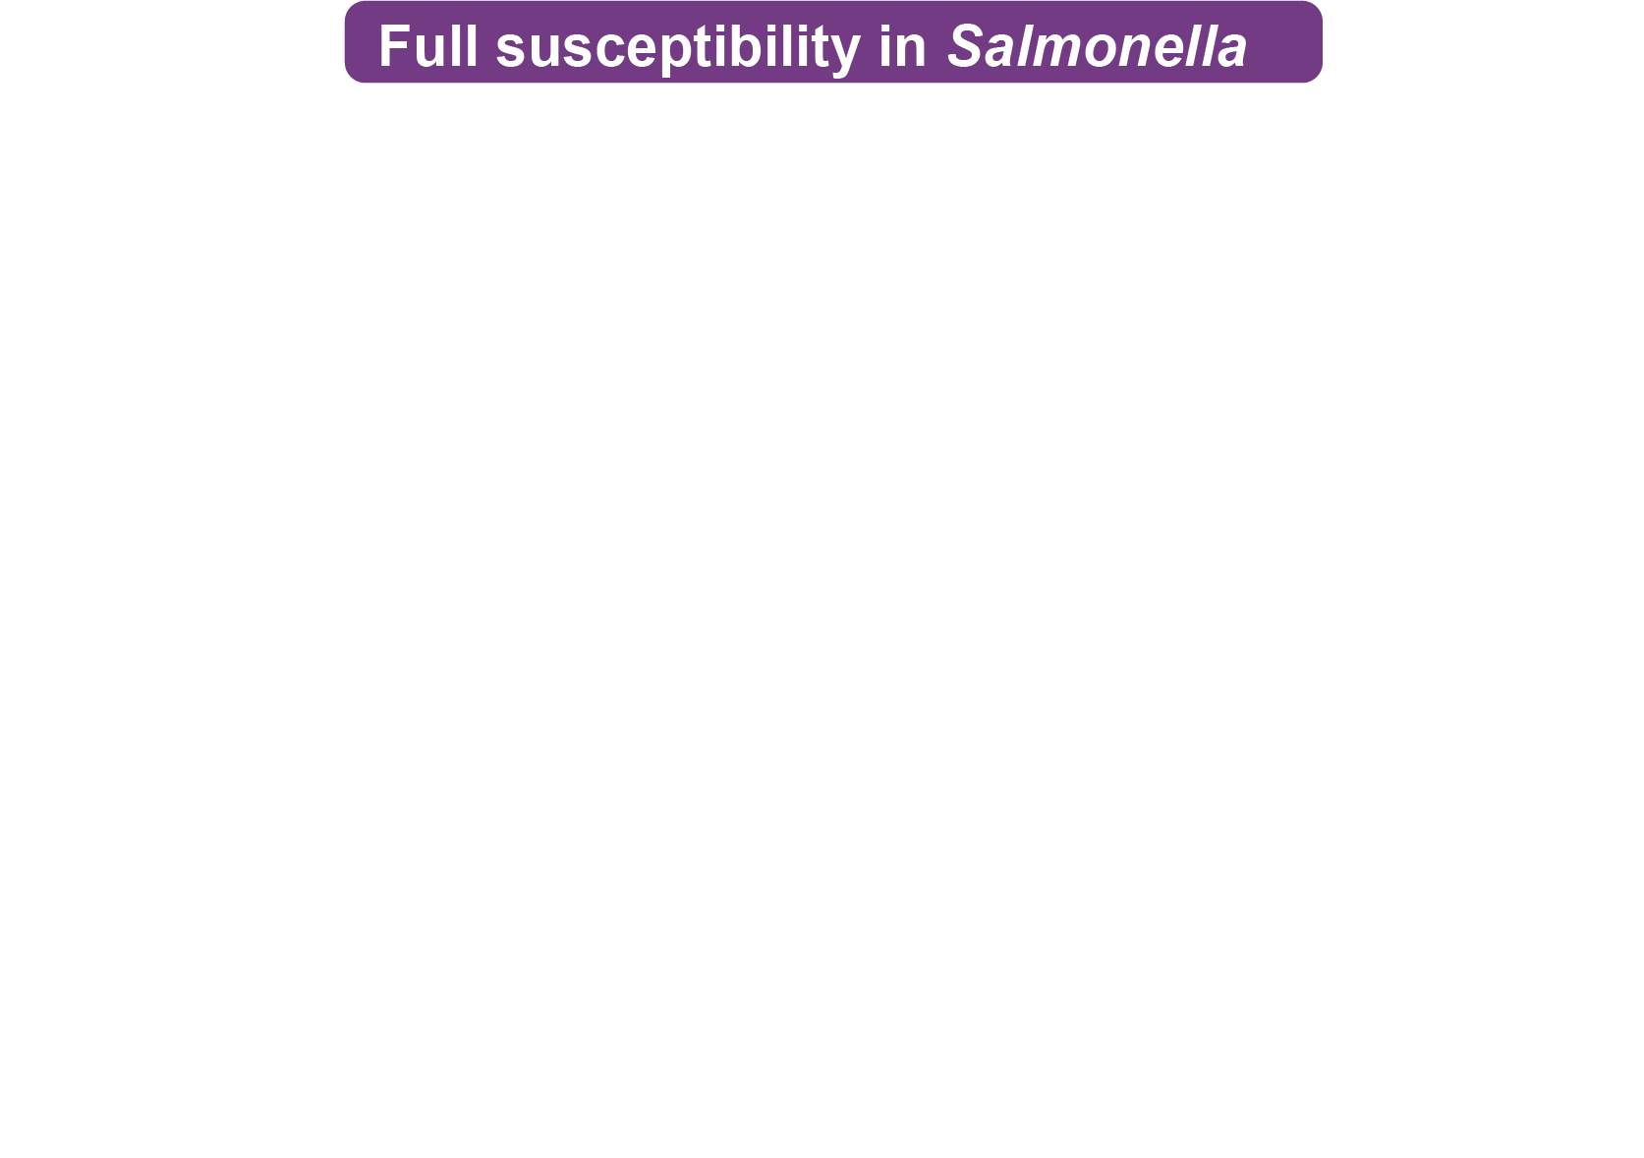
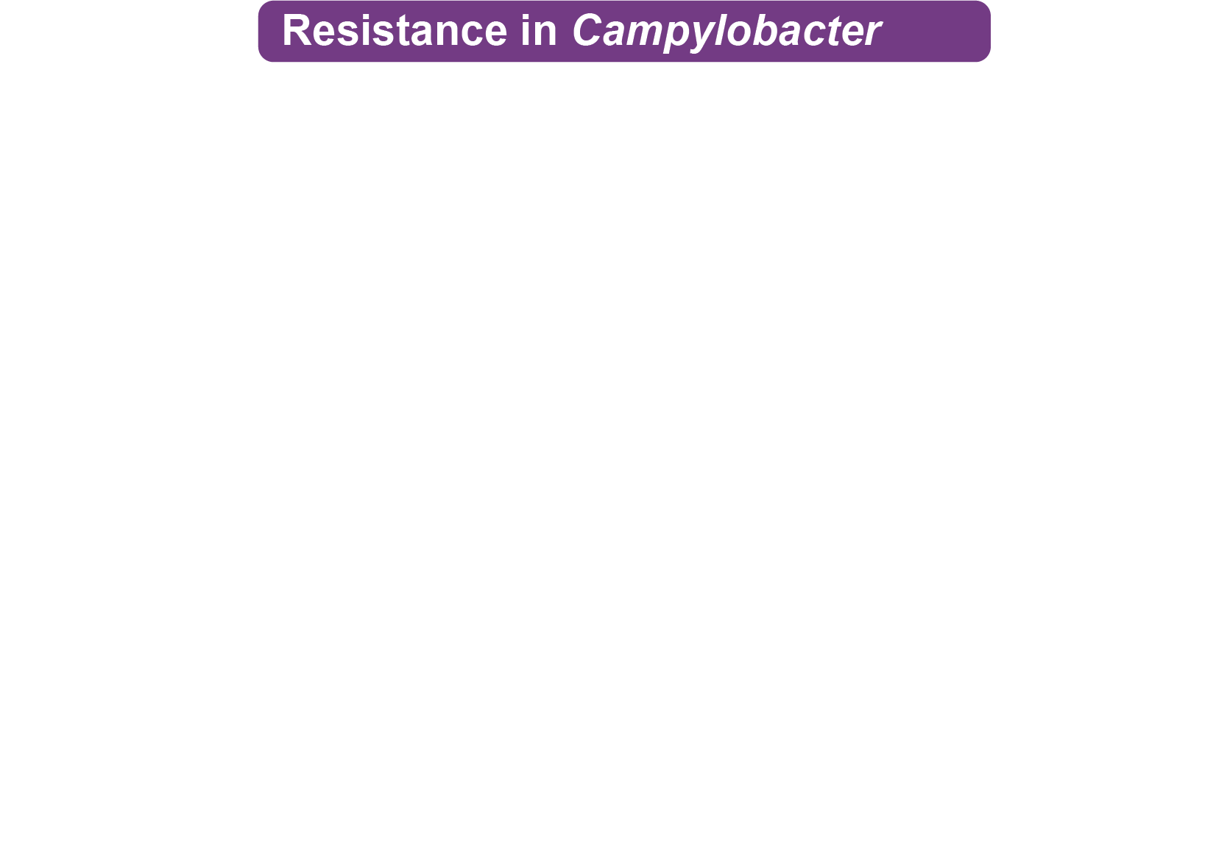
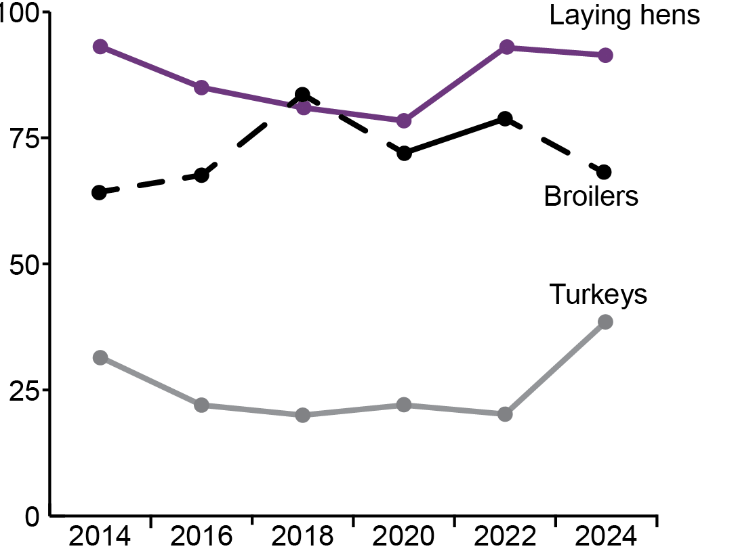
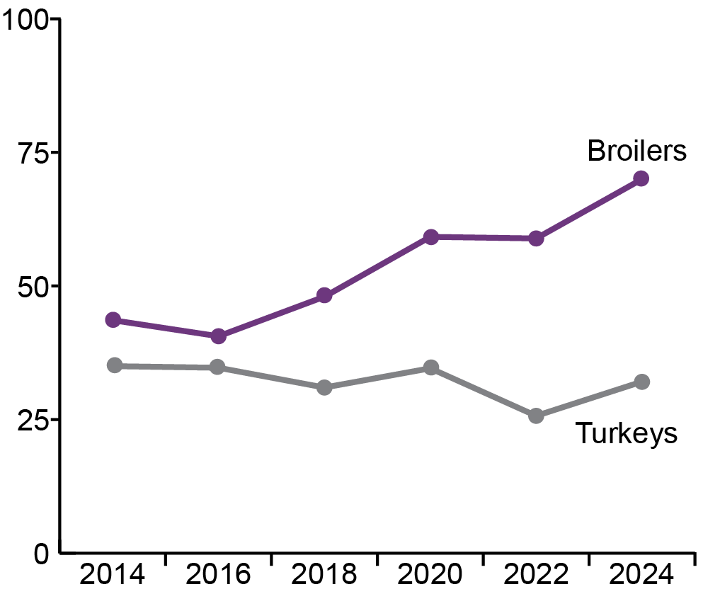
Harmonised Monitoring of AMR
In 2024, fully susceptible Salmonella isolated
from broilers and laying hens decreased but
increased in turkeys
Resistance to ciprofloxacin in Campylobacter
jejuni from broilers and turkeys has increased
since 2022 despite minimal use by these sectors.
Percentage of fully susceptible isolates (%)
Percentage of isolates
resistant to ciprofloxacin (%)
Source: p. 12

Slide 12
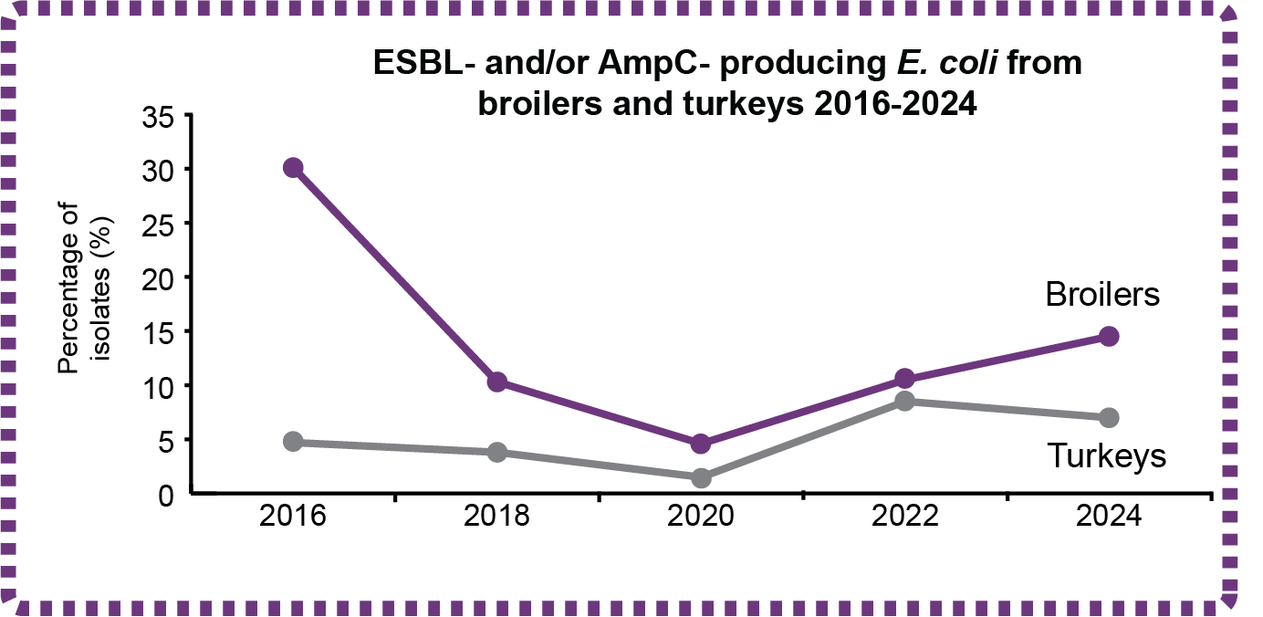
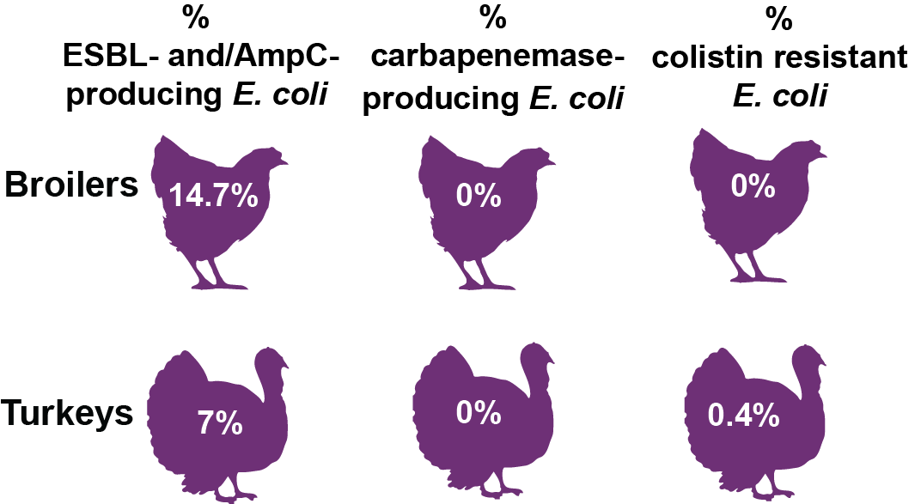
Harmonised Monitoring of AMR
Using selective media to detect E. coli
We also use selective media for more sensitive testing, which inhibits the growth of susceptible bacteria but allows bacteria with specific resistances to multiply, making them easier to detect. This tells us the percentage of individual samples containing resistance to the HP-CIAs, even when present in very low numbers.
In 2024, carriage of ESBL-/AmpC- producing E. coli, which are resistant to third and fourth generation cephalosporins and penicillins, increased in broilers and decreased in turkeys.
Source: p. 12

Slide 13
Harmonised Monitoring of AMR
Harmonised outcome indicators are also measured for antibiotic sales. Overlaying indicators for sales with those for resistance illustrates how reductions in antibiotic sales since 2014 are reflected in reductions in resistance over the same time period.
Each bar shows the percentage of multi-drug resistant Escherichia coli isolates from broilers, turkeys and pigs weighted by PCU (secondary indicator), combined over two years.
Source: Fig 3.4; p. 93

Slide 14
Harmonised Monitoring of AMR
In 2024, antibiotic susceptibility testing was conducted on 176 E. coli isolates obtained from broiler caecal samples.
Full susceptibility decreased from 45% [95% CI: 38-53%] in 2022 to 32% [95% CI: 26-40%] in 2024.
The percentage of MDR isolates remained stable at 27% [95% CI: 21-34%].
Key: ¢ 2014 ¢ 2016 ¢ 2018 ¢ 2020 ¢ 2022 ¢ 2024
Source: Fig 3.5; p. 94

Slide 15
Harmonised Monitoring of AMR
In 2024, antibiotic susceptibility testing was conducted on 176 E. coli isolates obtained from turkey caecal samples.
Full susceptibility to the panel of antibiotics was observed in 30% [95% CI: 23-37%] of isolates.
The percentage of MDR isolates has been increasing slightly year-on-year since 2018.
This trend continued in 2024 with 27% [95% CI: 21-34%] of E. coli isolates from turkeys showing MDR.
Source: Fig 3.7; p. 96
Key: ¢ 2014 ¢ 2016 ¢ 2018 ¢ 2020 ¢ 2022 ¢ 2024

Slide 16
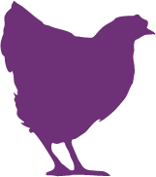
Harmonised Monitoring of AMR
Enterococci are indicator species for the detection of AMR in Gram positive bacteria, first added to the programme in 2022. For Enterococcus faecalis in broilers, high resistance was observed for erythromycin and tetracycline, although these are not used in the meat poultry sectors, other antibiotics in the macrolide and tetracycline classes accounted for 0.1% and 14% of antibiotics used in 2024, respectively
(A) Non-HP-CIAs
(B) HP-CIA and human-only antibiotics
No resistance to HP-CIAs and human-only antibiotics detected
Key: ◊ Human-only antibiotics, AG: aminoglycosides, AP: amphenicols, BL: beta-lactams, GP: glycopeptide, LP: lipopeptide, ML: macrolides, OX: oxazolidinone, QU: quinolones, TC: tetracyclines
¢ 2022 ¢ 2024
Source: Fig 3.9; p. 99

Slide 17

Harmonised Monitoring of AMR
Vancomycin resistant Enterococcus faecalis was isolated for the first time in turkeys (0.7% of isolates [95% CI: 0.1-3.6%]. Vancomycin is not used in animals. VRE are of concern to public health as they carry a higher associated mortality than vancomycin sensitive enterococci.
(A) Non-HP-CIAs
(B) HP-CIA and human-only antibiotics
Key: ◊ Human-only antibiotics, AG: aminoglycosides, AP: amphenicols, BL: beta-lactams, GP: glycopeptide, LP: lipopeptide, ML: macrolides, OX: oxazolidinone, QU: quinolones, TC: tetracyclines
¢ 2022 ¢ 2024
Source: Fig 3.10; p. 101

Slide 18
Harmonised Monitoring of AMR
In E. faecium isolated from broilers, the highest resistance was to quinupristin-dalfopristin, which has been reported in multiple countries and may be related to historical use of a similar streptogramin antibiotic, virginiamycin, as a growth promoter in livestock feed before this was banned in the UK and EU in 1999.
Resistance to HP-CIA and human only antibiotics were detected for first time in 2024.
(A) Non-HP-CIAs
(B) HP-CIA and human-only antibiotics
Key: ◊ Human-only antibiotics, AG: aminoglycosides, AP: amphenicols, BL: beta-lactams, GP: glycopeptide, LP: lipopeptide, ML: macrolides, OX: oxazolidinone, QU: quinolones, TC: tetracyclines
¢ 2022 ¢ 2024
Source: Fig 3.11, p. 103

Slide 19
Harmonised Monitoring of AMR
For E. faecium from turkeys, resistance to non-HP-CIAs remained largely similar to 2022. For the first time, resistance to gentamicin was detected in a single isolate that was also MDR (ampicillin, erythromycin, tetracycline and quinupristin/dalfopristin).
No resistance to human-only or HP-CIA antibiotics were not detected in 2024.
(A) Non-HP-CIAs
(B) HP-CIA and human-only antibiotics
Key: ◊ Human-only antibiotics, AG: aminoglycosides, AP: amphenicols, BL: beta-lactams, GP: glycopeptide, LP: lipopeptide, ML: macrolides, OX: oxazolidinone, QU: quinolones, TC: tetracyclines
¢ 2022 ¢ 2024
Source: Fig 3.12, p. 105

Slide 20
AMR in Clinical Surveillance
Clinical surveillance is a programme of passive surveillance which evaluates AMR in bacteria isolated from diagnostic samples some of which may also have zoonotic potential. As this kind of scanning surveillance is subject to biases and differences in the number of samples submitted to government laboratories, the results are not representative of the UK’s wider animal populations.
In total, 6,921 isolates were tested for AMR in England and Wales in 2024.
The percentages of isolates tested by main animal species were:
30% from poultry
17% from pigs
15% from cattle
9% from sheep
7.4% from dogs
The results are for surveillance and should not be used for treatment decisions.
Private Laboratories Initiative (PLI)
Most AMR data from animals in the UK is generated and held by private veterinary laboratories (PVLs) and does not feed into government surveillance programmes. This gap limits our understanding of AMR in animals and our ability to respond to emerging threats to animals and humans.
The VMD set up the PLI to address this gap by improving the sharing of AMR data held by PVLs with government. In 2025 it covers four major animal streams:
farm animals, companion animals, horses, and fish.
Source: p. 13

Slide 21
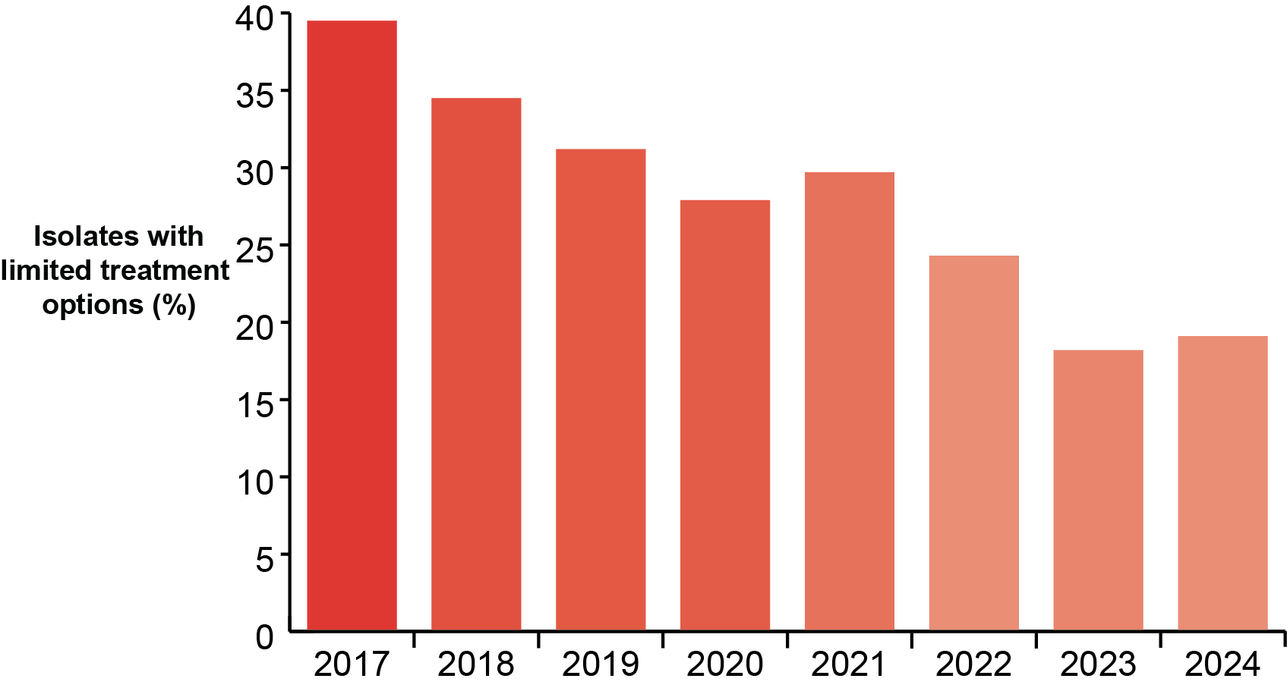
AMR in Clinical Surveillance
Percentage of E. coli with limited treatment options
In 2024, 19% of all clinical E. coli isolated from animals had limited treatment options (LTO), meaning they were resistant to four or more individual antibiotics. This has reduced significantly from 40% since 2017. The percentage of isolates with limited treatment options declined substantially in pigs, cattle and sheep between 2017-2024.
Source: p. 13

Slide 22
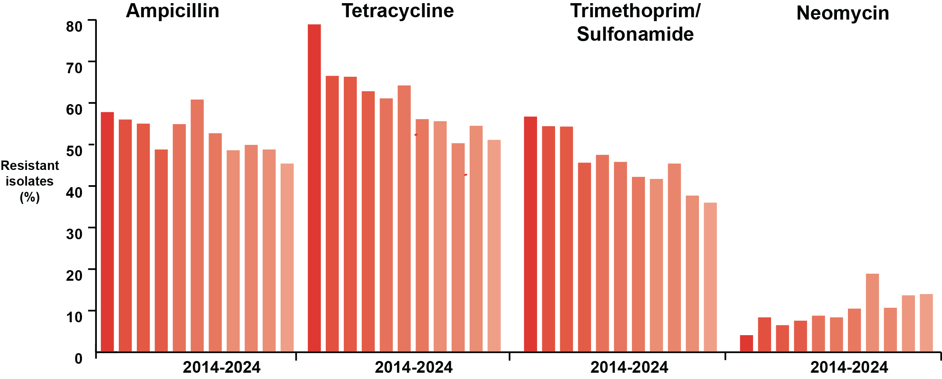
AMR in Clinical Surveillance
Resistance to selected antibiotics in E. coli isolates from pigs 2014-2024
In E. coli isolated from pigs in 2024, the highest levels of resistance were detected to the antibiotic classes that are most commonly used in the pig sector. Resistance of clinical E. coli to antibiotics in penicillins, trimethoprim/sulfonamide and tetracyclines has reduced since 2014, mirroring the reductions in antibiotic use.
Resistance to neomycin (aminoglycoside) has increased significantly from 3.9% in 2014 to 14% in 2024. This aligns with antibiotic use data for aminoglycosides in pigs, which has increased from 2 mg/kg in 2015 to 6.8 mg/kg in 2024.
Source: p. 13

