Slide 1

Annex H
Dress Code for Visitors
All visitors to prisons must adhere to a dress code. Prisons should display the below template in visits areas for visitors and prisoners to view. This information should also be made available to visitors when booking visits, to avoid having to cancel visits on arrival due to inappropriate dress.
The below list is an example and not exhaustive. Establishments may wish to add to this list or remove items, in accordance with local assessments and what is deemed necessary and proportionate in that establishment.
Staff working in visits should recognise the diversity of cultures and religions of their social and legal visitors, therefore a sensitive approach should be adopted when this affects dress and appearance.

Slide 2
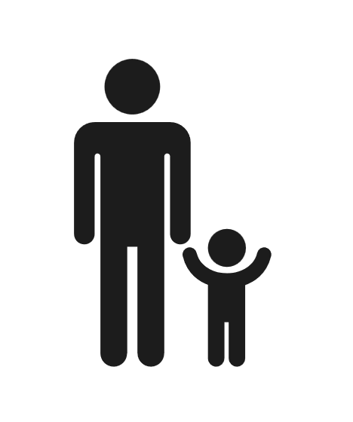

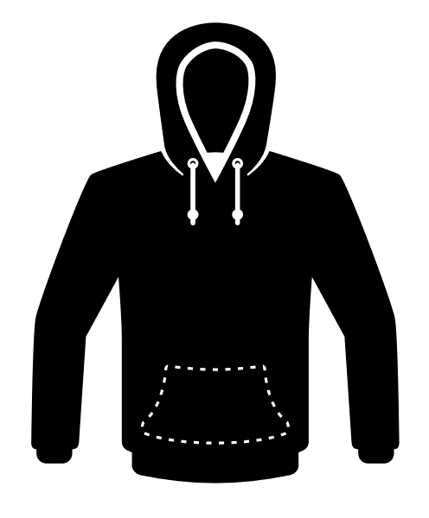


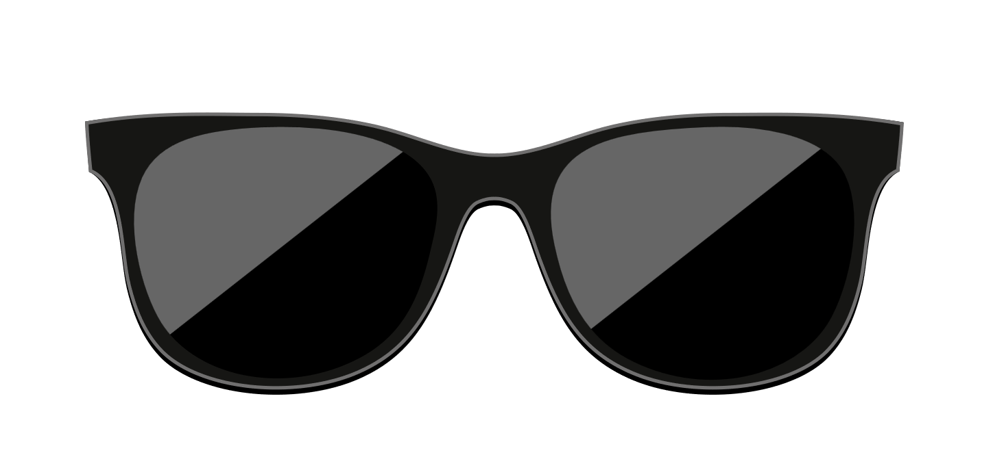

Dress Code for Visitors
HMP …… operates a family orientated visits policy. The majority of our visitors are accompanied by children and we want to foster a decent, safe and relaxed family environment.
The following items of clothing should NOT be worn:
Hats or scarves and head coverings which are not worn on religious grounds
Inappropriately damaged clothing
Non-prescription glasses i.e. sunglasses
See-through/ revealing clothing
Items of clothing that display offensive abusive or insulting words or gestures
Mini or very short skirts/dresses unless worn with leggings
Shorts which are shorter than mid-thigh to knee length
Visible or exposed underwear
Smart watches
This list is not exhaustive.
It is up to prison staff to make decisions and judgements as to when clothing is inappropriate. When making these decisions, staff will always consider decency and diversity. You may be asked to adjust clothing or wear alternative clothing if available. As a last resort your visit may be cancelled if the dress code cannot be followed.

