Slide 1


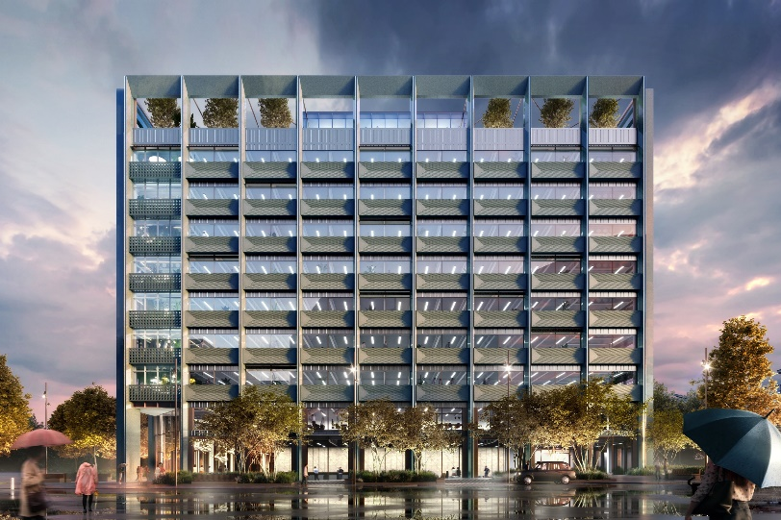
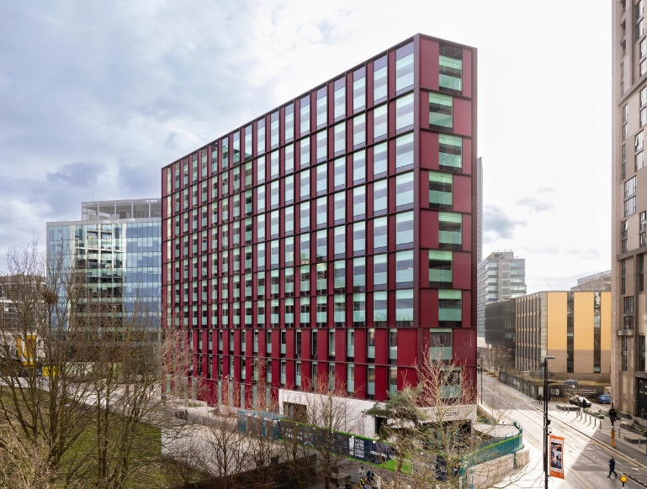
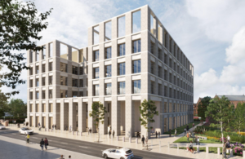
Government Property Agency
Strategic Asset Management Plan Summary 2025
Manchester, First Street
Croydon, 2 Ruskin Square
Darlington, Brunswick Street

Slide 2





ROLE AND PERFORMANCE
OUR ROLE
The GPA exists to provide a single general-purpose estate for the Civil Service managed centrally for the benefit of departments.
We are responsible for holding, managing and enhancing the performance of the assets within our GPA Managed Estate portfolio in accordance with core policy objectives the Government Estate Strategy to deliver best value, drive efficiency and meet the specialist needs of each Government Departments so that staff can thrive, whilst supporting the Plan for Change and contributing towards the move to Net Zero.
We also support the Office of Government Property (OGP) in developing excellent portfolio data and enhancing the capability of the government property profession through providing expert property advice to wider Government Departments.
Considerable progress has been made towards our vision. We are replacing and upgrading the estate; removing the barriers preventing departments from sharing space and collaborating on public services; reducing carbon emissions; and delivering impressive savings.
2024/25 PERFORMANCE
During 2024/25 we transferred 14 properties (acquisitions) comprising total NIA of 20,586 sq m and exited 25 buildings from the GPA Managed Estate with an annual property cost of c. £50m.
Since the launch of the GPA on 1 April 2018, we have transferred 1,147,650 sqm (NIA) of office floorspace to our management.
April 2025
TOTAL M2² OF GPA MANAGED OFFICE ESTATE
TOTAL INCOME
(£m) |REGULAR CHARGES|
0.93M
£756M
Kickstarting economic growth
Accelerating to net zero
Public service transformation
Delivering value for money and efficiencies
TOTAL NO. OF PROPERTIES
TOTAL NO. OF MULTI-LET PROPERTIES
NO. OF OCCUPATION AGREEMENTS / LEASE RECEIVABLES
221
93
621
Our four strategic objectives (above) will continue to make a real difference to people and places
Note: data from Horizon represents the Residual GPA Managed Estate i.e. assets transferred to GPA to date minus exited assets
Further detail on our objectives, achievements, KPI’s and delivery plan are set out in our GPA Strategy 2020-2030, GPA Business Plan 2025/26 and Annual Report and Accounts FY 24/25

Slide 3

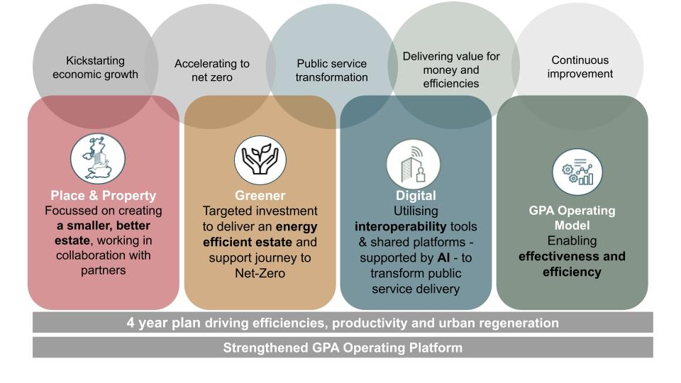
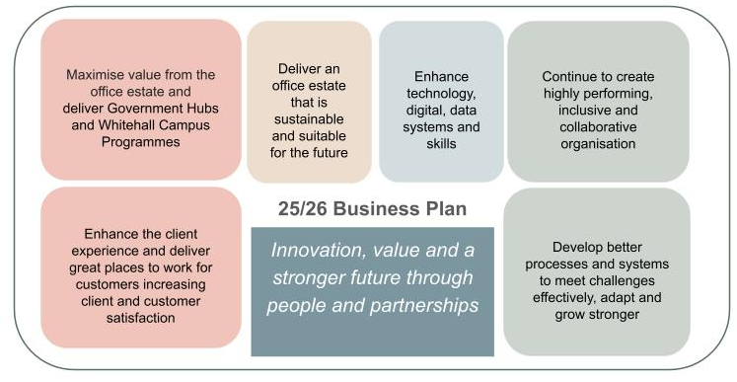
GPA Strategic Framework
Golden thread from vision to individual
GPA Performance At A Glance: Q1 April to June 2025/26
Our vision:
A transformed, shared,
sustainable and value
for money government
office estate supporting
civil servants to work
productively in every
nation and region of the UK
Our Mission:
We will work collaboratively across government to deliver a smaller, better, greener government office estate, stimulating economic growth across the UK, bringing civil servants closer to the communities they serve
KPIs/Metrics
KPIs/Metrics
KPIs/Metrics
KPIs/Metrics
Delivered through brilliant, skilled, diverse and empowered people and partners who embody the values of the GPA
Business Plan SMART Actions
Functional/Team Plans
Individual Objectives

Slide 4
GPA Estate: 4-Year Plan on a Page - SR25 Summary of Final Settlement
Kickstarting economic growth, delivering public service transformation and accelerating net zero, to unlock value for money and efficiencies
Total Number of HMG Offices (c.400) with £1.46bn annual running cost. Total civil servants using offices c.346,503
Current position
GPA: 228 offices = £845m pa
GPA: accommodates c.115,000 civil servants
Improved collaboration across entire office estate with HMRC/DWP/HO
Invest £440m CDEL to deliver Whitehall consolidation, the completion of Bristol TQH, and 3 new hubs (Manchester, York and Darlington), exiting 11 buildings
Invest up to £398.2m CDEL MDC (joint bid); Progress at reduced pace pending successful OBC Autumn 2025
Invest £522m CDEL in maintenance debt (LCR), net-zero and interop initiatives across 228 buildings
Invest £83m CDEL in digital interoperability including AV/GovPrint/GovPass/GovWifi; digital/data/AI
Deploy c. £170m RDEL over 3 years to operate and evolve GPA’s platform to deliver essential GPA activities
Deliver £83m annual (RDEL) savings through estate efficiencies by 2030 (£102m by 2032)
Target £0.7bn mainly cashable benefits (inc 7% social and economic value) over 20 yrs (by 2046)
The GPA’s delivery plan
Supporting Places for Growth to relocate 20,000 roles out of London through delivery of Government Hubs and Whitehall Campus Programme
Continuing to create great places to work, through brilliant workplace services, for civil servants across the UK, supporting improved and diverse talent attraction, greater employee retention rates and enhanced productivity
Underpinned by continuous improvement to build stronger foundations, enhance our skills, and enable Civil Service reform
Departmental cross cutting alignment on Civil Service workforce planning (including PfG)
Medium-term change to GPA operating model (inc ALB review / CO Futures), providing more financial control and people policy flexibility
Cross-departmental alignment on attendance rates and utilisation assumptions
Confirmation of priorities and scale of interoperability, proptech, digitalisation, etc
Support required

