Slide 1




“Campaign in a Box”
Update to the AQuA Book
For all government analysts, leaders in analysis, Analysis Function Champions, Analysis Professions, and communications teams

Slide 2









About this ‘Campaign in a Box’
The Analytical Quality Assurance (AQuA) Book is government guidance about what to do to produce robust, fit for purpose analysis. It's for all analysts, analytical managers and commissioners.
The AQuA Book has just been updated (summer 2025) to ensure it remains fit for purpose.
The AQuA Book has made a significant contribution to the cultural change in assurance practices in government by clearly setting out the core framework for assuring all forms of analytical evidence.
The products within this Campaign in a Box are designed to help you to promote the update within your department and/or profession.
The resources are designed to be used in a ‘pick and mix’ style, allowing freedom for you to do what is best for your teams.
There are recommended actions for Senior Leaders, QA leads, Analysts and Customers / Commissioners.
We hope that you find these useful. If you have any queries or feedback, email the team at Analysis.Function@ons.gov.uk
The Analysis Function is a cross-government community of 17,000 analysts from all the analysis professions. Our members work in every government department and are actuaries, digital and data analysts, economists, geographers, operational researchers, social researchers, statisticians, are ‘dual-badged’, ‘unaffiliated’, or work with analysis.

Slide 3

About the updated AQuA Book
The AQuA Book is government guidance about what to do to produce robust, fit for purpose analysis. It is designed for all analysts, analytical managers and commissioners. The AQuA Book has just been updated (summer 2025) to ensure it remains fit for purpose and is easier for non-specialists to understand and apply. Whilst the principles remain the same as the first edition, the update includes:
Updated presentation as a web-based guidance page, with modular sections and links to supporting resources
Clearer distinctions between commissioners, analysts, and assurers, with simplified role descriptions and responsibilities
Updated content to reflect developments in analysis, such as reflections on the use of Black box models
More detail on what to do around business-critical models
Condensed guidance with emphasis on communicating uncertainty effectively and proportionately, with links to the Orange Book and other risk resources
Links to detailed guidance, including a new maturity model template to support organisations in implementing good quality. We would encourage all organisations to consider implementing DfE's template within their organisations.
The Analysis Function is a cross-government community of 17,000 analysts from all the analysis professions. Our members work in every government department and are actuaries, digital and data analysts, economists, geographers, operational researchers, social researchers, statisticians, are ‘dual-badged’, ‘unaffiliated’, or work with analysis.

Slide 4






Message from AQuA Book sponsors
“The AQuA Book was initially developed in response to Sir Nicholas Macpherson’s review of modelling in government. Whilst there have been vast improvements since then in the way that quality assurance across government analysis is conducted, it remains as essential to good quality analysis as it was when it was first released.
While the new edition is about evolution not revolution, it adds detail on recent developments, such as assuring black box models (e.g. machine learning and AI), makes roles clearer and includes supporting resources. It maintains the same principles as the first edition around the need for proportionate quality assurance and effective analytical design.
We would recommend all analysts, particularly those involved in modelling, review the updated version and check whether they need to revise any of their processes and practices.”
AQuA Book sponsors:
Tony O’Connor
CBE FORS, Chair of Government Operational Research Service (GORS)
Matt Gurden
Deputy Government Actuary, Government Actuary’s Department (GAD)
Osama Rahman
Director, Data Science Campus, Office for National Statistics (ONS)

Slide 5



Aqua Book Actions
There are 4 groups of audience for the Aqua Book, these groups should undertake the following activities:
Senior leaders:
shall ensure their unit’s guidance is aligned with AQuA V 2.0,
shall communicate the local implementation of AQuA V2.0,
should take stock of their unit’s QA maturity using the DFE model or similar,
should ensure appropriate steps are taken to increase QA maturity.
Quality Assurance leads:
shall familiarise themselves with AQuA V2.0 and update local guidance,
shall communicate changes to the local guidance and train their colleagues if necessary.
Analysts, Assurers and Approvers:
shall know there is a new version of the AQuA book
shall take up any training in the local implementation of QA.
Commissioners / Customers:
may know that there is a new version of the AQuA Book
may familiarise themselves with their roles and responsibilities in the analytical lifecycle

Slide 6
Example wording for internal channels
Use for internal channels such as your departmental intranet or profession website, SharePoint, for internal newsletters or other message boards. Simply customise by adding in your department or profession name.
The updated AQuA Book
If you are a member of [DEPARTMENT or PROFESSION NAME] and need guidance on how to produce robust, fit for purpose analysis (particularly modelling), then the newly updated AQuA Book is for you.
Everyone in [DEPARTMENT or PROFESSION NAME] should be aware of the newly updated Analytical Quality Assurance (AQuA) Book, which provides guidance on producing good quality analysis for government to support well informed decision-making that creates better outcomes and improve the lives of citizens.
The AQuA Book has made a significant contribution to the cultural change in assurance practices in government by clearly setting out the core framework for assuring all forms of analytical evidence.
Do you want to know more about the updated AQuA Book, then make sure to dial in to the “Introduction to the AQuA Book” virtual session on 28 October. Secure your space on the Analysis Function EventBrite.

Slide 7
Template posts
Use for external channels such as X or LinkedIn:
All colleagues in [DEPARTMENT or PROFESSION NAME] should know that the AQuA Book has been updated. Every one of us should be aware of this vital guidance and make sure we are using it in our work
Do you want to know more about ensuring quality assurance within your analysis? Then check out the updated AQuA Book
The last version of the AQuA Book was published in 2015, following Sir Nicholas Macpherson’s Review of quality assurance of government models. Since then, assurance has become part of the fabric of good practice for developing evidence to support policy development, implementation and operational excellence.
The AQuA Book is the cornerstone of analytical quality assurance across government. It sets out high-level principles and practical guidance to ensure analysis is fit-for-purpose, reliable, and robust.
Analysts across [DEPARTMENT or PROFESSION NAME] should refer to the new AQuA Book to gain clarity on verification, validation, and uncertainty. The AQuA Book is critical for producing trustworthy output
Do you want to know more about the updated AQuA Book, then make sure to dial in to the “Introduction to the AQuA Book” virtual session on 28th October 11:30-12:30. Secure your space on the Analysis Function EventBrite.

Slide 8

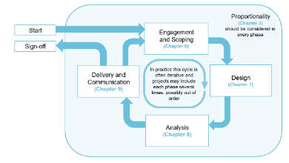
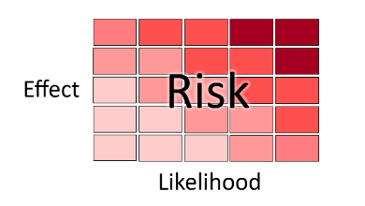
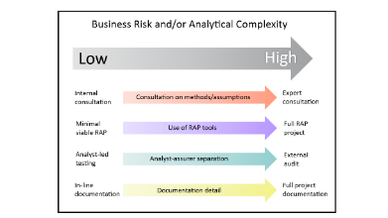
Useful graphics and logos
Analysis Function logo (contains link to guidance on the government ‘colour books’
AQuA Book logo (contains link to the AQuA Book)
The above graphics are from the AQuA Book, and all contain ALT text explanations

Slide 9






Find out more
Read the new AQuA Book on GOV.UK: https://www.gov.uk/guidance/the-aqua-book
Attend the “Introduction to the AQuA Book” event on 28 October. Secure your space on Eventbrite
Subscribe to and share your news in the monthly AF Newsletter for monthly updates direct to your inbox about all government analysis issues including updates to the ‘Colour Books’

Slide 10


Slide 11


