Slide 1













6th Annual
Analysis in
Government
Awards

Slide 2


‘Campaign in a Box’
Products to help promote the 6th Annual AiG Awards

Slide 3

AiG Awards Campaign in a Box
This is a ‘Campaign in a Box’ for the Analysis in Government Awards (AiG Awards)
This Campaign in a Box is designed for Communications and Support Teams (and anyone who would like to show their support for the campaign)
It is full of products and resources to help you to promote the AiG Awards within your department or profession
You can use the products in a ‘pick and mix’ style, allowing freedom for you to do what is best for your teams
We hope that you find these useful and if you have any queries or feedback, please contact the team at Analysis.Function@ons.gov.uk

Slide 4

Key messages
Nominations for the 6th AiG Awards are now open. You can nominate yourself or a colleague for an award by completing the AiG Awards nomination form by 23:55 on Friday 24 October 2025
Find out everything you need to know about the AiG Awards by visiting the new Analysis in Government (AiG) Awards Hub
The categories are Collaboration, Communication, Impact, Inclusion, Innovative Methods, and the Rising Star Award
Any civil servant is eligible to be nominated for an AiG Award. Public sector and external teams may be recognised for a Collaboration Award if they have worked with civil servants on the nominated project
Nominating is quick and easy: Analysis in Government Awards Nomination Form
The AiG Awards is organised by the Analysis Function Central Team
Connect with your government analysis community on LinkedIn, follow @gov_analysis on ‘X’, sign up to our monthly Newsletter, and find the latest news and information on the AiG Awards on our website Analysis.Function.CivilService.gov.uk

Slide 5


AiG Awards Timetable
2025
17 September: Nominations open
24 October: Nominations close
Mid-December: Shortlist announced
2026
Mid-January: Winners announced over the course of ‘Awards Week’
February: People’s Choice Award winner announced (all winners and runners up from the main awards are eligible to win the People’s Choice Award, voted on by the whole AF membership)

Slide 6


Sample wording for your intranet
Nominations for the 6th AiG Awards are now open. You can nominate yourself or a colleague for an award by completing the AiG Awards nomination form. The nominations period closes at 23:55 on Friday 24 October 2025.
If you want to recognise the excellent work in [insert Department Name here] and celebrate our most inspiring individuals and outstanding teams at a cross-government level, make sure to submit one (or more) nominations.
Find out everything you need to know about the AiG Awards, including timelines, templates, and advice on writing a winning nomination, by visiting the new Analysis in Government (AiG) Awards Hub.
The Analysis in Government (AiG) Awards is a highly respected and prestigious cross-government scheme. The awards recognise and celebrate the many inspirational individuals and outstanding teams working in government analysis.
The AiG Awards have helped to promote best practice throughout the government analysis community since 2020, sharing innovation, learning and leadership across the Analysis Function and beyond.
There are six different award categories: Collaboration, Communication, Impact, Inclusion, Innovative Methods, and the Rising Star Award.
Nominations close at 23:55 on Friday 24 October 2025. Good luck!

Slide 7



Social media
Analysis Function will be active on LinkedIn and X from nominations opening until the announcement of the winners in January and the winner of the People’s Choice Award in February. Follow us at @gov_analysis and connect with us on LinkedIn at Gov Analysis
Which department will submit the most nominations this year? Which profession will win the most awards? Who will submit the first nomination? Share, Like and tag us in to help build conversations and increase engagement / interest in the AiG Awards. Sample wording for your team’s social media
The Analysis in Government (AiG) Awards opened for nominations on 17 September. Find out how to nominate by visiting the new AiG Awards Hub
At [Insert team/department/profession name here] we’re very excited for this year’s Analysis in Government (AiG) Awards. Make sure you nominate the outstanding teams and inspirational individuals you work with AiG Awards nomination form
There has been so much incredible work taking place across [Insert team/department/profession name here] over the last year, so why not nominate your colleagues for an Analysis in Government (AiG) Award? Nominations close on 24 October 2025: AiG Awards nomination form
Nominating your colleagues in [Insert team/department/profession name here] for an Analysis in Government (AiG) Award is easy. Find out more about getting cross-government recognition for the outstanding analysts you work with. Visit the new AiG Awards Hub today

Slide 8



6th Annual
Analysis in Government Awards
Nominations for the sixth annual Analysis in Government Awards are open now, and you have until 23:55 on Friday 24 October to submit a nomination
The Analysis in Government Awards (AiG Awards) is a prestigious cross-government programme, recognising and celebrating the work of outstanding teams and inspirational individuals working in the field of analysis
There are six categories: Collaboration, Communication, Impact, Inclusion, Innovative Methods, and the Rising Star Award
Find out everything you need to know about the Awards on the new AiG Awards Hub
Press the big orange button to nominate now! Analysis in Government Awards Nomination Form Good luck!

Slide 9
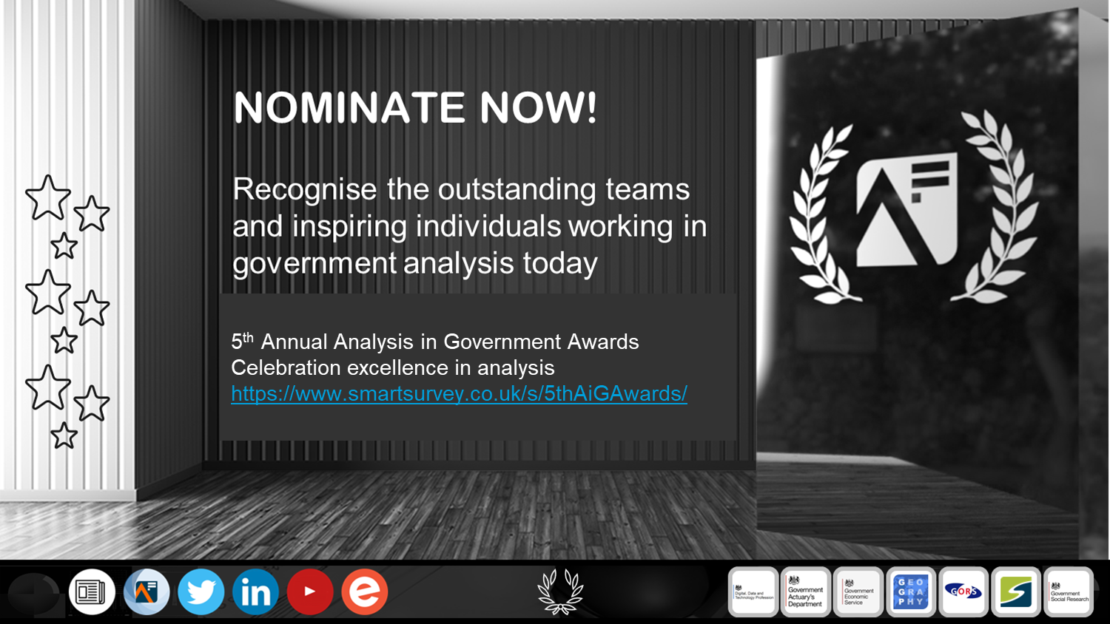
6th annual Analysis in Government (AiG) Awards
Find out everything you need to know about the AiG Awards on the new AiG Awards Hub
Nominations are open until Friday 24 October. Good luck! Analysis in Government Awards Nomination Form

Slide 10

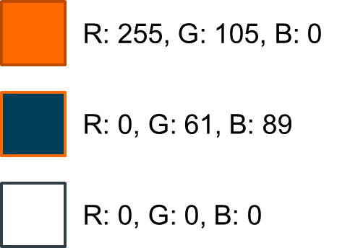
The AiG Awards logo
Simply Copy + Paste
Please note - if resizing the logos, please make sure ‘Lock aspect ratio’ is ticked in Format Shape menu to avoid squashing or stretching the logos
All logos contain a hyperlink to the new AiG Awards Hub homepage https://analysisfunction.civilservice.gov.uk/analysis-in-government-aig-awards-hub/
If you require any of these designs in a different format, or have any queries, please contact the Analysis Function Central team at Analysis.Function@ons.gov.uk

Slide 11
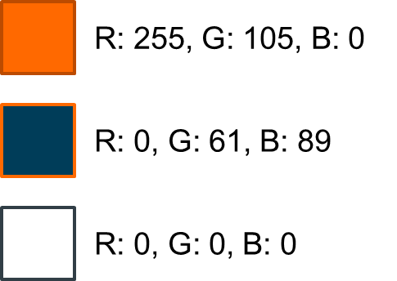
Logo (colour)

Slide 12

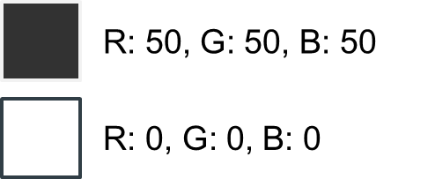
Logo (monochrome)

Slide 13


Logo (for dark backgrounds)

Slide 14

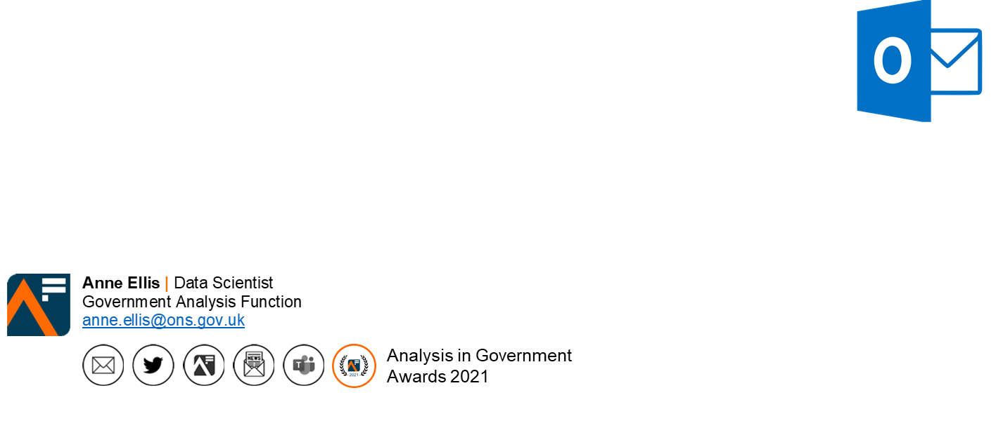

Email signature
Add the Analysis in Government Month ‘button’ to your email signature. The button contains a hyperlink to the AiG Awards nomination form
Remember to refer to the latest guidance on Understanding accessibility requirements for public sector bodies - GOV.UK (www.gov.uk)
COPY + PASTE

Slide 15


Round background logos (2D/3D)

Slide 16
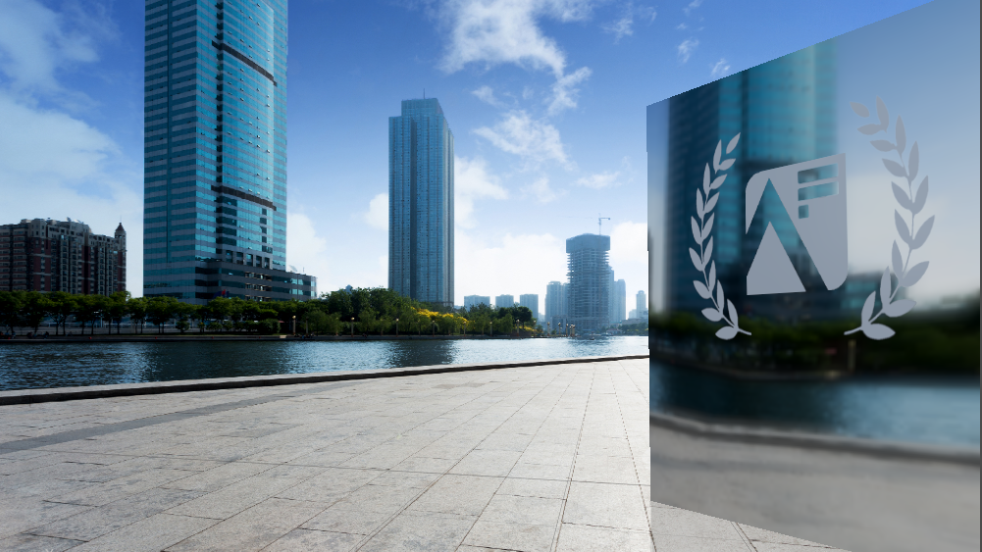

Slide 19


Slide 20


Slide 21


Slide 22


Slide 23


Slide 24


Slide 25


