Slide 1
A strategy for analysis in government: (2025 to 2028)
Your name
Your team
Date
Notes:
Why not add your departmental or profession logo to this page to personalise it and show the affiliation between you and the Analysis Function?

Slide 2
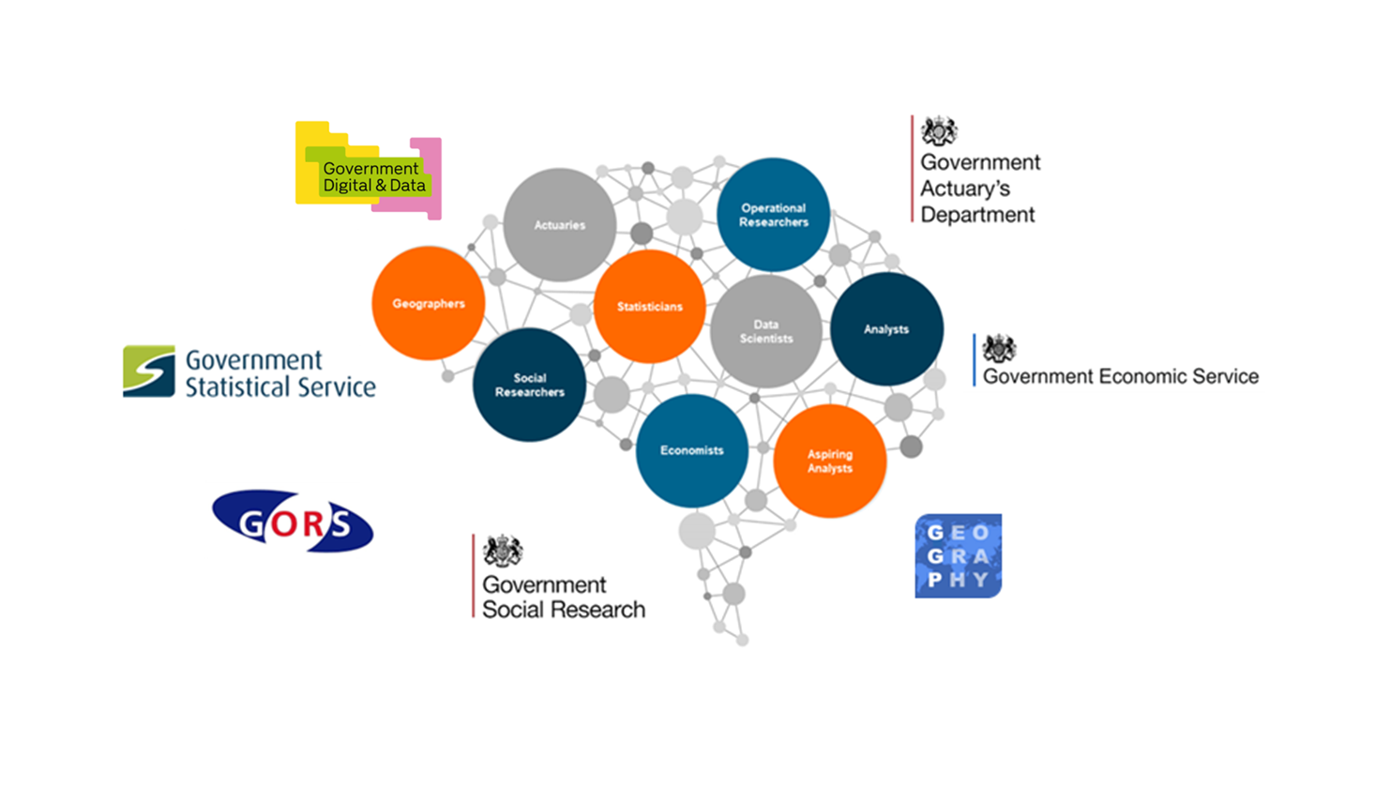
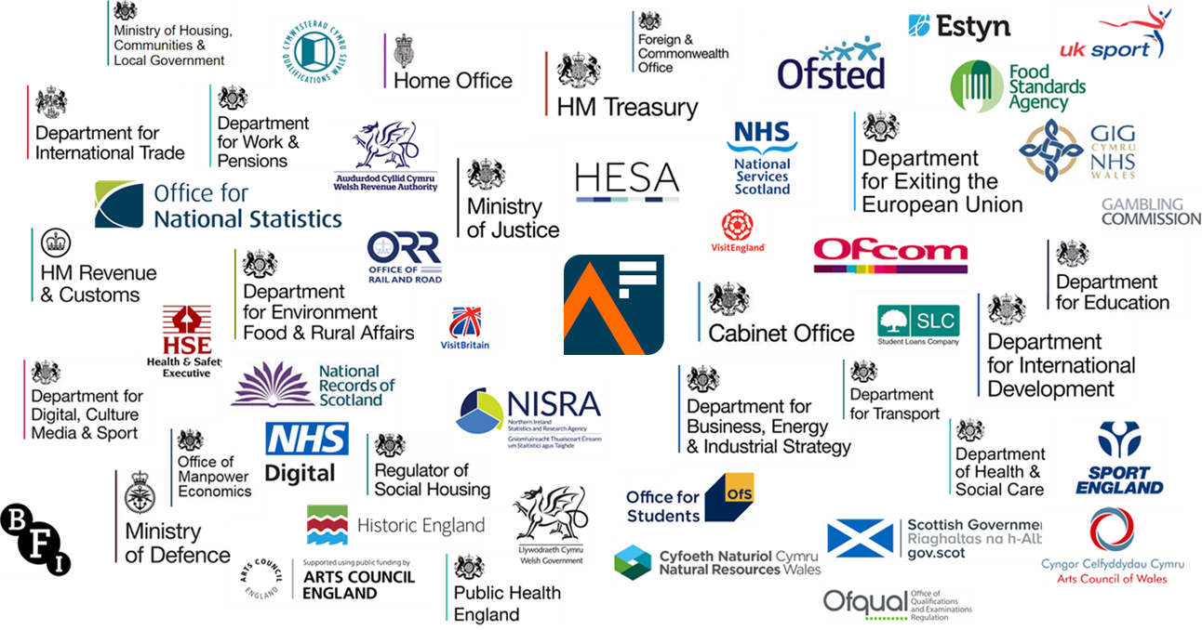
What is the Analysis Function?
The Analysis Function (AF) brings together analysts of all disciplines by facilitating cross-government and cross-profession collaboration on the highest priority analytical issues
Our community numbers more than 17,000 analysts
Members of the Analysis Function may also belong to one (or more) of the seven analysis professions, or be unaffiliated, and we also welcomes aspiring analysts anywhere in the Civil Service
If you work in government and your role involves analysis you are a member of the Analysis Function
Notes:
Welcome to this presentation about the Analysis Function and “A strategy for analysis in government (2025 to 2028)”

Slide 3
Vision, objectives + priorities for all analysts
Our vision: The vision for the Analysis Function is:
“The analytical community will provide better outcomes for the public by providing the best and most efficient analysis to inform decision making”
Our objectives:
We provide insight and impact
We are innovative
We are connected and collaborative
We are skilled and talented
Our priorities:
We will bring multi-disciplinary, impactful analysis to the government’s priorities
We will be innovative, driving efficiency across our function, the civil service and society
We will work across boundaries to harness the power of data
Our people are central to our future direction
Notes:
The vision, objectives, and priorities for all analysts is laid out in the new strategy
These are the cornerstones of delivering the strategy for all analysts in [Insert your Department/Profession name here]

Slide 4
Our objectives
We provide insight and impact by:
Providing timely and credible insights​ to shape and form decision making
Working closely with our customers, to ensure we are having a positive impact and supporting decision, whilst remaining impartial and being open to challenge.​
Having the skills to tell a clear story on what the data is telling us, with strengths and weaknesses communicated effectively
Focussing on what works and actionable insight​
Anticipating and reacting to new priorities, including missions
To achieve this, it is essential that we are ensuring quality analysis, this will be supported by ethical and other relevant guidance​.
We are innovative by:
Having access to current and relevant tools​
Understanding how to use novel techniques and capabilities ethically, including AI and automation​
Focussing on continually improving our processes so we are more efficient and insightful, with a focus on value added. Identifying duplication and gaps
We are connected and collaborative by:
Working across departments and professions, supported by thriving networks and effective data sharing​
Having an engaged and effective governance and leadership community​
Being transparent and consistent across government​
Being curious about what others are doing, including beyond government, and reaching out to each other.
We are skilled and talented by:
Having clear pathways for meaningful and rewarding careers across professions that attract and develop talent
Understanding the skills we need to be successful now, and in the future​, with a clear learning offer to support this
Ensuring our environment is inclusive and embraces diversity
Notes:
Our objectives are here to explain what unites all the different types of analysts and will help to explain to our stakeholders what our role is.
Highlight key points of each objective
There’s a lot that underlies these objectives and the strategy links in with the AF Standard and other guidance, which provide more detail on how we put these objectives into action

Slide 5
Analysis has never been so important to government as it is today…
Our mission as a function is to support the government to make better decisions in every aspect of policy, delivery, and operations, to deliver value for money and to improve the lives of the UK population
Notes:
Analysis in government has never been as important as it is today - analysis must be at the heart of the Government Missions (as outlined in the Plan for Change), Civil Service Reform and wider ever-evolving policy decisions and strategic priorities
All analysts have a role to play, including every one of us in [Insert your Department / Profession name]

Slide 6
Priority 1: We will bring multi-disciplinary, impactful analysis to the government’s priorities, including the missions and a productive, agile state
We need to shape, inform and achieve government’s aims, including missions and public sector reform. Some of the key challenges facing government, which we are instrumental in addressing are: adoption of digital tools, attracting and retaining high-demand specialist skills, and the increasing complexity in how we operate.
We will support this priority by:
ensuring analytical resource is focused on the highest priorities
bringing together data to shape the missions and other cross-cutting priorities.
considering how we can be more agile and productive,
moving beyond basic analysis to achieve greater insight, with an increased focus on prevention and evaluation.
working closely with Policy and ODP colleagues, to ensure our analysis is delivering their requirements
ensuring our analysis is communicated in a compelling way
Underlying all of this is ensuring that our analysis is of good quality.
Notes:
Priority 1: We will bring multi-disciplinary, impactful analysis to the government’s priorities, including the missions and a productive, agile state
Why is this a priority?
Given the ever-changing wider landscape and the tighter financial conditions across government, it is essential that the analysis leadership community ensures that the community successfully shapes, informs and achieves government’s aims, be they strategic objectives, policies, missions and public sector reform.
The new Civil Service Strategy 2030 focusses on some of the key challenges facing government, namely the adoption of digital tools, difficulties attracting and retaining high-demand specialist skills, and the increasing complexity in how the Civil Service operates, which we are all instrumental in
There’s lots already going on, but we will continue this journey by:
Ensuring that analytical resource is focused on the highest priorities within departments
Continuing to use our relationships across government to bring together data from across government to shape the missions and other cross-cutting priorities
We will consider how we can be more agile and productive, meeting the needs of citizens and supporting growth
We will increasingly move beyond basic analysis to achieve greater insight, with an increased focus on prevention and evaluation
We will work closely with Policy and Operational Delivery Profession colleagues, and beyond, to ensure our analysis is delivering their requirements and is having impact, and to understand what more we need to ensure analysis is integrated into decision making from the start, with analysts understanding the questions that need to be addressed and communicating the results of the analysis in a compelling way.
Underlying all of this is ensuring that our analysis is of good quality.

Slide 7
Priority 2: We will be innovative, driving efficiency across our function, the civil service and society, applying artificial intelligence, automation, and the best analytical tools and methods
Given increasingly complex decision making, it is essential that we become ever more innovative and skilled, embracing new technologies (including AI), where it is appropriate.
We will support this priority by:
Ensuring analysts are aware of the different technologies available to them and providing guidance for their effective use
We will address any cultural and ethical barriers to the use of new technology
We will learn from others both inside and outside of government
Notes:
Priority 2: We will be innovative, driving efficiency across our function, the civil service and society, applying artificial intelligence, automation, and the best analytical tools and methods
Given the increasingly complex decision making we need to support and the need to deliver efficiencies, it is essential that we become ever more innovative and skilled, and that we embrace new technologies and develop the use of AI in analysis, where it is appropriate, this will free up analysts’ time to focus on adding value.
To succeed, human and artificial ingenuity must work hand in hand and should not be viewed as a threat. Prioritising this work is particularly important, given the pace with which these tools and techniques are changing.
The analysis leadership community will support this priority by:
Ensuring our analysts are aware of the different technologies available to them
Providing guidance and support for their effective and ethical usage, ensuring that these tools are used throughout the community.
Providing the right leadership within our organisations to drive forward change, ensuring staff are prioritising the right actions.
We will address any cultural and ethical barriers to the use of new technology, whilst ensuring that we retain quality and transparency in our analysis
We will use support from Government Digital Service and the actions included in A blueprint for modern digital government to enable this change, as well as learning from those outside of government.
The actions will ensure we are better able to deliver the government strategic objectives and missions.

Slide 8
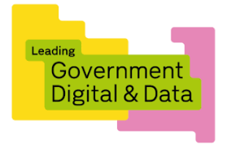
Priority 3: We will (work across boundaries to) harness the power of data, including data sharing, linkage and interoperability
Whilst there have been considerable improvements in data sharing and collaboration there are remaining challenges. Addressing these will mean we have access to the data we need to support decision making.
We will support this priority by:
Addressing cultural and legislative barriers to sharing data and other issues around interoperability.
Ensuring there is a better understanding of who holds what data.
Making better use of data sharing platforms
Continuing to build relationships, including with other government professions and functions
Being increasingly innovative around how we acquire data.
Notes:
Priority 3: We will (work across boundaries to) harness the power of data, including data sharing, linkage and interoperability
Whilst there have been considerable improvements in data sharing and collaboration across government, there are remaining challenges.
Given the increasingly complex decision making which needs to be delivered across organisations, it is even more important that we work to address these challenges.
This will help ensure the community successfully achieves efficiencies across government, working strategically and collaboratively to achieve its priorities.
We will be increasingly innovative around how we acquire data and are using this to address the questions that need solving.
The analysis leadership community will support this priority by:
Addressing cultural and legislative barriers to sharing data and other issues around interoperability
Ensuring there is a better understanding of who holds what data
This will be supported by making more effective use of data sharing platforms,
We will also work across siloes, continuing to build relationships, working in partnership and collaborating across the public sector and beyond.
We will continue to develop professional collaboration with other government professions and functions, including the Policy Profession, ODP, Finance Function, Government Digital and Data, Government Science and Engineering Profession, and beyond, enabling teams to work together more easily and effectively.

Slide 9
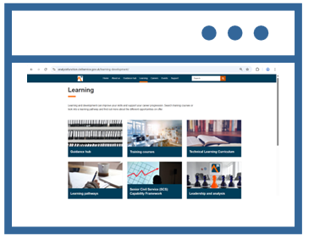
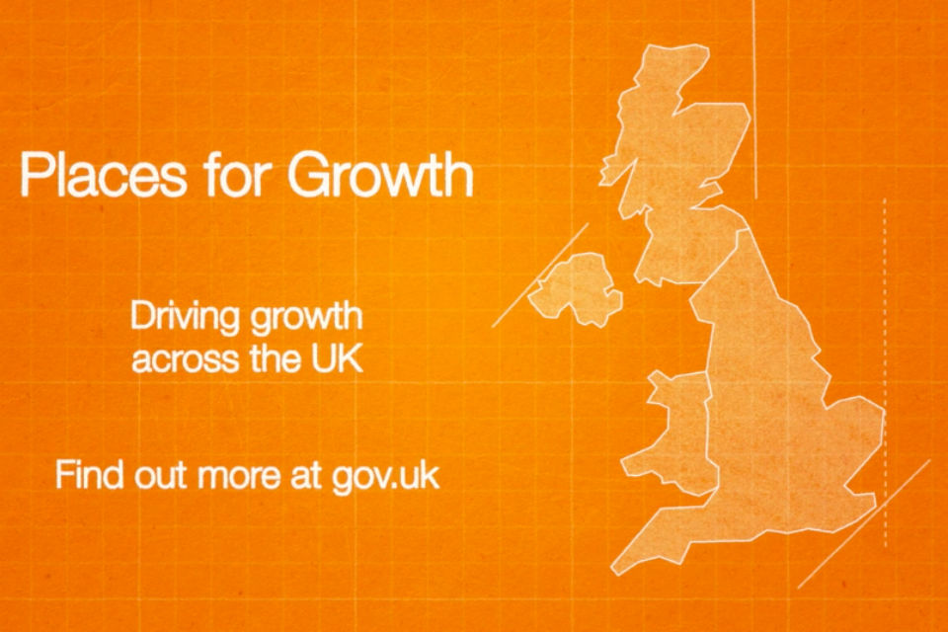
Priority 4: Our people are central to our future direction; we will ensure we attract, retain and support analytical careers and development
It is essential that we are supporting our people to meet these challenges.
We will engage and develop our analysts to ensure they have the right skills and capabilities needed to provide cutting edge analysis
We will ensure they feel part of a strong analytical community and have fulfilling careers.
We will work across the analysis professions to ensure we are continuing to make the most of our resources
Notes:
Priority 4: Our people are central to our future direction; we will ensure we attract, retain and support analytical careers and development
Given these challenges across government, it is ever more important to ensure our people are central in everything we do, that they are supported in meeting these challenges and that we are making the most efficient use of our resources
The analysis leadership community will support this priority by engaging and developing our analysts to ensure they have the right skills and capabilities needed to provide cutting edge analysis (and deliver the other priorities highlighted in the strategy) and feel part of a strong analytical community and have fulfilling careers
We will work across the analysis professions to ensure we are continuing to make the most of our resources, building on existing networks and engagement mechanisms and supporting cross government initiatives such as Places for Growth

Slide 10
Next steps and how to find out more:
Read “A strategy for analysis in government (2025 to 2028)” on the Analysis Function website
Access the new Analysis in Government Strategy Hub which contains useful info including case studies and other materials
Subscribe to our newsletter for monthly updates directly to your inbox
Read our latest Annual Report, showing what we have achieved over the past year (2025 report coming soon to the website)
Continue to collaborate across professions, departments, functions, and wider…
Contact us at Analysis.Function@ons.gov.uk for more information
Notes:
This slide highlights the range of ways you can find out more about the strategy

Slide 11
How to get involved
Subscribe to and share your news in the monthly AF Newsletter
Visit the Analysis Function website
Head directly to our Analysis in Government Strategy Hub
Connect with us on LinkedIn
Follow us on X @gov_analysis
Find out about our latest events on Eventbrite, including sessions for Analysis in Government (AiG) Month – the UK’s largest learning and development event for government analysts, held every May
Subscribe to our YouTube channel YouTube/Government Analysis Function
Nominate the inspirational individuals and outstanding teams you work with for an Analysis in Government (AiG) Award
Become an Analysis Function Champion
Notes:
This slide highlights the ways that all analysts can get involved in the wider work of the function

Slide 12
Thank you Any further questions?
Notes:
Please feel free to share any FAQs with us on the Analysis Function Central Team, and/or ask us about any queries you receive
Email us at Analysis.Function@ons.gov.uk

