Slide 1
“Campaign in a Box” A strategy for analysis in government 2025 to 2028 For leaders in analysis, Analysis Function Champions, professions and communications teams to support the launch of the new strategy

Slide 2
A strategy for analysis in government (2025-28) Key information

Slide 3
About this ‘Campaign in a Box’
“A strategy for analysis in government (2025 to 2028)” sets out the direction for all government analysts over the next three years
This strategy will be delivered with the help of the entire Analysis Function, and coordinated by the Analysis Function Central Team
The products within this Campaign in a Box are designed to help you to promote the new strategy within your department and/or profession and encourage engagement.
The resources are designed to be used in a ‘pick and mix’ style, allowing freedom for you to do what is best for your teams.
We hope that you find these useful. If you have any queries or feedback, email the team at Analysis.Function@ons.gov.uk
The Analysis Function is a cross-government community of 17,000 analysts from all the analysis professions. Our members work in every government department and are actuaries, digital and data analysts, economists, geographers, operational researchers, social researchers, statisticians, are ‘dual-badged’, ‘unaffiliated’, or work with analysis.

Slide 4
About the new strategy
In an era defined by rapid change, complexity, and unprecedented access to data, the UK government's ability to make informed effective decisions has never been more critical. High quality analysis is at the heart of this work through supporting sound policy, efficient delivery, and meaningful evaluation.
“A strategy for analysis in government (2025 to 2028)” has just been published and sets out our collective vision for how government analysts will rise to today's challenges and prepare for those ahead
Every analyst has a role to play in achieving our strategic aims
The best place to find out more is the new Analysis in Government Strategy Hub, which is packed with information and resources to help you, and your team better understand how you can get involved and make a difference.
You can also contribute to our new communications campaign, “Proud to be a government analyst”, which aims to collect and share stories from across the Analysis Function membership. You can take part, support your function, and celebrate the excellent work you know about, by submitting articles, blogs, and case studies to the campaign
Find out more, including how to submit a story, on our new AF Strategy Hub
The one pager overleaf can be used as a simple summary for you to share
The Analysis Function is a cross-government community of 17,000 analysts from all the analysis professions. Our members work in every government department and are actuaries, digital and data analysts, economists, geographers, operational researchers, social researchers, statisticians, are ‘dual-badged’, ‘unaffiliated’, or work with analysis.

Slide 5
Government Analysis Function A strategy for the future of analysis in government (2025-28)
Our vision: “The analytical community will provide better outcomes for the public by providing the best and most efficient analysis to inform decision making”
Our objectives:
Priority 1: We will bring multi-disciplinary, impactful analysis to the government’s priorities
Priority 2: We will be innovative, driving efficiency across our function, the civil service and society
We are innovative
We provide insight and impact
We are connected + collaborative
Priority 3: We will work across boundaries to harness the power of data
Priority 4: Our people are central to our future direction
We are skilled + talented
Proud to be a government analyst: To support the strategy, we have launched a new online hub full of useful resources, including information about our ‘Proud to be a government analyst’ campaign... Why are you proud to be a government analyst? The work we do is interesting, inspirational, and important, and if something has made you proud to be a government analyst, we want to know about it.
Learn more on the new Analysis in Government Strategy Hub and contribute your stories for the chance for your work to be published online, shared across government, and held up as an example of excellence in analysis across government.
Email: Analysis.Function@ons.gov.uk
Newsletter: Subscribe
Web: AnalysisFunction.CivilService.gov.uk
Find us on: LinkedIn, X, YouTube, Eventbrite, and coming soon to Basecamp

Slide 6
Message from Emma Rourke
“In today’s fast-moving and complex world, the need for high-quality government analysis has never been greater.
This strategy sets out a collective vision for how we, as analysts, will meet the challenges ahead — by delivering impactful, multidisciplinary analysis, embracing innovation and AI, improving how we share and use data, and investing in our people.
I’m incredibly proud of the strength and diversity of our analytical community.
I’m proud of the actuaries, data scientists, economists, geographers, operational researchers, social researchers, statisticians, badged, dual-badged, and unaffiliated analysts working in every department across government – and I want to thank you for your hard work.
This strategy is our framework for building capability, raising standards, and ensuring analysis is central to evidence-based decision-making across government.
I encourage everyone who uses, produces or relies on analysis in government to engage with it, champion its goals, and help shape the future of government analysis”.
Emma Rourke, Acting National Statistician

Slide 7
A strategy for analysis in government (2025-28) Useful content (template wording, posts, logos, and Teams backgrounds)

Slide 8
Example wording for internal channels
Use for internal channels such as your departmental intranet or profession website, SharePoint, for internal newsletters or other message boards. Simply customise by adding in your department or profession name.
A strategy for analysis in government (2025-28)
What will analysis in government be like in the future? How will AI, big data, and other innovations affect the work of government analysts? What training and skills will we need? How will we work together even better in [Insert your Department or Profession Name] and with colleagues across government?
A strategy for analysis in government (2025-28) has just been published and sets out a shared vision, strategic objectives and key priorities for the next three years. The strategy was shaped by feedback from members from all different professions and departments across the Analysis Function including analysts from [Insert your Department or Profession Name].
We all have a role to play in Insert your Department or Profession Name]. The new Analysis in Government Strategy Hub is the best place to find out more and is packed with information and resources to help you and your team better understand how you can get involved and make a difference.
Proud to be a government analyst - send us your stories
“What has made you proud to be a government analyst?”
We have so many reasons to be proud in [Insert your Department or Profession Name]
The AF Central Team is collecting stories of excellence in analysis to be published online. These stories will support the behaviours and aims of the new strategy and be held up as examples of excellence.
Stories can be submitted in article, blogs, or case study form, and the team is keen to find out about already published content which can be shared more widely
Find out more, including how to submit your stories, on the new Proud to be a government analyst campaign page
Wider ways to engage: Tell your colleagues and teams today, find out more on the AF website, follow the Analysis Function on Twitter and LinkedIn and sign up for our monthly newsletter for all the latest AF news.

Slide 9
Template posts 1/2
Use for internal channels such as your departmental intranet or profession website, SharePoint, for internal newsletters or other message boards.
All colleagues in [Insert your Department or Profession Name] should know that a new strategy for analysis in government has just been published. Every one of us will play a part in achieving the vision – find out what the new strategy means for us
A strategy for analysis in government (2025-28) sets out the vision for the Analysis Function, strategic objectives and deliverables for the next three years. Find out more on the new Analysis in Government Strategy Hub
“What has made you proud to be a government analyst?” We have so many reasons to be proud in [Insert your Department or Profession Name] The AF Central Team is collecting stories of excellence in analysis to be published online. These stories will support the behaviours and aims of the new strategy and be held up as examples of excellence. Find out more, including how to submit your stories, on the new Proud to be a government analyst campaign page
What makes you proud to be a government analyst? The Analysis Function Central Team is seeking case studies of excellence in analysis from across government departments and all the analysis professions. If you have done work that is interesting, important, or influential, why not submit a case study
Every government analyst is expected to know about the new strategy for the future of analysis in government (2025-28). Tell your colleagues and teams today and find out more on the new AF Strategy Hub

Slide 10
Template posts 2/2
There is a new Analysis in Government Hub which highlights all the excellent resources that will support you as analysts, including the new strategy for analysis in government (2025-28) , check it out
A strategy for analysis in government (2025-28) was shaped by feedback from analysts across government. It includes a focus on membership, governance and how you can get involved. If you're part of [Insert your Department or Profession Name] , this strategy is for you
The strategy for analysis in government (2025-28) is now live. Please share this update with colleagues in [Insert your Department or Profession Name] via your intranet, SharePoint, newsletters or other internal channels. Let’s make sure everyone knows
Are you proud to be a government analyst? The Analysis Function Central Team is collecting case studies that show how analysis is making a difference in [Insert your Department or Profession Name] Send us your examples and help showcase your work. Submit via the new Analysis in Government Hub
Every government analyst has a part to play in achieving excellence in analysis. How will [Insert your Department or Profession Name] use the new strategy to shape your work? Start the conversation in your team today. 🔗 Learn more: Analysis in Government Hub
The strategy for analysis in government (2025-28) has launched. It’s a bold and collaborative vision for the future of analysis in government. Let’s celebrate the role of analysts in [Insert your Department or Profession Name] and the impact we make every day. Read it and find out how you can make a difference

Slide 11
Analysis Function logos
Simply Copy + Paste. Please note - if resizing the logos, please make sure ‘Lock aspect ratio’ is ticked in Format Shape menu to avoid squashing or stretching the logos. If you require any of these designs in a different format, please contact the team at Analysis.Function@ons.gov.uk
AiG Awards
AiG Month
Diversity and Inclusion
Online Skills Tool
Continuous Improvement
X AF logo
Departmental Directors of Analysis (DDANs)
Head of Profession (HoP)
Analysis Function Board
AF People Shadow Board
AF Champions logo
Bright Ideas Scheme

Slide 12
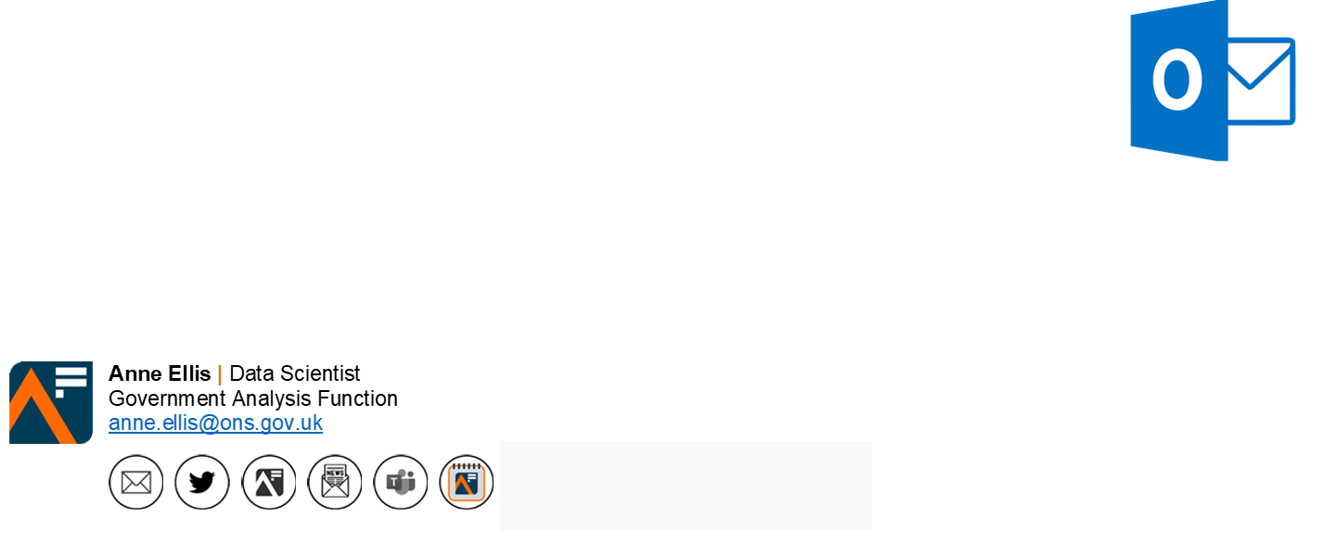
Analysis Function email badge
Add the Analysis Function ‘badge’ to your email signature. The button contains a hyperlink to the new Analysis Function Strategy Hub on the Analysis Function website
Remember to refer to the latest guidance on Understanding accessibility requirements for public sector bodies - GOV.UK (www.gov.uk)
Select, Copy and Paste

Slide 13
A strategy for analysis in government (2025-28) Get involved

Slide 14
Next steps
Read the strategy on the Analysis Function website
Check out the new AF Strategy Hub, which has the following content: Boosting your success (support for all analysts), Leadership and analysis (including a new secure area just for Departmental Directors of Analysis (DDANs), User Journeys, Case Studies, and much more
Read examples of excellence in analysis in our new Analysis Function Case Study database
Submit your stories of excellence in government analysis as part of our “Proud to be a government analyst” communications campaign
Get involved on our various channels and social media accounts (see next slide)
Use the assets in this Campaign in a Box to promote the strategy in your team, department, or profession
Give us feedback on any and all of our products! Email us at Analysis.Function@ons.gov.uk
The Analysis Function is a cross-government community of 17,000 analysts from all the analysis professions. Our members work in every government department and are actuaries, digital and data analysts, economists, geographers, operational researchers, social researchers, statisticians, are ‘dual-badged’, ‘unaffiliated’, or work with analysis.

Slide 15
How to get involved
Subscribe to and share your news in the monthly AF Newsletter
Visit the Analysis Function website
Head directly to our Analysis in Government Strategy Hub
Connect with us on LinkedIn
Follow us on X @gov_analysis
Find out about our latest events on Eventbrite, including sessions for Analysis in Government (AiG) Month – the UK’s largest learning and development event for government analysts, held every May
Subscribe to our YouTube channel YouTube/Government Analysis Function
Nominate the inspirational individuals and outstanding teams you work with for an Analysis in Government (AiG) Award
Become an Analysis Function Champion

Slide 16
Proud to be a government analyst campaign
Use our template wording: “Proud to be a government analyst: submit your case studies of excellence in analysis”
The Government Analysis Function is a community of 17,000 government analysts. We're a diverse group made up of actuaries, data and digital analysts, economists, geographers, operational researchers, social researchers, statisticians, and dual badged, ‘unaffiliated’. But we are so much more besides, and all proud to be government analysts...
Our new communications campaign “Proud to be a government analyst” has been launched to support the new Analysis Function strategy
To get people inspired about government analysis, we’d like to show some current examples of what good (in fact, excellence) in government analysis looks like, and what makes our members “proud to be a government analyst”. So, if you know of interesting, important, or influential work that’s made you feel proud to be a government analyst, we want to find out more.
By submitting a story that has made you proud to be a government analyst, your work could be published online and held up as an example of excellence in analysis for the whole of government
Stories could take the form of news articles, blogs, or more detailed case studies
We are also interested in anything that might already be published online that we can share with the Analysis Function community
Find out more about case studies, and read some examples
Submit your Articles, Blogs, and Case studies today

Slide 20
