Slide 1
Sustainability Reporting Thematic Review
Survey Results

Slide 2
Breakdown of responders by their business area

Slide 3
Breakdown of responders by organisation

Slide 4
Sustainability Reporting in ARA’s is…
Notes:
q9

Slide 5
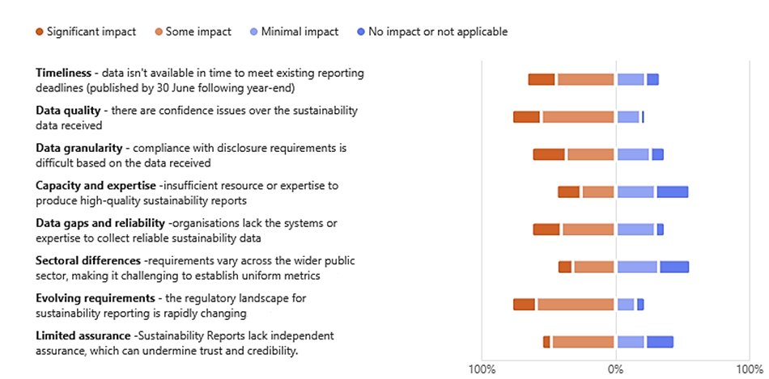
Challenges facing entities preparing sustainability information in ARAs
Notes:
q10

Slide 6
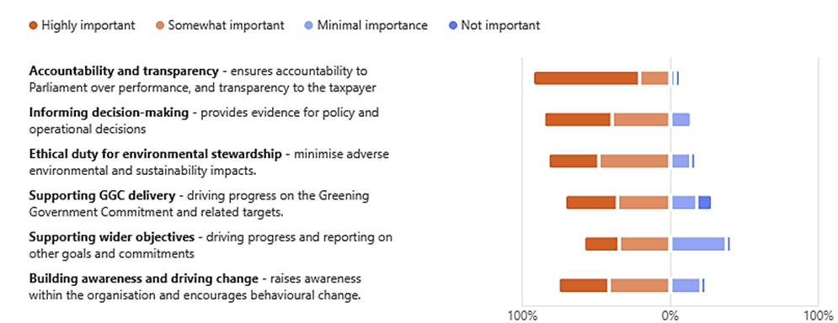
Rationale for inclusion of sustainability information
Notes:
q12

Slide 7
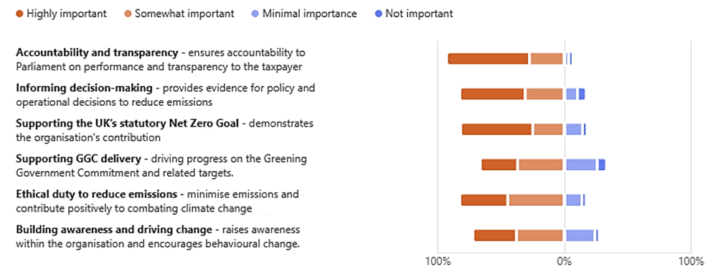
Rationale for inclusion of emissions data ARAs
Notes:
q13

Slide 8
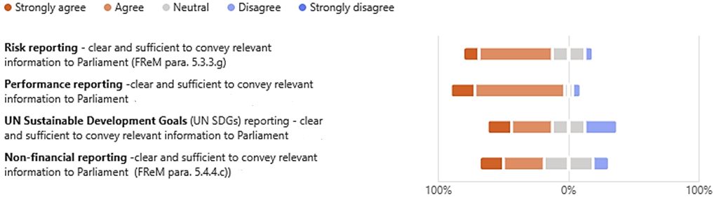
Performance reporting guidance in the FReM is…
Notes:
q15

Slide 9
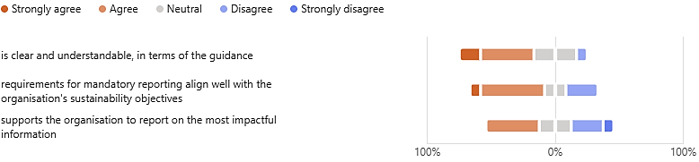
SRG requirements/guidance is…
Notes:
q18

Slide 10
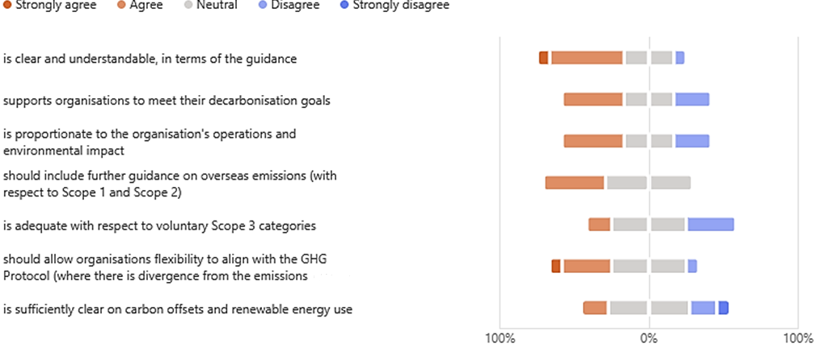
Greenhouse gas emission guidance in the SRG is…
Notes:
q19

Slide 11
Support for reducing the mandatory SRG reporting requirements for annual reports and accounts
Notes:
q34

Slide 12
Which sustainability and GGC commitment areas should be mandated?
Notes:
35 – taken of those that agree to the implementation of proposal 1 Reducing the number of mandatory SRG reporting requirements for annual reports and accounts - separating GGCs metrics and targets by: • key GGCs that are mandatory all central government departments and ALBs (see Proposal 2) • withdrawing mandatory reporting on other GGCs. These may then be moved to 'Chapter 6 Further Voluntary Reporting' or removed from the SRG completely.

Slide 13
Support for encouraging elements of sustainability-related information to be separately published
Notes:
q40

Slide 14
Central Government sustainability reporting should be…
Notes:
Net support score weighting agree and disagree against each other out of a maximum of 58

Slide 15
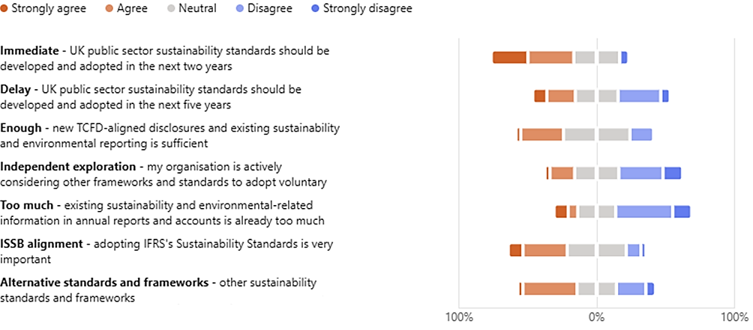
Advancing sustainability reporting in ARAs should be done by…

