Slide 1
Transforming Financial Reporting
Joshua Rushbrooke

Slide 2
The Current State of Financial Reporting
There has been a gradual decline in the number of departments laying their accounts pre-recess.
Increasing requirements consume more resources.
New technology and digital processes are yet to be fully implemented.
We aim to investigate the state of financial reporting, measuring:
The utility of accounts to different stakeholders,
Value for money, and
Clear Line of Sight.

Slide 3
Research Conducted
GFR Review
Changes to FReM
Best Practice report
Lessons Learned review (2022-23)
Project Management
Performance Reporting Thematic Review (2023)
Disclosures should be material
Cost vs benefit assessment
Current investigations
Sustainability review
International comparators, Select Committees and PQs

Slide 4
Levers at our disposal
The FReM
Thematic Reviews
Best Practice Reports
Creation of resources
Training delivery and community outreach

Slide 5
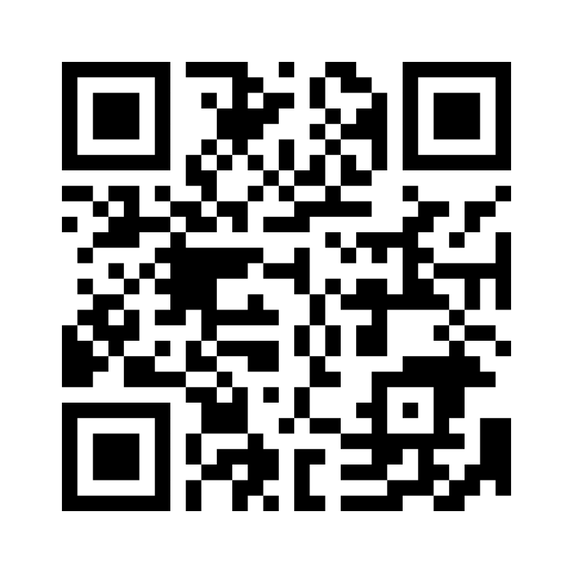
Discussion Points
Please scan this code, or follow this link:
https://www.menti.com/alo6uw17xmy4

