Slide 1
Whole of Government Accounts 23-24
24/02/2025

Slide 2
Structure
WGA 2022-23 Publication
WGA 2023-24 progress update
WGA 2024-25 / Future Years
Notes:
This presentation will cover…

Slide 3
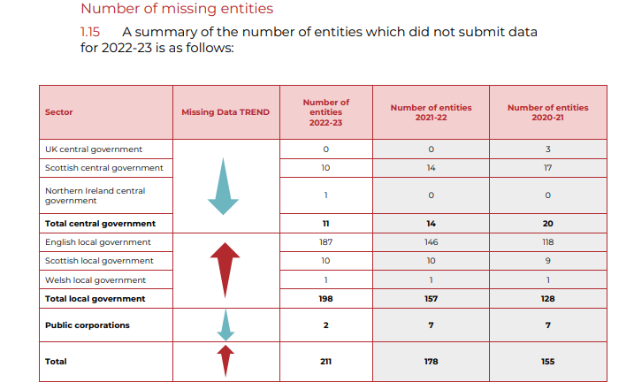
WGA 2022-23 Publication
Published in November 2024 – as per our recovery plan
Disclaimed opinion – due to missing data not submitted by bodies within the boundary and data submitted which has not been audited, primarily driven by the English local government accounting and audit sector
New additions to the 22-23 WGA include:
‘Year at a Glance’
Economic and fiscal context
Accounting spotlights
Notes:
This presentation will cover…

Slide 4
WGA 2023-24 Progress Update
Started production of 2023-24 WGA – currently in the Eliminations phase
Aiming for July publication
Recovery plan remains in place to return to 15-month WGA preparation by 2024-25
Notes:
This presentation will cover…

Slide 5
WGA 2024-25 / Future Years
WGA 2024-25 – Plan
DCT submissions open – 1 April 2025
Cycle 1 deadline – 15 August 2025
Cycle 2 deadline – 12 September 2025
Future Versions
On track to return to regular publishing schedule in 2024/25
DCT submissions open – June each year
Cycle 1 deadline – August each year
Cycle 2 deadline – September/October each year
Disclaimed opinion likely until 25/26 – reliant on backstop plan

Slide 6
Future Actions
Webinars
15 April 2025 – For New DCT Users Only
30 April 2025
13 May 2025
Further details will be emailed out in due course.
Account manager engagement
GFF Conference presentations/workshops
Continuous engagement with NAO
Implementation of PAC recommendations where possible

Slide 7
Questions

