Slide 1
IFRS 16 post implementation review
Sarah Logsdail
Notes:
I have chosen random examples of IFRS 16 disclosures from a variety of 2023-24 accounts that intend to display how IFRS 16 can be shown across government. Today, I want to walk you through them and see if you think there is any information missing, as a user of these accounts, or perhaps tweaks that would help your understanding?

Slide 2
Discussion: What do readers of ARAs think of IFRS 16?
As a user, were you aware that IFRS 16 was implemented in central government annual reports and accounts in 2022/23?
Did you specifically review any disclosures relating to IFRS 16 when using 2022/23 or 2023/24 annual reports and accounts? If yes, why?
Do central government annual reports and accounts provide sufficient explanation of the impact of the transition to the new IFRS 16 requirements in 2022/23?
Are there any areas where you feel IFRS 16 disclosures could be improved?

Slide 3
IFRS 16 – disclosures in accounts - examples
Notes:
Simple example from GPA – a note to financial statements

Slide 4
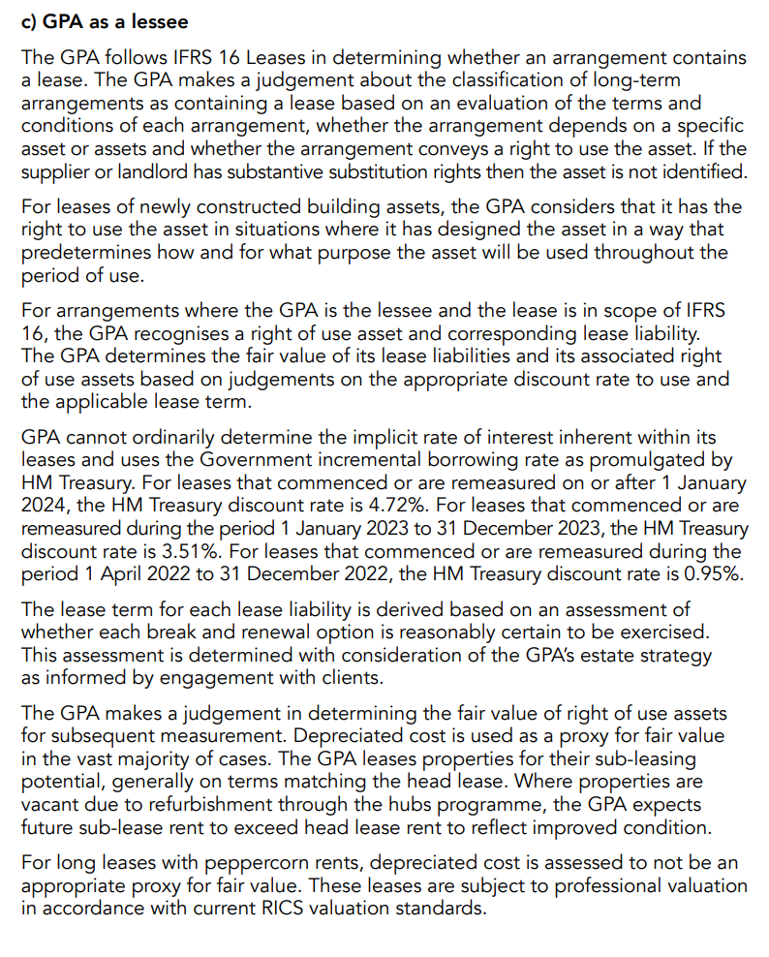
IFRS 16 – disclosures in accounts - examples
Notes:
Simple example – accounting policy explanation
Para 1 & 2: Basis for judgements made
Para 3: How a ROU asset and liability is recognised and basis for FV
Para 4: Discount rate
Para 5: Lease term judgements
Para 6 & 7: subsequent measurement judgements

Slide 5
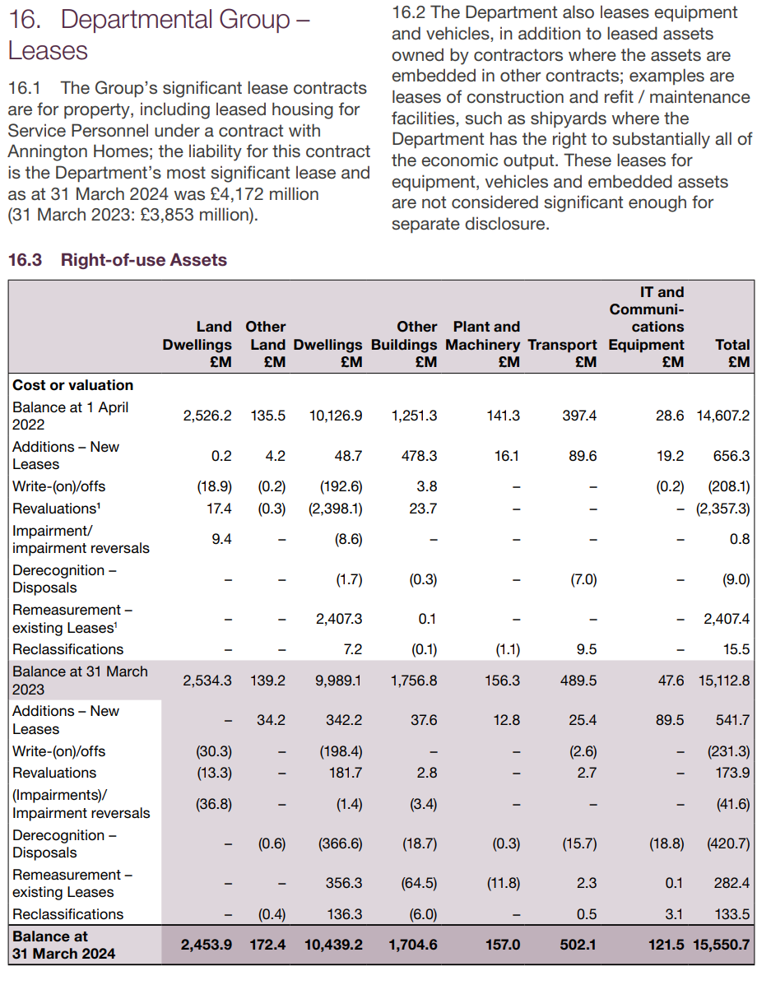
IFRS 16 – disclosures in accounts - examples
Notes:
More complex example.
Detail given

Slide 6
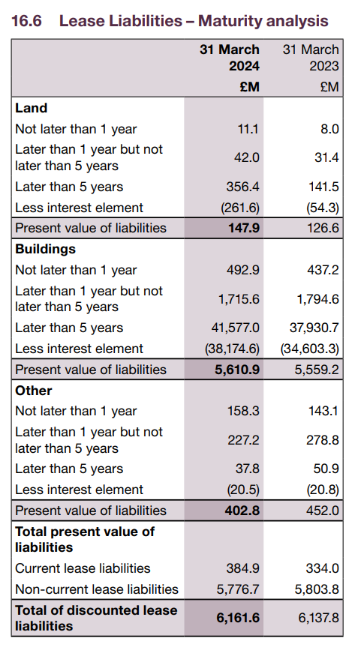
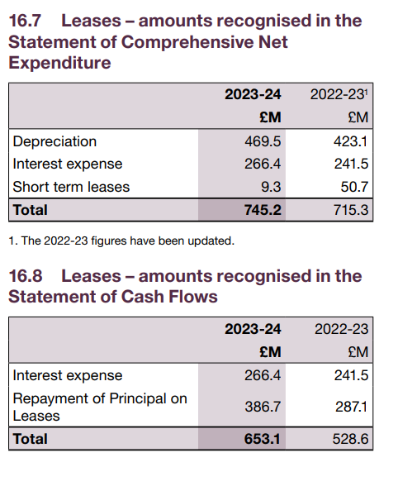
IFRS 16 – disclosures in accounts - examples
Notes:
More complex example.
Detail given

Slide 7
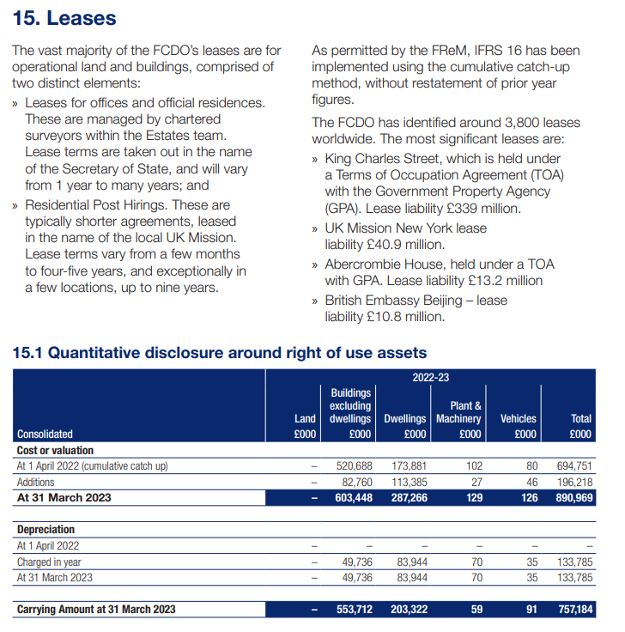
IFRS 16 – disclosures in accounts - examples
Notes:
An example from 2022-23 illustrating the implementation of IFRS 16.
Left hand side goes into the 2 distinct types of ROU assets
Right hand side mentions the cumulative catch up approach – no restatement of PY. Also details most significant leases in terms of liability value

Slide 8
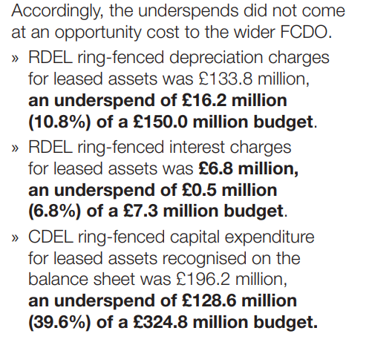
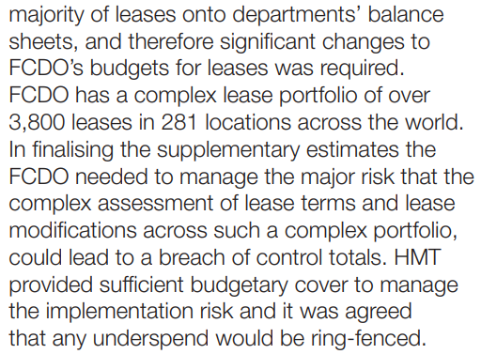
IFRS 16 – disclosures in accounts - examples
Notes:
An example from 2022-23 illustrating the implementation of IFRS 16 – budgeting impact

Slide 9
What do readers of ARAs think of IFRS 16?
As a user, you were aware that IFRS 16 was implemented in central government annual reports and accounts in 2022/23?
Did you specifically review any disclosures relating to IFRS 16 when using 2022/23 or 2023/24 annual reports and accounts? If yes, why?
Do central government annual reports and accounts provide sufficient explanation of the impact of the transition to the new IFRS 16 requirements in 2022/23?
Are there any areas where you feel IFRS 16 disclosures could be improved?

