Slide 1
The Civil Service Line Management Standards
Core stage

Slide 2
Welcome to the Line Management Standards

Slide 3
Contents
Developing great line managers
The Civil Service Code
Overview of the Standards
The Line Management Standards: Core stage
Managing other line managers
To use the buttons in this document, press 'Ctrl and Click'. To return to the main page click the Home button.
Glossary
What’s next?

Slide 4
Developing great line managers
The Civil Service needs great line managers who bring out the very best in our people, set high standards and ensure we deliver for the government of the day.
Great line managers bring out the best in individuals and teams, helping to ensure we deliver exceptional quality outcomes with professionalism and pride, for the ministers and citizens we serve. With our people at the heart of everything we do, line managers are central to creating the best conditions for the success of the Civil Service.
The Line Management Standards have been developed to support and empower you with the essential skills required for effective line management within the Civil Service. Their purpose is to enhance personal, team and organisational engagement, and unlock high performance and productivity to achieve quality outcomes for the government of the day and the public we serve.
Confident line managers, committed to their responsibilities, can use these Standards to effectively navigate the challenges of their roles, improve team performance, address poor performance promptly, and contribute to a modern and high performing Civil Service.
Home

Slide 5
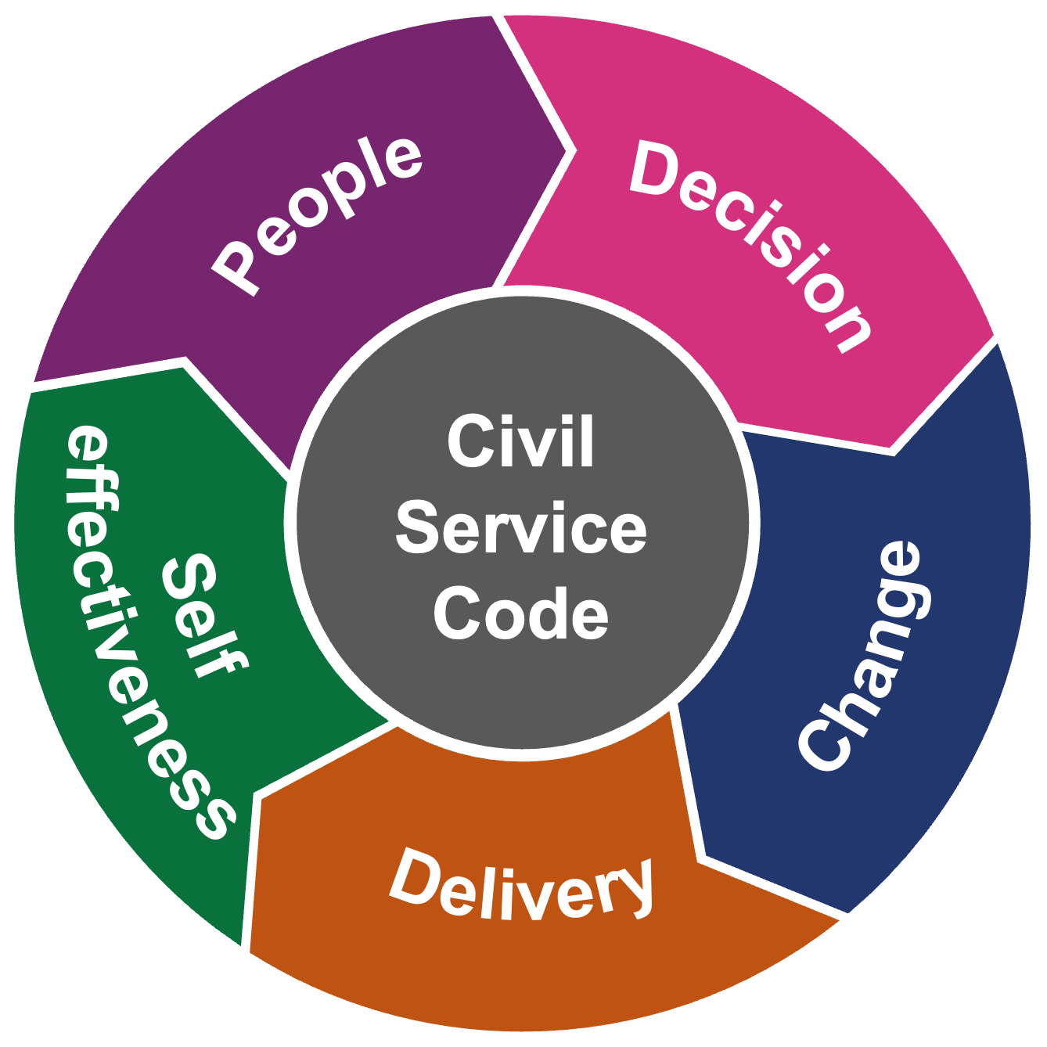
Developing great line managers 01
Developing great line managers
Why do we need Line Management Standards?
What are the Standards?
Effective line managers bring out the best in individuals and teams, ensuring we get the best quality outcomes as we serve the government of the day and the public.
We have some brilliant line managers across the Civil Service and the Standards seek to create consistency in expectations and good management practices.
Strengthening line management will pay real dividends in employee engagement, wellbeing, performance and productivity. Good line management leads to the best results for everyone – individuals, teams, organisations, ministers and the public.
The Standards serve as a comprehensive resource for your self-reflection and professional growth as a line manager.
They outline the expectations of you, ensuring greater consistency in your management practices and will help you build confidence to navigate the complexities and challenges you encounter daily.
Developed in collaboration with industry experts, the Standards are grounded in cross-sector, academic and Civil Service line management best practices. They are centred around the Civil Service Code, which sets out the Civil Service’s role to deliver for the government of the day and our values of integrity, honesty, impartiality and objectivity.
Home

Slide 6
Developing great line managers 02
Developing great line managers
The Standards will actively inform your personal and professional development as a line manager by identifying your strengths and areas for growth and development. You can use the Standards to:
How do I use them?
1
Reflect on your personal and line management practices.
2
Gather feedback from your direct reports, peers and managers.
3
Inform your personal development conversations and development plan.
4
Help you set high expectations to get the best out of your people and tackle poor performance quickly.
Home

Slide 7
Civil Service Code
The Civil Service Code is at the centre of everything we do as Civil Servants, including line management practices. Therefore, our Code sits at the core of this framework.​
The Civil Service Code and values should run through all aspects of your line management practices, helping you to drive high performance and deliver quality outcomes, so keep these at the forefront of your mind.
Our Code
states that:
Civil servants support the government of the day in developing and implementing its policies, and in delivering public services. Civil servants are accountable to ministers, who in turn are accountable to Parliament.
Our values are:
integrity: putting the obligations of public service above your own personal interests
honesty: being truthful and open
objectivity: basing your advice and decisions on rigorous analysis of the evidence
impartiality: acting solely according to the merits of the case and serving, equally well, governments of different political persuasions.
Civil Service Code
In addition to role modelling the Civil Service Code, you are also required to act and manage in line with the Civil Service Management Code and The Seven Principles of Public Life.
Home

Slide 8
Overview of the Standards
In this section, you will explore the five themes that outline the skills you require to bring out the best in individuals and teams. These skills will contribute to the success of the Civil Service by enabling the provision of high quality services and business outcomes for the government of the day and the public.
Manage with confidence and empathy so everyone feels respected, valued, included and motivated at work to deliver high quality services and outcomes.
Make ethical, inclusive and evidence-based decisions to deliver improved business outcomes.
Decision
People
Building an effective and inclusive team culture
Managing people to perform
Managing challenging and sensitive communications
Prioritising personal and professional development
Supporting the wellbeing of my team(s)
Making ethical and evidence-based decisions
Making inclusive decisions
Evaluating the effectiveness of decisions
Civil Service Code
Self
effectiveness
Change
Guide your team(s) through change and develop a culture of creativity and innovation.
Focus on your personal effectiveness and impact to ensure you deliver on your goals.
Being creative and innovative
Managing and supporting change
Reviewing the effectiveness of change
Delivery
Managing myself
Looking after myself
Developing myself
Create a sense of purpose, recognise successes, tackle poor performance and effectively manage resources to deliver results, and drive productivity and business outcomes.
Creating a sense of purpose
Managing performance and delivery
Improving productivity to deliver results
Managing resources effectively
Recognising and celebrating success
Home

Slide 9
Overview of the Standards 02
Overview of the Standards
In this slide, you will see an example of how the Standards look and what each part means.
The themes line managers are required to focus on and role model.
Decision
An example description of a theme.
People
Civil Service Code
Create a sense of purpose, recognise successes, tackle poor performance and effectively manage resources to deliver results, and drive productivity and business outcomes.
Self
effectiveness
Change
Managing resources effectively
I take responsibility for planning, organising and allocating resources, in line with organisational policies and processes, to meet changing business and environmental needs and deliver high quality, value for money outcomes.
Delivery
An example skill each line manager is required to practise.
An example summary of what you need to demonstrate in your management practice.
Home

Slide 10
The Line Management Standards: Core stage
Home

Slide 11
People-Focus
Manage with confidence and empathy so everyone feels respected, valued, included and motivated at work to deliver high quality services and outcomes.
Building an effective and inclusive team culture
I embrace diversity of thinking and enable open and respectful discussions to create an inclusive environment where everyone acts in line with the Civil Service Code and values, and can thrive, speak up, challenge safely and achieve collective success.
Managing people to perform
I set clear expectations for my team(s), using feedback and coaching techniques as part of regular performance conversations, providing honest feedback, recognising good performance and promptly addressing both poor performance and poor behaviours.
Managing challenging and sensitive communications
I recognise situations that are likely to lead to conflict or tension within my team(s), confidently approaching these to identify early resolutions, promptly managing performance-related matters with sensitivity, honesty and compassion.
Prioritising personal and professional development
I ensure regular development discussions happen within my team(s), empowering everyone to own their personal development plan and access formal and informal learning opportunities to progress their careers and improve individual performance and effectiveness.
Supporting the wellbeing of my team(s)
I actively support and monitor the wellbeing of my team(s), creating a safe space to understand, discuss and assess individual concerns, needs and any required adjustments to empower and bring out the best in our people.
Home

Slide 12
Decision-Focus
Make ethical, inclusive and evidence-based decisions to deliver improved business outcomes.
Making ethical and evidence-based decisions
I enable effective decisions to be made within my team(s) in line with the Civil Service Code and organisational values, ensuring relevant and reliable evidence has been analysed to deliver high performance and outcomes for the government and issues are escalated as required.
Making inclusive decisions
I empower my team(s) to seek different perspectives, enabling them to make fair and inclusive decisions to deliver high quality business outcomes.
Evaluating the effectiveness of decisions
I assess the effectiveness and impact of decisions made and communicated within my team(s), learning from our successes as well as when things haven't gone to plan.
Home

Slide 13
Change-Focus
Guide your team(s) through change and develop a culture of creativity and innovation.
Being creative and innovative
I empower my team(s) to identify, develop, test and challenge innovative ideas to drive continuous improvement, high performance, productivity and value for money outcomes, celebrating creativity and learning from failures.
Managing and supporting change
I guide my team(s) through both planned and unexpected change, creating a safe space where concerns can be heard, and using empathy and effective communication skills to inspire trust and build a high performance culture and deliver results.
Reviewing the effectiveness of change
I assess the effectiveness of change within my team(s) against agreed objectives, ensuring people and the environmental impact have been considered to ensure change is delivered effectively.
Home

Slide 14
Delivery-Focus
Create a sense of purpose, recognise successes, tackle poor performance and effectively manage resources to deliver results, and drive productivity and business outcomes.
Creating a sense of purpose
I communicate a clear sense of purpose for my team(s) in line with organisational objectives and ministerial priorities, setting high standards to ensure ambitious and achievable goals are set and monitored for everyone.
Managing performance and delivery
I monitor, measure and manage the performance of my team(s) against agreed objectives and metrics, taking action to mitigate risk and confidently address poor performance in an efficient and timely manner.
Improving productivity to deliver results
I empower my team(s) to shape how they do their work, motivating them to implement more effective and efficient ways of working to drive productivity, quality outcomes and deliver value for money results.
Managing resources effectively
I take responsibility for planning, organising and allocating resources in line with organisational policies and processes, to meet changing business and environmental needs and deliver high quality, value for money outcomes.
Recognising and celebrating success
I ensure successes and achievements within my team(s) are recognised and celebrated, creating a positive working environment that motivates individuals to achieve results that effectively deliver for the government.
Home

Slide 15
Stage 1: Self-effectiveness
Self-effectiveness
Focus on your personal effectiveness and impact to ensure you deliver on your goals.
Managing myself
I role model the Civil Service Code and organisational values, promoting a culture of inclusivity, respect and authenticity, and one that considers the needs of the individual, society and the environment.
I continuously develop self-awareness of my motivations, strengths and areas for improvement, ensuring I consider how my communications, actions, biases and reactions impact myself and others.
I take responsibility for managing my performance and the performance of my team(s), delivering high quality, value for money outcomes in a timely and productive manner.
Looking after myself
I take ownership of prioritising and managing my wellbeing so that I can deliver high quality outcomes for citizens.
I raise any concerns about the impact my work environment has on my wellbeing, accessing the support and resources available to me.
I role model looking after my wellbeing and have regular check-ins and conversations with my line manager.
Developing myself
I regularly seek honest feedback and reflect on my impact on others, taking action to inform my ongoing development, improve my performance and deliver quality services to the public and the government.
I learn from others and engage in peer development opportunities available to me, such as coaching and mentoring.
I commit to continuous learning and make time to focus on self-improvement so I can demonstrate the skills and behaviours required to be successful in my role.
Home

Slide 16
Managing other line managers
Managers of other line managers are responsible for upholding the Standards as part of their role. You can do this by role modelling and communicating what is expected of your line managers and helping them to understand what the Standards mean for them. Consider doing the following to support your line managers:
Explain how the Standards link to their specific roles, responsibilities and organisational goals.
Encourage self-reflection and assessment of their performance against the Standards to help identify their strengths and areas for development.
Facilitate goal setting to set out SMART (specific, measurable, achievable, relevant and time-bound) goals and a development plan.
Allow your team members protected time and space to reflect on and develop their skills as line managers.
Provide honest feedback on their development plans and self-assessments.
Monitor progress to celebrate achievements and discuss any challenges.
Home

Slide 17
Glossary 01
Glossary
Authenticity – being self-aware and true to yourself and your values in all situations, even when under pressure.
Authentic leadership – authentic leaders are true to themselves, their values and their beliefs, and they lead by example, inspiring trust and credibility among their followers.
Biases – a tendency, feeling or opinion that arises from pre-existing ideas or beliefs.
Challenge constructively – involves providing feedback or expressing disagreement in a respectful and productive manner. It focuses on addressing the issue at hand rather than the person’s character and aims to find solutions or improvements.
Compassion – the ability to understand and share the feelings of another person. It involves recognising and identifying with the challenges or distress of others and being motivated to help them solve these issues.
Considered – to think about something carefully and thoroughly before making a decision or taking action. It involves giving thoughtful attention to all relevant factors, weighing up the pros and cons, and evaluating the potential consequences of different choices.
Home

Slide 18
Glossary 02
Glossary
Diversity of thinking – the inclusion of a wide range of perspectives, ideas and approaches in decision-making and problem-solving.
Empathy – the ability to understand and share the feelings of another person. It involves putting oneself in someone else's shoes and experiencing their emotions as if they were one's own.
Ethical – the principles and standards that govern moral behaviour and decision-making in the Civil Service, acting in line with the Civil Service Code and organisational values, the Civil Service Management Code and The Seven Principles of Public Life. Ethical behaviour is doing the right thing, even when it's difficult. It's about honesty, trustworthiness, fairness and prioritising the public's interests over personal interests.
Ethical leadership – leading in line with the Civil Service Code and the Civil Service Management Code, The Seven Principles of Public Life and organisational values.
Fair – being impartial and unbiased in one's actions, decisions and treatment of others. It involves treating all individuals with respect and without favouritism or discrimination and promoting equality of opportunity between people.
Home

Slide 19
Glossary 03
Glossary
Inclusivity – a culture and environment where everyone feels valued, respected and able to fully participate and contribute, regardless of their background, identity or circumstances.
Open discussions – conversations where participants are encouraged to express their thoughts, ideas and opinions freely and respectfully.
Role model – to set an example by embodying values and behaviours that others can look up to or should follow.
Safe space – an environment where individuals feel comfortable, respected and supported in expressing themselves, sharing their thoughts and feelings, and taking risks without fear of judgment, criticism or discrimination.
Wellbeing – the state of having good mental, emotional and physical health and feeling contentment and satisfaction with one’s life.
Home

Slide 20
What’s next?
Now you have familiarised yourself with the Line Management Standards, it’s time to start implementing these in your day-to-day role. Here’s how you can get started:
Regularly reflect on your line management approach. Get feedback on the different skills required to identify your strengths and areas of growth.
Based on your reflections and feedback, choose the areas that you would initially like to focus on for building your line management skills.
Use the Line Management Standards development toolkit as it will assist you in understanding how to demonstrate the outlined skills in the Standards and provide suggestions to inform your development plan.
Discuss your development plan, including the skills you’ll be focusing on with your line manager. Track your progress and measure results.
Home

Slide 21
End credits
© Crown copyright 2025
You may re-use this information (excluding logos) free of charge in any format or medium, under the terms of the Open Government Licence. To view this licence, visit http://www.nationalarchives.gov.uk/doc/open-government-licence/ or email: psi@nationalarchives.gsi.gov.uk
Where we have identified any third party copyright material you will need to obtain permission from the copyright holders concerned.
April 2025 V1.2

