Slide 1
WINDRUSH DISCOVERY LESSON
Notes:
This lesson is designed to kickstart discussion with your class and get them thinking about what is happening in the video, photo or audio clip on each slide. You can click through to reveal one question at a time, with the idea to also get any extra thoughts or questions from your students around the content.

Slide 2
Introduction
The following slides will show a collection of images, videos and audio clips all around the history of the Windrush generation. You can then spend some time talking through the questions and any other thoughts you might have about what you’ve seen or heard.
https://windrush-monument.levellingup.gov.uk/education-resources/
Notes:
Explain to your class that is a starter activity that will be an open discussion, where you will show them a video, photograph or audio and then ask them a series of questions one by one for them to think about. They’ll then have the chance to ask their own questions or ideas around what’s happening and how it makes them feel etc.
You can also print out the lyrics to Windrush child ahead of the lesson if you would like the students to have the lyrics to read as the song is playing or you can show the lyrics on screen which are in the discovery pack downloads.

Slide 3
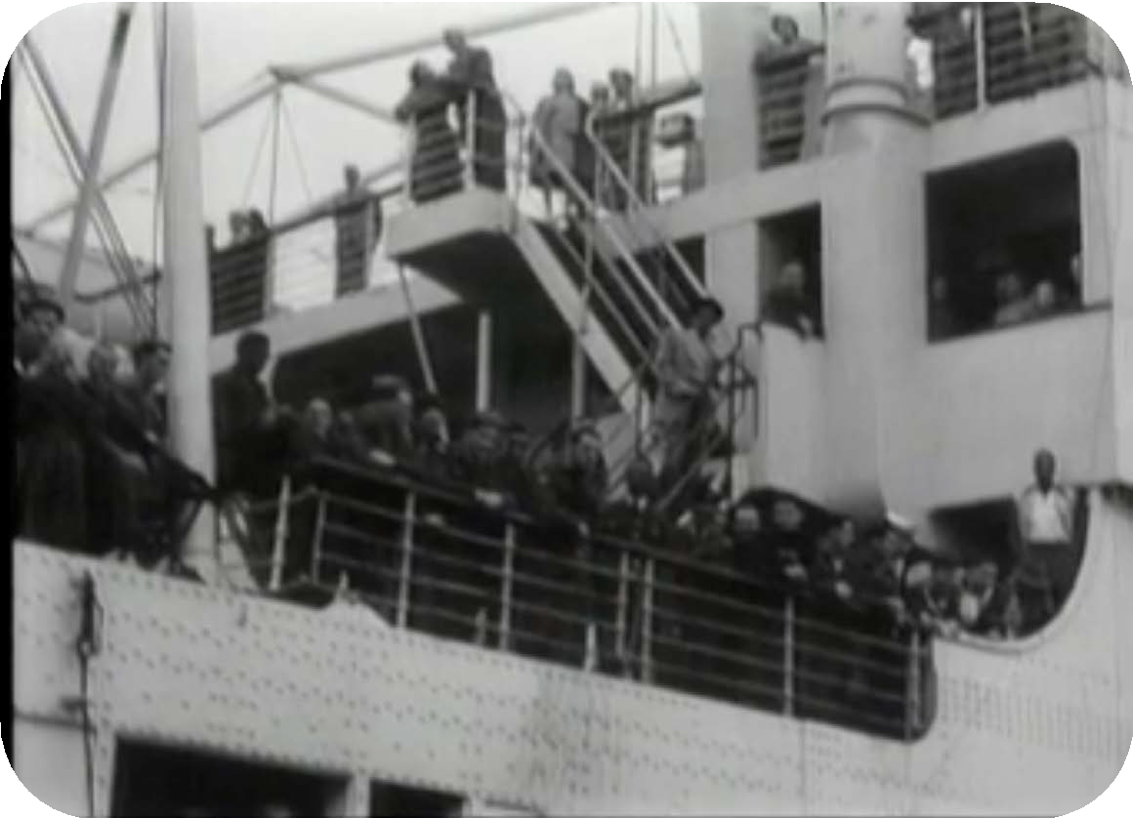
First resource
'Empire Windrush' ship arrives in UK carrying Jamaican immigrants, 1948.
© British Pathé
https://windrush-monument.levellingup.gov.uk/education-resources/
Notes:
Watch the video that links out to the British Pathé website and then use the questions on the next slide with your students

Slide 4
First resource (continued)
Discuss the following:
What do you think is happening in this video?
How do you think the people are feeling?
What do you think happened before it was taken?
What do you think happened after it was taken?
'Empire Windrush' ship arrives in UK carrying Jamaican immigrants, 1948.
© British Pathé
https://windrush-monument.levellingup.gov.uk/education-resources/

Slide 5
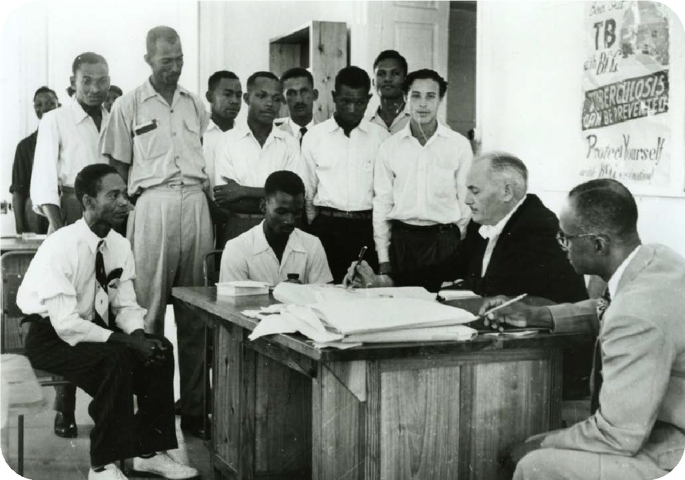
Second resource
Charles Gomm and recruits in Barbados, 1956.
© TfL from the London Transport Museum collection
https://windrush-monument.levellingup.gov.uk/education-resources/

Slide 6
Second resource (continued)
Discuss the following:
What is happening in this image?
What do you think happened before the image was taken?
What do you think the people in the image are thinking or feeling?
How does this photograph make you feel?
Charles Gomm and recruits in Barbados, 1956.
© TfL from the London Transport Museum collection
https://windrush-monument.levellingup.gov.uk/education-resources/

Slide 7


Third resource
Discuss the following:
What do you think the story behind this audio clip is?
What do you think happened after Gregory arrived in Britain?
How do think Gregory was feeling when he arrived in Britain?
Windrush personal story
© Inspiring Audio
https://windrush-monument.levellingup.gov.uk/education-resources/
Notes:
Play the audio clip and explain that this is a man called Gregory being interviewed about his Windrush story and then discuss the questions with your students

Slide 8
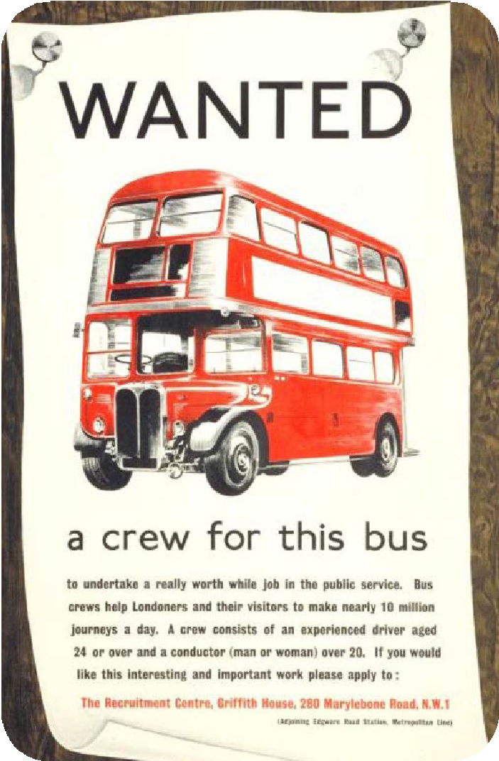
Fourth resource
Wanted a crew for this bus,
by Jack Maxwell, 1955
© TfL from
the London Transport Museum collection
https://windrush-monument.levellingup.gov.uk/education-resources/

Slide 9
Fourth resource (continued)
Discuss the following:
What is happening in this image?
What do you think happened before this image was taken?
What do you think happened after?
Wanted a crew for this bus, by Jack Maxwell, 1955
© TfL from the London Transport Museum collection
https://windrush-monument.levellingup.gov.uk/education-resources/

Slide 10
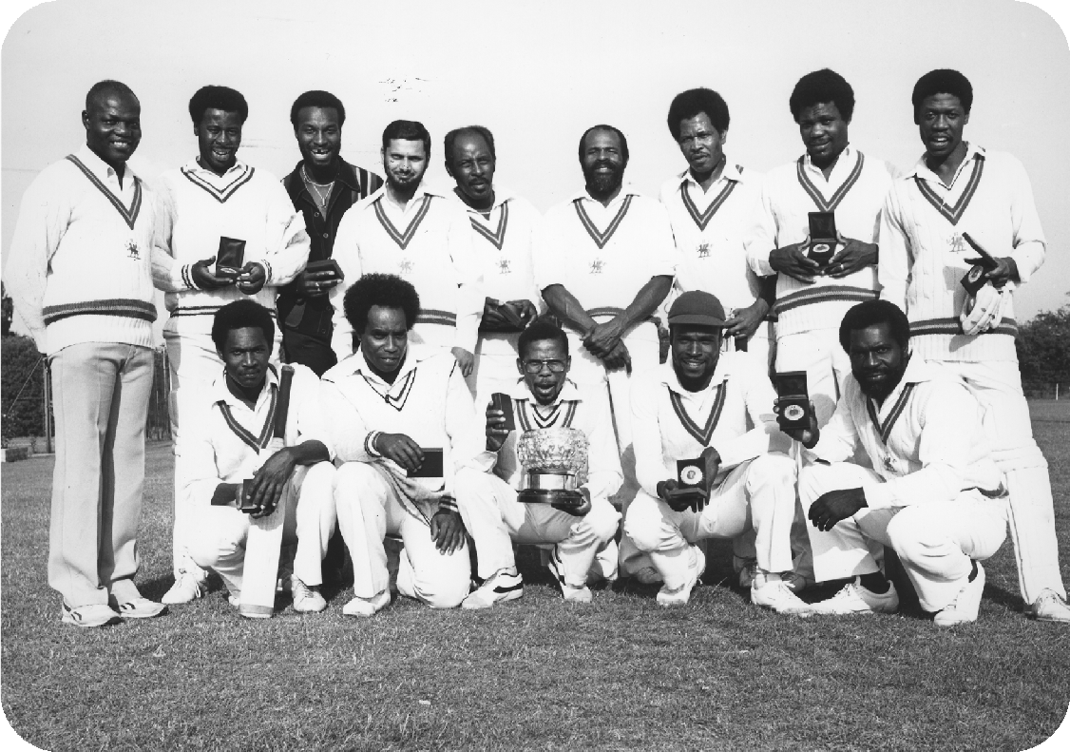
Fifth resource
Group shot of the Central Road Services cricket team, winners of London Regional Transport’s Babington-Smith trophy, by J A Ballard, 7 Aug 1984.
© TfL from the London Transport Museum collection
https://windrush-monument.levellingup.gov.uk/education-resources/

Slide 11
Fifth resource (continued)
Discuss the following:
What do you think is happening in this image?
How do you think the people are feeling?
What do you think happened before this picture was taken?
What do you think happened after?
Group shot of the Central Road Services cricket team, winners of London Regional Transport’s Babington-Smith trophy, by J A Ballard, 7 Aug 1984.
© TfL from the London Transport Museum collection
https://windrush-monument.levellingup.gov.uk/education-resources/

Slide 12

Sixth resource
Discuss the following:
What do you think the story is behind this audio clip?
What emotions or feelings do you think it is trying to convey?
How does this clip make you feel?
Recording of the original song, Windrush child
© Bristol Reggae Orchestra
https://windrush-monument.levellingup.gov.uk/education-resources/
Notes:
If you have printed out the lyrics to Windrush child, then please make sure the class have them in front of them. Play the audio clip and then discuss the questions with your students

Slide 13
Next learning step
Now you're well on your way to learning all about the Windrush generation, continue your learning by using the following resource:
KS4 - Interactive timeline
https://windrush-monument.levellingup.gov.uk/education-resources/
Notes:
Use the linked resource to expand on this Discovery lesson and develop your students’ learning around the Windrush generation and celebrating Windrush Day.

