Slide 1
PFI & PF2 Projects: 2024 Summary Data
OFFICIAL

Slide 2
Contents
OFFICIAL
Click on any of the below to navigate to that page.
3 Background
4 Notes on Data Quality
5 About PFI and PF2
6 Portfolio Overview
7 Future Unitary Charge (UC) Payments
9 Expiring Projects
12 Projects Expiring in 2024/25
13 Expiries Within the Next Seven Years
14 Portfolio Joiners and Leavers
17 Annex A: Definitions

Slide 3
Background
PFI & PF2 Projects: 2024 Summary Data
OFFICIAL
This summary note provides information about Private Finance Initiative (PFI) and Private Finance 2 (PF2) projects as of 31 March 2024.
This data is collated by the Infrastructure and Projects Authority (IPA) on behalf of HM Treasury (HMT).
What does it include?
Projects that are based on standard PFI or PF2 contractual terms which are delivered by:
Central government departments or their arms length bodies, including NHS Trusts
Local authorities which receive PFI grant from a sponsoring government department
Devolved administrations
What does is exclude?
Other forms of Public Private Partnerships, such as:
Projects delivered under the NHS Local Improvement Finance Trust programme
Projects delivered under the Non-Profit Distributing and hub models used in Scotland and the Mutual Investment Model in Wales
Projects delivered by Local Authorities which do not receive PFI grant funding from a sponsoring government department
Projects delivered by Universities

Slide 4
Notes on Data Quality
PFI & PF2 Projects: 2024 Summary Data
OFFICIAL
This information is provided by the central government departments and devolved administrations that have procured or sponsored projects.
Where there are gaps in the data, this is because it has not been provided by the department and/or contracting authority responsible for the project.
98.7% of PFI projects on the portfolio provided a data return in 2024. For the eight projects that did not provide a return, the most recently available data from previous years is used.
The data in this publication is not audited by HMT or the IPA, although the IPA continues to work with departments to improve its quality and reliability.

Slide 5
About PFI and PF2
PFI & PF2 Projects: 2024 Summary Data
OFFICIAL
PFI and PF2 are forms of Public Private Partnerships (PPPs). PPPs are long-term contractual arrangements between a public sector entity and a private sector provider.
The private sector partner is engaged to design, build, finance, maintain and operate infrastructure assets and related services. The risks associated with construction delay, cost overrun and asset maintenance are transferred to the private sector partner.
The public sector entity does not pay for the asset during construction, as these costs are financed by the private sector. Once the asset is operational, the public sector entity pays a monthly fee – sometimes referred to as a ‘unitary charge’ – to the private sector provider. This payment includes the costs of construction, financing costs, lifecycle replacement expenditure, maintenance and services and is subject to performance, meaning that payments are reduced if services are not delivered to the standards set out in the contract.
2.1 Change in policy
In 2012, PFI was replaced with PF2. PF2 was subsequently discontinued in 2018. Due to this change in policy, the portfolio consists of a sizeable but decreasing number of projects which each have a diminishing number of years left in their contract. As a result, the portfolio represents a decreasing amount in financial liabilities for the public sector (£136bn remaining unitary charge payments).

Slide 6
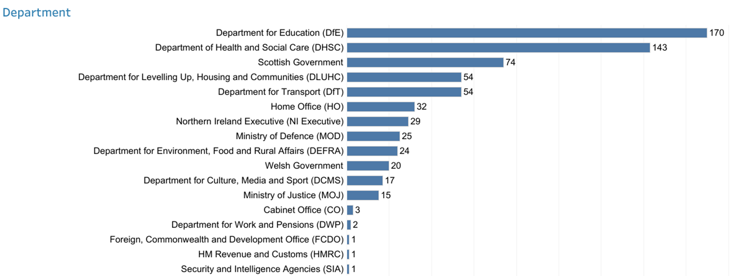
Portfolio Overview
PFI & PF2 Projects: 2024 Summary Data
OFFICIAL
As of 31 March 2024, there were 665 operational PFI projects with an original total capital value of £50bn.*
The two largest departments in the portfolio - Department for Education (DfE) and Department of Health and Social Care (DHSC) - account for 313 projects, just under half (47%) of the total number of projects in the portfolio.
Similarly, the most common sectors for PFI are “Hospitals and Acute Health,” “Schools (Non-BSF)” and “Schools (BSF), which represent 57% of the PFI portfolio (380 projects).
*Capital value is the total nominal capitalised cost as recorded in the financial model at financial close.

Slide 7
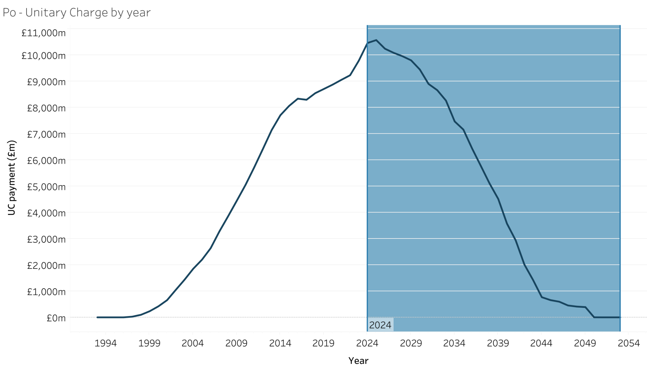
Future Unitary Charge Payments
PFI & PF2 Projects: 2024 Summary Data
OFFICIAL
The total remaining UC payments over the life of the contracts is estimated to be £136bn, with £10.5bn paid in 23/2024
This represents just under half (49%) of the total expected lifetime UC payments for the whole of the operational portfolio
It is anticipated that UC payments will peak in 2025 at £10.6bn, before declining year on year until 2050.
Over two thirds (69%, or £93.4bn) of the total remaining UC is expected to be paid within the next 10 years.

Slide 8
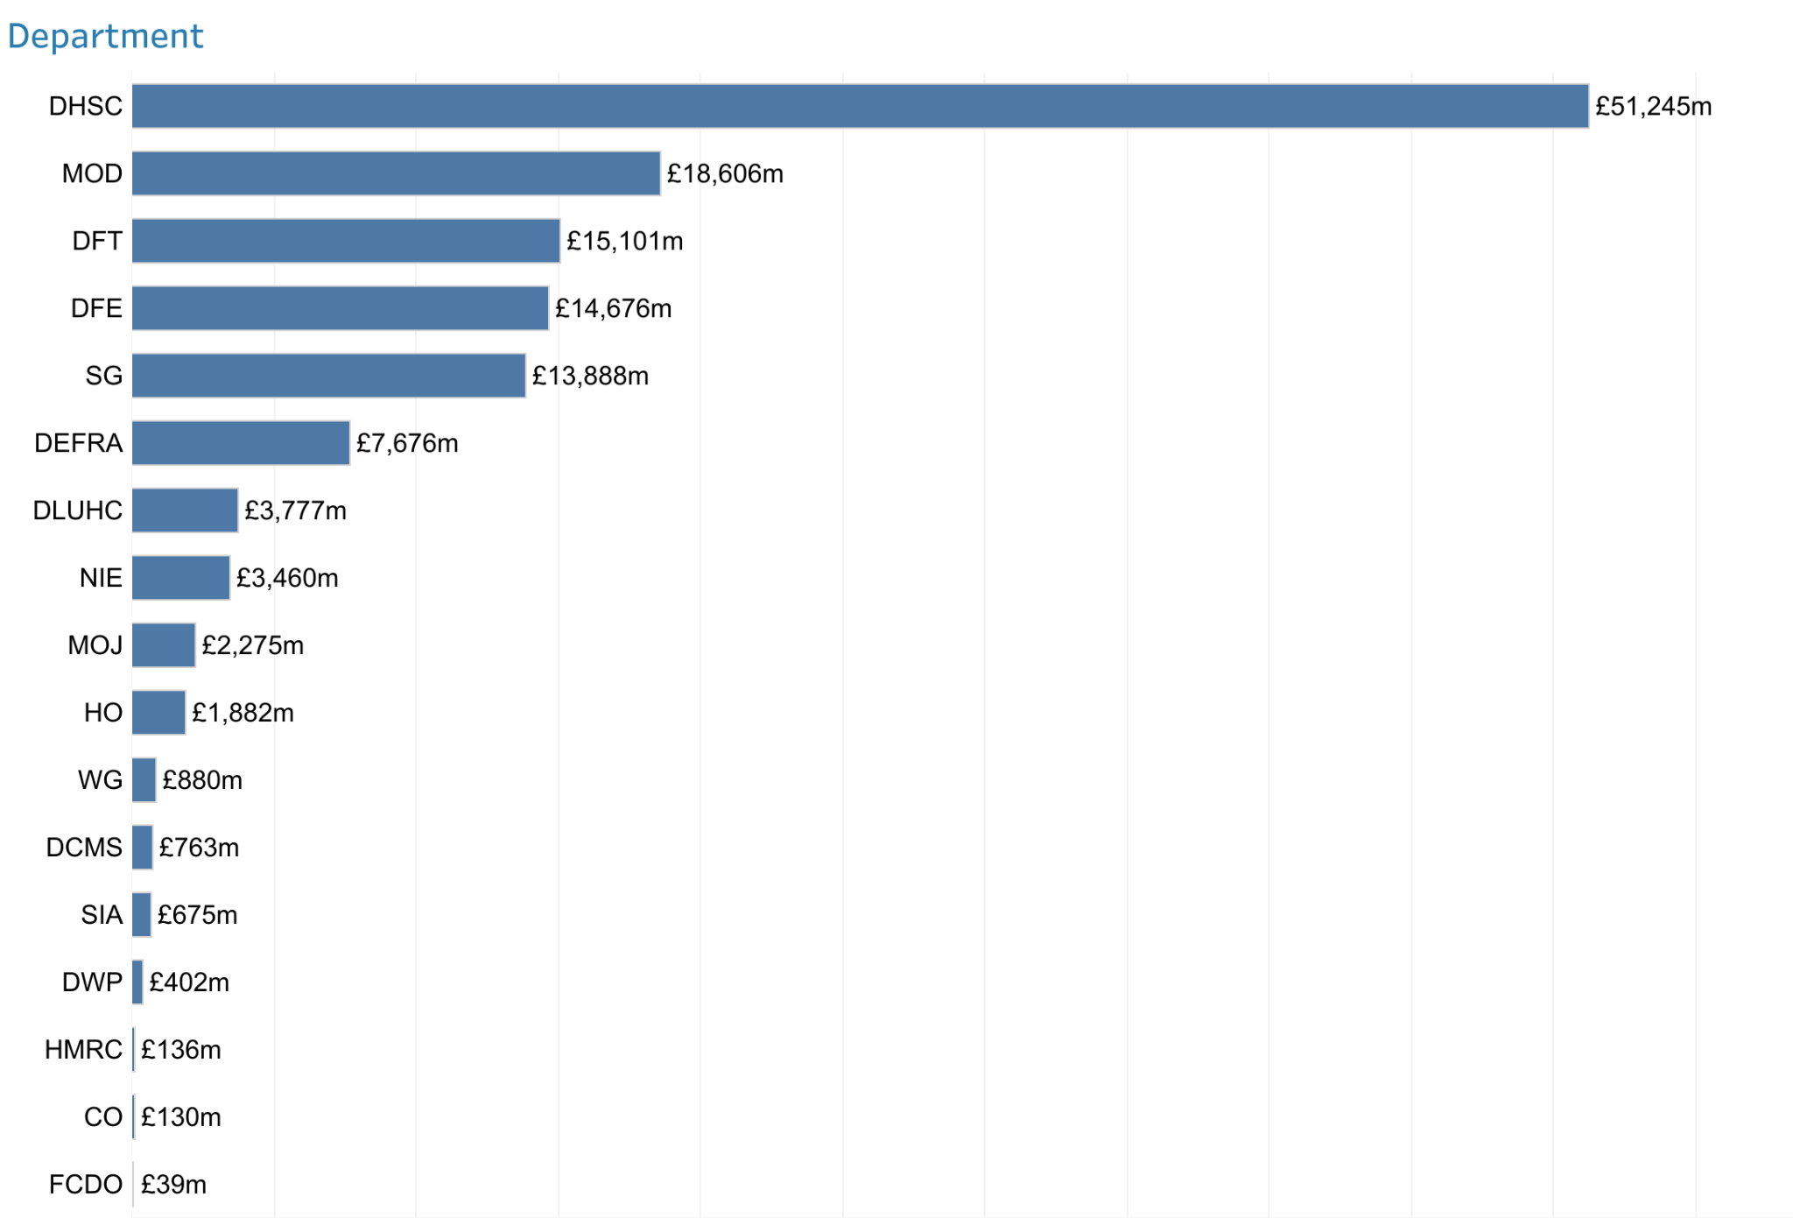
Future Unitary Charge Payments
PFI & PF2 Projects: 2024 Summary Data
OFFICIAL
While DfE has the greatest number of projects, DHSC and MOD have the largest remaining UC payments. A large portion of these payments relate to the ongoing required maintenance of assets.
Together, DHSC and MOD represent approximately half (51%) of total remaining UC payments, and accounted for over two fifths (41%) of the UC payments that were paid in 2024.

Slide 9
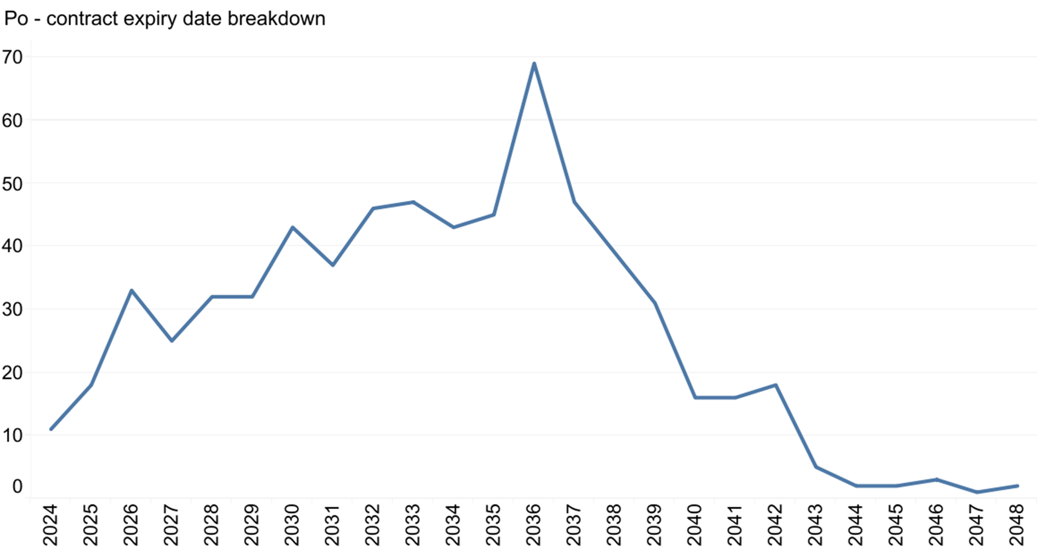
Expiring Projects
PFI & PF2 Projects: 2024 Summary Data
OFFICIAL
The number of contract expiries are expected to increase each year, from now until 2036.
There are 11 contract expiries expected in 2024, increasing steadily to a peak of 69 in 2036. After 2036, the number of expiries per year declines rapidly.
For a small number of DHSC projects, their expiry dates are listed as their first contract break date.
Number of projects

Slide 10
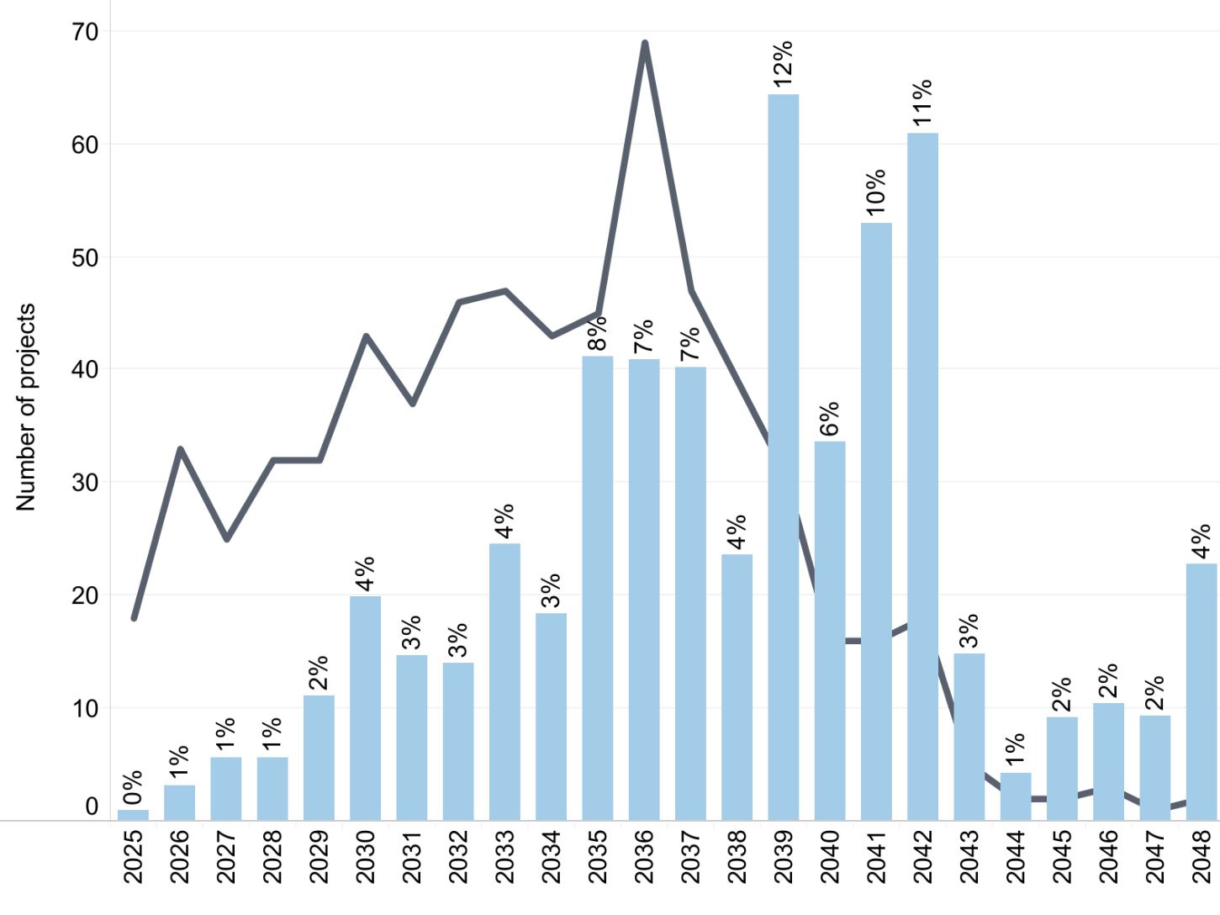
Expiring Projects
PFI & PF2 Projects: 2024 Summary Data
OFFICIAL
Projects expiring later account for a higher proportion of the total remaining UC payments
Number of expiring projects
% of total remaining UC accounted for by expiring projects
While the peak of expiries occurs in 2036, projects expiring between 2039-2042 account for the largest proportion (39%) of total remaining UC payments.
Gripping these projects now by improving contract management will protect the associated value at risk. This underlines the fact that the PFI Contract Management Programme should not be exclusively expiry focused.

Slide 11
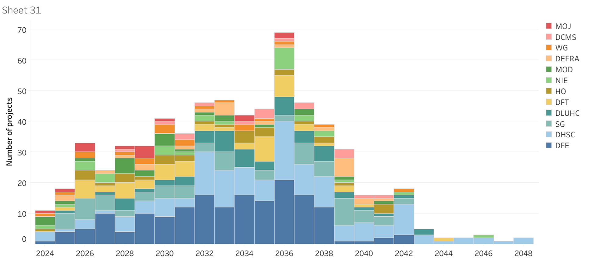
Expiring Projects
PFI & PF2 Projects: 2024 Summary Data
OFFICIAL
The 2036 expiry “peak” is driven mainly by DFE and DHSC projects. Later expiries consist mainly of DHSC projects.

Slide 12
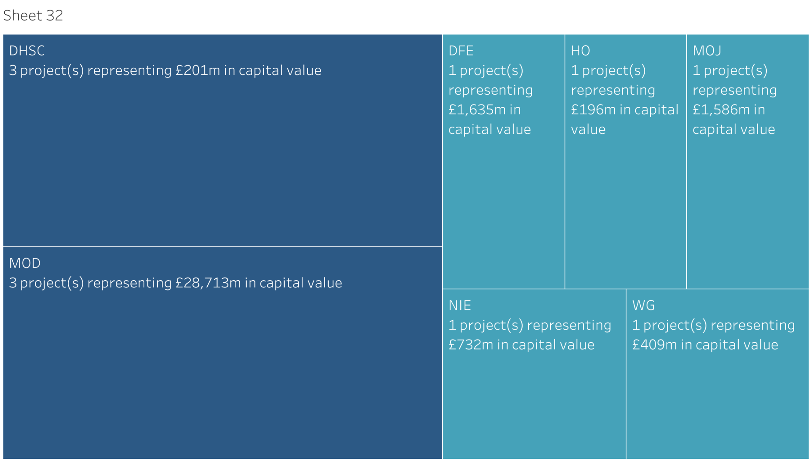
Eleven Projects Expiring in 2024/25
PFI & PF2 Projects: 2024 Summary Data
OFFICIAL
Capital value is the total nominal capitalised cost as recorded in the financial model at financial close.

Slide 13
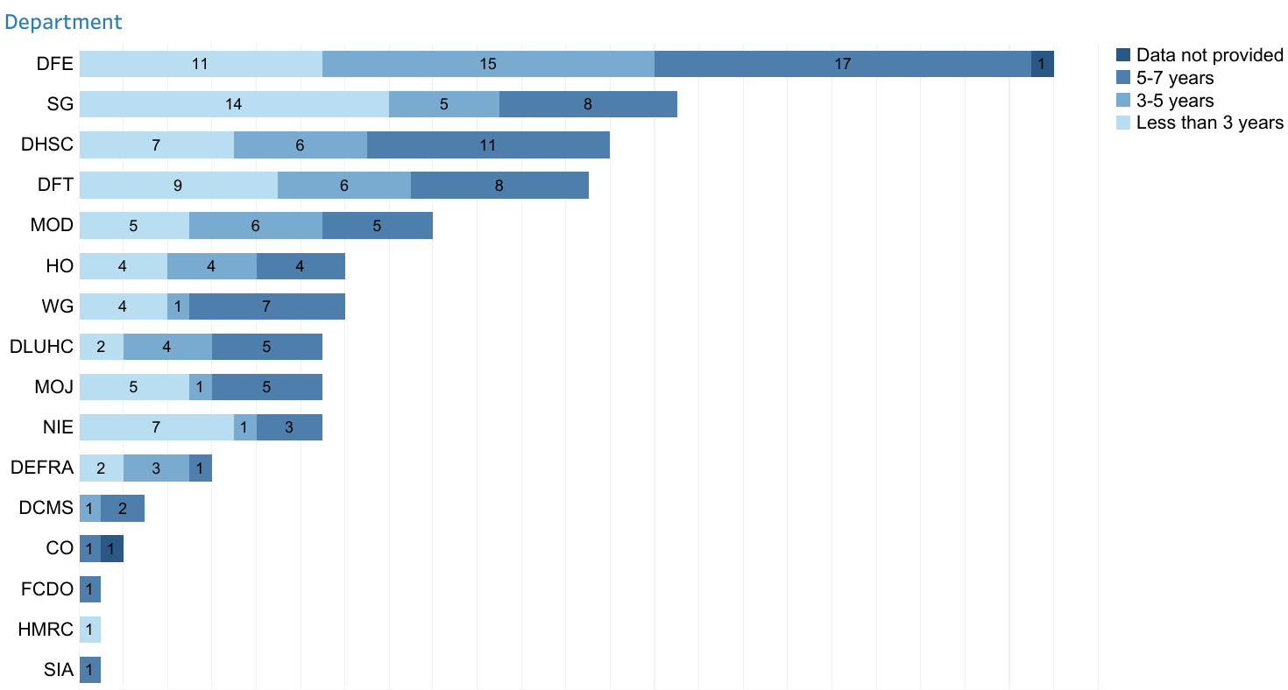
Expiries Within the Next Seven Years
PFI & PF2 Projects: 2024 Summary Data
OFFICIAL
DFE accounts for over two fifths (22%) of expiries occurring within the next 7 years.
Local authority contracted projects account for 43% of those expiring over the next seven years. A further 24% are contracted by devolved authorities.
Devolved authority contracted projects also account for the largest portion (33.8%) of projects expiring over the next three years.

Slide 14
Portfolio Joiners and Leavers
PFI & PF2 Projects: 2024 Summary Data
OFFICIAL
The size of the portfolio has reduced to 665 projects in 2024 compared to 669 in 2023. This is due to 10 projects leaving the portfolio and 6 joining.
Leavers:
HMT ID | Project Name | Department | Procuring Authority | Reason
44 | Victoria Dock Primary School | DFE | Hull City Council | Expired
318 | Kingston Hospital Phase 5 | DHSC | Kingston Hospitals NHS Foundation Trust | Terminated
388 | Bootle PFI | HMRC | HM Revenue and Customs | Expired
402 | Ilkeston Police Station | HO | Derbyshire Police Authority | Terminated
412 | North Kent PFI | HO | Kent Police Authority | Terminated
456 | Provision of Energy to RAF Fylingdales | MOD | Ministry of Defence | Expired

Slide 15
Portfolio Joiners and Leavers
PFI & PF2 Projects: 2024 Summary Data
OFFICIAL
Leavers:
HMT ID | Project Name | Department | Procuring Authority | Reason
458 | RAF Lyneham Sewage Service PFI Contract | MOD | Ministry of Defence | Expired
478 | HMP Altcourse | MOJ | National Offender Management Service (WPR) | Expired
499 | Managed Equipment Service (MES) ATICS | NI Executive | Belfast Health and Social Care Trust | Expired
600 | Kilmarnock Prison | Scottish Government | Scottish Prison Service | Expired

Slide 16
Portfolio Joiners and Leavers
PFI & PF2 Projects: 2024 Summary Data
OFFICIAL
Joiners:
HMT ID | Project Name | Department | Procuring Authority | Reason
2401 | Hallam Street Hospital | DHSC | Black Country Healthcare NHS Trust | Project previously fell below agreed capital value thresholds for publication. DHSC now requires all PFI projects to be captured and published
2402 | The Welland Centre | DHSC | North Northamptonshire County Council
2403 | Hertford County Hospital | DHSC | East and North Hertfordshire NHS Trust
2404 | GH Stone House | DHSC | Kent and Medway NHS and Social Care Partnership Trust
2405 | Byron House in Newark | DHSC | Nottinghamshire Healthcare NHS Trust
2406 | Chichester Project | DHSC | Sussex Weald and Downs NHS Trust

Slide 17
Annex A: Definitions
PFI & PF2 Projects: 2024 Summary Data
OFFICIAL
Capital Value: This is the total nominal capitalised cost of the project as recorded in the financial model at financial close. This includes SPV debt plus total shareholder investment (equity and shareholder loans) plus any authority capital contribution.
Financial Close: The date the project reached contract signature
Procuring Authority: The procuring authority responsible for commissioning the project
SPV: The Special Purpose Vehicle which is the company carrying out the project
Unitary Charge (UC): The payment made by the procuring authority to the contractor from the start of operation until the end of the contract. It covers the cost of the construction of the asset, of borrowing debt and equity investment, taxes, operating services such as cleaning, and maintenance.

