Slide 1
5th Annual
Analysis in
Government
Awards
WINNER & RUNNER UP promo pack

Slide 2
So, you’ve been successful in the AiG Awards?!
If you have won or are the runner up for an Analysis in Government Award, firstly congratulations! Competition was extremely tough, and you should be very proud
Why not share your success at being shortlisted and build excitement and anticipation for the People’s Choice Award by using some of our promotional products?
Frame your team photo using one of our custom AiG Awards social frames
Use our logos to promote your success across your networks
Add the AiG Awards button to your email signature
Use one of our custom AiG Awards ‘Winner’ Teams backgrounds in your meetings
Spread the word on social media using the hashtag #AiGAwards

Slide 7
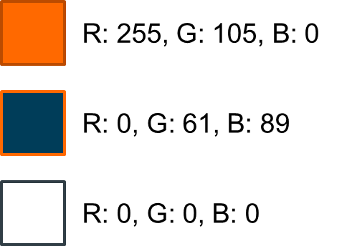
The AiG Awards logo
Simply Copy + Paste.
Please note - if resizing the logos, please make sure ‘Lock aspect ratio’ is ticked in Format Shape menu to avoid squashing or stretching the logos.
If you require any of these designs in a different format, please contact the team at analysis.function@ons.gov.uk

Slide 8
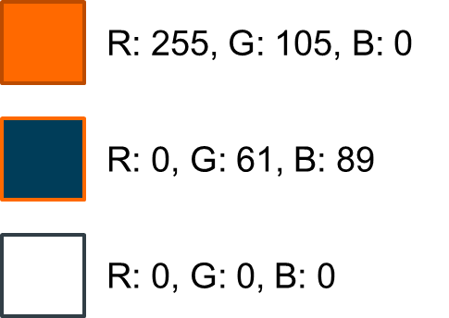
Logo (colour)

Slide 9
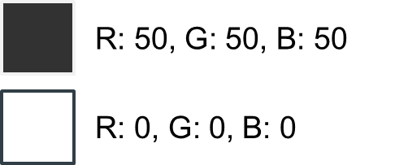
Logo (monochrome)

Slide 10
Logo (for dark backgrounds)

Slide 11
Email signature
Add the Analysis in Government Awards ‘button’ to your email signature. The button contains a hyperlink to the Analysis Function website for all the latest news
Remember to refer to the latest guidance on Understanding accessibility requirements for public sector bodies - GOV.UK (www.gov.uk)
COPY + PASTE

Slide 17
Notes:
Stylish studio

Slide 19
