Slide 1
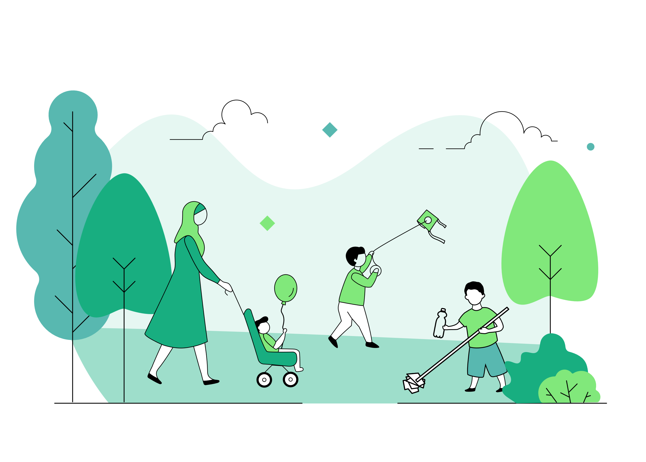
C-PaNS Insights
20.11.2024
The Children’s People and Nature Survey (C-PaNS) provides information on how children and young people experience, think about and engage with the natural environment.
In 2024, C-PaNS collected responses from 4001 children and young people (aged 8 to 15) across two survey waves, one in holiday time (Wave 7 - 14 to 25 August) and one in term time (Wave 8 -16 September to 2 October).
The following slides present some of the headline findings. Further information, the project report and data are available here:
Read the full report

Slide 2
GREEN PLACES VISITED
Green and natural places visited in the last week
Percentage of children and young people*
Children and young people* reported visiting a variety of green and natural places in the last week.
66%
62%
43%
Gardens
Parks, playing fields playgrounds
Grassy areas in the streets nearby
Notes:
[CS_Q3] Have you spent time in any of these places in the last week?
You can include visits of any length of time (including short trips to the park, dog walking etc). Please do not include any trips made abroad.
Please choose one or more options

Slide 3
TIME SPENT OUTSIDE
During term time, children and young people* reported spending time outside at school and when not at school
AT SCHOOL
WHEN NOT AT SCHOOL
85%
34%
54%
45%
spent time outside at school every day or most days
had done activities or lessons outside that were not PE every day or most days
spent time outside in their garden every day or most days
spent time outside in other places every day or most days
Notes:
[CS_Q6A] Now thinking about when you were not at school in the last week, how often have you spent any time in your own garden if you have one)? This includes any garden that you share with your neighbours

Slide 4
TIME SPENT OUTSIDE
During holiday time, more than half of children and young people* reported spending time outside every day or most days in their garden and in other outdoor spaces in the last week
48%
68%
spent time outside in their garden every day or most days
spent time outside in other places every day or most days
Notes:
[CS_Q6A] Now thinking about when you were not at school in the last week, how often have you spent any time in your own garden if you have one)? This includes any garden that you share with your neighbours

Slide 5
GREEN SPACES AT SCHOOL
We asked children and young people where they spent most of their time in nature during the last week.
37%
29%
NOT AT SCHOOL
More children and young people* reported that they spent time in nature mostly whilst not at school
SCHOOL
35%
EQUAL

Slide 6
GREEN PLACES VISITED
Green and natural places within easy walking distance
Percentage of children and young people*
Children and young people* reported being able to easily walk (by themselves or with someone else) from their home to a variety of green and natural places.
73%
71%
57%
Gardens
Parks, playing fields, playgrounds
Grassy areas in the streets nearby
Notes:
[CS_Q4] Which of these places can you walk to easily from your home (either by yourself or with someone else)? You can include visits of any length of time (including short trips to the park, dog walking etc). Please do not include any trips made abroad. Please choose one or more options

Slide 7
QUALITY OF LOCAL NATURAL SPACES
Children and young people* feel positive about the quality of their local outdoor spaces.
We asked children and young people how much they agreed with five statements relating to different aspects of quality of their local outdoor spaces.
ACCESSIBILITY
FEELINGS
NATURAL ENVIRONMENT
ENJOYMENT
CLEANLINESS
“They are easy to get to by walking”
“I feel welcome there”
“There are lots of places for animals and birds to make their homes”
“There are good spaces for playing”
“They are clean and well looked after”
84%
AGREE
79%
AGREE
74%
AGREE
75%
AGREE
63%
AGREE

Slide 8
MORE TIME OUTSIDE
What would encourage you to go out into natural spaces more?
% of children and young people* who ranked each item as most important
Children and young people* said that playgrounds and good weather were the most important things to encourage them to go out into natural spaces more
31%
26%
Playgrounds
Good weather

Slide 9
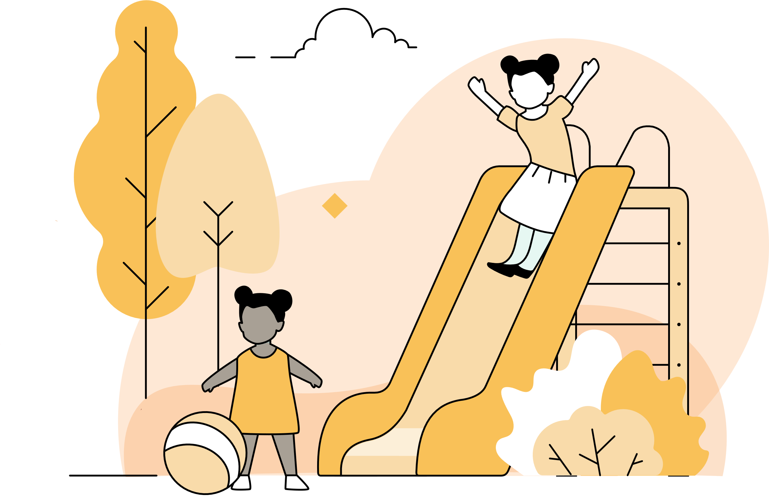
ENJOYMENT OF NATURE
91%
of children and young people* agreed with the statement:
“
Being in nature makes me very happy”
Notes:
[CS_Q12a] How much do you agree or disagree with the following - Being in nature makes me very happy

Slide 10
NATURE CONNECTION
Most children and young people* agreed with the statement: “Being in nature makes me very happy”
91%
1%
DISAGREE
AGREE
DISAGREE
NEITHER AGREE NOR DISAGREE
AGREE
STRONGLY AGREE
COMPLETELY AGREE
Notes:
[CS_Q12a] How much do you agree or disagree with the following - Being in nature makes me very happy

Slide 11
NATURE CONNECTION
23%
LOW CONNECTION
Over half of children and young people* reported feeling highly connected to nature†
57%
HIGH CONNECTION
MODERATE CONNECTION
20%
Notes:
[CS_Q11] How connected do you feel to nature? Please choose the picture that best describes your relationship to nature

Slide 12
ENVIRONMENTAL CONCERN AND ACTION
Reported actions taken to look after the environment
Percentage of children and young people*
Children and young people* reported doing a range of activities to look after the environment. The most common activities are…
61%
54%
53%
Recycling
Pick up litter
Turning off taps
Notes:
[CS_Q10] Which of the following things do you do to look after the environment? There are lots of options but they may not all apply to you or all make sense. Only pick the ones you understand and do yourself to look after the environment. Please choose one or more options

Slide 13
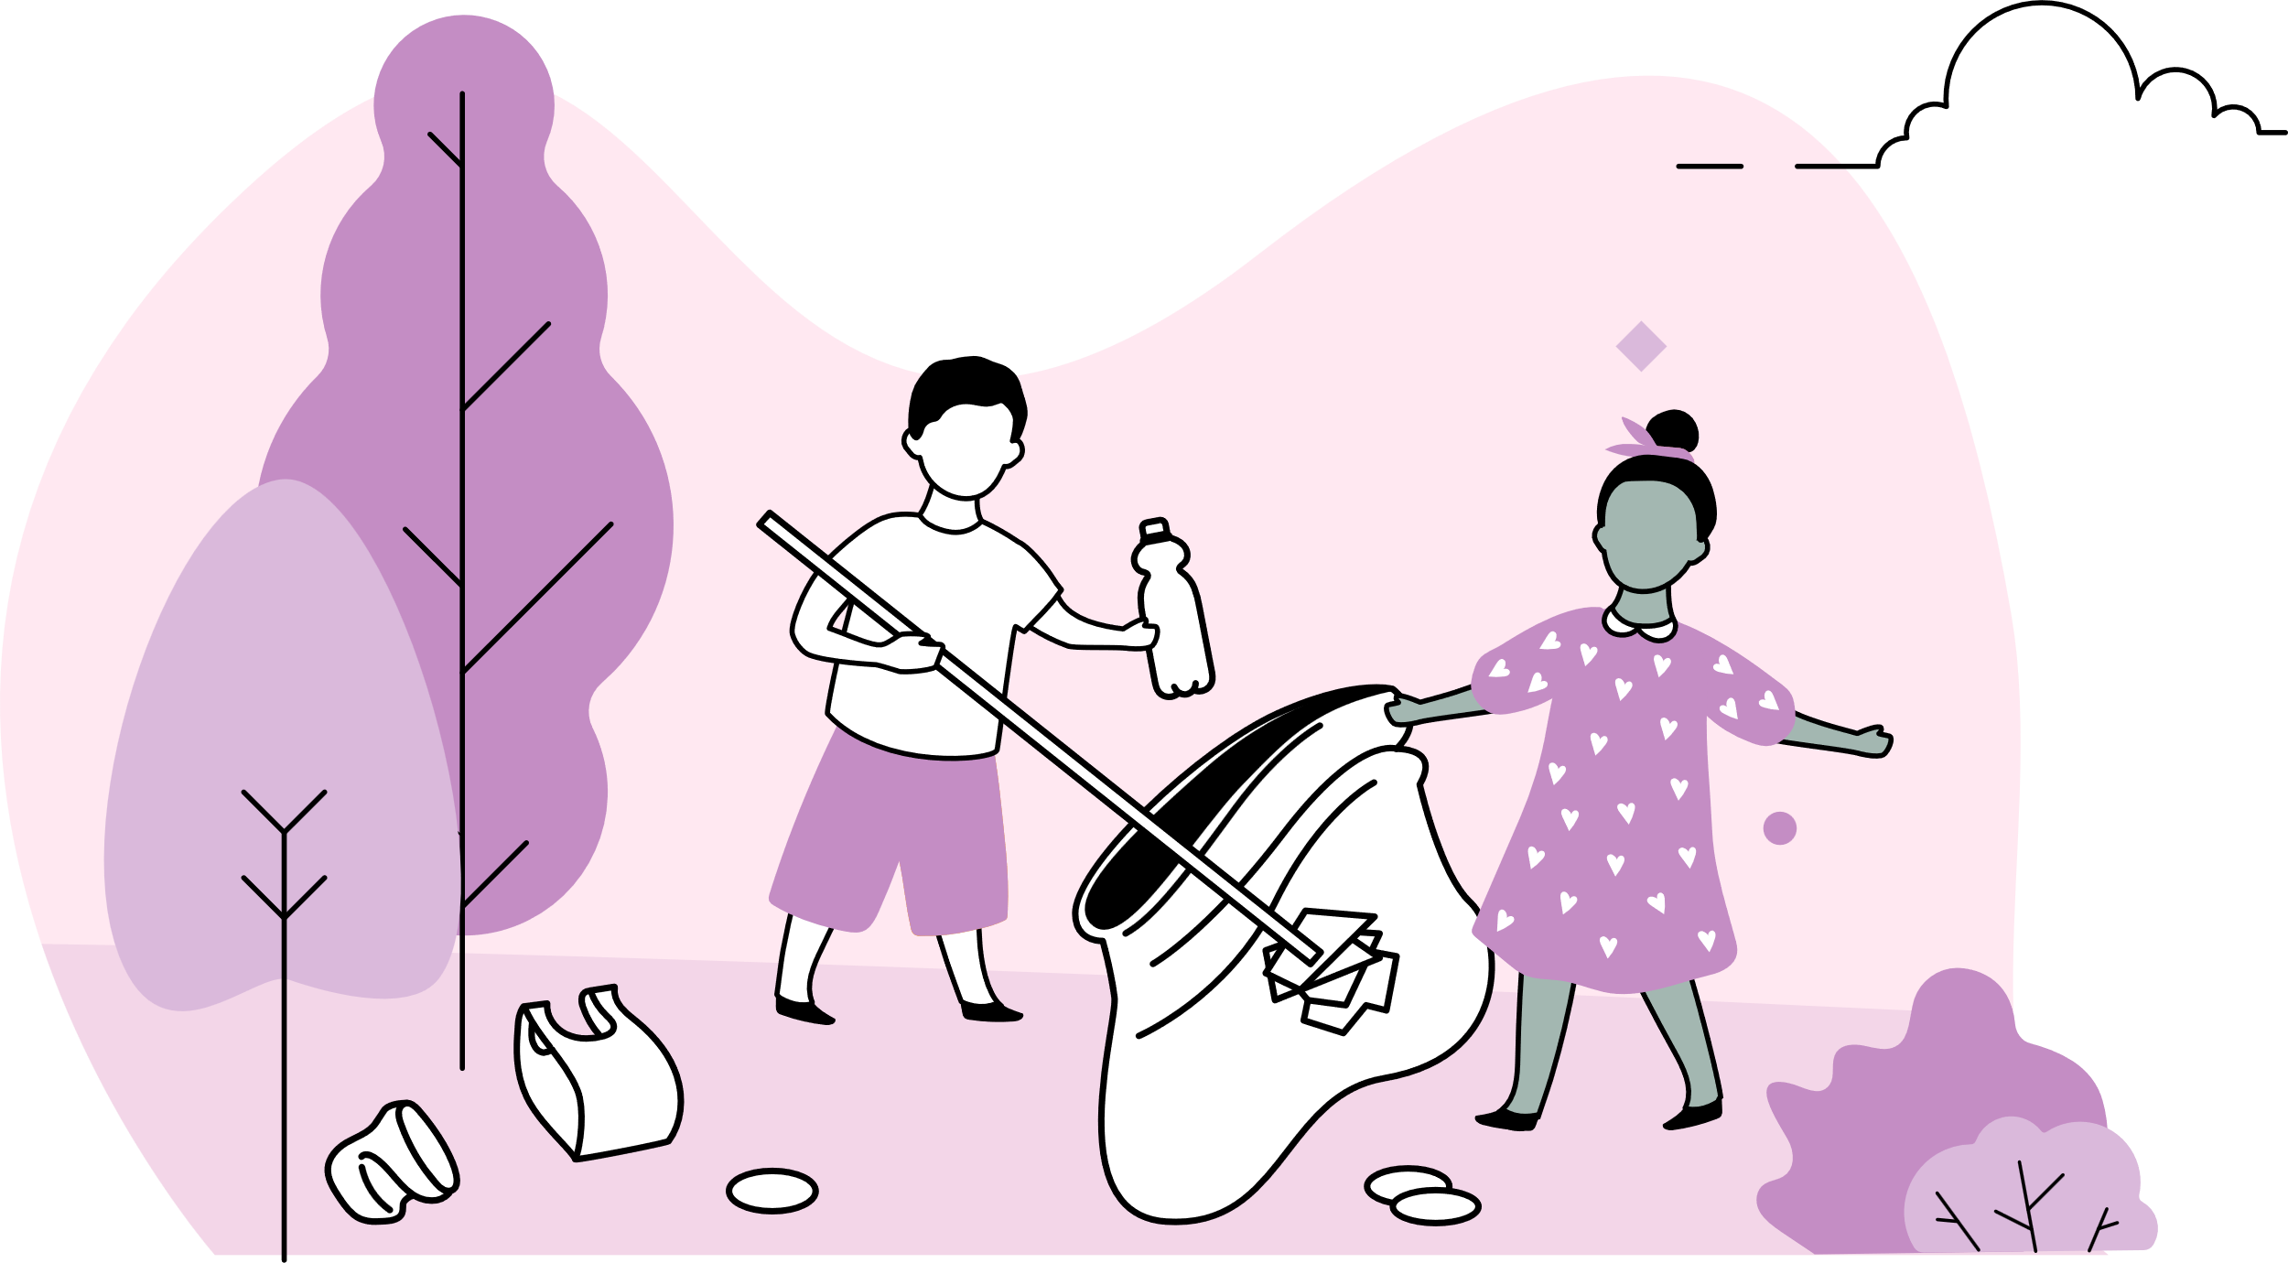
ENVIRONMENTAL CONCERN AND ACTION
83%
of children and young people* said that looking after the environment was important to them
Notes:
[CS_Q9] How important is looking after the environment to you? Please answer below where 1 is not at all important and 5 is very important

