Slide 1
UK-VARSS 2023 Power Point Set Published November 2024

Slide 2
UK-VARSS 2023
The following selected PowerPoint slides provide the core for a presentation on antibiotic sales, antibiotic use and antibiotic resistance.
These slides are based on the UK-VARSS 2023 Report which provides further details.
2

Slide 3
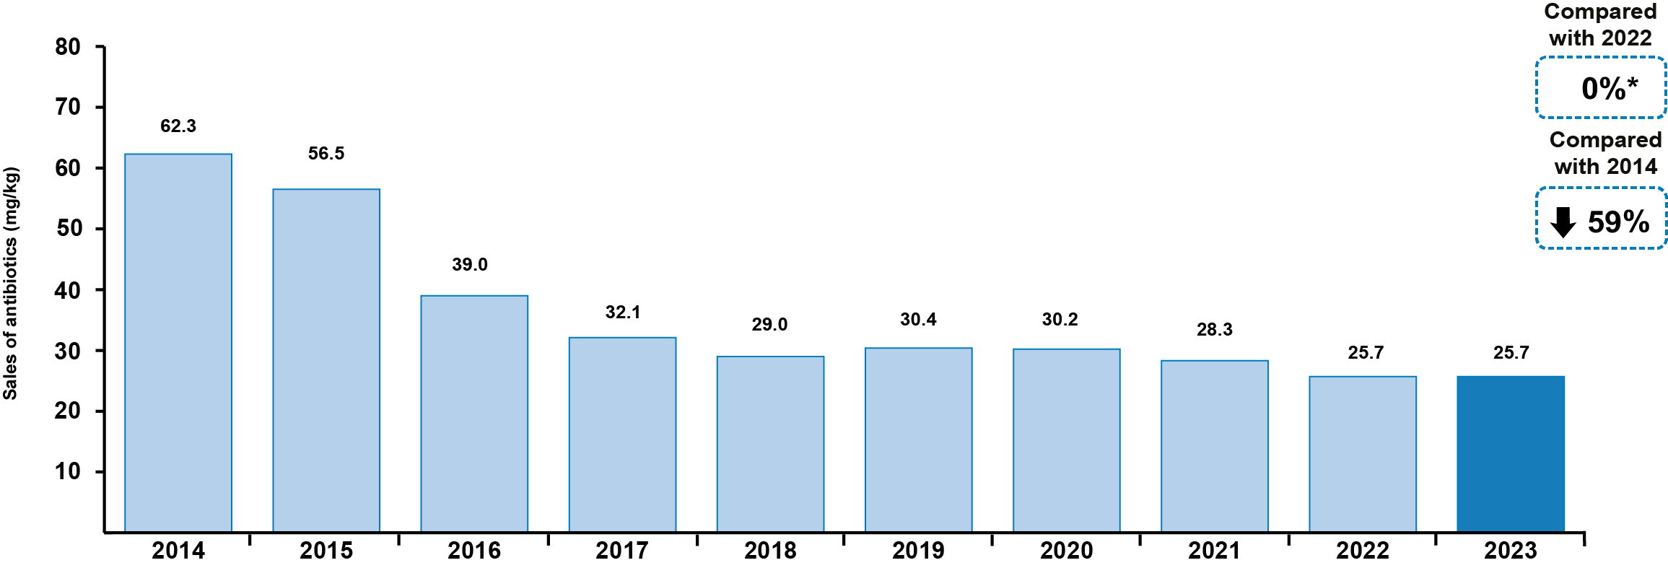
Antibiotic Sales
Sales of veterinary antibiotics for use in food-producing animals, adjusted for animal population, were 25.7 mg/kg in 2023. This represents no change since 2022 and an overall 59% (36.6mg/kg) decrease since 2014.
Total sales (all animals tonnes)
Source: p. 9
* 0.03% increase to 2 decimal places

Slide 4
Antibiotic Sales
Sales of Highest Priority Critically Important (HP-CIAs) for food-producing animals remain very low at 0.11 mg/kg and are essentially unchanged (0.01 mg/kg reduction) since 2022 and 84% (0.56 mg/kg) lower than 2014. For the fourth year in a row, no colistin was sold in the UK for use in animals.
Source: Fig. 1.3; p. 20

Slide 5
Antibiotic Sales
For the third year running, the proportion of total antibiotic sales licensed for an in-water/ milk* use (47%) was higher than the proportion of antibiotic sales licensed for in-feed route of administration (32%). 19% was for injectable use. Oral/water administration of antibiotics allows for more targeted treatment, which represents a lower risk of AMR compared to in-feed antibiotics.**
* Includes oral powders and oral solutions.
** Scientific Risk Assessment of risk of antibiotic use in animals to public health
Source: Fig. 1.5; p. 21

Slide 6
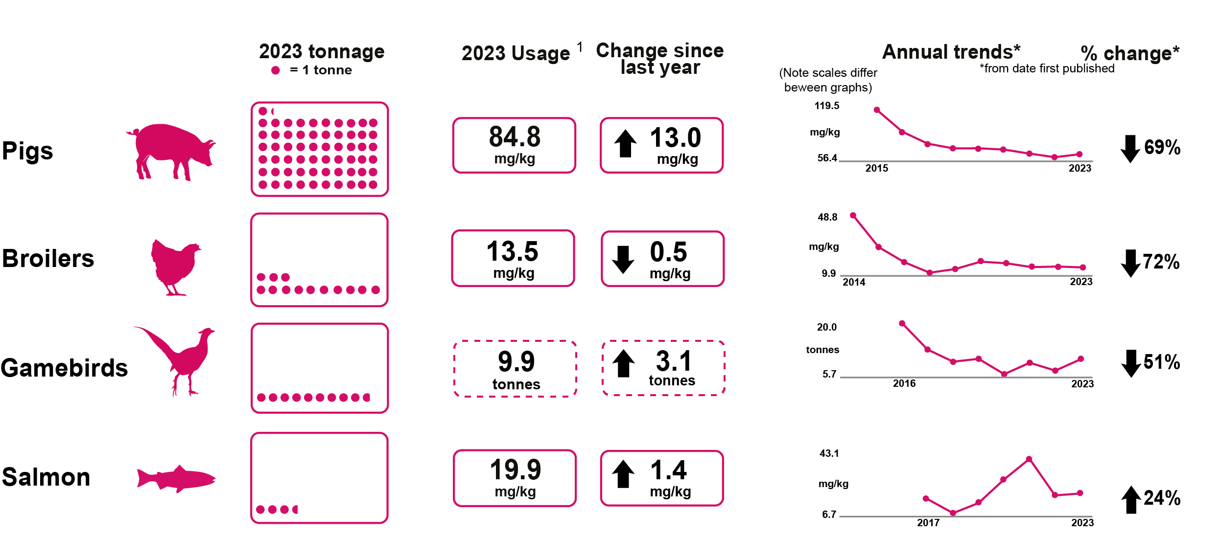
Antibiotic Usage Data
Antibiotic usage refers to the amount of antibiotics prescribed and/or administered per sector. The data have been collected and provided to the VMD by the animal industry on a voluntary basis. Coverage is at least 85% for all sectors shown. Ruminant coverage is of use data is low and may not be representative of the national sectors and is not included in this section of the report.
Antibiotic usage by food-producing animal species
¹ mg/kg relates to the amount of active ingredient standardised by kg biomass and calculated using ESVAC methodology,
% doses refers to ‘actual daily bird-doses/100 bird-days at risk’
indicates a different metric for usage
Source: p. 10

Slide 7
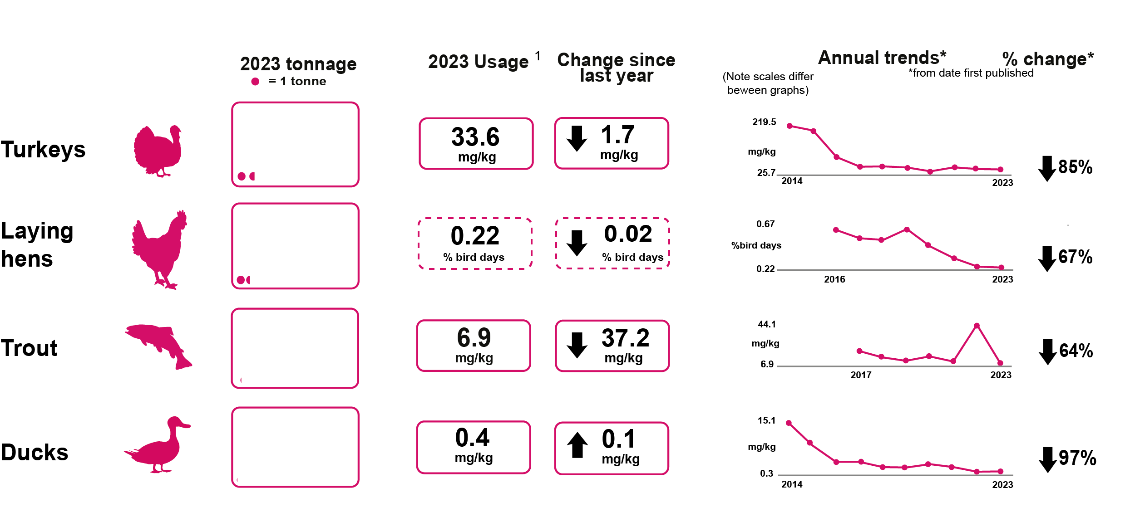
Antibiotic Usage Data
Antibiotic usage by food-producing animal species
¹ mg/kg relates to the amount of active ingredient standardised by kg biomass and calculated using ESVAC methodology,
% doses refers to ‘actual daily bird-doses/100 bird-days at risk’
indicates a different metric for usage
Source: p. 10

Slide 8
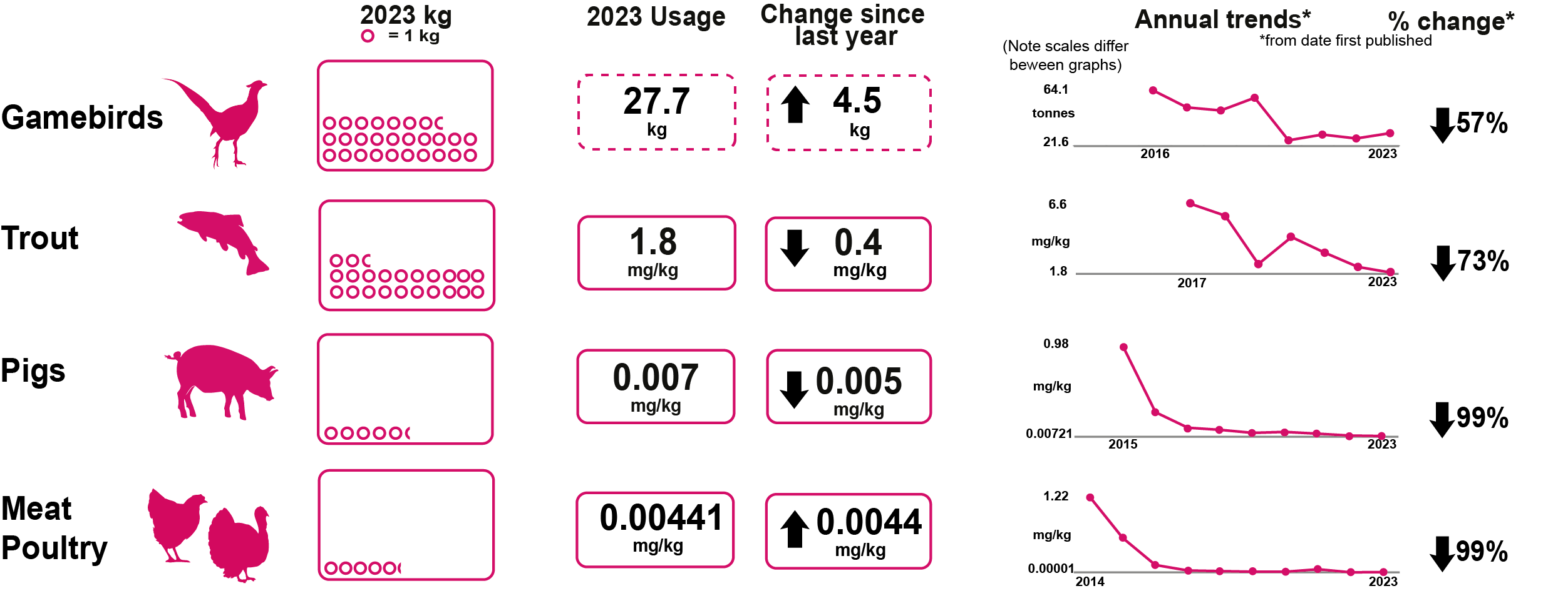
Antibiotic Usage Data
Highest Priority Critically Important Antibiotics by food-producing animal species
¹ mg/kg relates to the amount of active ingredient standardised by kg biomass and calculated using ESVAC methodology, % doses refers to ‘actual daily bird-doses/100 bird-days at risk’
indicates a different metric for usage
Source: p. 10

Slide 9
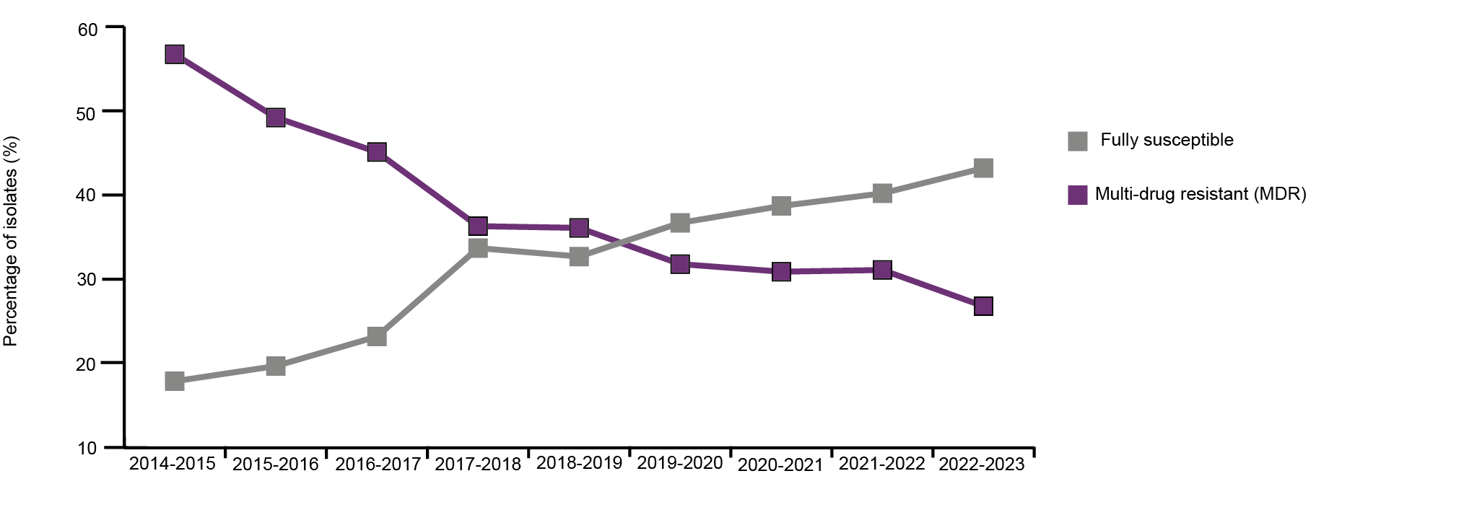
Harmonised Monitoring of AMR
Key resistance outcome indicators: E.coli
The harmonised monitoring outcome indicators combine results from healthy pigs and poultry at slaughter to give an overall picture of antimicrobial resistance (AMR) and are internationally comparable. Results from 2023 are very positive, with considerable improvements since 2015. The percentage of E. coli isolates showing full sensitivity to the panel of antibiotics tested is at a new high of 43%, more than doubling since 2014/2015. The percentage of multi-drug resistant isolates (resistant to three or more antibiotic classes) is at a new low of 27%.
Source: p. 11

Slide 10
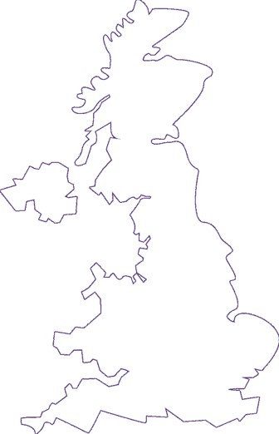
Harmonised Monitoring of AMR
Summary sampling locations, sector coverage and sampling dates for Harmonised Monitoring in pigs and PATH-SAFE surveys for beef cattle, sheep and dairy cattle in 2023
Pigs
Dairy cattle
Beef cattle
Sheep
Animal species
Sector coverage
81%
27%
28%
28%
January 2023 – December 2023
June 2023 – March 2024
February 2023 – November 2023
October 2022 – August 2023
Sampling dates
Key:  Sampling locations
Source: P73, Fig 3.1

Slide 11
Harmonised Monitoring of AMR
Full susceptibility in E.coli
This graph shows full susceptibility in E. Coli from: harmonised monitoring in pigs 2023, chickens and turkeys in 2022; and PATH-SAFE beef cattle and sheep 2023.
Results from the harmonised monitoring programme (2023 and 2022) are shown in dark purple and PATH-SAFE results are in light purple.
Raw bulk milk was tested from dairy cattle, all other animals were tested via caecal sampling.
Source: p. 72

Slide 12
Harmonised Monitoring of AMR
Using selective media to detect E. coli
We also perform a more sensitive type of testing using selective media which inhibits the growth of susceptible bacteria but allows ESBL-/AmpC-producing E.coli to multiply, making them easier to detect.
This tells us the percentage of individual animals carrying resistance to 3rd and 4th generation cephalosporins even at very low levels.
Source: Page 11

Slide 13
Harmonised Monitoring of AMR
A total of 170 E. coli isolates from pig caecal samples were tested. Full susceptibility to the entire antibiotic panel increased from 35% in 2021 to 42% in 2023 and has substantially improved from 2015 levels (23%). Percentage of fully susceptible and multi-drug resistant E. coli isolated from healthy pigs at slaughter (n=170 in 2023).
Source: Fig 3.7
Page 81
Key:  2015  2017  2019  2021  2023

Slide 14
Harmonised Monitoring of AMR
Resistance to non-HP-CIAs (A) and HP-CIAs (B) in Enterococcus faecalis isolated from healthy pigs at slaughter in 2023 (n=56). Interpreted using EUCAST ECOFFs unless otherwise indicated. Note scale differs between graphs.
(A) Non-HP-CIA (B) HP-CIAs
No resistance to HP-CIAs
QU
Key  2023
AG: aminoglycosides, AP: amphenicols, BL: beta-lactams, GP: glycopeptide, LP: lipopeptide, ML: macrolides, OX: oxazolidinone, QU: quinolones, SG: streptogramins, TC: tetracyclines
Source: Figs 3.9
P 84

Slide 15
Harmonised Monitoring of AMR
Resistance to non-HP-CIAs (A) and HP-CIAs (B) in Enterococcus faecium isolated from healthy pigs at slaughter in 2023 (n=176). Interpreted using EUCAST ECOFFs unless otherwise indicated. Note scale differs between graphs.
(A) Non-HP-CIA (B) HP-CIAs
No resistance to HP-CIAs
QU
Key  2023
AG: aminoglycosides, AP: amphenicols, BL: beta-lactams, GP: glycopeptide, LP: lipopeptide, ML: macrolides, OX: oxazolidinone, QU: quinolones, SG: streptogramins, TC: tetracyclines
Source: Figs 3.10
P 85

Slide 16
AMR in Clinical Surveillance
Clinical surveillance aims to provide veterinarians with relevant treatment information using results from bacteria isolated from diagnostic samples. As this kind of scanning surveillance is subject to biases and differences in the number of samples, the results are not representative of the UK’s wider animal populations.
Key findings
7,415 isolates were tested for AMR in England and Wales, predominantly Salmonella and E. coli and were the most frequently tested bacteria.
Resistance in E. coli across all animal species mostly shows decreasing resistance since 2014.
The percentage of isolates tested by animal species were: pigs (13%), poultry (30%), cattle (15%), sheep (7%), dogs (10%) and trout <1%)
Source: p. 12

Slide 17
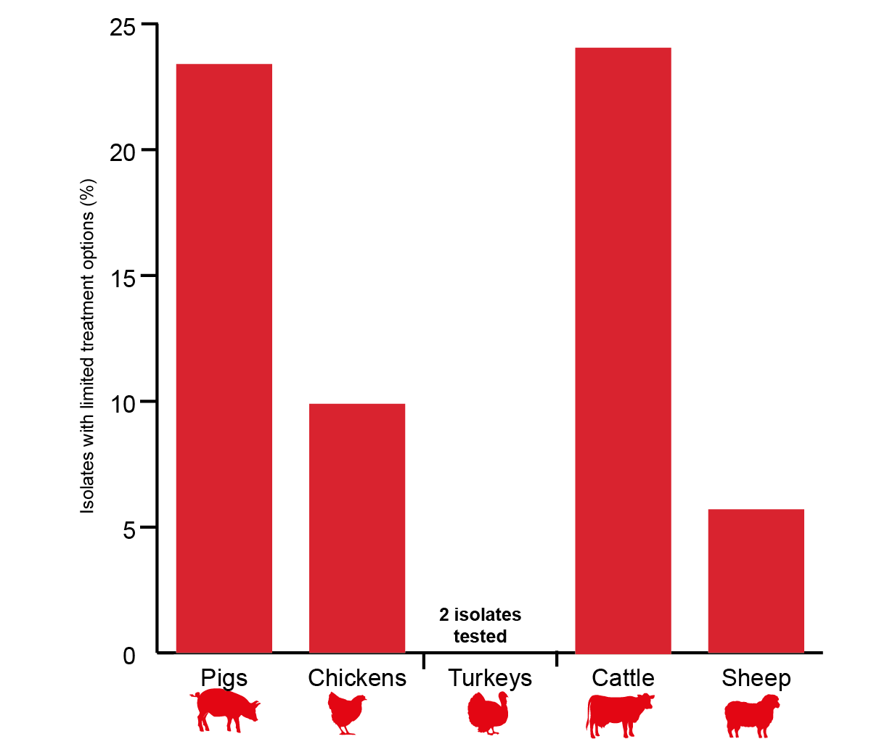
AMR in Clinical Surveillance
Resistance in Escherichia coli
1,168 E.coli isolates were tested from all species.
18% of isolates were resistant to four or more individual antibiotics, which could limit treatment options for veterinarians. This was most frequent in isolates from cattle (24% and pigs (23%), as shown in the adjacent graph.
Across species, resistance tended to be higher in younger animals, which may reflect more frequent antibiotic use in this age group.
Percentage of isolates with limited treatment options in 2023
(resistant to four or more individual antibiotics)
Highest priority critically important antibiotics (HP-CIAs):
Resistance was low, very low or not detected in E. coli: cefotaxime (8.7%), cefpodoxime (0.7%), ceftazidime (4.9%) and enrofloxacin (1.7%)
Source: p. 12

Slide 18
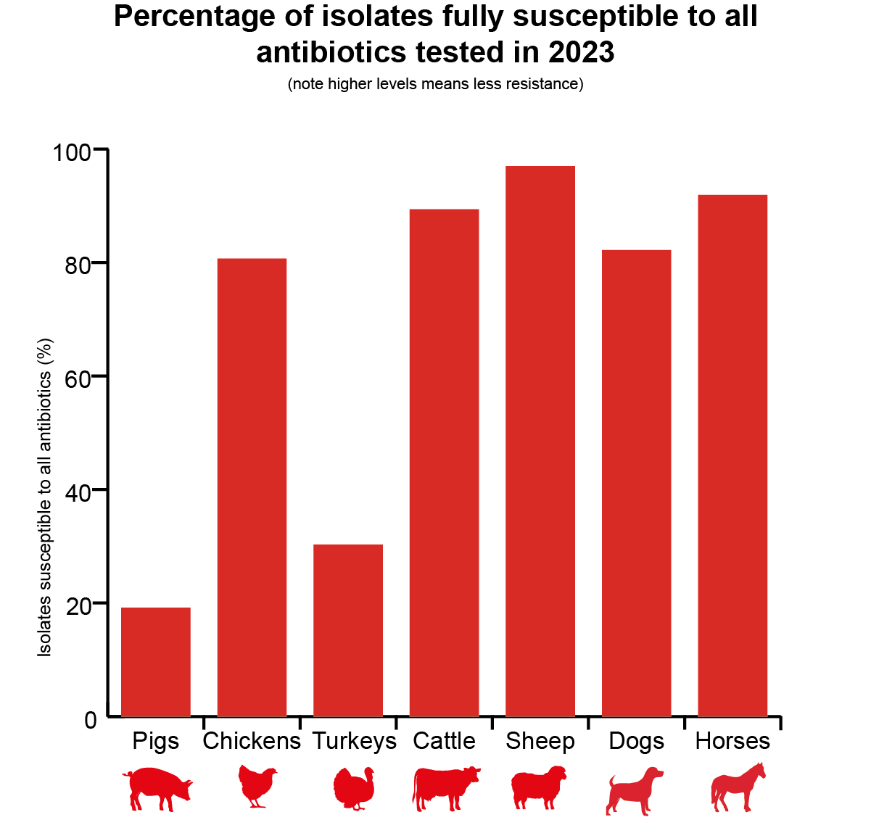
AMR in Clinical Surveillance
Resistance in Salmonella spp. from animals and their environment
Of the 5,513 Salmonella isolates tested, 73% were fully susceptible. The lowest levels of susceptibility were in pigs (19%) and turkeys (30%), as shown in the adjacent graph.
When looking at data since 2014, there are sector specific differences with pigs, chickens and turkeys all showing trends of increasing full susceptibility. Full susceptibility in salmonella from sheep and cattle remain high.
14% of Salmonella from all species indicated limited treatment options, that is, resistant to four or more individual antibiotics. This was most frequent in isolates from pigs (76%)
Percentage of isolates fully susceptible to all antibiotics tested in 2023
(note higher levels means less resistance)
Isolates susceptible to all antibiotics (%)
Highest priority critically important antibiotics (HP-CIAs):
Resistance was low, very low or not detected in Salmonella spp.: cefotaxime and ceftazdime (>0.9%) and ciprofloxacin (<2.6%).
Source: p. 12

