Slide 1



Results Highlights PowerPoint Set UK-VARSS 2022
Published November 2023 Updated October 2024

Slide 2

UK – VARSS 2022
The following selected PowerPoint slides provide the core for a presentation on antibiotic sales, antibiotic use and antibiotic resistance.
These slides are based on the UK-VARSS 2022 Report which provides further details.
2

Slide 3
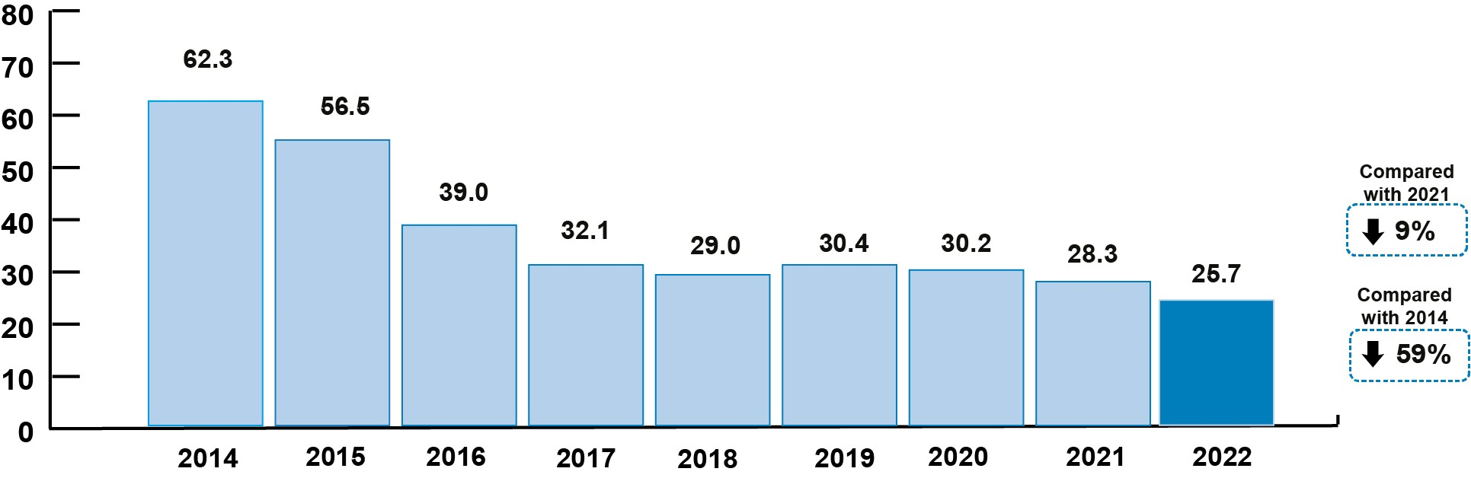

Antibiotic Sales
The total sales of veterinary antibiotics adjusted for the underlying food-producing animal population was 25.7 mg/kg, a 59% decrease since 2014. The total weight of active veterinary antibiotic sold (for all animals) in 2022 was 193 tonnes, a 57% decrease since 2014. This represents the lowest sales ever recorded.
Sales in mg/kg
Source: p. 7

Slide 4
Antibiotic Sales
Sales of Highest Priority Critically Important Antibiotics (HP-CIAs) in food-producing have decreased by 82% since 2014 to 0.12mg/kg and account for less than 0.5% of total sales. No colistin was sold for use in animals in 2022.
Source: Fig. 1.4; p. 17

Slide 5
Antibiotic Sales
For the second year running, the proportion of total antibiotic sales licensed for an oral/water¹ route of administration (45%) was higher than the proportion of antibiotic sales licensed for in-feed route of administration (31%). Oral/water administration of antibiotics allows for more targeted treatment, which represents a lower risk of AMR compared to in-feed antibiotics.²
¹ Includes oral powders, oral pastes, oral solutions, and bolus preparations.
² Scientific Risk Assessment of risk of antibiotic use in animals to public health
Source: Fig. 1.6; p. 18

Slide 6




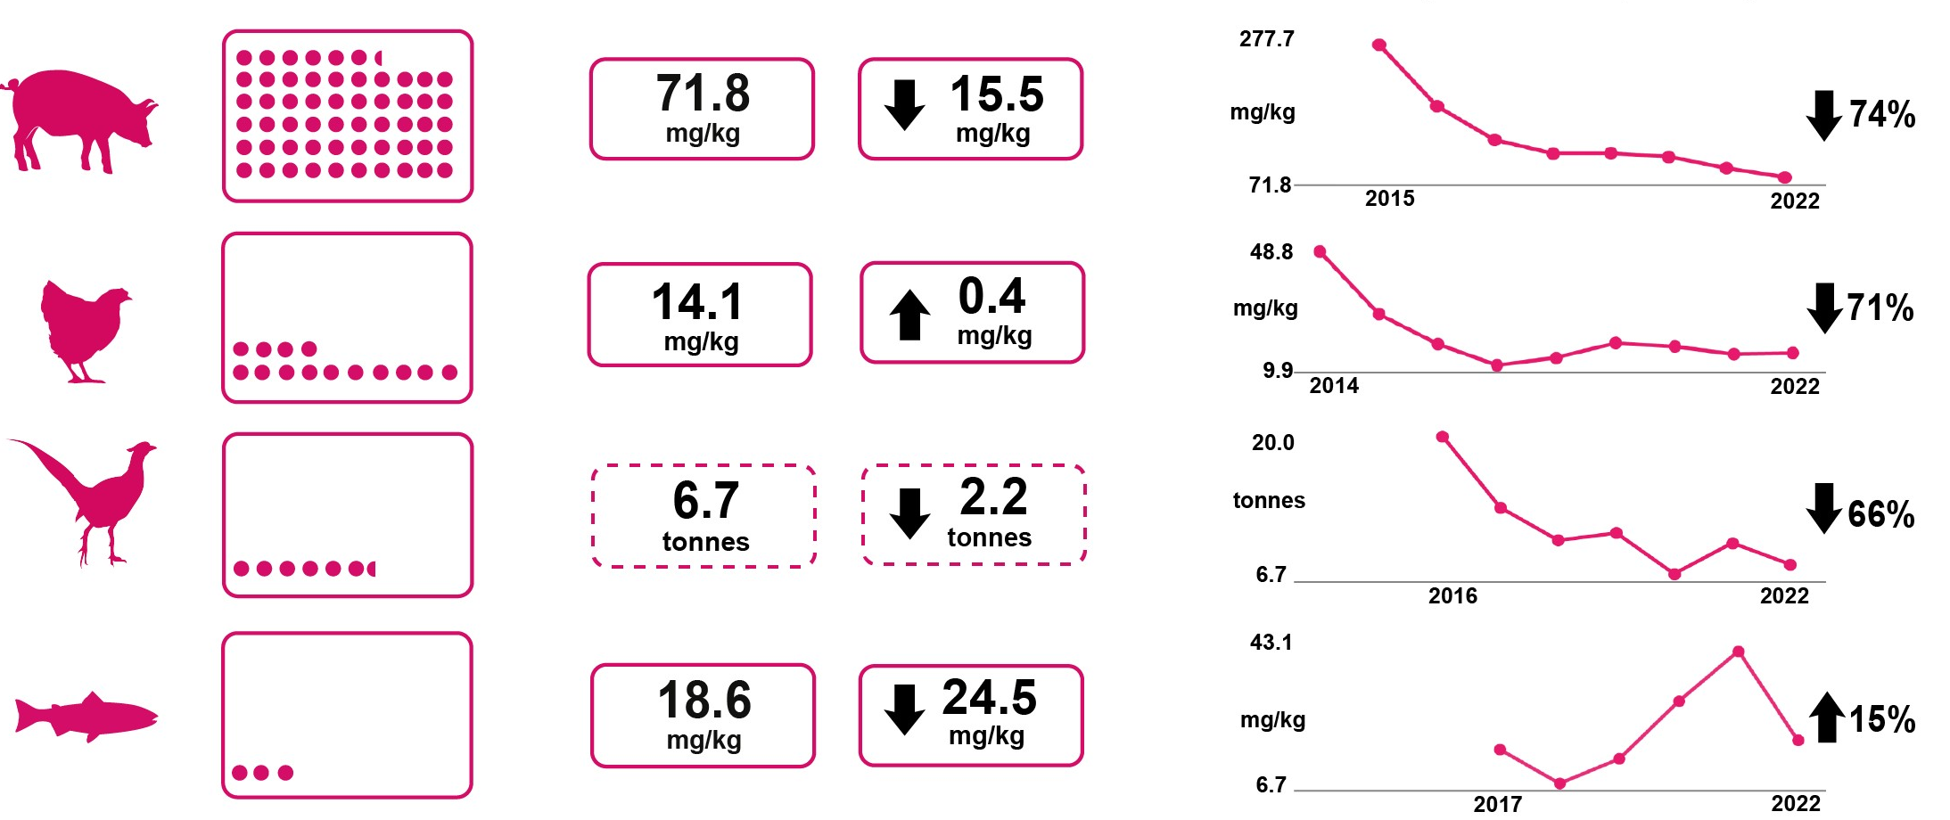
Antibiotic Usage Data
Antibiotic usage refers to the amount of antibiotics prescribed and/or administered per sector. The data have been collected and provided to the VMD by the animal industry on a voluntary basis
¹
Pigs
Broilers
Gamebirds
Salmon
¹ mg/kg relates to the amount of active ingredient standardised by kg biomass and calculated using ESVAC methodology,
% doses refers to ‘actual daily bird-doses/100 bird-days at risk’
indicates a different metric for usage
Source: p. 8

Slide 7

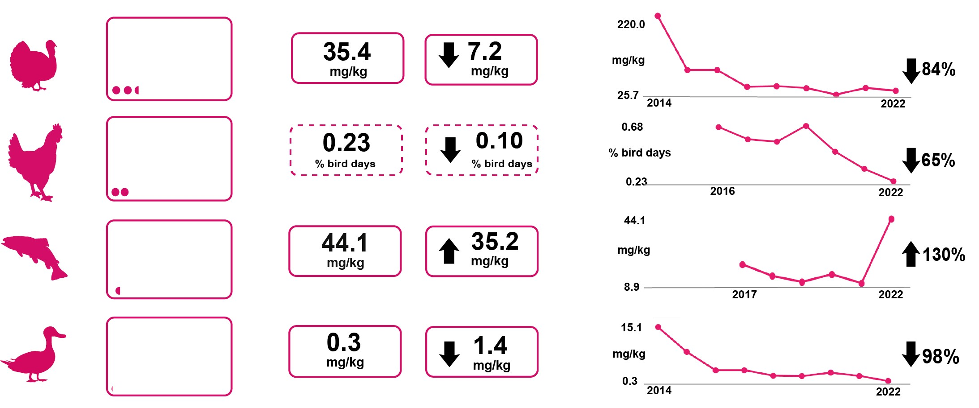
Antibiotic Usage Data
¹
Turkeys
Laying Hens
Trout
Ducks
¹ mg/kg relates to the amount of active ingredient standardised by kg biomass and calculated using ESVAC methodology,
% doses refers to ‘actual daily bird-doses/100 bird-days at risk’
indicates a different metric for usage
Source: p. 8

Slide 8
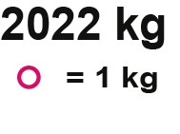
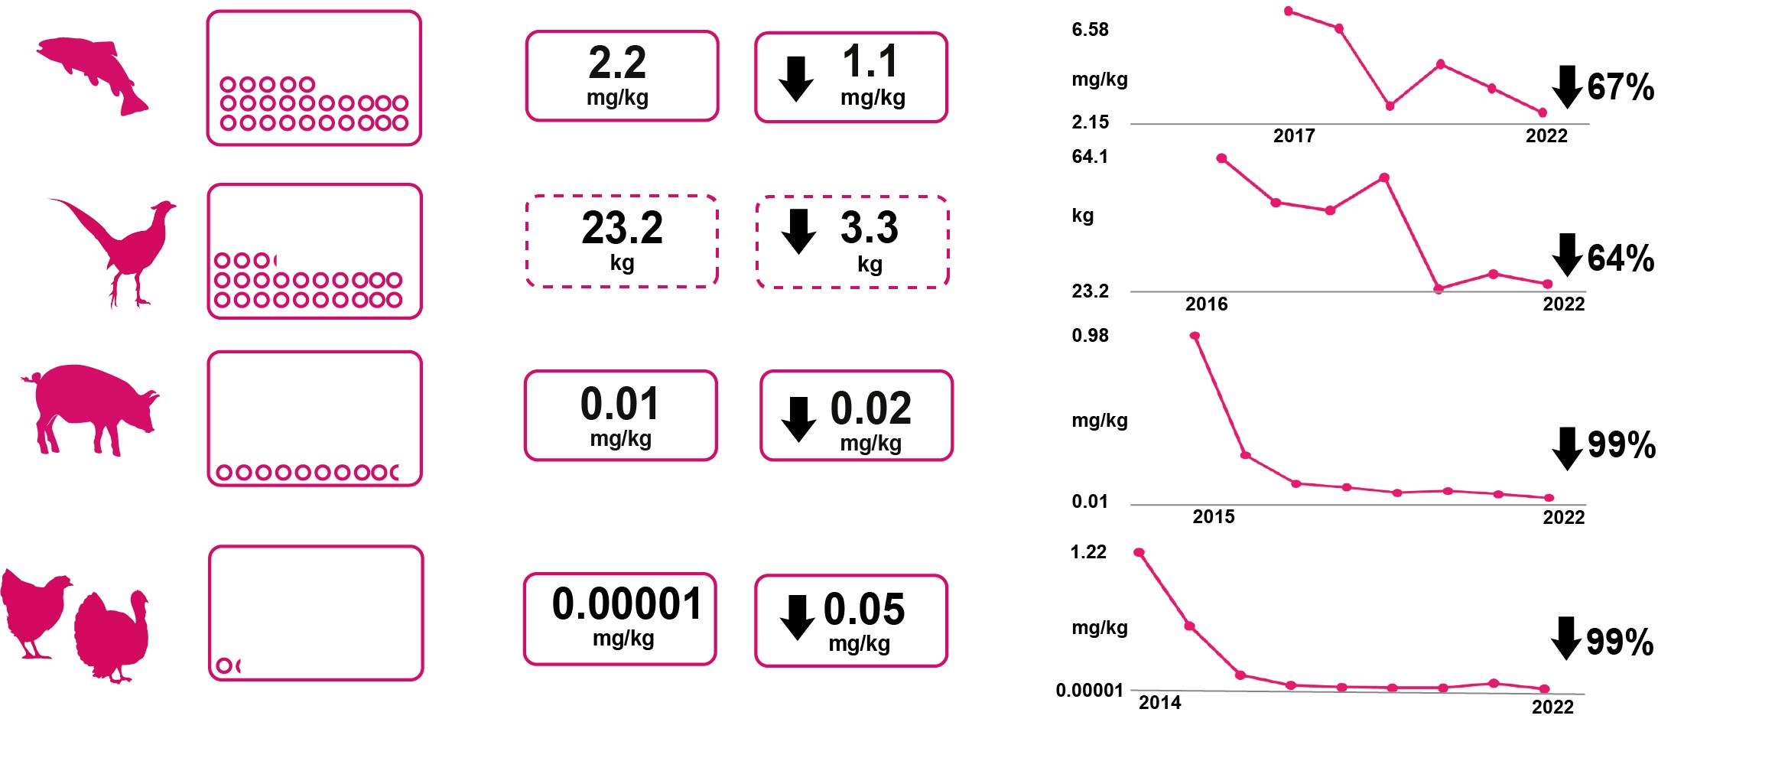
Antibiotic Usage Data
¹
Trout
Gamebirds
Pigs
Meat
Poultry
¹ mg/kg relates to the amount of active ingredient standardised by kg biomass and calculated using ESVAC methodology, % doses refers to ‘actual daily bird-doses/100 bird-days at risk’
indicates a different metric for usage
Source: p. 8

Slide 9
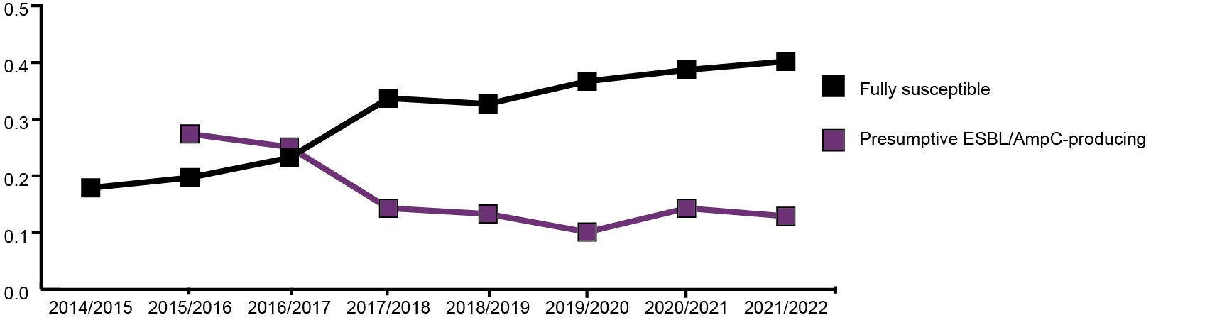
Harmonised Monitoring of AMR
The harmonised monitoring indicators from healthy pigs and poultry give an idea of the major trends in UK AMR surveillance, and are internationally comparable. The overall picture for 2022 is positive. The proportion of isolates showing full sensitivity to the panel of antibiotics tested has continued to increase, and the proportion of presumptive ESBL-/AmpC-producing E. coli has remained stable.
Active Ingredient (mg/kg)
Source: p. 9

Slide 10

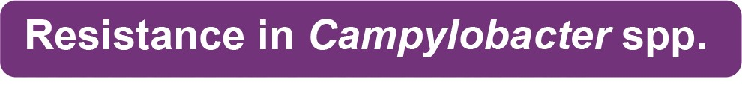
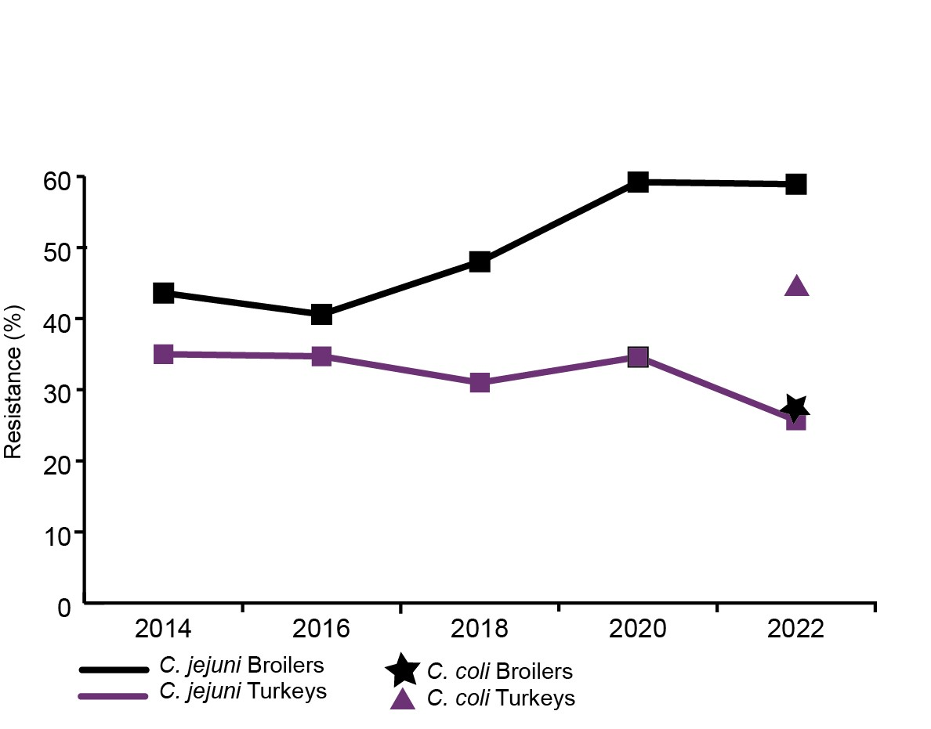
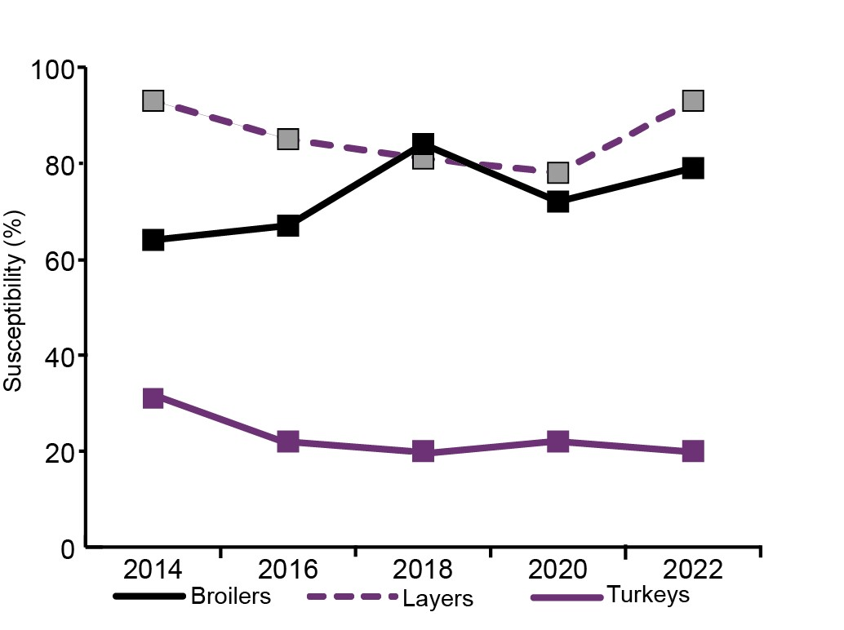
Harmonised Monitoring of AMR
In 2022, full susceptibility in Salmonella increased in broilers and layers and remained stable in turkeys.
In 2022, there were very high levels² of resistance to ciprofloxacin in Campylobacter from broilers and turkeys. This was the first year resistance in C.coli was tested.
Source: p. 9
² Description of % resistance referenced: very high
levels (50% to 70%)

Slide 11
Harmonised Monitoring of AMR
New Surveillance for 2022
This year’s harmonised monitoring includes three new species of bacteria which gives a more complete picture of AMR in animals and its relevance to people; Campylobacter coli, Enterococcus faecalis, Enterococcus faecium. The addition of Enterococcus allows for detection of vancomycin resistant enterococci (VRE), which is of clinical importance. No VRE were detected.
Source: p. 9

Slide 12
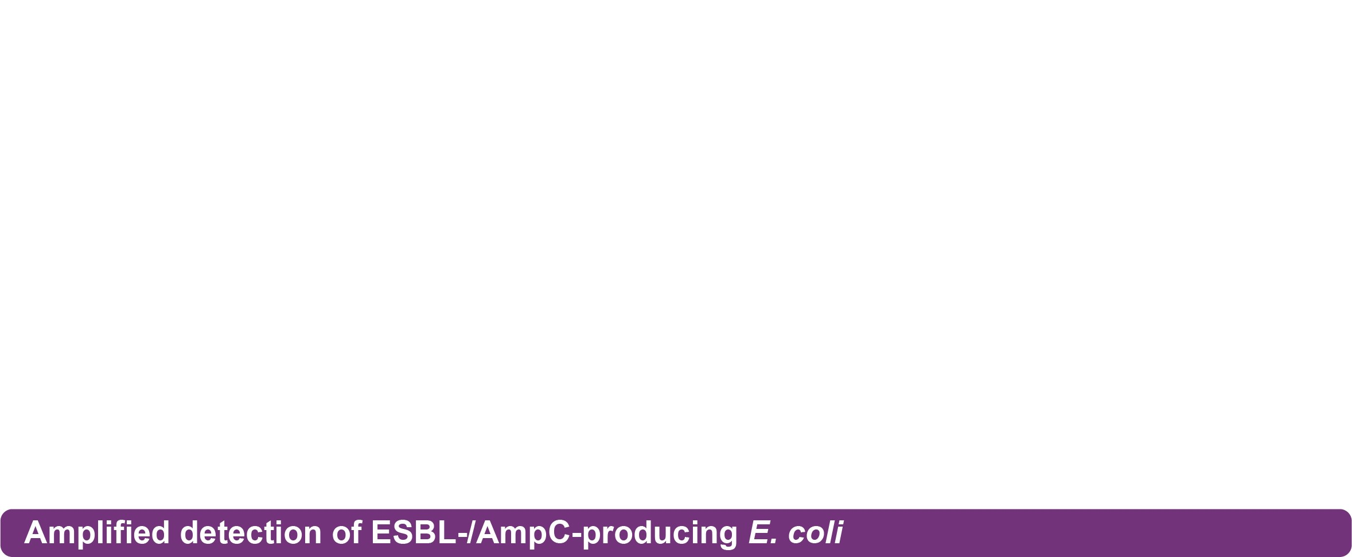
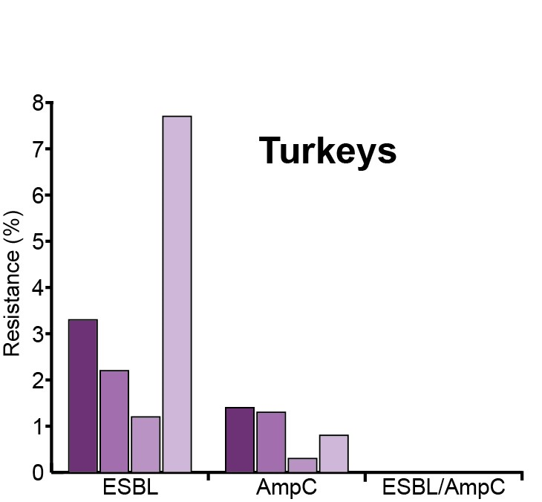
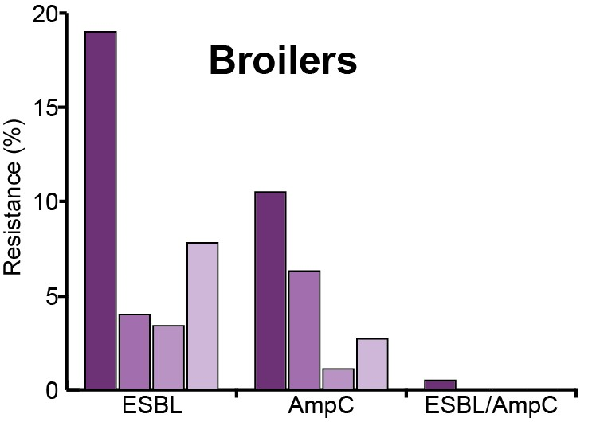
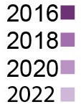
Harmonised Monitoring of AMR
We also perform a more sensitive type of testing using selective media. This test inhibits the growth of susceptible bacteria but allows ESBL-/AmpC-producing E.coli to multiply, making them easier to detect. This tells us the proportion of individual birds carrying resistance to 3rd and 4th generation cephalosporins even at very low levels.
There was an increase in the prevalence of broilers and turkeys carrying ESBL- and AmpC-producing E. coli compared to 2020. Of these organisms from broilers, 77% were co-resistant to ciprofloxacin, an increase from 37% in 2020.
Source: p. 9

Slide 13
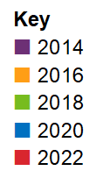
Harmonised Monitoring of AMR
Resistance to non-Highest Priority Critically Important Antibiotic (HPCIA) (A) and HP-CIAs (B) in Escherichia coli isolated from healthy broilers at slaughter. Interpreted using EUCAST ECOFFs unless otherwise indicated. Note scale differs between graphs.
(A) Non-HP-CIA (B) HP-CIAs
+ Not tested
* Interpreted using an EFSA-recommended ECOFF
AG: aminoglycosides, AP: amphenicols, BL: beta-lactams, ML: macrolides, PX: polymyxins, QU: quinolones, TC: tetracyclines, TS: trimethoprim/sulfonamides, 3/4GC: third- and fourth-generation cephalosporins
Source: Fig. 3.3; p. 66
13

Slide 14
Harmonised Monitoring of AMR
Resistance to non-Highest Priority Critically Important CIA (HP-CIAs)(A) and HP-CIAs (B) in Escherichia coli isolated from healthy turkeys at slaughter. Interpreted using EUCAST ECOFFs unless otherwise indicated. Note scale differs between graphs.
(A) Non-HP-CIA (B) HP-CIAs
+ Not tested
* Interpreted using an EFSA-recommended ECOFF
AG: aminoglycosides, AP: amphenicols, BL: beta-lactams, ML: macrolides, PX: polymyxins, QU: quinolones, TC: tetracyclines, TS: trimethoprim/sulfonamides, 3/4GC: third- and fourth-generation cephalosporins
Source: Fig. 3.4; p. 67
14

Slide 15
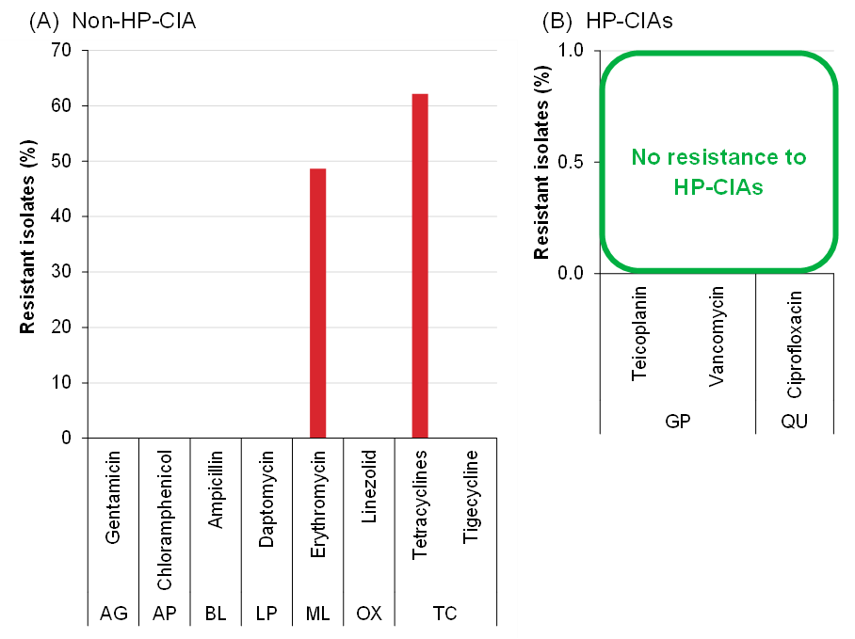
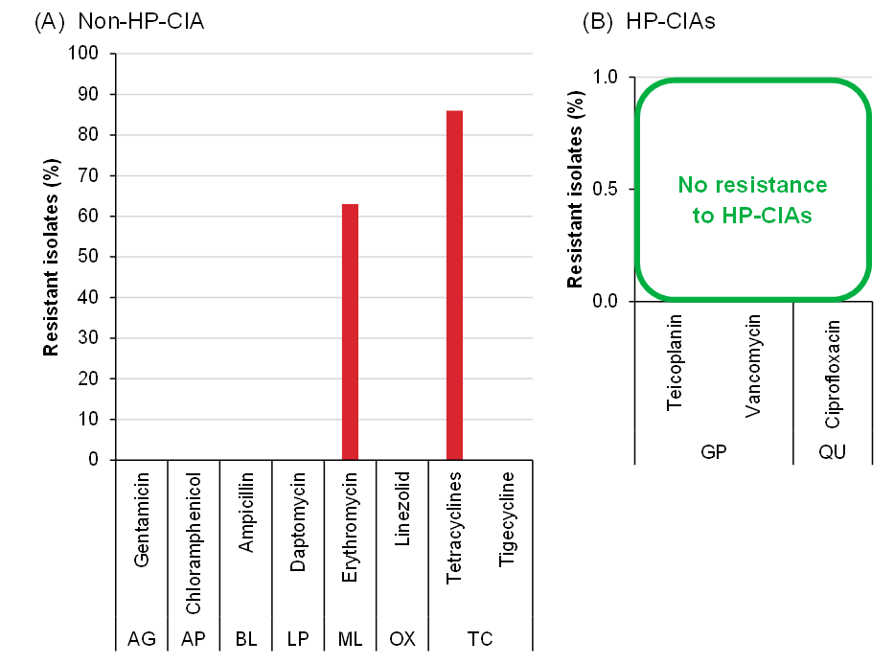
Harmonised Monitoring of AMR
Enterococcus faecalis was tested in broilers and turkeys for the first time this year.
Broilers
Turkeys
Resistance to non-Highest Priority Critically Important (HP-CIAs) (A) and HP-CIAs (B) in Enterococcus faecalis isolated from broilers at slaughter in 2022. Interpreted using EUCAST ECOFFs unless otherwise indicated. (Note scale differs between graphs.)
Resistance to non-HP-CIAs (A) and HP-CIAs in Enterococcus faecalis isolated from turkeys at slaughter in 2022. Interpreted using EUCAST ECOFFs unless otherwise indicated. (Note scale differs between graphs.)
Source: Fig. 3.5; p. 68 & Fig. 3.6; p. 69
15

Slide 16
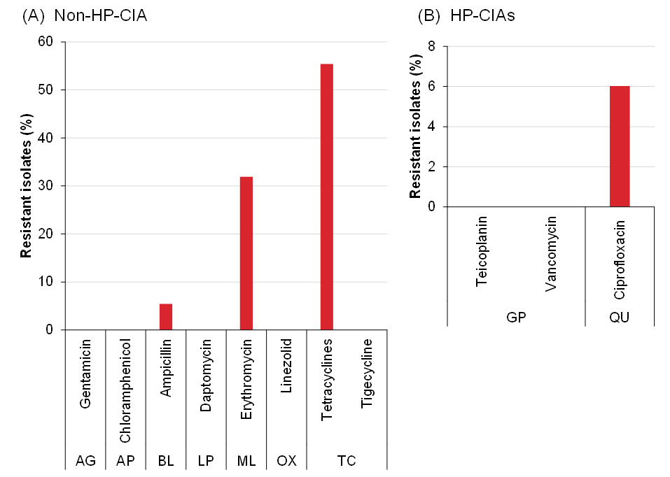
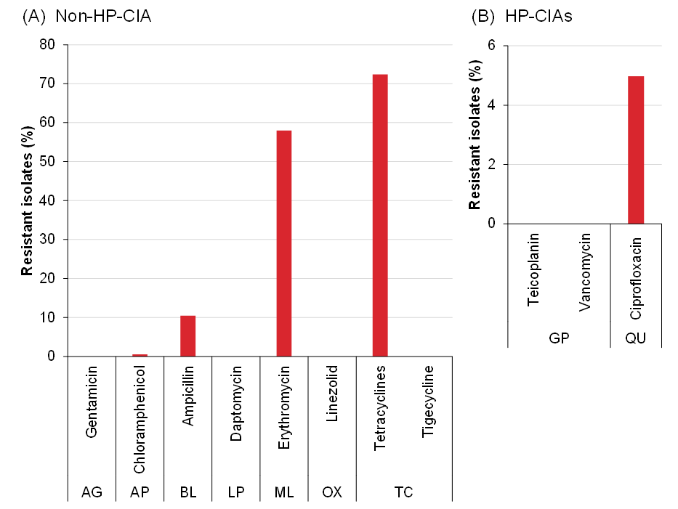
Harmonised Monitoring of AMR
Enterococcus faecium was tested in broilers and turkeys for the first time this year.
Broilers
Turkeys
Resistance to non- Highest Priority Critically Important (HP-CIAs) (A), and HP-CIAs (B) in Enterococcus faecium isolated from broilers at slaughter in 2022. Interpreted using EUCAST ECOFFs unless otherwise indicated. (Note scale differs between graphs)
Resistance to non-HP-CIAs (A) and HP-CIAs (B) in Enterococcus faecium isolated from turkeys at slaughter. Interpreted using EUCAST ECOFFs unless otherwise indicated. (Note scale differs between graphs.)
Source: Fig. 3.7; p. 70
Source: Fig 3.8; p. 71
16

Slide 17
AMR in Clinical Surveillance
Clinical surveillance aims to provide veterinarians with relevant treatment information using results from bacteria isolated from diagnostic samples. As scanning surveillance is subject to biases and differences in the number of samples, the results are not representative of the UK’s wider animal populations.
Key findings
7,284 isolates were tested for AMR in England and Wales.
E. coli and Salmonella were the most frequently tested bacteria.
Resistance was usually highest to the most commonly used antibiotics: aminopenicillins and tetracyclines.
Resistance tended to be higher in E. coli isolated from young animals, likely reflecting more frequent treatment.
Private Laboratory Initiative (PLI)
The PLI is a collaborative project between the VMD and APHA, which aims to routinely collect and analyse data from private veterinary laboratories, to provide an additional source of data for AMR surveillance. The PLI is feeding into the new National Biosurveillance Network (NBN) and will run pilot projects from April 2024 to April 2025.

Slide 18
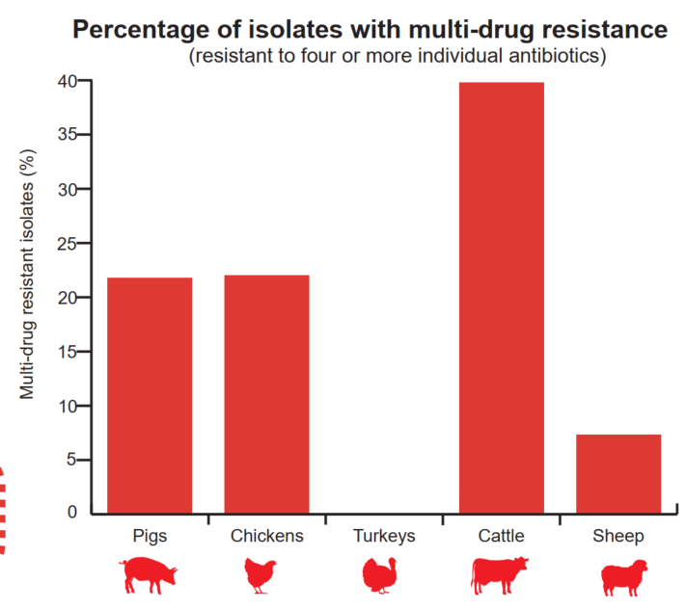
AMR in Clinical Surveillance
Resistance in Escherichia coli
Of the 984 E. coli isolates tested from all species, 24% were multi-drug resistant (resistant to four or more individual antibiotics). This was highest in cattle (40%).
The highest levels of resistance were detected to the most commonly used antibiotics: the aminoglycoside streptomycin (54%), the aminopenicillin ampicillin (49%) and tetracycline (46%).
In isolates from neonatal sheep, resistance to spectinomycin declined from 45% in 2021 to 23% in 2022. This is possibly due to withdrawal of this antibiotic from the market.
Highest priority critically important antibiotics (HP-CIAs):
Resistance was low across all species: cefotaxime (3.7%), cefpodoxime (0.9%), ceftazidime (0.7%) and enrofloxacin (2.5%)

Slide 19
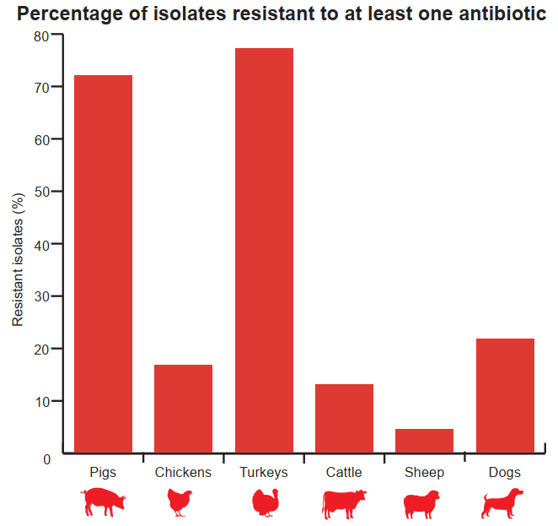
AMR in Clinical Surveillance
Resistance in Salmonella spp. from animals and their environment
Of the 5,562 Salmonella isolates tested, 24% of isolates from all species showed resistance to at least one antibiotic. This was highest in turkeys (77%) and pigs (72%).
A change to legislation in 2021 meant that Salmonella isolates from dogs became reportable under the Zoonoses Order in Great Britain. The number of isolates retrieved from dogs has increased from 105 in 2020 to 924 in 2022.
HP-CIA resistance was generally low (<2%), except to the quinolone nalidixic acid in turkeys (22%). This is difficult to interpret given the disruption to the poultry industry as a result of avian influenza during 2022 which impacted the number of samples submitted.

