Slide 1
5th Annual
Analysis in
Government
Awards

Slide 2
‘Campaign in a Box’ Products to help promote the 5th Annual AiG Awards

Slide 3
AiG Awards Campaign in a Box
This is a ‘Campaign in a Box’ for the Analysis in Government Awards (AiG Awards)
This Campaign in a Box is designed for Communications and Support Teams (and anyone who would like to show their support for the campaign)
It is full of products and resources to help you to promote the AiG Awards within your department or profession
You can use the products in a ‘pick and mix’ style, allowing freedom for you to do what is best for your teams
We hope that you find these useful and if you have any queries or feedback, please contact the team at Analysis.Function@ons.gov.uk

Slide 4
Key messages
The fifth annual Analysis in Government Awards (AiG Awards) opens for nominations on 17 September
The AiG Awards recognise and celebrate the outstanding teams and inspirational individuals working in analysis, wherever they work in government
The categories are Collaboration, Communication, Impact, Inclusion, Innovative Methods, and the Professor Sir Ian Diamond Rising Star Award
Any civil servant is eligible to be nominated for an AiG Award. Public sector and external teams may be recognised if they have collaborated with civil servants for the Collaboration Award
Nominating is quick and easy: Analysis in Government Awards Nomination Form (smartsurvey.co.uk)
For more information, visit our Analysis in Government Awards launch page or email the Analysis Function Central Team at Analysis.Function@ons.gov.uk
You can interact with @gov_analysis on ‘X’ (Twitter), connect with us on LinkedIn sign up to our monthly Newsletter and check the latest news and information on shortlisted nominations and winners on our website Analysis.Function.CivilService.gov.uk

Slide 5
AiG Awards Timetable
2024
Tue 17 September: Nominations open
Fri 25 October: Nominations close
Tue 12 December: Shortlist announced
2025
20-27 January: Winners announced over the course of ‘Awards Week’
18 February: People’s Choice Award winner announced (all winners and runners up from the main awards are eligible to win the People’s Choice Award, voted on by the whole AF membership)

Slide 6
A message from Professor Sir Ian Diamond
Now in its fifth year, the Analysis in Government (AiG) Awards recognises and celebrates excellence in government analysis. It has been an eventful year, and I know there have been countless scenarios where analysts have made a hugely positive difference to the business of government and, subsequently, all of us as UK citizens.
There is so much important, innovative, and varied analysis taking place across the Civil Service, and last year’s winners show what a wide range of work members of the Analysis Function are engaged in. For example, undertaking outstanding work on harnessing the power of linked data and academic collaboration, developing a Crisis Data Liaison Officer (DLO) Network, noise modelling, and inspiring analysts across the government analysis community.
Nominations for the AiG Awards open in September. I will be one of the judges and am incredibly excited to finding out about the inspirational individuals and outstanding teams that you work with.
Professor Sir Ian Diamond, Head of the Analysis Function and National Statistician

Slide 7
Categories
Collaboration: The Collaboration Award recognises collaboration between teams, departments, other professions and/or external organisations/researchers to deliver a piece of analysis or analytical project
Communication: The Communication Award recognises clear and successful presentation and dissemination of analysis using commentary, visualisations, interactives, social media and so on. This could include communicating with the general public, to specialist audiences, within teams, or across government departments and/or professions
Impact: The Impact Award recognises analysis which has had a positive impact, influenced decision-making and/or contributed to public debate
Inclusion: The Inclusion Award recognises an outstanding contribution in making the Analysis Function a more inclusive Function, reflective of the citizens we serve or an outstanding contribution in producing analysis on diversity or inclusion
Innovative Methods: This award recognises innovative methods of analysis
Professor Sir Ian Diamond ‘Rising Star’ Award: The Professor Sir Ian Diamond Rising Star Award recognises the potential of an individual in the earlier stages of their career as a government analyst (the first five years), who has gone above and beyond what would be expected for an analyst of their experience, and/or who has championed the importance of analysis

Slide 8
Categories: Collaboration
The Collaboration Award recognises collaboration between teams, departments, other professions and/or external organisations/researchers to deliver a piece of analysis or analytical project.
Judging criteria: The judges will consider whether evidence of the following has been demonstrated when considering nominations for this award:
Collaboration which improved data and methods
Ways of working which enabled effective collaboration
Collaboration which enhanced insight and understanding of the findings of analysis
Collaboration with stakeholders, such as other analytical professions, other teams in your department, other government departments, organisations outside government, topic and method experts, policy professionals, producers of related analysis, international organisations and researchers

Slide 9
Categories: Communication
The Communication Award recognises clear and successful presentation and dissemination of analysis using commentary, visualisations, interactives, social media and so on. This could include communicating with the general public, to specialist audiences, within teams, or across government departments and/or professions.
Judging criteria: The judges will consider whether evidence of the following has been demonstrated when judging nominations for this award:
Use of innovative methods of communicating and disseminating analysis
Ensuring accessibility is at the heart of communicating the results of analysis
Presenting analysis clearly and in a way that is meaningful to the audience
Demonstrating that the needs of different types of users and potential users were considered when determining how the analysis should be communicated

Slide 10
Categories: Impact
The Impact Award recognises analysis which has had a positive impact, influenced decision-making and/or contributed to public debate.
Judging criteria: The judges will consider whether evidence of the following has been demonstrated when judging nominations for this award:
Evidencing a link between the analysis undertaken and the positive impact. Is there evidence to show that the analysis influenced a policy decision, avoided risks or improved operational delivery?
Understanding the nature and significance of the impact from the users’ point of view
The nominated team were pro-active in ensuring the analysis has impact
New analysis being developed to meet an identified knowledge or information gap
Measurable, delivered impact will be considered more effective by the judges than anticipated or future 'potential' impact

Slide 11
Categories: Inclusion
The Inclusion Award recognises an outstanding contribution in making the Analysis Function a more inclusive Function, reflective of the citizens we serve or an outstanding contribution in producing analysis on diversity or inclusion.
Judging criteria: The judges will consider whether evidence of the following has been demonstrated when judging nominations for this award:
Developing or delivering outstanding analysis on diversity or inclusion subject matter
Making improvements in the way we analyse and understand diversity and inclusion data
Acting as a role model and championing the development of colleagues from different backgrounds and perspectives
Sharing unique viewpoints across their team, department and/or the Analysis Function
Building an inclusive culture by challenging inequalities, barriers, and bias to reflect a wider range of experience
Demonstrating how a real and measurable positive impact has come about due to their interventions or actions

Slide 12
Categories: Innovative Methods
The Innovative Methods award recognises innovative methods of analysis. Judging criteria: The judges will consider whether evidence of the following has been demonstrated when judging nominations for this award:
Innovative analytical methods and techniques used
Methods which led to new insight, answered complex questions, or improved efficiency
The strengths and limitations of the methods used were considered, and communicated effectively to users
Feedback from peer reviewers and experts was invited and acted upon to refine the methods
This work may include innovative usage of data sharing such as through the Integrated Data Service (IDS)

Slide 13
Categories: Rising Star
The Professor Sir Ian Diamond Rising Star Award* recognises the potential of an individual in the earlier stages of their career as a government analyst (the first five years), who has gone above and beyond what would be expected for an analyst of their experience, and/or who has championed the importance of analysis. Nominees for the Rising Star Award can be in grades up to and including G7 but can be of any profession or age.
Judging criteria: The judges will consider whether evidence of the following has been demonstrated when judging nominations for this award:
Demonstration of the nominee’s potential to excel in their future career
Positive contributions which have exceeded expectations
Demonstration of enthusiasm, passion, and drive for analysis
Ways of working that inspire the next generation of government analysts
Take a holistic view of the nominee – their work, relationships with others, qualities that will help them flourish

Slide 14
Showing why the AiG Awards matter
From the day nominations open we’ll be posting about the Analysis in Government Awards using the hashtag #AiGAwards (see Social Media for details)
We’ll be sending out a special “Analysis in Government Awards Newsletter” in mid-October
NB Professor Sir Ian Diamond would like as many government analysts as possible signed up to the AF Newsletter…
Make sure you don’t miss out by subscribing today and encouraging your colleagues to do likewise by emailing us at Analysis.Function@ons.gov.uk

Slide 15
Sample wording for your intranet
Nominations for the fifth Annual Analysis in Government Awards are now open.
The Analysis in Government Awards (AiG Awards) is a highly respected and prestigious cross-government programme, recognising and celebrating the wealth of inspirational individuals and innovative projects within the Analysis Function. Over the last three years, these unique and empowering awards have helped to spread best practice right across government, sharing innovation, learning and leadership.
There are six different award categories, including our new Professor Sir Ian Diamond ‘Rising Star’ Award
Nominations close at 23:59 on Friday 25 October
If you want to recognise the excellent work in [insert Department Name here] and celebrate our most inspiring individuals and outstanding teams at a cross-government level, make sure to nominate in this year's AiG Awards.

Slide 16
Social media
Analysis Function will be active on Twitter / X and LinkedIn from nominations opening until the announcement of the winners in January and the winner of the People’s Choice Award in February. Follow us at @gov_analysis and connect with us on LinkedIn at Gov Analysis
Share, Like and tag us in to help build conversations and increase engagement / interest in the event. Make sure you use the hashtag #AiGAwards.
Sample wording for your team’s social media
At [Insert team/department/profession name here] we’re excited for #AiGAwards. Make sure you nominate the outstanding teams and inspirational individuals you work with https://www.smartsurvey.co.uk/s/5thAiGAwards/ @gov_analysis
We’re delighted that [insert team name here] has been nominated for an Analysis in Government Award. Find out more about the #AiGAwards @gov_analysis”
I’m proud to be a government analyst because… @gov_analysis

Slide 17
5th Annual
Analysis in Government Awards
Nominations for the fifth annual Analysis in Government Awards are open now, and you have until 11:59pm on Friday 25 October to submit a nomination
The Analysis in Government Awards (AiG Awards) is a prestigious cross-government programme, recognising and celebrating the work of outstanding teams and inspirational individuals working in the field of analysis
There are six categories: Collaboration, Communication, Impact, Inclusion, Innovative Methods, and the Professor Sir Ian Diamond ‘Rising Star’ Award
Press the big orange button to nominate now! Analysis in Government Awards Nomination Form (smartsurvey.co.uk)

Slide 19
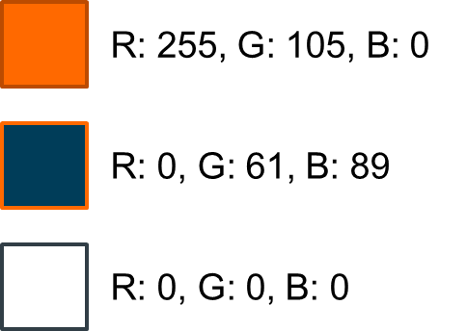
The AiG Awards logo
Simply Copy + Paste.
Please note - if resizing the logos, please make sure ‘Lock aspect ratio’ is ticked in Format Shape menu to avoid squashing or stretching the logos.
If you require any of these designs in a different format, please contact the team at Analysis.Function@ons.gov.uk

Slide 20
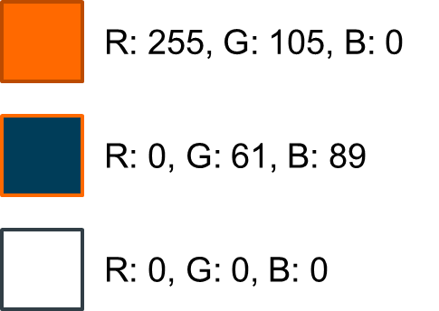
Logo (colour)

Slide 21
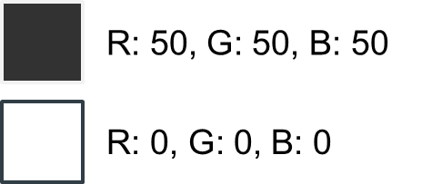
Logo (monochrome)

Slide 22
Logo (for dark backgrounds)

Slide 23
Email signature
Add the Analysis in Government Month ‘button’ to your email signature. The button contains a hyperlink to the AiG Awards nomination form
Remember to refer to the latest guidance on Understanding accessibility requirements for public sector bodies - GOV.UK (www.gov.uk)
COPY + PASTE

Slide 24
Twitter/X logo

