Slide 1
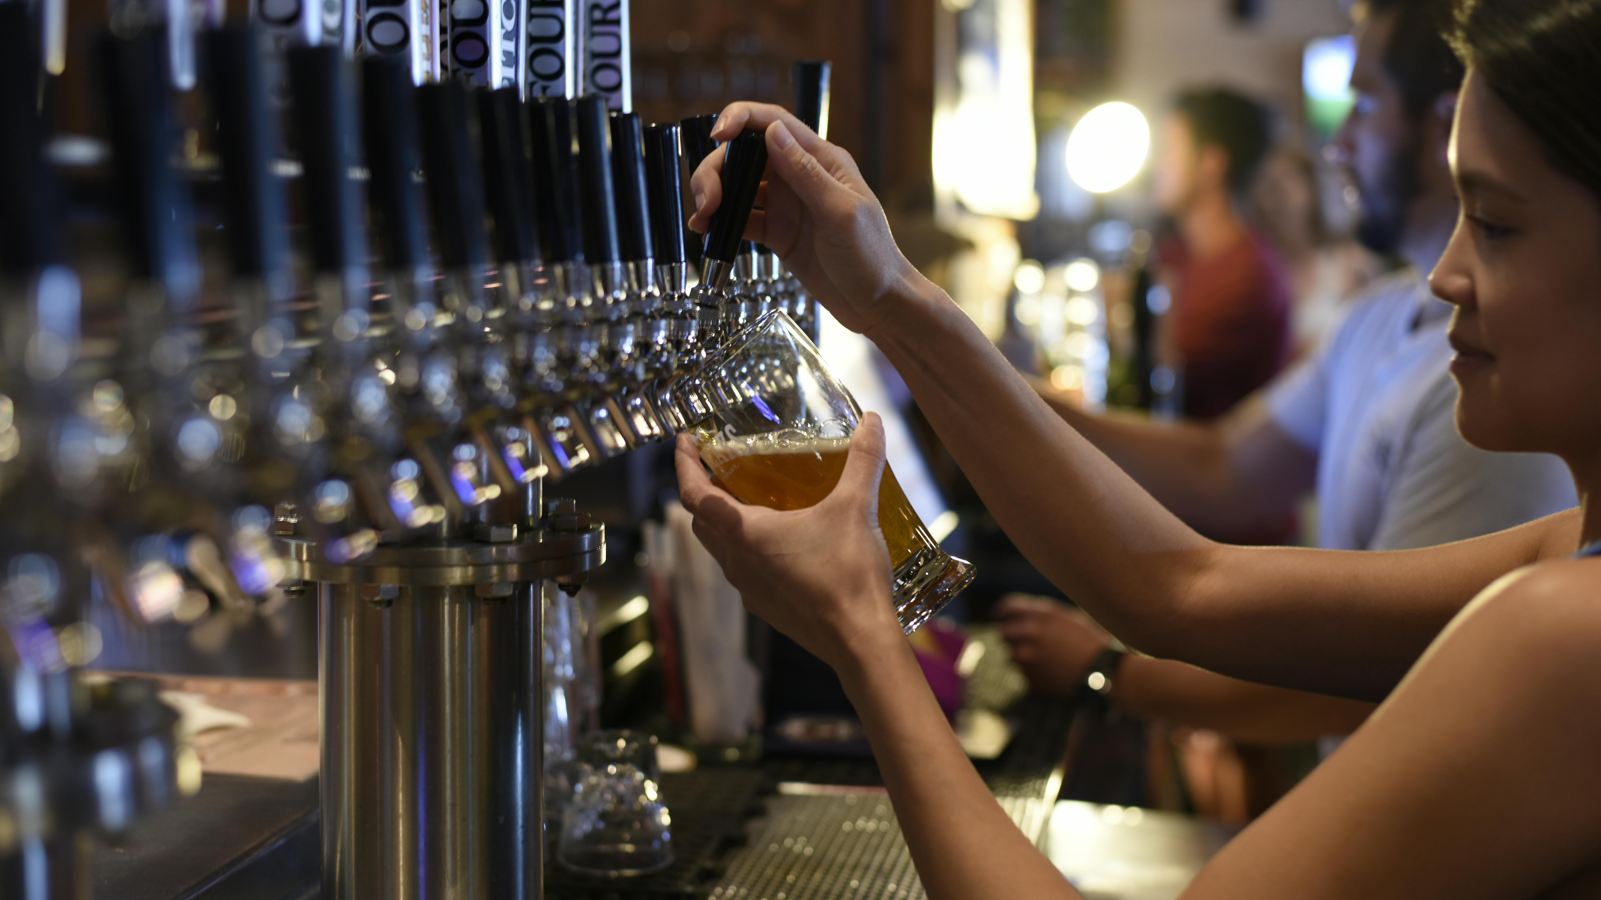
Pubs Code Adjudicator
Tied Tenants Survey 2024
Headline findings
© Ipsos | PCA Tied Tenants Survey 2024 | July 2024 | V1 | PUBLIC

Slide 2
Overview
01

Slide 3
Methodology
The Process:
Final number of interviews achieved:
1,203 tenant interviewed by phone between Jan 9th and March 13th, 2024.
Pubs invited to take part at random by Ipsos.
Quotas were placed on interviews achieved by size of pub company estate and region within.
Confidence intervals for the whole sample are approx. +/- 3 percentage points and range from +/- 5 to 8 points by pub company.
Pub company | Interviews
Admiral | 152
Marston's | 165
Punch Pubs | 134
Star Pubs & Bars | 233
Greene King | 135
Stonegate | 384
TOTAL | 1203

Slide 4
Findings at a glance (1)
Many findings consistent with 2023. Awareness of code unchanged at 78% and awareness of PCA at 55% (+1pt from 2023).
Familiarity with code rights at similar levels to 2022/ 23 – as is satisfaction when experiencing them.
Overall satisfaction with tenant relationship at 63% (+1pt from 2023), dissatisfaction at 21% (-1).
  Marstons (79%), Admiral (78%) and Greene King (77%) above average. Stonegate satisfaction the lowest (47%). Biggest movers are Star with a 9 pt year on year increase in tenant satisfaction (64%).
  BDM scores largely unchanged overall. Marstons, Admiral and Greene King tenants tend to give best scores – reflecting positive overall satisfaction scores.
  Perceptions BDMs fair in discussions has fallen back slightly from 2023 (-4 pts) but is at similar high levels to 2022 (76%) and fall is driven primarily by Stonegate tenants.
More awareness of CCO this year but performance scores fall back to 2022 levels.
Trust in the PCA’s independence has improved this year – especially in terms of being independent from pub companies (64%, +7 pts).

Slide 5
Profile of tied tenants
02

Slide 6
Profile of tied tenants – some key stats
58% male.
Almost 2/3 (65%) aged 45 or over (around one in ten aged under 35).
9 in 10 are white.
1 in 10 have a disability or long-term illness.
52% have held tenancies 10 years or more.
62% started current tenancy arrangement since code came into force.
85% single operator (2023: 88%).
Base: All tied pub tenants (1203)

Slide 7
Type of pub arrangement by pub company
S3. Is your arrangement for [PUB NAME]…
Type of arrangement | Among all | Admiral | Marston's | Punch Pubs | Star Pubs & Bars | Greene King | Stonegate (trading name of Ei Group)
A tied lease agreement | 36% | 24% | 5% | 37% | 53% | 27% | 43%
A tied tenancy | 42% | 57% | 15% | 51% | 36% | 51% | 43%
A franchise agreement | 10% | 1% | 71% | 0% | 0% | 10% | 0%
A short agreement of less than 12 months or tenancy at will | 7% | 14% | 5% | 7% | 6% | 5% | 6%
Something else | 6% | 5% | 5% | 5% | 5% | 7% | 7%
Base: All tied pub tenants (1203), Franchise includes those referring to themselves as operating under a retail agreement

Slide 8
Topline findings
03

Slide 9
Whether tenants have received information about the Pubs Code
C1. Have you ever read, seen or heard anything in relation to The Pubs Code?
% Ever read, seen or heard anything in relation to Pubs Code
80% of tenants have heard of the pubs code – a significant drop on 2023 but still at high levels.
Awareness is below 8 in 10 for tenants of Star (76%) and Stonegate (79%) but still at healthy levels overall.
2024 Survey
2023 Survey
2022 Survey
2019 Survey
2017 Survey
Base: All tied pub tenants (1203)
Statistically significantly different from previous survey

Slide 10
Awareness of the Pubs Code
C2. How aware, if at all, were you of The Pubs Code before today?
72%
68%
79%
78%
78%
NET aware
Awareness of the Pubs Code has remained stable at four in five tenants since 2022.
Base: All tied pub tenants (1203)
Statistically significantly different from previous survey

Slide 11
Where tenants have seen information about the Pubs Code
Proportion mentioning a source of information under each heading
Greene King tenants most likely to have got info from their pub company/ BDM (71%).
C3. Where have you read, seen or heard anything about The Pubs Code in the past 12 months?
Most tenants get their information from their pub company or BDM. Within this category, the most common response was from pub company emails (25%), followed by pub company website (13%) and information or advice from BDM (8%).
There was a wide variety of responses under Other for sources of information.
The most common Other sources of information were Internet/Google search (12%), other social media (5%).
Base: All tied pub tenants who have read, seen or heard anything about the Pubs Code (2023: 1010; 2024: 963)
Statistically significantly different from previous survey

Slide 12
Where tenants would go for information about the Pubs Code
Proportion mentioning a source of information under each heading
C4. If you wanted to find out some information on The Pubs Code, where would you go for this information?
Half of tenants (45%) said they would search the Internet/Google if they wanted information about the Pubs Code (under Other). This was the most common response – others sub 5%.
Pub company/ BDM was the second most common potential source of information. One in five tenants (16%) said they would go to their pub company website for information and 8% said they would go to their BDM.
There has been an increase in the proportion of tenants that say they would visit the PCA website (17%, +7pts).
Base: All tied pub tenants (2023: 1206; 2024: 1203)
Statistically significantly different from previous survey

Slide 13
Awareness of the Pubs Code Adjudicator
F1. Before today, how aware, if at all, were you of The Pubs Code Adjudicator?
Two thirds of tenants who are aware of the Pubs Code know the Pubs Code Adjudicator. This has remained stable for the past two years (66% in 2023 and 64% in 2022).
Over half of all tied tenants are aware of the PCA. This has also remained consistent since 2022 (54%).
Base: All pub tied tenants (1203), Tied tenants aware of the Pubs Code (938)

Slide 14
Tenant trust in PCA independence
F2. To what extent if at all, do you trust the PCA to…
change in % trust since 2023
+7
Trust in the PCA to be independent has improved among tenants aware of the PCA since 2023.
+5
+8
+9
Base: All tied pub tenants who were very / quite / not very aware of the PCA (970)
Statistically significantly different compared to 2023

Slide 15
Awareness and experience of code rights
04

Slide 16
Familiarity with rights
C6. Before today, how familiar, or not, would you say you were with your rights as a tenant in the following areas of The Pubs Code?
Familiar
Unfamiliar
change in % familiarity since 2023
Familiarity with rights has remained consistent since last year.
-
+1
-
+1
Base: All tenants with a tied tenancy, tied lease agreement, something else or who don’t know what their agreement is (992)

Slide 17
Satisfaction with pub company handling of Pubs Code events
C7. Overall, how satisfied or dissatisfied were you with how [PUB COMPANY] dealt with you when you did the following?
Among tenants who experienced the following events, satisfaction has stayed the same.
Satisfied
Dissatisfied
change in % satisfaction since 2023
-
+1
-4
-1
Base: All tied tenants who sought to price match the amount you pay your Pub Company for premises insurance on the open market (155), received a Rent Proposal from your Pub Company regarding a new or renewed tenancy (292), received a Rent Assessment Proposal from your Pub Company regarding an existing tenancy (252) and requested a market rent only option to go free of tie (112)

Slide 18
Tenant satisfaction with tenancy and pub company
05

Slide 19
Overall satisfaction with pub company
D3. Overall, taking everything into account, how satisfied or dissatisfied are you with your relationship with [PUB COMPANY] today?
Satisfied
Dissatisfied
change in % satisfied since 2023
Overall satisfaction has remained stable, yet Star has improved tenant satisfaction since 2023.
+1
-6
+3
+2
+9
+1
-3
Base: All tied pub tenants (1203) with Admiral (152), Marston’s (165), Punch Pubs (134), Star Pubs and Bars (233), Greene King (135), and Stonegate (384)
Statistically significantly different compared to 2023
Indicate the proportion of a sub group is statistically significantly higher or lower than the total sample

Slide 20
Satisfaction with pub company year on year
D3. Overall, taking everything into account, how satisfied or dissatisfied are you with your relationship with [PUB COMPANY] today?
2022
2023
2024
Marston’s
Admiral
Greene King
Satisfaction with Marston’s, Admiral and Greene King remains high. While Admiral has been more stable, Greene King has steadily improved over the 3 years. Star has improved 9 pts since 2023, while Punch has maintained its 2023 improvement. Stonegate has not recovered from falling last year.
Star
Punch
Stonegate
Base: All tied pub tenants (1203) with Admiral (152), Marston’s (165), Punch Pubs (134), Star Pubs and Bars (233), Greene King (135), and Stonegate (384)
Statistically significantly different compared to 2023

Slide 21
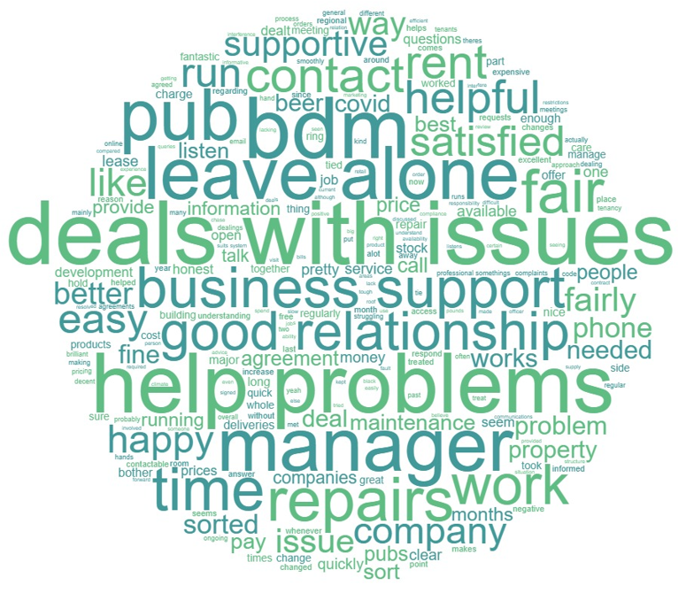
Reasons tenants are satisfied with the relationship
D.4 What are the main reasons why you are [fairly satisfied/very satisfied] with the relationship?
Good communication and relationship with BDM/ area manager
Listens and responds to issues quickly
Provides information
Fair and transparent
Gives freedom
Supportive during Covid-19 pandemic/ cost of living crisis
“I think they are fair and honest – most of that comes from the good relationship that I have with my BDM.” A tied lease agreement
“Any issues we have they are on it and quick. I am happy with that.” Multiple operator, 2-4 pubs
Base: All tied tenants who are satisfied with their relationship at D3 (756)

Slide 22
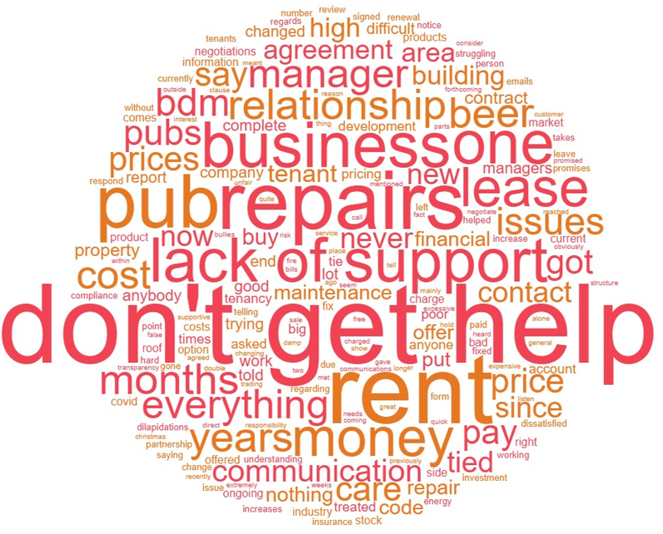
Reasons tenants are dissatisfied with the relationship
D.4 What are the main reasons why you are [fairly dissatisfied/very dissatisfied] with the relationship?
High/ increasing prices (e.g. rent and tied alcohol)
Lack of support/ one-sided relationship
Little to no contact with BDM
Slow repairs/ disputes with repairs and dilapidations schedules
Lack of stock to order and issues with deliveries
Lack of transparency and communication around changes
“I don't know who my BDM is, they don't get back in touch with me…no one talks to me, but they charge for everything and still do it wrong.” A tied tenancy
“Their failure to repair and maintain the building. The irregular and limited supply, the huge price increases during the crises, and they just want to sell high profit mainstream products.” A tied lease agreement
Base: All tied tenants who are dissatisfied with their relationship at D3 (257)

Slide 23
Satisfaction with type of tenancy agreement
G4. Overall, how satisfied or dissatisfied are you with the type of tenancy arrangement you chose for your pub?
Satisfied
Dissatisfied
change in % satisfied since 2023
As 2023, tenants with a tied lease agreement are least satisfied (61%), while those with an Other type of agreement (mainly Marston’s / franchise) are most satisfied (75%).
+6
+4
+5
+6
+11
+1
+4
Base: All tied tenants who knew their type of agreement (1184), Admiral (151), Marston’s (163), Punch Pubs (134), Star Pubs & Bars (228), Greene King (130), Stonegate (378)
Statistically significantly different compared to 2023
Indicate the proportion of a sub group is statistically significantly higher or lower than the total sample

Slide 24
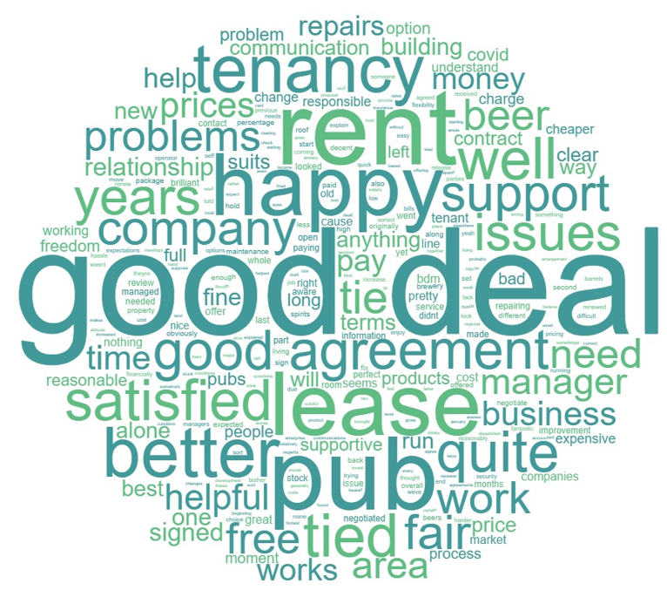
Reasons tenants are happy with their type of agreement
G5. And why do you say that?
Terms of agreement are fair and transparent/ sticks to the agreement
Good negotiation (on rent, repairs)/ mutually beneficial
Good communication with area manager/ BDM
Flexibility to go free of tie on some menu items, choice of alcohol
Investment in the pub
Makes money/ happy with % of the turnover (franchise agreement)
Happy company covers the rent/ bills/ utilities (franchise agreement)
“The information is very clear and you operate upon that, there are no surprises and I am very happy.” A tied tenancy
“[The] BDM is very supportive, the framework is clear in relation to managing repairs and the condition of the building.” A tied lease agreement
Base: Tied tenants who know their type of tenancy and are satisfied with their tenancy at G4 (805)

Slide 25
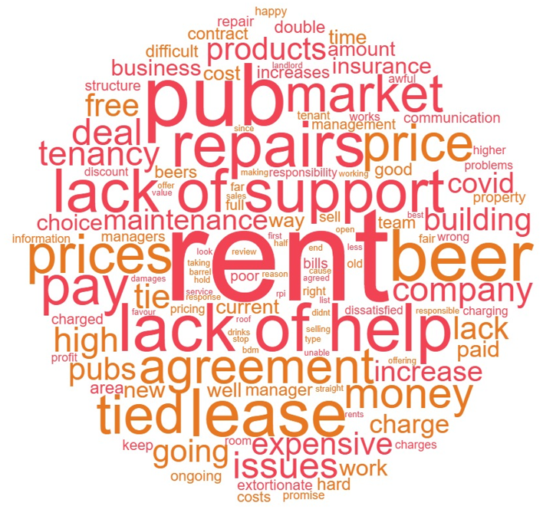
Reasons tenants are unhappy with their type of agreement
G5. And why do you say that?
High/ increasing prices (rent, tied products etc.)
Self-repairing lease issues/ disputes over responsibility for repairs and dilapidations
Slow to make repairs/ late paying for repairs
Lack of support/ difficult to contact
Lack of transparency (do not inform on changes, not following through with investment promises, hidden charges)
Inflexible (negotiating contracts, what drinks they can sell)
Slow to renew agreements
“The rents are far too high, we are paying too much for bills and they don't care about you considering the current economic climate, they are not helping at all.” A tied lease
“For the amount of rent they charge [and] the amount of repairs I have to do.” A tied tenancy
Base: Tied tenants who know their type of tenancy and are dissatisfied with their tenancy at G4 (202)

Slide 26
Relationship with pub company
06

Slide 27
Awareness of business development manager and code compliance officer
D1/D2. To what extent, if at all, do you agree or disagree with the following statements about your business development manager/Code Compliance officer?
Tenants were asked a series of statements about their business development manager (BDM) and Code Compliance Officer (CCO) and those that responded that they did not know who their BDM/CCO was were excluded from the base. The proportions of tenants not aware of their BDM or CCO are displayed below.
There has been a significant uplift in tenant awareness of who their CCO is – from 25% in 2023 to 39% this year.
Awareness still highest for Greene King (48%) but now others are catching up e.g. Marstons (44%).
Aware of BDM
Not aware of BDM
Aware of CCO
Not aware of CCO
Base: All tied pub tenants (1203)
Statistically significantly different compared to 2023

Slide 28
Tenant ratings of business development manager
D1. To what extent, if at all, do you agree or disagree with the following statements about your business development manager?
Agree
Disagree
change in %
agree since 2023
-4
Overall tenants are slightly less likely to think their BDM is fair with them in discussions compared to 2023, however this remains high at around three in four tenants.
+1
-3
N/A
+2
Satisfaction with how repairs are handled is up 7 pts to 49% if feedback from Stonegate tenants is removed.
+2
+3
Base: All tied pub tenants who knew who their business development manager was (1181).
**They provide me with the information I need about dilapidations at my pub not asked of franchises. All (1,157).
*wording changed between 2023 and 2024 from “I am happy with the way they manage repairs and/or dilapidations at my pub”
Statistically significantly different compared to 2023

Slide 29
BDM fairness in discussions
D1. To what extent, if at all, do you agree or disagree with the following statements about your business development manager?
% Agree that their BDM is fair with them in their discussions
Base: All tied pub tenants that knew who their BDM was: Admiral (151), Marston’s (165), Punch Pubs (130), Star Pubs and Bars (228), Greene King (134) and Stonegate (373)
Indicate the proportion of a sub group is statistically significantly higher or lower than the total sample
Statistically significantly different compared to 2023

Slide 30
BDM ongoing business support
D1. To what extent, if at all, do you agree or disagree with the following statements about your business development manager?
% Agree their BDM supplies the business planning support they need on an ongoing basis
Base: All tied pub tenants that knew who their BDM was: Admiral (151), Marston’s (165), Punch Pubs (130), Star Pubs and Bars (228), Greene King (134) and Stonegate (373)
Indicate the proportion of a sub group is statistically significantly higher or lower than the total sample

Slide 31
BDM management of repairs
D1. To what extent, if at all, do you agree or disagree with the following statements about your business development manager?
% Agree they are happy with the way their BDM manages repairs their pub*
Admiral and Star tenants are happier with how their BDM manages repairs at their pub compared to 2023 – though wording change should be noted.
Base: All tied pub tenants that knew who their BDM was: Admiral (151), Marston’s (165), Punch Pubs (130), Star Pubs and Bars (228), Greene King (134) and Stonegate (373) *wording changed between 2023 and 2024 from “I am happy with the way they manage repairs and/or dilapidations at my pub
Statistically significantly different compared to 2023
Indicate the proportion of a sub group is statistically significantly higher or lower than the total sample

Slide 32
Reasons tenants are happy with how repairs are managed
D1A. Earlier you said you strongly / tend to agree that you are happy with the way your business development manager manages repairs at your pub. Why did you say that?
Reason | Quote
Repairs are done quickly | “Repairs are either completed or passed on to someone within 72 hours, which is the longest I have had to wait, the shortest was 24 hours”.
BDM helps push requests through | “When something goes wrong, they make it clear who is responsible. They make sure it is quick and if it is not fixed, they chase it up.”
BDM listens to problems/ has regular meetings to discuss repairs | “Because like I said, she's very fair…we have good meetings and she listens to what I have to say.”
BDM is approachable/ understanding/ easy to contact | “Anything you say to him is done immediately. He is always contactable, He is willing to pop in and see you so you can see him face to face and I can email him at any time. He is very easy to get in touch with.”
BDM gives information on who to contact/ what is tenant’s responsibility | “I can go to him with a repair and he can give information on whether it's covered by the lease agreement. He helped liaise with [the pub company for] cheaper alternatives.
Base: All tied tenants who knew who their business development manager was and agree they are happy with the way their BDM manages repairs at their pub at D1 (481)

Slide 33
Reasons tenants are unhappy with how repairs are managed
D1A. Earlier you said you strongly / tend to disagree that you are happy with the way your business development manager manages repairs at your pub. Why did you say that?
Reason | Quote
Repairs are slow | “We’ve had a lot of repair issues and have been waiting several months to be sorted. Which is down to the business manager, it’s his responsibility.”
BDM does not have enough power/ tenants need to use difficult system or portal | “It's not down to them. The BDM is good but the repairs through Head Office are absolutely useless.”
Admin / website problems | “We have ongoing issues that the BDM cannot deal with because of the [pub company] property reporting system. You have to raise a ticket on the website portal and nobody responds to you.”
BDM does not get involved or help to push requests forward | “He’s not chasing up what we asked to be done and he is not checking up on us.”
BDM is difficult to contact | “They give the area managers too many pubs and they can't concentrate on the personal stuff [like] the little details. You feel like they haven't got time for you”.
Lack of information/ advice from BDM | “He does not communicate, no advice, it is a waste of meeting with him.”
Base: All tied tenants who knew who their business development manager was and disagree they are happy with the way their BDM manages repairs at their pub at D1 (478)

Slide 34
BDM provision of information about dilapidations
D1. To what extent, if at all, do you agree or disagree with the following statements about your business development manager?
% Agree their BDM supplied them with information about dilapidations
Base: All tied pub tenants that knew who their BDM was and no franchise: Admiral (150), Marston’s (159), Punch Pubs (129), Star Pubs and Bars (227), Greene King (121) and Stonegate (371)
Indicate the proportion of a sub group is statistically significantly higher or lower than the total sample

Slide 35
Tenant ratings of code compliance officer
D2. And thinking now about your Code Compliance Officer, to what extent, if at all, do you agree or disagree with the following statements about the Code Compliance Officer?
Agree
Disagree
change in % agree since 2023
-11
-9
-5
-8
Base: All tied pub tenants who knew who their code compliance officer was (479)
Statistically significantly different compared to 2023

Slide 36
Tenant ratings of code compliance officer year on year
D2. And thinking now about your Code Compliance Officer, to what extent, if at all, do you agree or disagree with the following statements about the Code Compliance Officer?
2022
2023
2024
I know how to contact my Code Compliance Officer
I have all the information I need about their role
As awareness of who their CCO is has increased, scores have fallen, though in most cases only to 2022 levels.
They provide me with the information and advice I need about the Pubs Code
I have confidence in how my Code Compliance Officer handles issues related
to The Pubs Code
Base: All tied pub tenants who knew who their code compliance officer was (479)
Statistically significantly different compared to 2023

Slide 37
Information received by new tenants
07

Slide 38
What information new tenants remember receiving before starting
G7. What, if any, of the following information do you remember receiving from [PUB COMPANY] BEFORE your tenancy started?
Up from 44% last year
Base: All tied pub tenants who started their tenancy after 21st July 2016 (746)
Statistically significantly different compared to 2023

Slide 39
How useful tenants found information before starting tenancy
G8. And how useful or not did you find the information you received from [PUB COMPANY] before your tenancy started?
Newer tenants found info received before tenancy more useful
Marston’s and Greene King tenants found info most useful vs other pub tenants – Stonegate tenants least so.
Those with tied lease agreements were less likely to find the information they received useful (74%) than other tenant types.
Base: All tied pub tenants who started their tenancy after 21st July 2016 (746), tenants who started between 2022 and 2024 (313)
Indicate the proportion of a sub group is statistically significantly higher or lower than the total sample

Slide 40
How useful tenants found their sustainable business plan
G9. How useful, or not, do you find your sustainable business plan in managing your tenancy?
Newer tenants found sustainable business plan more useful
Marston’s and Greene King tenants found sustainable business plan most useful vs other pub tenants – Stonegate tenants less so.
Base: All tied pub tenants who started their tenancy after 21st July 2016 (746), tenants who started between 2022 and 2024 (313)
Indicate the proportion of a sub group is statistically significantly higher or lower than the total sample

Slide 41
In closing…
08

Slide 42
What have we learned?
Almost 8 in 10 tenants aware of the Pubs Code and majority of tenants aware of PCA.
Just over 6 in 10 tenants are satisfied with the relationship with their pub company – with tenants of Marstons, Admiral and Greene King the most satisfied. Positive relationships are typified by transparent, open business relationships and strong business support.
One in five tenants are dissatisfied with the relationship, with satisfaction levels amongst Stonegate tenants dragging the overall average down. Poor communications / lack of support key reasons for dissatisfaction.
Handling of repairs remains a key concern for many tenants. Slow, bureaucratic processes blamed for dissatisfaction as is a lack of communication. Scores by pub company closely mirror the pattern of overall satisfaction.
Some evidence that trust in the PCA’s independence has improved this year – especially in terms of being independent from pub companies themselves.

Slide 43
Final thoughts…
Results continue to suggest link between positive Code interactions and tenant satisfaction.
Relative POB rankings and movement consistent over many metrics.
Tenant satisfaction relating to repairs shows signs of movement for some POBs.
  What are pub companies doing to understand and improve tenant experience in this area?
Is Code compliance sufficiently resourced?
Compliance is a minimum. Can the industry work together to share best practice and how?

Slide 44
Ipsos
Pubs Code Adjudicator
Tied Tenants Survey 2024 – Toplines
For more information
Keiran Pedley
Research Director
Keiran.pedley@Ipsos.com

