Slide 1
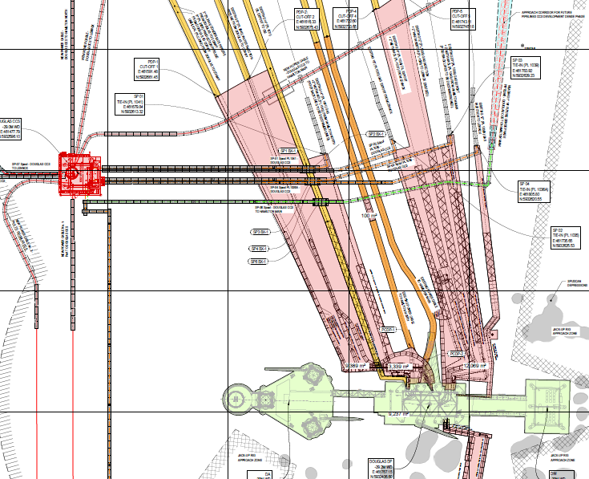
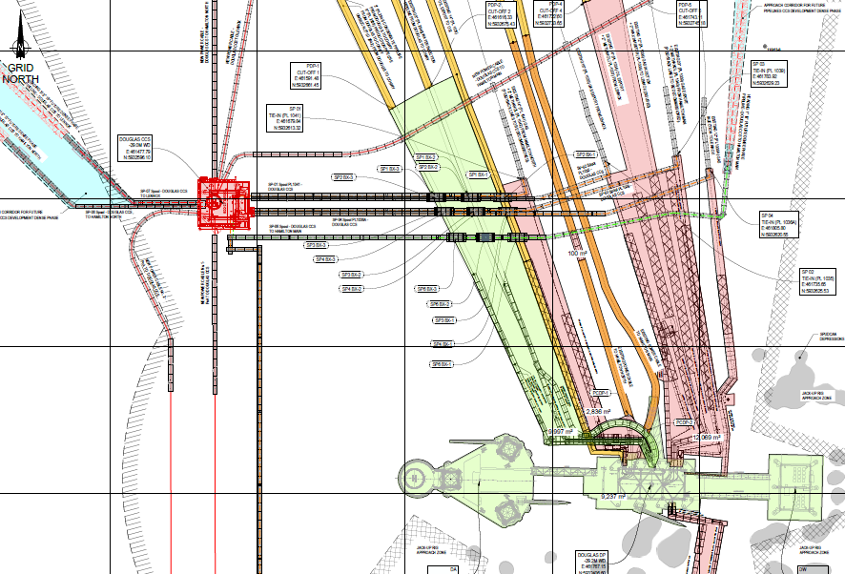
8” PL2939
3” PL2941
POWER CABLE PL6424
POWER CABLE PL6423
16” PL1035
8” PL2940
14” PL1034 + 2” PL1037
NEW DOUGLAS CCS
12” PL1036 + 2” PL1038
14” PL1031
20” PL1039 + 2” PL1040
14” PL1041 + 2” PL1042
FUTURE PIPELINE CORRIDOR FOR CCS
12” PL1036A
FUTURE SPOOLS FOR CCS
SSBV CONTROL UMBILICAL
PLU6445
NEW POWER CABLES FOR CCS
CONTROL
UMBILICAL
PLU2942
DOUGLAS COMPLEX
3” PL1032
20” PL1030
3” PL1033

Slide 2
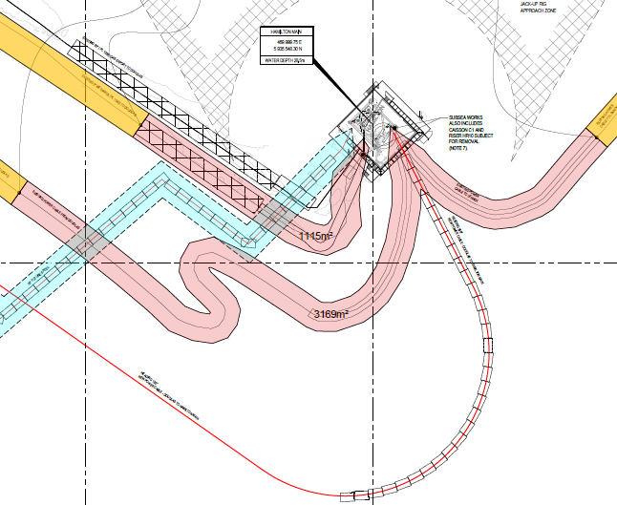
HAMILTON PLATFORM
20” PL1039
2” PL1040
POWER CABLE PL6426
FUTURE PIPELINE FOR CCS
POWER CABLE PL6424
FUTURE POWER CABLE FOR CCS

Slide 3
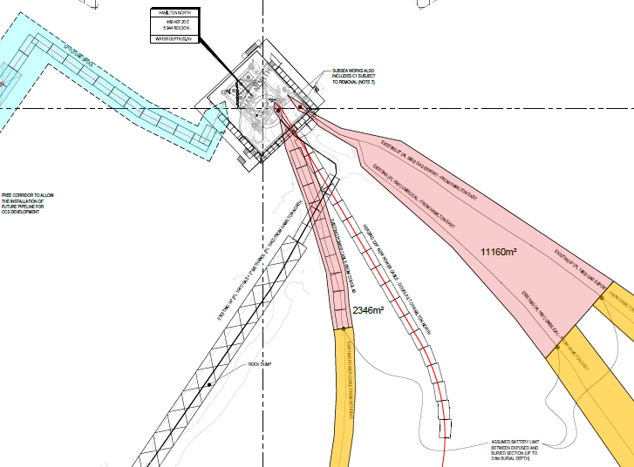
HAMILTON NORTH PLATFORM
FUTURE PIPELINE FOR CCS
8” PL1860
14” PL1041 + 2” PL1042
8” PLU1861
POWER CABLE PL6423
FUTURE POWER CABLE FOR CCS

Slide 4
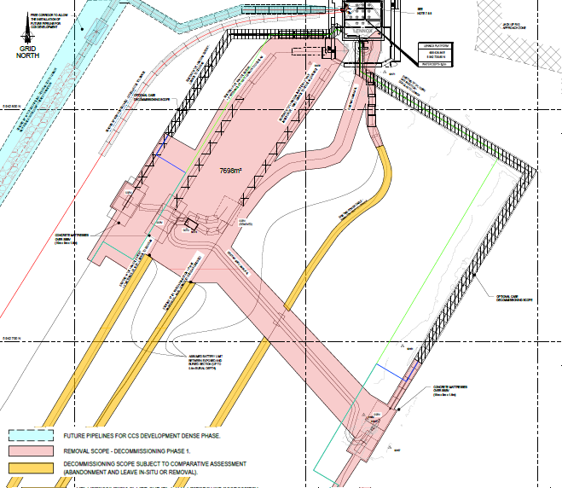
LENNOX PLATFORM
FUTURE PIPELINE FOR CCS
16” PL1035
FUTURE POWER CABLE FOR CCS
14” PL1034 + 2” PL1037
12” PL1036 + 2” PL1038
SSBV TO BE RE-USED
SSBV CONTROL UMBILICAL
PLU6438
SSBV CONTROL UMBILICAL
PLU6437
PL1036A
SSBV TO BE REMOVED
POWER CABLE PL6426
SSBV CONTROL UMBILICAL
PLU6435
SUTU
SSBV CONTROL UMBILICAL
PLU6436
SSBV TO BE RE-USED

