Slide 1
Single-source contracting with the MOD: demystifying the Single-Source Regulatory Framework
Introduction by: John Russell - Chief Executive, SSRO
17 July 2024
Notes:
Image: The UK has completed its 11th airdrop into Gaza today (09/05/24), reaching the milestone of over 100 tonnes of life-saving aid delivered by air. Over the course of 11 Royal Air Force flights, the UK has delivered ready-to-eat meals, water, rice, tinned goods and flour, with a total of 12 tonnes dropped into Northern Gaza today. The UK began conducting airdrops in late March, as part of the Jordanian international initiative. The Royal Air Force has used A400Ms, flying from Amman, Jordan, where aid pallets attached to parachutes are collected and loaded by RAF and British Army personnel. The aid is dropped along the northern coastline of Gaza, with drop zones regularly surveyed to ensure civilians are not harmed. Each flight takes around one hour and British personnel work closely with the Royal Jordanian Air Force to plan and conduct each mission.

Slide 2
Introduction by John Russell
SSRO role
The SSRO plays a vital role in helping the Government to ensure that good value for money is obtained for the UK taxpayer, and that suppliers are paid a fair and reasonable price
Size of the regulatory framework
The contracts we regulate equal roughly half of all UK defence spending each year on equipment and support (£102 billion in the regime since 2015)
Global challenges
Volatile and challenging international environment: the SSRO can play a full and effective role in enabling swift and efficient delivery of defence capabilities that also enhance UK industrial resilience
Support
We want to further support the effective use of the single source procurement framework by industry and the MOD
In common with many countries that have a defence industry the UK has strict rules about how Single Source Contracts must be priced

Slide 3
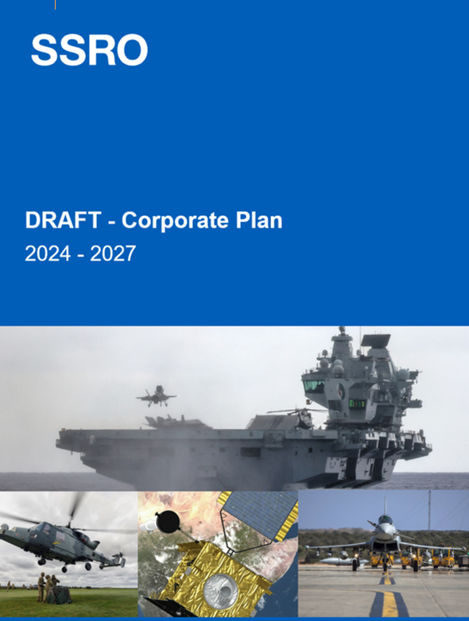
Four strategic themes for the SSRO
Four areas of strategic focus
Relevance
Visibility
Accessibility
Trust
One of our core objectives looks at how we engage with our stakeholders
We work collaboratively with industry and the MOD
We’re here and want to build on our good relationship with ADS!

Slide 4
How do these strategic themes translate into practice?
Out on the ground meeting stakeholdersand speaking at industry & MOD conferences
Making it easier to upload data and driving better insight from it
Assisting in solving contract disputes: offering advice and support and publishing our findings
Making our guidance and webpages easy to use
Our training offer: tailored to user need
Stakeholder Teach Ins & to support Procurement Act and new guidance
All contribute to increasing our visibility, accessibility, relevance and trust among stakeholders

Slide 5
Single-source contracting with the MOD: demystifying the Single-Source Regulatory Framework
Presentation by:
Joanne Watts - Chief Regulatory Officer, SSRO
Charly Wason - Single Source Contract Regulations Review Team (Head), Ministry of Defence
Notes:
Image description (07/05/24): A Soldier guides a Warrior Mechanised Combat Vehicle over a bridge on Drawsko Pomorskie Training Area during a training exercise on Ex STEADFAST DEFENDER, Poland. Exercise Steadfast Defender 2024, the largest NATO deployment of its kind in a generation, is a programme of exercises designed to train and demonstrate the Alliance’s ability to reinforce continental Europe via movement of forces from the United Kingdom, Europe and the United States. This demonstrates the ability to move soldiers, their vehicles and equipment quickly across thousands of miles to enable the defence of NATO territory. The UK plays a leading role in NATO and this exercise is about demonstrating the British Army's ability to operate and fight, including providing leadership and operating well with partners from across the alliance. In turn this demonstrates the importance of NATO to the security resilience of the UK. As part of Exercise Steadfast Defender, the British Army’s 12th Armoured Brigade Combat Team (ABCT) are conducting Exercise Immediate Response, alongside NATO allies as the Lead Armoured Brigade Combat Team, with 4-10 (US) Cavalry Squadron from the 4th (US) Infantry Division. The US forces are integrated into the Brigade and working alongside Battle Groups formed from 1st Battalion The Royal Welsh and 1st Battalion The Mercian Regiment. The exercise provides opportunities for learning between allies and as a leading member of NATO, Exercise Immediate Response is just one example of the UK’s leadership, readiness and confidence as a global force, alongside partner forces across the Alliance.

Slide 6
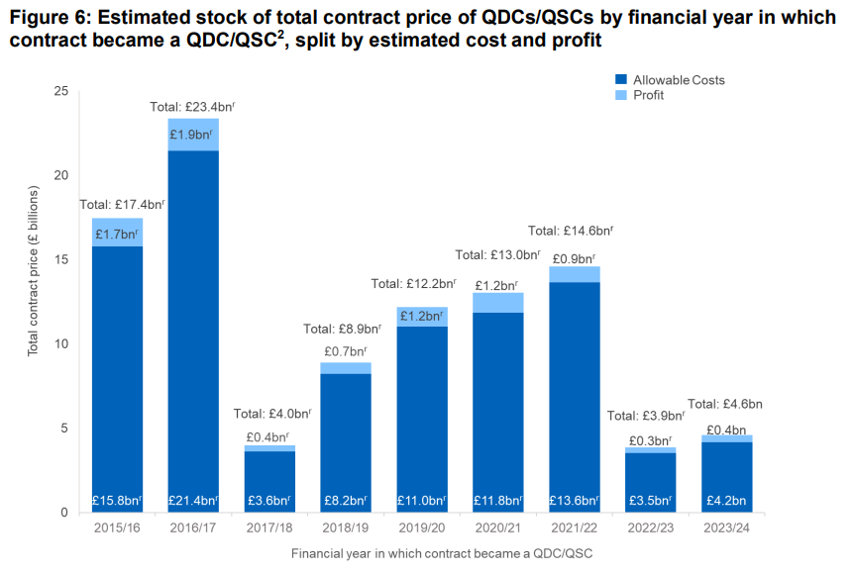
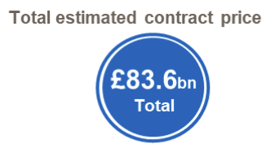
SSRO established by the Defence Reform Act and Single Source Contract Regulations 2014
Legislation introduced in 2014
Regulatory framework with controls on prices of qualifying contracts and transparency
As of 30 April 2024: 615 single source contracts, with an estimated price c.£102 billion
The SSRO publishes statistical bulletins regularly
£102 billion
Source: Annual qualifying defence contract statistics 2023/24 (https://www.gov.uk/government/publications/annual-qualifying-defence-contract-statistics-202324)
Published 9 July 2024.

Slide 7
The SSRO is notified of Qualifying Defence Contracts (QDC) and Qualifying Sub-Contracts (QSC)
What is a QDC?
A QSC is a non-competitive contract between a primary contractor and another contractor or between a sub-contractor and another contractor (minimum value £25 million)**
There are exceptions which are set out in Regulation 7 (for example, contracts with foreign governments) or Secretary of State exemption.
A QDC is a contract made by the Secretary of State for goods, works or services for defence purposes from a ‘primary contractor’. The award of the contract is not the result of a competitive process, and the value of the contract is equal to or greater than £5 million*
*Section 14(2) of the DRA provides the full definition of a QDC
**Section 28(2) of the DRA provides the full definition of a QSC

Slide 8
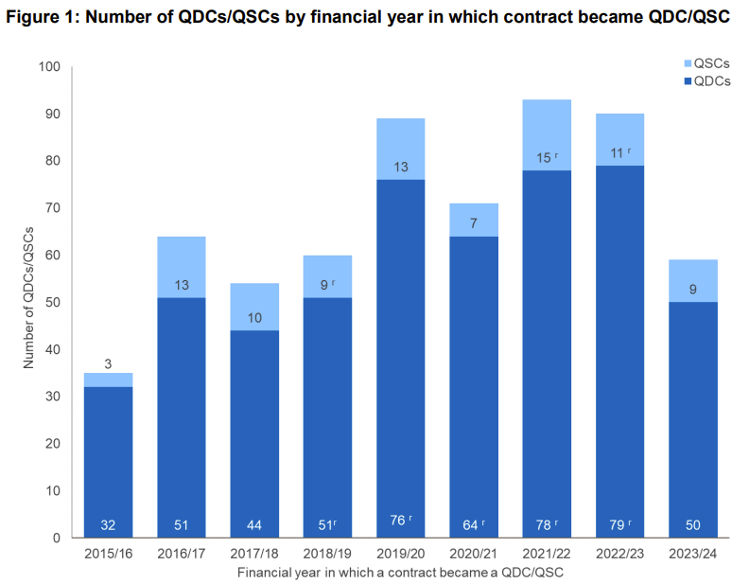
As of 30 April 2024, 525 contracts became QDCs and 90 became QSCs
Myth Buster
“The regime mostly applies to the prime defence companies…few SMEs are subject to the regulatory framework”
31 of the 615 QDCs/QSCs were with contracting companies that identified as a small or medium enterprise (SME).
Source: Annual qualifying defence contract statistics 2023/24 (https://www.gov.uk/government/publications/annual-qualifying-defence-contract-statistics-202324). Published 9 July 2024.

Slide 9
The formal relationship between the SSRO and MOD is set by the Defence Reform Act and SSRO Framework Document
Contractors with QDCs
SSRO *
(c40 people, c£6m budget)
MOD SSCR Review Team (oversee the legislation)
MOD Performance & Scrutiny Team (ensures that MOD meets it obligations)
* The SSRO is sponsored by the MOD’s Directorate of Sponsorship and Organisational Policy (DSOP)
Sub-contractors with QSCs
MOD Delivery Teams (manage individual or multiple QDCs)
Myth Buster
“The regulatory framework means that contracting takes longer”.
The regulations require that contractors demonstrate costs charged to a contract are reasonable and the profit fair. The MOD would usually require this information in any case.
The framework requires transparency on the part of defence contractors regarding prices. Larger suppliers may have to provide details about their strategic operations – again likely requirement in competitive bidding.

Slide 10
MOD role in regulatory framework
The MOD periodically puts legislation to Parliament to update the regime to ensure that it’s delivering the policy intent.
Specialist teams in MOD Head Office set the standards for implementation of the SSCRs across MOD and ensure MOD’s obligations under the legislation are met.
The SSCR Casework team provides advice to delivery teams on the SSCRS and MOD policy. They deal with around 200 complex queries a year and a further 600 that are quickly resolved without needing formal tracking.
The SSCR Compliance & Data team ensures that the reporting obligations are complied with, and that the MOD properly exploits the reported data.
The SSCR Review Team is responsible for reviewing the existing legislation and updating it where necessary

Slide 11
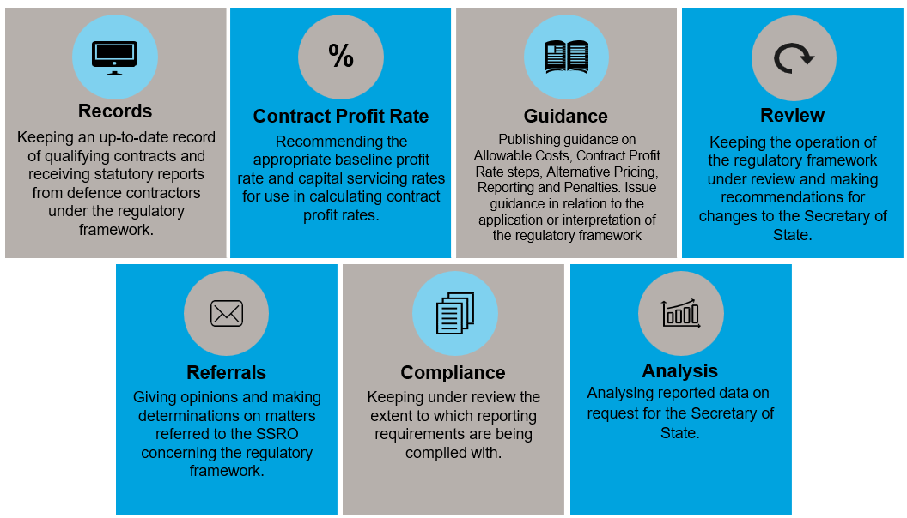
The SSRO has a range of functions to support the regulatory framework
Myth Buster
“The SSRO is not impartial and always sides with the MOD”
The SSRO is an arms’ length body, has its own budget / Board. The MOD is not involved in SSRO day-to-day operations. The SSRO has ruled against the MOD on several occasions.

Slide 12
The SSRO Support offering to you
We are here to help you
There is a comprehensive SSRO Support offering
Q&A document receives good feedback and is a helpful reference source (https://www.gov.uk/government/publications/responses-to-commonly-asked-questions)
Encourage you to make early contact if you are to become subject to the regime
The SSRO is looking to engage with you in your forums – please do invite us if we can help!
SSRO Support
Helpdesk
Onboarding
Training
Website
Engagement
helpdesk@ssro.gov.uk or 020 3771 4785

Slide 13
Support from the MOD
Myth Buster
“The MOD can be inconsistent in the way it applies the SSCRs”
There are central bodies within the MOD who oversee use of SSCRs to ensure consistency of use.
If you think this is not the case, please do let us know – your Delivery Team will be able to direct you.
The MOD teams provide support to delivery teams rather than suppliers.
If you think that your delivery teams are not applying the rules correctly, you can get in touch with the SSCR casework team.
They will then form a view, and liaise with the delivery team. They may be involved in any subsequent discussions.
The SSCR Casework team are also the MOD lead on referrals. They will usually attend any oral hearings, and may take overall lead from the delivery team.

Slide 14
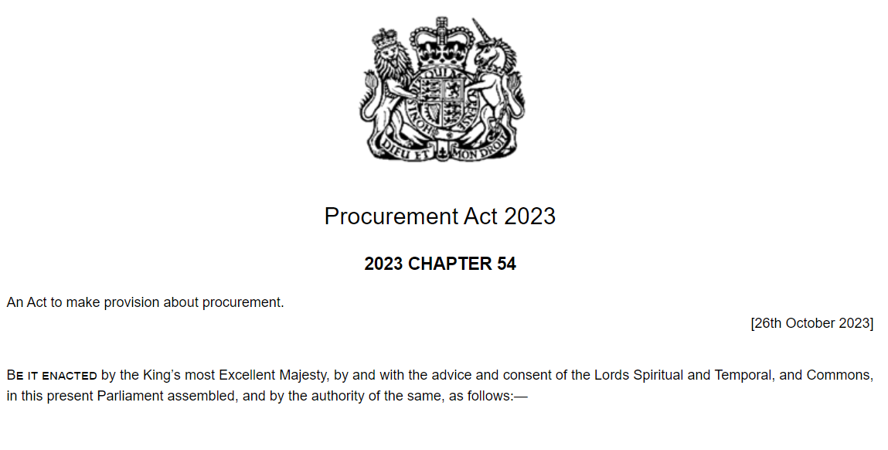
Updates to the Single Source Contract Regulations
Considerable changes to the existing regulatory framework
Two steps removed from the contract profit rate calculation resulting in 4 not 6 steps
Flexibility introduced through use of alternative pricing methods of contracts; as well as introduction of componentisation
The SSRO is supporting industry and the MOD through these changes: Teach-In sessions; updating guidance; and training
Myth Buster
“The legislation and Regulations have been developed in isolation”.
MOD has led development alongside stakeholder engagement.
The legislation has been changed to solve procurement problems that existed – as reported by industry and MOD end users

Slide 15
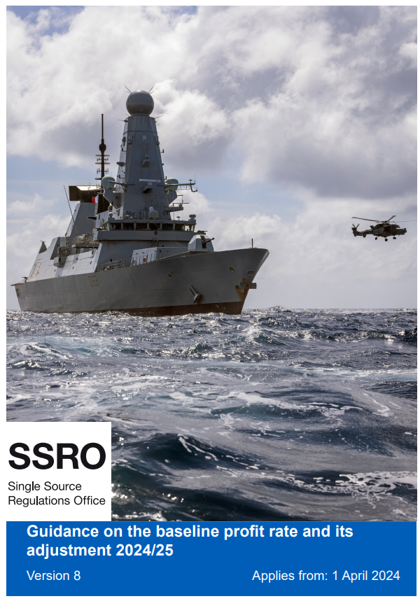
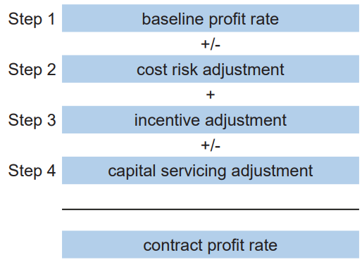
Pricing QDCs
The Defence Reform Act and the Single Source Contract Regulations require that the price payable under a qualifying contract be EITHER determined in accordance with the formula:
OR in limited cases the price can be determined using prescribed alternative pricing methods as set out in the Regulations: e.g. with reference to a previously agreed price or commercially priced items.
(Contract profit rate x Allowable Costs) + Allowable Costs
Myth Buster
“Single sourcing and the SSCRs = difficult & laborious contracting”
Competitive contracting must also be priced – this is not single source specific.
The SSCR can be tailored: just ensure a fair price and have regard to SSRO guidance
The Defence Reform Act specifies a four-step process to determine the contract profit rate for qualifying defence contracts:
SSRO guidance on the baseline profit rate and its adjustment can be found here.

Slide 16
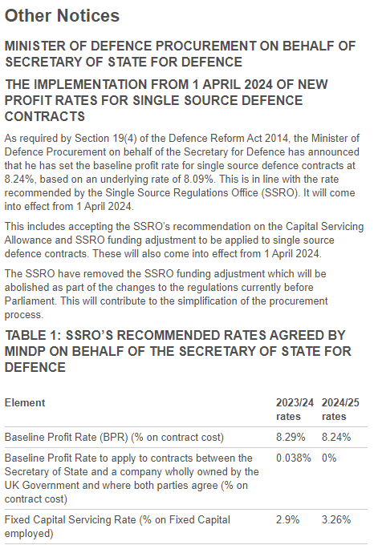
Baseline Profit Rate
The baseline profit rate is applied to QDCs and QSCs
The SSRO recommends the baseline profit rate to the Secretary of State on an annual basis
Alongside the rate, the SSRO publishes information on the methodology for calculating the rate, and provides information to aid those who may wish to scrutinise or replicate the approach taken
The SSRO is confident that the methodology is correct and robust
The rate for 2024/25 is 8.24 per cent
Myth Buster
“The profit rate is inflexible and stops contracting freedom”.
BPR is not the CPR!
Your capital investment: Capital Servicing Adjustment
Risk rewarded: Cost Risk Adjustment ADS members did not support the idea of increasing the available range when the MOD floated it in 2022.
Our recommendation for 2024/25 can be found here:
https://www.gov.uk/government/news/2024-contract-profit-rate

Slide 17
Myth Buster
“Can’t make good level of profit through single sourcing”
The evidence does not point to companies with significant exposure to the regulatory framework performing financially poorer than their peers.
Overheads are an Allowable Cost - if AAR
Baseline profit rate approach and methodology
Objective
OECD: Transfer Pricing principles
Replicable
Reliable
Actual profit on actual cost
IFRS / GAAP numbers
Predictable
Stable approach
3 year rolling average
Calibrated
Stakeholder feedback (including QA of accounting data)
Completed contracts
Company selection process
Databases:
Orbis, Bloomberg,
Bank of England
Active
companies
Limited liability companies
Latest year of accounts
Consolidated accounts
Independence
Geographic location
Turnover
Operating Profit
Assets / liabilities
Functions
NACE code
Text terms
Activities
MOD supplier
lists
Defence
keyword
Average
Automated search
Manual review

Slide 18
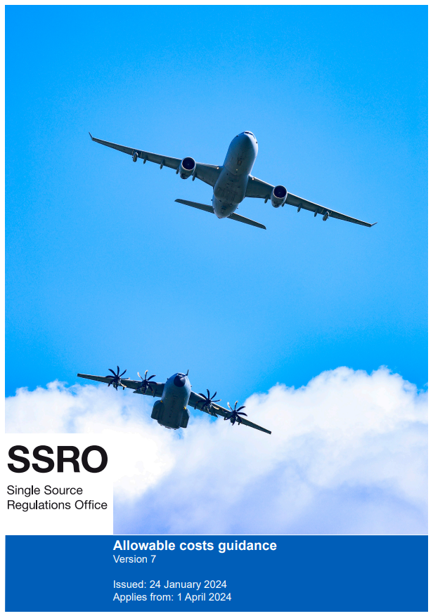
Allowable Costs
Myth Buster
“You can’t charge the MOD for bid costs”.
Bid costs, if AAR and agreed, are allowable.
Allowable Costs make up the majority of the contract price
Costs must be appropriate, attributable to the contract, and reasonable in the circumstances to be an Allowable Cost
The contracting parties must have regard to the SSRO guidance in determining whether costs are Allowable Costs
Current guidance (v7) applies from 1 April 2024 https://assets.publishing.service.gov.uk/media/665f11ea16cf36f4d63ebddc/Allowable_Costs_guidance_Version_7_4_June.pdf
AAR Test
Appropriate
Attributable to the contract
Reasonable
in the circumstances
Myth Buster
“The guidance only applies to the contractor and not the MOD”.
The MOD is bound by the guidance as much as the contractor.

Slide 19
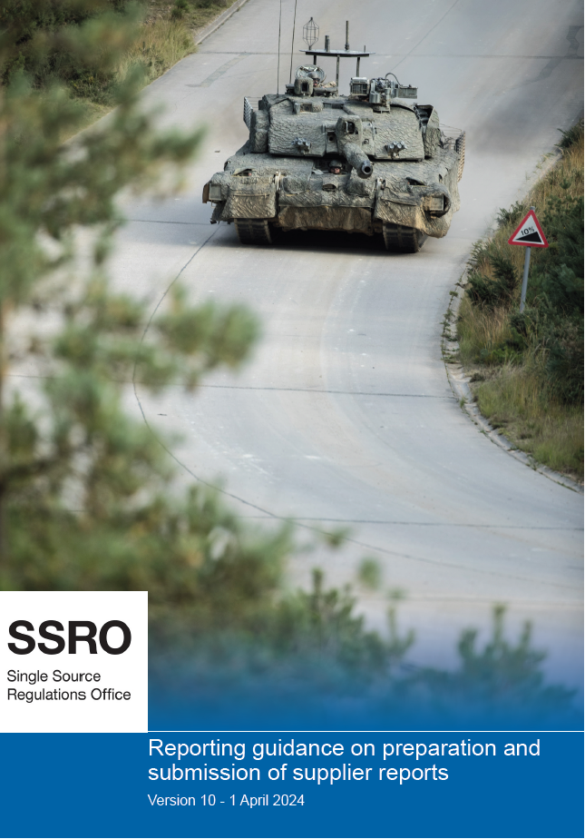
Myth Buster
“Nothing is done with the data that is collected under the regime”
The SSRO uses it to undertake analysis and provide the MOD with MI to inform their procurement. The MOD also uses the data for a wide range of purposes.
Our reporting guidance is three documents
The most recent reporting guidance update was published on 20 March 2024.
Guidance is built into DefCARS via use of links on each page to take users to the relevant section and is sent to new users.
The guidance was developed in parallel with the system and will continue to be updated in line with future system developments
The SSRO seeks and captures views of stakeholders and users of DefCARS through the Reporting and IT Sub-Group of the SSRO’s Operational Working Group.
Contract reports
Supplier reports
DefCARS functionality

Slide 20
The SSRO is empowered to give opinions or make determinations on matters referred to it by the contractors or the MOD
The legislation identifies:
the range of matters that may be referred
who may refer them
the circumstances in which referrals may be made
whether the SSRO may or must provide an opinion or determination
Referrals can:
make legally binding changes to the price of an existing contract.
support the agreement of contract prices that are VFM as well as fair and reasonable
help to resolve disagreements on individual contracts
clarify how the regulatory framework should be applied
generate insights that inform subsequent improvements in the regulatory framework
Referral investigations are funded on a case-by-case basis
Myth Buster
“Referrals are complex”.
Referrals can help resolve complex contract issues.
The SSRO offers pre-referral support and is continuing to enhance the services in this area
(see next slide on Non Referral Advice Service)

Slide 21
We have launched a new ‘Non-referral advice service’ for complex contract-specific queries that cannot be dealt with by the SSRO Helpdesk or are inappropriate for referral
Responsive services
Myth Buster
“Referrals are time intensive”.
NRAS aim to help speed up contract negotiations and enable the parties to qualifying contracts to resolve disagreement without the need for a formal opinion or determination
Helpdesk
Referrals
Non-referral advice service
General enquiries on applying the regulatory framework
More complex queries on applying the regulatory framework to specific contracts
Consider proportionality in choosing service
Matters which the legislation provides may be referred to the SSRO for a formal opinion or legally-binding determination.
Further information on the service is available here.

Slide 22
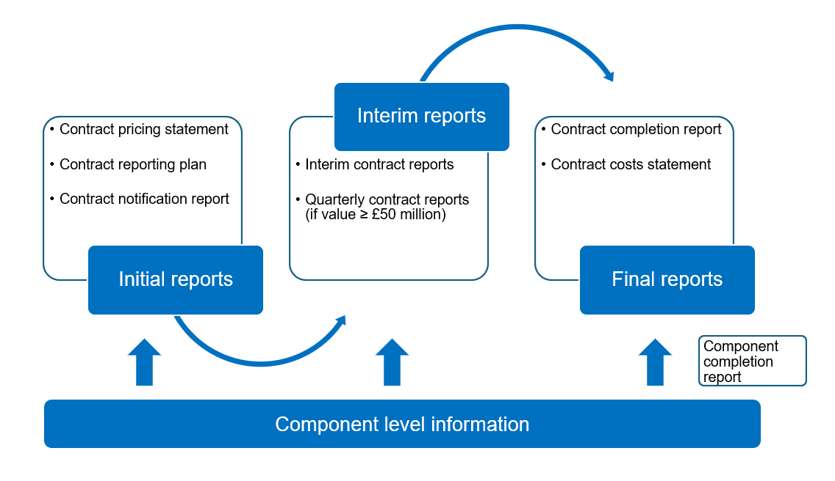
Contract reports relating to QDCs or QSCs are required by the Single Source Contract Regulations 2014
Myth Buster
“There is a reporting burden associated with being subject to the regulatory framework”.
Frequency of reports can be tailored to value of the contract.
This is information that a contractor should already be collecting: should involve a minimal increase in additional information required. Can build in the cost of reporting to contract bid, as an Allowable Cost.

Slide 23
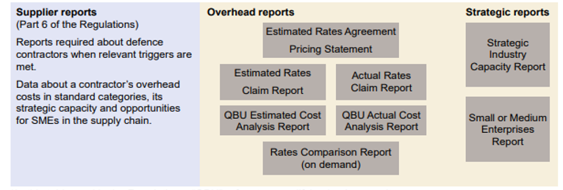
Supplier reports relating to business units that hold QDCs or QSCs over a certain value are required by the Regulations
Myth Buster
“There is a reporting burden associated with being subject to the regulatory framework”.
Many contractors will not have to provide any supplier reports at all. Those that do will often have to provide information through the MOD’s rate setting process.

Slide 24
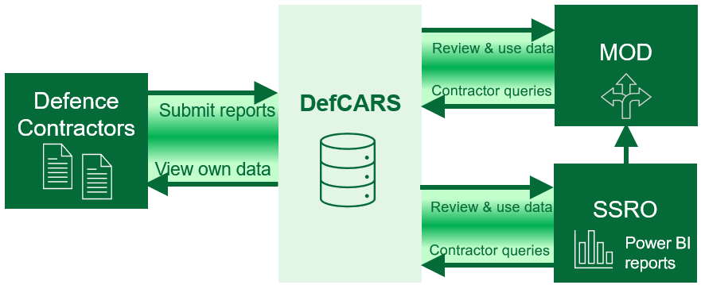
The Defence Contracts Analysis and Reporting System (DefCARS) is the central system for the capture, storage and analysis of all data submitted in accordance with statutory reporting requirements
Myth Buster
“Using DefCARS is complicated”.
You will need training to use the system, but the SSRO provides this and its Helpdesk can assist throughout the life of the contract.
All queries and comments on reports are within the system, rather than via email correspondence.
The SSRO monitors the extent to which reporting requirements are met.
As well as the live system there is a potential QDC and training environment available

Slide 25
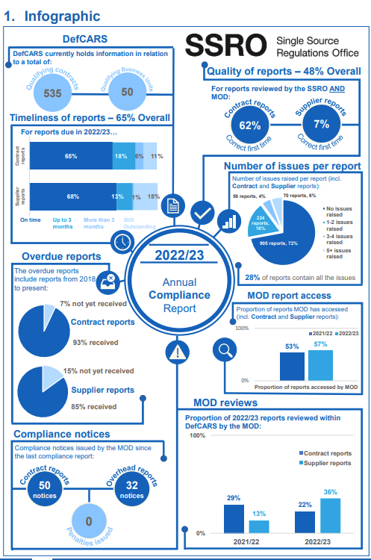
Annual Compliance Report 2023
Link to report
65 per cent of contract reports and 68 per cent of supplier reports were received on time in 2022/23.
62 per cent of contract reports and 7 per cent of supplier reports were submitted right first time.
89 per cent of contract report submissions and 82 per cent of supplier overhead report submissions are received, however often this is post the report due dates.
The MOD issued 82 compliance notices against late reports since the last compliance report. This is a significant increase to the 12 notices issued the previous year and resulted in 68 (83 per cent of those with a notice) providing additional submissions
Myth Buster
“SSRO is there to catch you out”.
SSRO is there to help you comply with the regulatory framework.
Myth Buster
“MOD is there to catch you out”.
MOD wants to get high quality data / information that is useful

Slide 26
SSRO Support – a variety of ways to help you
Helpdesk
Non-Referral Advice Service
Onboarding
Training
Website
OWG & R&ITSG
Over 1000 queries a year, from simple to complex
A growing interest in this from stakeholders
c. 2 or 3 sessions a month
Sessions based on user need
Improvements underway
Five set meetings a year
SSRO Support is a key engagement mechanism for the organisation
Multiple points of contact for stakeholders
The SSRO first looks to help the stakeholder but will also use the nature of stakeholder information / insight to improve SSRO Support
Stakeholder satisfaction with what the SSRO offers is high
helpdesk@ssro.gov.uk or 020 3771 4785

Slide 27
Any questions?
Date: Arial 12pt
Version: x
PRESENTATION TITLE
DATE
Notes:
Image file (08/03/24) description: HMS PRINCE OF WALES TRANSITING NORAWAYS FJORDS Pictured: HMS Prince Of Wales with fjords in the background On the 8th March, HMS Prince of Wales led one of the taskgroups taking part in Exercise Steadfast Defender through one of Norways many fjords. HMS Portland is part of the task group alongside with HMS Prince of Wales and other supporting vessels that form that forms the UK’s carrier strike group (UKCSG). Steadfast Defender 24 (STDE 24), the principal NATO, multi-domain flagship exercise for 2024, is a large-scale multinational live exercise (LIVEX) conducted across various geographical locations within Saceur’s area of responsibility. Steadfast Defender 24 demonstrates NATO’s unity and strength, as Allies from Europe and North America operate together in support of our shared security.

