Slide 1
Meningococcal ACWY immunisation programme for adolescents Training slides for healthcare professionals June 2024

Slide 2
Notes for users
this slide set contains a collection of core slides for both individual use, and for use or adaptation during the delivery of MenACWY vaccination training
trainers should select the slides required depending on the background and experience of the immunisers they are training and according to the role they will have in delivering the MenACWY vaccine programme
the information in this slide set was correct at time of publication
updates to the slide set may in the future be required, for example in response to changing epidemiology or vaccination recommendations - please check online to ensure you are using the latest version of these slides
the next slide contains information about the contents, which can be used to select which section(s) you require

Slide 3
Contents
Section/topic(s) | Slide number
Aims of this resource | 4
Learning outcomes | 5
Key messages | 6
Meningococcal disease (overview/aetiology, transmission, clinical presentation/rash, complications) | 7
MenW disease control (epidemiology, programme rationale and impact, current eligibility) | 14
MenACWY vaccines: Menveo®, Nimenrix® and MenQuadfi® (overview/ordering, preparation/administration, dose/schedule, legal authorisation, contraindications & precautions, adverse reactions, Yellow Card reporting requirements) | 20
Vaccine uptake (adolescent coverage data, role of HCPs, opportunistic vaccination) | 34
Summary & resources (key messages, links, references) | 38

Slide 4
Aims of this resource
to raise awareness of invasive meningococcal disease (IMD) epidemiology and the impact of IMD on infants and adolescents
to support and educate healthcare professionals involved in discussing immunisation against meningococcal ACWY disease with patients, parents or carers
to promote the uptake of meningococcal ACWY vaccine through increasing awareness in healthcare professionals involved in immunisation
Notes:
Key roles for those who advise on or deliver the MenACWY vaccination programme are as follows. To:
• understand the evidence base for the administration of the MenACWY vaccination
• understand why high vaccine coverage is required
• ensure those eligible to receive the vaccine can do so
• schedule appointments
• understand how the vaccine works and what vaccines are used
• provide individuals who are eligible to receive the MenACWY vaccine (and/or their parents/carers) with the information necessary for them to provide informed consent
• safely administer MenACWY vaccine
• provide individuals and/or their parents/carers with post vaccination advice and signpost to other sources of information

Slide 5
Learning outcomes
after completing this training, healthcare professionals will be able to:
describe the aetiology and epidemiology of invasive meningococcal disease, with specific reference to the UK
advise and inform individuals, and/or parents/carers of those who are eligible about the importance of receiving MenACWY vaccine and provide evidence-based information where required
identify sources of additional information and resources

Slide 6
Key messages
meningococcal disease is caused by invasive infection with the bacterium Neisseria meningitidis also known as the meningococcus
meningococcal disease is an important clinical and public health problem; it most commonly presents as meningitis or septicaemia and can affect all age groups
the meningococcal bacteria colonise the nasopharynx of humans; asymptomatic carriage prevalence increases throughout childhood, peaks in late teens/ early 20s and subsequently decreases in adulthood
there are 12 capsular groups of meningococcus; in the UK disease is usually caused by groups B, C, W and Y; vaccination has largely eliminated group C disease
the MenACWY vaccine was introduced in response to an increase in cases of invasive meningococcal capsular group W (MenW) disease
offering MenACWY vaccine to adolescents offers them direct protection against capsular groups A, C, W and Y and prevents carriage of these bacteria in this age group, thereby offering protection through herd protection to other age groups
There are now very few cases of MenW and MenY disease. MenB accounts for most UK disease.

Slide 7
Meningococcal disease
Meningococcal disease

Slide 8
Overview
meningococcal disease occurs as a result of an invasive bacterial infection caused by Neisseria meningitidis also known as the meningococcus
there are 12 identified capsular groups of meningococcus; groups B, C, W and Y are the most common in the UK
invasive meningococcal disease (IMD) is rare but serious, resulting in significant mortality and morbidity
meningococcal disease most commonly presents as either meningitis or septicaemia, or a combination of both
the highest rates of disease are in children under 2 years, particularly infants aged 5 months although disease can occur at any age
95% of cases are sporadic
Notes:
Plural: meningococci. The organism is associated with both asymptomatic carriage and invasive disease
Each group has a distinct (i.e. group specific) outer polysaccharide (sugar) capsule
Disease onset is sudden and often dramatic
The overall case fatality rate is ~10% but varies with age, capsular group and clinical presentation and many survivors have long term complications which may include brain damage, deafness, epilepsy, limb/digit loss and cognitive deficit
Less commonly, individuals may present with pneumonia, myocarditis, endocarditis, pericarditis, arthritis, conjunctivitis, urethritis, pharyngitis and cervicitis.
Occasional outbreaks occur e.g. in families, schools, universities: onward transmission from cases to close contacts can rarely result in secondary cases, as well as clusters of infection but fewer than 2% of invasive meningococcal disease (IMD) cases, result from close contact with a primary IMD case

Slide 9
Carriage, transmission, infectivity and incubation
asymptomatic carriage prevalence increases throughout childhood from around 5% in infants to a peak of 24% in 19-year olds and subsequently decreases in adulthood to around 8%
transmission is through person-to-person spread from respiratory aerosols, droplets or by direct close contact with the respiratory secretions of someone who is carrying the bacteria
infectivity of meningococcal disease is relatively low and requires prolonged close contact, for example those living in the same household or through direct contact with nose and respiratory secretions such as intimate ‘wet’ kissing
incubation period ranges from 2 to 7 days with the onset of disease ranging from severe with overwhelming features to insidious mild prodromal symptoms

Slide 10
Clinical presentation of meningococcal disease
Notes:
Please note that some or all symptoms may appear, in any order, and this list is not exhaustive. Table contents are based on content from the Meningitis Trust http://www.meningitis-trust.org/meningitis-info/signs-and-symptoms/.
Onset of disease varies from fulminant with severe acute and overwhelming features, to insidious with mild prodromal symptoms. Symptoms may be harder to identify in young infants particularly as the onset may be insidious and the signs be non-specific without classical features of meningitis.

Slide 11
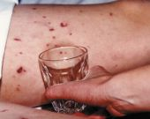
The meningococcal rash
a distinctive red rash can appear anywhere on the body
the rash is formed of tiny ‘pinprick’ blood spots under the skin, also known as petechiae, and appears red in colour. The rash may later develop into purple bruising of the skin
the meningococcal rash can be distinguished from other rashes by pressing a glass tumbler against it:
a meningococcal rash will not fade when a glass tumbler is rolled over it (non-blanching)
a febrile illness and rash that does not fade is a sign of meningococcal septicaemia
The ‘tumbler’ test picture courtesy of Meningitis Research Foundation
http://www.meningitis.org/symptoms
Notes:
A non-blanching rash tends to be a late symptom and should be treated as a medical emergency.
It is important to note the absence of a rash does not preclude meningococcal disease.

Slide 12
Clinical presentation of MenW disease
cases of meningococcal W disease have often presented atypically with septic arthritis and severe respiratory tract infections (including pneumonia, epiglottis, and supraglottitis) being seen more commonly among MenW cases compared to cases caused by other meningococcal groups
several adults with meningococcal W septicaemia have presented primarily with gastrointestinal symptoms without the characteristic rash making clinical diagnosis of the disease difficult

Slide 13
Potential complications of meningococcal disease
it is estimated that approximately one quarter of those diagnosed with meningococcal disease caused by Neisseria meningitidis will suffer complications as a result
complications can vary in severity and can either be temporary or permanent. The more severe the disease, the greater the risk of complications
complications can include loss of hearing, loss of vision, loss of memory and/or concentration, difficulties in co-ordination and balance, epilepsy, cerebral palsy and limb amputations, and may result in death

Slide 14
Meningococcal W disease control

Slide 15
Changing epidemiology of IMD
although cases of meningococcal disease overall had been in decline since 2000, cases of capsular group W were first observed in previously healthy adults in 2009^{1,2}
by 2011, cases had extended across all age groups and across all regions in England, indicating the strain had become endemic
for the first time in a decade, meningococcal W related deaths were observed in young children, particularly those under 2 years of age
additionally, an increase in MenW cases among university students across the country suggested that carriage and transmission of bacteria had become established
the increase in MenW cases was linked to the emergence of a specific, virulent clone in 2010/11^{1,2}; from 2015/2016 the number of cases increased rapidly
Notes:
Since the introduction of the routine meningococcal C conjugate immunisation programme (1999), cases of invasive meningococcal disease (IMD) in the UK from group C have reduced dramatically and invasive MenC disease has nearly been eliminated. The vaccine was introduced into the infant schedule and there was an initial catch-up of under 18s; cases have fallen in all age groups as a result of reduced carriage (indirect herd protection). Although MenB infections were declining before the introduction of MenB vaccination, and have continued to fall, they still account for the majority (87%) of notified, laboratory confirmed cases. The overall incidence of meningococcal disease has continued to decline.

Slide 16
Rationale for the adolescent MenACWY vaccination programme
in February 2015, the JCVI agreed that the increase in meningococcal W cases in England and Wales constituted an outbreak³
as a control measure, an immunisation programme was recommended for all adolescents aged 13-18 years and included the replacement of the adolescent dose of MenC with MenACWY
this was to ensure direct protection against meningococcal capsular group C as previously recommended, and ensure direct protection against capsular groups A, W and Y
operationally, adolescents aged between 13-18 years were offered the vaccine as part of routine and catch up programmes during 2015 and 2016; university ‘freshers’ up to the age of 25 years were also offered vaccination
JCVI recommended this as the best option to generate population level herd immunity, providing protection across all other age groups, including infants at highest risk
Notes:
Teens are at high risk and are known to have high carriage rates. Vaccination for adolescents was therefore expected to rapidly impact on carriage and hence, disease, in all age groups.

Slide 17
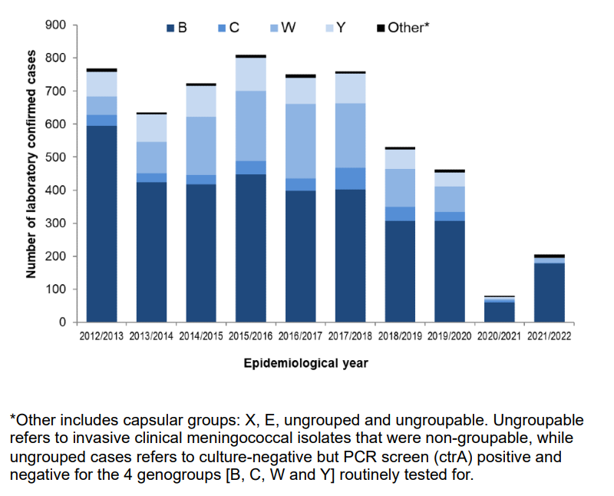
IMD in England by capsular group 2011/2012 to 2021/22
Annual MenW cases peaked at 225 cases in 2016 to 2017 and have since decreased year on year
Note the significant impact on the spread and detection of IMD as a result of the COVID-19 pandemic and the implementation of social distancing measures and lockdown periods across the UK from 23 March 2020.
Notes:
Source:
Invasive meningococcal disease in England: annual laboratory confirmed reports for epidemiological year 2021 to 2022 - GOV.UK (www.gov.uk)

Slide 18
Impact of MenACWY vaccination
MenW cases plateaued within 12 months of the adolescent MenACWY immunisation programme starting, with cases peaking in 2015–16, stabilising in 2016–17, and declining during the next 2 years.⁴
MenACWY vaccine effectiveness against disease caused by capsular groups C, W and Y combined was 94% (95%CI 80-99%). Note that MenA cases are very unusual in the UK.
The MenACWY immunisation programme has successfully reduced cases of MenW disease across the whole population and now accounts for few cases each year (13 cases in 2021/22)

Slide 19
Currently eligible groups
The purpose of the MenACWY programme is to actively offer a single dose of MenACWY vaccine to:
• all teenagers - this is usually administered in school year 9 or 10 (at around age 14 years)
• anyone aged 10 years up to their 25th birthday if they have an incomplete or unknown MenC vaccination history
The terms of the General Medical Services (GMS) statement of financial entitlement (SFE) make provision for GP practices to offer the vaccine opportunistically to adolescents who miss out on the routine school based MenACWY vaccination programme
any patient born on or after 1 September 2001 who has missed the school-based dose remains eligible for this vaccine up to the age of 25 years
there is no longer a specific ‘freshers’ dose but prospective university entry is a good opportunity to offer vaccine to anyone who is under 25 years of age and un-immunised. Ideally the dose should be administered at least two weeks before attending university to ensure timely protection. Note that if an individual’s vaccination history cannot be confirmed before attending university, it is acceptable to offer them a dose of MenACWY conjugate vaccine

Slide 20
Meningococcal ACWY vaccines

Slide 21
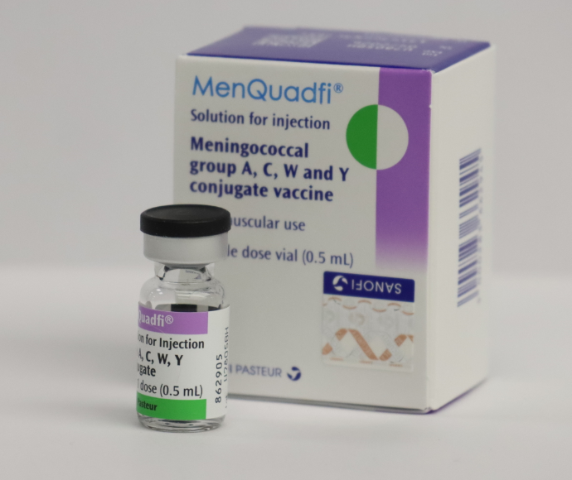
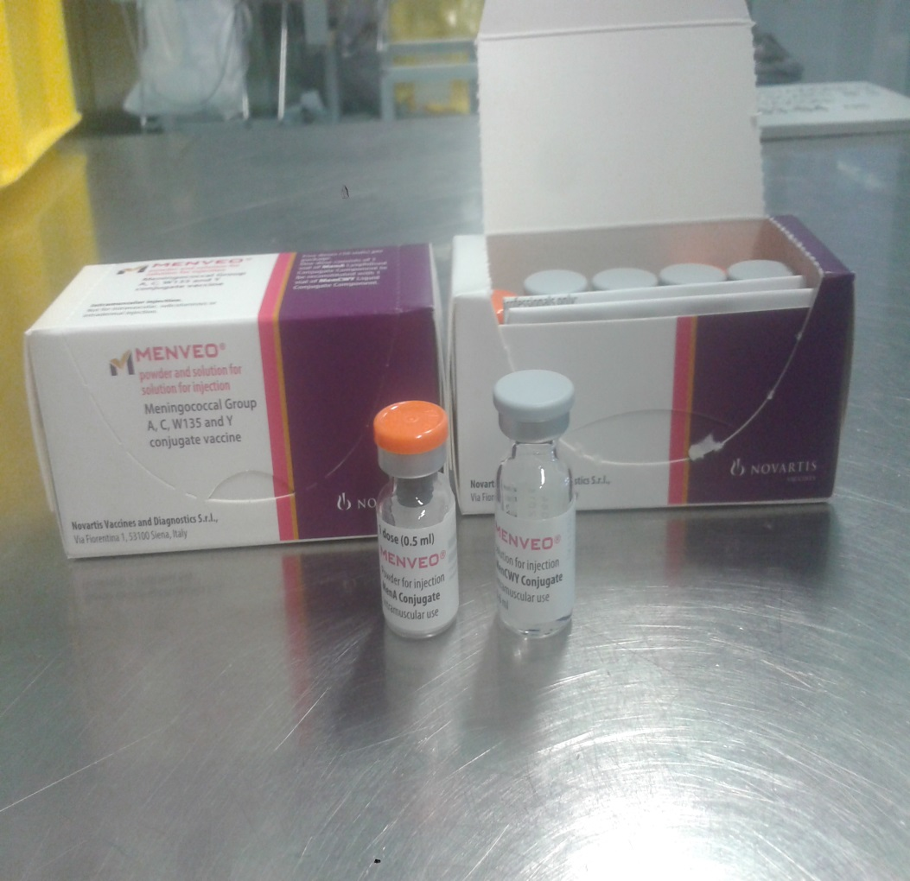
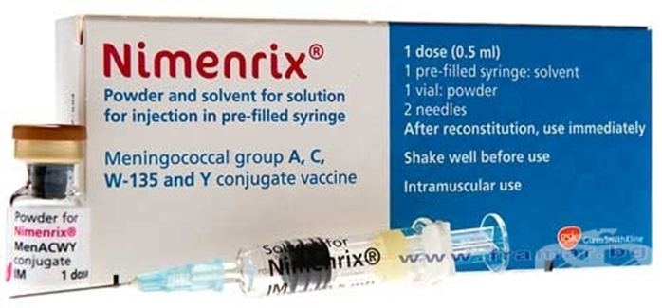
MenACWY vaccines
three MenACWY conjugate vaccines are currently licensed: Menveo®, Nimenrix® and MenQuadfi®
all vaccines for the routine adolescent programme are centrally supplied through ImmForm
it is important that immunisers familiarise themselves with the specific product information for any vaccine in current use to avoid administration errors
Image courtesy of GSK
Image courtesy of GSK
Image courtesy of Sanofi
Notes:
Not all vaccines may be routinely supplied. Details of all licensed products are included here in case a short-notice substitution of one product for another is required to maintain the programme in the event of manufacturing issues. Supplies of MenQuadfi will commence during 2024. Ordering is via ImmForm: https://portal.immform.phe.gov.uk/ - the latest information about supplies is also provided on that website.

Slide 22
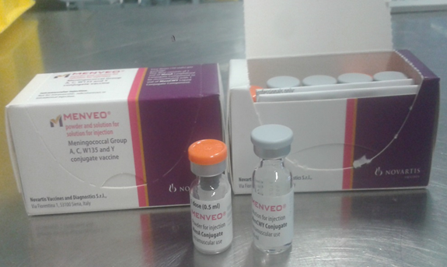
Menveo®
full product name: Menveo® powder and solution for solution for injection
Meningococcal Group A, C, W-135 and Y conjugate vaccine
marketed by GlaxoSmithKline
contains: 10 micrograms of Neisseria meningitidis group A oligosaccharide and 5 micrograms of each of Neisseria meningitidis groups C, W and Y, each conjugated to Corynebacterium diphtheriae CRM197 protein oligosaccharides per 0.5ml dose
is licensed for use in children from 2 years, adolescents and adults at risk of invasive disease from Neisseria meningitidis A, C, W and Y and can safely be given with other routine adolescent vaccines
is recommended for adolescents (and young adults
aged less than 25 years, including those with an unknown
or incomplete MenC or MenACWY immunisation history) as part
of the routine immunisation programme
Image courtesy of GSK

Slide 23
Preparation and administration of Menveo®
the vaccine is supplied in two separate vials – one vial containing Men A (a white to off-white powder) and the second vial containing Men C,W & Y (a colourless, clear solution)
draw up and inject the entire contents of the vial of Men C, W & Y solution into the vial of MenA powder then invert and vigorously shake the vial
after reconstitution, the solution should be clear, colourless to light yellow and free from visible foreign particles; the vaccine should not be administered where there are variations in physical appearance or signs of foreign particulate are observed after shaking
withdraw 0.5ml of reconstituted product; it is normal for a small amount of liquid to remain in the vial following withdrawal of the dose
change the needle prior to administration; choose a size suitable for IM administration into the chosen muscle of each individual patient
Menveo® should be administered via intramuscular injection (IM), preferably into the deltoid muscle of the upper arm
Notes:
The vaccine should be stored between +2°C to +8°C. Both vials should be visually inspected before reconstitution (see SPC Menveo Group A,C,W135 and Y conjugate vaccine - Summary of Product Characteristics (SmPC) - print friendly - (emc) (medicines.org.uk)). After reconstitution, the medicinal product should be used immediately. However, chemical and physical stability after reconstitution have been demonstrated for 8 hours below 25°C.

Slide 24
Nimenrix®
full product name: Nimenrix® powder and solvent for solution for injection in pre-filled syringe
Meningococcal groups A, C, W-135 and Y conjugate vaccine
marketed by GlaxoSmithKline
contains: 5 micrograms of each of Neisseria meningitidis groups A, C, W-135 and Y polysaccharides, each conjugated to tetanus toxoid carrier protein per 0.5ml dose
is licensed for use in children from 12 months, adolescents and adults at risk of invasive disease from Neisseria meningitidis A, C, W and Y and can safely be given with other routine adolescent vaccines
is recommended for adolescents (and young adults aged less than 25 years, including those with an unknown or incomplete MenC or MenACWY immunisation history) as part of a the routine immunisation programme
Image courtesy of GSK

Slide 25
Preparation and administration of Nimenrix®
The vaccine is supplied as one vial of (white) powder containing the active components and one pre-filled syringe containing a clear solvent (sodium chloride solution):
prior to administration the entire contents of the pre-filled syringe should be injected into the vial of powder; the vial should be shaken well to mix the contents - until the powder dissolves, providing one dose (0.5ml)
after reconstitution, the solution should be clear, colourless to light yellow and free from visible foreign particles
the vaccine should not be administered where there are variations in physical appearance or signs of foreign particulate are observed after mixing
change the needle prior to administration; choose a size suitable for IM administration into the chosen muscle of each individual patient
Nimenrix® should be administered via intramuscular injection (IM), preferably into the deltoid muscle of the upper arm
Notes:
The vaccine should be stored between +2°C to +8°C
After reconstitution, the vaccine should be used immediately. However, stability after reconstitution has been demonstrated for 8 hours below 30°. Discard any reconstituted vaccine not used within 8 hours.

Slide 26
MenQuadfi®
full product name: MenQuadfi® solution for injection
Meningococcal groups A, C, W-135 and Y conjugate vaccine
marketed by Sanofi
contains: 10 micrograms of each of Neisseria meningitidis groups A, C, W-135 and Y polysaccharides, each conjugated to tetanus toxoid carrier protein per 0.5ml dose
is licensed for use in children from 12 months, adolescents and adults at risk of invasive disease from Neisseria meningitidis A, C, W and Y and can safely be given with other routine adolescent vaccines
is recommended for adolescents (and young adults aged less than 25 years, including those with an unknown or incomplete MenC or MenACWY immunisation history) as part of the routine immunisation programme
this is a black triangle medication which means it is subject to additional monitoring. Healthcare professionals are asked to report any suspected adverse reactions to the MHRA’s Yellow Card scheme (see slide 34 and Green Book, chapter 9)

Slide 27
Preparation and administration of MenQuadfi®
MenQuadfi® solution for injection is a ready-to-use solution that does not require reconstitution
the vaccine is supplied as a single dose vial
the vaccine should be inspected visually for any particulate matter and/or variation of physical aspect (or discolouration) prior to administration; in the event of either being observed, discard the vaccine
remove the flip off seal and using a suitable syringe and needle, withdraw 0.5 ml of solution, ensuring no air bubbles are present before injection
change the needle prior to administration; choose a size suitable for IM administration into the chosen muscle of each individual patient
MenQuadfi® should be administered via intramuscular injection (IM), preferably into the deltoid muscle of the upper arm

Slide 28
Dose and scheduling
all licensed MenACWY conjugate vaccines induce very high serum bactericidal antibody titres - i.e. excellent protection - after one dose in adolescents and adults and are therefore administered as a single 0.5ml dose
the need for, and the timing of a booster dose of MenACWY vaccine has not yet been determined and is therefore not currently recommended
it can be administered at any interval before, after or at the same time as all other vaccines, including MenC, Td/IPV, MMR, travel vaccines
those who have already received a MenC vaccine over the age of 10 years should still be offered MenACWY conjugate vaccine as part of a catch-up programme to ensure protection against the additional capsular groups A, W and Y
those who have already received a MenACWY conjugate vaccine at the age of 10 years or over do not require an additional dose (with the exception of close contacts of a confirmed case of disease caused by Men A, C, W or Y capsular groups, who will be offered a dose of MenACWY conjugate vaccine if they have not received a dose in the preceding 12 months).
Notes:
The local Health Protection Team (HPT) will advise about vaccination of close contacts of any confirmed case of MenACWY infection according to the Guidance for Public Health Management of Meningococcal Disease in the UK: Meningococcal disease: guidance on public health management - GOV.UK (www.gov.uk).

Slide 29
Legal authorisation
MenQuadfi® ,Nimenrix® and Menveo® are prescription only medicines and should therefore only be administered:
against a prescription written manually or electronically by a registered medical practitioner or other authorised prescriber
against a patient specific direction
against a patient group direction
a Meningococcal groups A, C, W and Y (MenACWY) Conjugate Vaccine Patient Group Direction (PGD) template is available on the UKHSA website https://www.gov.uk/government/collections/immunisation-patient-group-direction-pgd for:
individuals eligible for national routine MenACWY programme (including individuals with an incomplete or unknown vaccination history until their 25th birthday)
outbreak control and contacts of confirmed cases (under the direction of the local Health Protection Team)
all three licensed vaccines are included in the PGD template
NB: Local authorisation is required before UKHSA PGD templates can be used
Notes:
A separate PGD template is also available for the vaccination of individuals who, due to an underlying medical condition, require doses of MenACWY vaccine that are not included the routine programme

Slide 30
Contraindications
Menveo®, Nimenrix® and MenQuadfi® should not be administered to those who have had:
a confirmed anaphylaxis to a previous dose of the same vaccine OR
a confirmed anaphylaxis to any constituent or excipient of the vaccine, including tetanus toxoid (Nimenrix® and MenQuadfi®) or diphtheria toxoid (Menveo®)
there are very few individuals who cannot receive meningococcal vaccines
where there is doubt, appropriate advice should be sought rather than withholding immunisation

Slide 31
Precautions and additional information
postpone vaccination of any individual suffering from acute severe febrile illness
note: minor illnesses without fever or systemic upset are not valid reasons to postpone immunisation
pregnancy and breast-feeding
meningococcal vaccines may be given to pregnant women when clinically indicated. There is no evidence of risk from vaccinating pregnant women or those who are breastfeeding with inactivated vaccines or toxoids
immunosuppression and HIV infection
individuals with immunosuppression and human immunodeficiency virus (HIV) infection (regardless of CD4 count) should be given meningococcal vaccines in accordance with the routine schedule

Slide 32
Possible adverse reactions
all three MenACWY conjugate vaccines have excellent side effect profiles; adverse reactions very commonly or commonly reported in the clinical trails were the short-lived, self-resolving type that are expected after vaccination
only those that were very commonly reported in the clinical trials (by 1 in 10 or more recipients) are listed below; full details of all adverse reactions can be found in the summaries of product characteristics (SPCs), which vaccinators should always consult
Vaccine | Menveo® SPC | Nimenrix® SPC | MenQuadfi® SPC
Very commonly reported local reactions | Injection site pain, redness, induration | Injection site pain, redness, swelling | Injection site pain
Very commonly reported systemic reactions | Headache, nausea, myalgia, malaise | Loss of appetite, headache, fever, fatigue | Headache, myalgia, malaise

Slide 33
Reporting suspected adverse reactions
all suspected adverse reactions should be reported to the MHRA using the Yellow Card scheme http://mhra.gov.uk/yellowcard
for vaccines that have been marketed in the UK for two years or more only serious suspected ADRs should be reported: this includes Menveo® and Nimenrix®
for vaccines that are newly licensed in the UK, and which are therefore subject to enhanced surveillance and are given ‘black triangle’ status (indicated by an inverted triangle on the product information), all serious and non-serious suspected ADRs should be reported: this includes MenQuadfi®
success of the scheme depends on early,
complete and accurate reporting; report even
if uncertain about whether the vaccine caused
the condition
see chapter 9 of the Green Book for details
Notes:
Healthcare professionals and vaccine recipients (and/or their parent or carer) are encouraged to report suspected adverse reactions to the Medicines and Healthcare products Regulatory Agency (MHRA) using the Yellow Card reporting scheme.
The MHRA additionally monitored the safety of MenACWY vaccine as its use was increased through the adolescent programme. No safety concerns have been raised since this vaccine has been more widely used in adolescents. Safety monitoring is a continuous process.

Slide 34
Vaccine uptake

Slide 35
MenACWY coverage in adolescents in school years 9 and 10 by academic year from 2015 to 2022
From March 2020, the COVID-19 pandemic led to some disruption of and additional challenges for the school-based immunisation programme (school closures; reduced school attendance which did not quickly recover; staff absences; introduction of the COVID-19 vaccination programme and extension of the influenza vaccination programme) from which there has been a partial but not yet complete return to pre-pandemic levels of vaccine coverage
Notes:
Source: Meningococcal ACWY (MenACWY) vaccine coverage for adolescents in England, academic year 2021 to 2022 Meningococcal ACWY immunisation programme: vaccine coverage estimates - GOV.UK (www.gov.uk)
Coverage peaked in 2018/2019. Despite the considerable efforts of the school-based teams since the pandemic commenced, a significant number of eligible young people and young adults have not yet received their MenACWY vaccine. Healthcare staff are encouraged to use every available opportunity to offer/administer the adolescent dose, noting that disease rates were artificially reduced as a result of lockdown and social distancing and the risk remains.

Slide 36
The role of healthcare professionals
to provide clear, concise and accurate information to young people and the parents or carers of those receiving the MenACWY vaccine as part of the routine adolescent immunisation programme
every effort should be made by healthcare professionals to maximise the uptake of the meningococcal ACWY vaccine in adolescents and to ensure that young people and their parents or carers are fully informed about the importance of ensuring protection against meningococcal disease caused by A, C, W and Y meningococcal strains
staff should be clear about arrangements in their area so that they can signpost young people and their parents or carers to the correct service provider – or promptly offer vaccination, as appropriate
leaflets and posters are available from: Meningococcal ACWY (MenACWY) vaccination programme - GOV.UK (www.gov.uk) (download) and https://www.healthpublications.gov.uk (download and order) – staff should use these and the available digital resources to raise awareness about the disease and the vaccine amongst the target population and to support the process of informed consent prior to vaccine administration
Notes:
Information for the public is increasingly being made available in accessible formats; at the time of publication of this slide set, the pictured leaflet is currently also available translated into 32 community languages.
Key roles of immunisers in relation to immunisation against disease caused by A, C, W and Y meningococcal strains in adolescents/ young adults:
Advise individuals eligible for the meningococcal ACWY immunisation programme (and/or their parents/carers) that the vaccine is strongly recommended to ensure direct protection against meningococcal capsular groups A, C, W and Y.
Explain the risks and complications of invasive meningococcal disease in all age groups and in particular explain that up to 25 % of adolescents can carry the bacteria in their nose and throat without showing any signs or symptoms of the disease. In being immunised against meningococcal ACWY, carriage of the bacteria will also be prevented.
Explain what vaccine will be used, the contraindications and possible side effects of immunisation and the evidence for this immunisation programme.
Advise individuals eligible for the vaccine (and/or their parents/carers) that this immunisation schedule for adolescents will extend protection within the wider community/population

Slide 37
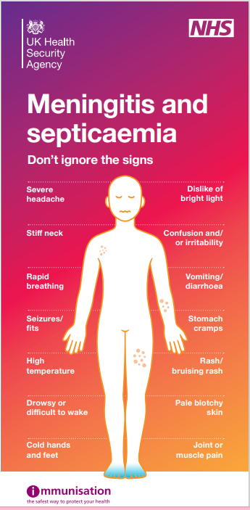
Opportunistic vaccination
Individuals who have left school and remain unvaccinated should be offered vaccination opportunistically – they remain eligible until they become 25 years of age
Contact with young people/ young adults, in school or GP practices and upon entrance to a sixth form college or university, provides a good opportunity to promote and offer vaccination and raise awareness of the signs and symptoms of the disease
Notes:
The UKHSA publishes specific guidance for higher education settings: Meningitis and septicaemia: prevention and management in higher education institutions. - GOV.UK (www.gov.uk). Additionally, resources for the ‘Save a Life’ MenACWY campaign are available to order and download and include a campaign booklet, A5 sticker, social media cards, animation video and banners, posters for universities and further education settings, and banner artwork. Search Publications - Health Publications (https://www.healthpublications.gov.uk/). The meningitis charities (see ‘Useful links’ slide) also have resources

Slide 38
Summary and resources

Slide 39
Key messages
meningococcal disease is caused by invasive infection with the bacterium Neisseria meningitidis also known as meningococcus
invasive meningococcal disease most commonly presents as meningitis or septicaemia and can affect all age groups
there are 12 capsular groups of meningococcus of which groups B, C, W and Y. In the UK disease is usually caused by groups B, C, W and Y; vaccination has largely eliminated group C disease
the MenACWY vaccine was introduced in response to an increase in cases of invasive meningococcal disease caused by capsular group W (MenW) disease
offering MenACWY vaccine to adolescents offers them direct protection against capsular groups A, C, W and Y and prevents carriage of these bacteria in this age group, thereby offering protection through herd immunity to other age groups
vaccine coverage had steadily increased and case numbers had declined between the commencement of the programme and the onset of the COVID 19 pandemic
the measures (lockdown, social distancing) used to control the COVID-19 pandemic led to a dramatic reduction in cases and to poorer vaccine coverage: encouraging vaccination uptake of the routine cohorts and maximising opportunistic vaccination of those under the age of 25 years who remain unprotected are crucial to mitigating the impact of lower coverage against any increasing risk of disease

Slide 40
Useful links
Public Health England/ NHS England. Meningococcal ACWY conjugate vaccination (MenACWY). 22 June 2015 https://www.gov.uk/government/publications/menacwy-vaccine-introduction
UKHSA. Immunisation against infectious diseases (The Green Book) Meningococcal chapter 22 https://www.gov.uk/government/publications/meningococcal-the-green-book-chapter-22
UKHSA. Meningococcal leaflets, consent forms, PGD, information for healthcare practitioners and other MenACWY-specific materials: https://www.gov.uk/government/collections/meningococcal-acwy-menacwy-vaccination-programme
Meningitis Research Foundation: http://www.meningitis.org/
Meningitis Now. https://www.meningitisnow.org/
NHS Choices. http://www.nhs.uk/conditions/Meningitis/Pages/Introduction.aspx
Notes:
References
1. Ladhani, S. Beebeejaun, K. Lucidarme, J. Campbell, H. Gray, S. Kaczmarkski, E. Ramsay, M.E, Borrow, R. (2015). Increase in Endemic Neisseria meningitidis Capsular Group W Sequence Type 11 Complex Associated With Severe Invasive Disease in England and Wales. Clin Infect Dis. (2015) 60 (4): 578-585. [internet] accessed 15 January 2024. https://cid.oxfordjournals.org/content/60/4/578
2. Public Health England (2015) Health Protection Report: Continuing increase in meningococcal group W (MenW) disease in England. Weekly report. Vol 9. No.7. Published 27 February 2015. [internet]. accessed 15 January 2024. Health Protection Report volume 9 (2015) - GOV.UK (www.gov.uk)
3. Joint Committee on Vaccination and Immunisation (2015). Minutes of the meeting 4 February 2015. [internet] accessed 15 January 2024. https://www.gov.uk/government/groups/joint-committee-on-vaccination-and-immunisation
4. Campbell H and others (2022). Impact of an adolescent meningococcal ACWY immunisation programme to control a national outbreak of group W meningococcal disease in England: a national surveillance and modelling study, England, 2015 to 2016. Lancet Child Adolescent Health: volume 6 issue 2 [internet] accessed 15 January 2024. https://pubmed.ncbi.nlm.nih.gov/34883094/

Slide 41
Sources
Meningococcal disease: clinical and public health management Guidance for health professionals on diagnoses, prevention and treatment of meningococcal disease: Meningococcal disease: clinical and public health management - GOV.UK (www.gov.uk)
Meningococcal ACWY programme: information for healthcare professionals:
MenACWY programme: information for healthcare professionals - GOV.UK (www.gov.uk)

