Slide 1
Assistant Economist Scheme
Welcome to our Q&A session
Applications close 18 March 2024

Slide 2
Hello
Today’s session will cover:
An overview of the Government Economic Service (GES)
Overview of the Assistant Economist Scheme
What the application process looks like
Hear from a GES assistant economist
Q&A session
Please keep your cameras and microphones off for the duration of the session, and submit your questions in the chat

Slide 3
Who are we?
We are the professional body for economists in the UK Civil Service, established in 1964.
• We are the largest recruiter of economists in the UK, with over 3,500 professionals across government.
• Our members are employed, paid and managed by their departments or agencies.
• We help the government to make decisions based on high quality analysis.

Slide 4
Benefits of working in the Civil Service
Extra paid day off work for the King’s birthday.​
Competitive contributory pension scheme.
Occupational sick pay.​
Generous paid maternity and paternity leave.​
Interest-free loans for annual travel season ticket or new bicycle.​
25 days annual leave (30 after 5 years of service.) Plus 8 public holidays.​
Facilities, including fitness centres and staff canteens (where applicable).​
Flexible working patterns.

Slide 5
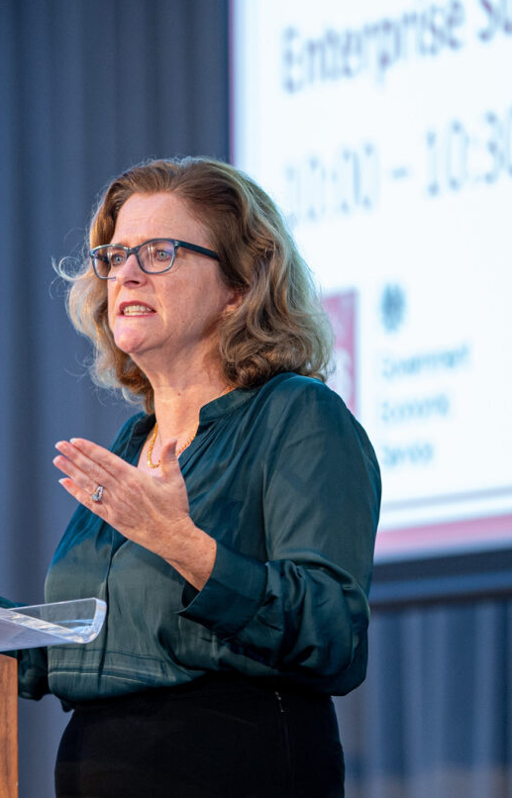
A message
from Sam
We are incredibly proud of the work of economists in the civil service.
Our relevant, rigorous and respected analysis has put us at the heart of major policy decisions over the years and the GES has come to be recognised as a highly effective body of professional economists.
A key part of this is our commitment to having a diverse workforce, attracting the brightest and the best, and creating an environment in which economists from all backgrounds thrive and succeed.
Sam Beckett, Head of the Government Economic Service

Slide 6
The role of economists in government
In government, economists help with decision-making based on analysis and evidence, whilst considering ethics and expectations.
Whatever the topic, you'll be influencing decision-making at the heart of government, working on issues which affect millions of people and make a real difference to society.
Wherever you're working, you can count on support from your team and colleagues, including plenty of training to help you to get the most out of your role.
If you want to change the world, working in government is the best place to start your career. The work you do matters.

Slide 7
Types of roles
These are just a few of the types of roles that you could find yourself in:
Competition policy and regulation
Infrastructure
Taxation
Behavioural Economics
Labour market trends
Public Health
Macroeconomic modelling
Criminal Justice
Welfare and Employment

Slide 8
What is the Assistant Economist Scheme?
JOIN THE GES
MAKE A DIFFERENCE
PART OF A COMMUNITY
USE YOUR SKILLS
This is a recruitment scheme for economics graduates to work as an Assistant Economist in the Government Economic Service.
We are recruiting over 200 economists to join us to help us deliver analysis and influence the day-to-day lives of every person in the UK.
As an assistant economist, you will be joining a community of over 3,500 economists across more than 30 organisations.
You will be putting your economic learning to direct use by influencing high profile public policies with the best possible economic analysis.

Slide 9
What is an assistant economist?
Minimum salary London £30,000 & Nationwide £28,000
Strong quantitative skills: you’ll become a data expert.
Applied economics skills: using economic insights and techniques to inform policy.
Passionate about making meaningful
change
Part of a community of over 2,000 economists.
Writing and presentation techniques: communicating economics clearly and succinctly.

Slide 10
Entry requirements
Academic requirements:
Eligibility requirements:
Applicants will need to possess or will be expected to have at least an upper second-class honours degree.
Please review the essential criteria below:
Hold an Economics degree.
If you completed a joint degree, at least 50% of the modules must be economics or have a masters or postgraduate diploma in economics.
Modules must have covered both micro and macroeconomics to qualify.
If you graduated more than five years ago then you must have examples of how you have maintained your economic knowledge on the technical section of the application form.
You are eligible to apply if you’re a:
British citizen European Economic Area (EEA)
Commonwealth citizen Swiss national
Turkish national, in some circumstances
Nationality requirements are explained in more detail in the Civil Service nationality rules
Individuals will need to demonstrate that they meet the relevant immigration requirements and demonstrate their eligibility under the Civil Service Nationality Rules (CSNRs).
Individuals must have the right to work in the UK.
We do not offer sponsorship for these vacancies.

Slide 11
How to apply
Step 1 > registration
Registration
Online
tests
Application Form
Sift
​
Assessment
Centre​
To begin your application, you’ll need to apply on Civil Service Jobs.​

Slide 12
How to apply
Step 1 > registration
Registration
Online tests
Application Form
Sift
​
Assessment
Centre​
There are two online tests to complete: verbal and numerical. Only once you have passed one test, can you move on to the next.
There may be a delay between completing your tests and progressing to the next stage.
You will need to have access to a laptop/desk computer.

Slide 13
How to apply
Step 1 > registration
Registration
Online tests
Sift
​
Assessment
Centre​
Application form
If you meet the minimum standard of online tests, you will be invited to fill out a full application form including your degree modules.
Including a statement of suitability and 3 additional questions, around UK footprint, holding a straight economic degree and strongest topic area.

Slide 14
How to apply
Step 1 > registration
Registration
Online tests
Application Form
​
Sift
Assessment
Centre​
If you are successful at both tests, you will then be sifted on your economics qualifications, including the full description of your modules.

Slide 15
How to apply
Step 1 > registration
Registration
Online tests
Application Form
​
Sift
Assessment Centre
Those passing the sift will be taken forward to a virtual assessment day. There are three separate economics exercises (technical report, presentation and SAQs) to complete. You will also be assessed against three strength competencies and three behaviour competencies:
Technical
Knowledge of economics
Application of Economics
Communications
Behaviour
Making Effective Decisions
Delivering at Pace
Working together
You must pass all six competencies to be successful for this scheme.
You will receive further guidance in advance of the interview.

Slide 16
Hear from our economists

Slide 17
Questions?

Slide 18
How to apply
Please follow us for more information on our
recruitment schemes:
@ges_uk
@ges_uk
@governmenteconomicservice

