Slide 1
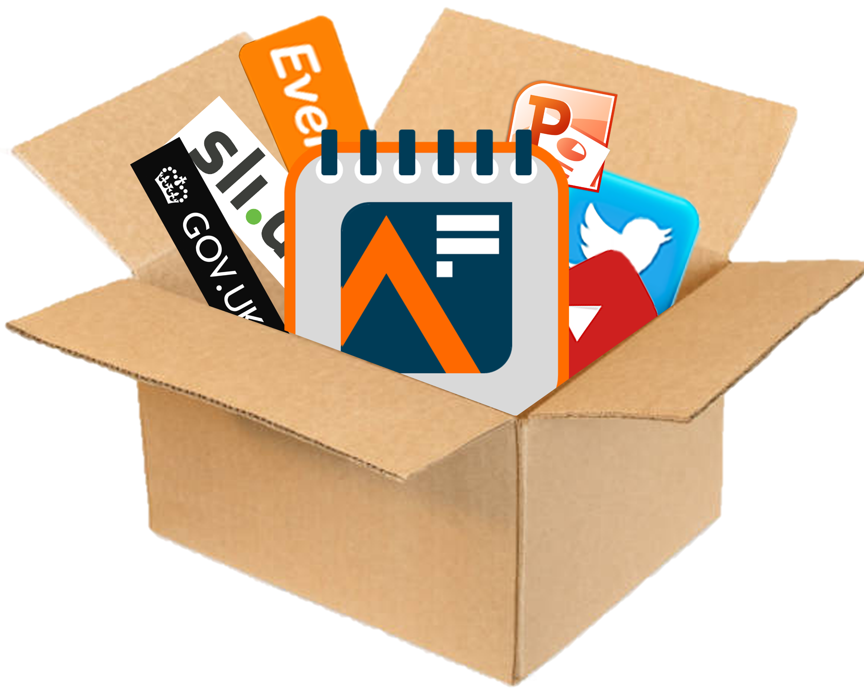
24
Analysis in Government Month
Campaign in a Box
May 2024
For Analysis Function leaders, Communications, and Support Teams
The UK’s largest learning and development event for government analysts
Innovation

Slide 2
AiG Month 24: Using this pack
Analysis in Government Month (AiG Month), the UK’s largest L&D event for government analysts, is back for the fourth year. This year’s theme is “Innovation”.
Whilst we are certainly interested in topics such as cutting-edge AI or Large Language Models, we are equally interested in new ways of doing anything to do with analysis, including new ways of communicating the results of analysis or new ways of working together.
AiG Month 24 will demonstrate how important it is for government analysts to understand different types of innovation and learn how to keep up to date in such a fast-moving area.
During the month we will share lots of L&D, hints and tips, and experiences from analysts of all grades across government, so we can all learn to maximise our impact through better collaboration, communication, inclusion, and using innovative methods more effectively.
The products within this Resource Pack are designed to help you to promote the event within your department, show people how to get involved, and ensure a joined-up approach
The resources are designed to be used in a ‘pick and mix’ style, allowing freedom for you to do what is best for your teams
We hope that you find these useful and if you have any queries or feedback, please contact the team at Analysis.Function@ons.gov.uk
Innovation

Slide 3
AiG Month 24: Theme
The theme of AiG Month is “Innovation”, and whilst topics such as cutting-edge AI and Large Language Models like ChatGPT are very much welcomed, sessions that explore new ways of doing anything are of equal interest; for example, new ways of communicating analysis, new ways of engaging, or simply new ways of working together.
AiG Month will focus on:
How to use innovative tools or techniques in your analysis
How to deploy innovative new ways to engage people with your analysis
Sharing new ways of working with your colleagues, policy professionals and operational delivery professionals
And much more!
Learn directly from a diverse range of government analysts (and speakers from the outside world), access exclusive Learning and Development (L&D) resources and blogs, or get involved in an interactive session…

Slide 4
AiG Month 24: Senior endorsement
“As Head of the Analysis Function I’m very pleased to see the return of Analysis in Government Month this May.
I am now very much looking forward to AiG Month this May. There will be more exciting presentations and demos from analysts working across government, including yet more opportunities to learn from our AiG Award winners. The theme of this year's AiG Month is “Innovation” and is set to be another fantastic month of learning and development for you to enjoy. And, if you have skills or experiences to share about the innovative work I know is going on across the whole function, AiG Month is also the perfect chance for you to do so.
By participating in AiG Month 24, you will develop your analysis skills, expand your professional network, and gain inspiration from colleagues across the government. I strongly encourage you to sign up and take advantage of this valuable opportunity”.
Professor Sir Ian Diamond
Head of Government Analysis Function, National Statistician, Head of Government Statistical Service

Slide 5
What’s happening during AiG Month 24?
Analysis in Government Month 2024 (AiG Month 24), the UK’s largest learning and development event for government analysts, returns this May.
AiG Month is primarily a learning event. The AiG Month ‘Main Stage’ will deliver content throughout May, including live events, the release of new L&D resources, publication of an exclusive new blog or interview, Twitter/X ‘takeovers’, and Question and Answer sessions, and much more.
Events will happen at set times on set days throughout May, so our audience knows when to ‘tune in’. AiG Month main stage events take place on Tuesdays, Wednesdays and Thursdays at ‘Ten, Twelve, and Two’ (10:00, 12:00, and 14:00).
AiG Month is open to members of the Analysis Function and anyone with an interest in government analysis, so put the date in your diary to make valuable connections and find out how you can make a positive impact by innovating.
All activities and content will be listed on the Analysis in Government Month 2024 hub

Slide 6
Community Programme
Want to run your own event for AiG Month 24?
Already got something going on for Learning at Work Week?
Got something that’s only for specialists?
Then let us know about it and we’ll promote it as part of our Community Programme
We’ll help to promote all Community Programme events in the run up to and during AiG Month, and offer you support by providing graphics, top tips, and links to more information on running an event.
By holding a Community Programme event you’ll be helping to build a greater sense of community, cross-government interaction and engagement, and opportunities to share best practice with an audience of 17,000 government analysts
If you are hosting a live event or webinar during May that would be of interest to government analysts, get in touch with us so we can help promote it
Email us at Analysis.Function@ons.gov.uk

Slide 7
Make an innovation on social media
The Analysis Function Central Team will be active on Twitter/X and LinkedIn in the build-up and throughout AiG Month 24.
You can help us make an even bigger innovation by interacting and engaging with us on social media. Every time you retweet, like, or even look at our content, it makes an innovation on the algorithm and makes it more likely more people will see our tweets and posts!
So, whether you’re an influencer, or just interested…
Follow us on Twitter/X at @gov_analysis
Connect with us on LinkedIn at Gov Analysis Function
Retweet, Like and tag us in to help build conversations and increase engagement and interest in the event.
Make sure you use the hashtag #AiGMonth24
On the next two slides you’ll find some examples of template posts you could use on your own
Twitter or LinkedIn account, or social media accounts you manage...

Slide 8
Wording for your intranet / social media
The UK’s largest learning and development event for government analysts is back for the fourth year! Analysis in Government Month (AiG Month) returns this May with the theme of ‘Innovation’. The month-long L&D event includes webinars, panel sessions, learning resources, and more that you can participate in and develop your skills.
Last year, thousands of people took part in AiG Month. This is an unmissable opportunity to share learn from a diverse range of government analysts, connect and collaborate with other analysts from different professions and departments, and find out why innovation is so important to government analysis.
The month-long event is open to anyone with an interest in government analysis. So, whether you are already an analyst, want to know more about working with analysts or analysis in government or would like to investigate a career in government analysis, AiG Month is for you…
Tell your colleagues and teams today!
The AiG Month hub on the Analysis Function website has links to all key content
Go straight to the full calendar of events on Eventbrite
Follow the Analysis Function on Twitter/X @gov_analysis and LinkedIn
Sign up for their monthly newsletter for the latest news on how to register by emailing Analysis.Function@ons.gov.uk

Slide 9
Template tweets and posts
Why not use our template tweets and posts on your departmental / profession / personal social media accounts to join in AiG Month 24?
[Insert department name] is proud to support #AiGMonth24! Join us and other government professionals to learn more about the power of data analysis in improving decision-making. Sign up for events on Eventbrite and visit the Analysis Function AiG Month 24 hub today! @gov_analysis https://analysisfunction.civilservice.gov.uk/aig-month/
Are you ready for #AiGMonth24? [Insert department name] is excited to participate in this celebration of data-driven decision-making. Stay tuned for updates on our upcoming events and how you can get involved! @gov_analysis
As part of #AiGMonth24, [Insert department name] will be hosting a session on [insert topic]! Don't miss this opportunity to learn from experts in the field. Sign up on Eventbrite and join us on [insert date and time]. @gov_analysis
[Insert department name] is dedicated to staying up to date with the latest innovations including [add example] and we're thrilled to be a part of #AiGMonth24. Check out our website and follow us on LinkedIn for updates on our upcoming events! @gov_analysis
#AiGMonth24 is the perfect opportunity to learn more about the role of innovative analysis in government decision-making. Join [insert department name] for our session on [insert topic] on [insert date and time]. Sign up on Eventbrite today! @gov_analysis

Slide 10
Blogs
We will be publishing blogs from a diverse range of analysts throughout AiG Month 24
If you are planning on publishing any blogs on your website during the month, or already have blogs from analysts in your area we’d love to hear about them. Send us the links at Analysis.Function@ons.gov.uk and we will share them with our audience
Why not read some of our brilliant blogs to get inspired?
“ ”
“Throughout my career I have always felt that a cornerstone of analysis is quality. So, it is fair to say that what motivates me is ensuring that data are collected and analysed thoroughly. In guaranteeing the quality of analytical insights we ensure that it is “fit for purpose...
…It is that sense of being “fit for purpose” that leads me onto my second motivation: serving citizens. Statistics on their own are interesting artefacts but it is only when they are considered in the wider context of the lives of our fellow citizens that their real importance becomes apparent. It is for that reason that providing analysis to enhance the lives of others is a key motivation for all that we do in the Analysis Function and my motivation for this has never been higher.”
“ ”
Professor Sir Ian Diamond “5 Quickfire Questions”

Slide 11
Five Question Quickfire Interview
We’re also keen for colleagues from diverse grades and roles to answer our Five Question Quickfire Interview! Why not answer for yourself and nominate a colleague or senior leader to take the challenge too?
What’s the best thing about your job?
What motivates you?
What does ‘innovation’ mean to you?
What was your first job OR worst job and what did it teach you?
If you could go back in time and give your 16-year-old self just one piece of advice, what would it be?
Send your responses to us at Analysis.Function@ons.gov.uk

Slide 12
Videos
Remember to subscribe to the Analysis Function channel at YouTube/GovernmentAnalysisFunction where you can watch some of our current videos
Proud to be the Government Analysis Function
Making charts accessible
Three Top Tips for better Data Viz
Exceptional Analysis - AiG Award winner stories
Why you should work in Government Analysis

Slide 13
AiG Month 24: Connect with us
Subscribe to the monthly AF Newsletter
Visit the Analysis Function website
Follow us on Twitter/X @gov_analysis
Connect with us on LinkedIn at Gov Analysis Function
Subscribe to our YouTube channel YouTube/Government Analysis Function
Be the first to find out about our events at Eventbrite/Government Analysis Function
Use the hashtag #AiGMonth24

Slide 14
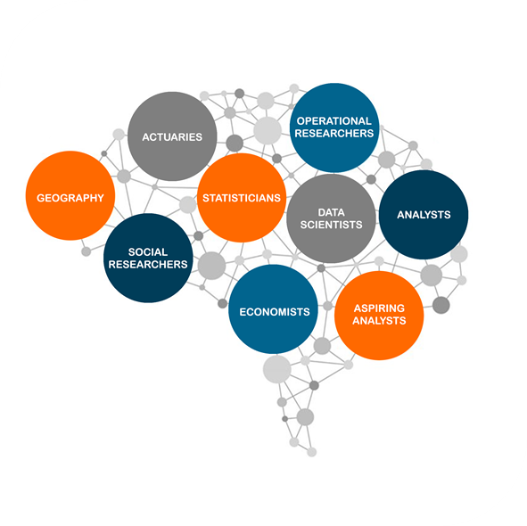
Logos
Simply Copy + Paste.
Please note - if resizing the logos, please make sure ‘Lock aspect ratio’ is ticked in Format Shape menu to avoid squashing or stretching the logos.
If you require any of these designs in a different format, please contact the team at Analysis.Function@ons.gov.uk
Analysis Function LOGO
Analysis in Government Month (AiG Month) LOGO
Analysis in Government Awards (AiG Awards) LOGO
Analysis Function Diversity & Inclusion Group LOGO
The Analysis Brain (all our professions)

Slide 15
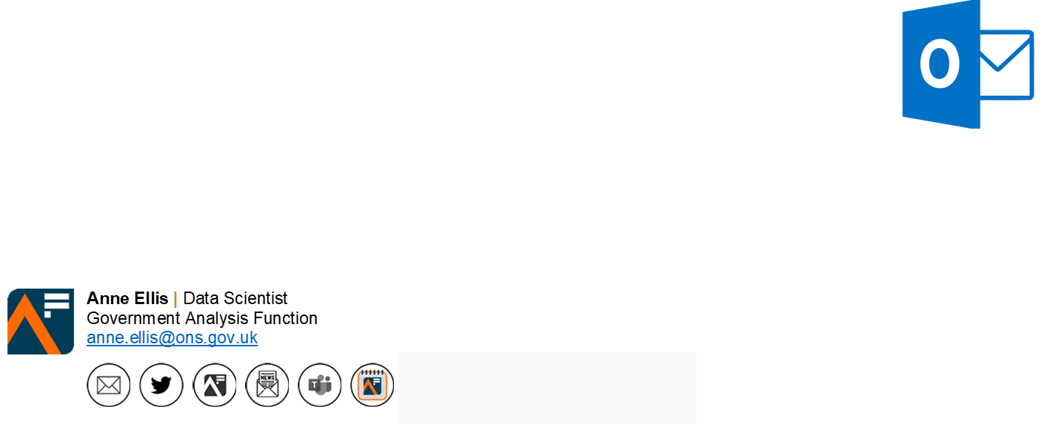
Email signature ‘button’
Add the AiG Month 24 ‘button’ to your email signature. The button contains a hyperlink to the Analysis in Government Month hub on the Analysis Function website
Remember to refer to the latest guidance on Understanding accessibility requirements for public sector bodies - GOV.UK (www.gov.uk)
COPY + PASTE

Slide 16
AiG Month 24: Community Programme events
Holding an AiG Month Community Programme event? Then add this AiG Month banner to your Eventbrite page…

Slide 17
Notes:
Gallery Space

Slide 20
Notes:
Chic Office

Slide 21
Notes:
Urban hub

Slide 22
Notes:
Stylish studio

Slide 23
Notes:
Sunny office

