Slide 1
Engineering Biology for Defence and Security (Phase 2)
20th November 2023

Slide 2
1
Welcome & Housekeeping
Ann Maw, DASA Delivery Manager

Slide 3
Housekeeping
Welcome to today’s Briefing and Q&A for the new DASA competition: Engineering Biology for Defence and Security Phase 2
Please note your camera and microphone will be kept off
Today’s event will be recorded (audio only) and if it becomes available after the meeting, you will be notified
Discussions will remain at OFFICIAL
Q&A session will take place after via Slido. To access, go to the website www.sli.do (on a separate tab or device) and enter the code #DASACOMP
If you are having any technical issues, please use the chat function in Teams and direct message the team at DASA to assist
Notes:
Emphasise that this is similar but not identical to the 2022 competition

Slide 4
Submitting Questions
Please submit or upvote any questions via Slido
Scan above, or go to website sli.do and enter code #DASACOMP
Notes:
Emphasise that this is similar but not identical to the 2022 competition

Slide 5
Agenda
Time | Item | Presenter
13:00 | Welcome, Housekeeping, Introduction | Ann Maw, DASA Delivery Manager
13:05 | Overview of DASA | Dr Deb Carr, DASA Innovation Partner (Scotland)
13:15 | Competition Background and Details | Prof Petra Oyston, Dstl
13:45 | Question & Answer Session | DASA/Dstl Competition Team
14:30 | Wrap Up | Ann Maw

Slide 6
2
What is DASA?
Dr Deb Carr, DASA Innovation Partner (Scotland)

Slide 7
DASA finds, funds and fast-tracks innovative ideas to benefit the Armed Forces and National Security while supporting UK prosperity

Slide 8
Technology readiness levels (TRL)
TRL | MOD definition
1 | Basic principles observed and reported
2 | Technology concept and/or application formulated
3 | Analytical/experimental critical function and/or proof of concept
4 | Technology basic validation in a laboratory environment
5 | Technology basic validation in a relevant environment
6 | Technology model or prototype demonstration in a relevant environment
7 | Technology prototype demonstration in an operational environment
8 | Actual technology completed and qualified through test and demonstration
9 | Actual technology qualified through successful mission operations

Slide 9
Available funding and support
competitions (<TRL6)
business mentoring
access to alternative and higher TRL funding
access to customers (for funded projects)

Slide 10
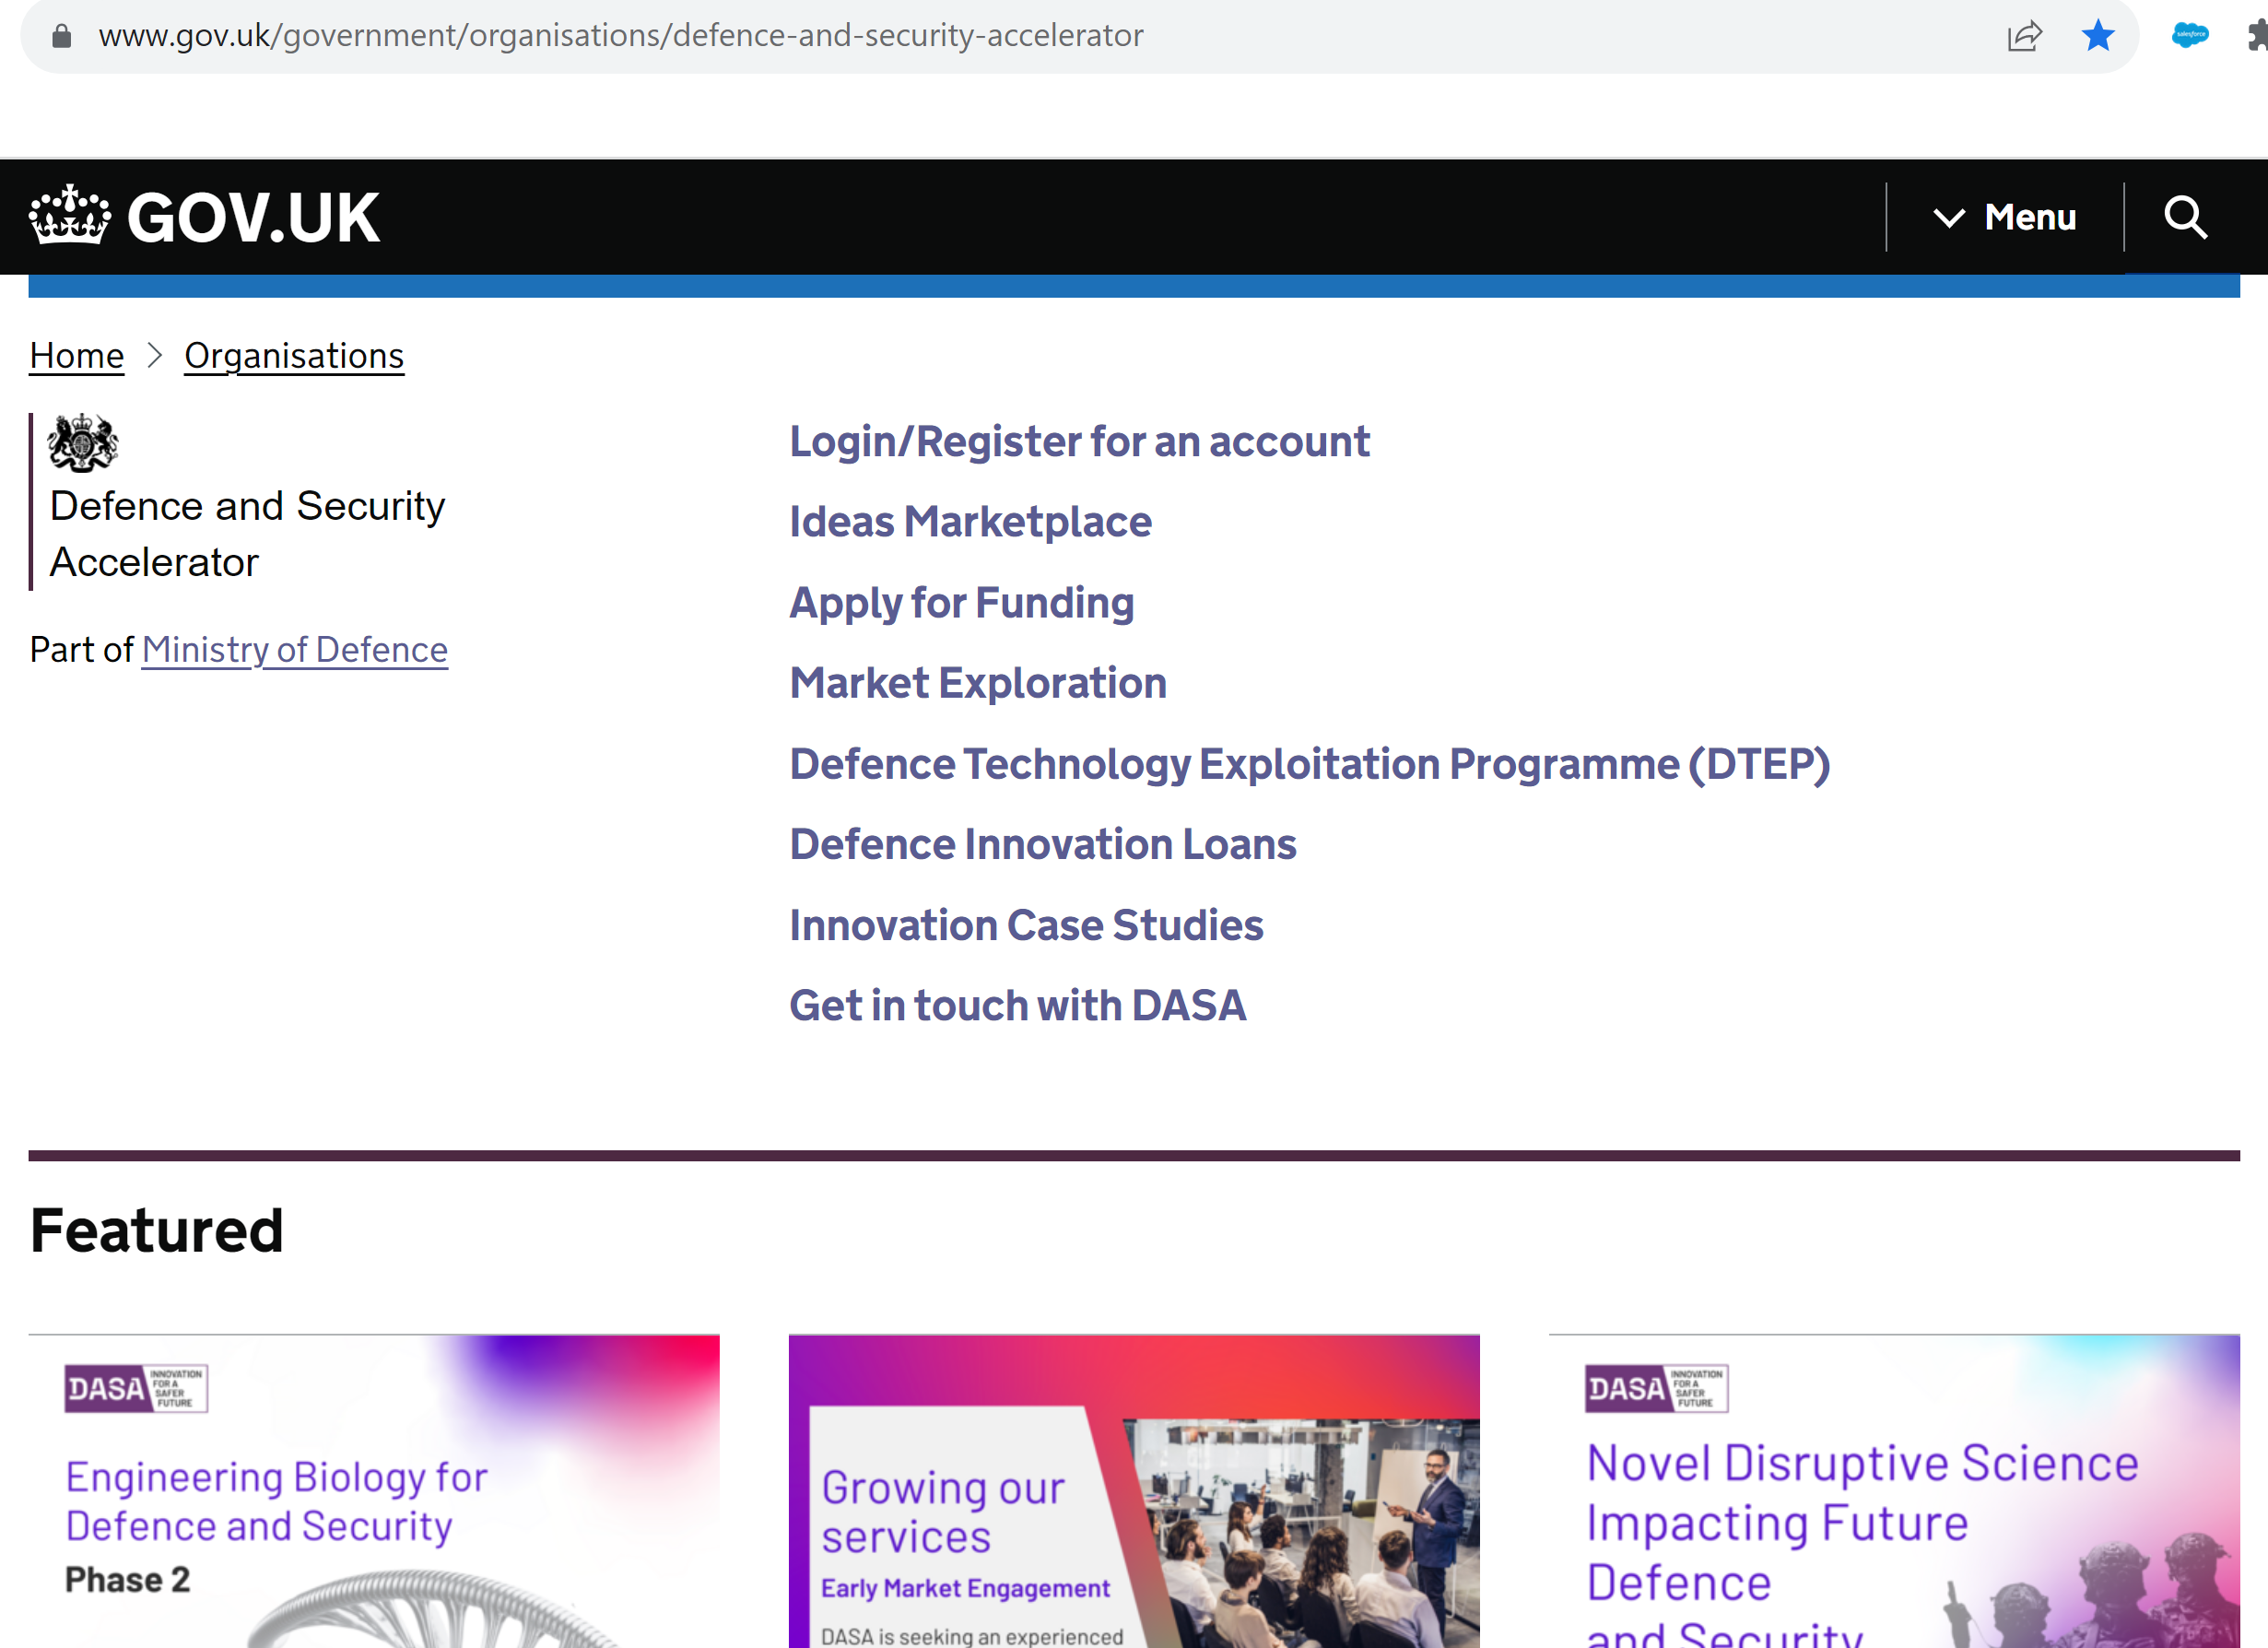
How do you get in touch?
Outreach Team
Devolved Nations
English Economic Regions
International

Slide 11
Key facts (launched December 2016)
6969 assessed applications from 2628 innovators
Small 59%, Academia 31%, Large 10%
1306 projects funded, 545 innovators, £231m
58% funded projects are from small businesses

Slide 12
DASA competitions
Themed Competitions
Online
Portal
Open Call for Innovation
Market Explorations

Slide 13
Why apply?
anyone can apply from anywhere in the world (businesses and academia)
no partners required
100% FEC funding
intellectual property stays with you
equity stays with you
simple application and assessment processes
R&D tax credits for businesses

Slide 14
Current and pipeline Themed Competitions
Disruptive science – closes midday (GMT) 05 December
Engineering biology – closes midday (GMT) 17 January
Good for missiles to talk – November launch
Remote monitoring of sensitive sites – December launch
Blood products for use in remote or austere locations – February launch
Land-based solutions to sea-based threats – TBC
Anti-body based explosive testing – TBC

Slide 15
Open Call for Innovation
Defence focused proposals (~TRL6/7) - maximum 24-months, no funding limit (<£350k)
Security focused proposals (~TRL6/7) - mandatory Innovation Outline, complete by March 2025, no funding limit (<£350k)
Innovation Focus Areas (IFAs) - length, TRL and funding varies

Slide 16
Higher TRL funding
Defence Technology Exploitation Programme (DTEP) (TRL3-7) | grant funding for SMEs to collaborate with higher-tier suppliers
Defence Innovation Loans (TRL6+) | helps SMEs move towards commercialisation

Slide 17
3
Competition Background and Details
Prof Petra Oyston, Dstl

Slide 18
Engineering Biology for Defence & Security
Prof. Petra Oyston
DSTL/PUB141306

Slide 19
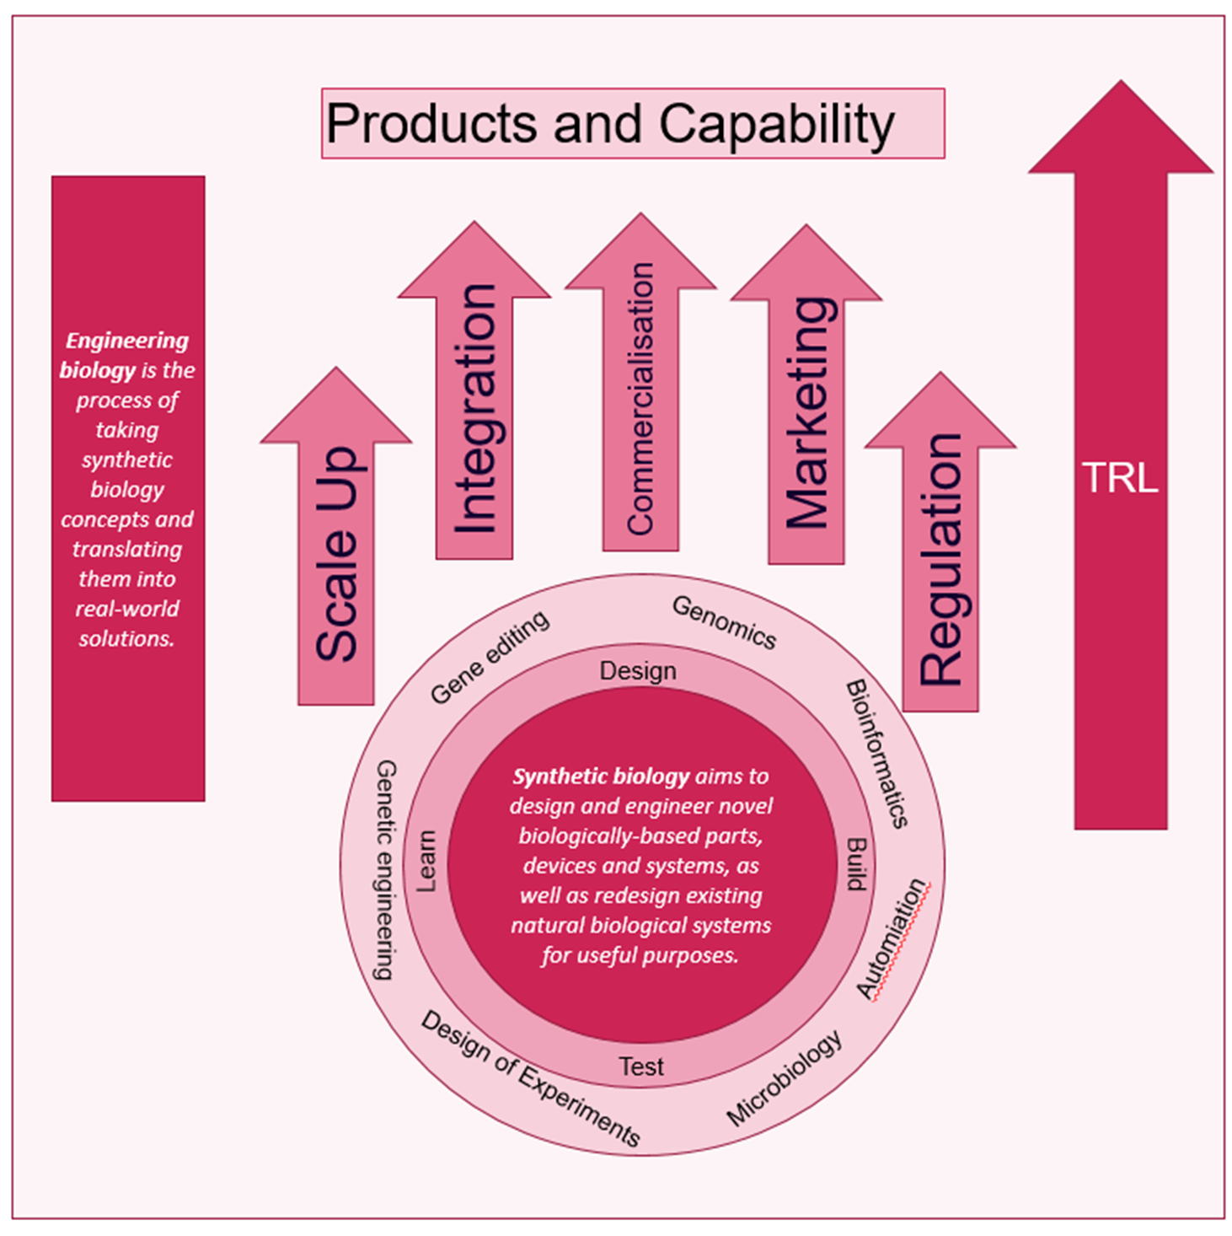
Definitions
What are Engineering Biology and Synthetic Biology?
Engineering biology is the process of taking synthetic biology concepts and translating them into real-world solutions.
Encompasses the entire innovation ecosystem, from breakthrough synthetic biology research to translation and application.
Synthetic biology aims to design and engineer novel biologically-based parts, devices and systems, as well as redesign existing natural biological systems for useful purposes.
Bringing the Power of Biology to challenging problems in Defence
There are other definitions….
BUT….If it isn’t clear to the assessors how the application exploits synthetic biology, it will be out!
20/11/2023 / © Crown copyright 2022 Dstl

Slide 20
The competition
This Defence and Security Accelerator (DASA) competition seeks proposals for novel and innovative high risk-high reward projects finishing at proof-of-concept (Technology Readiness Level 3/ 4). The challenges will be based on innovative engineering biology solutions that address one or more of the three topics
Materials
Power and Energy
Sensing
Phase 1 Engineering Biology Competition demonstrated the potential of the technology
Phase 2 now looks to further develop applications which identify and evaluate innovative engineering biology approaches to improve wider Defence and Security capability.
This competition will involve cutting edge, multidisciplinary research through the application of engineering biology tools and techniques, using novel research approaches and the discovery of new knowledge.
20/11/2023 / © Crown copyright 2022 Dstl

Slide 21
Technology Readiness Levels
Challenge | TRL level to be achieved for each area of interest
Power and Energy | 3 - Analytical and experimental critical function and/or characteristic proof-of-concept
Materials | 4 - Technology component and/or basic technology subsystem validation in laboratory environment
Sensing | 3 - Analytical and experimental critical function and/or characteristic proof-of-concept

Slide 22
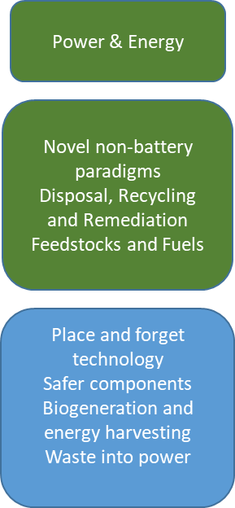
Challenge 1: Power & Energy
Step change in Power & Energy source solutions for military applications
Why? - Address some limitations of batteries
Safety/Energy density/Shelf life/Logistics/Environmental performance
Sub-challenge 1: Improving existing energy sources
Replace one or more components of a ‘traditional’ battery construction to improve energy, safety or other performance metrics
Produce packaging or other materials that enhances a battery’s safety or performance
Sub-challenge 2: Disruptive change to power and energy provision
To produce an entirely novel engineering biology solution to the production of useable electrical energy
20/11/2023 / © Crown copyright 2022 Dstl

Slide 23
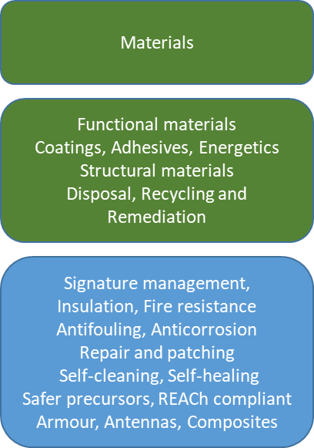
Challenge 2: Materials for defence
Materials for a range of uses in Defence and Security.
Potential examples
Functionalised material e.g. self-disclosing for fatigue and corrosion
Lightweight but strong structural materials, including composites
Novel camouflage solutions, including active or reactive colour change materials, variable emissivity surfaces and very high performance acoustic absorbers
Materials for eye protection, covering physical and laser protection
Materials for protection of physical sensors on equipment e.g. against dazzle or jamming, without blocking performance of the sensor
Coatings suitable for defence purposes that are relatively easy to apply, repairable in the field, and easy to remove without damaging substrate. Coatings may include functional materials e.g. self-healing properties.
Durable novel materials for equipment with an application to specific environments, e.g. high altitude, high velocity, ice and snow, including heat shielding, anti-fouling in marine environments
Biological approaches to creation of, or recovery of, critical materials
Materials for enhanced antenna design or enhanced performance
Novel adhesives for a variety of Defence and Security applications
20/11/2023 / © Crown copyright 2022 Dstl

Slide 24
Challenge 3: Sensing
Engineering biology enabling new sensing paradigms in Defence and Security Bioengineered systems that aim to push the boundaries of what can be achieved for measurement.
Any sensing modality from molecular sensing to more ambitious goals moving beyond traditional analytical sensors
e.g. gravity, radiation, vibration, electronic/optical or magnetic signatures
Potential outcomes
Sensing modalities enabled by bioengineered components
Integrated response functions
Biomimetic or bioinspired sensing approaches
Rational design of biological components for e.g. increased breadth of function, persistence, robustness and sensitivity of biological components
Exclusions
Proposals focussing exclusively on Diagnostics, Medical (including Physiological monitoring) and CBR applications
Sensing
Novel Sensors
Low cost
Novel fabrication
Wider range of inputs
Bio-inspired
(e.g. quantum bio)
Biomimetic
(e.g. olfactory)
Bioengineered
(e.g. DNA aptamers, DNA Origami)
20/11/2023 / © Crown copyright 2022 Dstl

Slide 25
We want:
High risk, high pay-off projects, but mitigation of potential technical risks must be considered
Consideration of eventual scalability and translation.
A clear statement of the benefit posed by the proposed approach over existing technology
Theoretical development, method of advancement or proof of concept research which can demonstrate potential for translation to practical demonstration in later phases.
Innovation or a creative approach.
Clear demonstration of how the proposed work applies to any defence and security context.
20/11/2023 / © Crown copyright 2022 Dstl

Slide 26
We do not want proposals that:
Do not include a significant engineering biology component.
Solutions requiring release of viable genetically modified organisms into the environment.
Offer no real long-term prospect of integration into defence and security capabilities.
Offer no real prospect of out-competing existing technological solutions.
Constitute consultancy, paper-based studies or literature reviews which just summarise the existing literature without any view of future innovation
Focus on in silico studies without experimental validation.
Focus on a Chemical, Biological or Radiological (CBR) or medical application exclusively
Focus on Energetics
Are an unsolicited resubmission of a previous DASA bid or a duplication of a bid submitted through other Dstl funding channels seeking engineering biology proposals, such as R Cloud.
Offer demonstrations of off-the-shelf products requiring no experimental development (unless applied in a novel way to the challenge).
Require the completion and attainment of ethical favourable opinion from the Ministry of Defence Research Ethics Committee (MODREC)
20/11/2023 / © Crown copyright 2022 Dstl

Slide 27
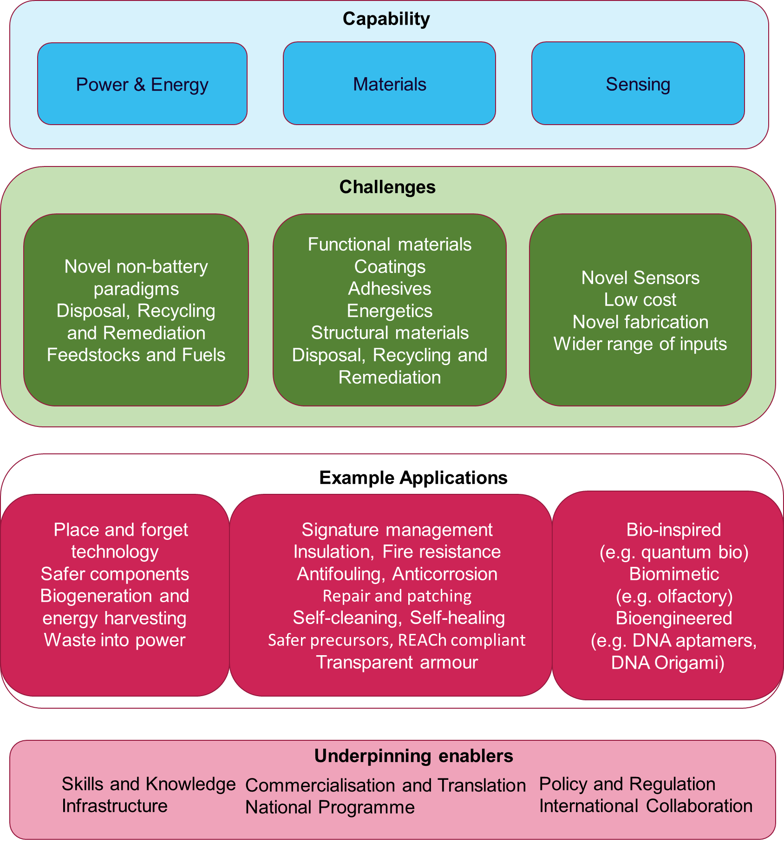
Anticipating FAQs
Can my proposal address more than one challenge?
Yes, but please identify the primary challenge it fits against
Does my plan have to fit all the challenges?
No, at least one challenge is acceptable
How will the budget be divided between the challenges?
That remains to be determined based on the number and quality of the applications
The starting assumption is that it will be pretty balanced between the three
20/11/2023 / © Crown copyright 2022 Dstl

Slide 28
Bidding…making reviewers’ lives easier and improving your chances
Identify the defence application clearly
What will be the benefit?
Identify the synthetic biology component clearly
How is this highly innovative?
What advantages does this provide over currently available solutions?
Have you assembled a team that can do this?
Read the guidance
Submit early
The deadline really is the deadline.
20/11/2023 / © Crown copyright 2022 Dstl

Slide 29
20/11/2023 / © Crown copyright 2022 Dstl

Slide 30
Q&A
Scan above, or go to website sli.do and enter code #DASACOMP

Slide 31
Thank you for attending! We look forward to receiving your submissions by 12:00 hrs (GMT) Wednesday 17th January 2024.

Slide 32
Contact us
www.gov.uk/DASA
@DASAccelerator
Defence and Security Accelerator
accelerator@dstl.gov.uk
01980 950000 option 3

