Slide 1
4th Annual
Analysis in
Government
Awards
Shortlisted digital goodie bag

Slide 2
So, you’ve been shortlisted for an award?!
If you have been shortlisted for an Analysis in Government Award, firstly congratulations! Competition was extremely tough, and you should be very proud to have got this far!
Why not share your success at being shortlisted and build excitement and anticipation by using some of our promotional products?
Frame your team photo using one of our custom AiG Awards social frames (slides 5-7)
Use our logos to promote your success across your networks (slides 8-11)
Add the AiG Awards button to your email signature (slide 12)
Use one of our custom AiG Awards ‘Shortlisted’ Teams backgrounds in your meetings (slides 13-22)
Spread the word on social media using the hashtag #AiGAwards

Slide 3
A message from Professor Sir Ian Diamond
Now in their fourth year, the Analysis in Government (AiG) awards show, as we continue to address the issues of the day, that the work of government analysts is more important than ever. The AiG Awards have celebrated the diverse work of analysts, from the reality of kitchen hygiene in our homes and restaurants, to communicating analysis through a BBC documentary series, to the establishment of the Evaluation Task Force.
Nominations for the AiG Awards opened this month. I will be one of the judges and am very much looking forward to hearing your stories of best practice, innovation, and success. Please make sure you take five minutes to recognise and celebrate the brilliant analysts you work with by nominating them for an AiG Award.
Professor Sir Ian Diamond, Head of the Analysis Function and National Statistician

Slide 4
AiG Awards Timetable
2023
18 September: Nominations open
2 November: Nominations close
Mid-December: Shortlist announced
2024
Mid-January: Awards winners announced
Nominations open for the People’s Choice Award
February: Celebration Day event and announcement of People’s Choice Award winner

Slide 8
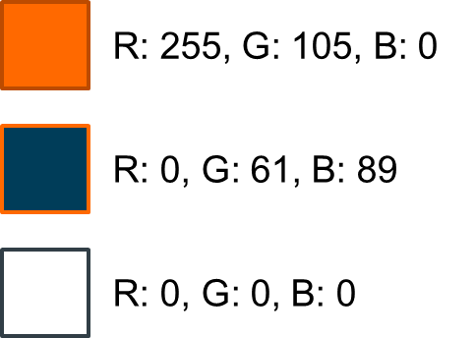
The AiG Awards logo
Simply Copy + Paste.
Please note - if resizing the logos, please make sure ‘Lock aspect ratio’ is ticked in Format Shape menu to avoid squashing or stretching the logos.
If you require any of these designs in a different format, please contact the team at analysis.function@ons.gov.uk

Slide 9
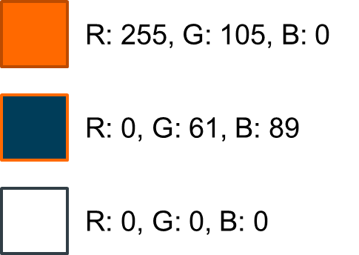
Logo (colour)

Slide 10
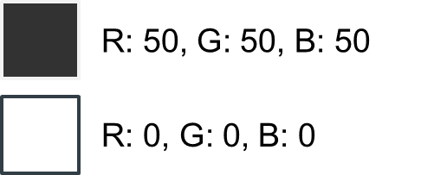
Logo (monochrome)

Slide 11
Logo (for dark backgrounds)

Slide 12
Email signature
Add the Analysis in Government Month ‘button’ to your email signature. The button contains a hyperlink to the AiG Awards nomination form
Remember to refer to the latest guidance on Understanding accessibility requirements for public sector bodies - GOV.UK (www.gov.uk)
COPY + PASTE

Slide 18
Notes:
Stylish studio

