Slide 1
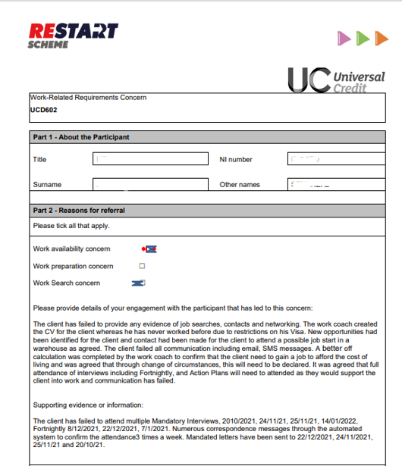
Completing the UC602 – Work-Related Requirements Concern
Work-related requirement concern:
Work Availability
Work Preparation
Work Search
Free text:
Provide as much detail as to why there appears to be a concern
Provider details

