Slide 1
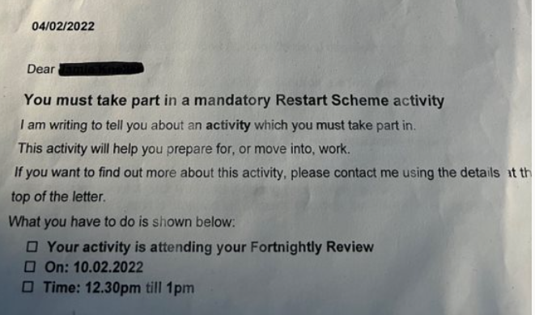
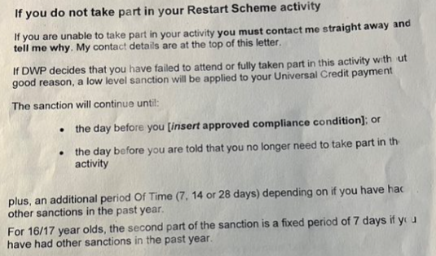
Mandatory Activity Notification (MAN)
Consequences in that a sanction could be applied and the compliance condition needs to be inserted from the 4 supplied by DWP.
Details of the What, Why, When and Where.

