Slide 1
Looking ahead to results days for qualifications this year Dr Jo Saxton Richard Garrett July 2023

Slide 2
Notes:
Students are the compass that guides our decisions at Ofqual.

Slide 3
Arrangements for 2023
Notes:
It’s important that we get back to normal so that students receive grades assessed in the usual way for college, university or employment, and help them to make the right choices about their next steps.
This year GCSEs, AS and A levels are returning to pre-pandemic grading arrangements, with protection built into the grading process to recognise the disruption students have faced. This means Ofqual expects national results this year to be similar to those in pre-pandemic years.
The protection means that a typical student who would have achieved, for example, a B grade in A level geography before the pandemic will be just as likely to get a B in geography in 2023, even if their performance in the exams and assessments is a little weaker than it would have been before the pandemic.
It is very likely that the results in your school or college will be lower than in 2022.
Since we are returning to pre-pandemic grading arrangements, it will be more meaningful to compare this year’s results with 2019, rather than 2022.
For students taking vocational and technical qualifications, such as BTECs or Cambridge Nationals, awarding organisations will use suitable grading approaches for their qualifications, which are assessed in a range of ways. Awarding organisations will take into account the grading approach used in GCSE and A level, where appropriate to the particular qualification, so that students are not advantaged or disadvantaged, irrespective of the qualifications they take.

Slide 4
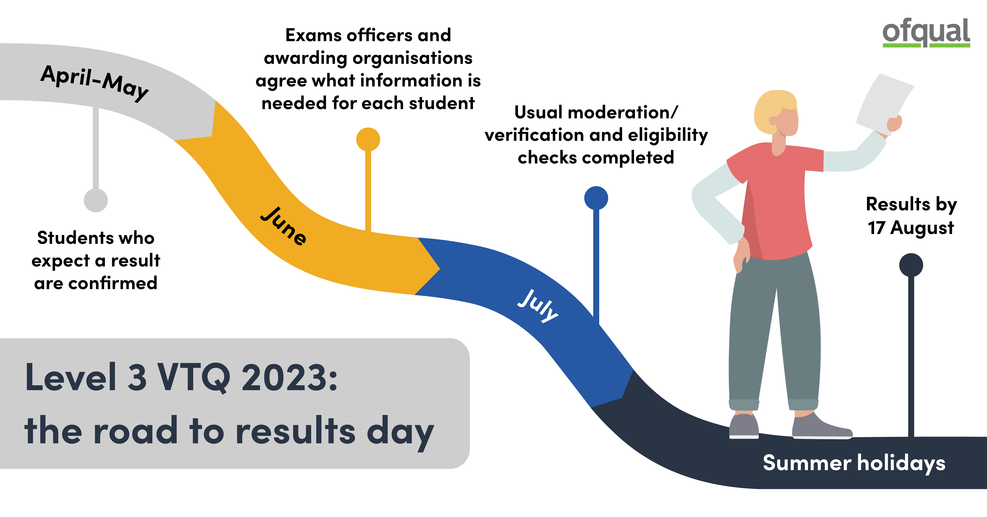
VTQ Level 3 Action Plan 2023
334,000 students will receive Level 3 VTQ results this summer – a significant step towards parity of qualifications
New term-time deadlines for AOs to ensure results will be released to students by Thursday 17 August
Requires earlier engagement in term-time to minimise engagement in August​
Student records need to be up to date so all eligible students receive a result​
Schools and colleges should continue engaging throughout July so that moderation and verification can continue as normal​
​

Slide 5
Summer 2023 – return to pre-pandemic grading
GCSE, AS and A level – Grade boundaries recommended by senior examiners after reviewing student work, guided by data from pre-pandemic exam years.
VTQs – Grade boundaries recommended by senior examiners based on expert judgement and data, using an approach appropriate for each qualification. Approach used in GCSEs and A levels taken into account, where appropriate, so that students are not advantaged or disadvantaged.
Protection for students – but in a way that’s consistent within a qualification, so the same grading rules apply to all students taking a particular qualification.
T Levels – AOs will be generous in awarding TQ in T Levels as these are new qualifications. This is the 1st year T Levels are fully based on exams (previous had TAGs) so profile of results may look different.

Slide 6
How grading works every year – GCSE, AS and A level
No fixed quota of grades
Not norm referencing, or strong criterion referencing
Data/statistics used for two reasons
To align standards between exam boards in a subject
To compare the ability of this year’s students with those in previous years

Slide 7
Marking, then grading
Starts when the first paper is sat
Judging student responses against a mark scheme
No change to marking standard
Standardised for each paper
Monitored for quality
Distributed among examiners
Grading
When most marking is complete
Sets the standard for each grade, using data and expert judgement
2023 will be in line with pre-pandemic years
Grade boundaries set each year to reflect difficulty of assessments
Consistent across students and schools/colleges
First, marking
Then, grading

Slide 8
Grade boundaries – GCSE, AS and A level
Ofqual’s role: to ensure consistent standards across exam boards and over time
Grade boundaries are set each year to reflect the demand of exam papers. If papers are more difficult, grade boundaries will be lower; if they’re easier, boundaries will be higher.
Before the pandemic, grade distributions were very stable from one summer series to the next, but this is not because there is a quota – grades are not fitted to a bell-curve or normal distribution.
The stability in grading over time reflects the stability we see in the marks that students achieve.

Slide 9
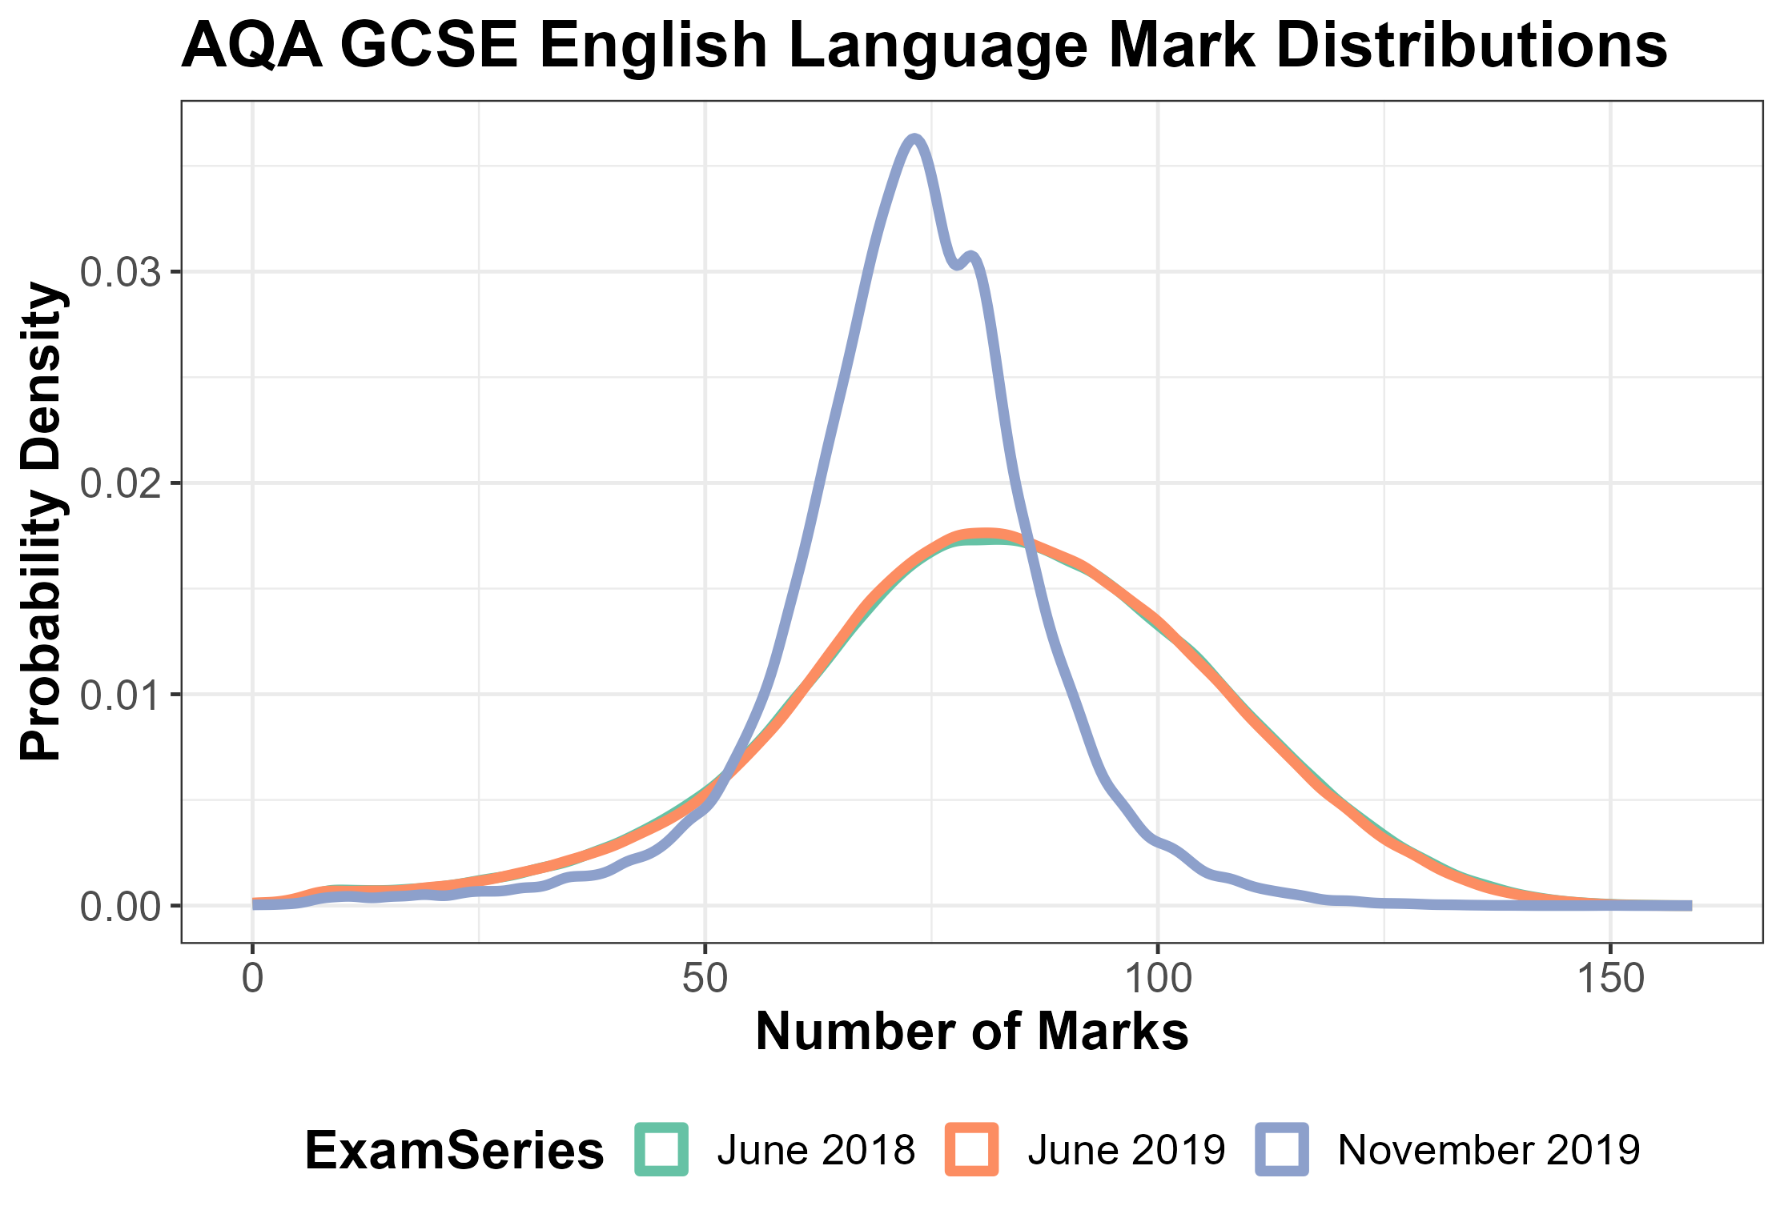
Notes:
This slide exemplifies the point about there not being a cap on grades.
You can see this when you compare the overall mark distributions from year to year. This is AQA GCSE English language, which is the largest single specification.
The mark schemes in GCSE English language don’t change much from year to year or from series to series. The questions will obviously be different, but the mark schemes include generic mark grids – for extended writing questions, for example. Those mark grids are the same every year.
The graph shows the distribution of the marks for all students in the June 2018 and 2019 series, and the November 2019 series. The mark distributions for summer 2018 and 2019 are so similar that they’re overlaid – just a few bits of green poking out from the orange. You can see the peak in the middle – the average mark – is around 80 out of 160. Very few students score below 25 marks, and few score more than about 125-130 marks. That’s why the grade profile from summer 2018 was very similar to the grade profile in summer 2019.
But the shape of the mark distribution for November – the blue line – is very different. The peak is more extreme, but the average mark is a bit lower – around 70. That’s not because the marking is different between summer and November – the questions will be different but those generic marking grids will be the same and examiners are trained to mark in the same way. Rather, it reflects the different cohort of students. November is a resit series, so the students tend to be those who didn’t achieve a grade 4 the previous summer.
In the November series, as in June, the distribution of grades reflects that different mark distribution. In November 2019, only 0.6% achieve a grade 7 or above, because very few students score enough marks to achieve a 7 or above. That’s compared to nearly 14% of students in summer 2019.
If the shape of the mark distribution was different one summer, perhaps if no students scored below half marks, the grades would reflect that. But we haven’t seen it.

Slide 10
NRT – an objective measure of year 11 attainment in English and maths
Sample
Population: year 11 students* taking GCSE English and/or maths in England, including in independent schools.
Stratification: schools are stratified on 2 variables:
school size
previous results in GCSE English and/or maths
Over 300 schools each year
Up to 60 students randomly selected from each school:
30 for English; 30 for maths
Approximately 13,000 students in total in 2023.
Statutory requirement for maintained schools.
Test design
Taken in Feb/March
1 hour, 50 marks.
Questions are the same from year to year.
Reflects the GCSE curriculum.
Results reported as estimated % of students at grade 7, 5 and 4.
https://www.gov.uk/government/collections/national-reference-test-information
* Excluding those in special schools, PRUs, FE colleges or any schools with fewer than 15 students
Notes:
The other piece of evidence we would point to to explain the stability we’ve seen in the overall grade profile prior to the pandemic, at least in GCSE English and maths, is the National Reference Test (NRT). The NRT measures year 11 performance over time. The questions in the NRT don’t change from year to year, so we can measure quite precisely any changes in year 11 performance over time.

Slide 11
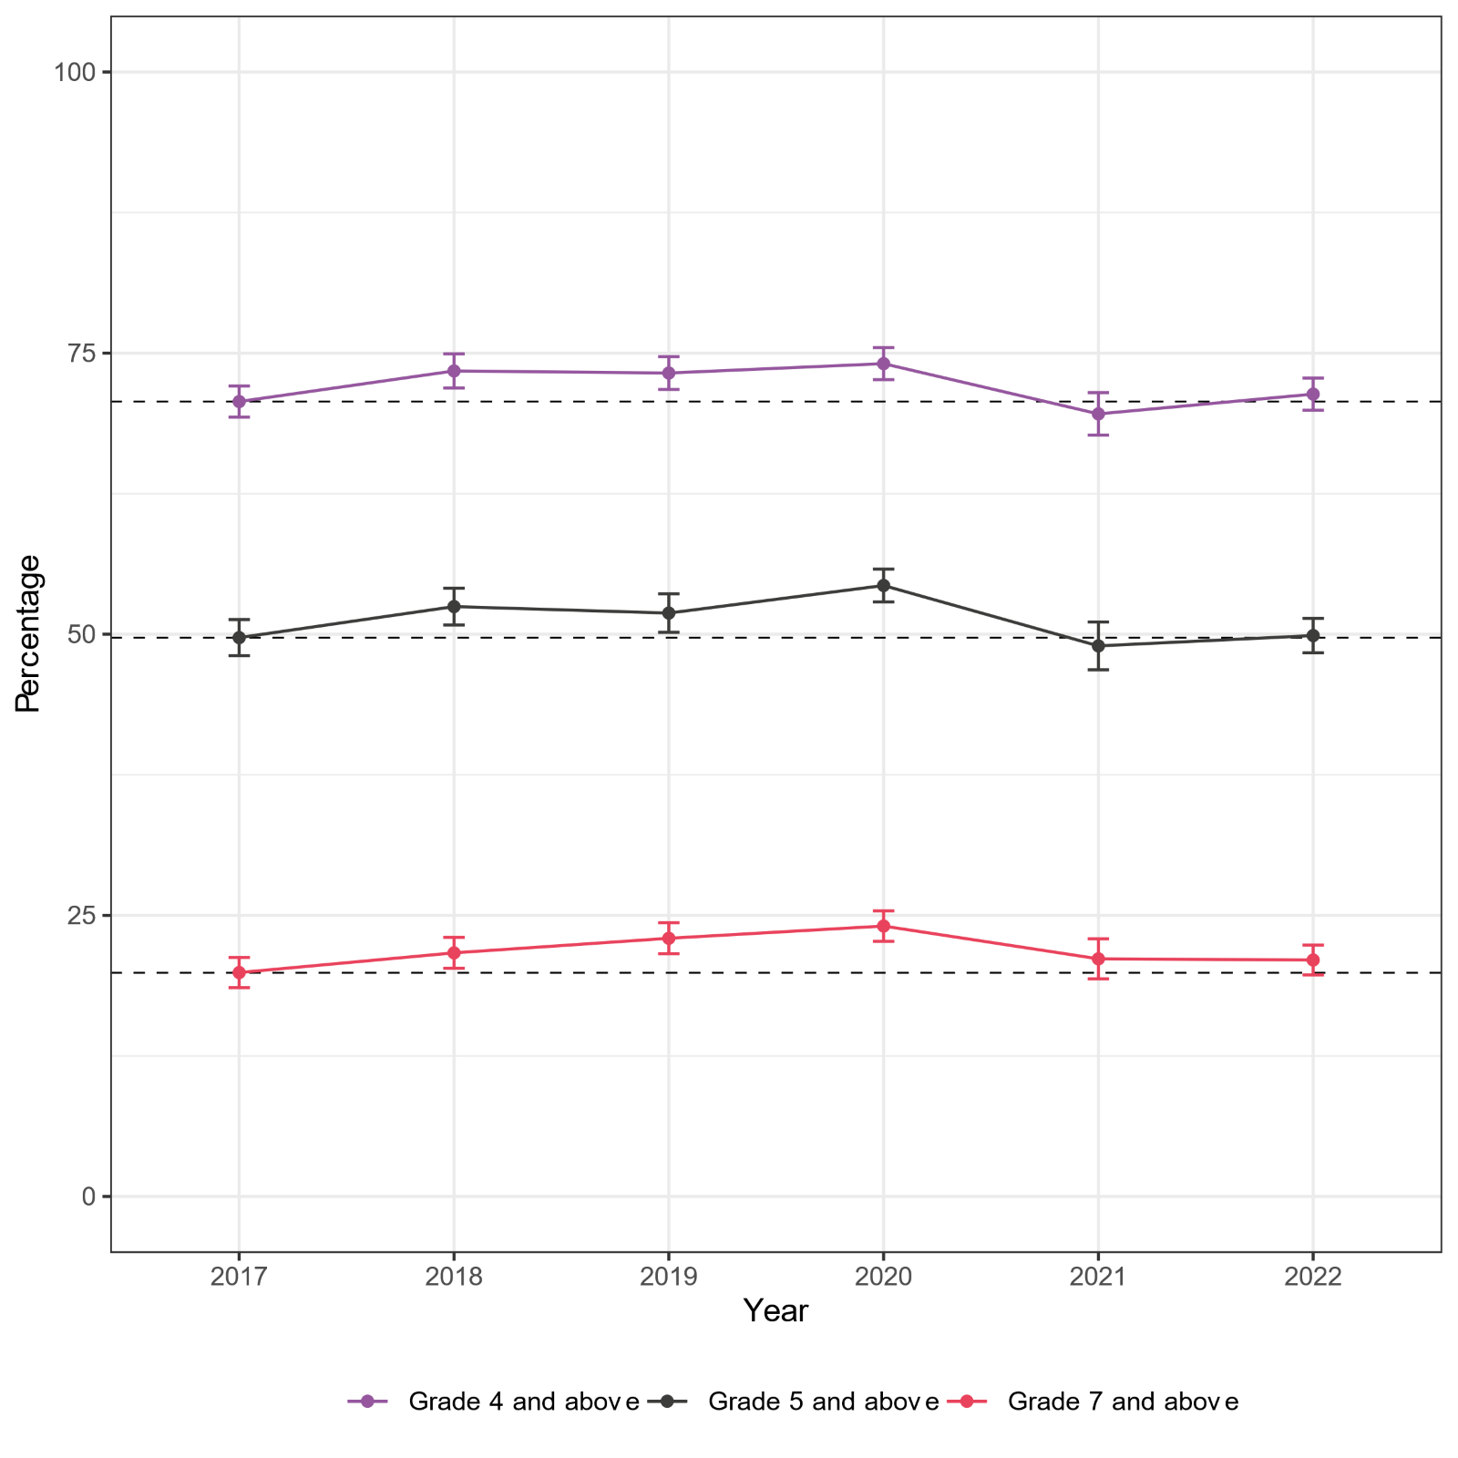
NRT results 2017-2022
English
Maths
Notes:
In English so far we’ve seen a fairly stable picture – but in maths, pre-pandemic we saw a small but steady improvement between 2017 and 2020. (The 2020 test was just before lockdown, so it was largely unaffected by the pandemic.) This small but steady improvement between 2017 and 2020 was in line with improvements in PISA scores for the same cohort. As you can see, NRT maths attainment dropped back in 2021, due to the pandemic, but only back to 2017 levels.
To help us consider whether we should use the NRT results to inform awarding each year, we consider whether the changes in results are statistically significant from a previous year, since not all changes are statistically significant. For example, in 2022, we compared the results with 2020 – the most recent year that was not impacted by the pandemic. This showed that there was no statistically significant change in English results, but a statistically significant downwards change in maths.

Slide 12
Predicted grades
In pre-pandemic years, only around 1 in 5 accepted applicants achieved or exceeded their predicted grades, but around 85% of 18-year-olds applying to UCAS took up a higher education place.

Slide 13
Post-results services
A school or college can:
Request access to marked scripts
Request a review of marking or moderation – if it feels there is an error
Appeal – if it feels an error remains after the review
Ask Ofqual’s EPRS to undertake a final review
In summer 2022:
3.7% of GCSE grades were challenged; 0.9% were changed
4.9% of GCE grades were challenged; 1.2% were changed

Slide 14
Ofqual resources
General
Sign up to receive email updates
Schools and colleges
Students and parents
Ofqual website, including:
Rolling update
Guide for schools and colleges
Letter to governors and trustees
Ofqual blog – VTQ road to results
Exams officer resources
Student guide
Ofqual/UCAS letter to students
Consultation: Ensuring the resilience of the qualifications system

