Slide 1


Commercial Overview
JET Decommissioning and Repurposing

Slide 2
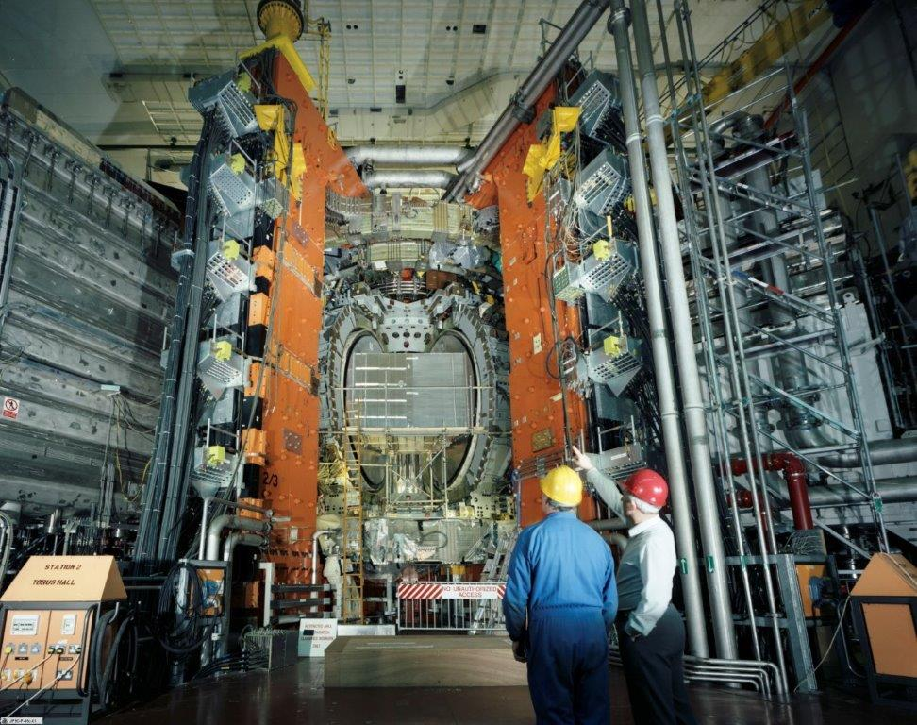

Mission Statement
To deliver the safe Decommissioning & Repurposing of the JET facilities in an ethical, innovative manner, demonstrating maximum value for money.

Slide 3
Market Engagements
March 2023
PIN Event
25th October
May 2023
Supplier Engagements
Supplier Event MTC Coventry
OBC Commercial Case
Full OBC Submission
15th
November
2023

Slide 4
Outline Business Case
Business Case Option | Brief Description
Lifetime Plan Option | Full demolition of all ancillary buildings and the main building that houses the JET experiment (J1). Intermediate level waste placed in long term storage in the geological disposal facility
Alternative Decommissioning Option (Preferred Option) | Re-use of suitable buildings, proposed re-use of the main building that houses the JET experiment. De-tritiation of intermediate level waste wherever possible using a furnace to off-gas and capture tritium, reducing the categorisation to LLW in many materials
Care and Maintenance Option | Remove Beryllium tiles and demolish ancillary plant in pre-care and maintenance phase. JET vessel and main building that houses JET to be placed in 30 year care and maintenance period, after which JET would be dismantled using suited operations and robotics.
The Outline Business Case will contain three options for a decommissioning strategy:
Cira £500M Programme
2024 > 2040

Slide 5
JDR Programme Delivery
Programme Scope Areas
Isolations, Reconfigurations & Overlays
De-plant, Demolition & Land Remediations
Detritiation Research and Development
Waste Operations and Off-Site Disposal
Waste Inventory and Characterisation
Design & build Intermediate Level Waste Processing
Facility Low-Level Waste Processing Facility
Ex-vessel Decommissioning
In-vessel Decommissioning
Enabling Services
Isolations
Characterisation
Overlays
Survey Requirements
Knowledge Capture
IT Services / Data Systems
Consignent
Project Management, Engineering & Planning
Permit & Regulartory Compliance
Planning Advice
Project Delivery Area
De-plant Active Buildings
De-plant Non Active Buildings
Demolition
New Build LLW Facility
New Build ILW Facility
Waste Operations
Land Remediation
Repurposing
Civils & Site Infrastructure

Slide 6
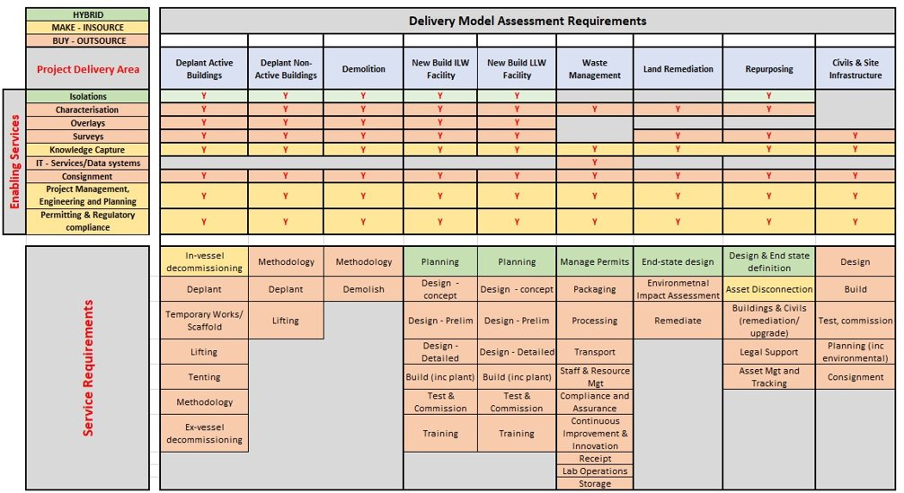

Slide 7
Next commercial steps
Supplier Event 15th November
Launch questionnaire to drive market feedback.
Commercial strategy submission for OBC.

Slide 8
For more information
Contact: enquiries@jdr.ukaea.uk https://www.eventbrite.co.uk/e/jet-decommissioning-repurposing-supplier-day-registration-441567168287

