Slide 1
FIRST AID
DURING A TERRORIST ATTACK
WITHDRAWN

Slide 2
Learning Objectives
At the end of this module, you will have an improved awareness of the:
Stay safe guidance – Run, Hide, Tell
Assessment of the scene
Ways to assess and prioritise treatment of the injured
Method used to administer first aid
Emergency services response
How to be prepared
Further support for first aid
WITHDRAWN

Slide 3
First Aid During a Terrorist Attack
Performing first aid during a terrorist attack could be very dangerous, yet could improve the chances of survival for an injured person.
This awareness product informs the wider implications individuals should consider before any first aid is given during a terrorist attack.
Further guidance on how to treat casualties is available from St John Ambulance and CitizenAID. Links to this information can be found at the end of this product.
WITHDRAWN

Slide 4
WITHDRAWN

Slide 5
WITHDRAWN

Slide 6
WITHDRAWN

Slide 7
Run, Hide, Tell
Run, Hide, Tell must be the first consideration during a terrorist attack.
WITHDRAWN
Administering first aid to others should only be considered if:
You are not injured yourself
The injured person is unable to help themselves
You are willing and able to help others

Slide 8
Assessment of the Scene
The immediate area of the attack MUST be assumed to be unsafe, even if you think the attacker(s) have left.
You should remain vigilant at all times as the attacker(s) could return at any time.
Be aware of your surroundings, and think of an escape route should the attacker(s) return, you know where to go.
Do not become a victim yourself.
WITHDRAWN

Slide 9
Assessment of Casualties
Make sure you are not injured yourself before you attempt first aid on another, as your own injury may impede your effectiveness.
Those with life threatening injuries should be treated first.
Not all casualties will require immediate first aid, those with minor injuries or experiencing shock and confusion should be directed to a safe place.
If necessary, consider moving an injured person to a place of safety.
If they are trapped, do not attempt to move them as this may cause further injury.
WITHDRAWN

Slide 10
Prioritisation of Casualties
There are two types of casualty that should be a priority for receiving first aid:
WITHDRAWN
Those who have major bleeding, such as a severed limb, open wound or where there is substantial blood loss.
Those who are unresponsive with absent or abnormal breathing.
YOU SHOULD ONLY HELP ONE CASUALTY AT A TIME
1
2

Slide 11
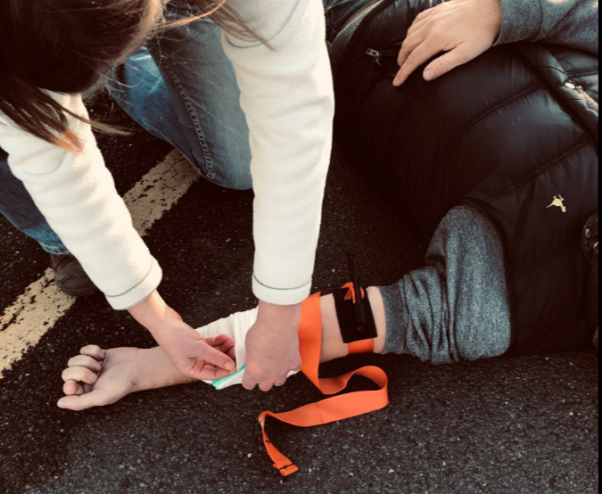
Stop Major Bleeding
Use bandages or any clean cloth material such as a t-shirt or a jacket
1
Cover the injury and press firmly, directly over the wound.
Consider applying a tourniquet, but only if the bleeding is on the arm or leg and cannot be stopped with firm pressure. Once applied, windlass tourniquets should not be removed.
Tourniquets can be improvised by wrapping a belt, necktie or scarf above the wound and twisting until the bleeding slows.
WITHDRAWN
2
3

Slide 12
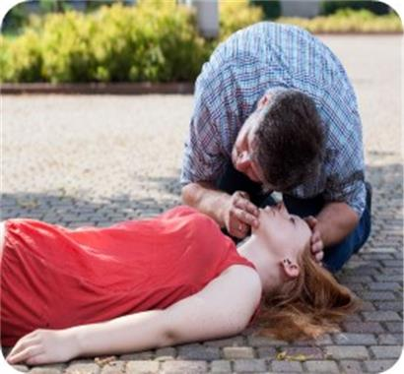
Check Breathing
Make sure they are breathing
If the casualty is not responding (talking or making any motions), then check they are breathing. Their chest will rise and fall. Gently tilting their head backwards may help them breath.
If the casualty is breathing yet not responding, gently roll them onto their side and tilt their head back. This will help them breath on their own.
Make sure you recheck that any large bleeds are controlled.
1
WITHDRAWN
2
3

Slide 13
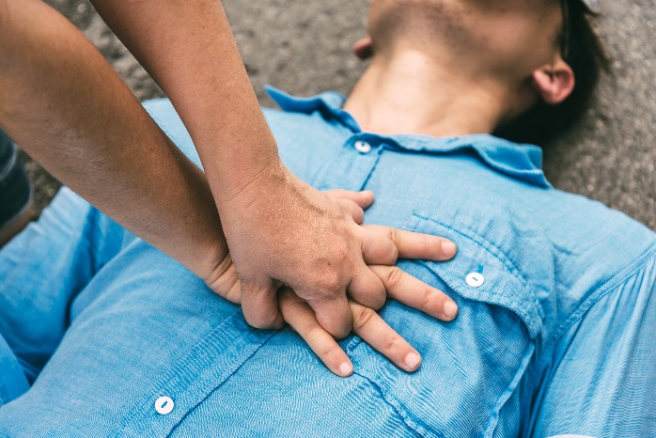
Resuscitation
If the casualty is NOT responsive and NOT breathing then perform chest compressions and mouth to mouth.
WITHDRAWN
Compress the chest 30 times and then, if willing to do so, give 2 mouth to mouth breaths whilst pinching their nose.
Continue the cycle of 30 compressions and 2 breaths until you unable to continue or the emergency services take over from you.
1
2

Slide 14
Resuscitation - during COVID-19
If the casualty is NOT responsive and NOT breathing then perform chest compressions only.
WITHDRAWN
Due to the risk of COVID-19 transmission, the Resuscitation Council UK advises rescuers to place a cloth/towel over the mouth and nose of the injured and attempt chest compressions only.
Resuscitation Council UK advice found here
Compress the chest at a rate of 100 – 120 chest compressions per minute until you are unable to continue or the emergency services take over from you.

Slide 15
The First Responders
The emergency services response may take time to arrive depending on the type of incident and the dangers that are present.
Armed police may be the first emergency service responders to attend.
They will prioritise dealing with any attackers over administering first aid.
If they instruct you to leave the area then you MUST do so.
DO NOT HINDER THEIR RESPONSE
WITHDRAWN

Slide 16
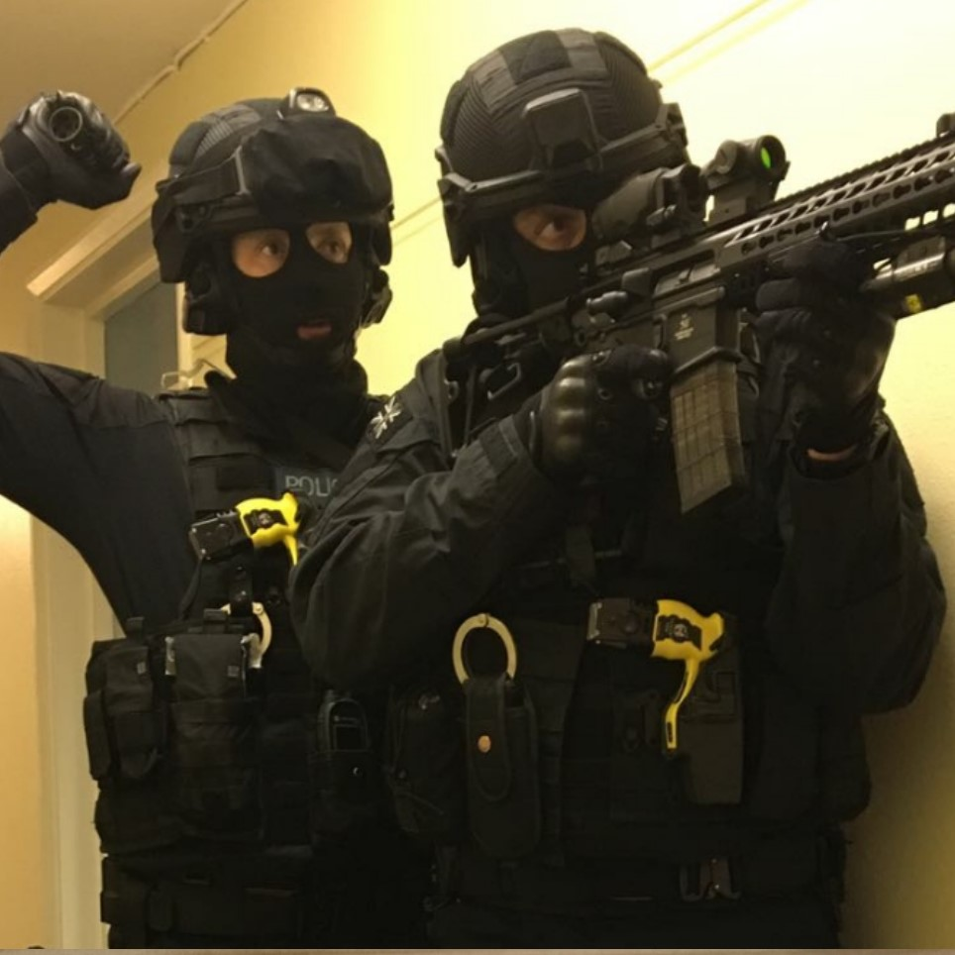
Armed Police Response
Armed police officers responding to this incident may:
Be dressed differently from the usual appearance of uniform police officers.
Be unable to distinguish you from the attacker.
Question you, and treat you firmly.
Only evacuate you or provide medical assistance when it is safe to do so.
WITHDRAWN

Slide 17
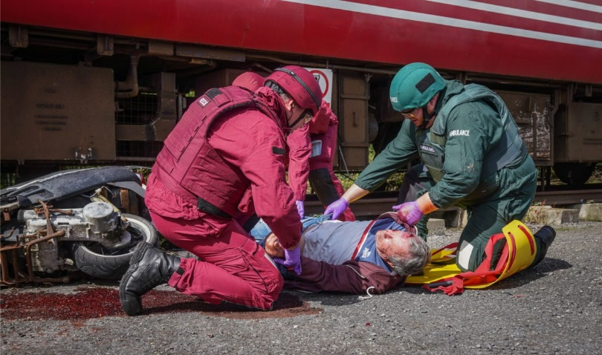
Emergency Services Response
Emergency service personnel may be wearing enhanced protective equipment, such as body armour and helmets.
Tell them what you have done, as this will help them understand what further treatment may be required.
They may ask you to help them.
They may remove injured people from the scene before any treatment.
WITHDRAWN
Make sure you have passed on your contact details.

Slide 18
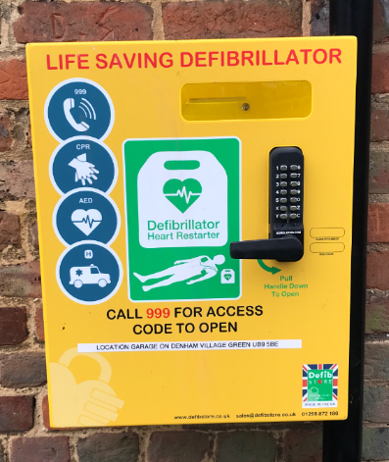
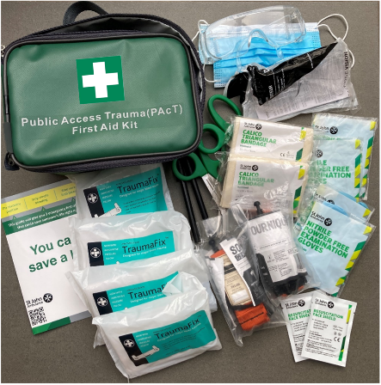
How to be prepared
Two life saving pieces of kit which can help to save lives include:
WITHDRAWN
Automated External Defibrillators (AEDs) are a life saving device that can help to save the life of someone experiencing a sudden cardiac arrest.
Public Access Trauma (PAcT) First Aid Kits which support the treatment of those who have major bleeding, such as a severed limb, open wound or where there is substantial blood loss and those who are unresponsive with absent or abnormal breathing.

Slide 19
How to be prepared
Anyone can perform first aid.
You do not need any formal training to be able to administer first aid.
Legislation is in place to support the actions of individuals acting for the benefit of society or intervening to help someone in an emergency Social Action Responsibility and Heroism Act 2015 (England & Wales).
THINK ABOUT WHAT YOU WOULD LIKE SOMEONE TO DO FOR YOU IF YOU WERE INJURED.
WITHDRAWN

Slide 20
Post Incident Support
After a terrorist attack you may experience the following, which should subside over time:
WITHDRAWN
Anxiety
Feeling more on edge
Being more watchful
Avoidance of people and/or places
For more information see https://www.nhs.uk/conditions/post-traumatic-stress-disorder-ptsd/

Slide 21
Further Support
Further first aid educational training, guidance and products are provided by the following organisations:
WITHDRAWN
Accredited First Aid training and suppliers of first aid products.
https://www.sja.org.uk/
Free information on how to stay safe and treat casualties before the 999 services arrive. Suppliers of first aid products.
www.citizenaid.org

Slide 22
END
WITHDRAWN
To find out more about Counter Terrorism First Aid, visit us at
www.protectuk.police.uk

